Slide 1
CEPC ScECAL Optimization for the 3th CEPC Physics Software Meeting
Hang ZHAO

Slide 2
Outline
ScECAL Simulation
SiPM and scintillator test result
Digitization

Slide 3
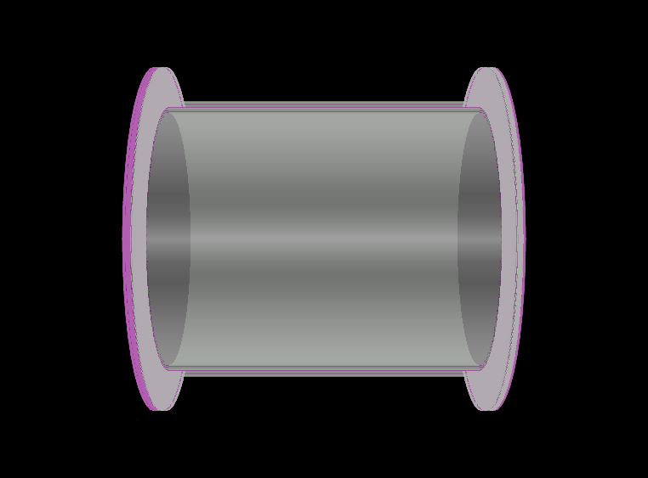
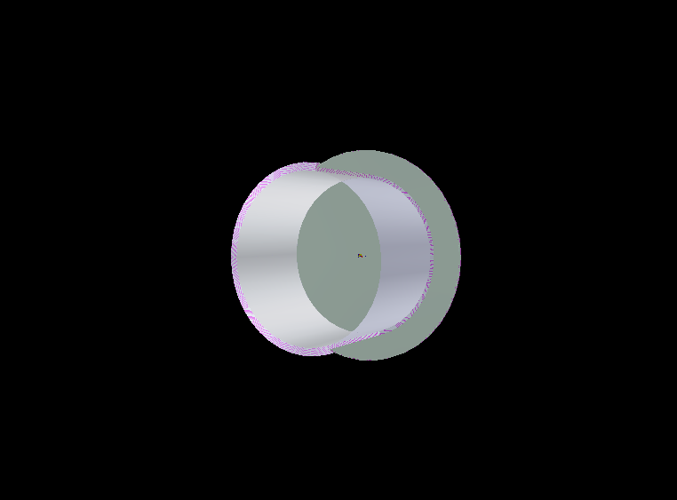
Simplified Geometry
Only consists of ECAL and ignore affect from other detectors
Has a barrel and two endcaps

Slide 4
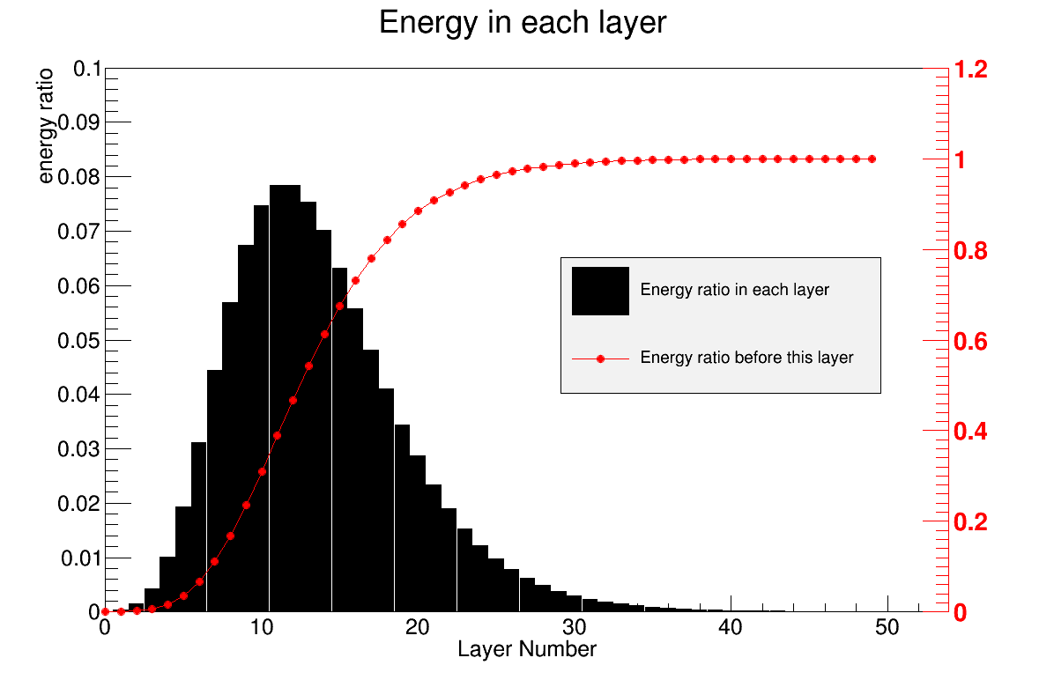
ScECAL thickness
CEPC’s center-of-mass energy is ~250GeV, which is half of ILC’s.
ScECAL can be shorten, to lower the cost.
Layers | Energy Ratio（175GeV photon）
20 | 88.4%
25 | 96.4%
30 | 98.9%
Simulation result of 175GeV photon, which is beyond the range of photon’s energy CEPC can produce.
More than 95% energy is deposited in first 25 layers (~21.4 X0).
3mm Tungsten + 2mm Scintillator + 2mm PCB in each layer

Slide 5
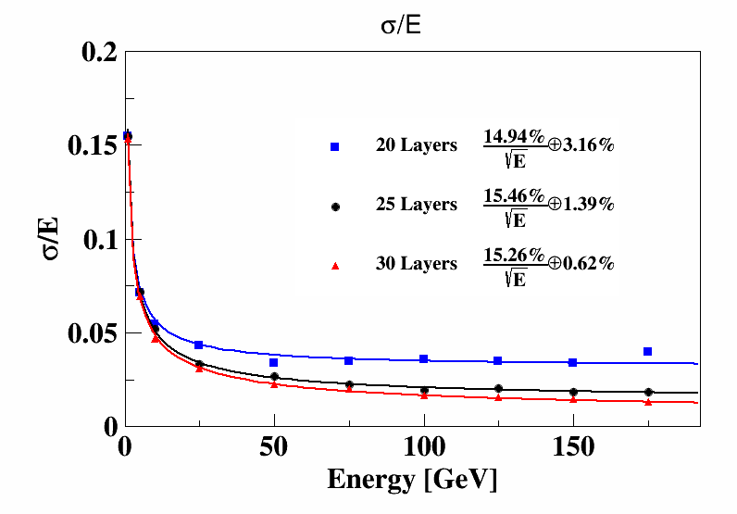
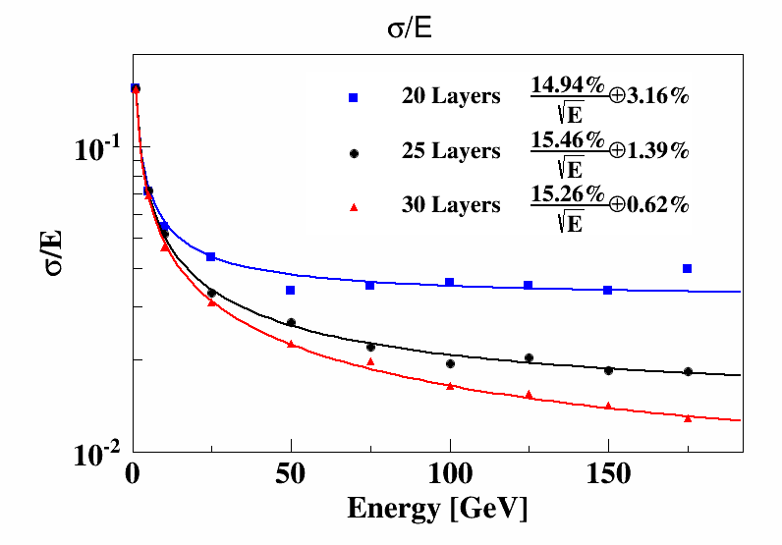
ScECAL Layer Num
For single photon energy resolution, 25 layer ECAL is not notable worse than 30 layer ECAL.
In logarithmic coordinates
3mm Tungsten + 2mm Scintillator + 2mm PCB in each layer

Slide 6
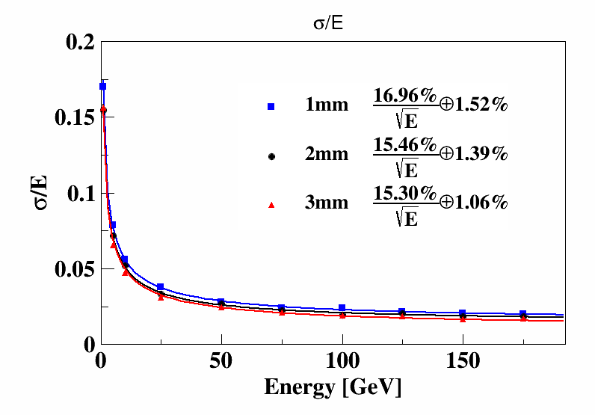
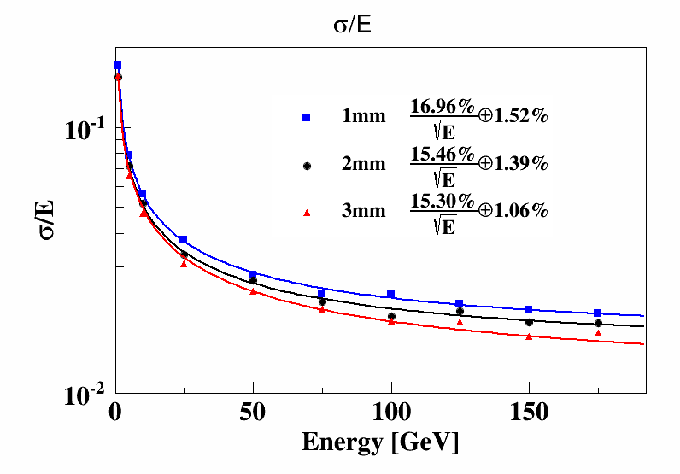
ScECAL Sensor Thickness
In logarithmic coordinates
25 layer ECAL is used.
Scintillator thickness dose not affect single photon energy resolution too much.
Final option should consider the performance and demands of scintillator and SiPM

Slide 7
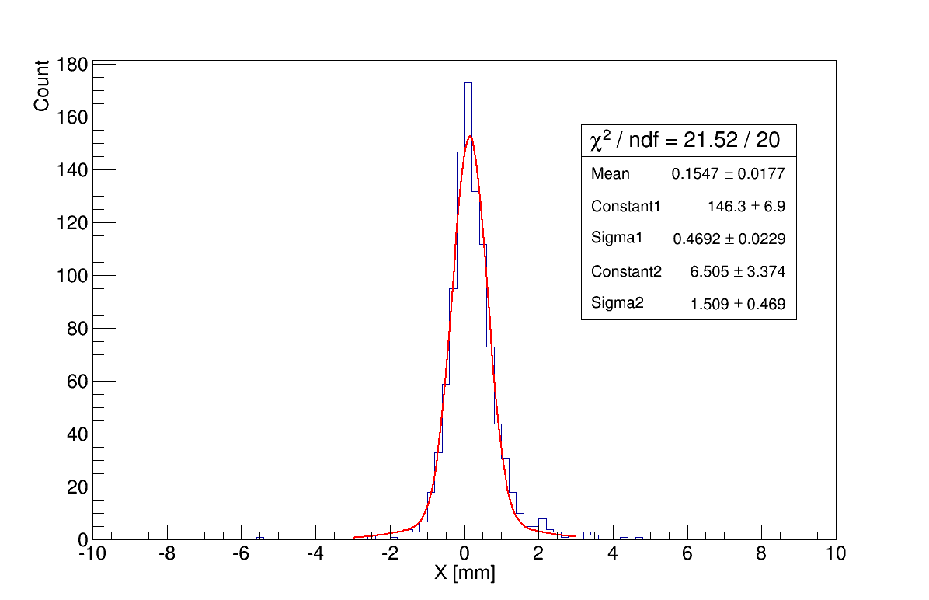
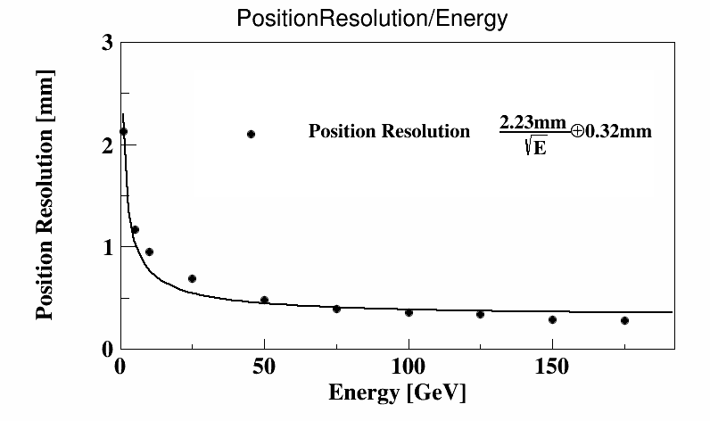
Photon Position Resolution
The inject position on the XY plane can be regarded as the shower energy weighted center, for x direction we have :
X = ∑x_{i}E_{i}/∑E_{i}
The distribution can be fitted by a sum of two Gaussians, and the sigma of the narrower Gaussian was used to represent position resolution here.
50GeV photon，5mm*5mm cell size reconstructed inject position distribution
Photon position resolution as a function of its energy, by 5mm*5mm cell size ECAL

Slide 8
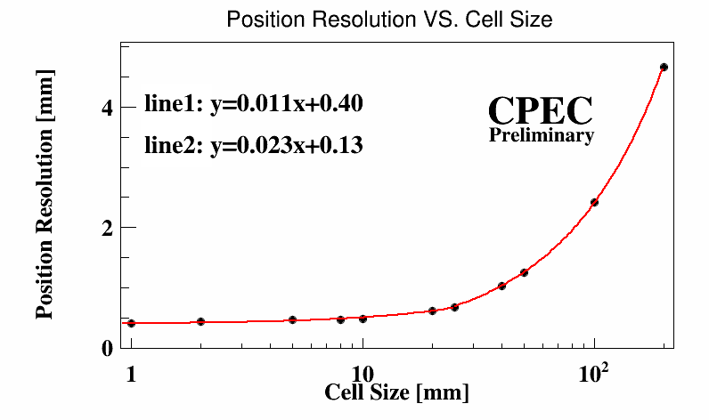
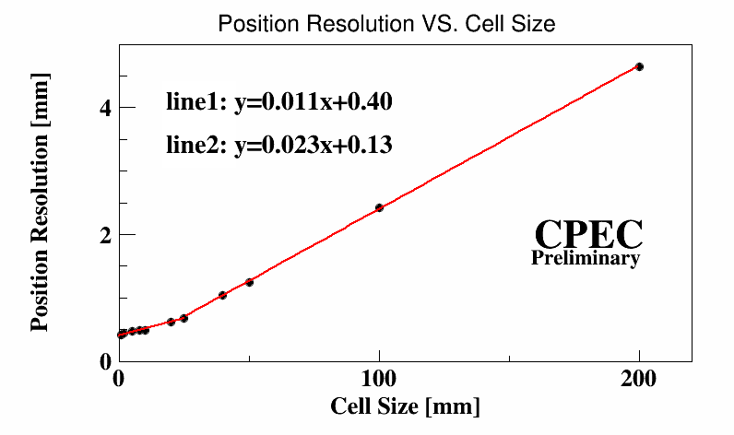
Cell Size
Inject position
50GeV photon’s position resolution with different cell size
Sectioned line function is used to describe the relationship between position resolution and cell size. The fit result indicates the difference between two slopes.

Slide 9
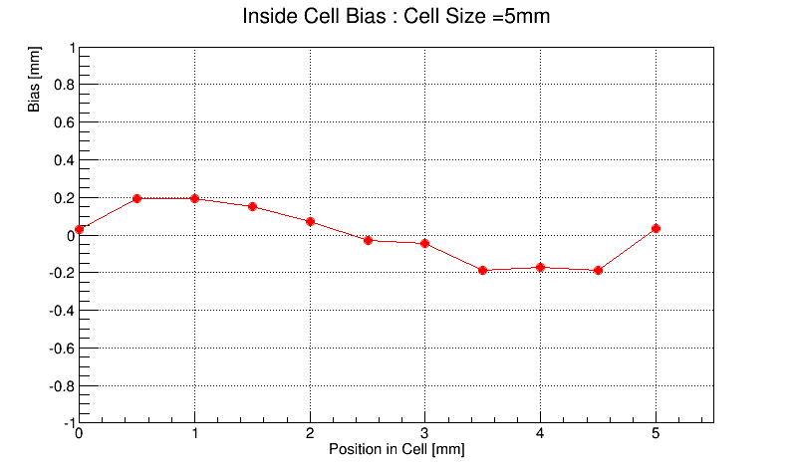
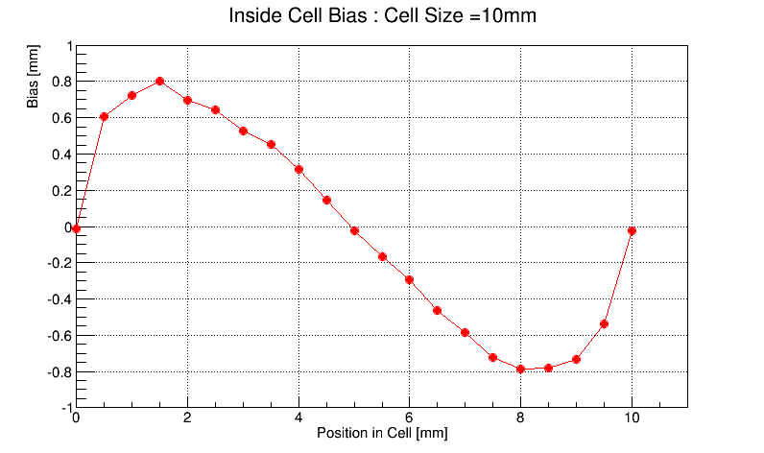
Reconstruction Bias
Bias caused by COG reconstruction method, with different inject position inside a cell
Cannot be ignored as cell size grows
5mm
5mm

Slide 10
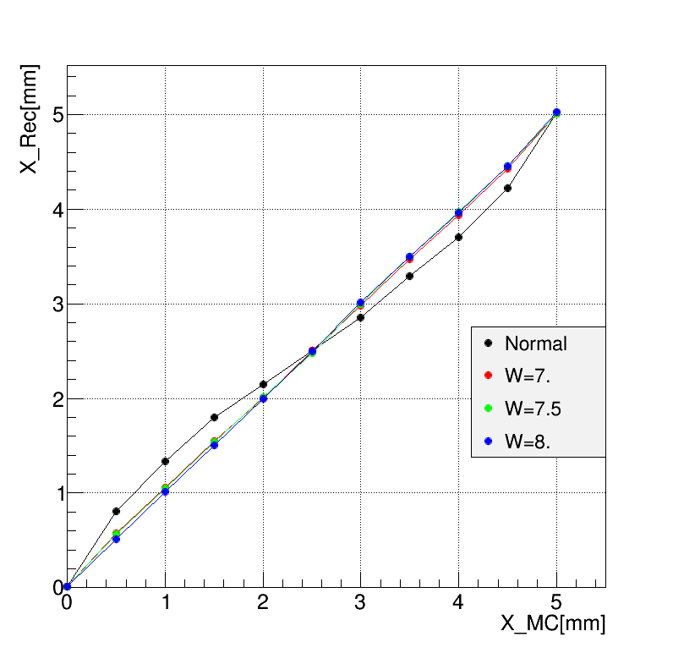
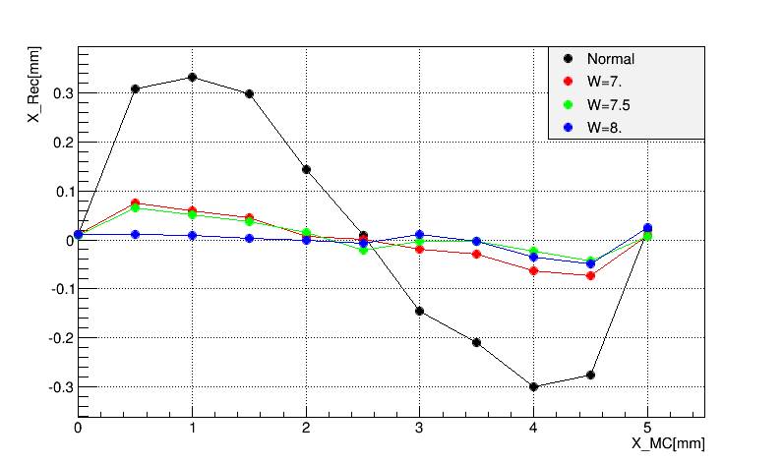
A Possible Solution
Standard weighting
Logarithmic weighting
w_{i}=E_{i}
w_{i}=max(0,w₀+ln(E_{i}/E_{C}))
compared in 5mm*5mm cell

Slide 11
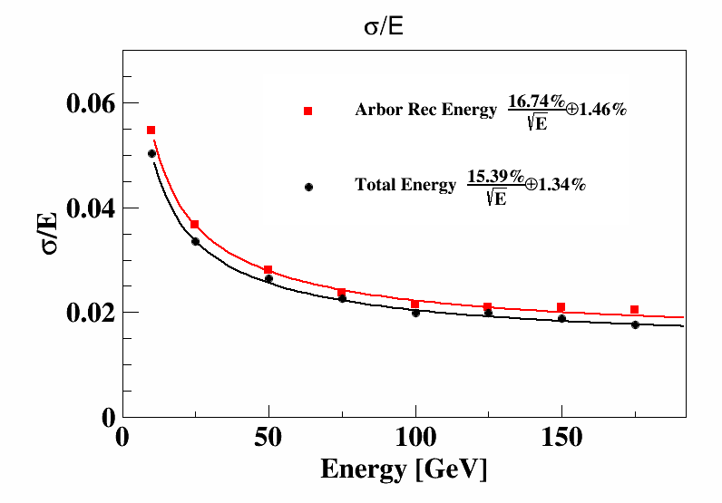
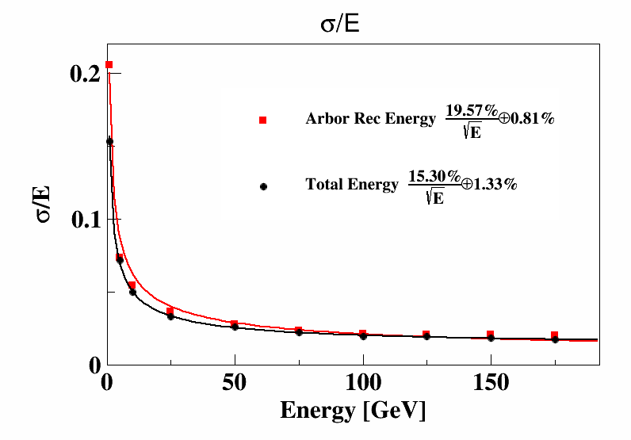
Arbor Rec test in simplified geometry
Bad with lower energy photon but acceptable when >10GeV
For energy > 10GeV

Slide 12
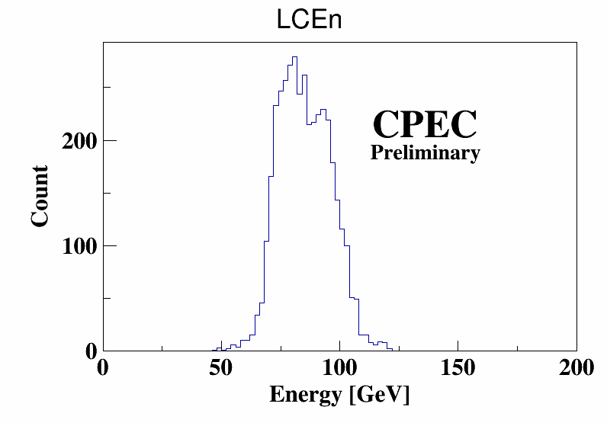
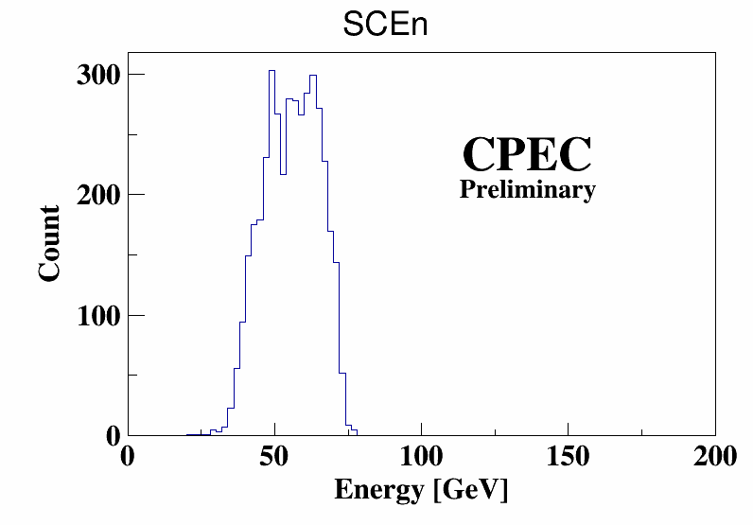
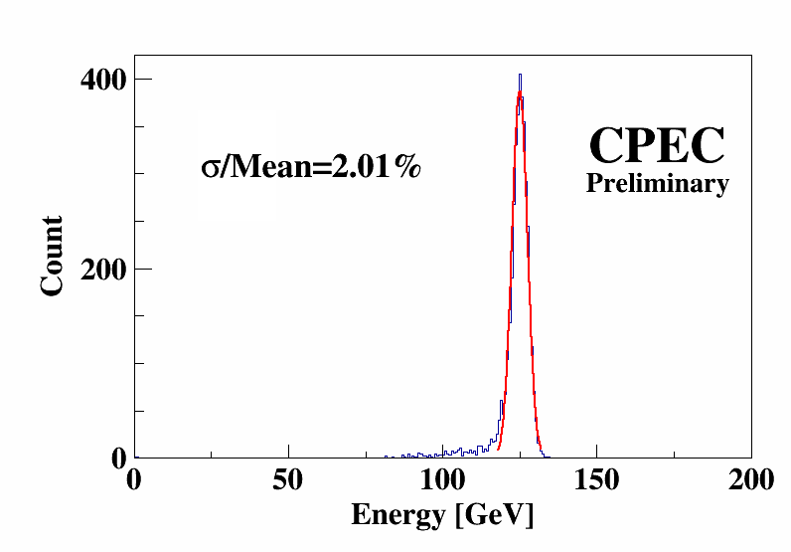
H->diphoton
H->diphoton branch can test the performance of ECAL
Energy distribution of two photon reconstructed by Arbor
The distribution has a long tail because the reconstruction is not perfect.

Slide 13
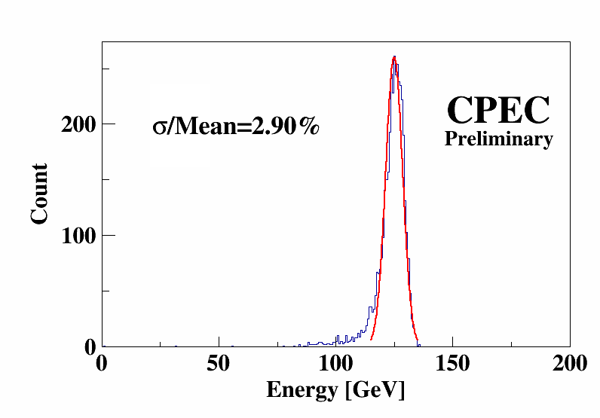
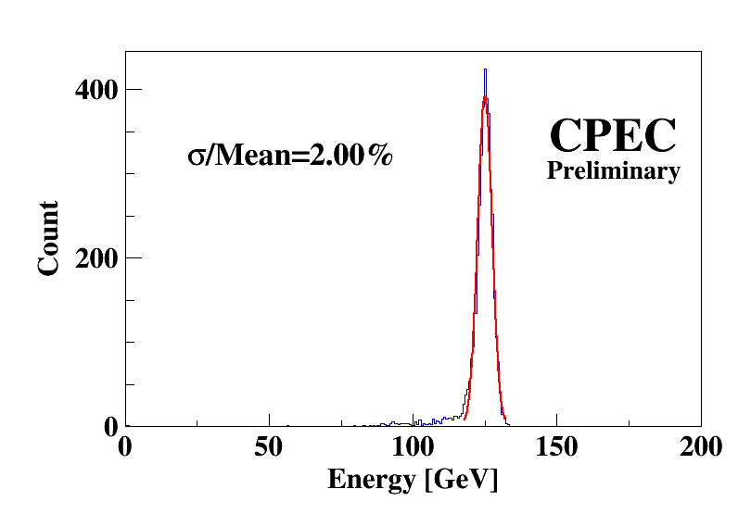
H->diphoton in different layers ECAL
20 layers
sigma/mean=2.90%
25 layers
sigma/mean=2.01%
30 layers
Sigma/mean=2.00%
Little difference between the results of 25 layer and 30 layer ECAL, which is accordance with the result of single photon.

Slide 14
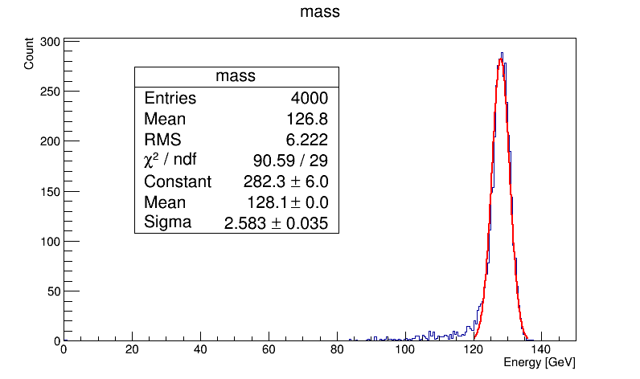
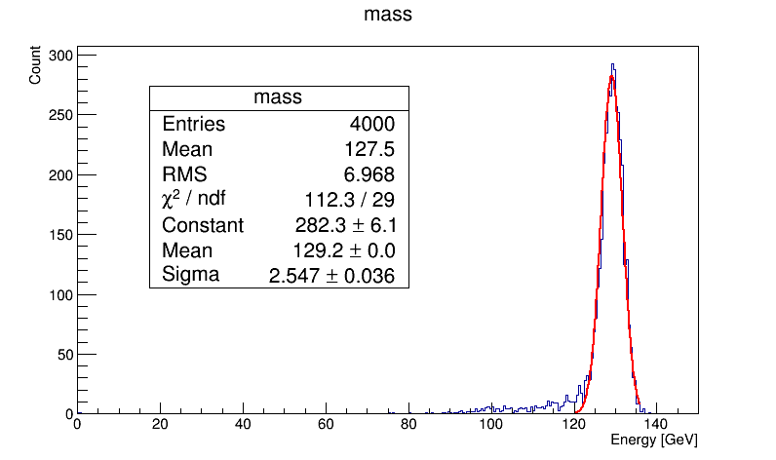
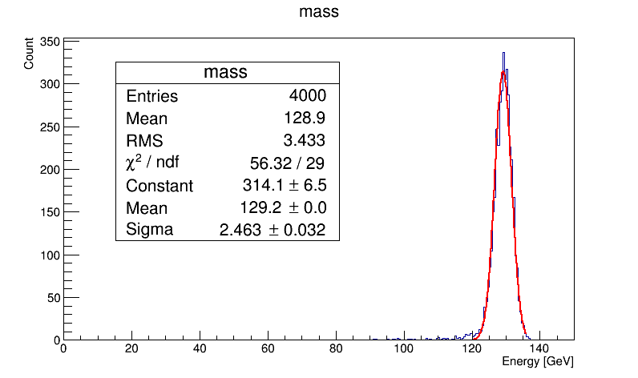
H->diphoton in different cell size ECAL
5*5mm
sigma/mean=2.01%
10*10mm
sigma/mean=1.97%
20*20mm
sigma/mean=1.91%
For single particle, Arbor works better when cell size is lager.
So when only considering H->diphoton, and leaving out the background, energy resolution gets better with larger cell size.

Slide 15
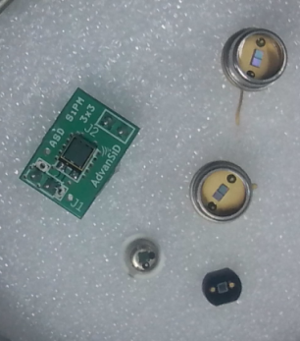
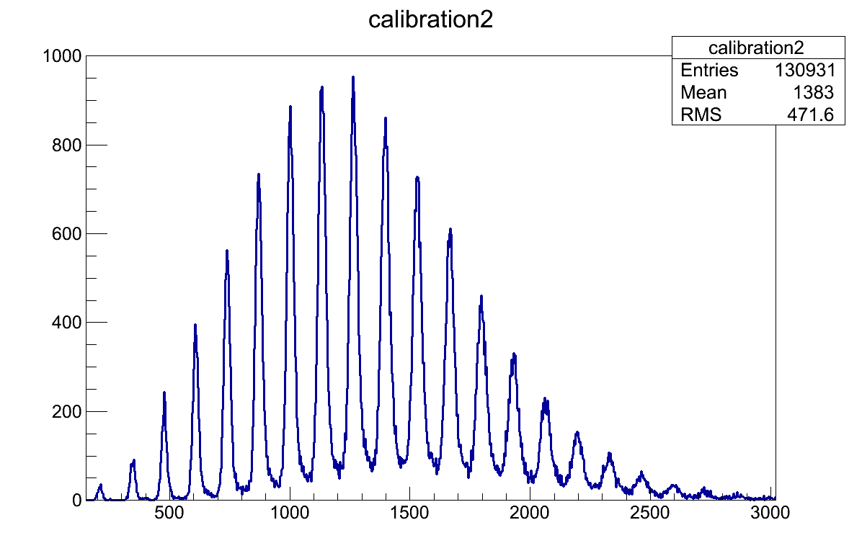
SiPM study
Different types of SiPM
Pulse height spectrum
Excellent photon counting ability

Slide 16
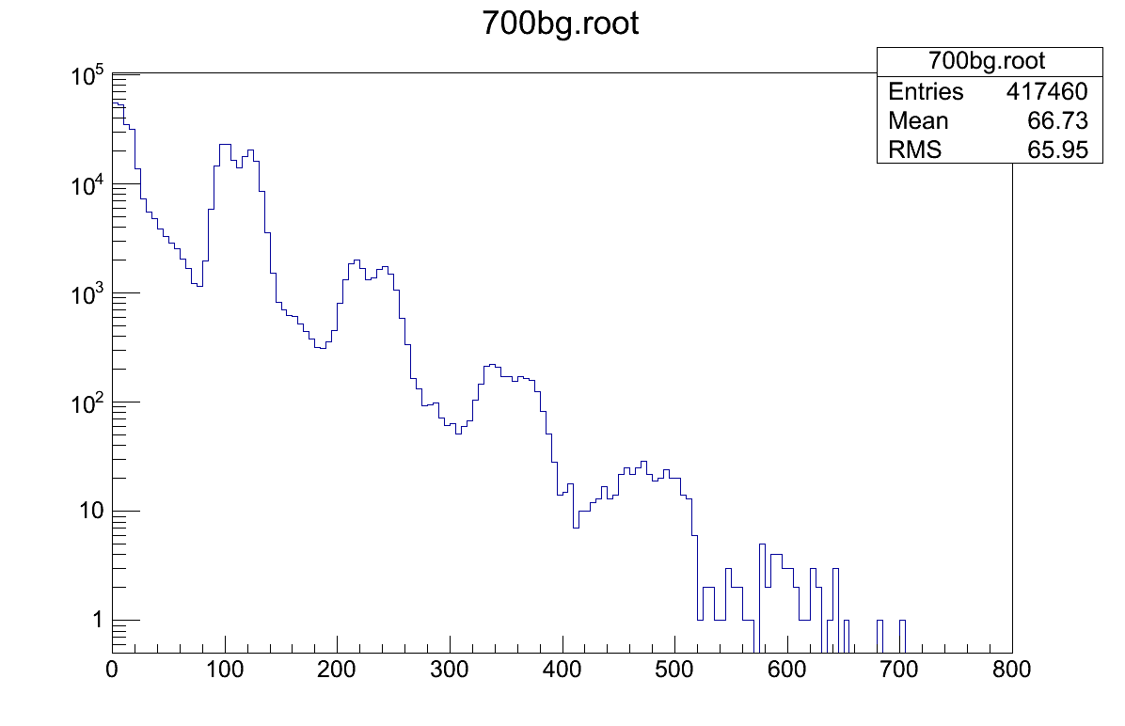
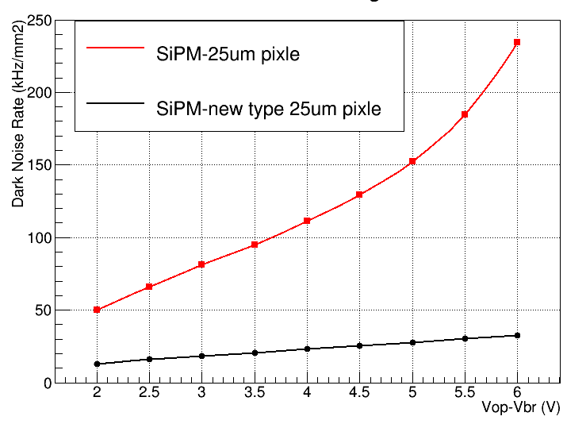
Dark Noise
Electron hole pairs generated without the involvement of photons give rise to unwanted noise.
1 p.e.
2 p.e.
3 p.e.
Spectrum of SiPM dark noise
Dark noise rate with over-voltage
Dark noise rate rises exponentially with the applied over-voltage.
New SiPM can reduce dark noise.

Slide 17
SiPM Response Curve
10000 pixel SiPM’s dynamic range is better than 1600 pixel SiPM, with only 1/3 photon detection efficiency of the latter.

Slide 18
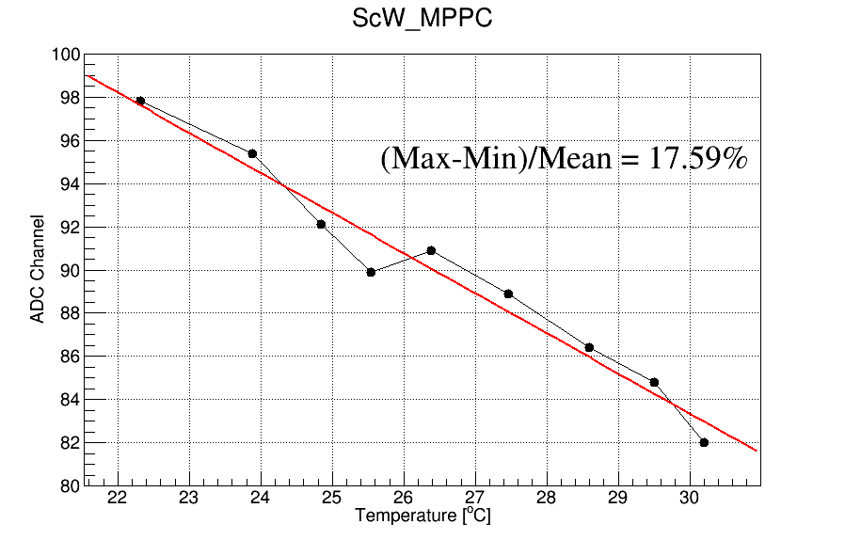
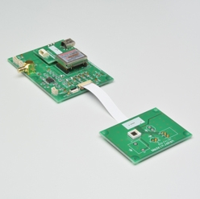
Gain stabilization
Temperature effect of SiPM
Calibrated by single P.E.
Gain stabilization
Calibrated by single P.E.
• The gain of SiPMs depends both on bias voltage and on temperature:
Gain decreases with temperature
Gain increases with bias voltage
• It is valuable to adjust V_{bias} to compensate for Temperature changes to keep the gain constant
Temperature-compensation
circuit: C12332-01

Slide 19
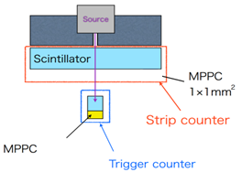
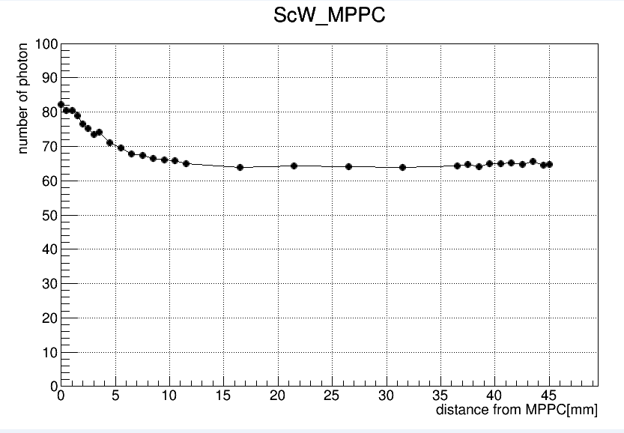
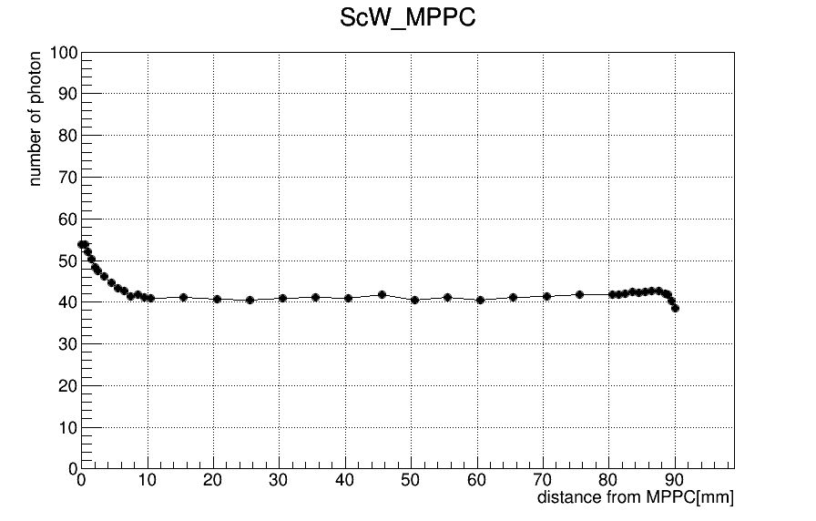
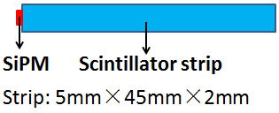
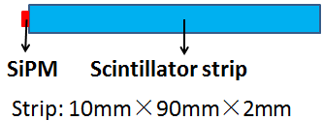
Scintillator strip test
Photon number collected by SiPM depends on the distance from source position to SiPM.

Slide 20
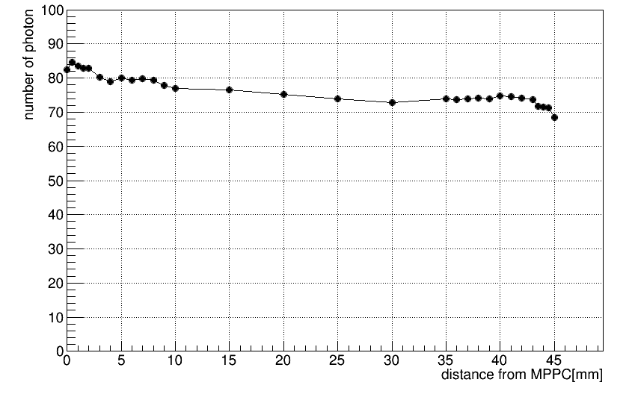
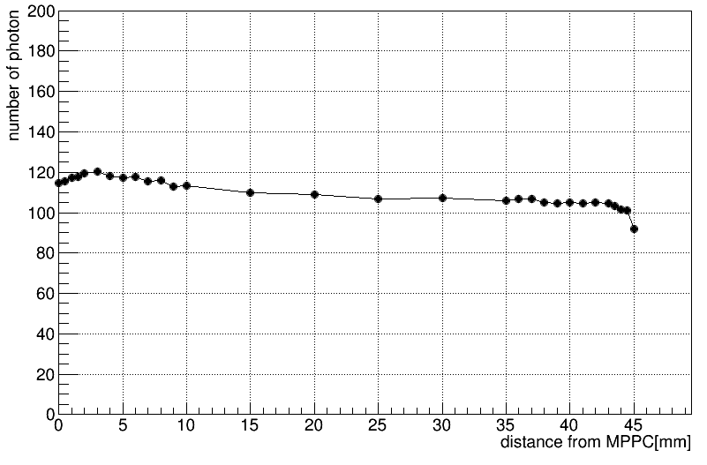
More test in ongoing..
Totally polished scintillator strip
Embed SiPM into scintillator strip
Try to get better homogeneity and less dead area.

Slide 21
ScECAL Digitization
G2CDHGC for ScECAL
Saturation
Non-homogeneity
Dead area
…

Slide 22
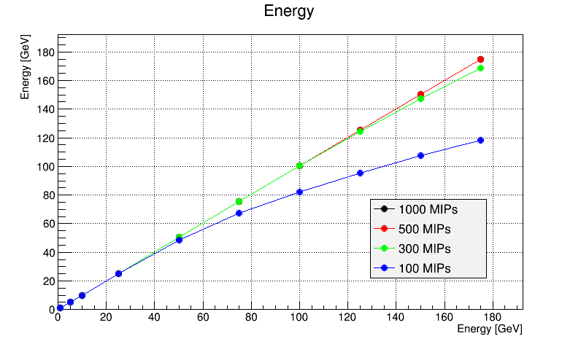
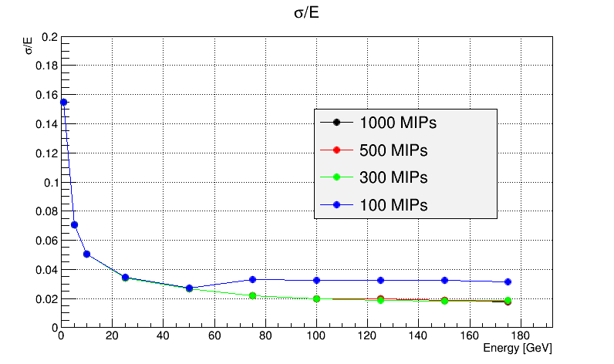
Saturation
Linearity
Energy Resolution
Under extremely ideal condition，300 MIPs range can meet the demand of ScECAL.

Slide 23
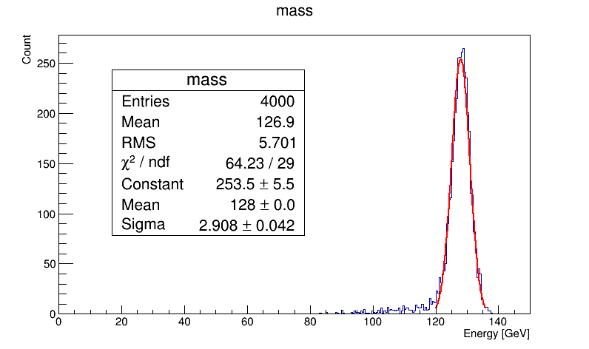
Non-homogeneity
Put the result on page19 into digitization, and use H->diphoton events to check the affect.
Energy resolution get worse by 13%.
H->diphoton sigma/mean=2.27%

Slide 24
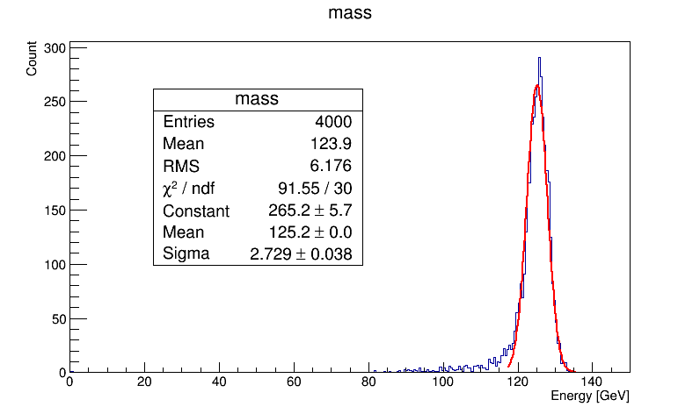
Dead Area
Since SiPM is coupled at one side of scintillator strip, some dead area may be caused by the thickness of SiPM.
1mm thick SiPM is considered here, and energy resolution get worse by around 8%.
We are trying to avoid dead area by embedding SiPM into scintillator.
H->diphoton sigma/mean=2.18%

Slide 25
Thanks!

