Slide 1
Ppjs data check

Slide 2
Time
 | (micro second)
DummyLoadOldROOTAlg | 2.03294000e+05
TrigEventMaker | 3.07212200e+06
EsTimeAlg | 2.22152490e+07
MdcFastTrkAlg | 5.85252720e+07
MdcDedxRecon2 | 2.00622374e+08
MdcTrkRecon | 3.99308255e+08
Hough | 3.06479763e+08 | 1.55%
KalFitAlg | 2.80163552e+09
MdcMakeHits | 1.98954630e+07
TrkReco | 1.61150506e+09
EmcRec | 5.32651676e+08
MdcxTrackFinder | 1.33094027e+10
ChronoStatSvc | 1.93050472e+10

Slide 3
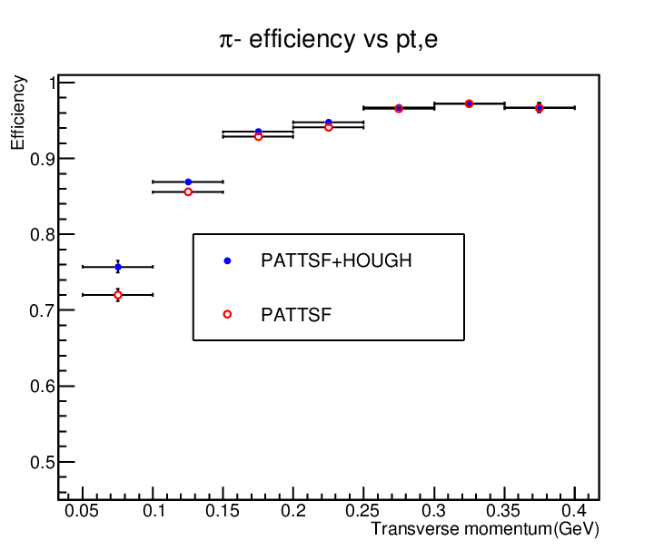
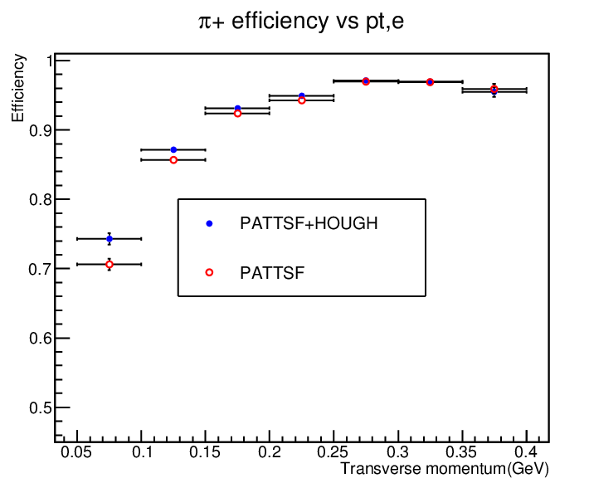
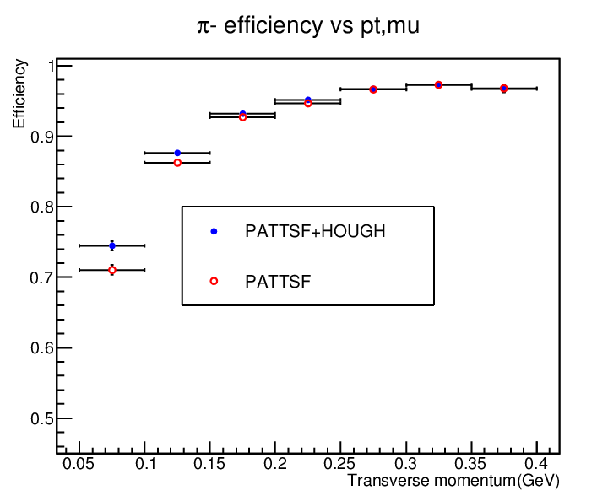
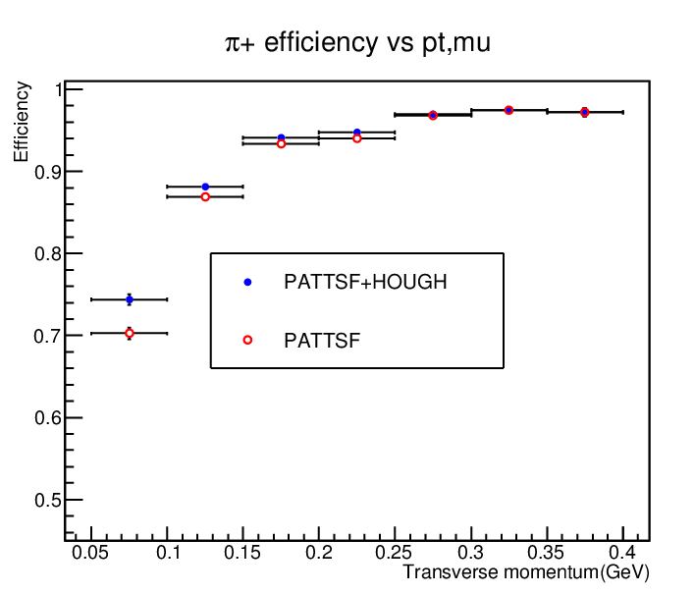
Data test pipijpsi

Slide 4
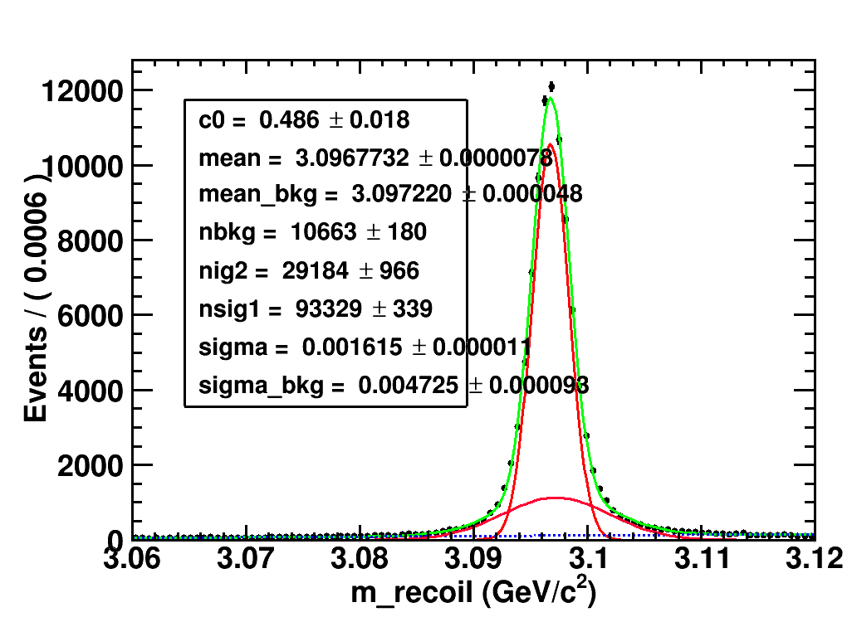
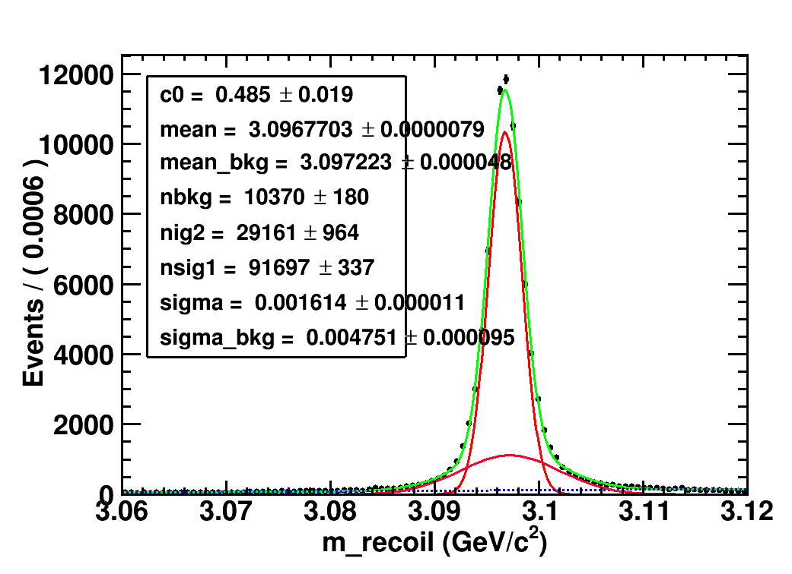
Data recoil pipi mass
PATTSF+HOUGH
PATTSF
Recoil pipi mass fit:
PATTSF+HOUGH: 29184+93329=122513
PATTSF:29161+91697=120858
Signal increases : 1655 1.37%
4c fit success:
PATTSF+HOUGH:90383
PATTSF:88570
Increases:1813

