Slide 1
Performance Analysis after Removing the Inner Chamber
speaker : Miao Nannan
3 November 2016

Slide 2
Motivation
to check the efficiency after removing the inner chamber with th code fixed
to check the proportion that the MDC can reconstruct after removing the inner chamber

Slide 3
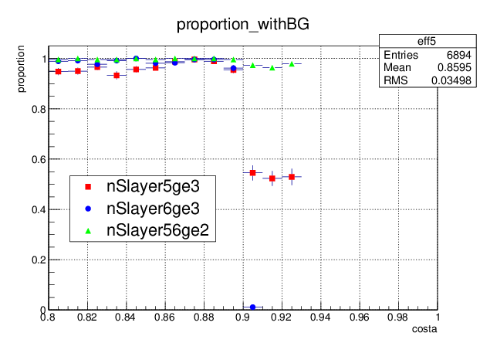
data sample : /besfs/groups/yuany/commondata/yuanjh/rtraw/fixpt_muon_1GeV.rtraw
eff = nTk>0 / Simulation of event number
MDC : the efficiency of MDC full resconstruction;
MDC w.o. inner : the efficiency of MDC resconstruction without inner chamber ;
MDC w.o. inner fixed : the efficiency of MDC resconstruction with inner chamber fixed;
nSlayer5ge3 : in fifth super layer ,the proportion of hit number is equal or greater than three;
nSlayer6ge3 : in sixth super layer ,the proportion of hit number is equal or greater than three;
nSlayer56ge2 : in the two super layer ,the proportion of hit number more than two;

