Slide 1
IHEP 9-cell Cavity Work (Oct. 24-28)
Jiyuan Zhai, Conglai Yang, Mineyuki Asano
October 31, 2016, KEK, Japan

Slide 3
Week Schedule
Date | Work
Mon (10-24) | talks in group meeting; disassemble cavity support jig
Tue (10-25) | equator inspection (weld, up and down)
Wed (10-26) | iris inspection, frequency and field flatness check, assemble cavity support jig
Thu (10-27) | cavity flange fit check for vertical test and HPR, flange seal surface check; (participate vertical test of 1.5 cell SRF gun)
Fri (10-28) | Pre-EP and EP1 preparation (outside and inside rinsing, ultrasonic cleaning, dry)

Slide 4
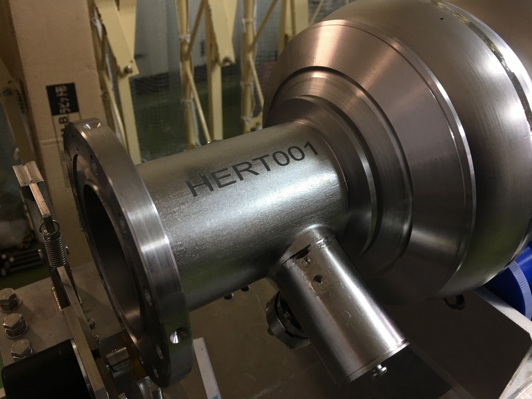
Inner Surface Inspection

Slide 5
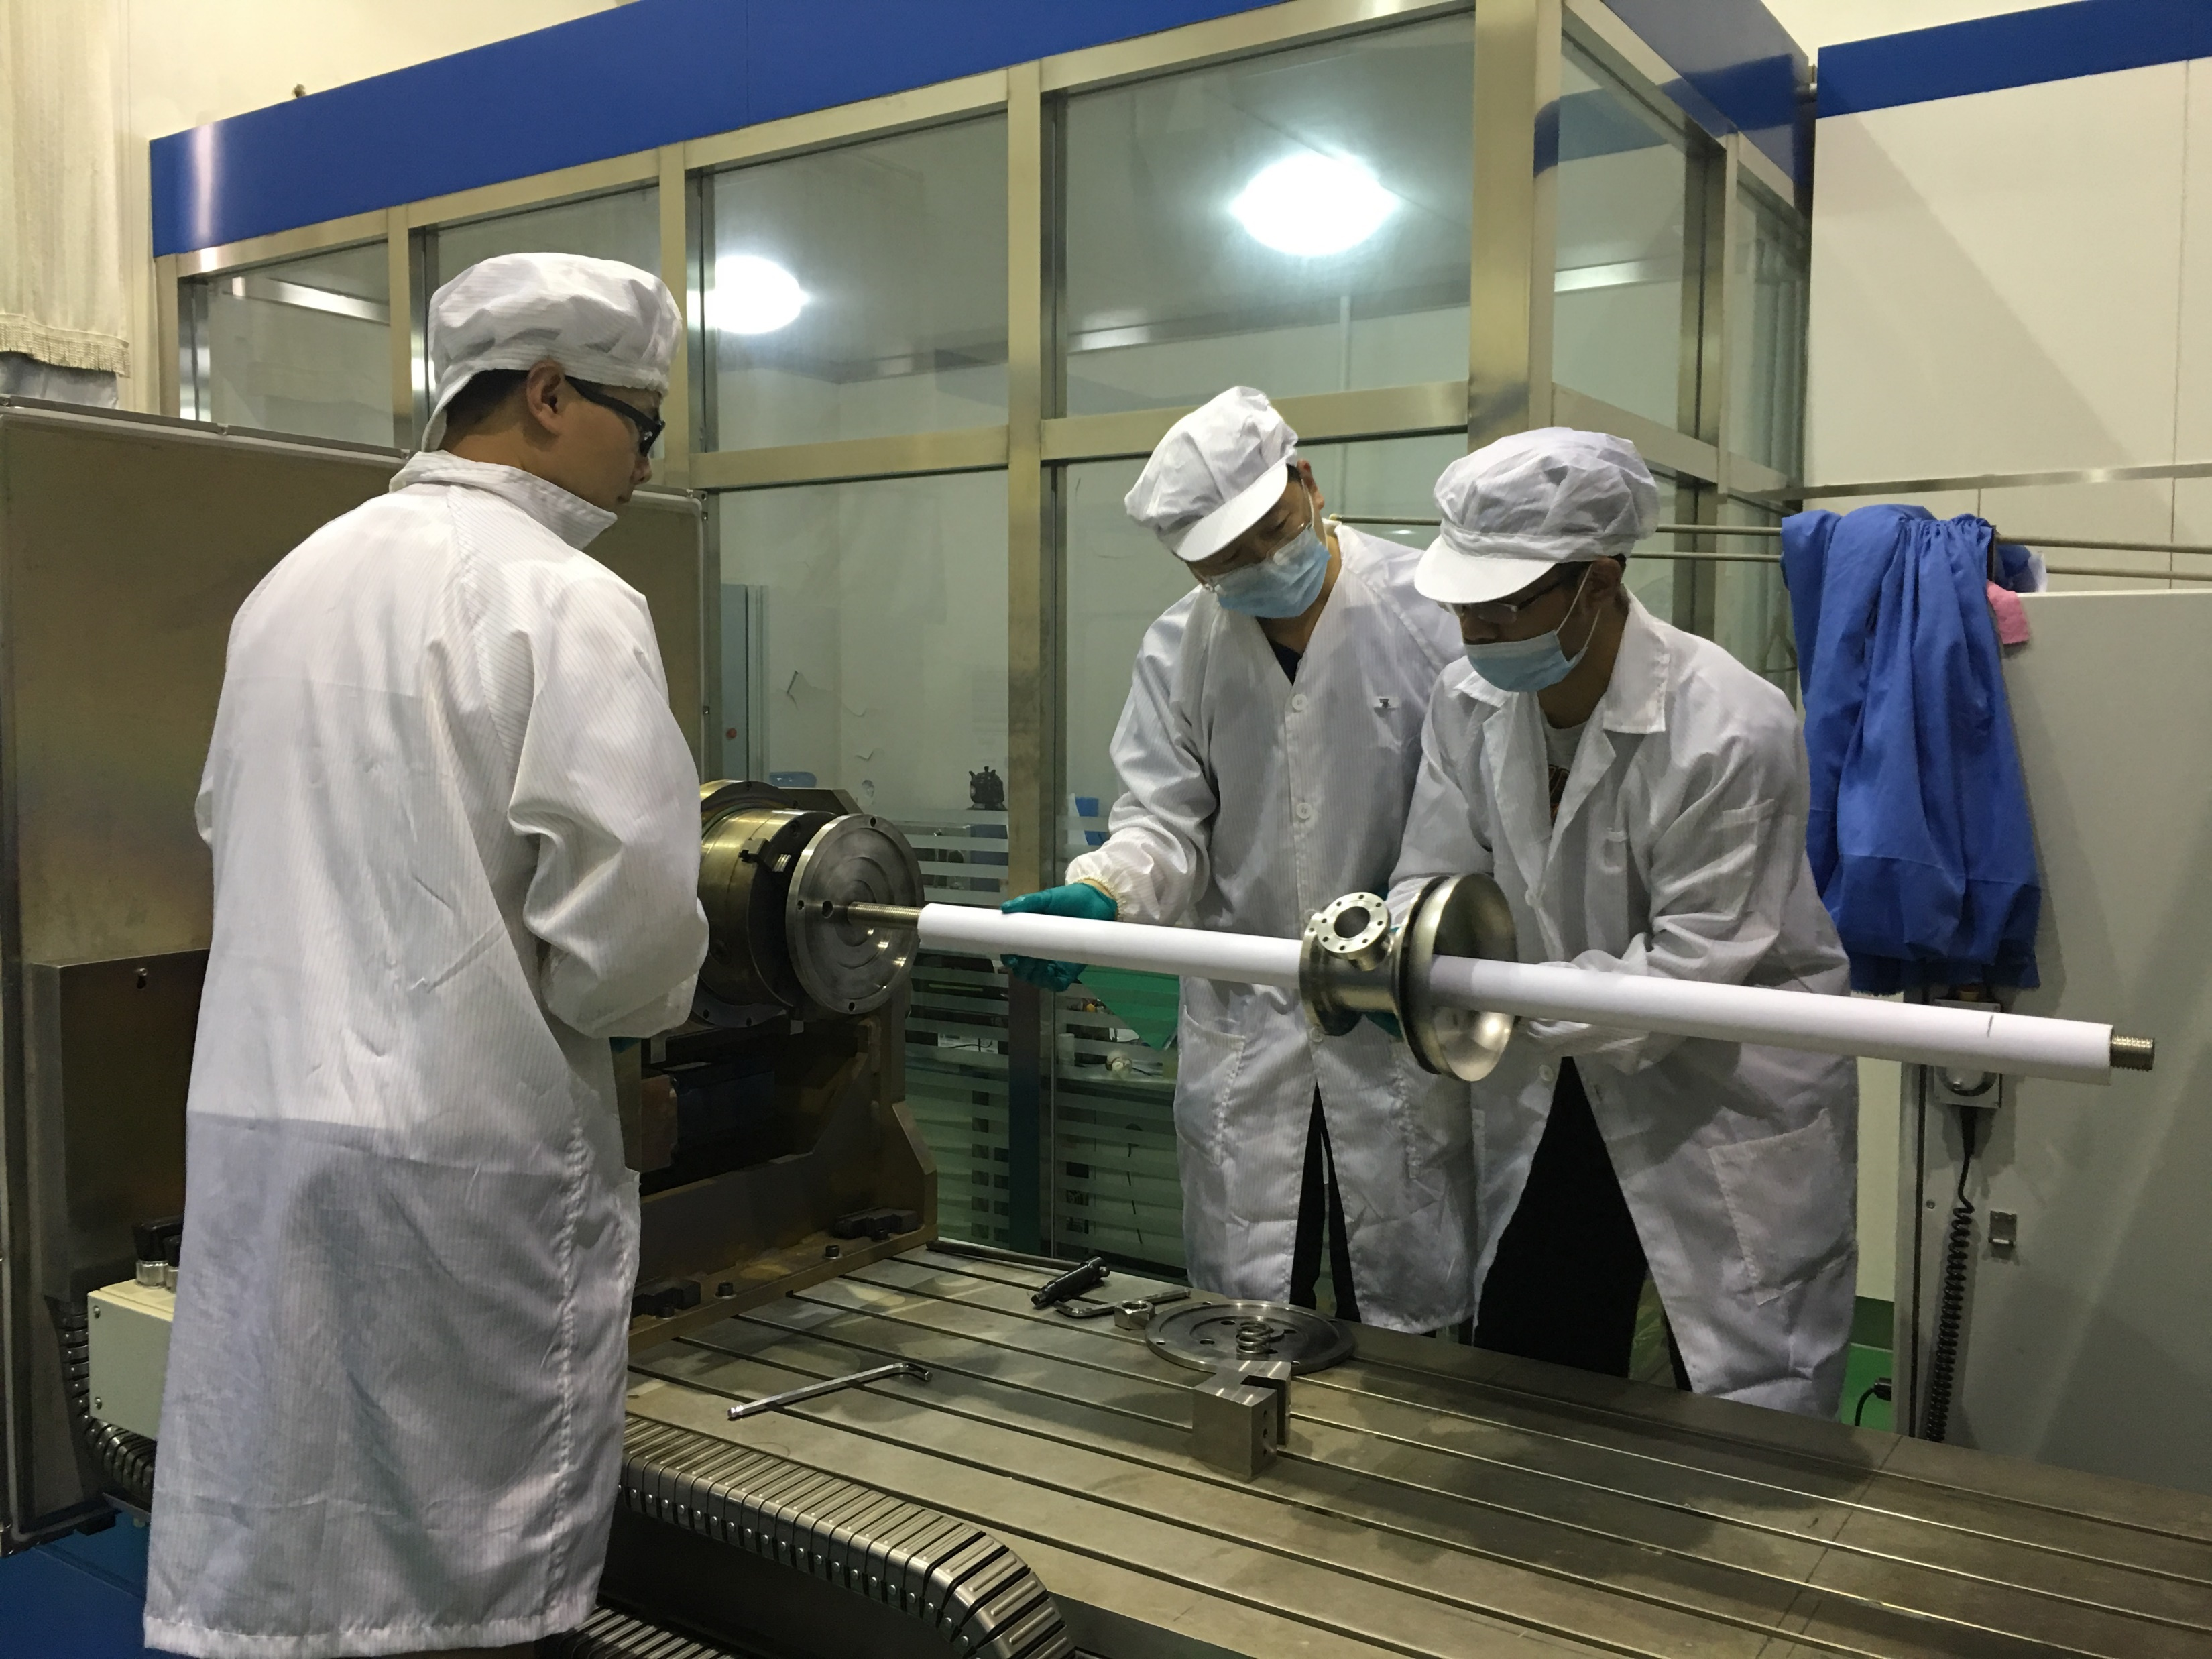
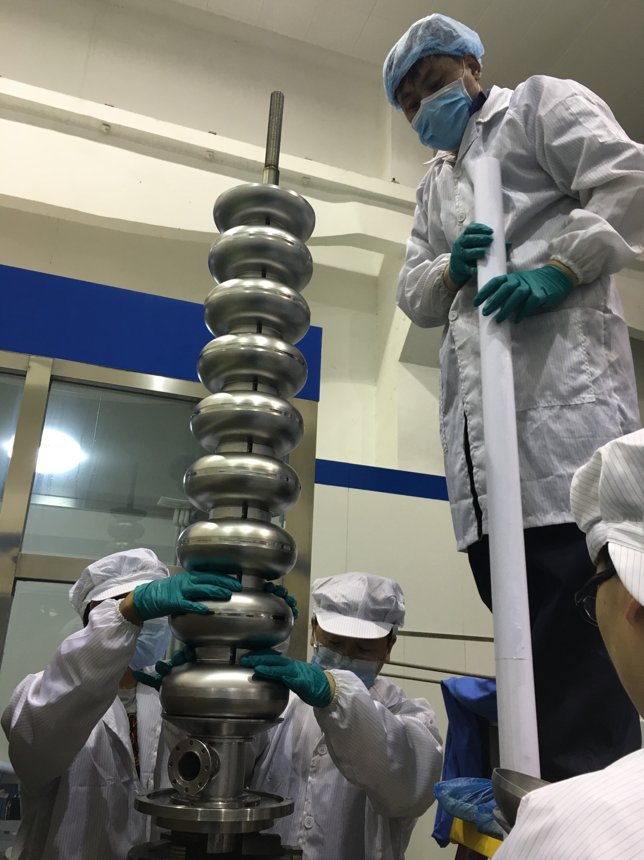
Burnt Paper Scraps on Equator Area
before wipe
after wipe
E01: 76 deg (and many in other cells)
Burnt scraps of the protection paper jacket of the center screw in final EBW assembly; wipe the end cell (cell#1&9) equator by hand, dust disappeared; Will be removed by rinsing and ultrasonic cleaning.

Slide 6
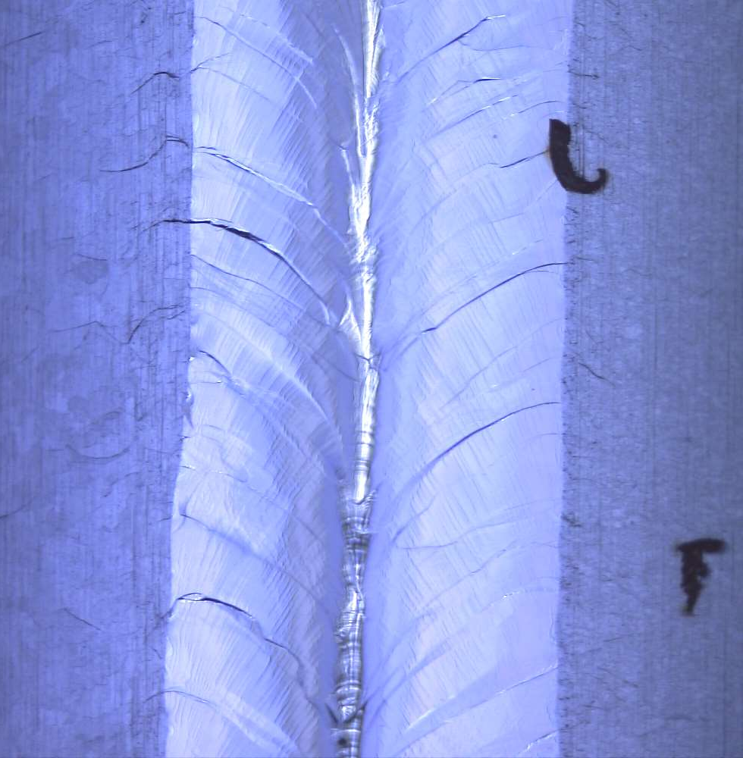
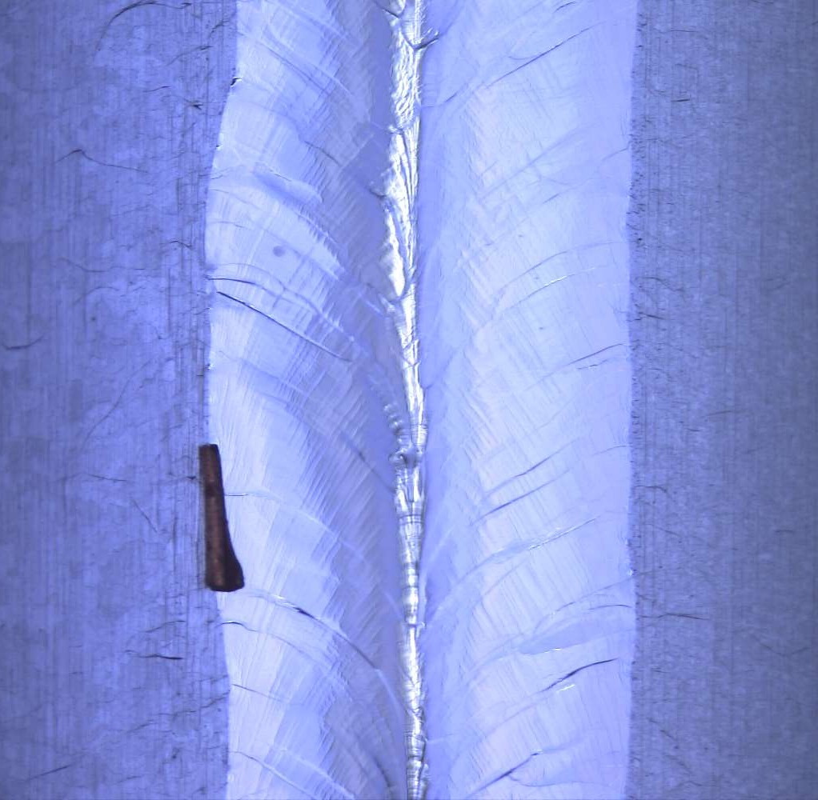
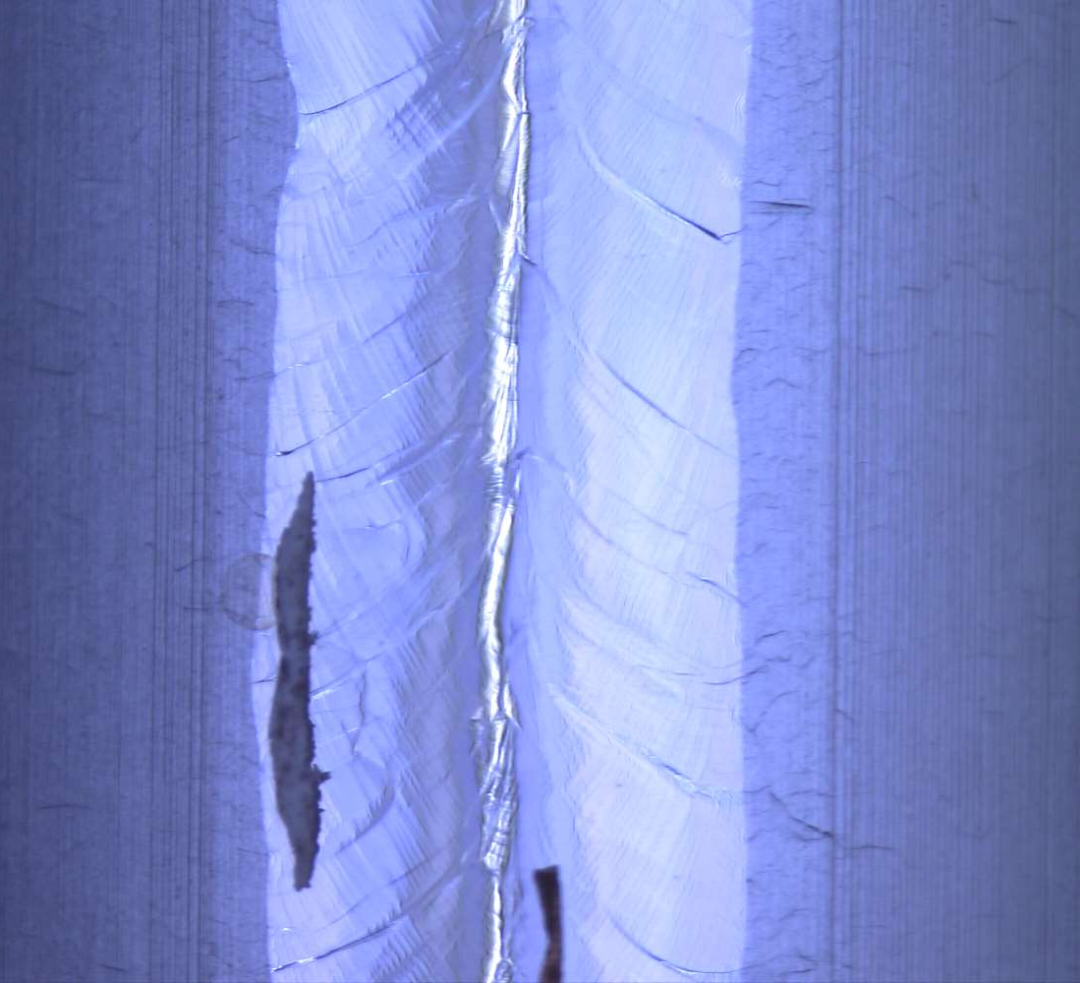
Burnt paper scraps in middle cells
E09: 72 deg (removed by hand wiping)

Slide 7
Equator Defects: Suspected Dusts
E02: 54 & 293 deg; E08: 252 deg
suspect dust; hope to disappear after ultrasonic cleaning and pre-EP. If not, local grind before EP2

Slide 8
Equator Defects: Undercuts
E09: 36 deg; E07: 104 deg (and many in other cells)
hope to smooth by EP

Slide 9
Equator Defects: Lathe Cutter Pits
E04: 121~144 (~1 cm) & 225 deg
due to initial dumbbell vibration during turning; hope EP can smooth the pits

Slide 10
Equator Defects: Narrow Down
E08: 27 (18-32) & 113 (63, 108, 121) deg
Seems full penetration; EP will smooth the uneven welds.

Slide 11
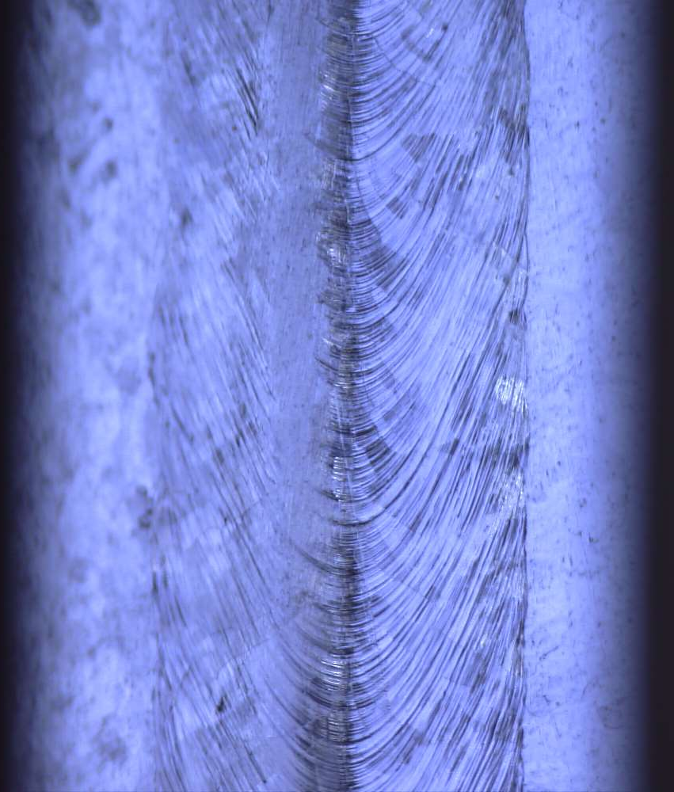
Iris Defects
i8-9: 81 deg; i1-2: 99 deg; i2-3: 72 deg (original not-grinded weld)
Most of the iris area grinded by hand because of deep drawing pits and grooves;
smooth by EP

Slide 12
Cavity Frequency and Field Flatness Check

Slide 13
As-received Frequency and Field Flatness
Pi mode Freq: 1301.545 MHz
As-received field flatness: 64 %

Slide 14
Cavity Frequency and Length Control
 | df (MHz) | Freq (MHz) | dL (mm) | Length (mm)
Parts average / sum | / | 1298.626 | / | 1292.3
EBW | + 3 | 1301.545 | - 4.7 | 1287.6
EP1 | - 1.0 | 1300.545 | 0 | 1287.6
Pretuning | - 1.9 | 1298.650 | - 6 | 1282.6
EP2 | - 0.2 | 1298.450 | 0 | 1282.6
EP in future treatment | - 1.2 | 1297.250 | 0 | 1282.6
RT to 2 K | + 2.45 | 1299.700 | - 2 | 1280.6
Design | 0 | 1299.700 | 2.8 | 1283.4
One-side equator EBW shrink: 4.7 mm / 18 = 0.26 mm
EBW freq increasing: 0.26 mm * 5.23 MHz / mm = 1.37 MHz
Unknown freq increasing: ~ 1.6 MHz
Average cell pre-tuning squeeze length: ~ 0.7 mm

Slide 15
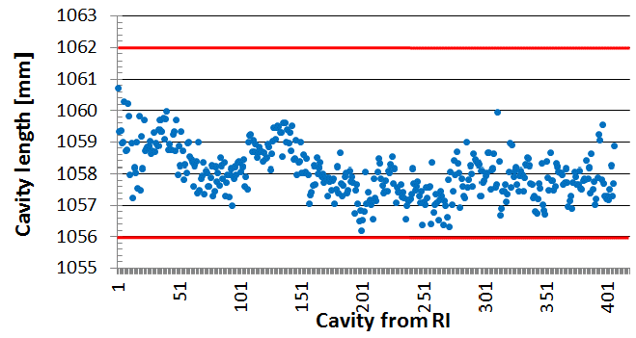
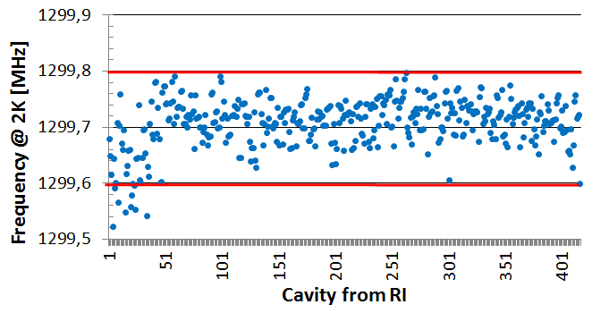
Euro-XFEL Data (400 RI 9-cell cavities)
W. Singer et al., Phys. Rev. Accel. Beams 19, 092001 (2016)

Slide 16
Pre-tuning Amount
pretuning target

Slide 17
8 Pi / 9

Slide 18
7 Pi / 9

Slide 19
6 Pi / 9

Slide 20
5 Pi / 9

Slide 21
4 Pi / 9

Slide 22
3 Pi / 9

Slide 23
2 Pi / 9

Slide 24
Pi / 9

Slide 25
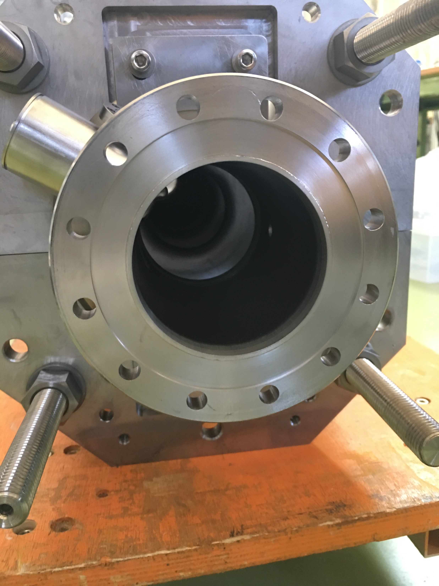
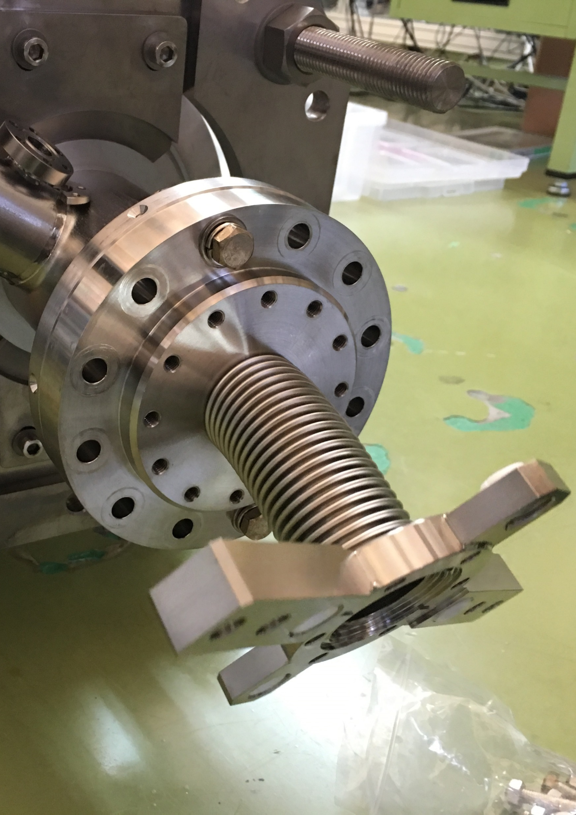
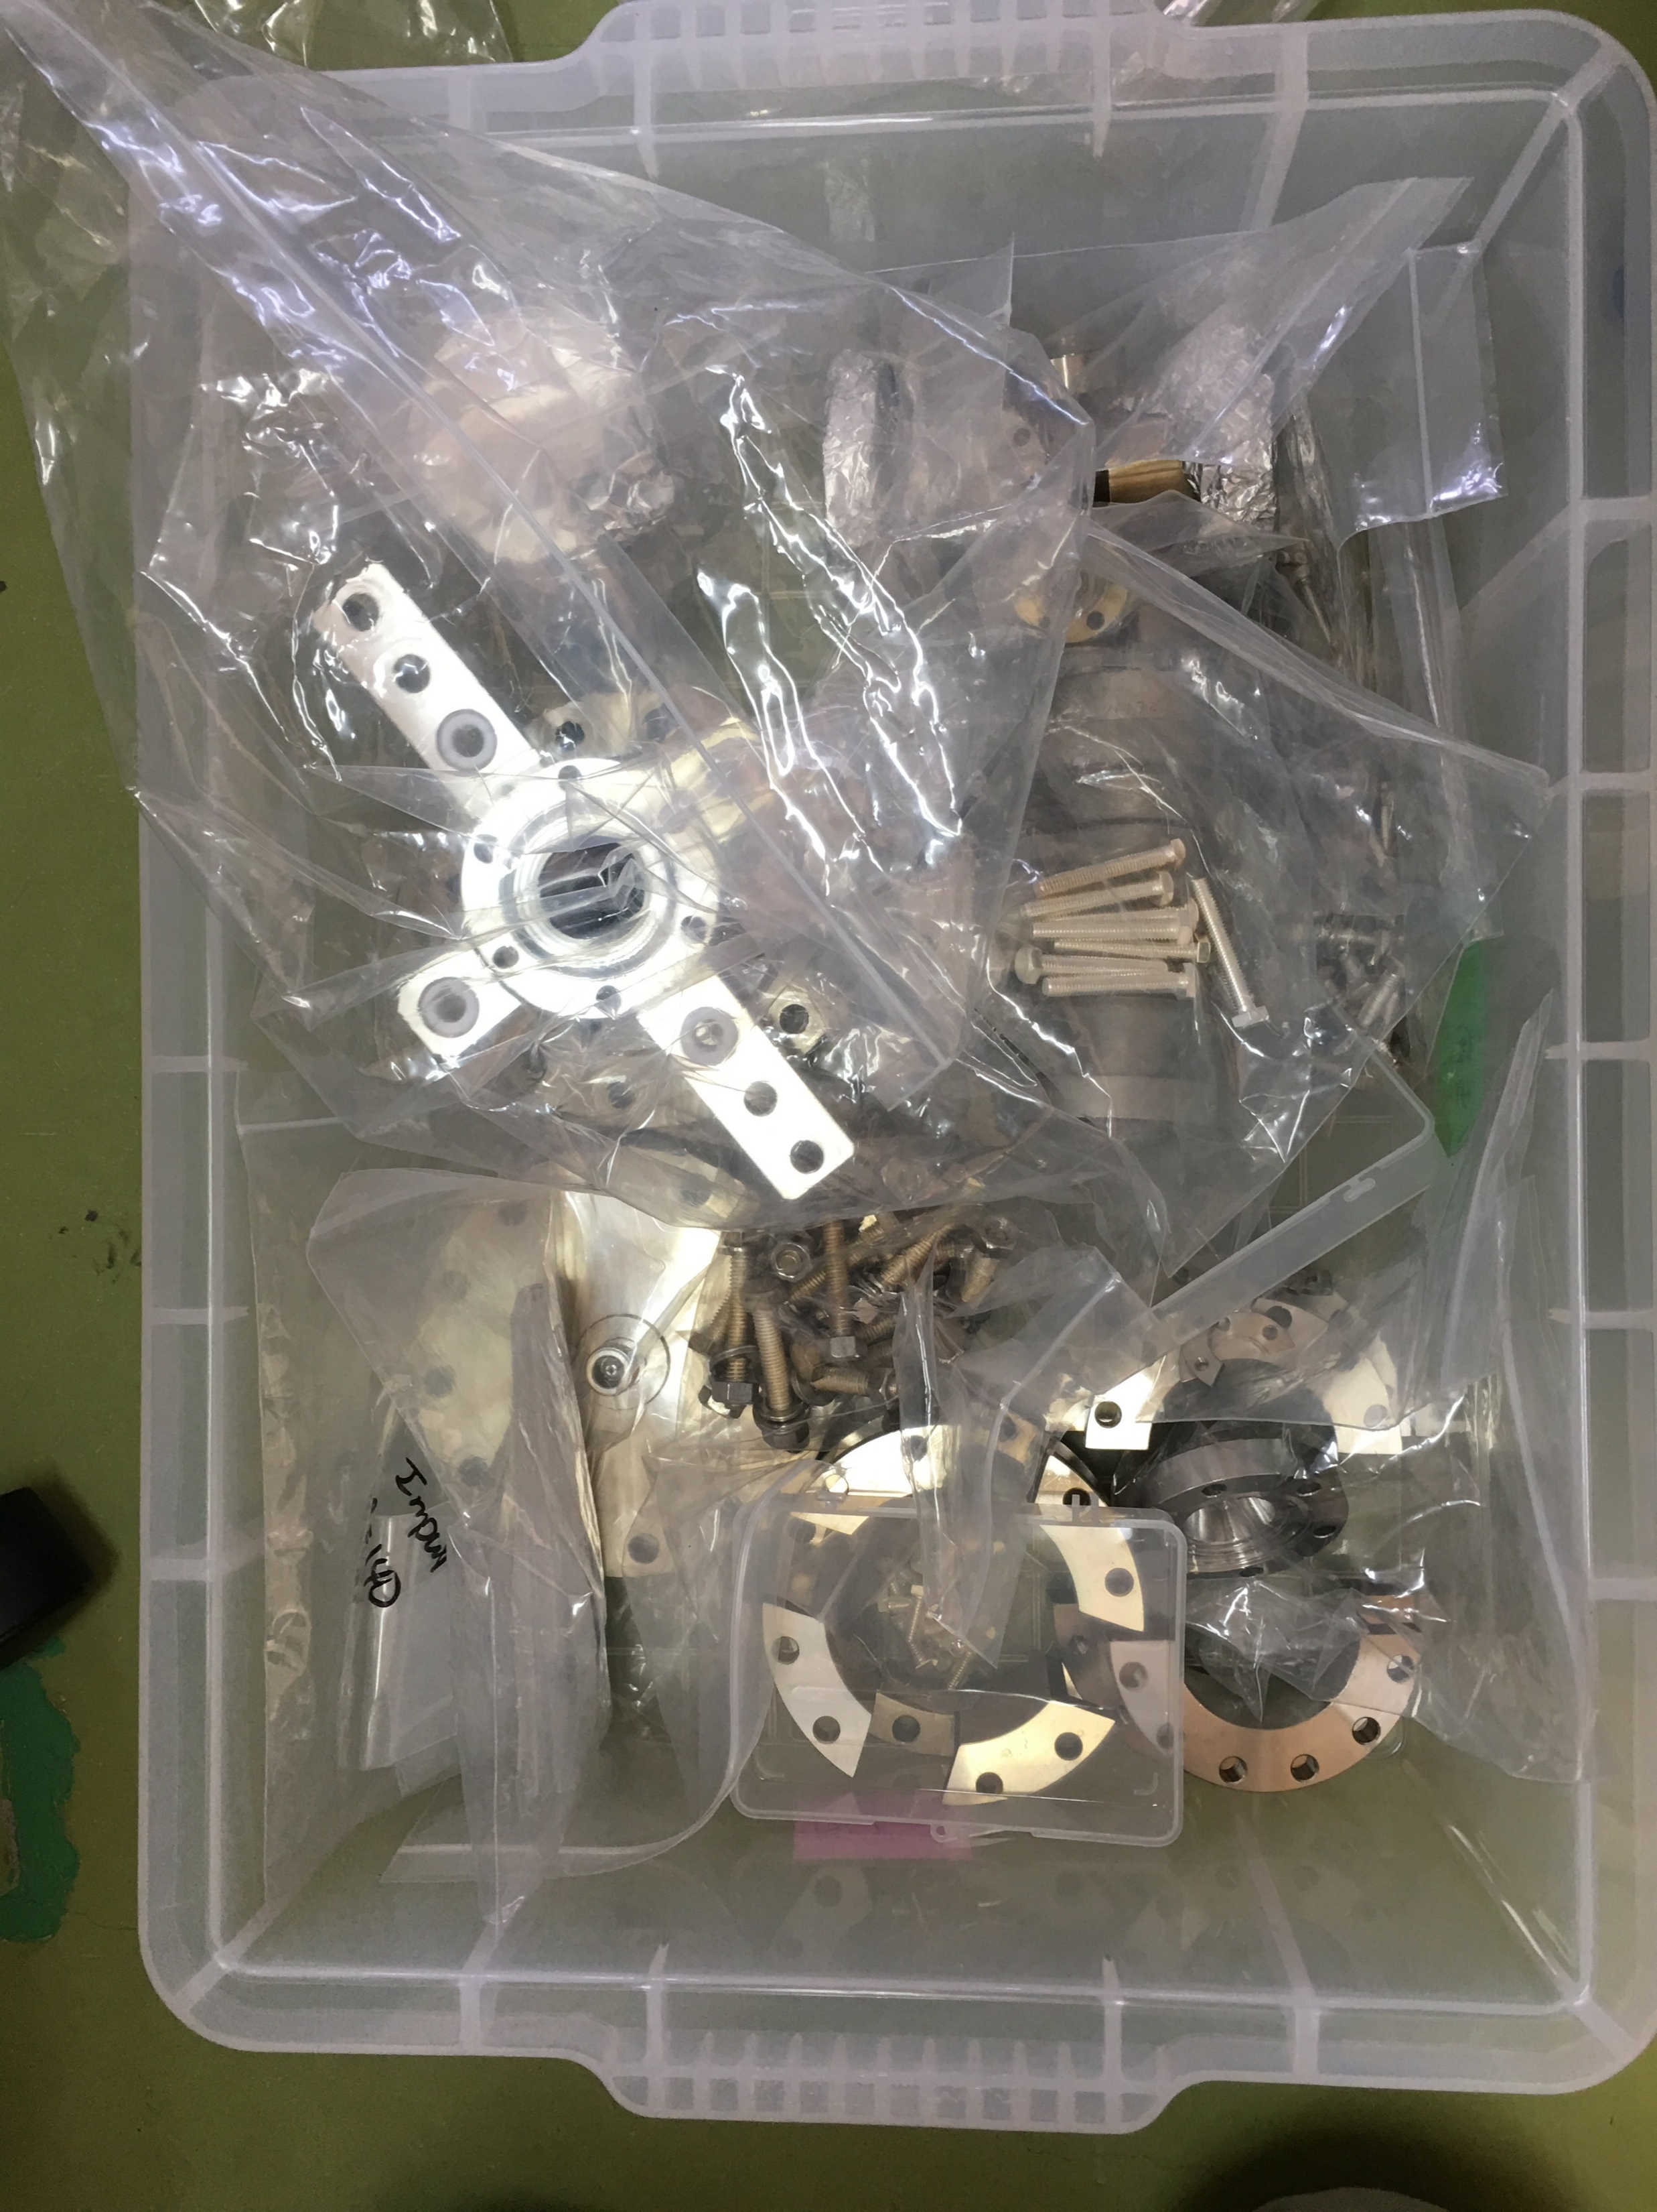
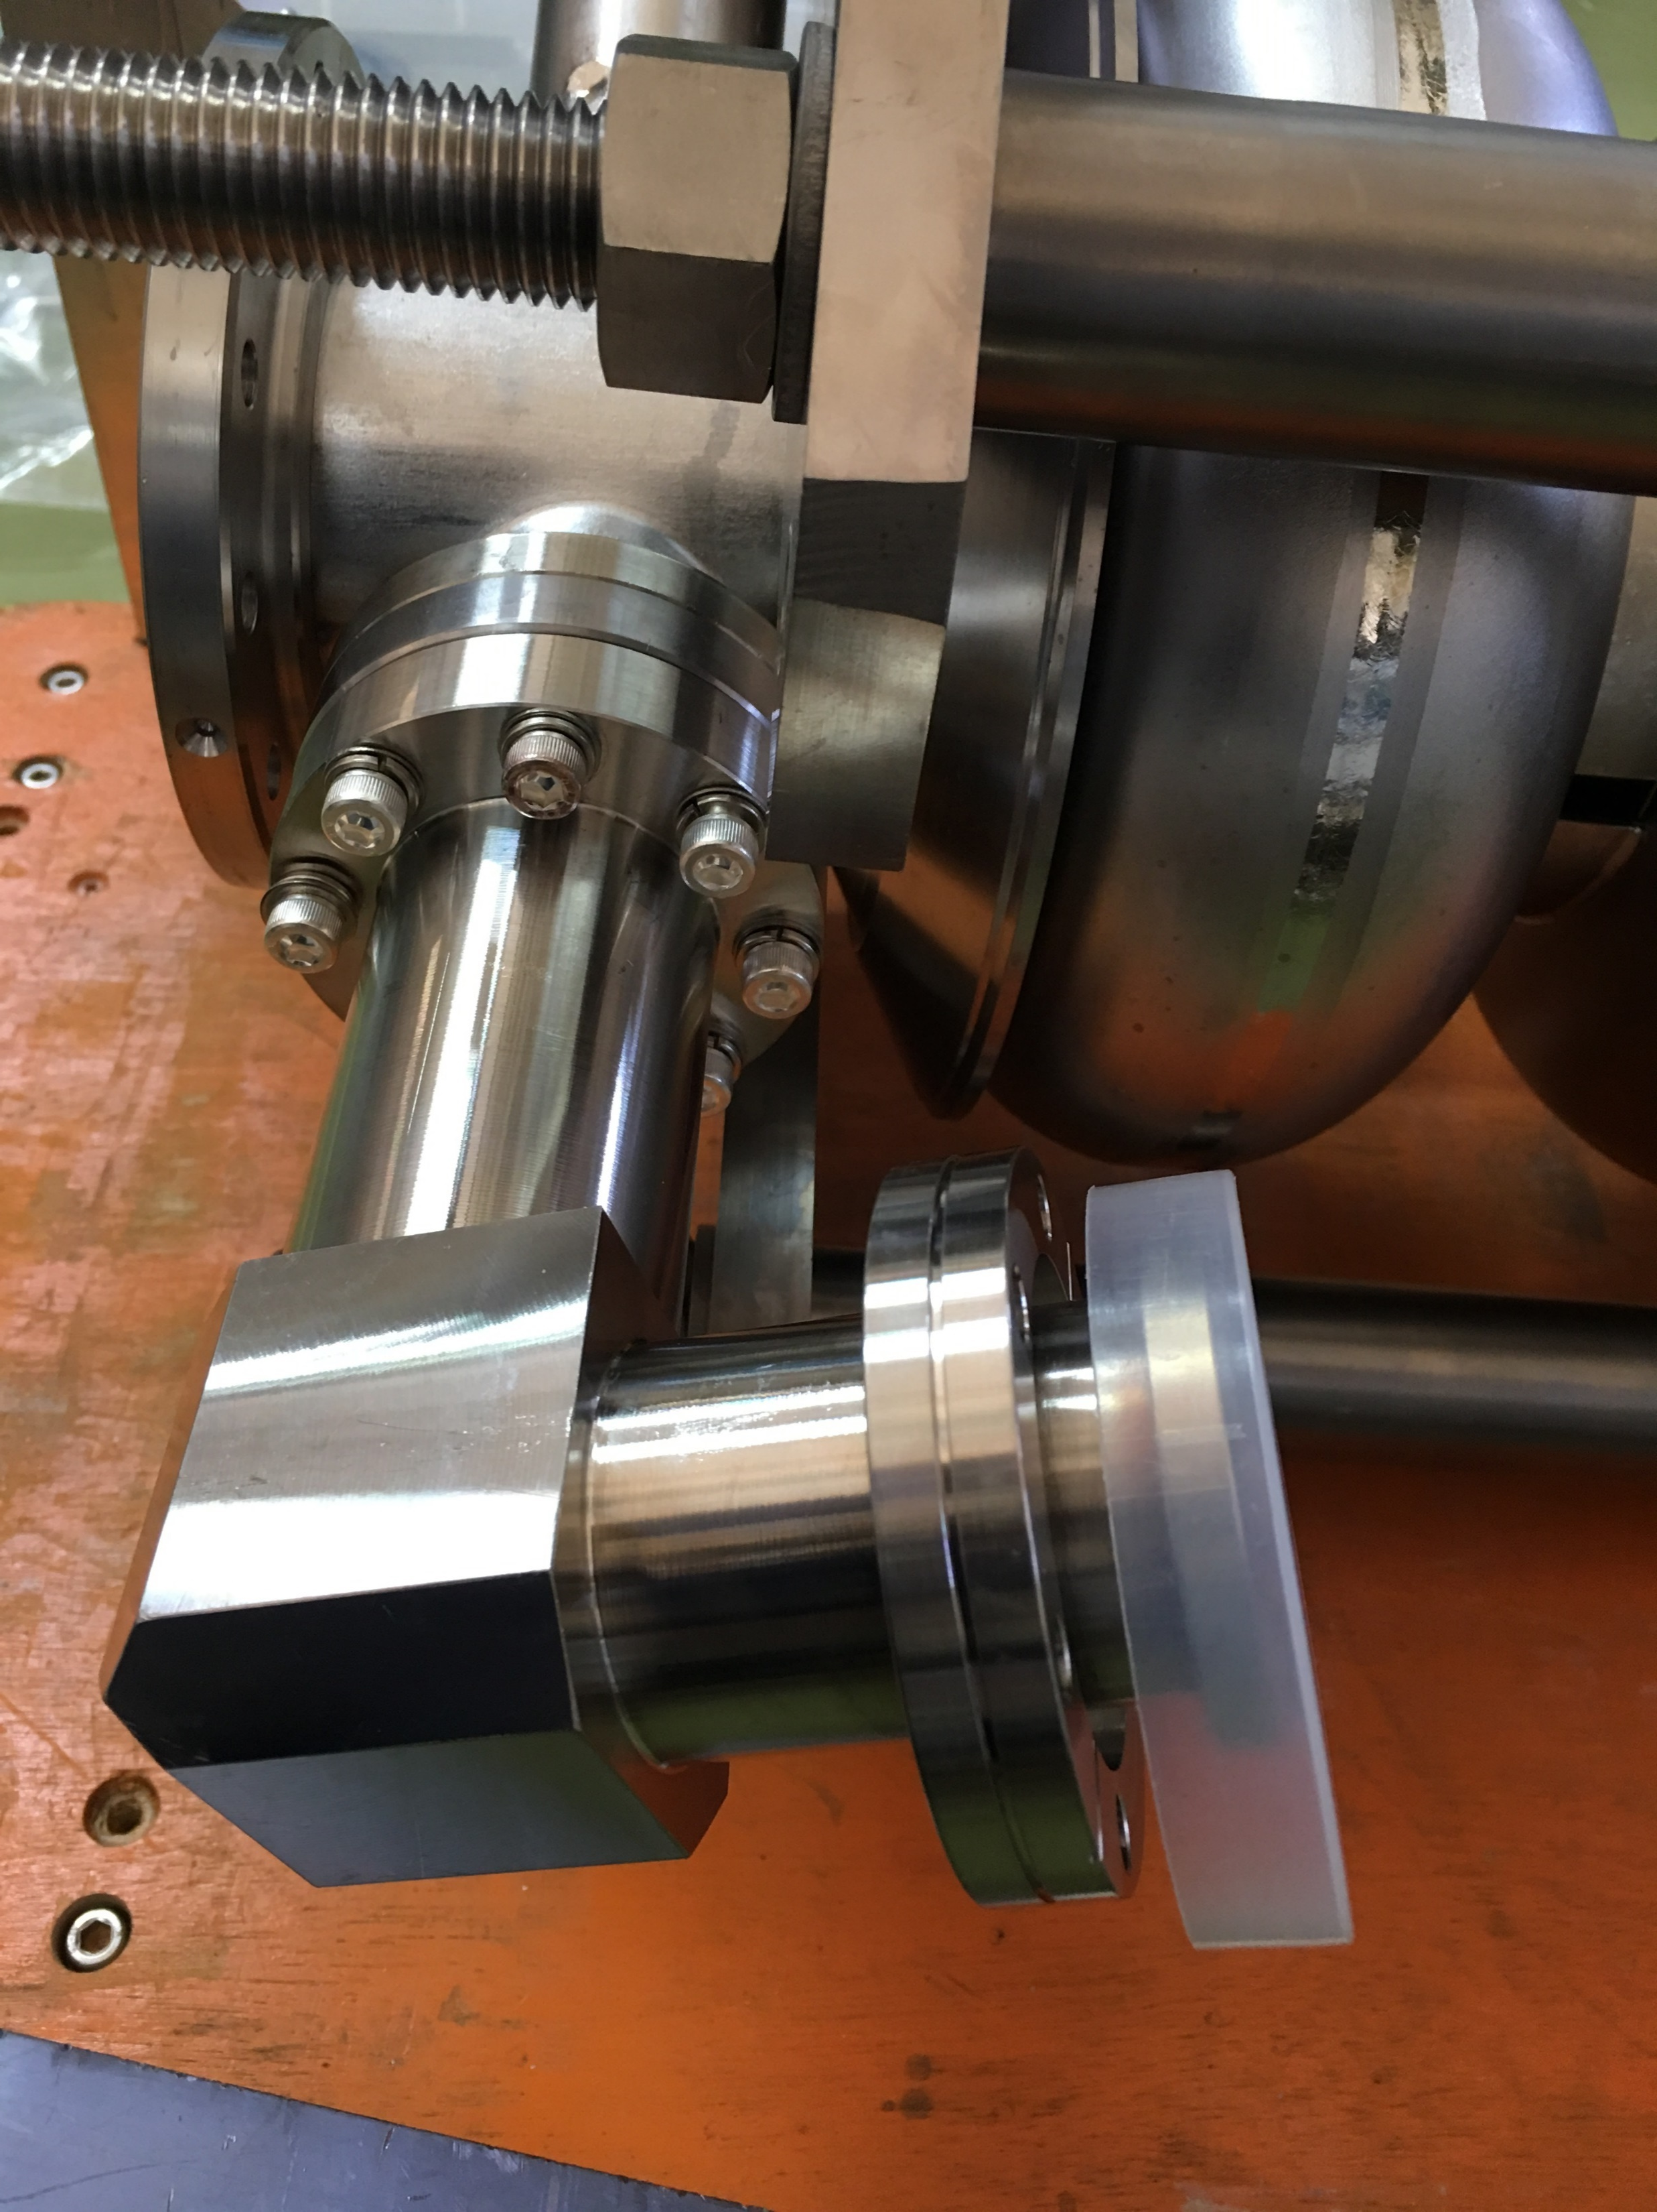
Flange Seal Surface and Fit Check
Seal surfaces OK.
Pick-up port flange 0.5 mm lower than design, to use double washers to avoid digging the bolts into the beam pipe.
Vertical test (input, pick-up and electron-probe) flange and HPR flange fit OK.
Plan to use KEK’s vertical test components for PKU TESLA cavity, so Q_{in} and Q_{t} will be the same (< 1 mm fabrication error).

Slide 26
Redesigned Cavity Support Jig

Slide 27
U shape frames for the four rods
Adjustable stiffening ring supports and end-support
More assembly steps, but less lateral and longitudinal deformation of cavity

Slide 28
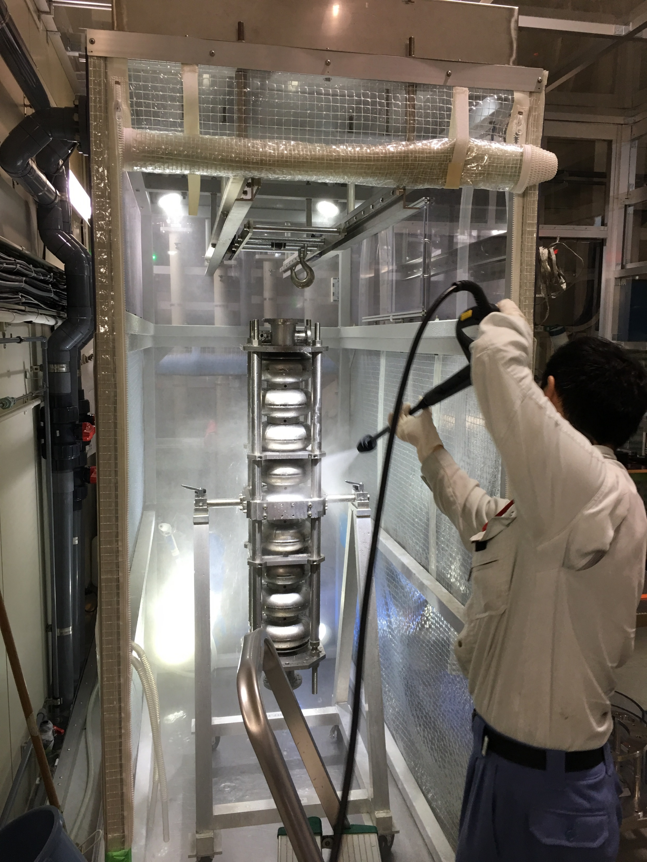
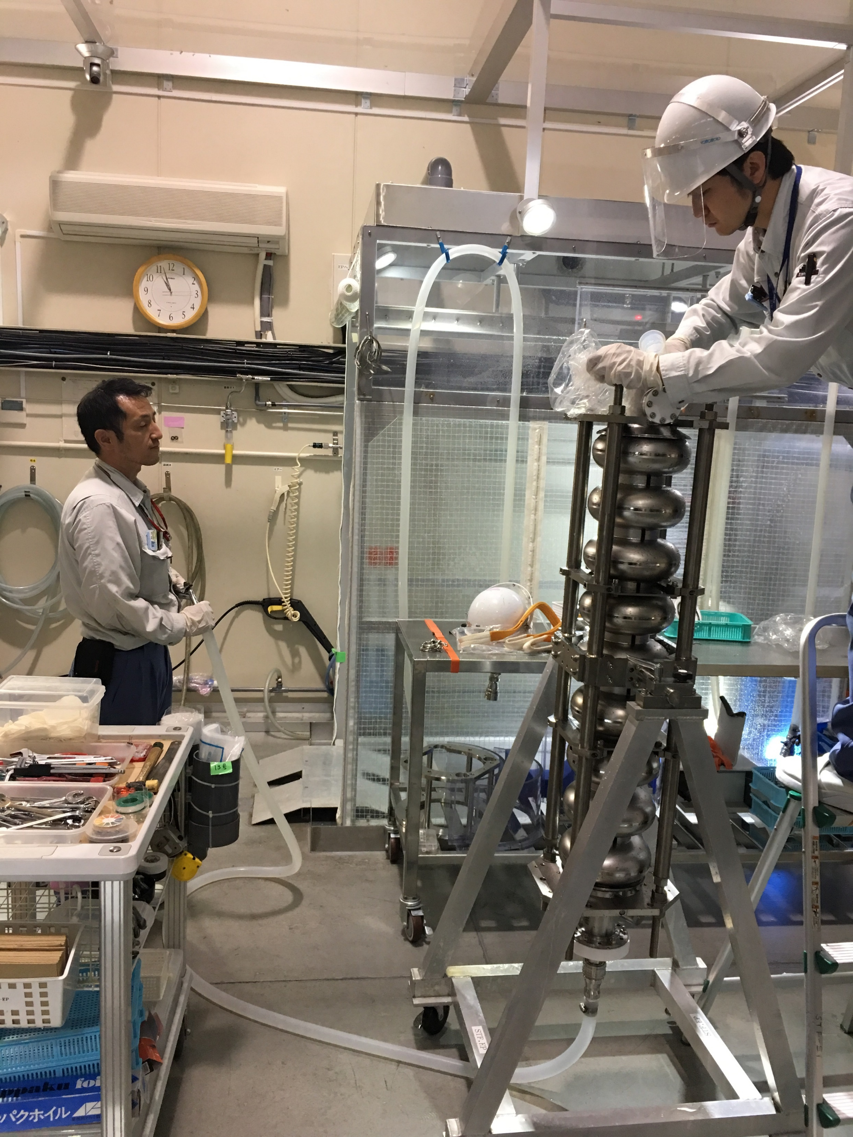
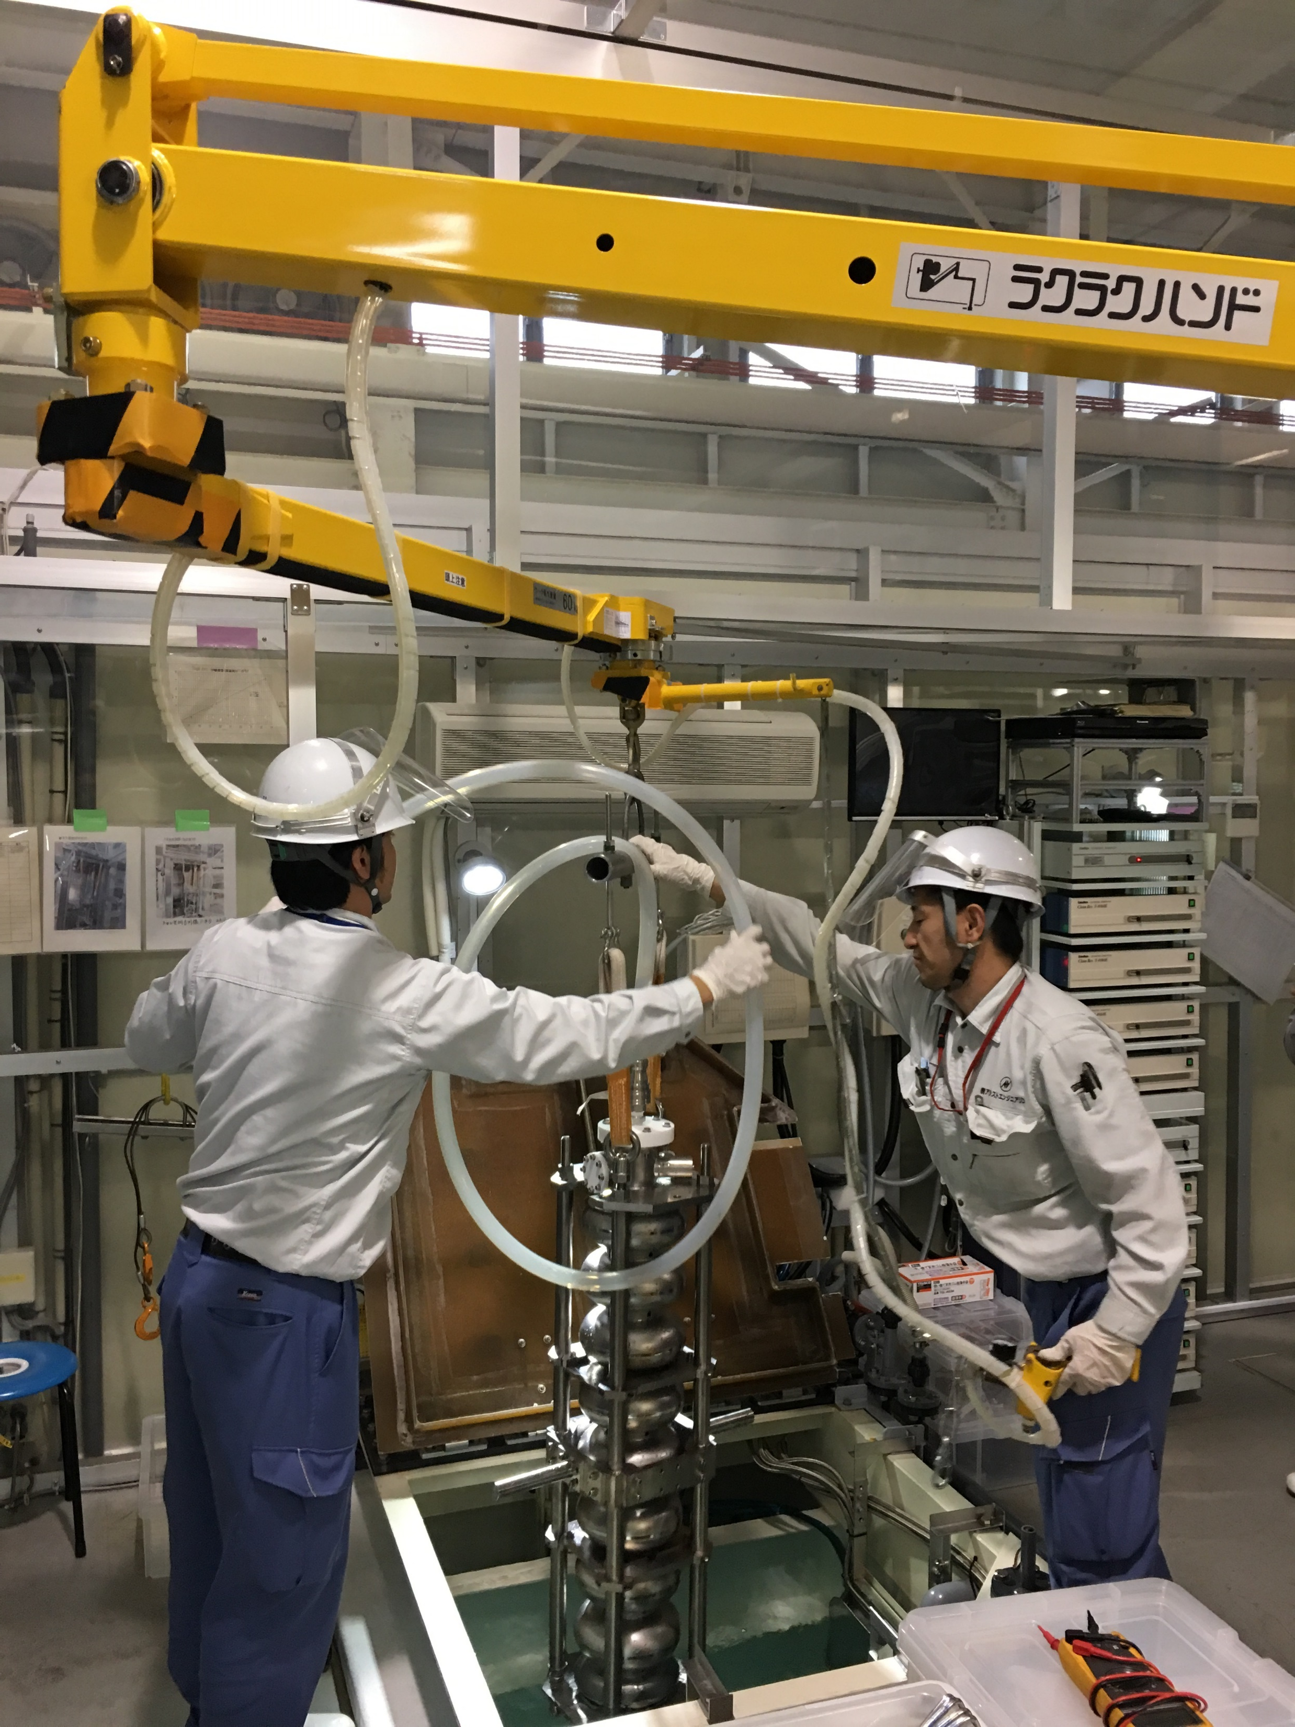
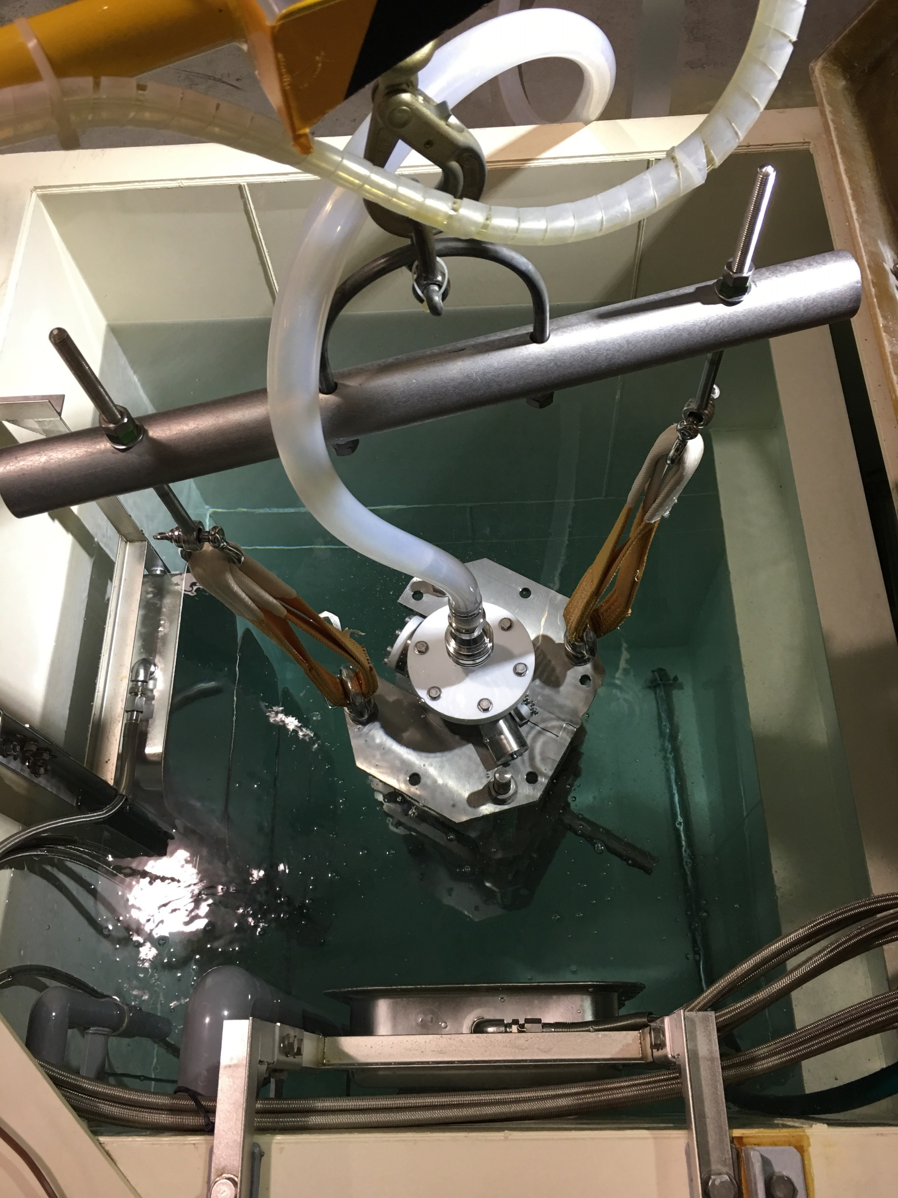
Pre-EP & EP1 Preparation
Cavity move to EP area
Cavity outside and inside “car wash”
Put into FM-20 detergent 500 mL (2 % of cavity volume 25 L)
Ultrasonic cleaning (50 C, 2 h), dry

Slide 29
7th Vertical Test of KEK 1.5-cell SRF-Gun

Slide 33
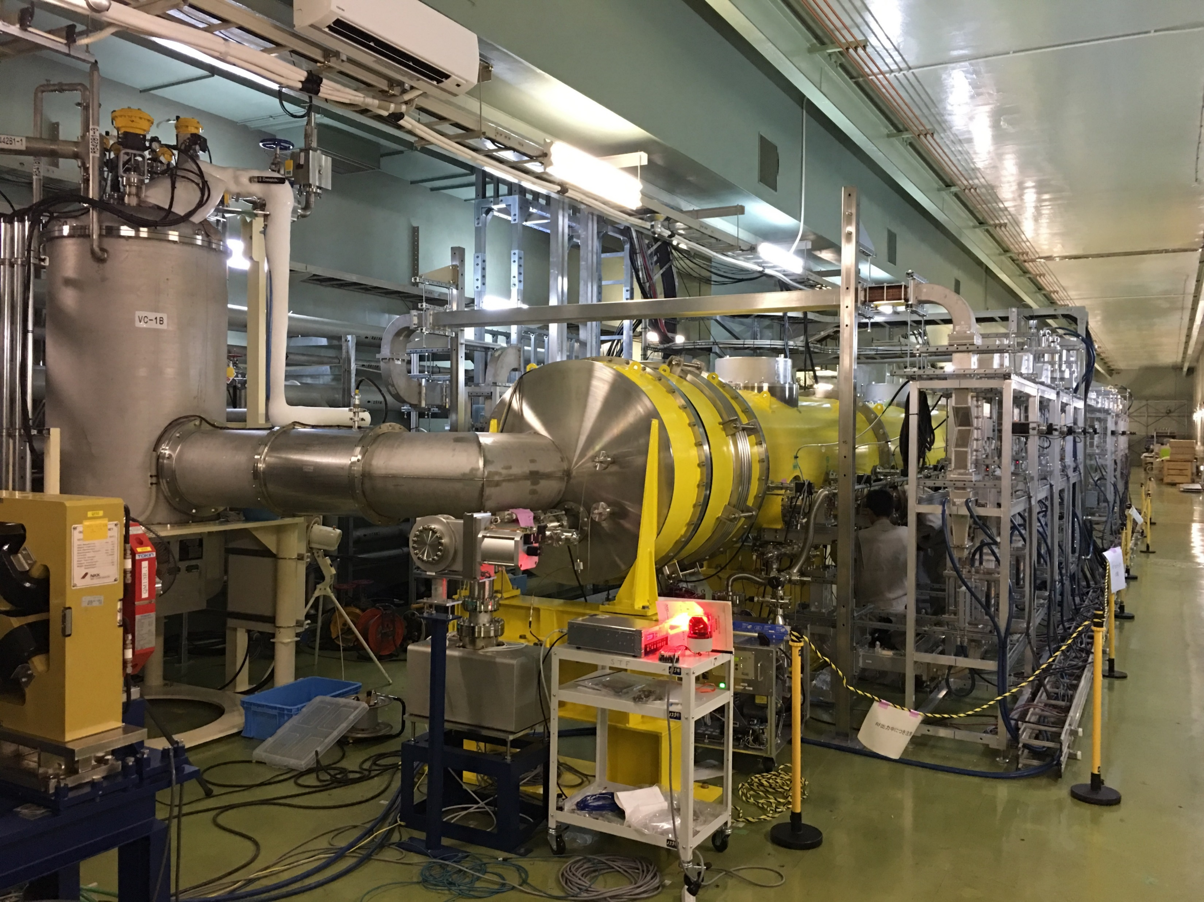
Cavity Q₀ Measurement of STF Cryomodule

Slide 35
Summary
As received weld inspection and flange check done
Cavity flange OK for the seal, and vertical test and HPR flanges
No serious weld defects, but contamination during EBW assembly. Plan to do inspection after pre-EP & EP1 and annealing, local grind if big defects remain (in the week of November 14th)
Cavity frequency and length OK for vertical test performance study, and having margin for further treatment.

