Slide 1
Hough Based Tracking For Low Pt In MDC

Slide 2
outline
Motivation
Implementation of Hough transform based tracking
  Tracking performance of Ψ(2s)-> π⁺π⁻J/Ψ , J/Ψ ->l⁺l⁻
  MC
  DATA
Time occupancy
Summary and outlook

Slide 3
Motivation

Slide 4
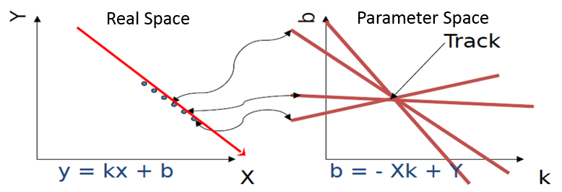
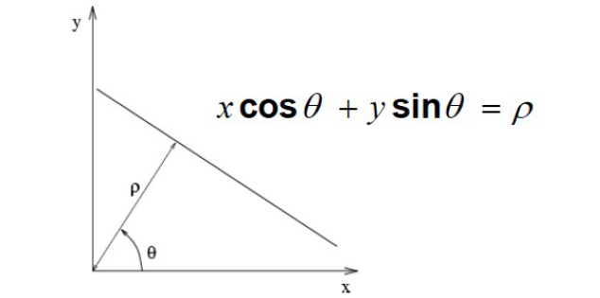
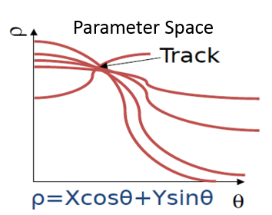
Review of Hough transform method
Hough transform : a mathematical transformation
Transform a point in real space to a line or a curve in parameter space
Points rest on a line in real space ← → lines or curves focus in Hough space
ρ=xcos(θ)+ysin(θ) hits becomes sinusoidal curves

Slide 5
HOUGH Implemented in MDC
2D fitting
Mdc hit
Hough map
Peak finding
3D hit finding
MDC Digi
PATTSF
Hough
track finding
3D fitting
compare and
Reserve good tracks
Rungekutta
Kalman fitting
Now cut condition of HOUGH is for low pt tracks ( event )
Track (pt>120MeV) lost by PATTSF may also found by HOUGH
Low Pt track by TSF&HOUGH will compare and reserve*
  *Compare tracks
  If pt and center position satisfy certain condition , we consider them same track ,
  reserve one track with more hits , or better (dr,dz) , decided by different physics channel

Slide 6
HOUGH Implemented in MDC
Peak finding in HoughMap
  Conformal transform is used to convert hits in a circle track to hits in a line
  Use Hough transform to convert points in a line to curves in parameter space
  Vote lines in histogram
  Peak finding method to determine tracks
Cut condition on HoughMap :
………
2D fitting
3D track finding
3D fitting

Slide 7
Tracking Performance
  (MC) Ψ(2s)-> π⁺π⁻J/Ψ , J/Ψ ->l⁺l⁻
    tracking efficiency
    track matching with MC truth
    ghost track rate
    efficiency varies with dip angle
  (DATA) Ψ(2s)-> π⁺π⁻J/Ψ , J/Ψ ->l⁺l⁻
    tracking efficiency
    signal of j/psi recoil mass

Slide 8
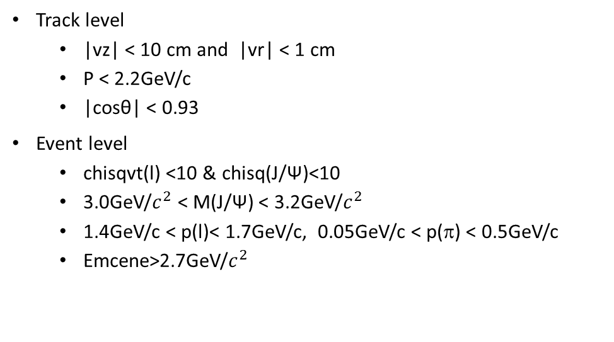
Tracking performance check with
Ψ(2s) ->J/ Ψ π ⁺ π ⁻ , J/ Ψ ->l⁺ l⁻
Track level
  |vz| < 10 cm and |vr| < 1 cm
  P < 2.2GeV/c
  |cosθ| < 0.93
Event level
  chisqvt(l) <10 & chisq(J/Ψ)<10
  3.0GeV/$c^{2}$ < M(J/Ψ) < 3.2GeV/$c^{2}$
  1.4GeV/c < p(l)< 1.7GeV/c, 0.05GeV/c < p(π) < 0.5GeV/c
  Emcene>2.7GeV/$c^{2}$
n4 : find 4 good tracks , pass selection
npion: find 3,4,5 good tracks , pass selection
efficiency：n4/npion

Slide 9
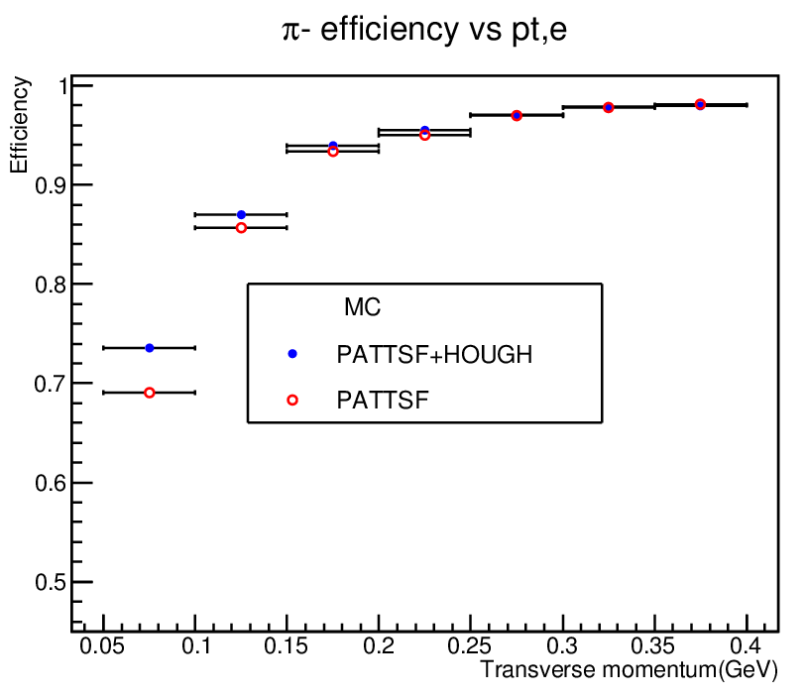
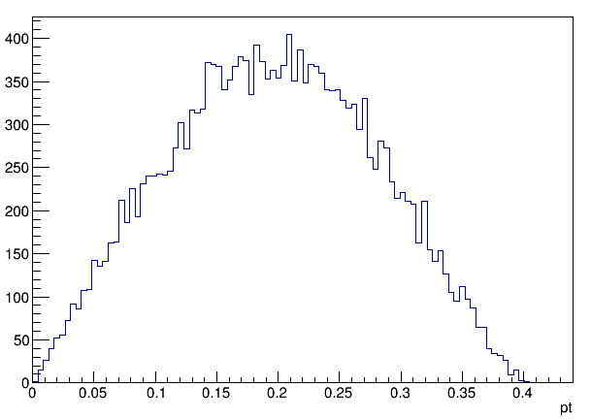
Tracking performance check with
  Ψ(2s)-> π⁺π⁻J/Ψ , J/Ψ ->l⁺l⁻
From signal MC 500k events
mix noise in reconstruction
π tracks vs pt
(GeV)
14% tracks inside pt(0.05~0.12)GeV
Tracking efficiency increased ~4.5% for 50<MeVpt<100MeV , relative increased ~6.5%

Slide 10
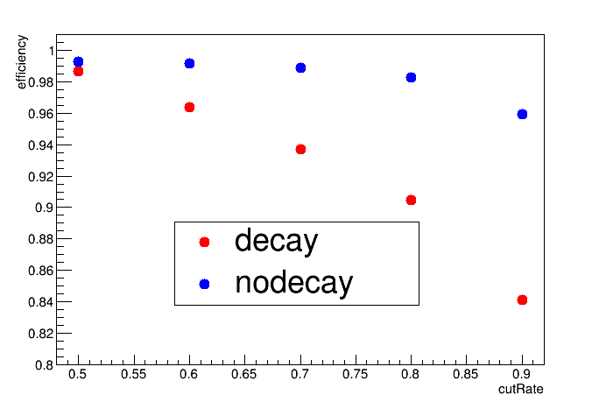
Track Matching with MC truth
when set cutRate = 0.5
if >50% hits of the reconstructed track come from one track in MC -> match in MC
Matching efficiency vs cutRate
tracks reconstructed by HOUGH from the MC ppjs events
Set cutRate to 0.5, 0.6, 0.7,0.8,0.9
Matching efficiency all higher than 80%
We can see tracks found by HOUGH are most real tracks in MC

Slide 11
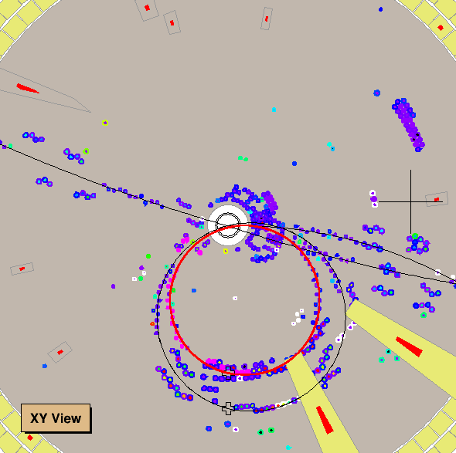
Ghost Track Rate
find 5 tracks passed physics selection : a ghost track in this event
Most ghost track from multi turn tracks
 | N=3,4,5 | N=4 | N=5 | N5/N(3,4,5)
PATTSF+HOUGH | 209257 | 193428 | 290 | 1.38%
PATTSF | 207338 | 189847 | 240 | 1.16%
HOUGH won’t get much ghost tracks

Slide 12
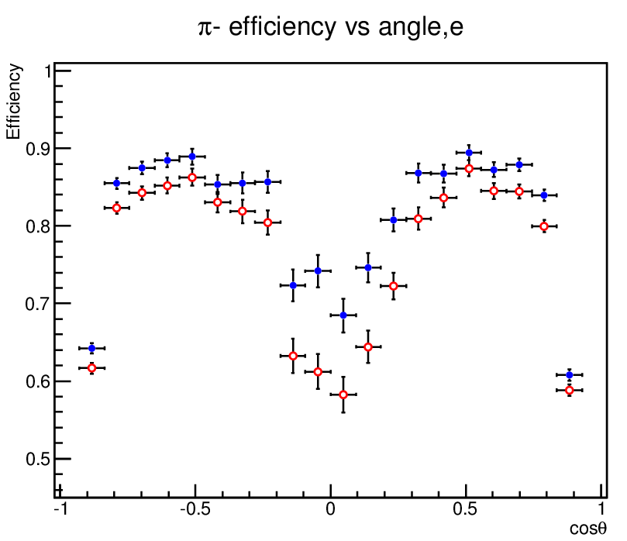
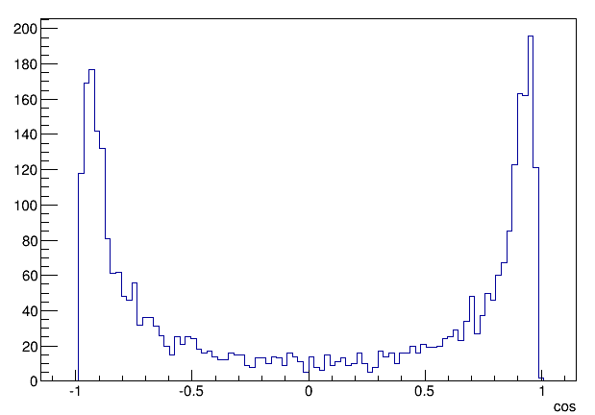
Tracking efficiency vs cosθ
pt(0.05~0.12GeV)
π tracks distribution vs cos
|cosθ|<0.2 6% tracks , increase 10%
|cosθ|>0.83 54% tracks , increase 2%
Big dip angle tracks take the most part , so we can’t see clearly tracking efficiency increase in this channer

Slide 13
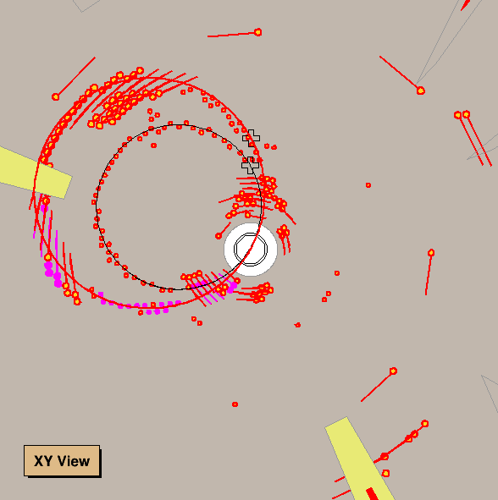
Curved tracks salvaged by HOUGH
(compare curfinder)
Hough transform can easily determine a circle track on HoughMap
Show 2D histogram

Slide 14
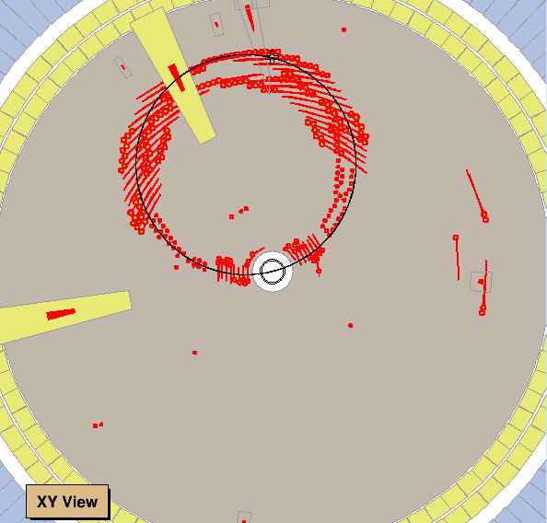
Multi turn tracks retrieve by HOUGH
In some cases , 2nd turn track close to the 1st
We collect hits but can’t tell from which turn
Bad track parameter , need some fitting method

Slide 15
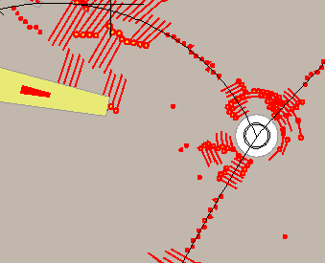
Difficulties With Large Dip Angle Tracks
Layer max vs cos
Big dip angle tracks has few hits , hard to reconstruct

Slide 16
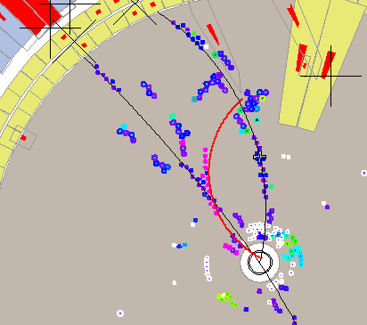
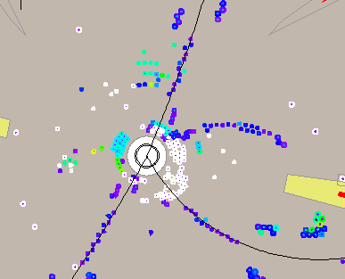
Hits covered by other tracks
Stereo hits influenced by inner chamber noise

Slide 17
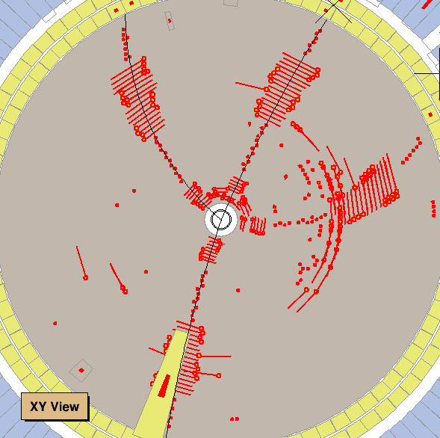
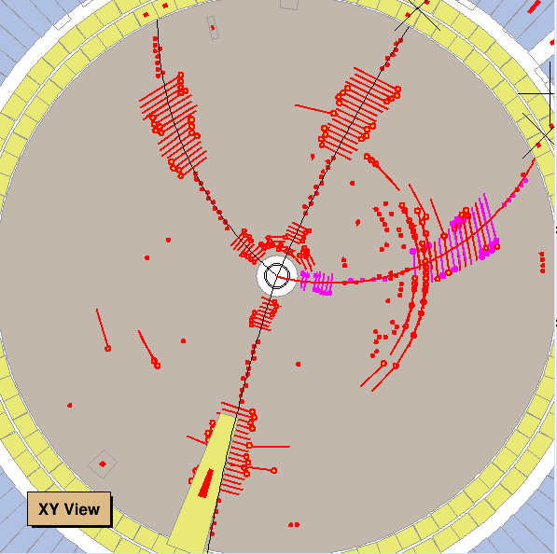
Salvage Tracks (pt>0.12GeV)
HOUGH can get back lost track more than 120MeV
PATTSF
PATTSF+HOUGH
Noise hit nearby the track cause bad influence in PATTSF

Slide 18
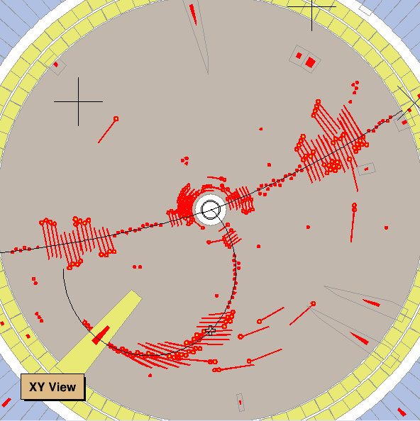
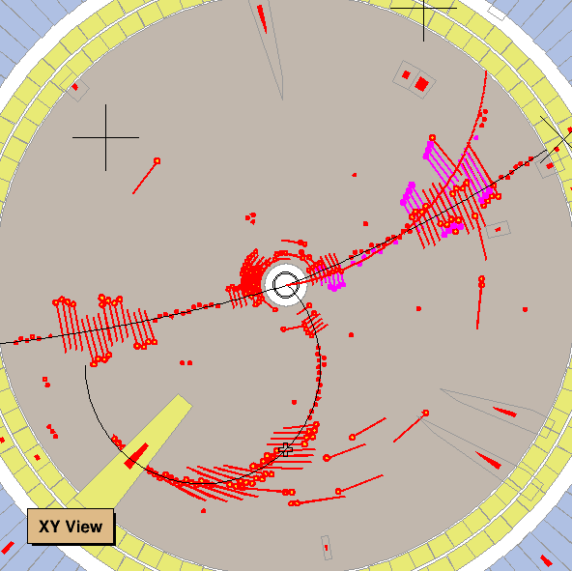
Salvage Tracks (pt>0.12GeV)
PATTSF
PATTSF+HOUGH
track lost because two track too close in PATTSF

Slide 19
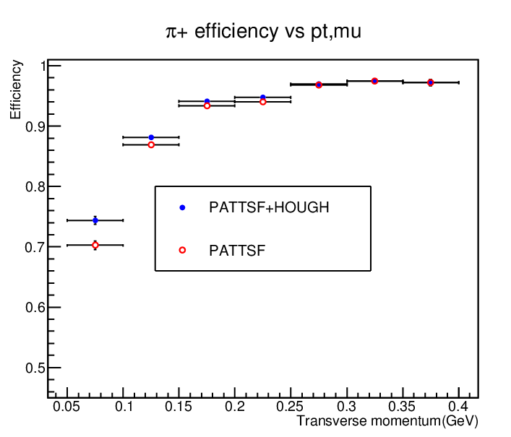
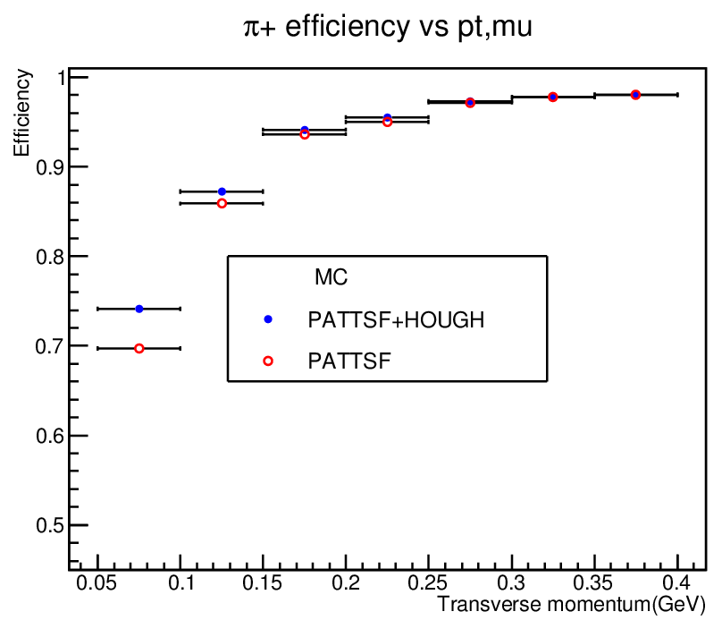
Tracking efficiency check with
Ψ(2s) ->J/ Ψ π ⁺ π ⁻ , J/ Ψ ->l⁺ l⁻
Data take from 8093~8195 , Boss version 6.6.5
Signal MC
Increase of tracking efficiency can be proved in data

Slide 20
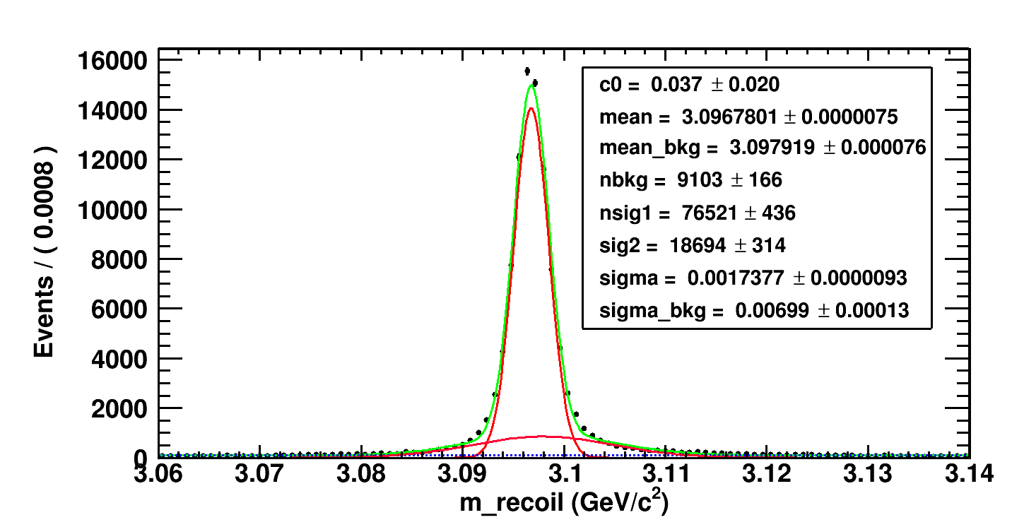
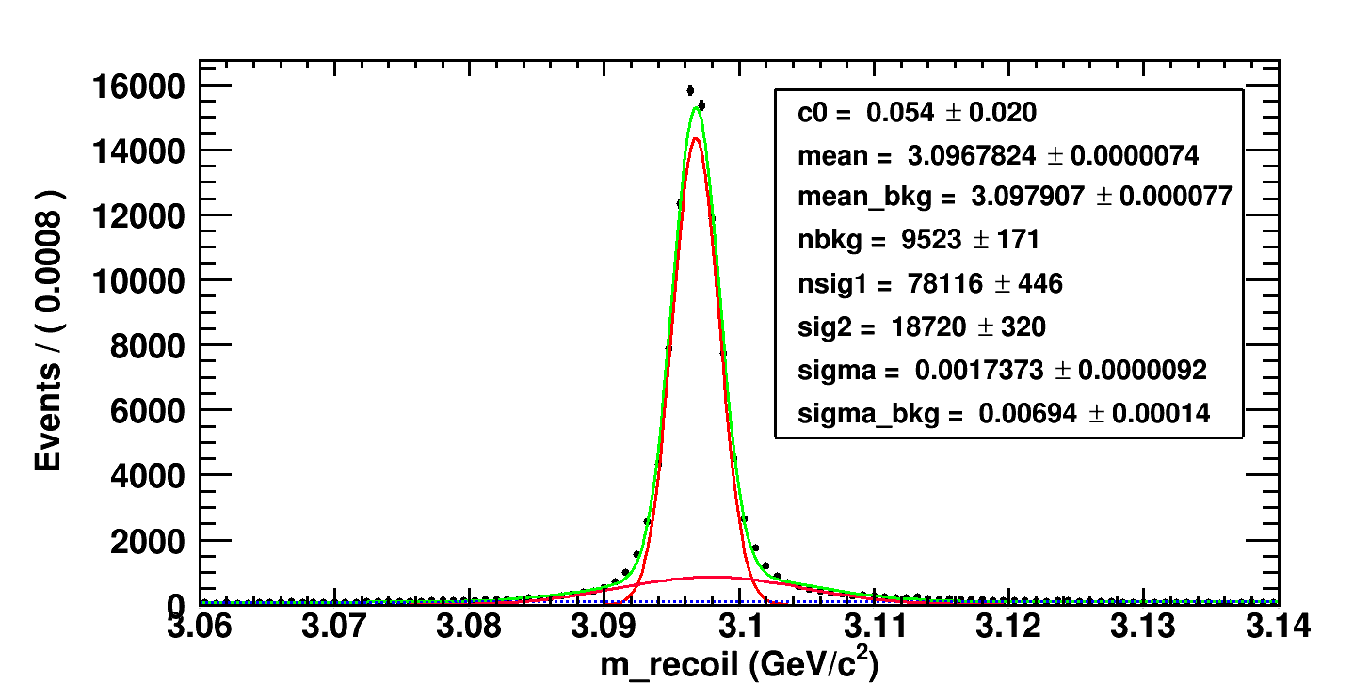
J/psi recoil mass increased after HOUGH
PATTSF
PATTSF+HOUGH
PATTSF+HOUGH : 96836 sig/sqrt(sig+noise)= 297
PATTSF: 95215 sig/sqrt(sig+noise)= 295
signal add 1.7% with HOUGH , signal/noise ratio don’t get worse

Slide 21
Good J/psi event Found with HOUGH
Show some data events from besvis

Slide 22
Time Occupancy
Cpu : Intel(R) Xeon(R) CPU E5-2650 v2
@ 2.60GHz
Cpu cores :8
64 bit system
Three track finding algorithm
version | Time (ms)
PAT | 3.99e+08
TSF | 1.61e+09
Hough | 3.06e+08
Time of one Reconstruction Job
version | Time (ms)
Reconstruction time(No HOUGH) | 1.85e+10
Reconstruction time(Add HOUGH) | 1.93e+10
Time cost increase 4.3%
Hough tracking package won’t cost too much time for the current reconstruction

Slide 23
summary

Slide 24
outlook

Slide 25

e efficiency:
N4/(N3+N4)
PATTSF+HOUGH: 24279/46160= 52.6%
PATTSF :20864/41738=50%
N==4 increase 4422 , 10.6%

