Slide 1
IHEP 9-cell Cavity Work (Oct. 31 - Nov. 4)
Jiyuan Zhai, Conglai Yang,
Motoaki Sawabe, Mineyuki Asano
November 7, 2016, KEK, Japan

Slide 2
Weekly Schedule
Date | Work
Mon (10-31) | Pre-EP setup
Tue (11-1) | EP facility trouble (reservoir acid temperature monitor communication problem; fixed by changing the monitor-box with the one in the 2nd EP system)
Wed (11-2) | Pre-EP 5 μm, EP1 setup (one day delay)
Thu (11-3) | 文化の日
Fri (11-4) | EP1 100 μm, ultrasonic cleaning, HPR, dry

Slide 3
EP Facility

Slide 4
Pre-EP Procedure
Time | Process | Details
09:05 | Pre-EP 5 um | 5 V, cavity rotate 1 rpm, 40 min 55 s; if > 40 C, power off, water shower cooling
10:01 | Surface stabilization | Rotate 3 rpm, 20 min
10:21 | EP acid drain and water rinsing | 5 min vertical, 2 min horizontal, 2 min vertical; 10 min water in (continuous), 3 min drain, about 1 h (5 times)
11:45 | Cavity and EP components washing | cathode rod, flanges, o-rings etc.
18:30 | EP1 setup | temperature sensor, hook

Slide 5
Pre-EP Parameters

Slide 6
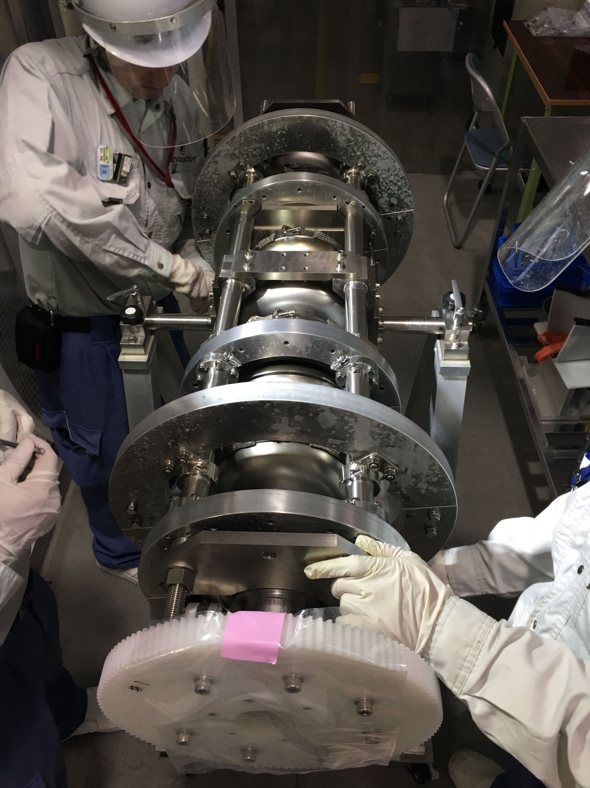
EP Support Jig

Slide 7
Pre-EP Setup

Slide 8
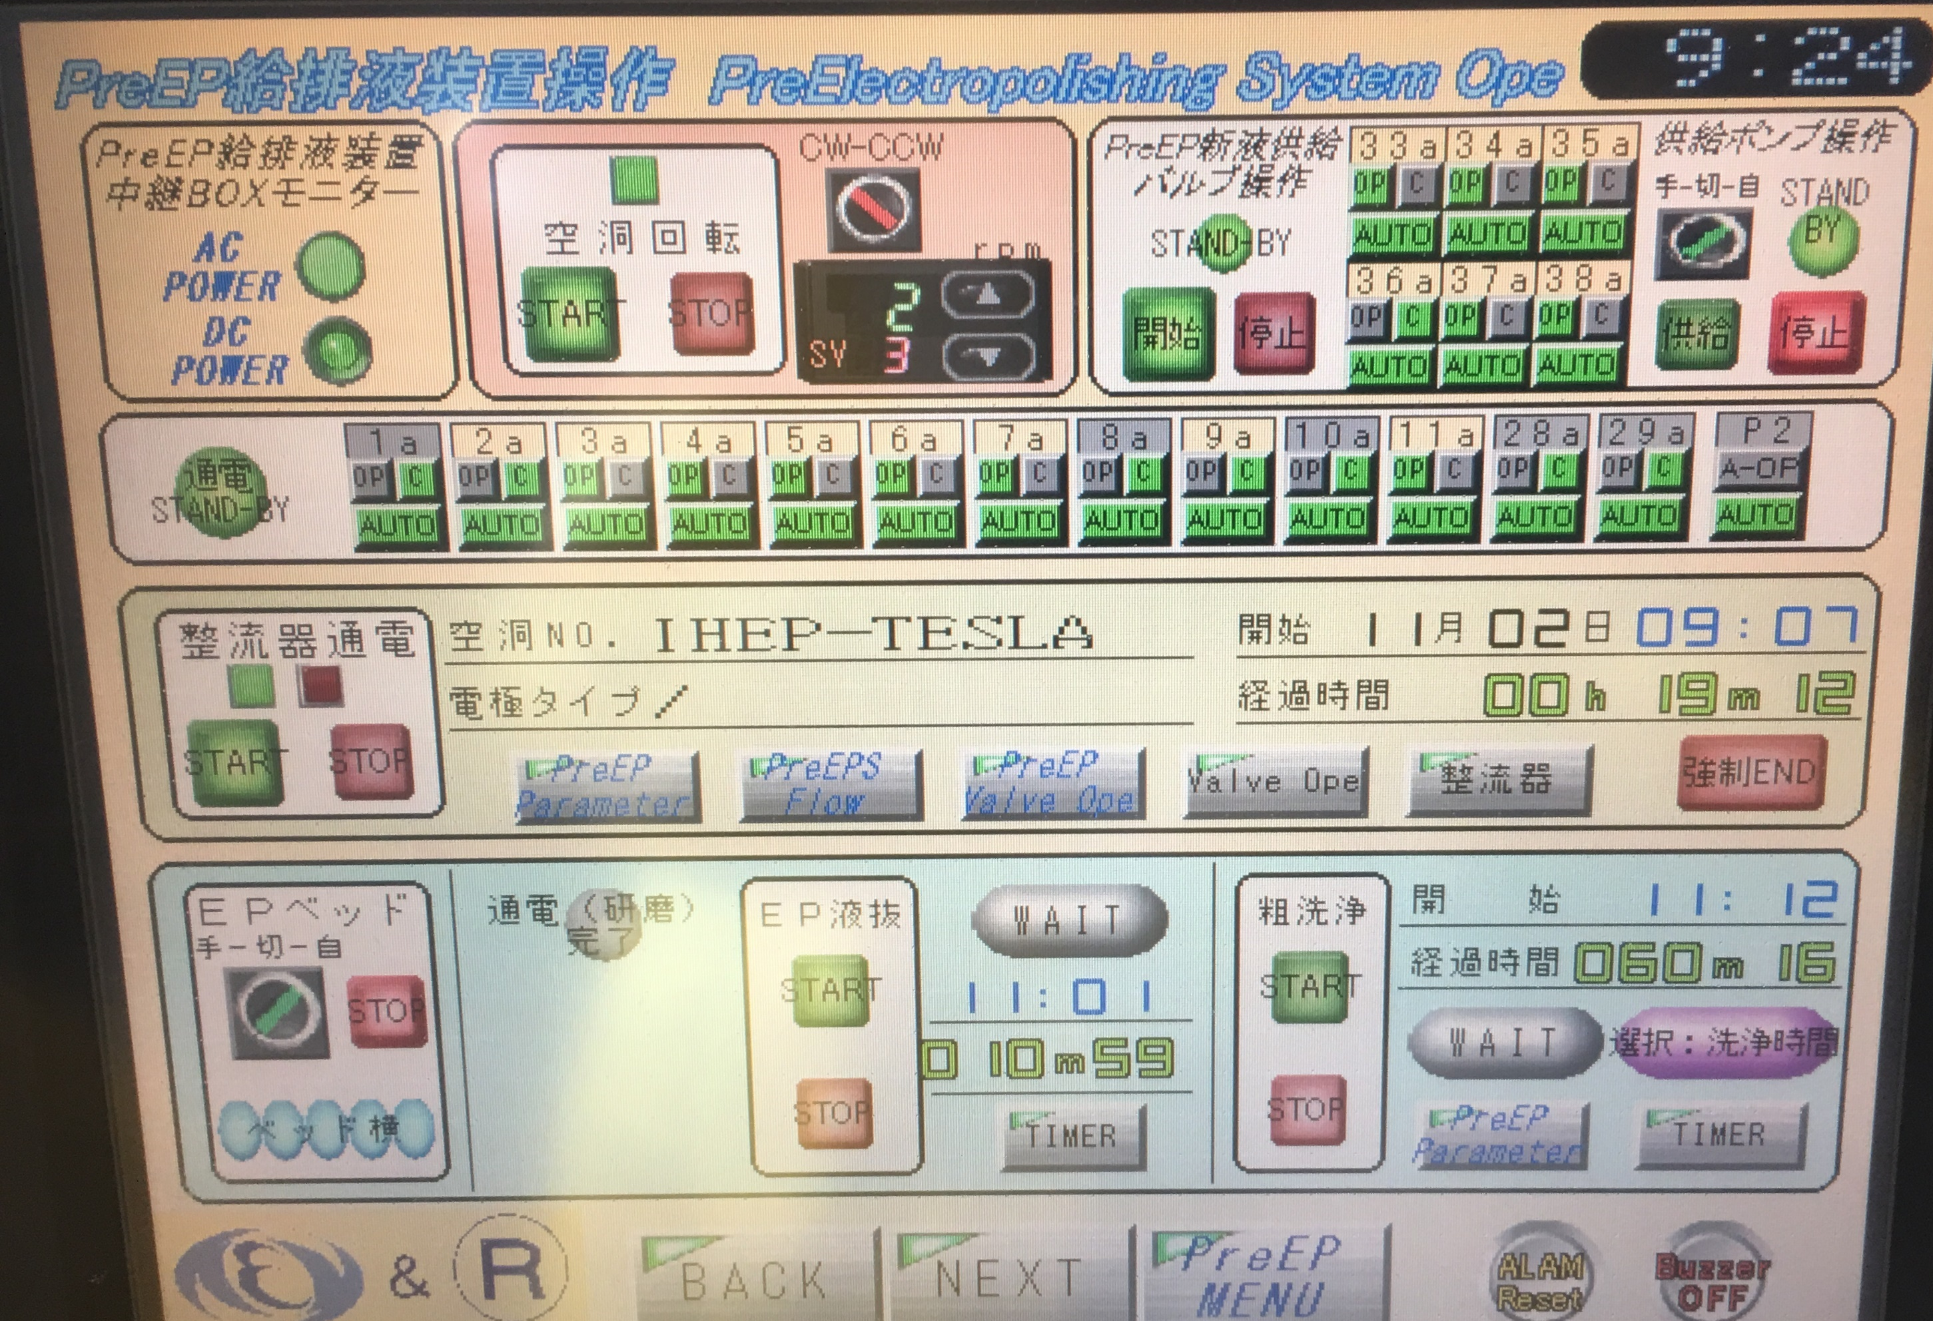
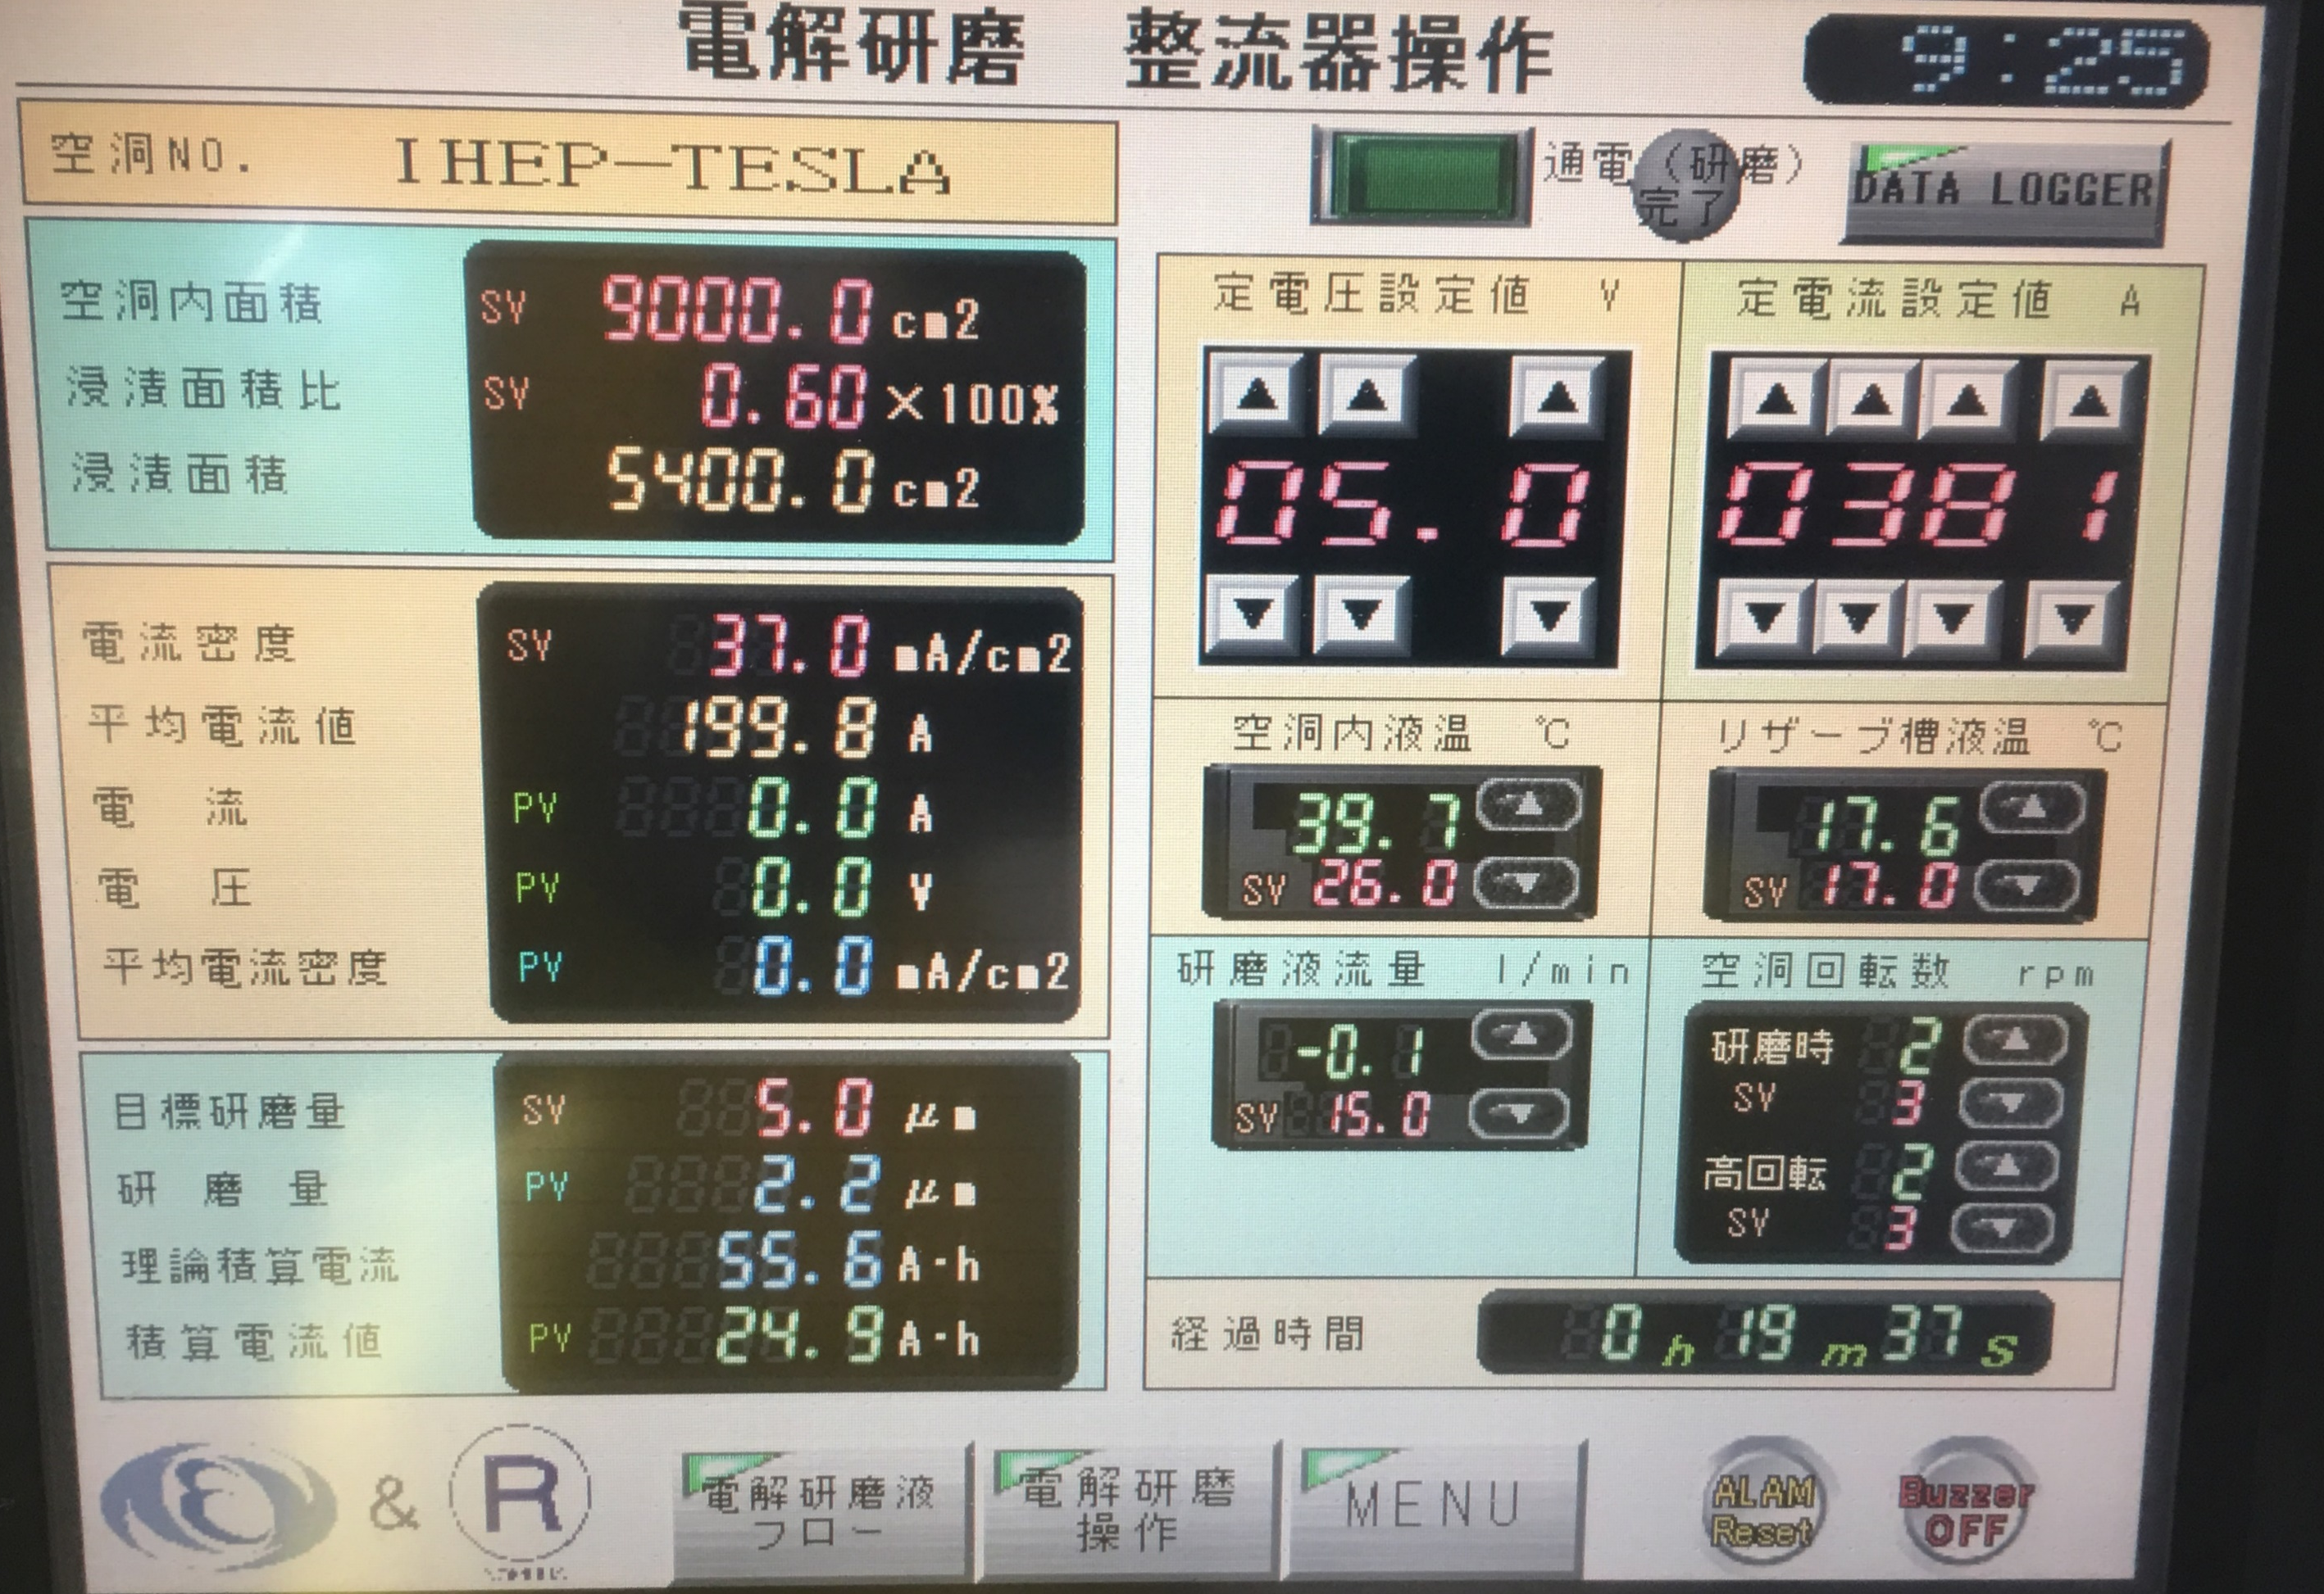
Pre-EP

Slide 9
Cathode and EP Flange Cleaning

Slide 10
EP1 Procedure
Time | Process | Details
08:57 | EP1 (bulk EP) 100 um | 25 V, ~ 50 mA/cm², 4 h 21 min 55 s
13:19 | Surface stabilization | Rotate 3 rpm, 20 min
13:39 | EP acid drain and water rinsing | 5 min vertical, 2 min horizontal, 2 min vertical; 10 min water in (continuous), 3 min drain, about 1 h (5 times)
15:12 | Cavity and EP components washing | cathode rod, flanges, o-rings etc.
16:29 | Ultrasonic cleaning | FM-20 2% ultrasonic 50 C, 15 min
16:44 | Water washing
17:26 | HPR (1 h) | cavity inside, 8 MPa, 10 rpm, 200 mm/min
18:30 | Dry

Slide 11
EP1 Parameters

Slide 12
EP1 Parameters

Slide 13
Downstream beam pipe temperature high. Cathode mask problem?
Not critical for EP1, but EP2 should be careful.

Slide 14
Cathode Insert

Slide 15
EP1 Setup

Slide 16
Cavity Temperature Monitor

Slide 17
EP1

Slide 19
HPR and Dry

