Slide 1
HOM coupler design
Hongjuan Zheng，Fanbo Meng
2016-11-08

Slide 2
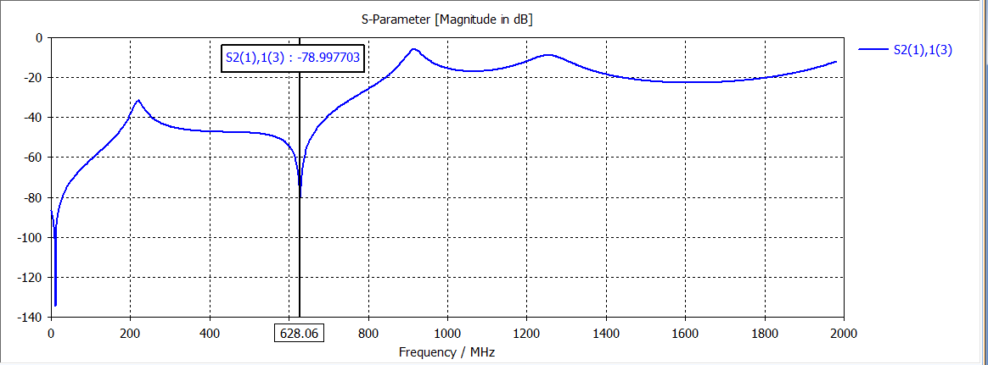
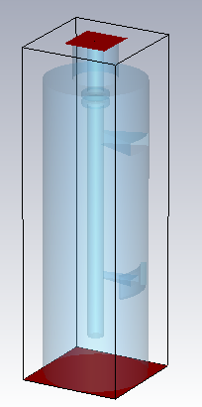
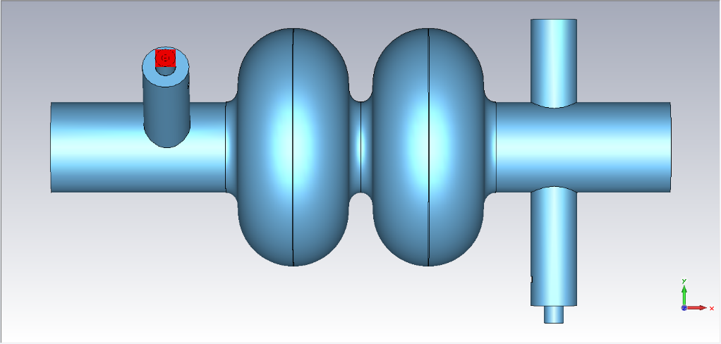
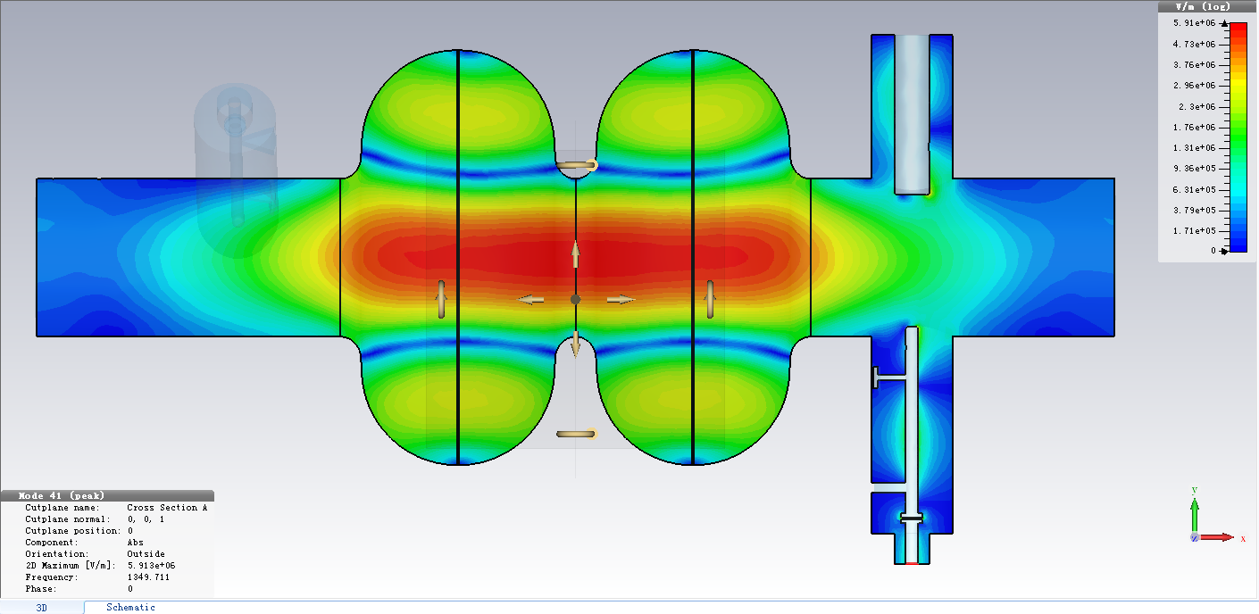
Reduced model & 3D model with cavity-v.1
TM01-TEM
f=1349.71 MHz

Slide 3
Qe with HOM couplers & Qe threshold-v.1
Monopole mode results
Dipole mode results
Beam parameters (wangdou20160918)
Qe (CST) is the result with HOM couplers
The other 3 Qe values are stand for the threshold for different design.
For Z design, the Qe for the TM011 mode can not meet the requirement.
For H design, the Qe for the TE111 mode can not meet the requirement. This mainly caused by the small frequency difference between this mode and the fundamental mode.
More work need to be done.

Slide 4
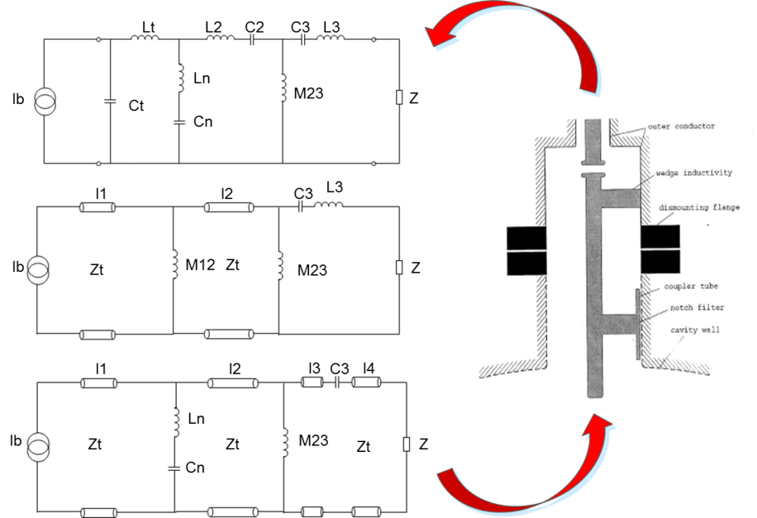
Transmission line equivalent circuit results-v.2
l4
l3
l2
l1
Values for the transmission line equivalent circuit：
l1=4.83cm, l2=10.027cm, l3=2.0cm, l4=1.0cm, Ln=13.52nH, Cn=4.43pF, M23=8.29nH, C3=1.57pF, Zt=96.6 Ω, Z=50 Ω
Outer diameter of the coupling tube is 80 mm. Inner diameter of the coupling tube is 16 mm.

Slide 5
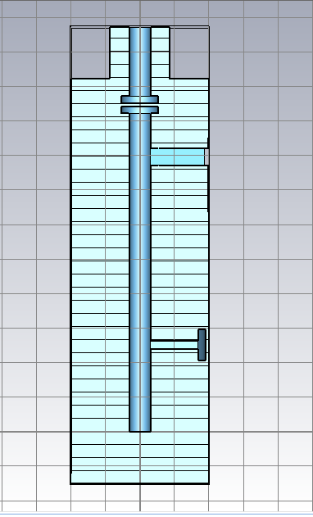
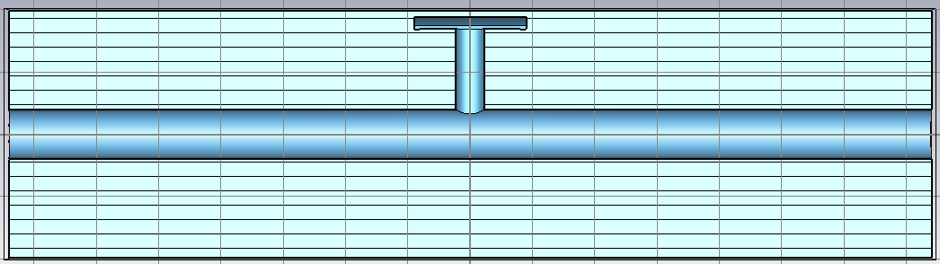
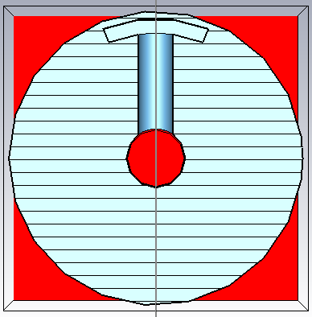
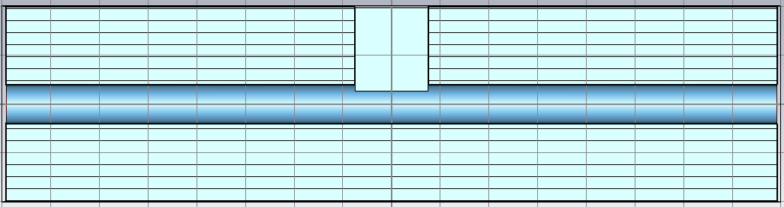
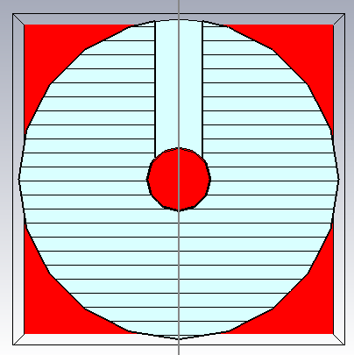
Mutual inductance & notch filter inductance
decide the geometry and size
Using transmission line models to determine the mutual inductance and notch filter inductance.
mutual inductance
r
Design requirement: M12=8.29 nH
r=4.7 mm M12=11.925 nH
notch filter inductance
a
b
Design requirement: M23=6.79 nH
a=30 mm, b=12 mm M23=6.78 nH
Difference between v.2 and v.1:
Inner conductor radius increase.
The damping bandwidth change from 700-1400MHz to 780-1400MHz.
M23 change from sector to cuboid.
M12 change from sector to rod.

Slide 6
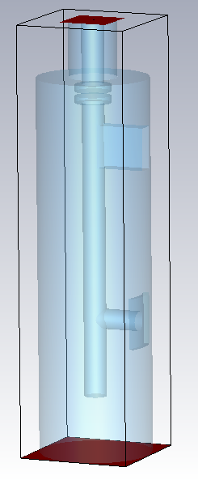
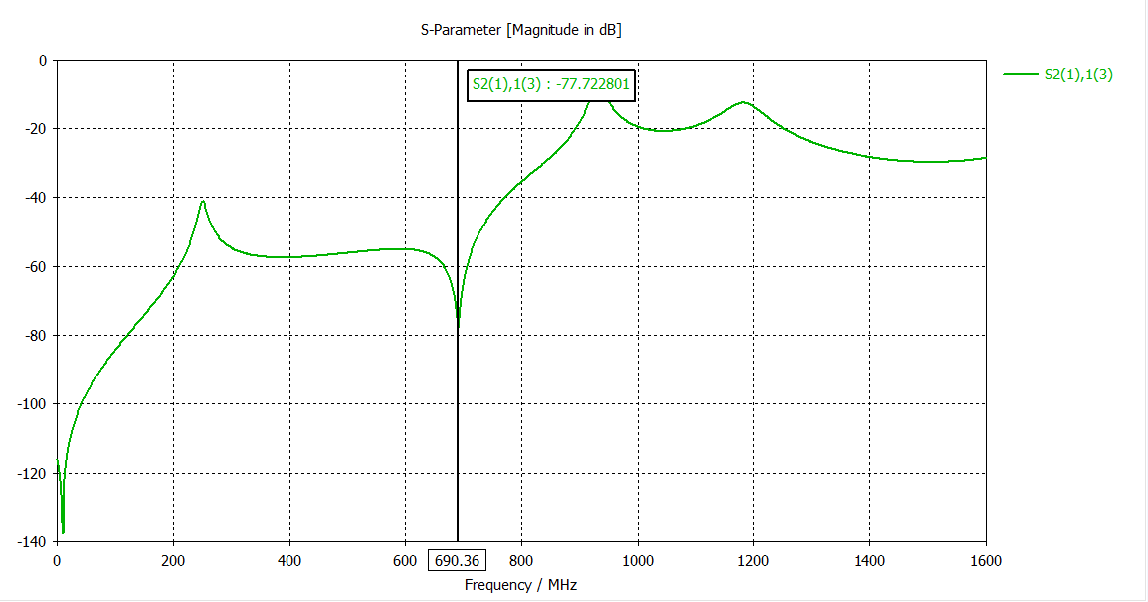
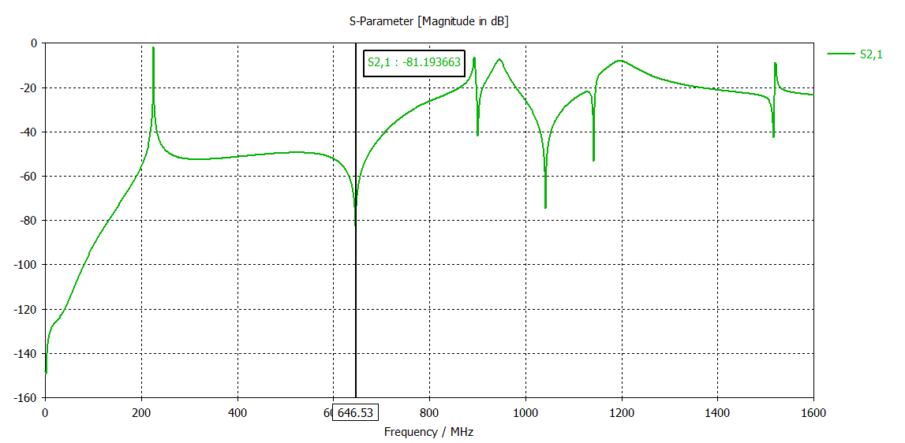
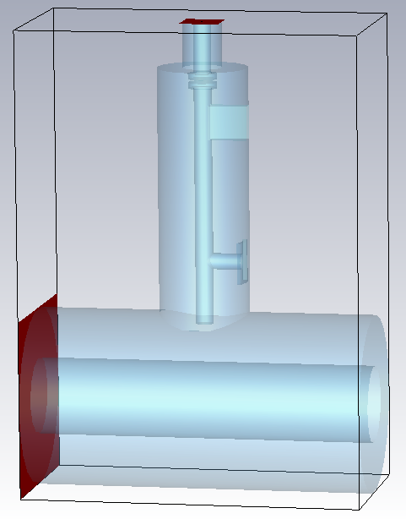
3D simulations-v.2
The 3D model is built with the TML results.
Compare the reduced model with coaxial line model, the notch frequency is different.
There are several stop bands with coaxial model.
TM01-TEM
Reduced model
TEM-TEM
Coaxial line model

Slide 7
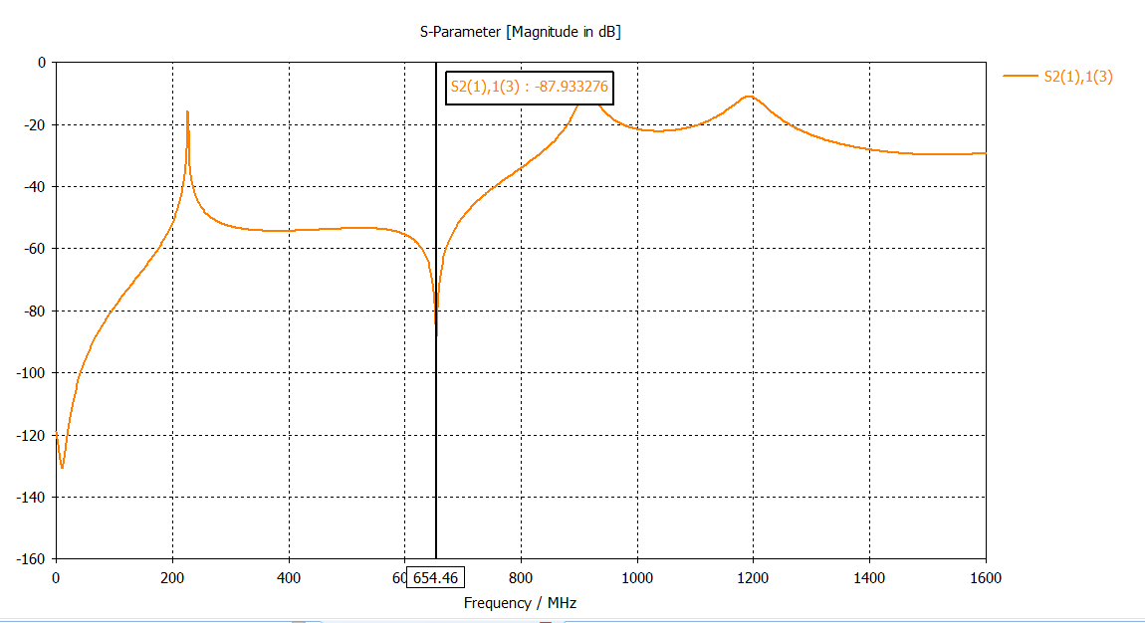
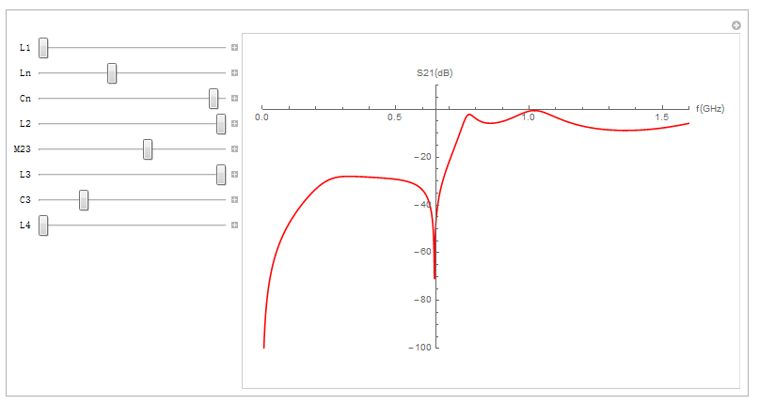
Reduced model vs TML model-v.2
after tune fundamental mode f
TM01-TEM

Slide 8
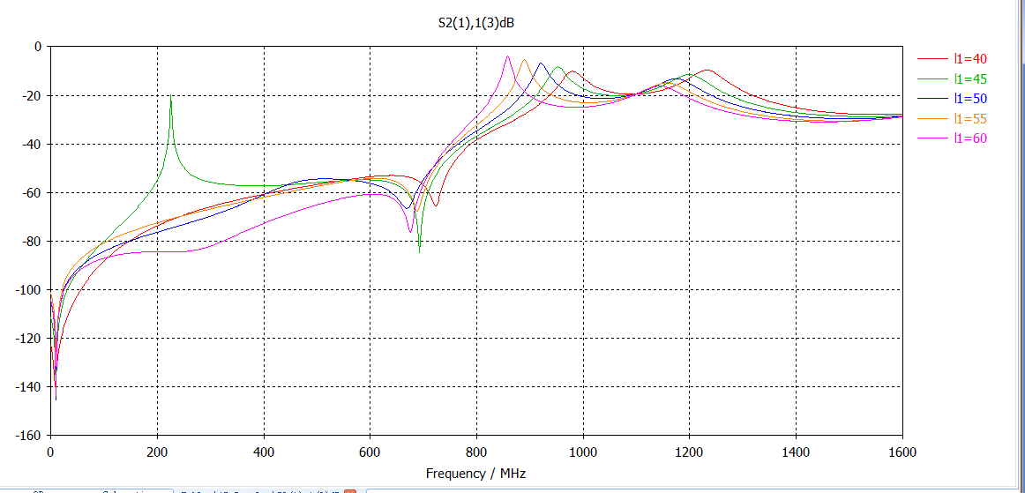
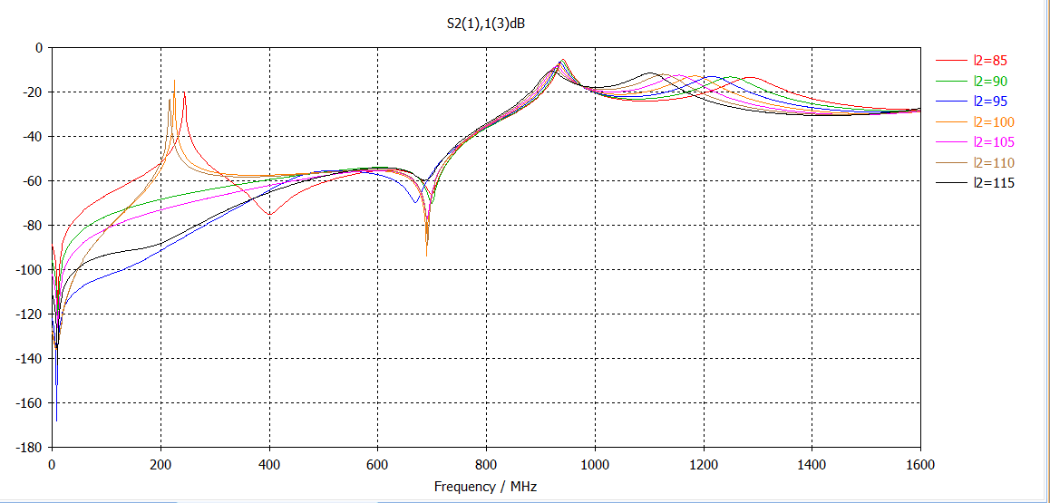
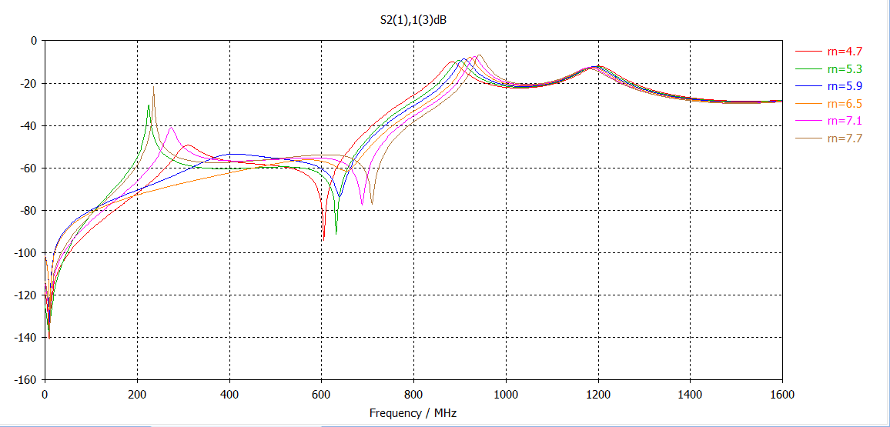
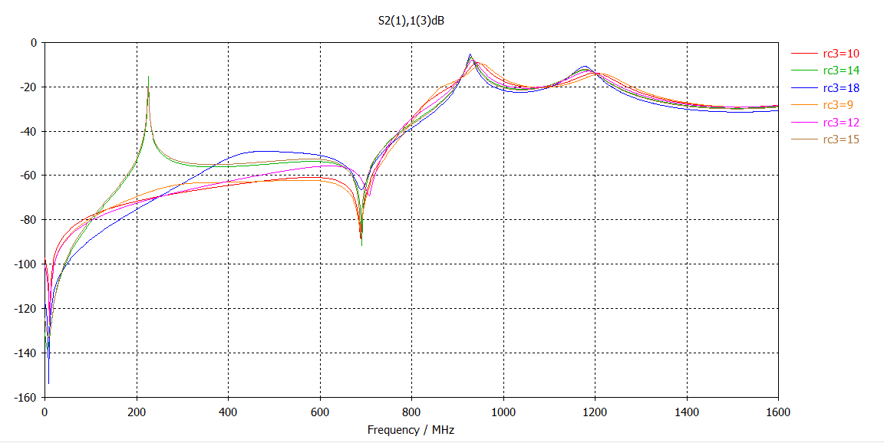
Reduced model--different parameters-v.2

Slide 9
Broadband coupler for SPL
对高次模阻尼在-10dB左右

Slide 10
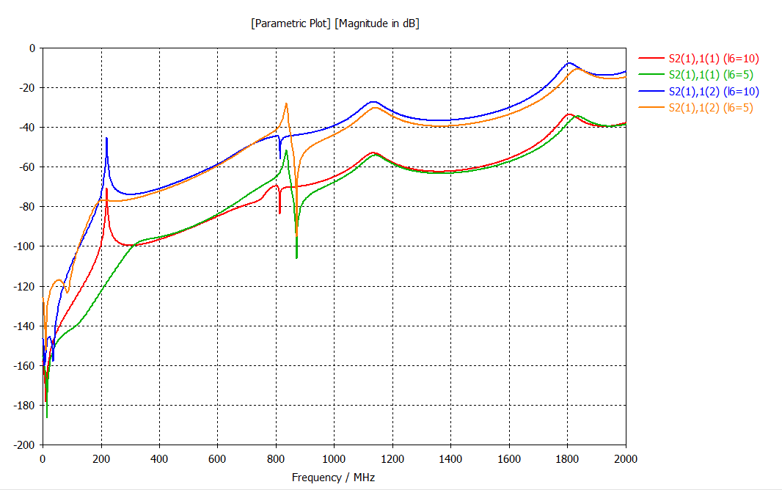
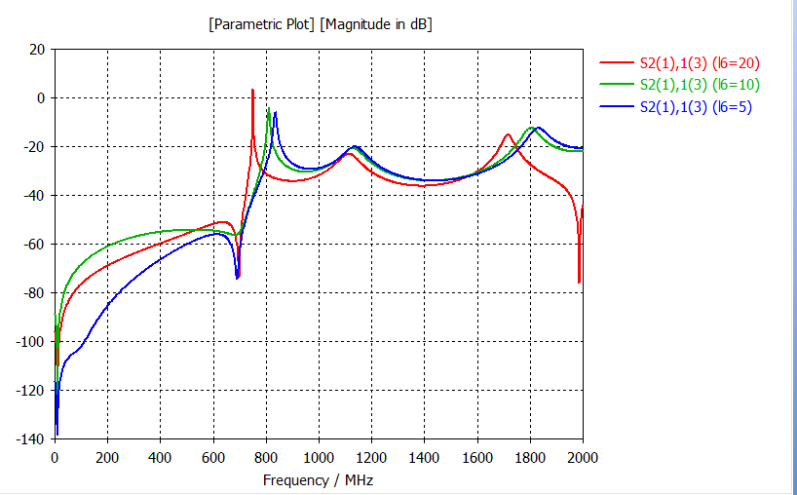
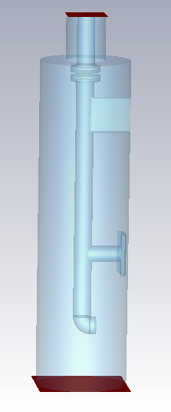
Increase the area of the probe end-v.2
TM01-TEM
TE11-TEM
增加探针头部和场接触面积（初步结果）
对TE111阻尼效果改善不大？
宽带阻尼效果变差，需要重新优化其他几个几何参量
基模阻尼效果不好

Slide 11
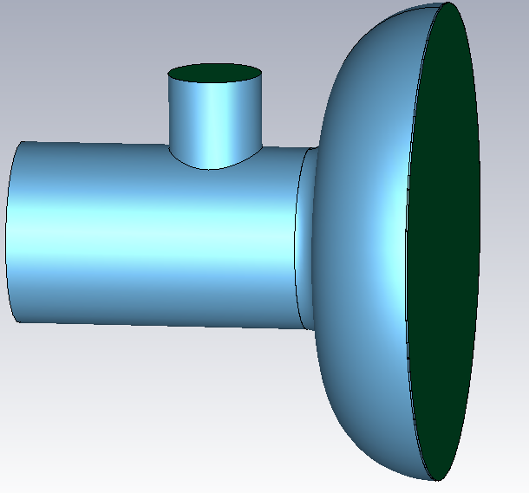
HOM coupler tube length
Face1
HOM coupler r=40mm
h
d=100mm
l2=100mm
2r=10mm
a=36mm
l1=48mm
h’
h=70mm, power dissipated on face1 is
P1=0.157mW(Eacc)
When Q0=2E+10
Pc=12.5W
h’=48-10+36/2=57 mm

Slide 12
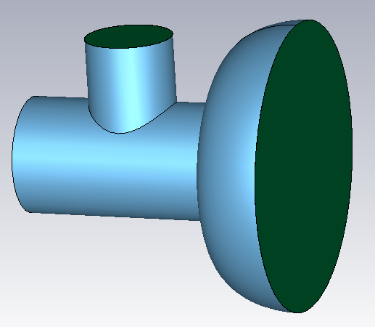
HOM coupler tube length
Face1
Face1
main coupler r=30mm
HOM coupler r=40mm
h
height=46mm
Face2
Face2
d=65mm
d=100mm
model 1
1.3 GHz IHEP02 cavity end group
Face1_integral_e=15.1,
Face2_integral_e=3.1e+5
model 2
650 MHz cavity end group
h | F1_int._e | F2_int._e
75 | 9.2 | 4.7e+5
70 | 12.8 | 4.7e+5
65 | 17.5 | 4.7e+5
60 | 23.1 | 4.7e+5

Slide 13
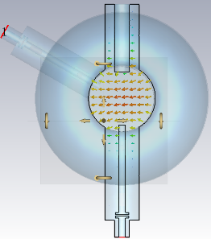
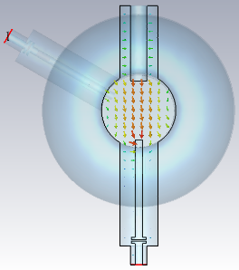
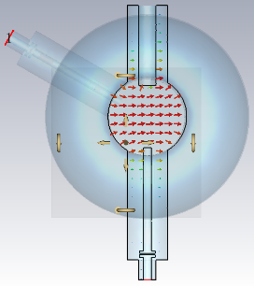
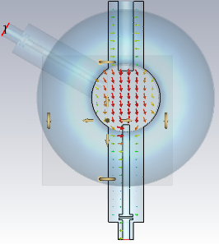
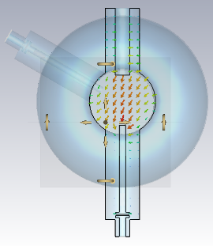
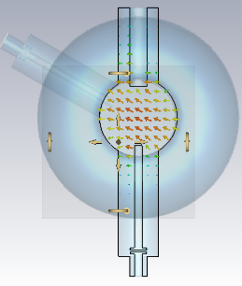
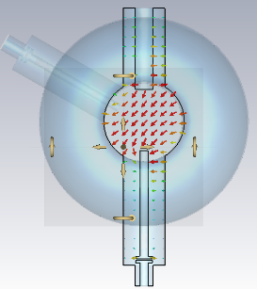
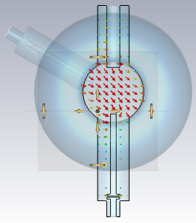
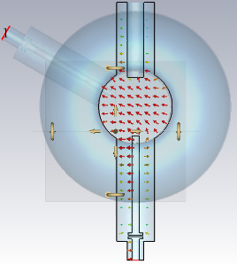
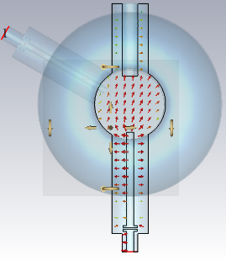
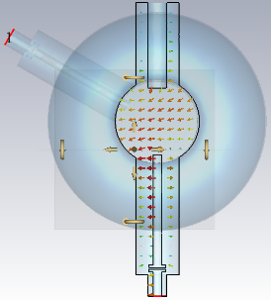
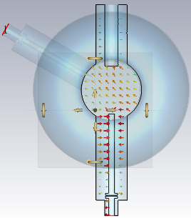
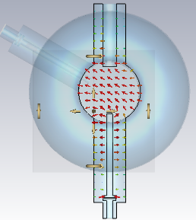
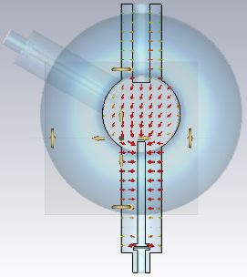
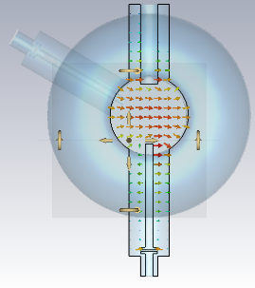
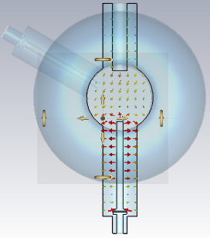
Qe with different depth of penetration
10mm
10mm
10mm
10mm
TE111-PI/2
TE111-PI/2
TE111-PI
TE111-PI
15mm
15mm
15mm
15mm
TM110
TE111
TE111-PI/2
TE111-PI/2
TE111-PI
TE111-PI
10mm
10mm
10mm
10mm
The polarization direction for the dipole is different.
The longer the depth of penetration, the better.
TM110-PI
TM110-PI
TM110-PI/2
TM110-PI/2
15mm
15mm
15mm
15mm
TM110-PI
TM110-PI
TM110-PI/2
TM110-PI/2

Slide 14
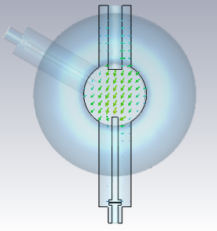
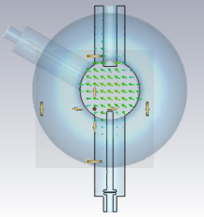
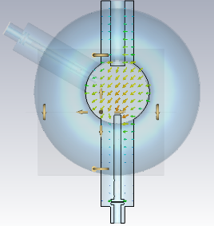
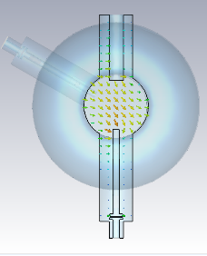
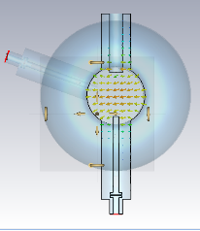
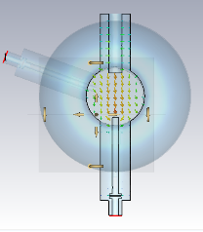
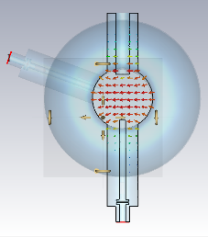
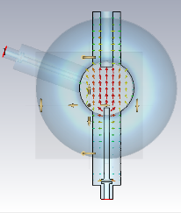

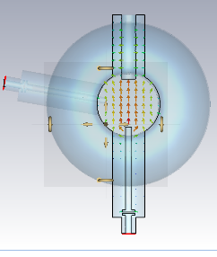














Qe with different angles between HOM couplers
120deg
TE111-PI/2
TE111-PI/2
TE111-PI
TE111-PI
TM110
110deg
TE111
TE111-PI/2
TE111-PI/2
TE111-PI
TE111-PI
120deg
110deg
100deg
90deg
100deg
TE111-PI/2
TE111-PI/2
TE111-PI
TE111-PI
TM110-PI-1
120deg
110deg
100deg
90deg
90deg
TM110-PI-2
TE111-PI/2
TE111-PI/2
TE111-PI
TE111-PI

Slide 15
存在的问题&下一步
存在问题
对TE111的阻尼如何解决？（离基模太近，保证基模的阻尼足够则不能保证TE111的阻尼）
下一步
继续探索增加内导体端部与场的接触面积的可能性
窄带耦合器设计（loop型），与宽带耦合器结果对比

