Slide 1
Electroweak physics at CEPC
Zhijun Liang
(IHEP)

Slide 2
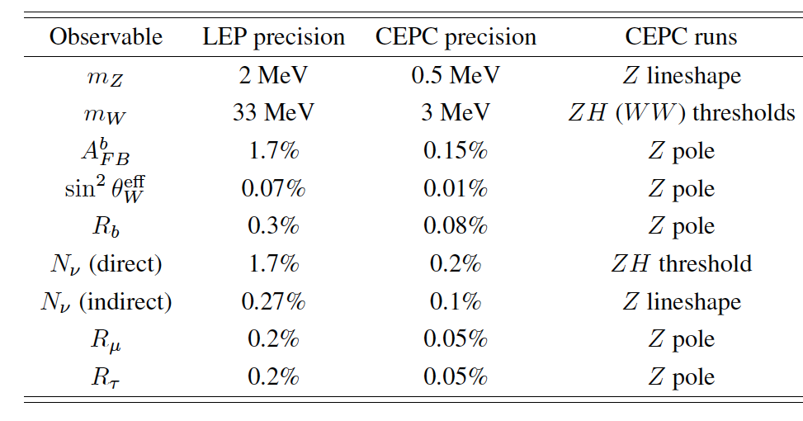
The prospect of CEPC electroweak physics in pre-CDR study
Expected precision on some key measurements in CEPC Pre-CDR study based on projections from LEP.
http://cepc.ihep.ac.cn/preCDR/volume.html

Slide 3
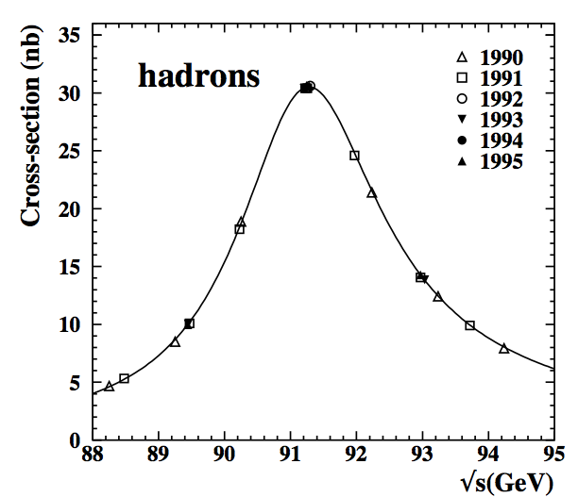
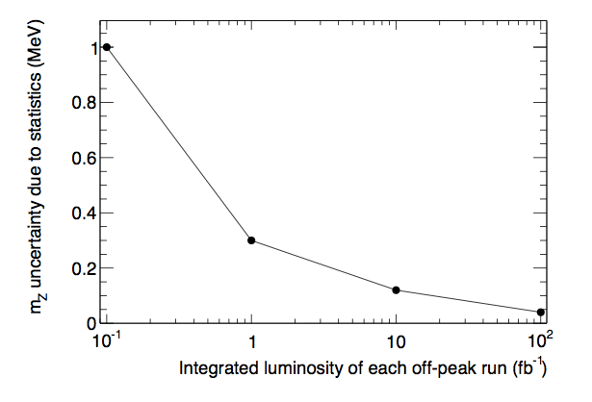
Z mass measurement
LEP measurement : 91.1876±0.0021 GeV
CEPC possible goal: 0.5 MeV
Z threshold scan runs is needed to achieve high precision.
Stat uncertainty : 0.1MeV (assuming >500fb-1 )
Better to have more than 10fb⁻¹ for off-peak runs ( 6 off-peaks runs)
Syst uncertainty: ~0.5 MeV
Beam energy uncertainty need to be better than 5ppm
start to Establishing a accelerator model relating the measured beam energy
Study of the resonant depolarization technique to measure beam energy (LEP approach)
CEPC off-peak runs stat
LEP

Slide 4
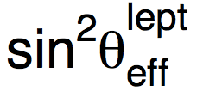
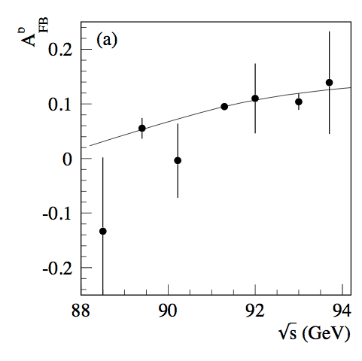
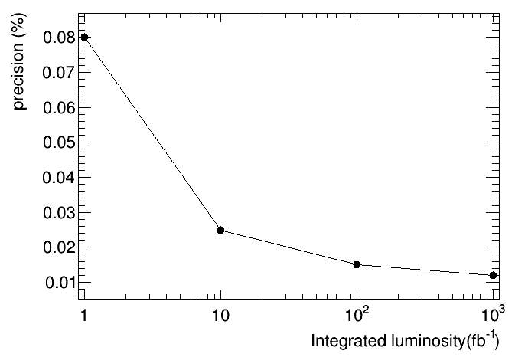
Weak mixing angle
LEP/SLD: 0.23153 ± 0.00016
0.1% precision.
Stat error in off –peak runs is one of limiting factor.
CEPC
Stat error : 0.02% ; ( off-peak runs)
systematics error : 0.01%
Input From Backward-forward asymmetry measurement
The statistics of off-Z peak runs is one of the important issue.
Need at least 10 fb⁻¹ for off-peak runs to reach high precision.
CEPC off-peak runs stat
LEP

Slide 5
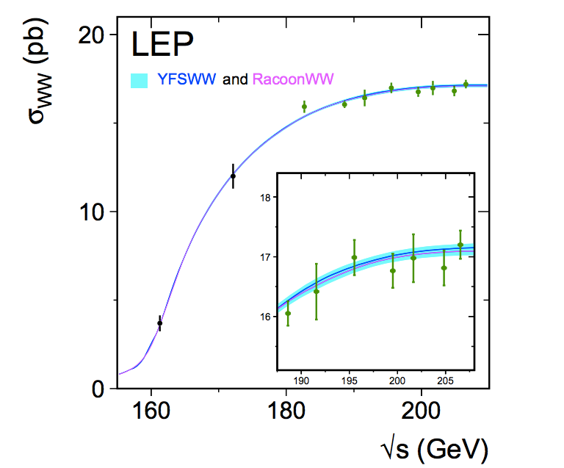
W mass measurement
Current PDG precision : 80.385±0.015 GeV
Possible goal for CEPC : 3 MeV
Three methods for W mass measurements:
1.WW Threshold scan (√s=160GeV):
Advantage: Very robust method, can achieve high precision.
Disadvantage
Beam polarization design has not finished.
Higher cost , Require dedicated runs >100fb⁻¹ on WW threshold(160-170GeV)
2.Direct measurement of the hadronic mass (major method for CDR)
Based on 10¹⁰ Z->hadrons sample to calibrate jet energy scale ( < 3MeV )
Advantage :
No additional cost :measured in ZH runs (sqrt(s)=250GeV)
Higher statistics: 10 times larger than WW threshold region
Lower requirement on beam energy uncertainty.

Slide 6
Summary
From preliminary study on major electroweak precision measurement.
10¹⁰ Z seems to be good enough for most of Z pole measurements
10¹³ Z may help a lot Weak mixing angle measurement
Need to optimize on off-peak runs statistics
Need at least 100fb⁻¹ on WW threshold(160-170GeV)
for W mass measurement if we decide to use WW threshold scan method .

Slide 7
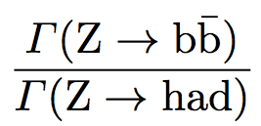
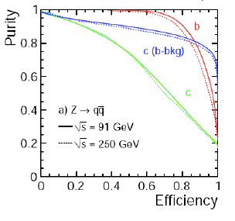
Branching ratio ( R^{b})
LEP measurement 0.21594 ±0.00066
Stat error : 0.44%
Syst error : 0.35%
Typically using 65% working points
CEPC
Expected Stat error ( 0.04%)
Expected Syst error (0.07%)
Expect to use 80% working points
15% higher efficiency than SLD
20-30% higher in purity than SLD
Uncertainty | LEP | CEPC | CEPC improvement
charm physics modeling | 0.2% | 0.05% | tighter b tagging working point
hemisphere tag correlations for b events | 0.2% | 0.1% | Higher b tagging efficiency
gluon splitting | 0.15% | 0.08% | Better granularity in Calo

