Slide 1
Remarks on the hidden-color component
Jialun Ping, Hongxia Huang
Nanjing Normal University
Fan Wang
Nanjing University

Slide 2
Outline
I. Introduction
II. Physics bases and symmetry bases
III. Physical effects of hidden-color component
IV. Summary

Slide 3
I. Introduction
What is the hidden-color component?
To deal with the dynamics of multi quark systems, quark cluster model simplifies the many body problem into a two body one via fixing the internal structure of cluster.
Typical example: using two nucleon cluster to deal with NN interaction from quark-gluon degree of freedom. Nuclear physics shows this is a god approximation.
In nuclear physics we only have colorless nucleon, for QCD based nuclear physics we have the new degree of freedom: hidden color component.
Clusters A and B are colorless, A+B colorless,
color singlet component
Clusters A and B are colorful, A+B colorless,
hidden-color component

Slide 4
I. Introduction
What is the hidden-color component?
quark cluster model
multi-quark systems
many body problem a two body one
internal structure of cluster is fixed
Typical example: NN interaction from quark-gluon d.o.f.
Nuclear physics: a good approximation.

Slide 5
Definition
In conventional nuclear physics: only colorless nucleon,
QCD based nuclear physics: new d.o.f: hidden color component.
Clusters A and B are colorless, A+B colorless,
color singlet component
Clusters A and B are colorful, A+B colorless,
hidden-color component

Slide 6
Multiquark states
Tetraquark: Zc(3900), Zb(10610) (BES Belle 2013)
Pentaquark: Pc(4380), Pc(4450) (LHCb 2015)
Dibaryon: d* (IJ^{P}=03⁺), (WASA-at-COSY 2009-2014)
NΩ ? (STAR@RHIC 2017)
PRL 102, 052301 (2009); M=2.36 GeV, Γ=80 MeV
PRL 106, 242302 (2011); M=2.37 GeV, Γ=70 MeV IJP=03+
PLB 721, 229 (2013); M=2.37 GeV, Γ=70 MeV
PRC 88, 055208 (2013); M=2.37 GeV, Γ=70 MeV
PRL 112, 202301 (2014); M=2.380±0.010 GeV, Γ=40±5 MeV

Slide 7
Multiquark structure
Many models proposed:
hadronic molecules
compact multiquark states
hybrid ……
hidden-color
No consensus yet
There are misunderstandings on the physical effects of the hidden-color components for the multi-quark systems.

Slide 8
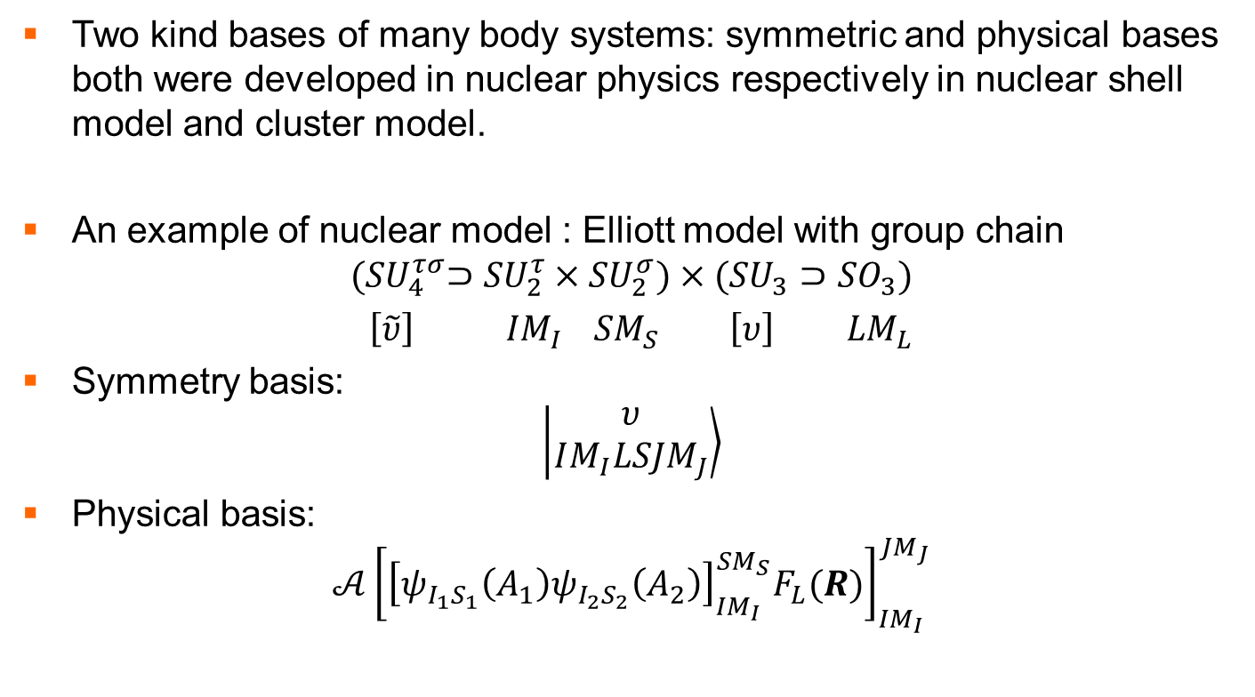
II. Physical bases and symmetry bases
Two kind bases of many body systems: symmetric and physical bases both were developed in nuclear physics respectively in nuclear shell model and cluster model.
An example of nuclear model : Elliott model with group chain
$${(SU}_{4}^{τσ}⊃{SU}_{2}^{τ}{×SU}_{2}^{σ})×({SU}_{3}⊃{SO}_{3})$$
$\left[\tilde{υ}\right]$ ${IM}_{I}$ ${SM}_{S}$ $\left[υ\right]$ ${LM}_{L}$
Symmetry basis:
$$\left|\left.\begin{matrix}υ \\ IM_{I}LSJM_{J}\end{matrix}\right\rangle \right.$$
Physical basis:
$$𝒜{\left[{\left[ψ_{I_{1}S_{1}}\left(A_{1}\right)ψ_{I_{2}S_{2}}\left(A_{2}\right)\right]}_{IM_{I}}^{SM_{S}}F_{L}(R)\right]}_{IM_{I}}^{JM_{J}}$$

Slide 9
Generalized to quark model
M. Harvey: NPA352(1981)301, J.Q. Chen: NPA393(1983)122,
F. Wang, J. L. Ping, T. Goldman: PRC51(1995)1648
Physical basis:
Symmetry basis:

Slide 10
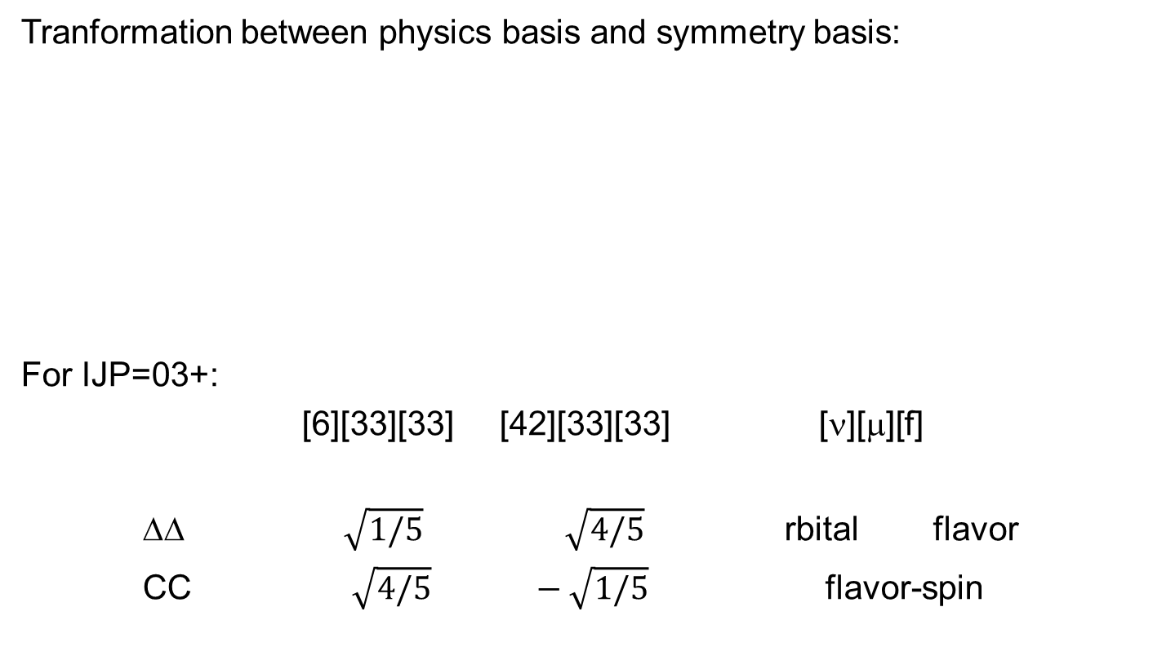

Slide 11
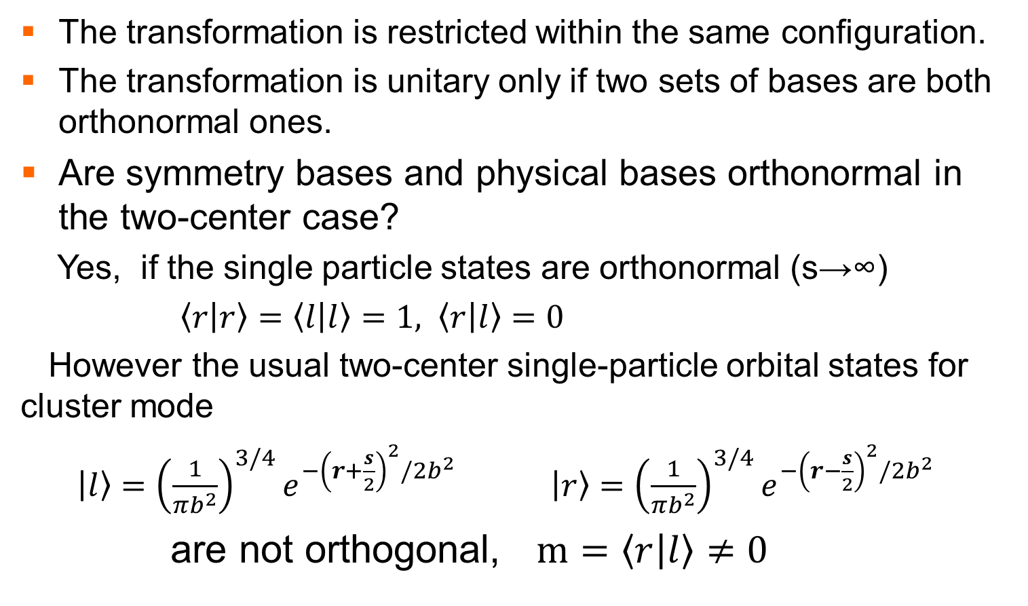
Unitary transformation?
The transformation is restricted within the same configuration.
The transformation is unitary only if two sets of bases are both orthonormal ones.
Are symmetry bases and physical bases orthonormal in the two-center case?
Yes, if the single particle states are orthonormal (s→∞)
$\left\langle r | r\right\rangle =\left\langle l | l\right\rangle =1, \left\langle r | l\right\rangle =0$
However the usual two-center single-particle orbital states for cluster mode
$\left|\left.l\right\rangle \right.={\left(\frac{1}{πb^{2}}\right)}^{3/4}e^{−{\left(r+\frac{s}{2}\right)}^{2}/2b^{2}}$ $\left|\left.r\right\rangle \right.={\left(\frac{1}{πb^{2}}\right)}^{3/4}e^{−{\left(r−\frac{s}{2}\right)}^{2}/2b^{2}}$
are not orthogonal, $m=\left\langle r | l\right\rangle ≠0$

Slide 12
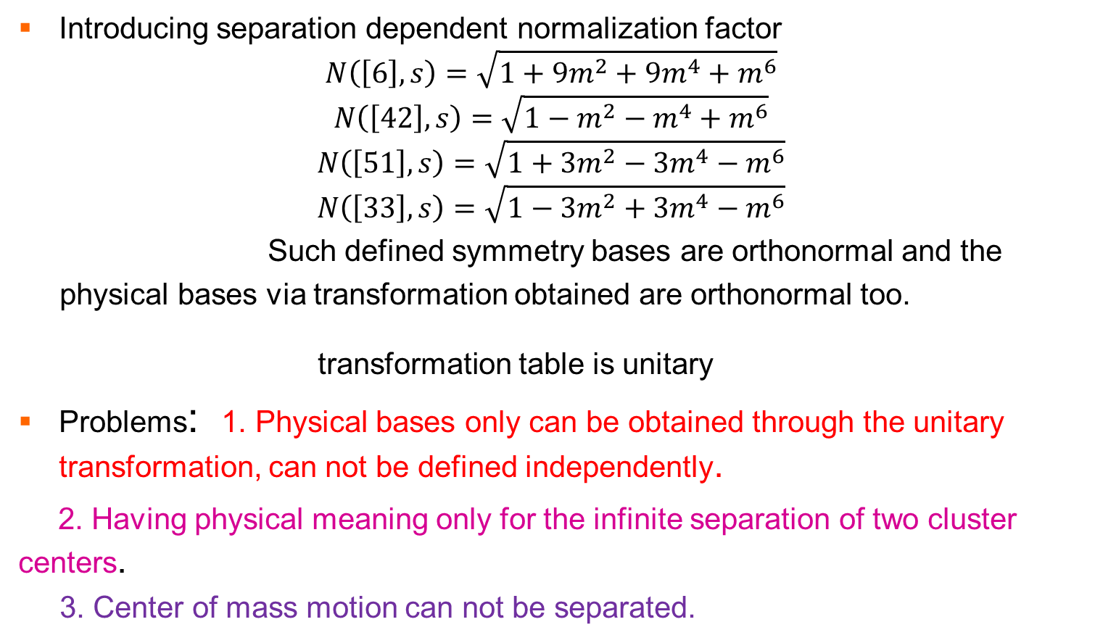
Harvey’s method
Introducing separation dependent normalization factor
$$N\left(\left[6\right],s\right)=\sqrt{1+9m^{2}+9m^{4}+m^{6}}$$
$$N\left(\left[42\right],s\right)=\sqrt{1−m^{2}−m^{4}+m^{6}}$$
$$N\left(\left[51\right],s\right)=\sqrt{1+3m^{2}−3m^{4}−m^{6}}$$
$$N\left(\left[33\right],s\right)=\sqrt{1−3m^{2}+3m^{4}−m^{6}}$$
Such defined symmetry bases are orthonormal and the
physical bases via transformation obtained are orthonormal too.
transformation table is unitary
Problems: 1. Physical bases only can be obtained through the unitary transformation, can not be defined independently.
2. Having physical meaning only for the infinite separation of two cluster centers.
3. Center of mass motion can not be separated.

Slide 13
Transformation (con’t)
In quark cluster model calculation one uses this relation for independent defined physical (cluster) bases,
valid for non-orthogonal single particle orbital states
center of mass motion can be separated from the internal motion
Note: the physical bases are not orthonomal in general.

Slide 14
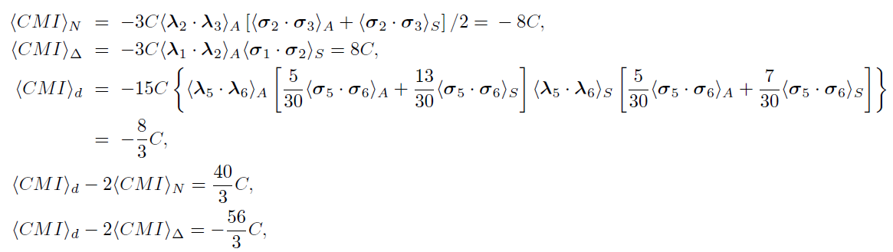
III. Physical effects of hidden color component
Is NN repulsive core due to hidden color component?
S. Brodsky et al., PRL51(1983)83, C.R. Ji, J.Phys.Conf.Ser. 543(2014)No.1,012004
No! Deuteron and d* have the same amount hidden-color component at short distance, but d* has strong short range attraction instead of repulsive core.
It is due to CMI of one-gluon-exchange!

Slide 15

Is the NN Intermediate-range attraction due to color
van der Waals force HC? Just partly! Not the dominant one!
S.Brodsky, PR64(1990)1011, PLB412(19970125
N-N interaction is a QCD duplication of QED H-H molecular interaction.
H atoms: electric neutral,
electric charge and orbital distortion → molecular force
(electron percolation)
Nucleons: color neutral,
color charge and orbital distortion → nuclear force
(quark delocalization)
We developed a molecular bond analog model for NN interaction, QDCSM, which describe the deuteron and NN scattering quantitatively well. PRL69(1992)2901

Slide 16
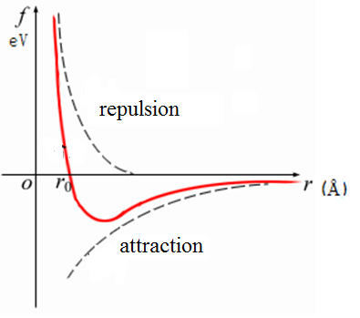
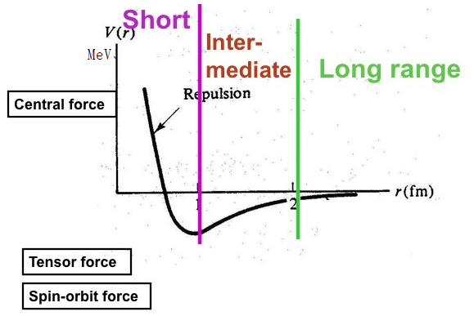
Similarity between nuclear force and molecular force
A.Bohr and B. Motelson, Nuclear structure，1975
spin singlet spin triplet isospin singlet
interaction between atoms interaction in deuteron

Slide 17
CPEP statement in Standard model chart
The strong binding of color-neutral protons and neutrons to form a nuclei is due to residue strong interactions between their color charged constituents. It is similar to the residual electrical interaction that binds electrical neutral atoms to form molecules.

Slide 18
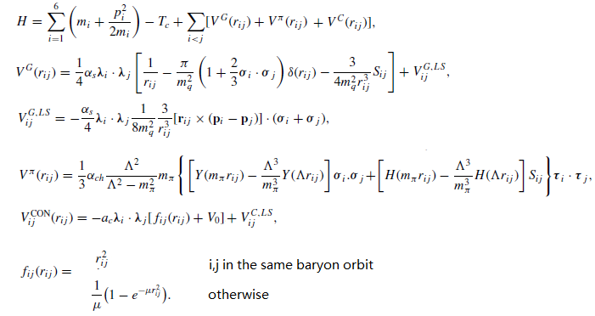
QDCSM
Color screening：
qq interaction: inside baryon usual confinement
outside baryon color screening confinement
The HC coupling is taken into account via this color screening confinement and has
been checked through a quantitative color singlet-HC channel coupling calculation.
PRC84(2011)064001

Slide 19
Delocalized two center quark orbit
N(s) normalization constant,
delocalization parameter,
it is not an adjusted parameter,
but determined by
the dynamics of the multi-quark system !

Slide 20
delocalization parameter

Slide 21
deuteron

Slide 24
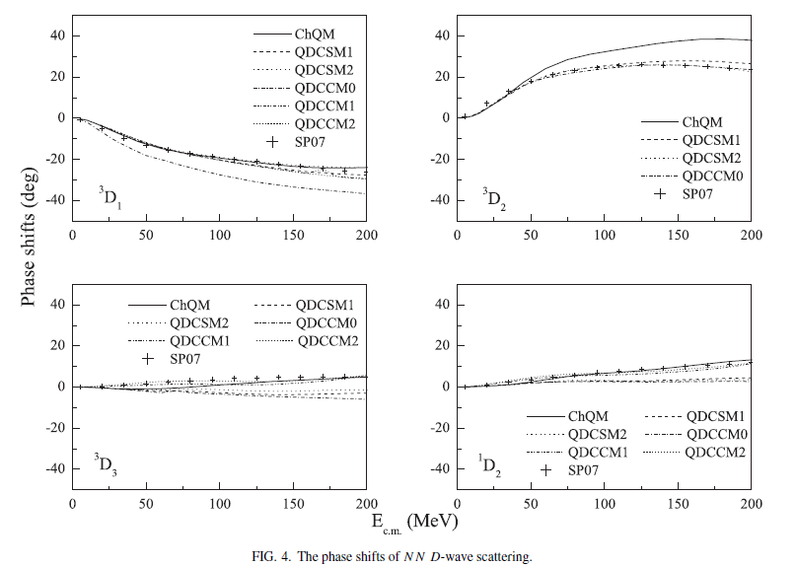

Slide 28
Narrow width of d*
Bashkanov-Brodsky-Clement: PLB 727(2013)438

Slide 29
Huang-Zhang-Shen-Wang: arXiv:1408.0458
CC channel: 66%--68% → 70 MeV
Huang-Ping-Wang: PRC89(2014)034001
B.Juan-Diaz,T.S.H. Lee,
A.Matsuyama, T.Sato:
PRC76(2007)065201

Slide 30
Our Feshbach resonance calculation obtained the right resonance scattering partial width (14 Mev versus 12 MeV), it is consistent with the WASA-at-COSY measurement: the d* is formed from formation.
Our rough estimate of the decay width is much larger than the measurement one ( 110 MeV versus 70 MeV ) means after formation it shrinks into a compact six-quark state due to strong attraction between two (with a rms~1.2 fm.)

Slide 31
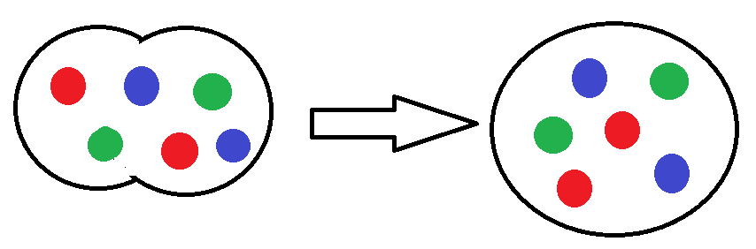
Hidden-color component or compact six-quark state
d* compact object -----
taking limit: six quarks in one bag

Slide 32
Cluster model is an approximation used to describe the multi quark system. It is good for a system like deuteron or hadron scattering.
If the system is a compact multi-quark one, the cluster approximation is no longer useful. Still to talk about color singlet di-hadron and hidden-color component is meaningless.
In fact, as the two clusters close together, the overlap of colorless and hidden color components become bigger and bigger and finally collapse into the same one.

Slide 33
6 quarks are in the same orbit: [ν]=[6] remains,
[42] disappears
Symmetry basis: only [6][33][33] exists
------> number of physical basis: 1
ΔΔ and CC are the same !
< ΔΔ | CC > =1

Slide 34
numerical results
Calculation method: RGM+GCM

Slide 35
+S/2, -S/2: the reference centers of baryons
S→0, [6] exists, [42] disappears
< ΔΔ | CC > =1
Continuity → < ΔΔ | CC > approx. 1, when S is small.
S (fm) < ΔΔ | CC > S (fm) < ΔΔ | CC >
3 0 0.3 0.997
2 7x10⁻³ 0.2 0.999
1 0.7 0.1 0.99996
0.5 0.98 0.001 ~ 1
0.4 0.99

Slide 36
Matrix elements:
S (fm) < ΔΔ |H| ΔΔ > < CC |H|CC > < ΔΔ |H| CC >
3 2580 7770 ~0
2 2571 4870 9.9
1 2451 2679 1616
0.5 2649 2714 2609
0.3 2739 2763 2741
0.2 2771 2782 2774
0.1 2791 2794 2792

Slide 37
d* in chiral quark model (two channels: ΔΔ and CC)
S(fm) 0.1 0.2 0.3 0.4 0.5
E(MeV) 2404.0 2404.0 2404.1 2404.1 2405.0
ΔΔ (%) 50 50.2 40.8 85.2 94.2
CC(%) 50 49.8 59.2 14.8 5.8
Physical basis and symmetry basis: same results

Slide 38
Using Harvey’s method
S(fm) 0.1 0.3 0.5 0.7 0.9
E(MeV) 2745.7 2706.4 2635.0 2546.0 2463.5
ΔΔ (%) 46 46 50 54 60
CC(%) 54 54 50 46 40
S(fm) 1.1 1.3 1.5 1.7 1.9
E(MeV) 2423.6 2454.0 2513.7 2550.6 2567.1
ΔΔ (%) 71 87 97 100 100
CC(%) 29 13 3 0 0
CC is not dominant

Slide 39
To use the hidden color component dominant assumption to explain the small width is questionable.
In fact it is due to the space compactness of the d*, which has small overlap with the
Configuration.
G.A. Miller’s explanation of the deuteron tensor structure function based on the HC component has the same problem.

Slide 40
Hidden color component is spurious or new degree of freedom
For any (n+m module 3) quark antiquark system, one always can choose only color singlet hadron channels to form a complete set to describe it, i.e. any HC channel can be transformed into color singlet channels through quark rearrangement for the present formalism of multi-quark wave function.
F. Wang et al., Nuovo Cim., 86A (1985)283; F. Wang, Prog. Phys. 9(1989)297.
Based on this possibility, P. Gonzales and V. Vento, (preprint MIT-CTP-1347, 1986) argued that the HC is a spurious concept.
If we want to keep the overall color singlet multi quark wave function gauge invariant under SU(3) color gauge transformation, we have to add gauge link to this wave function. Then the elimination recipe of HC no longer work.

Slide 41
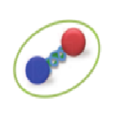
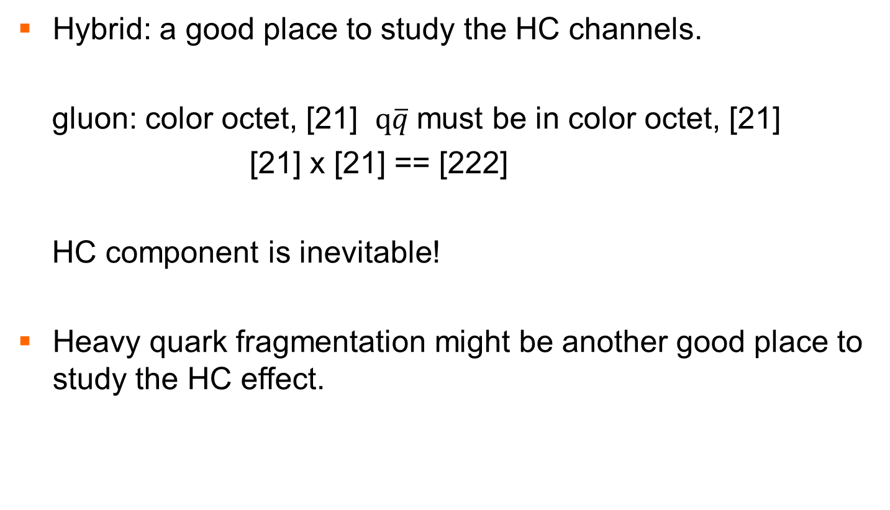
hybrid
Hybrid: a good place to study the HC channels.
gluon: color octet, [21] $q\overline{q}$must be in color octet, [21]
[21] x [21] == [222]
HC component is inevitable!
Heavy quark fragmentation might be another good place to study the HC effect.

Slide 42
Summary
Color singlet and HC both are cluster model idea, for compact multi quark state, these cluster model approximation is no longer adequate. The separation of two cluster smaller, the overlap of color singlet and HC components bigger. As the separation close to zero, the color singlet and HC component collapse into the same one.
The NN short range repulsion is not due to HC component dominant but due to color magnetic interaction. The NN interaction is a QCD duplication of QED H-H molecular interaction, the color van der Waals force is a minor contribution.
To explain the narrow width of d* by assuming the HC component dominant is questionable.
HC component is a new degree of freedom of multi quark systems.
Hybrid and heavy quark fragmentation are good place to study the HC
channel effects. Thanks!!!

