Slide 1

Tensor-Optimized Antisymmetrized Molecular Dynamics (TOAMD) for light nuclei
with bare nuclear interactions
TOAMD ... New variational method for nuclei
to treat V_{NN} directly
Takayuki MYO
明 孝之
Hiroshi TOKI (RCNP) Kiyomi IKEDA (RIKEN)
Hisashi HORIUCHI (RCNP) Tadahiro SUHARA (Matsue)
The Seventh Asia-Pacific Conference on Few-Body Problems in Physics (APFB 2017), 2017.8.25-30

Slide 2
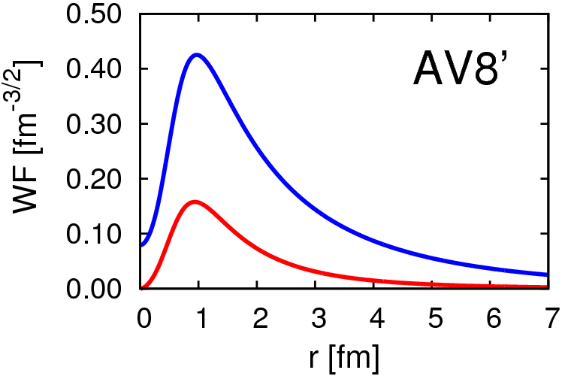
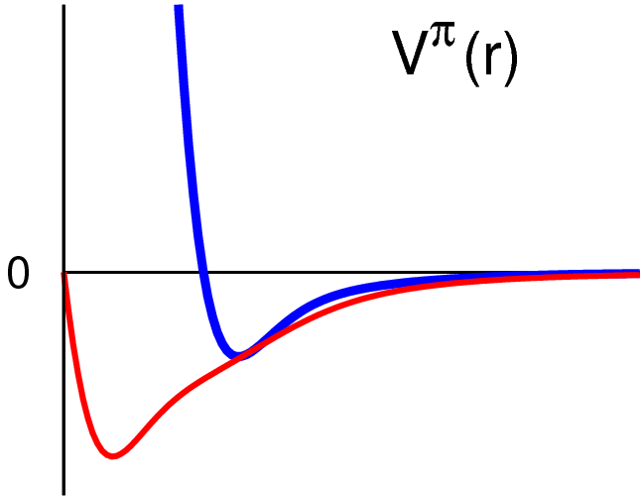
Deuteron properties & tensor force
Energy | -2.24 MeV
Kinetic | 19.88
Central | -4.46
Tensor | -16.64
LS | -1.02
P(L=2) | 5.77%
Radius | 1.96 fm
S
S 11.31
D 8.57
D
SD -18.93
DD 2.29
AV8’
V_{central}
R_{m}(s) = 2.00 fm
R_{m}(d) = 1.22 fm
d-wave is
“spatially compact”
(high momentum)
r
V_{tensor}

Slide 3
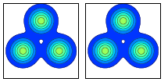
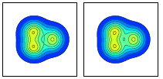
¹²C in Antisymmetrized Molecular Dynamics
V_{eff} : Effective central force
+ LS force
NO tensor force
nucleon w.f.
$$φ∝e^{−ν{(\vec{r}−\vec{Z})}^{2}}χ_{σ}χ_{τ}$$
Gaussian wave packet
0⁺(Hoyle) triple-α config.
¹²C
α-particle ... (0s)⁴
AMD
0⁺(GS) shell-model-like
+
T. Suhara. and Y. Kanada-En’yo,
Phys. Rev. C 82, 044301 (2010)
proton
neutron

Slide 4
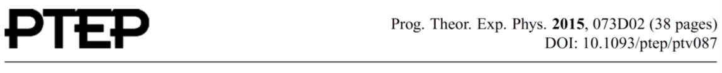
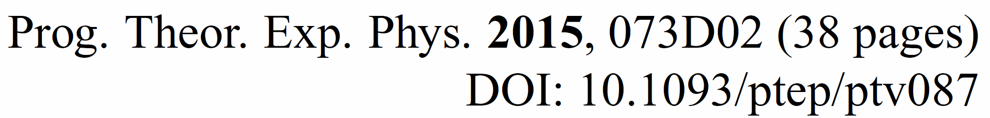
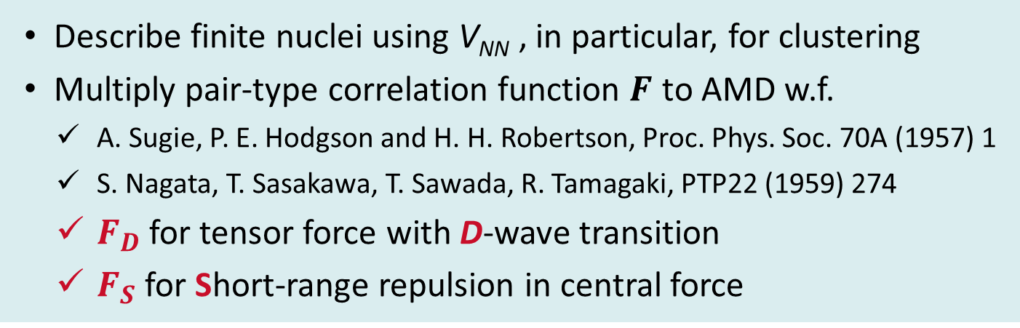
Tensor-Optimized Antisymmetrized Molecular Dynamics (TOAMD)
TM, Hiroshi Toki, Kiyomi Ikeda, Hisashi Horiuchi,
and Tadahiro Suhara
Describe finite nuclei using V_{NN} , in particular, for clustering
    Multiply pair-type correlation function $F$ to AMD w.f.
      A. Sugie, P. E. Hodgson and H. H. Robertson, Proc. Phys. Soc. 70A (1957) 1
      S. Nagata, T. Sasakawa, T. Sawada, R. Tamagaki, PTP22 (1959) 274
      $F_{D}$ for tensor force with D-wave transition
      $F_{S}$ for Short-range repulsion in central force

Slide 5

Formulation of TOAMD
Deuteron wave function
K. Ikeda, TM, K. Kato, H. Toki
Lecture Notes in Physics 818 (2010)
$$R_{D−wave}\sim 0.6×R_{S−wave}$$
Involve high-k component induced by V_{tensor}
spatially
compact
Tensor-optimized AMD (TOAMD)
isospin
F
Pair excitation via tensor operator with D-wave transition
Optimize relative motion with Gaussian expansion
General formulation with respect to mass number A

Slide 6
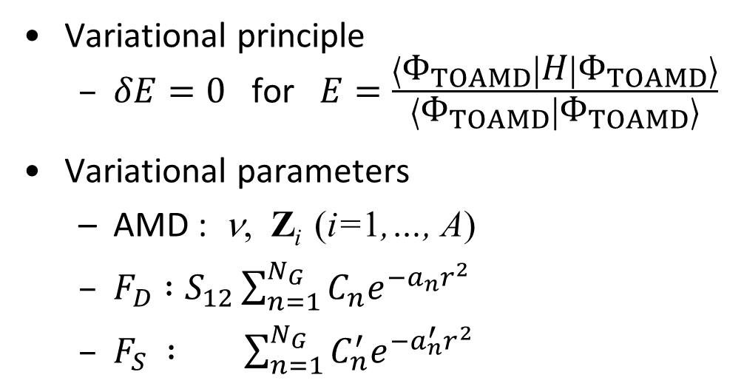

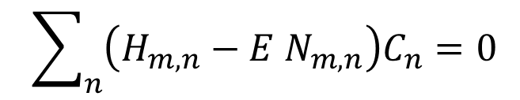
General formulation of TOAMD
tensor
short-range
tensor × short-range
Variational principle
  $δE=0$ for $E=\frac{\left\langle Φ_{TOAMD} | H | Φ_{TOAMD}\right\rangle }{\left\langle Φ_{TOAMD} | Φ_{TOAMD}\right\rangle }$
Variational parameters
  AMD : ν, Z_{i} (i=1,…, A)
  $F_{D} :S_{12}\sum_{n=1}^{N_{G}}{C_{n}e^{−a_{n}r^{2}}}$
  $F_{S} : \sum_{n=1}^{N_{G}}{C_{n}^{′}e^{−a_{n}^{′}r^{2}}}$
F are independent
nucleon w.f.
$$φ(r)∝e^{−ν{(\vec{r}−\vec{Z})}^{2}}χ_{σ}χ_{τ}$$
Gaussian wave packet
spin-isospin dependent
$$\sum_{n}{\left(H_{m,n}−E{ N}_{m,n}\right)C_{n}}=0$$
Eigenvalue problem

Slide 7

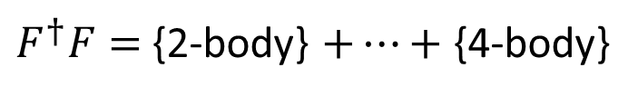
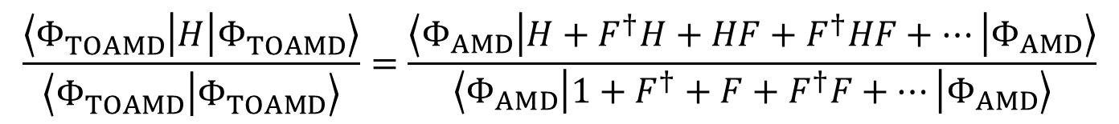
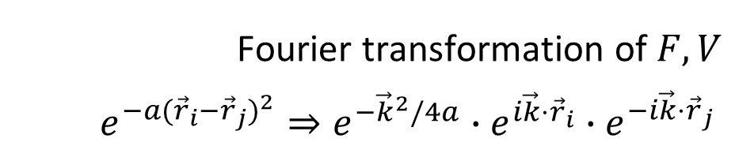

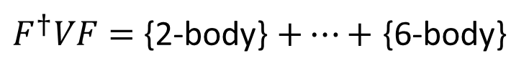
Matrix elements of correlated operator
Correlated Hamiltonian
$$\frac{\left\langle Φ_{TOAMD}^{} | H | Φ_{TOAMD}^{}\right\rangle }{\left\langle Φ_{TOAMD}^{} | Φ_{TOAMD}^{}\right\rangle }=\frac{\left\langle Φ_{AMD} | H+F^{†}H+HF+F^{†}HF+⋯ | Φ_{AMD}\right\rangle }{\left\langle Φ_{AMD} | 1+F^{†}+F+F^{†}F+⋯ | Φ_{AMD}\right\rangle }$$
Correlated Norm
Classify the connections of F, H into many-body operators using cluster expansion method
3-body
4-body
bra
F†
V
$F^{†}F=${2-body} $+⋯+${4-body}
F
ket
(2-body)²
$$𝒜$$
i j k
$$𝒜$$
i j k l
$F^{†}VF=${2-body} $+⋯+$ {6-body}
Fourier transformation of $F, V$
$$e^{−a{({\vec{r}}_{i}−{\vec{r}}_{j})}^{2}}⇒e^{−{\vec{k}}^{2}/4a}∙e^{i\vec{k}⋅{\vec{r}}_{i}}∙e^{−i\vec{k}⋅{\vec{r}}_{j}}$$
(2-body)³
relative
single particle

Slide 8
Diagrams of cluster expansion - V_{NN} -
2-body
3-body
4-body
bra
F
F
V
V
V
F
ket
5-body
6-body

Slide 9
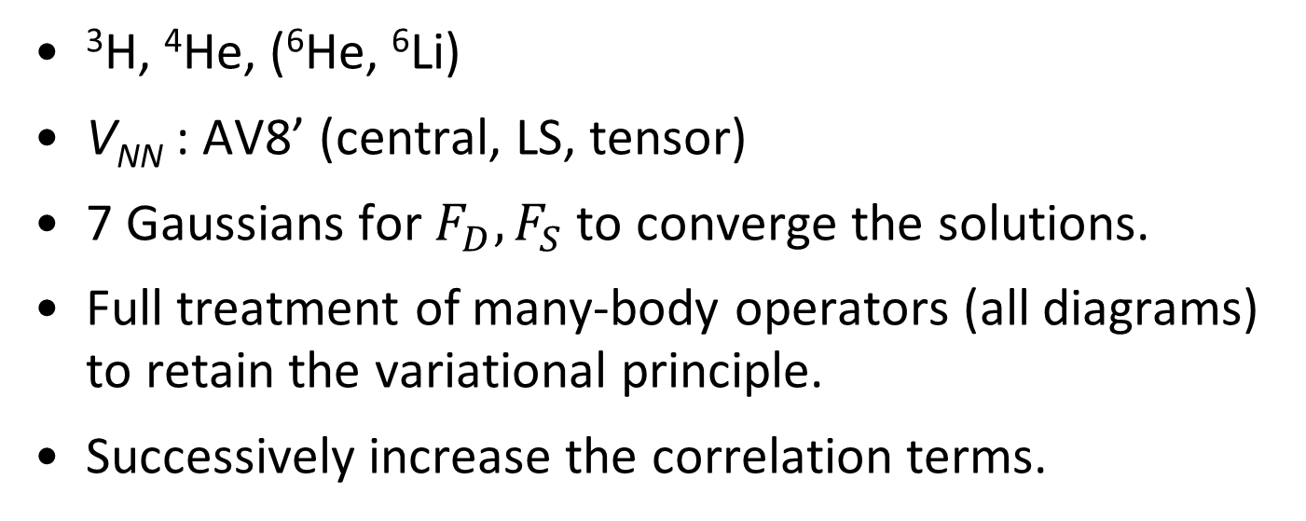
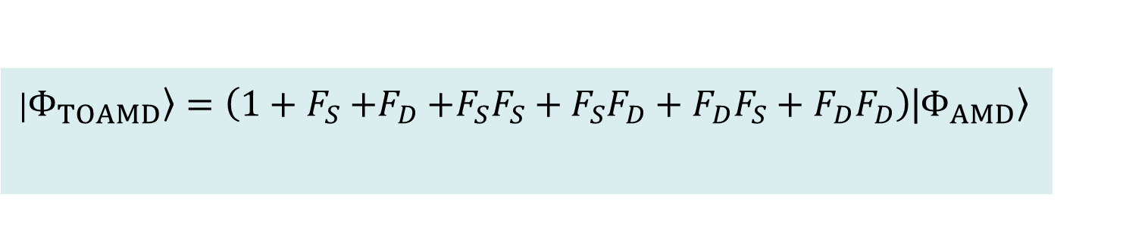
Results
PLB 769 (2017) 213
PRC 95 (2017) 044314
PTEP (2017) 073D01
PRC (2017) in press
³H, ⁴He, (⁶He, ⁶Li)
V_{NN} : AV8’ (central, LS, tensor)
7 Gaussians for $F_{D},F_{S}$ to converge the solutions.
Full treatment of many-body operators (all diagrams)
to retain the variational principle.
Successively increase the correlation terms.
    |$\left.Φ_{TOAMD}\right\rangle =\left(1+F_{S}{+F}_{D}+F_{S}F_{S}+F_{S}F_{D}+F_{D}F_{S}+F_{D}F_{D}\right)\text{|}\left.Φ_{AMD}\right\rangle$
Single F
Double F
2p-2h
F
F
F
F
F
4p-4h
3p-3h

Slide 10
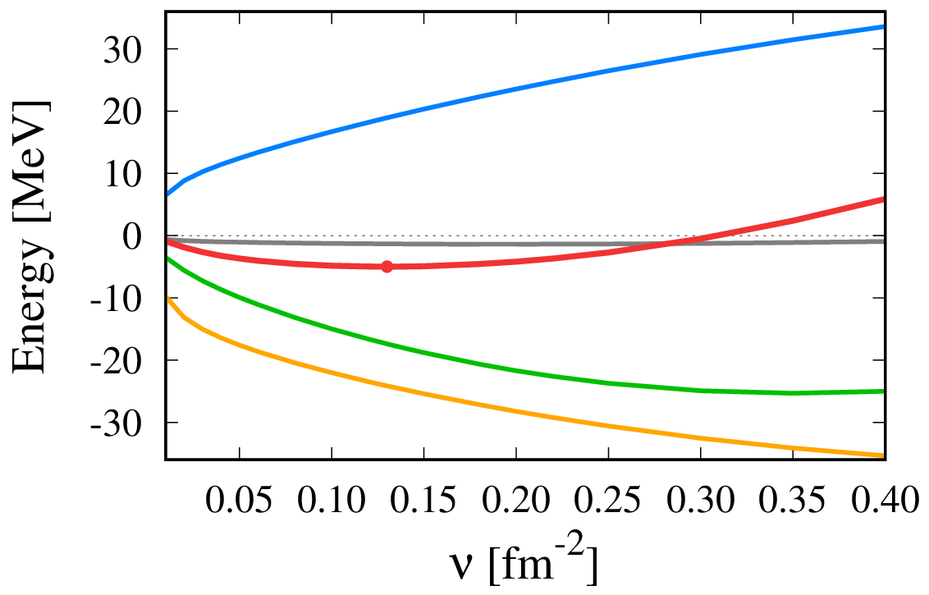
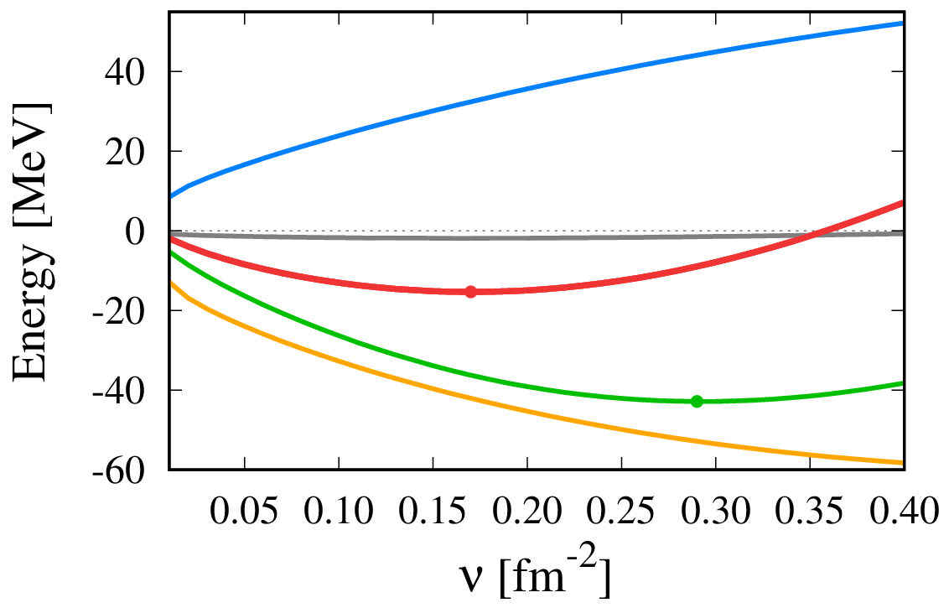



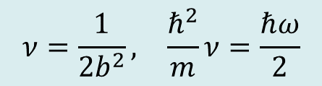
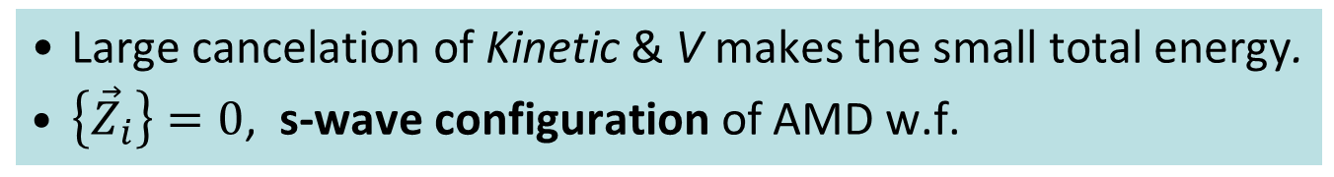
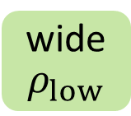
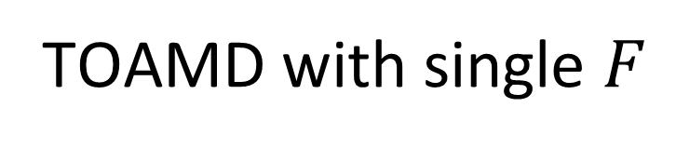
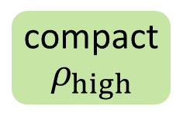
TOAMD with single $F$
F
    $$\left(1+F_{D}{+F}_{S}\right)\text{|}\left.Φ_{AMD}\right\rangle$$
Kinetic
$$×\frac{1}{2}$$
³H
⁴He
Energy
LS
Central
Tensor
wide
$ρ_{low}$
compact
$$ρ_{high}$$
$$ν=\frac{1}{2b^{2}}, \frac{ℏ^{2}}{m}ν=\frac{ℏω}{2}$$
$$φ∝e^{−ν{(\vec{r}−\vec{Z})}^{2}}$$
Large cancelation of Kinetic & V makes the small total energy.
$\left\{{\vec{Z}}_{i}\right\}=0$, s-wave configuration of AMD w.f.

Slide 11
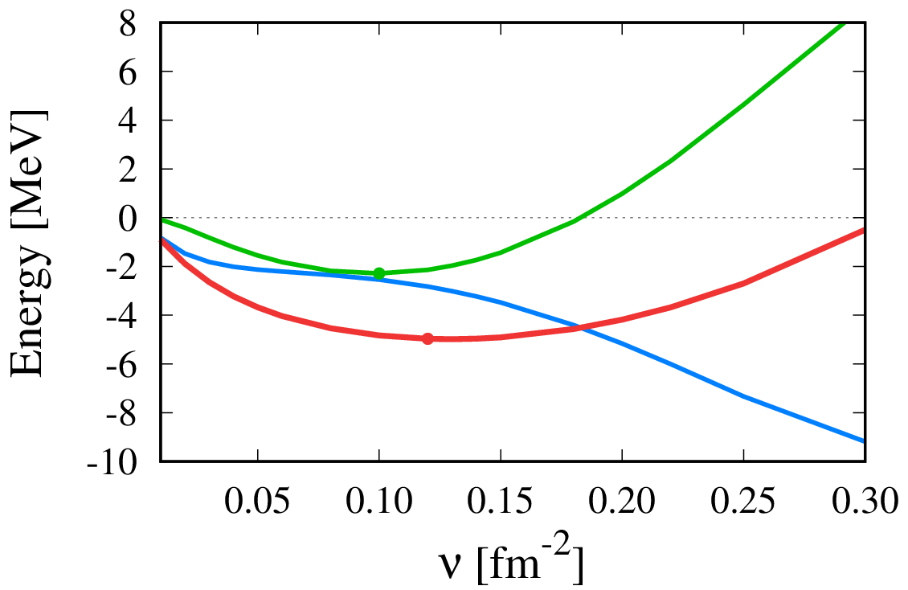
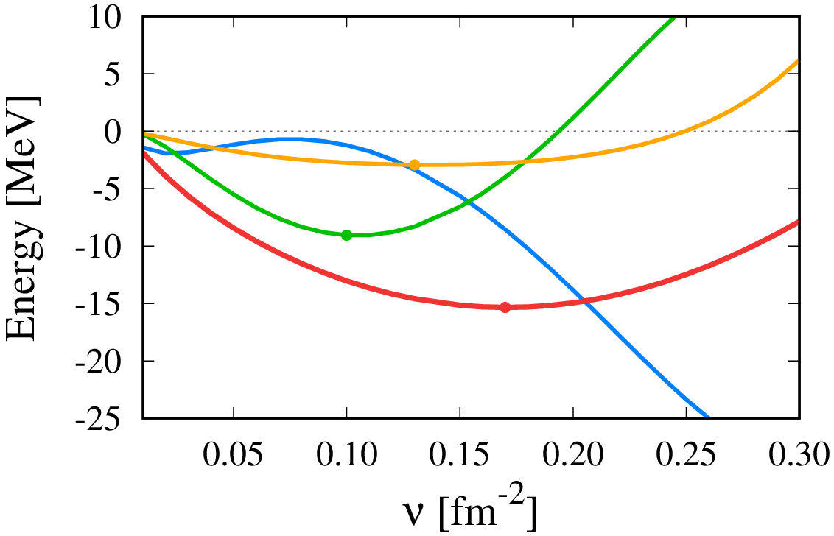

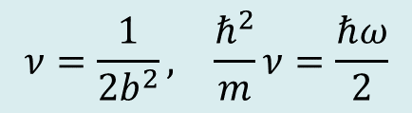
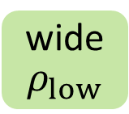
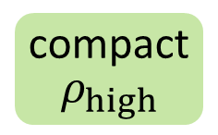

Many-body operators of $F^{†}HF$
3-body
3-body
4-body
³H
⁴He
Energy
Energy
2-body
wide
$ρ_{low}$
compact
$$ρ_{high}$$
2-body
NO energy saturation
within 2-body
$$ν=\frac{1}{2b^{2}}, \frac{ℏ^{2}}{m}ν=\frac{ℏω}{2}$$
$$\left\{{\vec{Z}}_{i}\right\}=0$$
PTEP (2017) 073D01
Many-body correlation plays a decisive role for energy saturation.
  Similar to Bethe-Brueckner-Goldstone approach with G-matrix (Baldo)

Slide 12
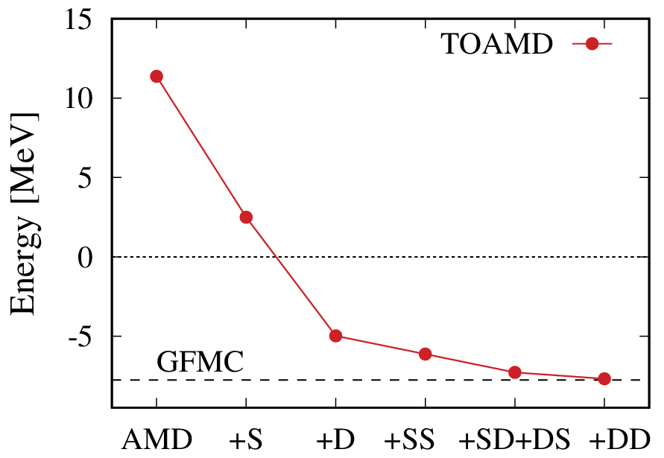
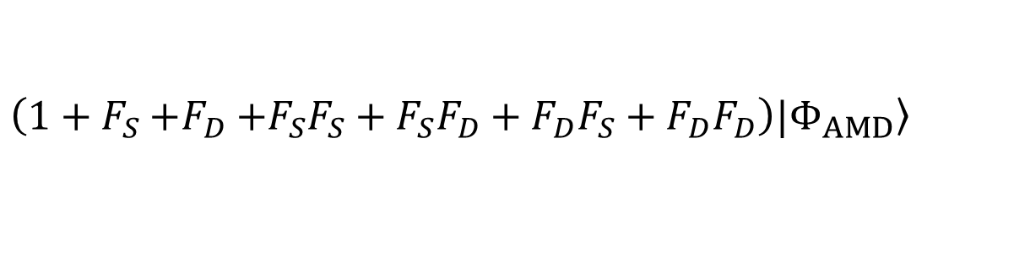
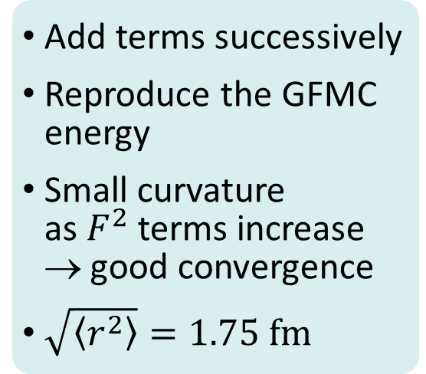


Double $F$ effect in TOAMD
F
F
AV8’
$$\left(1+F_{S}{+F}_{D}+F_{S}F_{S}+F_{S}F_{D}+F_{D}F_{S}+F_{D}F_{D}\right)|\left.Φ_{AMD}\right\rangle$$
S
D
SS
SD
DS
DD
F are independent
AMD
³H
Add terms successively
Reproduce the GFMC energy
Small curvature
as $F^{2}$ terms increase
→ good convergence
$\sqrt{\left\langle r^{2}\right\rangle }=1.75 fm$
$${1+F}_{S}$$
Correlation functions

Slide 13
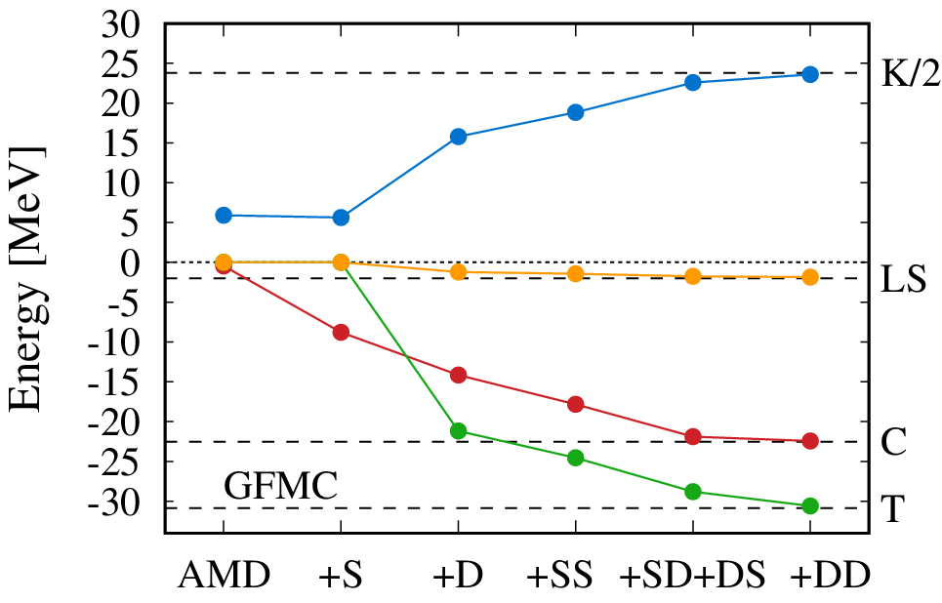

Double $F$ effect in TOAMD
F
F
AV8’
$$\left(1+F_{S}{+F}_{D}+F_{S}F_{S}+F_{S}F_{D}+F_{D}F_{S}+F_{D}F_{D}\right)|\left.Φ_{AMD}\right\rangle$$
S
D
SS
SD
DS
DD
PLB769 (2017) 213
³H
Kinetic/2
F are independent
Reproduce the Hamiltonian components of ³H
Central
Tensor
Correlation functions

Slide 14
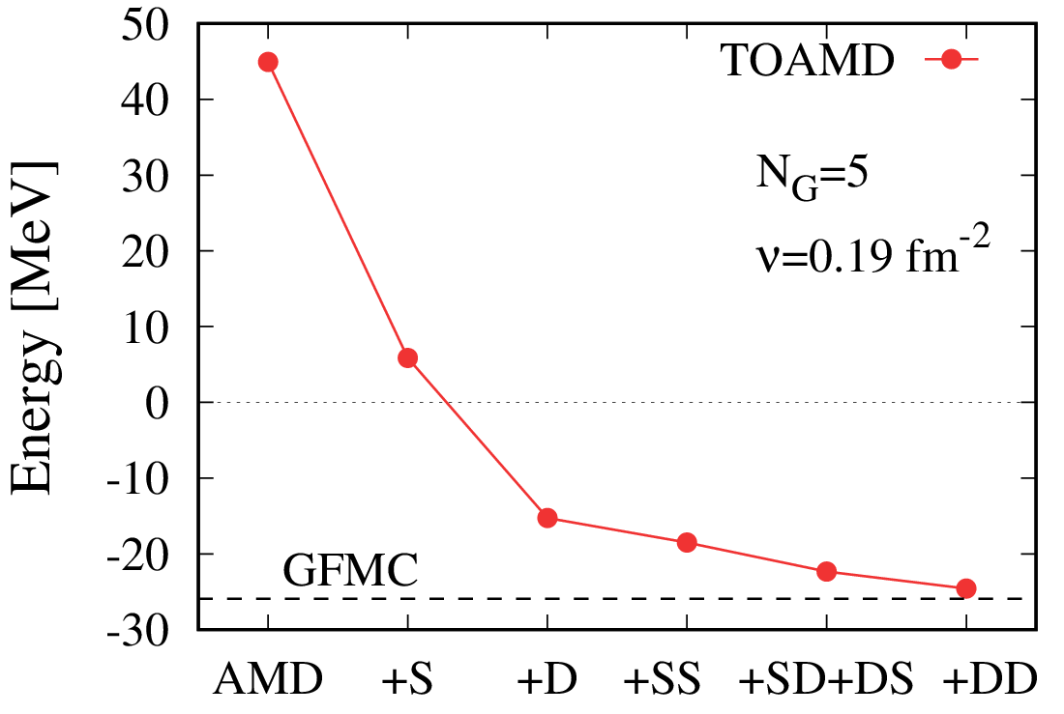
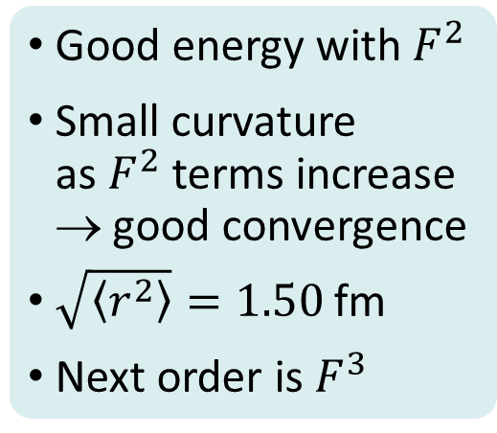


Double $F$ effect in TOAMD
F
F
AV8’
$$\left(1+F_{S}{+F}_{D}+F_{S}F_{S}+F_{S}F_{D}+F_{D}F_{S}+F_{D}F_{D}\right)|\left.Φ_{AMD}\right\rangle$$
S
D
SS
SD
DS
DD
F are independent
AMD
⁴He
Good energy with $F^{2}$
Small curvature
as $F^{2}$ terms increase
→ good convergence
$\sqrt{\left\langle r^{2}\right\rangle }=1.50$fm
Next order is $F^{3}$
$${1+F}_{S}$$
Correlation functions

Slide 15
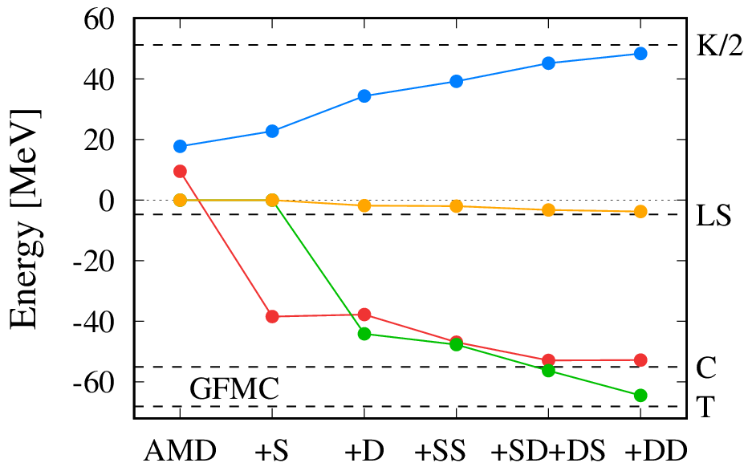
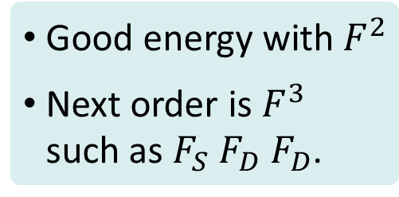

Double $F$ effect in TOAMD
F
F
AV8’
$$\left(1+F_{S}{+F}_{D}+F_{S}F_{S}+F_{S}F_{D}+F_{D}F_{S}+F_{D}F_{D}\right)|\left.Φ_{AMD}\right\rangle$$
S
D
SS
SD
DS
DD
⁴He
F are independent
Kinetic/2
Good energy with $F^{2}$
Next order is $F^{3}$
such as $F_{S}{ F}_{D} F_{D}$.
Central
Tensor
Correlation functions

Slide 16
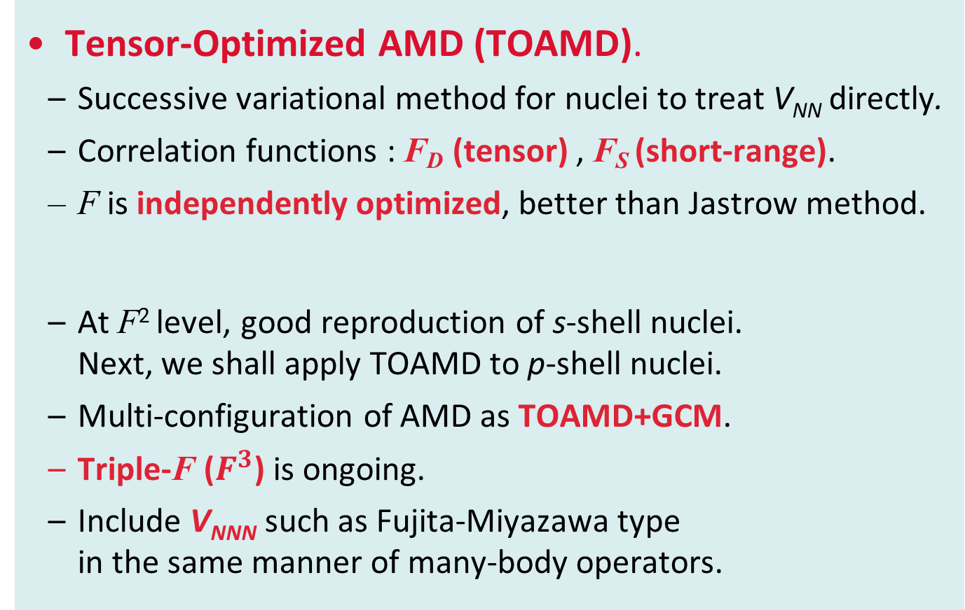
Summary
Tensor-Optimized AMD (TOAMD).
  Successive variational method for nuclei to treat V_{NN} directly.
  Correlation functions : F_{D} (tensor) , F_{S} (short-range).
  F is independently optimized, better than Jastrow method.
  At F² level, good reproduction of s-shell nuclei.
  Next, we shall apply TOAMD to p-shell nuclei.
  Multi-configuration of AMD as TOAMD+GCM.
  Triple-F ($F^{3}$) is ongoing.
  Include V_{NNN} such as Fujita-Miyazawa type
  in the same manner of many-body operators.
PRC (2017) in press
π
Δ
π
Notes:
16

Slide 17
Backup

Slide 18
Short-range correlation in TOAMD
$$|\left.Φ_{TOAMD}\right\rangle =\left(1+F_{S1}+F_{S2}⋅F_{S3}\right)|\left.Φ_{AMD}\right\rangle$$
power series
expansion
single
double
PRC95 (2017) 044314
V_{NN} : Malfliet-Tjon V (central short-range)
  Nucl. Phys. A127, 161 (1969).
  $v\left(r\right)=1458.05\frac{e^{−3.11r}}{r}−578.09\frac{e^{−1.55r}}{r}$ (MeV)
TOAMD vs. Variational Monte Carlo with Jastrow-type
$Φ_{Jastrow}=\prod_{i<j}^{A}{f_{ij}}⋅Φ_{0}$
$\prod_{i<j}^{A}{f_{ij}}\text{=}\prod_{i<j}^{A}{\left(1+{\tilde{f}}_{ij}\right)=}1+\sum_{i<j}^{A}{{\tilde{f}}_{ij}}+\sum_{i<j<k}^{A}{{\tilde{f}}_{ij}{\tilde{f}}_{ik}}+⋯$
f
f
(reference state)
same
(2-body term)
$$\tilde{F}$$
$$\sim \tilde{F}∙\tilde{F}$$
(3-body term)

Slide 19
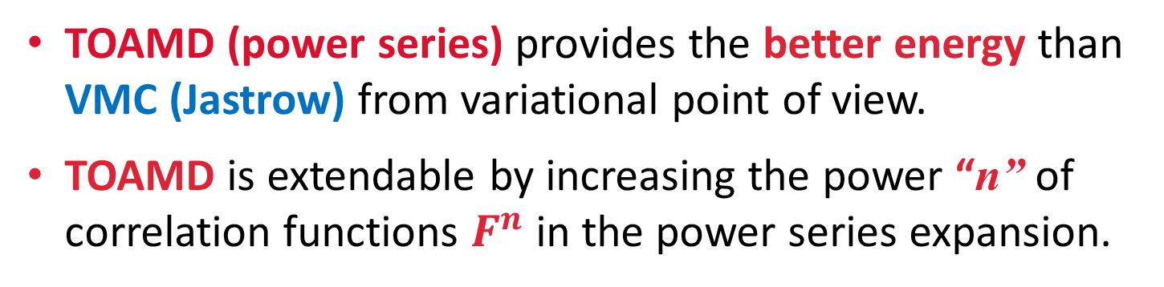
TOAMD vs. VMC with Jastrow
V_{NN} : Malfliet-Tjon V (central short-range)
PRC95 (2017) 044314
 | Few-body | TOAMD (double) | VMC (Jastrow)
³H | − 8.25 | − 8.24 | − 8.22(2)
⁴He | − 31.36 | − 31.28 | − 31.19(5)
(MeV)
FY, SVM, GFMC
Carlson, Pandharipande,
Nucl. Phys. A371, 301 (1981).
TOAMD (power series) provides the better energy than VMC (Jastrow) from variational point of view.
TOAMD is extendable by increasing the power “n” of correlation functions $F^{n}$ in the power series expansion.

Slide 20
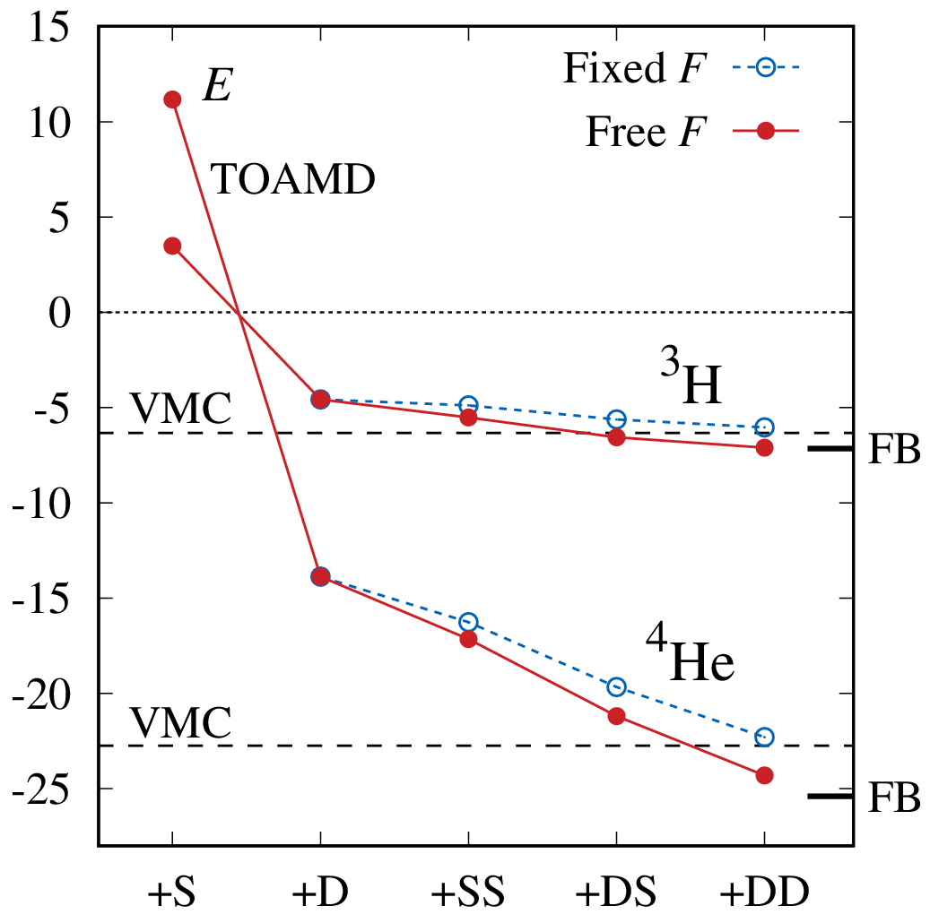

TOAMD vs. VMC with Jastrow
(MeV)
Common $F$
V_{NN} : AV6 with central
& tensor forces
(omit LS, L², (LS)² from AV14)
F
³H
F
Few-body
TOAMD (power series) gives better energy than VMC (Jastrow) from variational point of view
⁴He
Correlation functions

Slide 21
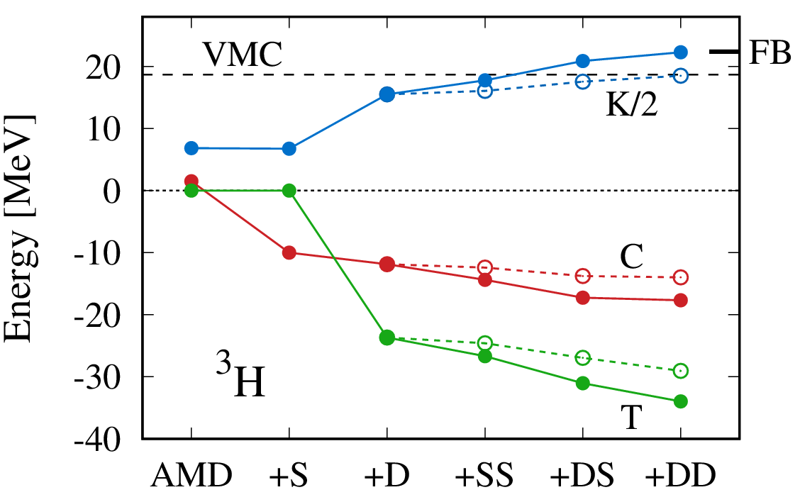
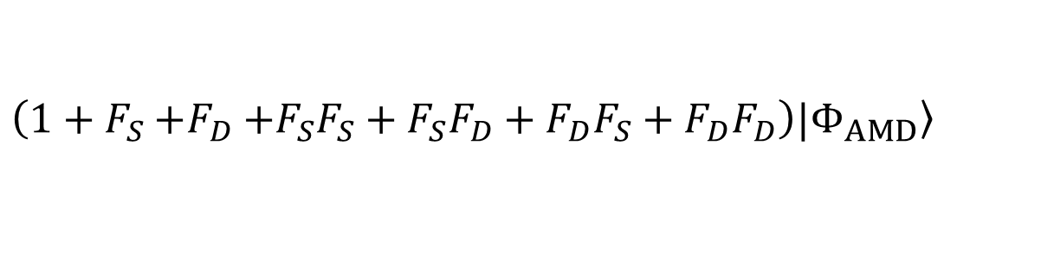
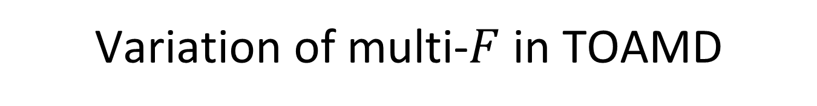
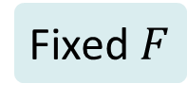
Variation of multi-$F$ in TOAMD
AV6
$$\left(1+F_{S}{+F}_{D}+F_{S}F_{S}+F_{S}F_{D}+F_{D}F_{S}+F_{D}F_{D}\right)|\left.Φ_{AMD}\right\rangle$$
S
D
SS
SD
DS
DD
Few-body
same
Kinetic/2
F
F
Central
Fixed $F$
³H
Tensor
Free F
Correlation functions

Slide 22
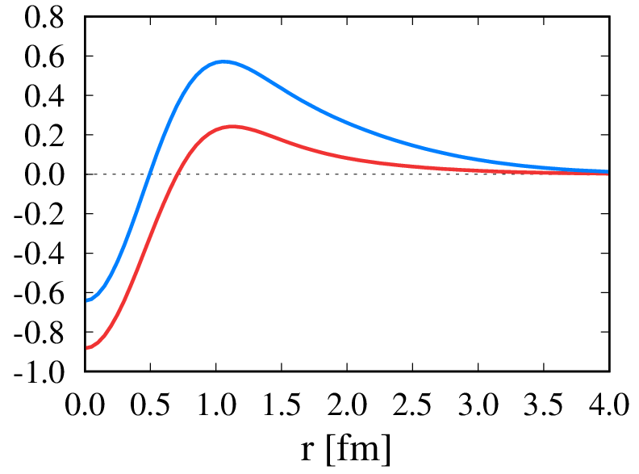
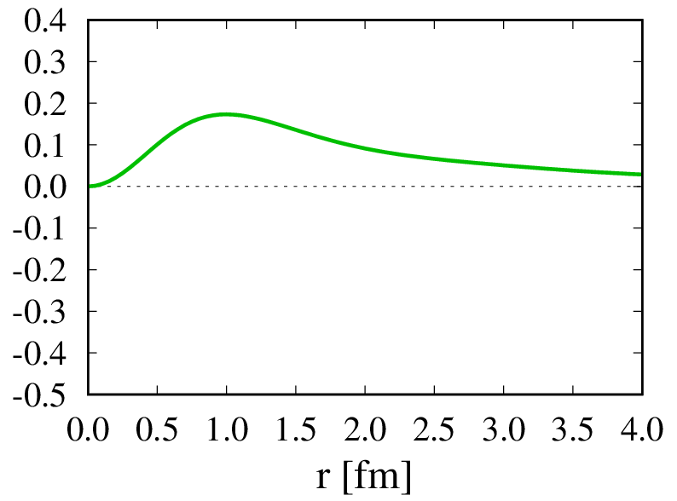
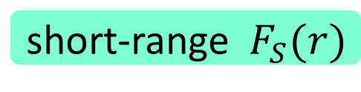
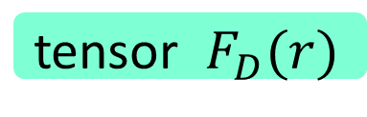
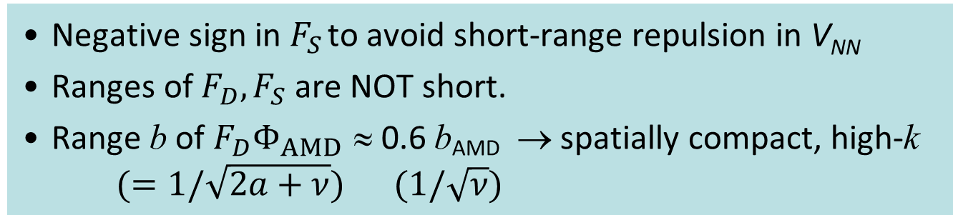
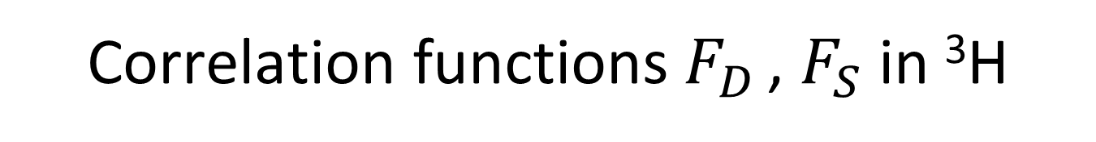
Correlation functions $F_{D}$ , $F_{S}$ in ³H
short-range${ F}_{S}(r)$
tensor $F_{D}(r)$
F_{S} ³E
r²×F_{D} ³E
Amplitude
intermediate
long
F_{S} ¹E
Negative sign in $F_{S}$ to avoid short-range repulsion in V_{NN}
Ranges of $F_{D}, F_{S}$ are NOT short.
Range b of $F_{D}Φ_{AMD}$ ≈ 0.6 b_{AMD} → spatially compact, high-k
$(=1/\sqrt{2a+ν})$ $(1/\sqrt{ν})$
Tensor-optimized
shell model
TM, K. Kato, K. Ikeda
PTP113 (2005) 763

Slide 23
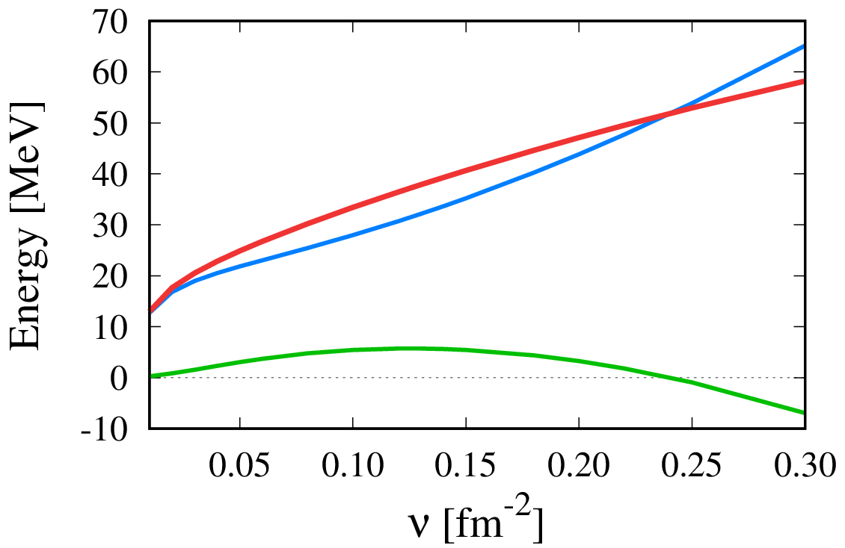
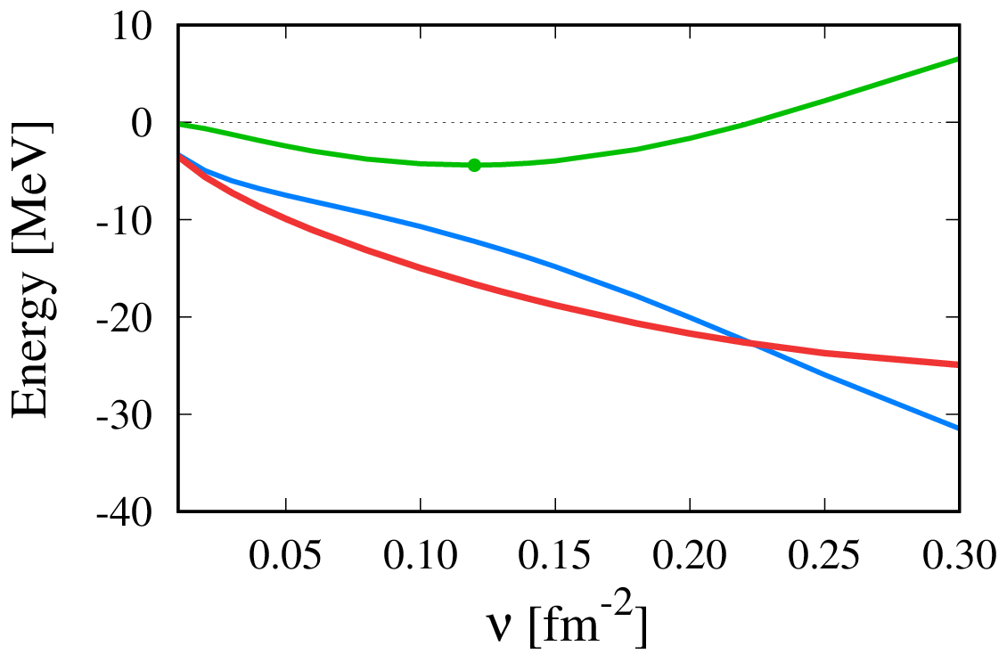



Many-body terms of $F^{†}HF$ in ³H
uncorrelated kinetic
$$\frac{ℏ^{2}}{m}ν=\frac{ℏω}{2}$$
Kinetic
Full
T+ 2-body
same trend in central & tensor
2-body > 3-body
(not negligible)
3-body
Central
Tensor
wide, $ρ_{low}$
compact, $ρ_{high}$

Slide 24





Many-body Hamiltonian terms in ⁴He
PTEP (2017) 073D01
Kinetic
Full
1+2 body
3-body
Higher-body term tends to give smaller scale, but, not ignored.
4-body
Central
Tensor
wide, $ρ_{low}$
compact, $ρ_{high}$

Slide 25


Variation of multi-$F$ in TOAMD
AV8’
$$\left(1+F_{S}{+F}_{D}+F_{S}F_{S}+F_{S}F_{D}+F_{D}F_{S}+F_{D}F_{D}\right)|\left.Φ_{AMD}\right\rangle$$
S
D
SS
SD
DS
DD
PTEP (2017) 073D01
cf. Jastrow ansatz
$F_{D}\left(r\right),F_{S}(r)$ are fixed at single level, and used in $F^{2}$ terms
³H
ΔE=1.4 MeV
F are independent as a full variation
Correlation functions

Slide 26


Variation of multi-$F$ in TOAMD
AV8’
$$\left(1+F_{S}{+F}_{D}+F_{S}F_{S}+F_{S}F_{D}+F_{D}F_{S}+F_{D}F_{D}\right)|\left.Φ_{AMD}\right\rangle$$
S
D
SS
SD
DS
DD
same
Kinetic/2
F
³H
F
Fixed $F$
Central
Few-body
Free F
Tensor
Correlation functions

Slide 27


Variation of multi-$F$ in TOAMD
AV8’
$$\left(1+F_{S}{+F}_{D}+F_{S}F_{S}+F_{S}F_{D}+F_{D}F_{S}+F_{D}F_{D}\right)|\left.Φ_{AMD}\right\rangle$$
S
D
SS
SD
DS
DD
PTEP (2017) 073D01
cf. Jastrow ansatz
⁴He
$F_{D}\left(r\right),F_{S}(r)$ are fixed at single level, and used in $F^{2}$ terms
ΔE=2.3 MeV
F are independent as a full variation
Correlation functions

Slide 28


Variation of multi-$F$ in TOAMD
AV8’
$$\left(1+F_{S}{+F}_{D}+F_{S}F_{S}+F_{S}F_{D}+F_{D}F_{S}+F_{D}F_{D}\right)|\left.Φ_{AMD}\right\rangle$$
S
D
SS
SD
DS
DD
same
Kinetic/2
⁴He
F
F
Fixed $F$
Central
Free F
Tensor
Independent optimization of all F
Correlation functions

Slide 29



Hamiltonian components in ⁶He & ⁶Li
α
n
n
Kinetic
$$×\frac{1}{2}$$
1 fm
α
p
n
Up to 6-body terms
Energy
Central
⁶He > ⁶Li
Tensor
⁶Li > ⁶He
wide, $ρ_{low}$
compact, $ρ_{high}$
Larger tensor contribution in ⁶Li due to last pn pair
Next, TOAMD+GCM (multi configuration of AMD)

Slide 30



⁶He with α+n²
α
n
n
1 fm
Kinetic
Full
1+2 body
3-body
4-body
5-body
small
6-body
small
Central
Tensor
wide, $ρ_{low}$
compact, $ρ_{high}$

Slide 31

Pion exchange interaction & V_{tensor}
involve large
momentum
δ interaction
Yukawa interaction
Tensor operator
V_{tensor} produces the high momentum component.
31
Notes:
31

