Slide 1
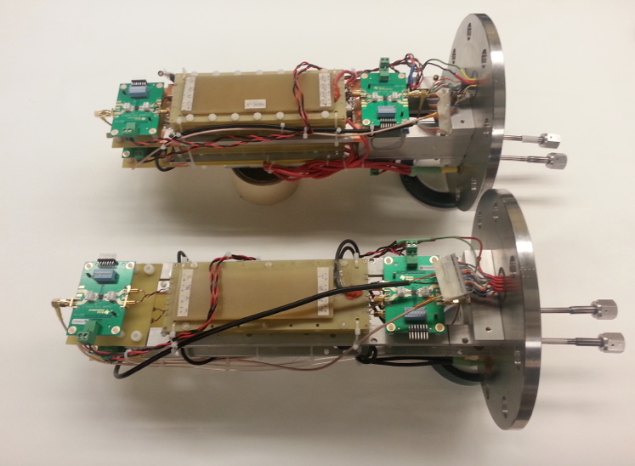
UIUC mRPC R&D o Introduction & Physics Motivation o RPC design & assembly o Cosmic Ray Muon Test o Beam Test
with BNL (lead), Howard University, CCNY, IHEP and ACU, Matthias Grosse Perdekamp, UIUC

Slide 2

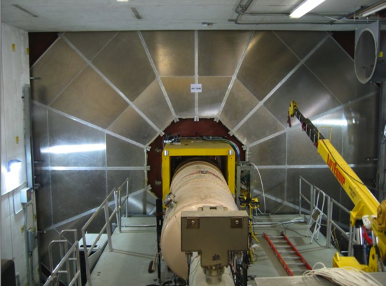
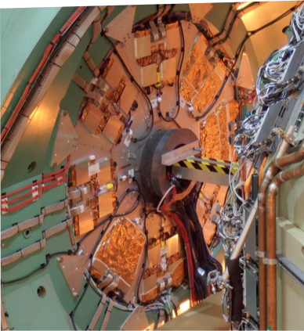
Previous RPC Work at UIUC: 2 Gap Bakelite RPCs for Triggering – Adapting CMS Design for PHENIX at RHIC
o RPC system (1.2ns timing resolution) for the PHENIX W-trigger.
UIUC (lead), RBRC, UC Boulder, ISU, CIAE, Columbia, GSU, UCR,
Korea University, ACU, Muhlenberg, Hanyang University
o R&D 2002 to 2008, construction 2008 to 2011, data taking 2011-2013,
final results released at Spin 2014 at PKU in Beijing
Two 10 m diameter RPC-3 stations
Two 3 m diameter RPC-1 stations

Slide 3
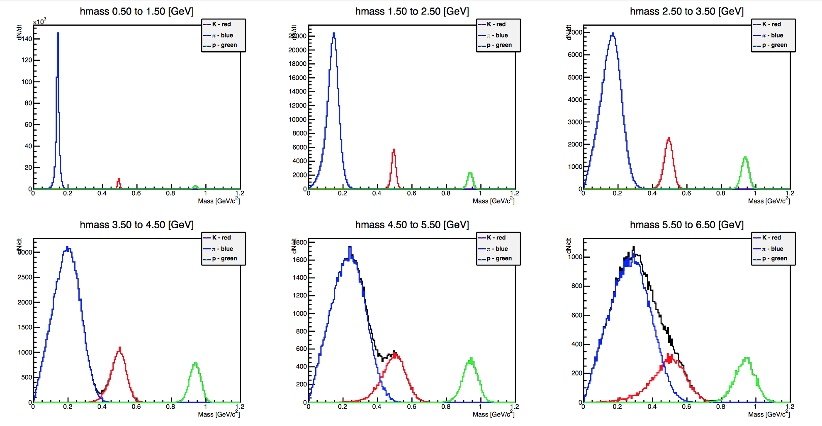
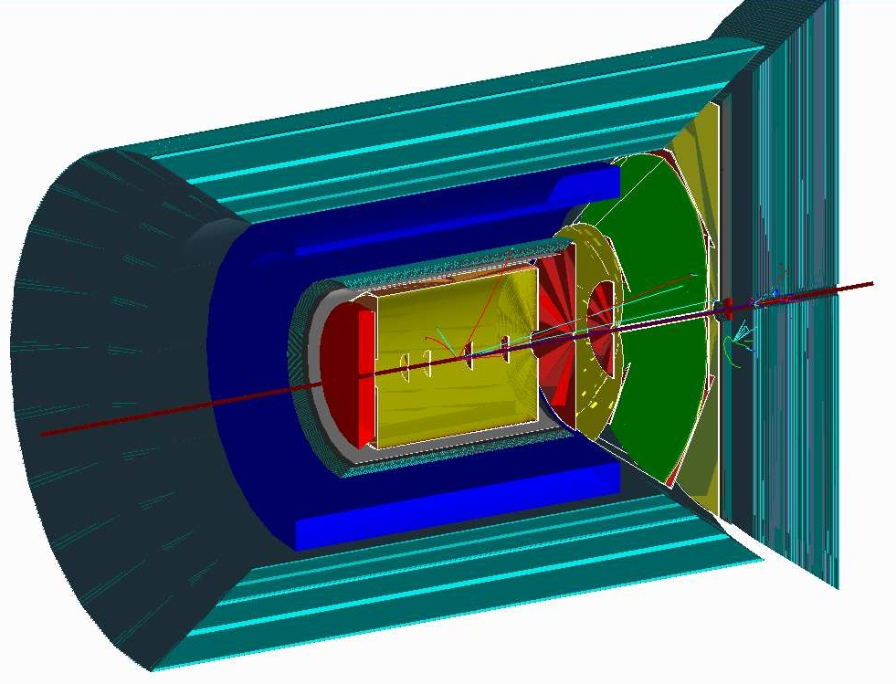
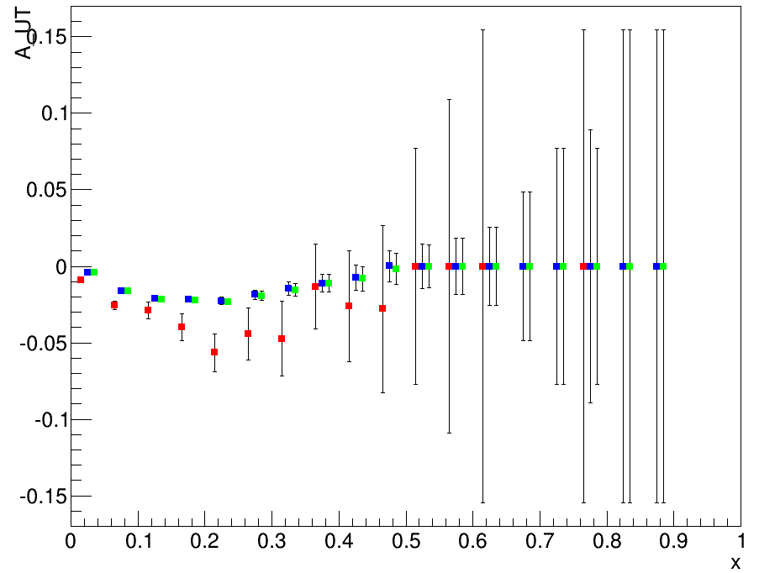
ePHENIX: SIDIS with TOF for PID
psTOF Wall
π
K
p
Previous event generator level simulation: Difference ΔA_{UT} in A_{UT} for δs_{I}(x) and δs_{II}(x)
TOF response with propaga-
ted errors in momentum and
timing resolution in v vs p
for π, K and p
Carried out initial event generator simulation for a mRPC TOF wall added to the endcap of a future ePHENIX detector at a possible EIC.
Choose one channel (of many possible in SIDIS with PID) to demonstrate utility of a TOF based PID: measurement of AUT resulting from non zero strange quark distributions.
Assumed very high timing resolution: 10 ps for the simulation!
ΔA_{UT}
RICH only
TOF only
TOF & RICH
psTOF significantly increases statistical significance !

Slide 4

TOF PID: Particle Separation vs σ_{t}
Timing resolution | Distance | Pion-Kaon Separation | Kaon-Proton Separation
σ_{tot}=100 ps | 1m
σ_{tot}=10 ps | 1m
σ_{tot}=10 ps | 3m
Momentum range of TOF PID reaches interesting levels if one can achieve ~ 10-20 ps

Slide 5
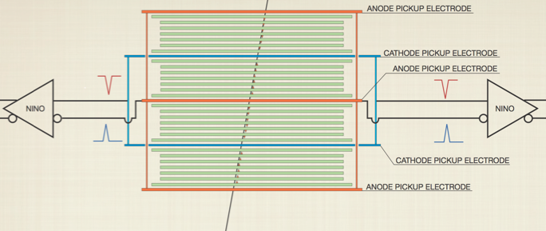
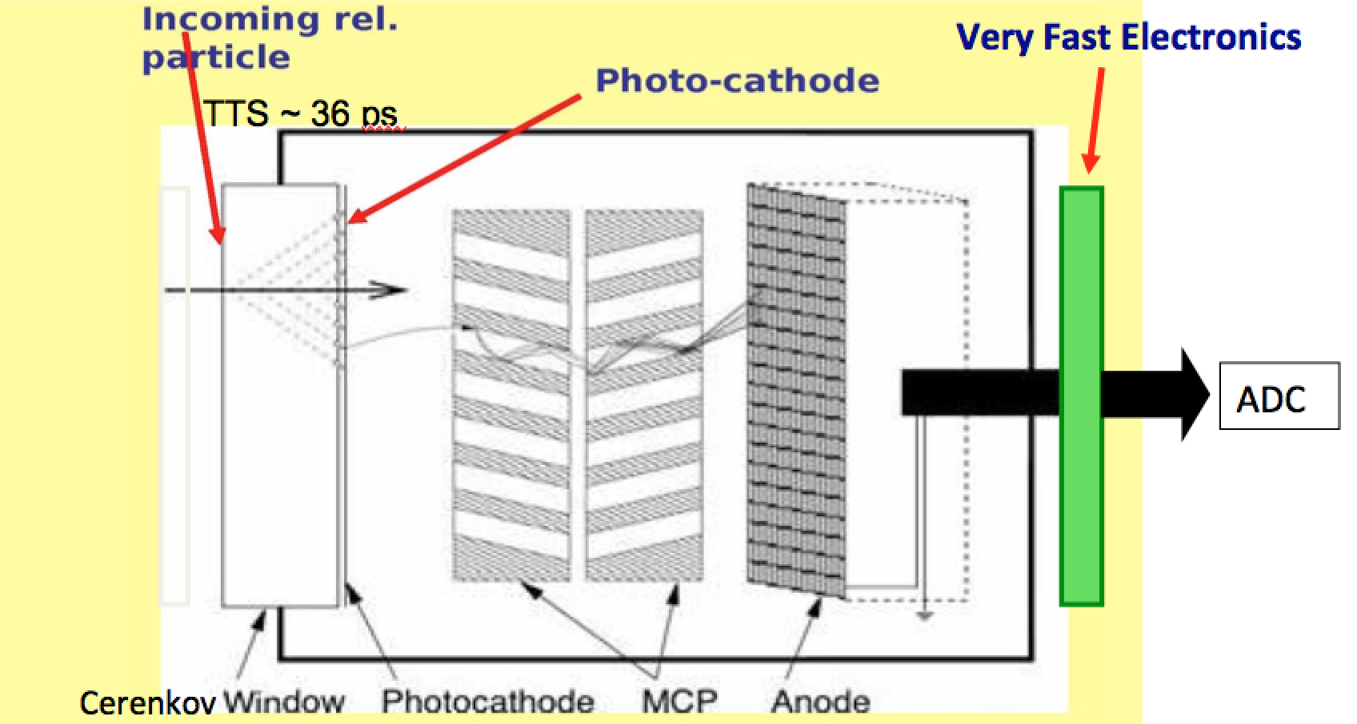
Two TOF Options Considered for ePHENIX
mRPC TOF
MCP-PMT TOF
psTOF Walls
mRPC technology likely will be cheaper and available earlier, but not perform as well compared to the MCP-PMT based TOF

Slide 6
mRPC Design Derived from ALICE/Williams mRPC
PCB
glass
ALICE/CERN, Crispin Williams
BNL&UIUC Prototype
4 x
4 x
Gas gap width : 160um
(16ps timing resolution)
Gas gap
Gas gap width : 105um
 | MRPC ( C. Williams et al. ) | MRPC ( UIUC & BNL)
Gas Gap Width | 160um (fishing line) | 105um (fishing line, and 165, 125, 75um)
# of Gas Gaps | 4 stack x 6 layers = 24 | 4 stack x 9 layers = 36
# of thin glass layers | 4 stacks x 5 layers = 20 (250um thick glass) | 4 stack x 8 layers = 32 (210um thick glass)
Preamplifier | Differential type, NINO chip | TI LMH6554 2.8-GHz + Evaluation Board
TDC and DAQ | Oscilloscope (10Gs) | DRS4-V5(5Gs) + PC
Time resolution | 20 ps published (16 ps private comm) | 18 ps with cosmic rays, 25 ps at 80 Hz/cm²

Slide 7
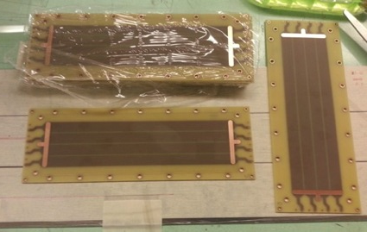
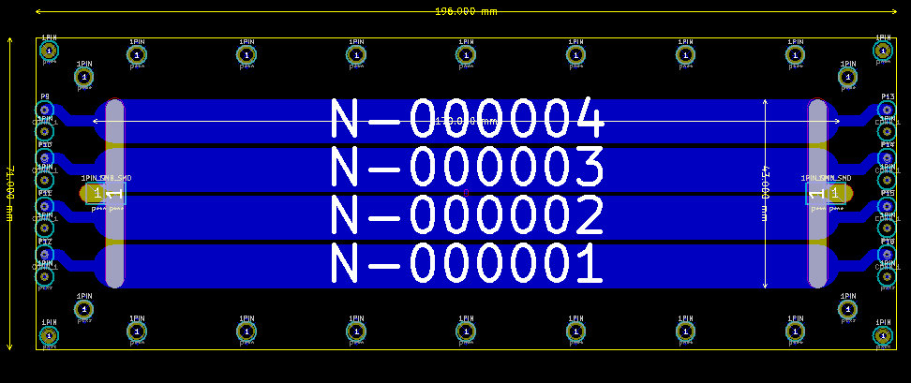
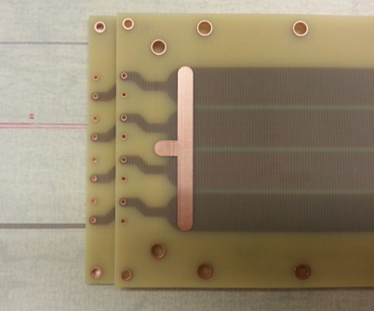
BNL/UIUC PCBs for Electrode and Signal Pickup
PCB Design
12 PCBs
Post for spacers
+ fishing line
PCBs (3 layers)
- One board flavor – interchangeable
- HV connection integrated on board
- Rounded readout strips
- Outer dimension : 196mm x 70mm x 1.5mm
- Readout strip : 4 strips, 170mm x 10mm
- The strips are placed in the middle layer
ch1
ch2
ch3
ch4
HV feed pad

Slide 8
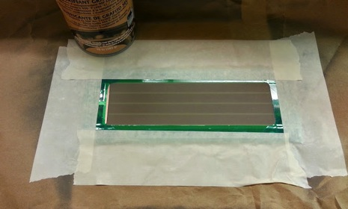
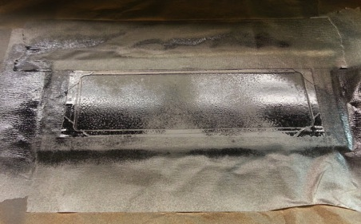
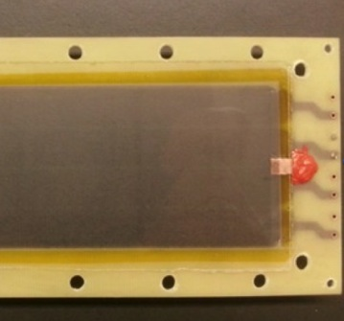
UIUC Electrodes on the PCB Surface
Preparing carbon painting
Carbon coating with carbon spray
Polished the surface with soft paper
Measured the resistivity
( 0.5 ~ 1.5 M Ohm/Square)
Thick glass plate (550um) for a insulation
Double sided Kapton tape
Carbon electrode
HV connection pad
Silicon (RTV 159)

Slide 9
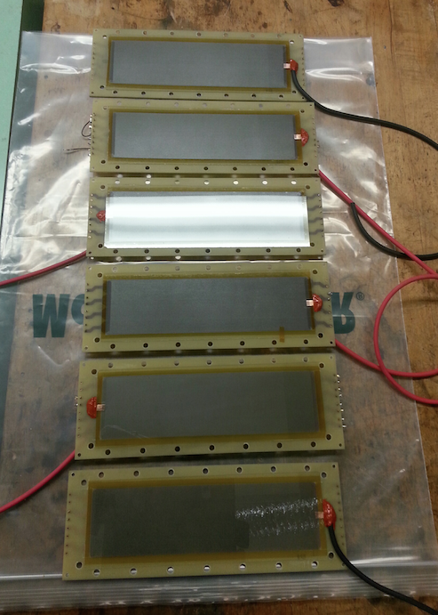
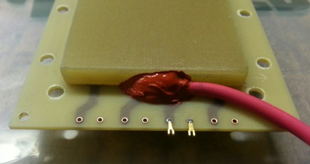
UIUC
Electrode PCBs
Electrode coating ✔
Electricity Insulation ✔
Cable connection ✔
10 PCBs for two MRPCs(4 stacks)
Silicon (RTV 159)

Slide 10
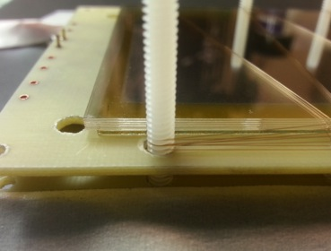
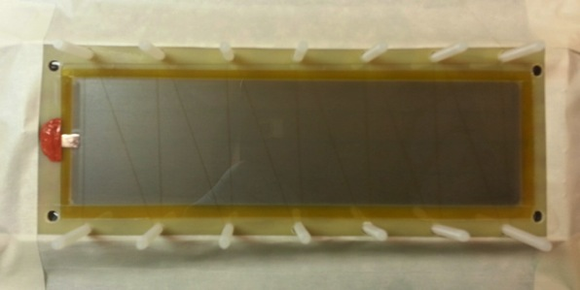
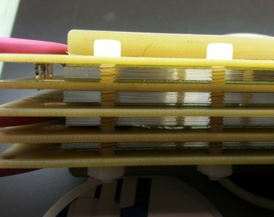
Wiring of Fishing Line for Gas Gap
105um diameter of fishing line
Stacking glass plates and fishing lines
4 stacks

Slide 11
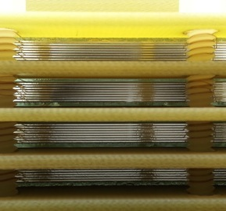
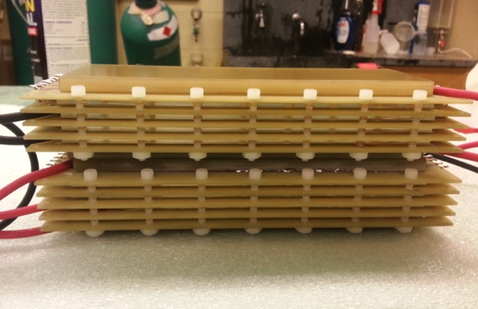
MRPC Prototypes Assembled at UIUC
Two MRPCs assembled
Close view of glass plates

Slide 12
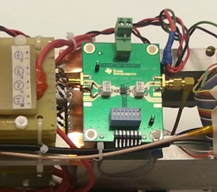
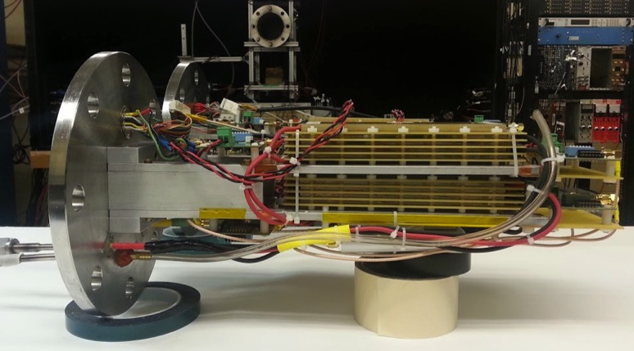
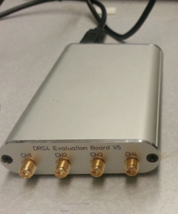
MRPCs
Gas chamber in the cosmic ray test stand at UIUC
Differential Preamp.
TI, LMH 6554
2.8GHz bandwidth
MRPC1
MRPC2
Waveform
Analyzer
(DRS4-V5)
5GHz sampling
speed
Gas Input & Output
HV : eg. 20kV ( +11kV, -11kV)

Slide 13
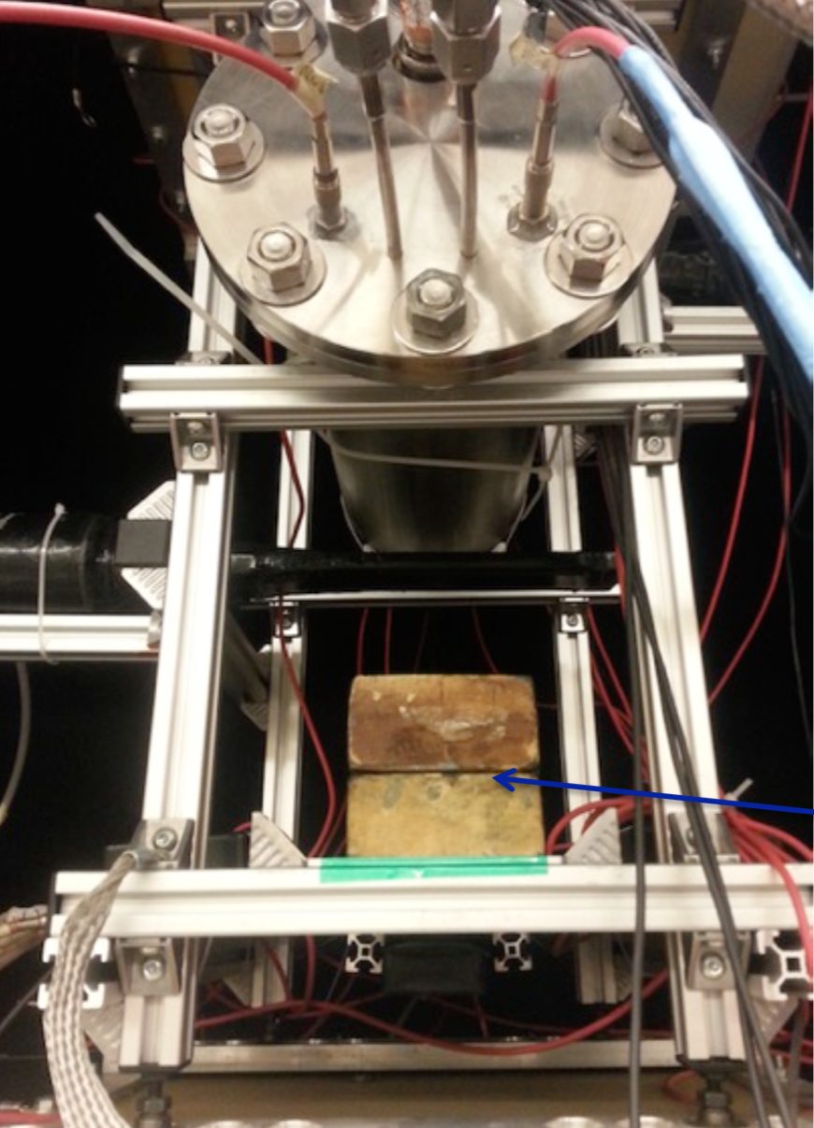
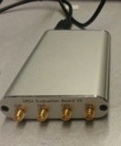
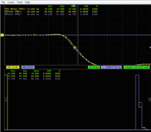
Time Resolution Measurement at UIUC
DC0,1,2
SC1
SC2
Muon trigger
Gas Cylinder
preamp
50 Ohm cable (<1m)
MRPC-A
ch2
DRS4-V5
(Wave form digitizer)
USB
PC
(DAQ)
MRPC-B
ch2
preamp
SC3
Pb Block
SC4
DC3,4
Gas Mixture : “Freon” (R134a) 90% : Iso 5% : SF6 5%

Slide 14
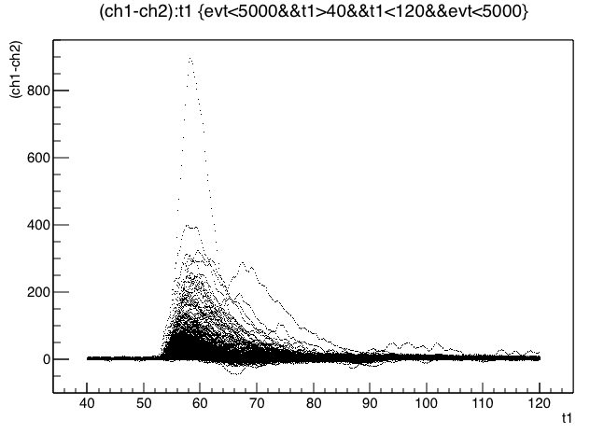
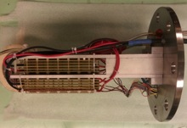
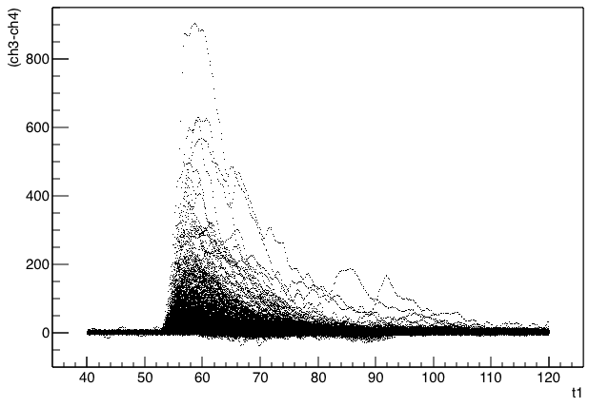
Raw Cosmic Ray Events: Scope Traces
[mv] vs [ns]
w/o preamp ,+-9kV(18kV)
Top MRPC
Bottom MRPC

Slide 15
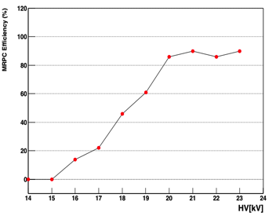
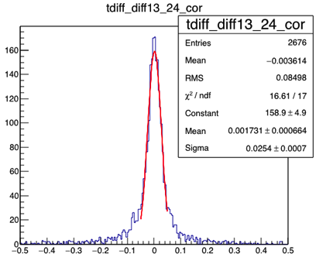
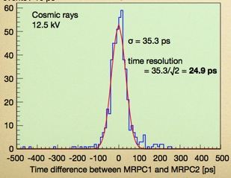
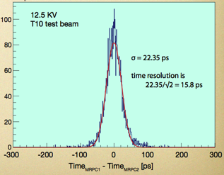
Efficiency and Time Resolution
Cosmic rays
22kV
Efficiency
Cosmic rays
22kV
25.4ps / √2
~ 18ps
C. Williams
CERN, 2010
[ns]
MRPC1- MRPC2
Preamp : NINO
10 GHz, Oscilloscope

Slide 16
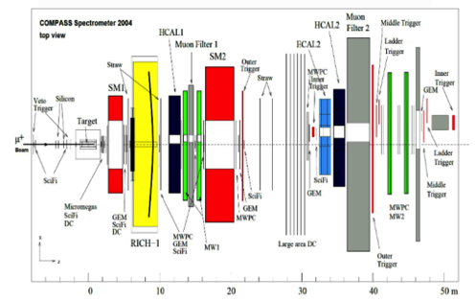
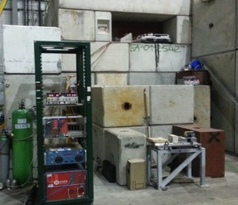
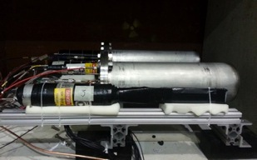
Beam (Halo) Test at COMPASS, CERN
For the MRPC rate capability test, Oct 15th ~ Nov 15th 2015
Beam
Halo
Obsorber
MRPCs
π⁻
COMPASS Spectrometers
Parasitic to COMPASS Drell-Yan Run 2015
- Fixed target experiment – transversely polarized targets
- 190 GeV π⁻ beam, Intensity of 4x10⁸ /s
Setup the MRPCs at the downstream of the COMPASS detectors
Varied flux rate by moving the MRPC up and down position
Maximum flux rate measured ~80Hz/cm²
Two MRPCs in the same gas chamber

Slide 17
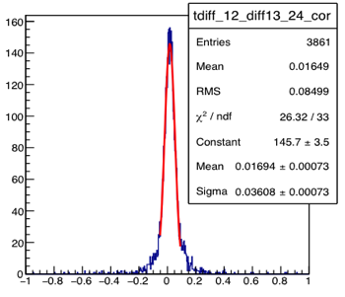
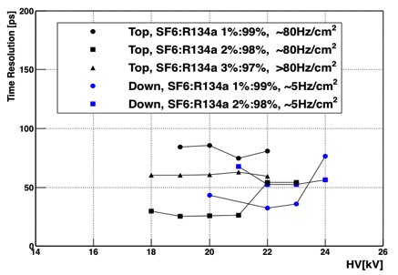
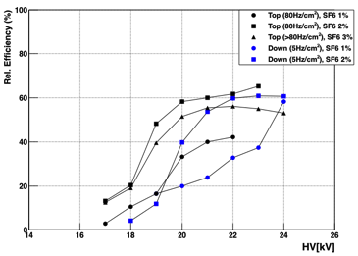
Efficiency and Time Resolution
Time resolution [ps]
COMPASS
19kV
36ps / √2
= 25.4ps
25ps
MRPC1 – MRPC2 [ps]
[ns]
Blue : 5Hz/cm²
Black : 80Hz/cm²
Obtained 25.4ps with flux rate of 80Hz/cm²
Overall efficiency results are lower than cosmic ray
-> Background issue? (no tracking system included)
Efficiency results on 5Hz/cm² lower than on the 80Hz/cm²
-> possibly related to gas issue.
Need more tests.

Slide 18
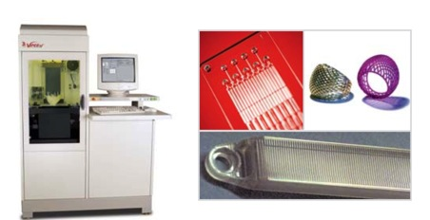
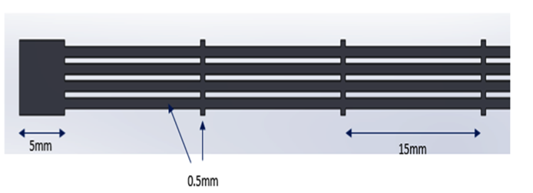
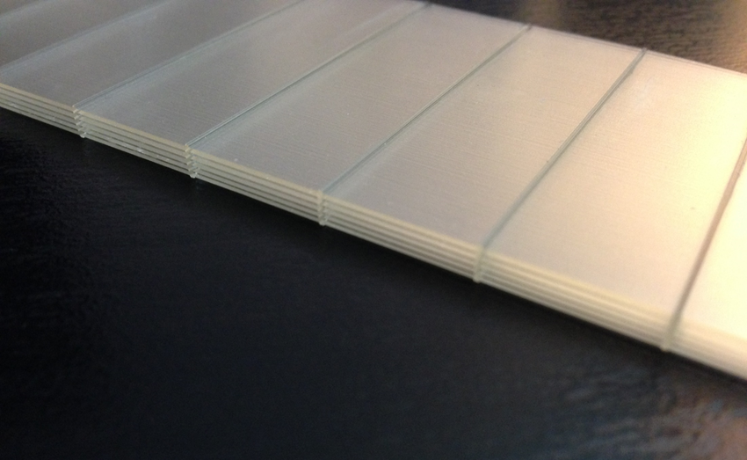


(I) Experimenting with 3D Printed Gas Gaps for mRPCs
SLA (Stereo Lithography Apparatus)
Build size : 250x250x250mm
Vertical resolution : 0.0025mm
Position repeatability : 0.0076mm
Typical velocity : 5mm/sec
Two resins
  WaterClear Ultra 10122
  (Dielectric constant : 3.0 ~ 4.0)
  ProtoGen O-XT 18420
  (Dielectric constant : 3.1 ~ 3.6)
0.3 mm gas gap width
5 gas gaps every column

Slide 19
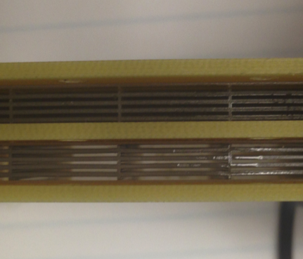
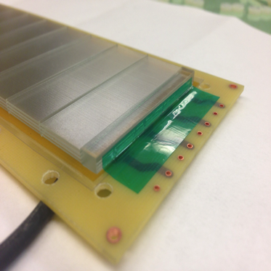
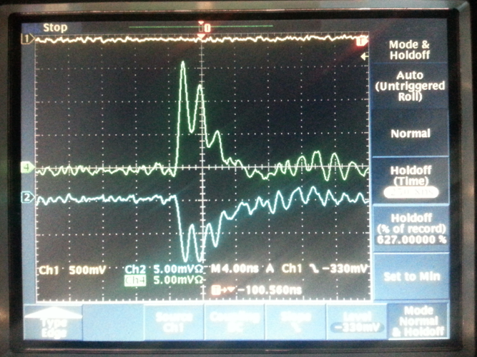
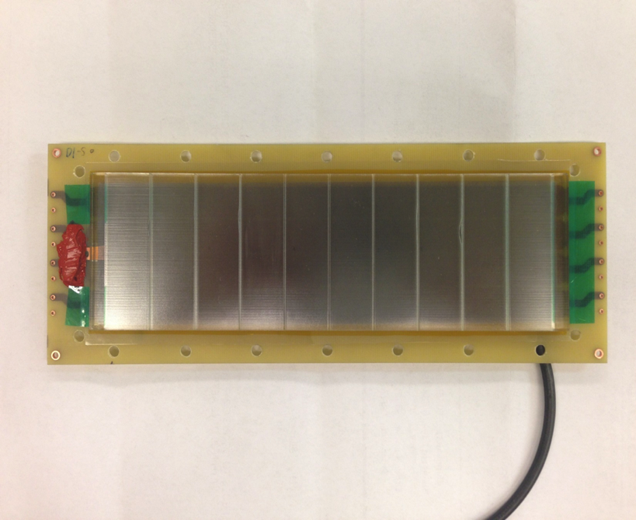
First (noisy) Signals from 3D Printed Gas Gaps in a mRPC at UIUC
Cosmic ray signal @ 14kV.
97% Freon R134a, 3% SF₆.
2 stacks, 10 gas gaps, 0.3mm gas gap width
easy assembly!

Slide 20
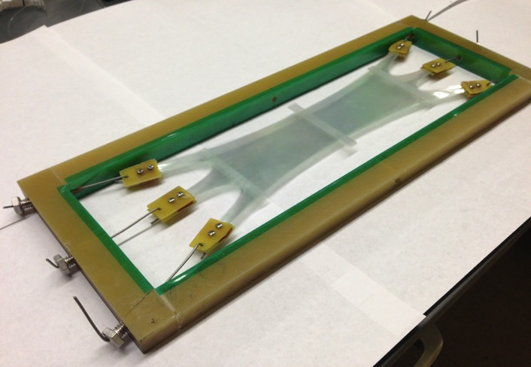
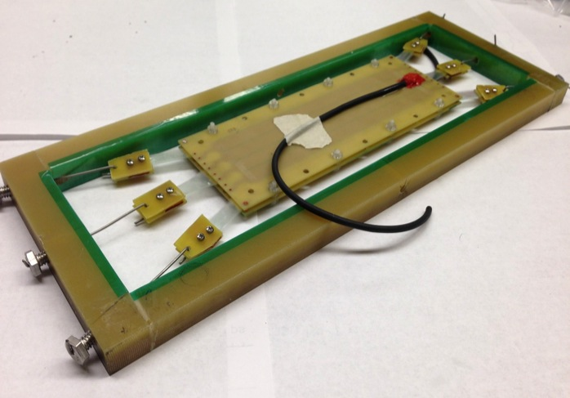
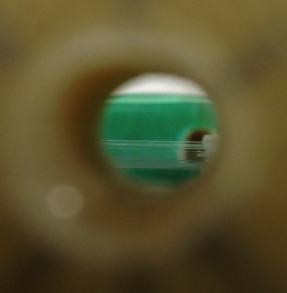

(II) Experimenting with Mylar mRPCs
25um Mylar film
125um Mylar
Spacers
12 layers of 25um thick Mylar
13 gas gaps with 125um gas gap width
Used 125um thick Mylar for the spacers.
Side view of 12 Mylar layers

Slide 21
Summary
UIUC has been working with BNL, Howard, ACU, CCNY and IHEP Protvino on 20ps timing resolution mRPCs.
Reached resolution of 18 ps with cosmic rays and 25 ps with 80 Hz. Possibly additional test beam for
systematic studies.
Use of float glass limits rate capabilities.
Consider different resistive plate materials.
Funding situation uncertain. Focus currently on R&D
for RPC and mRPC use in port scanners.

Slide 22






Issues on the size of signals
Height of signal changed significantly at the COMPASS experimental hall
Gas flow : Input flow (Yellow arrow), output flow (Red arrow)
Beam
Pressure ~ 1bar
(Top) Pressure > 1bar
(Bottom) Pressure >> 1bar
[mV]
[ns]
Did not operate correctly pressure regulation at COMPASS limited by access during
beam operation ….

Slide 23




Time Correlations
Ch1
HV 19kV
R134a 98% : SF6 2%
80Hz/cm²
MRPC1
Ch3
MRPC2
Ch2
Ch4
Beam direction
MRPC1 ch1
MRPC1 – MRPC2
MRPC2 ch2
[ns]
Ch1 Signal slope [mV/ns]
Blue : MRPC1, ch1 – ch3
Red : MRPC2, ch2 – ch4
MRPC1 – MRPC2
[ns]
(ch1 – ch3) – (ch2- ch4)

