Slide 1
TOF readout for high resolution timing for SoLID
Alexandre Camsonne
Jefferson Laboratory
Hadron China 2017
TOF miniworkshop
July 28 2017

Slide 2
Outline
SoLID SIDIS
SoLID requirements for TOF
Readout options : discriminator TDC vs sampling
A/D chips
TDC options
Sampling chips
DRS5 option from PSI
Kansas University Amplifier
SoLID SIDIS background studies
SoLID TOF chip specs wish list
Conclusion

Slide 3
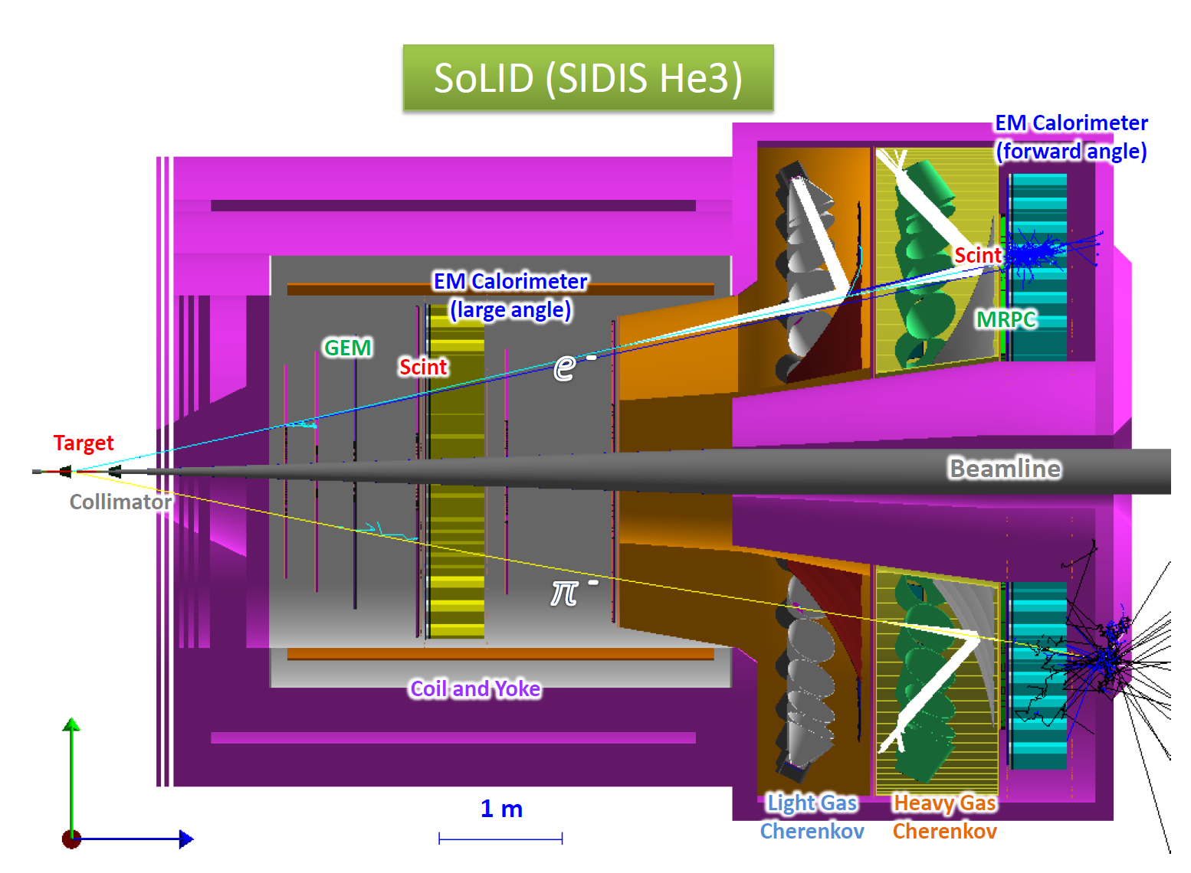
SoLID SIDIS setup

Slide 4
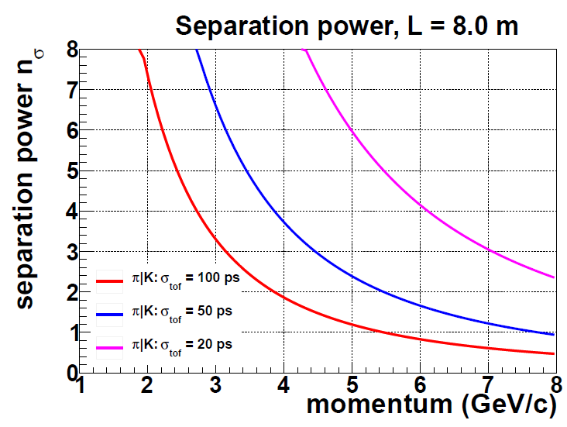
Pion Kaon Separation by TOF

Slide 5
SoLID requirements
TOF for SIDIS experiment for Kaon ID
Baseline 80 ps , ideally 20 ps
Trigger rate 100 KHz min, ideal 200 KHz
FADC based trigger with up 8 us latency
GEM readout 4 us latency
Need 4 us latency for TOF ideally 8 us

Slide 6
Two options
Depends on detector performance : Usual method : discriminator + TDC
    Amplifier discriminator
    TDC : ASIC or new FPGA technique
  Waveform sampling
    No discriminator
    Full bandwidth
    Better timing resolution up to 1 ps
    Need algorithm to extract time on board
    Or readout full waveform ( very large amount of data)

Slide 7
Readout options
Amplifier Discriminators front end
  NINO (CERN) (8 channels – 32 channels version )
  GSI Padiwa (16 channels) 150 $ for 16 channels
  MAROC ( Omega IN2P3)
  VMM3 (BNL)
  Need to check timing performance of discrimination and amplification, bandwidth, timewalk corrections

Slide 8
TDCs
HPTDC 25 ps
  V1290 (32 channels about 10 K$ )
  CAEN planning to develop better TDC
FPGA TDCs
  TRB3 11 ps ( 192 channels / 2300 euros )
  VETROC JLAB 20 ps ( need development ) 128 channels about 6 K$ ( 5 board ordered for Compton, can test TDC )

Slide 9
Sampling chip
Chip | Sampling Frequency (GHz) | Bandwidth GHz | Number of samples | Number of channels | Readout frequency (MHz) | Resolution (ps)
PSEC4 | 4 to 15 | 1.5 | 256 | 6 | 40 to 60 | 9
SAMPIC | 3 to 8.2 | 1.6 | 64 | 16 – 8 (at 10 GHz) | 80 | 5
DRS4 | 0.7 to 5 GHZ | 0.950 | 1024 | 9 | 33 | 1
DRS5 | 10 | 3 | 4096 | 32 | 300? | 5?
PSEC5 | 5 to 15 | 1.5 to 2 | 32768 | 4 | 500 | 5?
Latest generation with multilevel analog buffer : dead time less up to a few MHz and allow for L2 ( DRS5 )

Slide 10
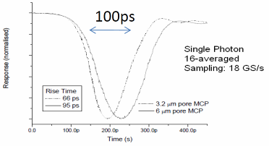
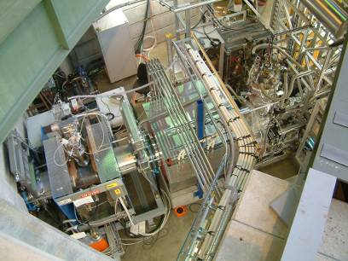
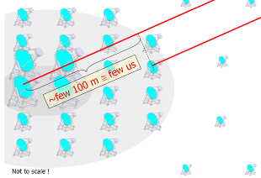
Plans for DRS5
J. Milnes, J. Howoth, Photek
μSR
~MHz event rate
CTA
Increase analog bandwidth ~5 GHz
  Smaller input capacitance
Increase sampling speed ~10 GS/s
  Switch to 110 nm technology
Deeper sampling depth
  8 x 4096 / chip
Minimize readout time (“dead time
free”) for muSR & ToF-PET
  (minor) reduction in analog
  readout speed (30 ns → 20 ns)
  Implement FIFO technology

Slide 11
Next Generation SCA
Short sampling depth
Deep sampling depth
Low parasitic input capacitance
→ High bandwidth
Large area
→ low resistance bus, low
resistance analog switches
→ high bandwidth
Digitize long waveforms
Accommodate long trigger delay
Faster sampling speed for a given trigger latency
How to combine
best of both worlds?

Slide 12
Cascaded Switched Capacitor Arrays
input
shift register
32 fast sampling cells (10 GSPS/110nm CMOS)
100 ps sample time, 3.1 ns hold time
Hold time long enough to transfer voltage to secondary sampling stage with moderately fast buffer (300 MHz)
Shift register gets clocked by inverter chain from fast sampling stage
. . . . . . . . . . . . . . . . . . . . . . . . . . . . . . . . .
fast sampling stage
secondary sampling stage

Slide 13
How noise affects timing
voltage noise
band of signal
voltage noise Δu
timing jitter arising
from voltage noise
timing uncertainty Δt
signal height U
rise time t_{r}
timing jitter is
much smaller
for faster
rise-time
number of samples on slope

Slide 14
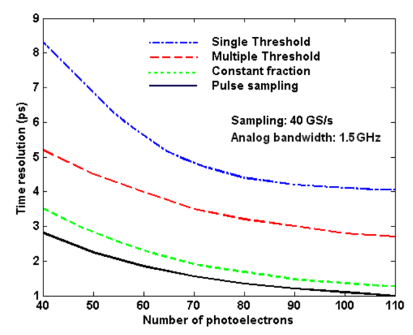
TDC vs. Waveform Digitizing
Constant
Fraction
Discriminator
Q-sensitive
Preamplifier
PMT/APD
Wire
Shaper
TDC
CFD and TDC on same board → crosstalk
CFD depends on noise on single point,
while waveform digitizing can average over several points
Inverter chain is same both in TDCs and SCAs
Can we replace TDCs by SCAs?
→ yes if the readout rate is sufficient

Slide 15
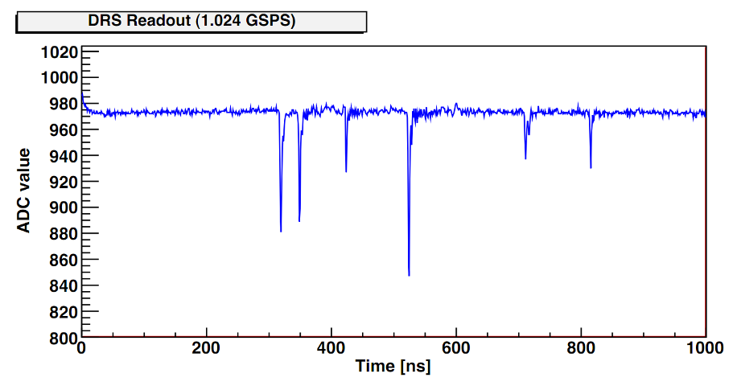
Typical Waveform
Only short segments of waveform need high speed readout

Slide 16
Dead-time free acquisition
DRS5
Self-trigger writing of short
32-bin segments
Simultaneous reading of
segments
Quasi dead time-free
Data driven readout
    Ext. ADC runs continuously
    ASIC tells FPGA when there is new data
Coarse timing from
300 MHz counter
Fine timing by waveform
digitizing and analysis in FPGA
20 * 20 ns = 0.4 μs readout time
→ 2 MHz sustained event rate
Attractive replacement for CFD+TDC

Slide 17
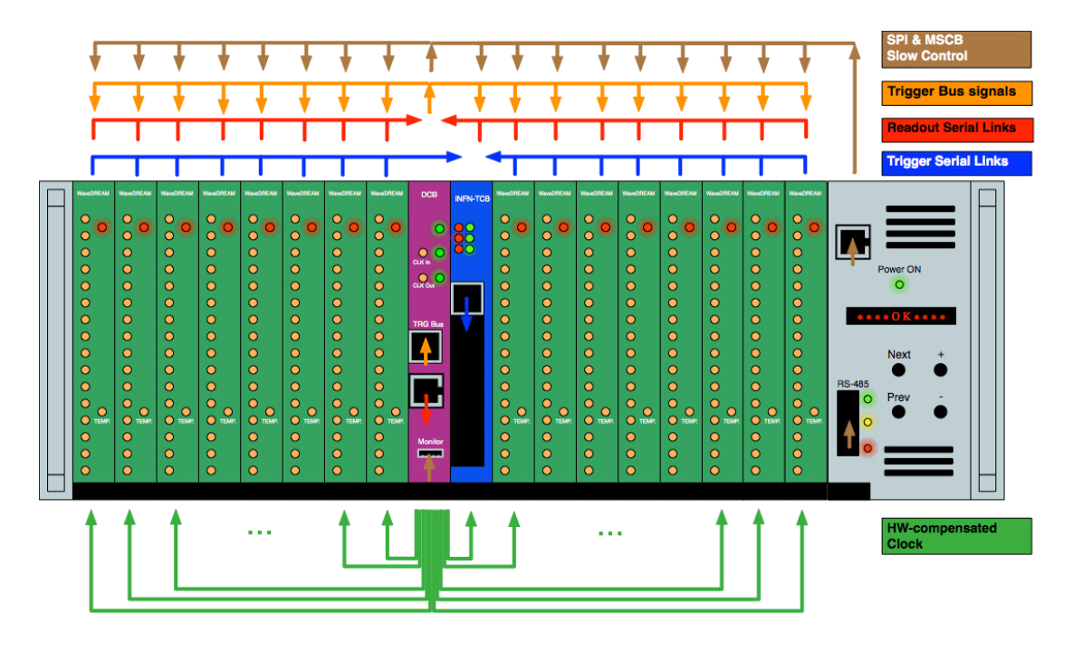
WaveDAQ System
Crate Management Board
Power supply 24V / 300W
Fan / Temp. control
Power cycle each slot
FPGA Firmware upload
Local control via buttons
Ethernet remote control
Data Concentrator Board (DCB)
Trigger Concentrator Board (TCB)

Slide 18
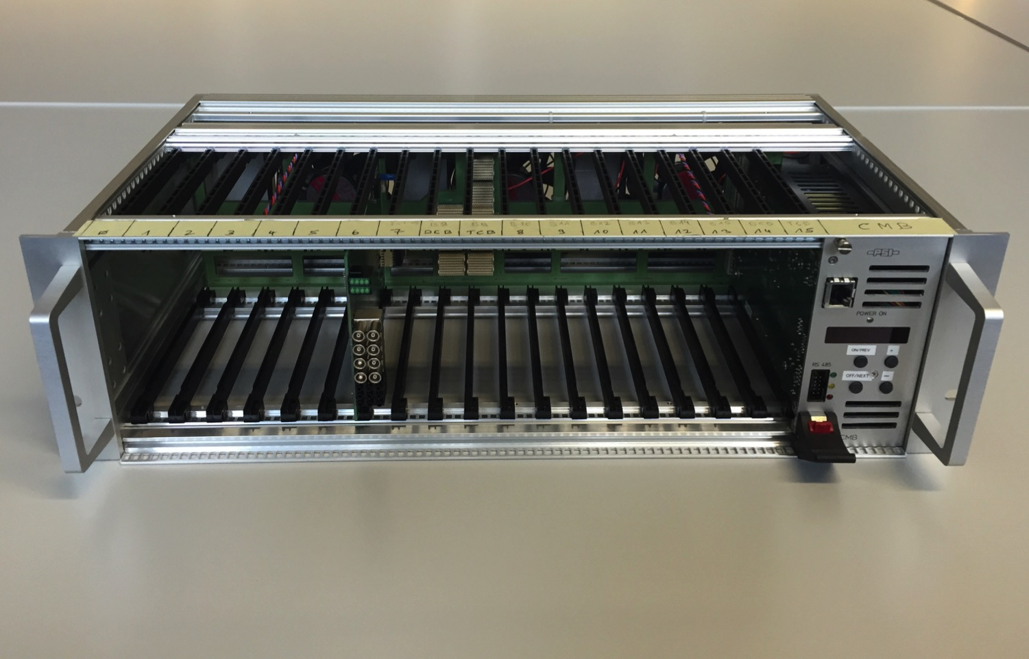
PSI WaveDAQ
WaveDAQ system has been designed to fulfill needs of MEG II experiment
System has huge potential for many others
(costs: ~150 US$ / channel incl. crate, power, HV)
Status: Crate fully working, trigger board and WaveDREAM board successfully tested, beam test 2015, DCB under design
4 crate system end of 2016,
full system (35 crates) in 2017
DRS5 chip (no dead-time) planned for 2018+

Slide 19
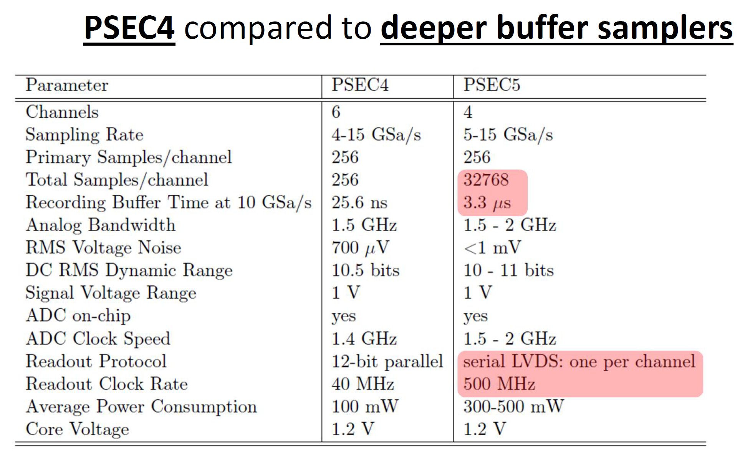
PSEC

Slide 20
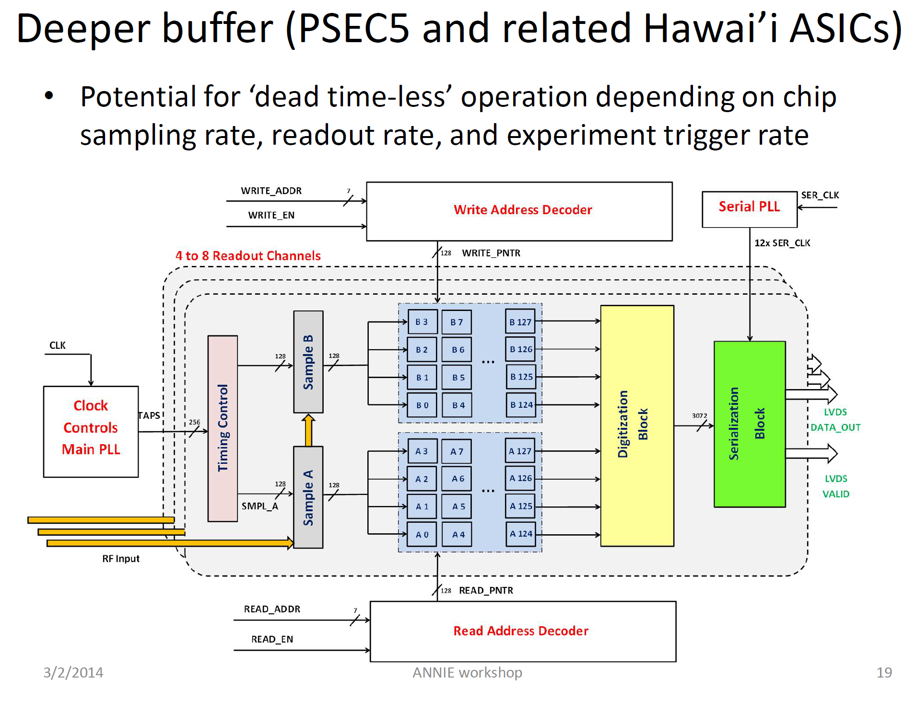
Eric Oberla
http://annie.uchicago.edu/lib/exe/fetch.php?media=2014_3_1_annie_electronics.pdf

Slide 21
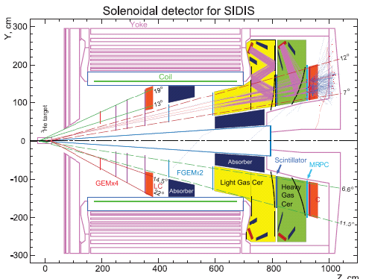
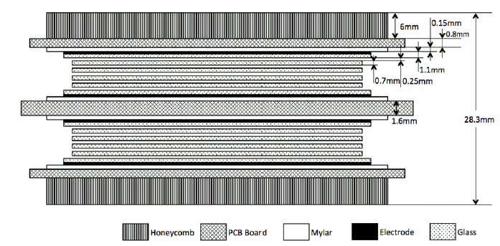
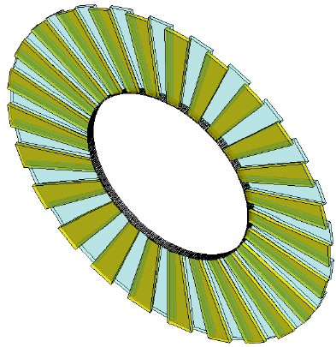
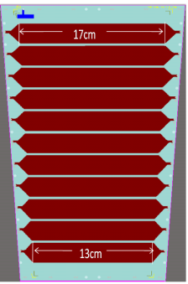
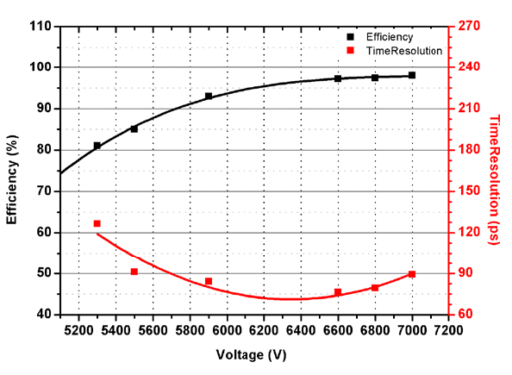
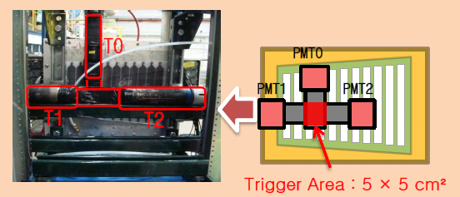
SoLID MRPC High resolution TOF
Test in beam at JLAB in 2011 during g2p experiment
Better
than 95 %
efficiency
Timing resolution
~ 85 ps
A MRPC prototype for SOLID-TOF in JLab
Y. Wang, X. Fan DOI: 10.1088/1748-0221/8/03/P03003 JINST 8 (2013) P03003

Slide 22
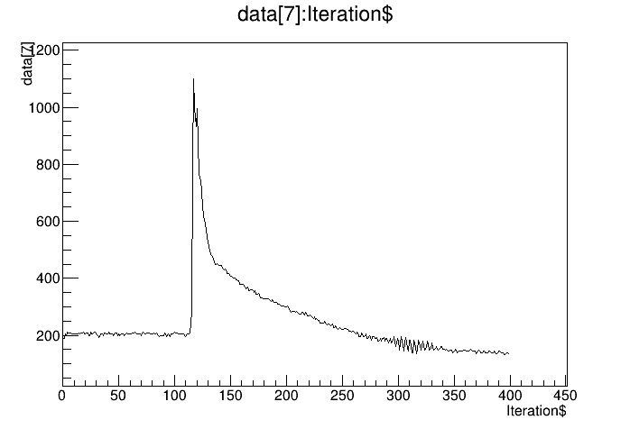
Test run signals
Signal after long cables
500 ns
~ 1 us
40 ns
4ns samples
1 tick = 10 samples = 40 ns

Slide 23
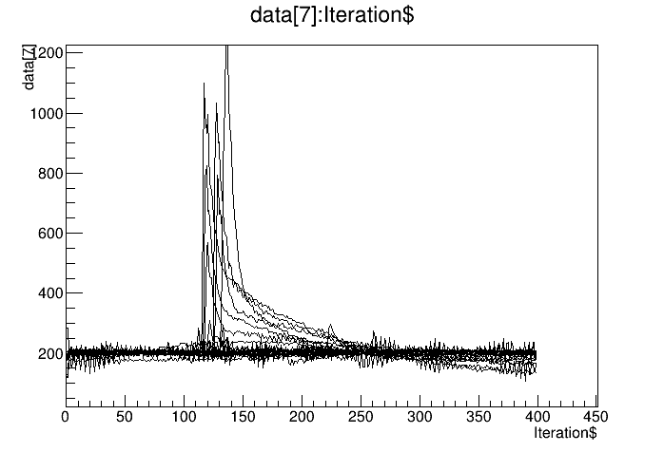
In time signal
Good signals

Slide 24
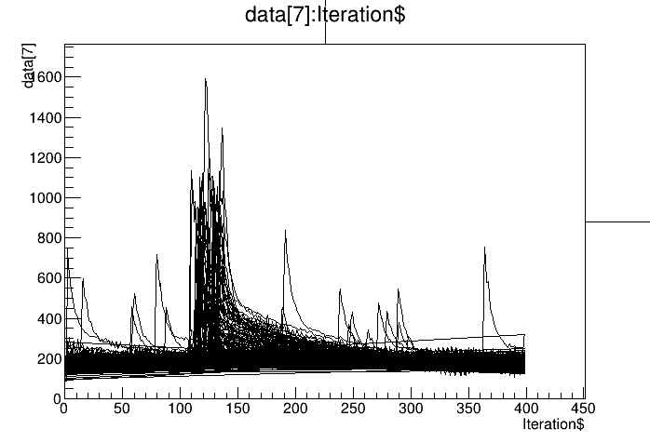
Effect of background
Accidental pulses
Data was taken at 50 nA
scale by 240 to have an idea
of 12 uA
baseline
widens

Slide 25
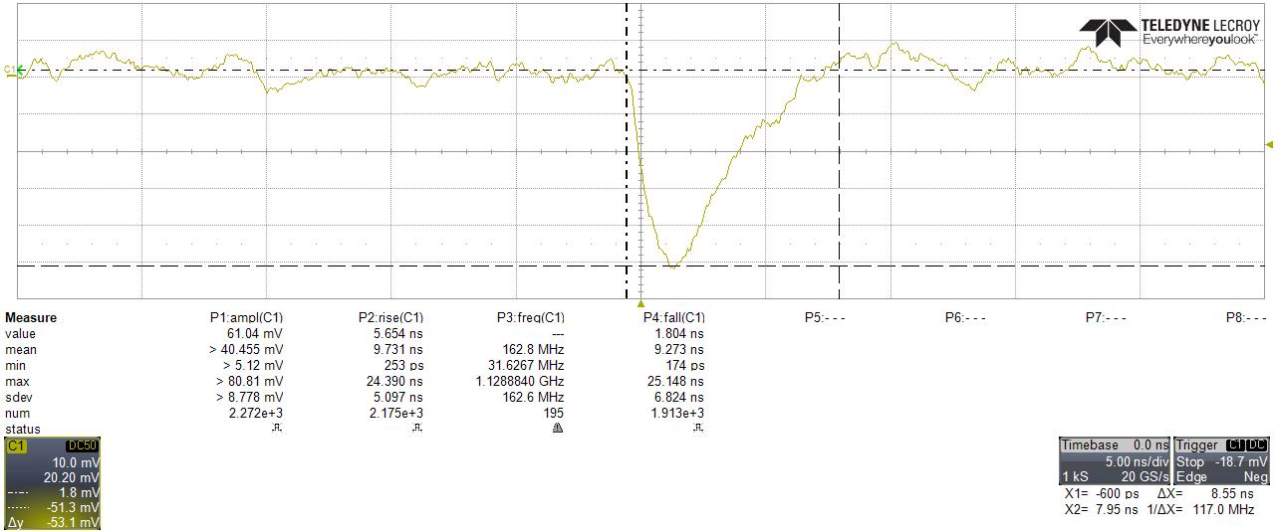
Amplifier Kansas University
SiGe amplifier developped to TOTEM Ultra Fast silicon detector by Kansas University
less than 10 ns width with diamond detector

Slide 26
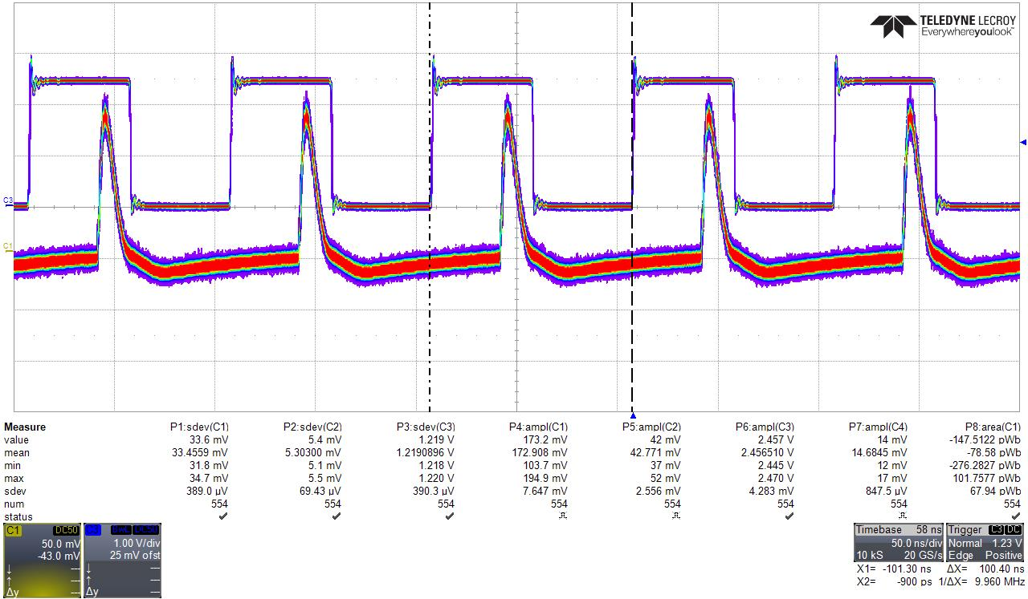
Amplifier laser signal silicon
Silicon pulsed at 10 MHz with KU amplifier

Slide 27
SoLID background

Slide 28
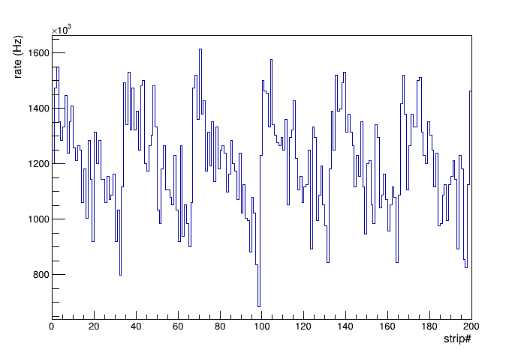
Single rate
Beam on target
Average rate/channel:
  total induced charge > 0.0 pC: 1.2 MHz
  total induced charge > 0.5 pC: 893.2 kHz
total induced charge cut (pC) | Average rate / channel (MHz)
0.0 | 1.20
0.1 | 1.11
0.2 | 1.06
0.3 | 1.00
0.5 | 0.95
0.6 | 0.84
0.7 | 0.80
0.8 | 0.76
0.9 | 0.72
1.0 | 0.69
1.1 | 0.65
total induced charge > 0 pC
Study by Sanghwa Park ( Stony Brook )

Slide 29
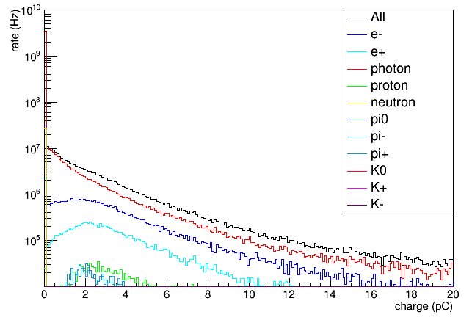
Total incident particle rate - cut scan
Charge cut scan: scan range (0.2 - 0.9) pC
Study by Sanghwa Park ( Stony Brook )

Slide 30
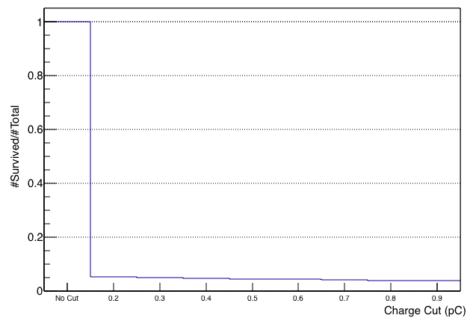
Total incident particle rate - cut scan
Charge cut scan: scan range (0.2 - 0.9) pC
Charge > 0.2 pC
~ 95% reduced
(#total incident particles)
Study by Sanghwa Park ( Stony Brook )

Slide 31
SoLID background
Single channel rate at about 1 MHz level
Assume 30 ns timing window, about 3% probability to have a hit
Preliminary rate show pile-up should be ok
TDC option should work
Sampling option still desired option for better timing resolution and pile-up events

Slide 32
Pile-up

Slide 33
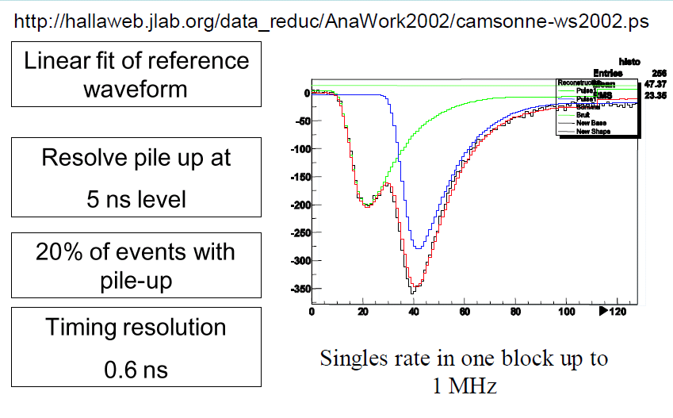
Pile-up example calorimeter DVCS

Slide 34
Ideal features for SoLID TOF
5 to 10 GHz sampling rate
20 ps or better timing resolution
1 GHz or more analog bandwidth
Waveform readout
On chip Zero suppression
Discriminator for fast trigger
External trigger ( single channel trigger rate is about 1 MHz )
can handle up to 200 KHz of trigger rates
Data transfer capability
  on chip suppression required
  assume 3300 channels 10 ns at 10 GHz 12 bit
  at 200 KHz and occupancy 1 % : 900 MB/s
  (1.6 MB/s per chip 6 channel per chip : 10 Mbit/s link ok, 100 Mbit/s link desired)
8 us buffer latency ( 4 us minimum)

Slide 35
Conclusion
SoLID SIDIS experiment requires 80 ps
20 ps timing resolution extend K/pi separation at high momentum up to 5.5 GeV
Preliminary background studies about 1 MHz per channel but need more studies
TDC and A/D option should work
New generation chips available in 2018
Sampling option desired for SoLID DRS5 or AARDVARC good candidates

