Slide 1
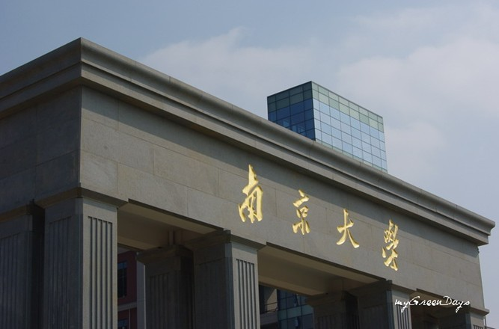

Quark and Glue Spins of the Nucleon
Quark spin from anomalous Ward identity
Momentum and angular momentum sum rules
Glue spin
Nanjing University, July 27, 2017

Slide 2
Where does the spin of the proton come from?

Slide 3
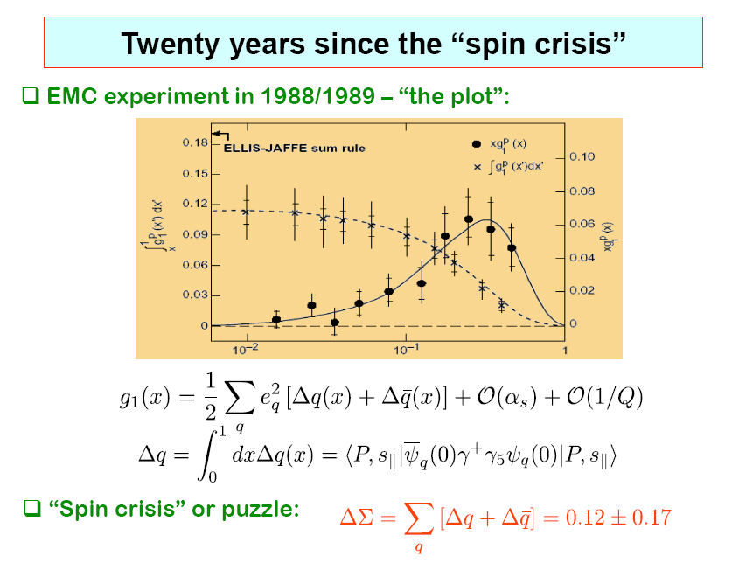
8
∧

Slide 4
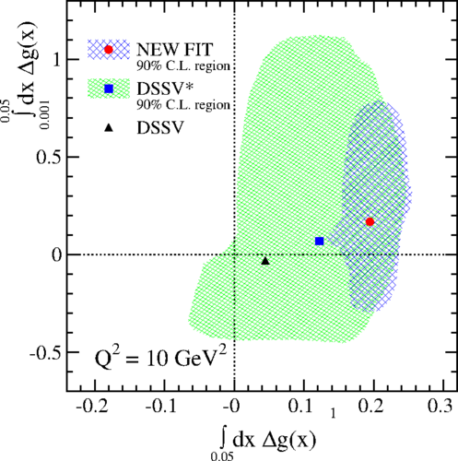
Glue Helicity ΔG
Experimental results from STAR [1404.5134]
PHENIX [1402.6296] COMPASS [1001.4654]
ΔG ~ 0.2 with large error
D. de Florian, R. Sassot, M. Stratmann, W. Vogelsang, PRL 113, 012001 (2014)

Slide 5
Hadron Structure with Quarks and Glue
Quark and Glue Momentum and Angular Momentum in the Nucleon

Slide 6
Quark Spin Calculation with Axial-vector current
Recent calculation of strange quark spin with dynamical fermions
  R. Babich et al. (1012.0562)
  QCDSF (G. Bali et al. 1112.3354)
  M. Engelhardt (1210.0025)
  C. Alexandrou et al. (arXiv:1310.6339)
  A.J. Chambers et al. (arXiv:1508.06856)
Leader et al., 1410.1657

Slide 7
Quark Spin from Anomalous Ward Identify
Calculation of the axial-vector in the DI is very noisy
Instead, try AWI
  P is totally dominated by small eigenmodes.
  q(x) from overlap is exponentially local and captures the high modes from A_{μ}⁰.
  Direct check the origin of `proton spin crisis'.

Slide 8
Quark Spin from Anomalous Ward Identify
Calculation of the point axial-vector in the DI is not sufficient.
AWI needs to be satisfied.
Unrenormalized AWI for overlap fermion for point current
  Overlap fermion --> mP is RGI (Z_{m}Z_{P}=1)
  Overlap operator for has no multiplicative renormalization.
  Espriu and Tarrach (1982)

Slide 9
g_{P}(q^2) and g_{G}(q^2)
charm
strange

Slide 10
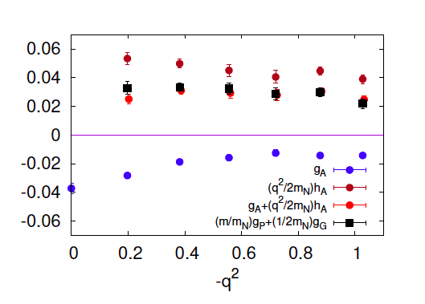
Disconnected Insertion
Strange
u/d

Slide 11
2+1 flavor DWF configurations (RBC-UKQCD)
La ~ 4.5 fm m_{π} ~ 170 MeV
32^3 x 64, a =0.137 fm
(O(a²) extrapolation)
La ~ 2.8 fm m_{π} ~ 330 MeV
La ~ 5.48 fm m_{π} ~ 140 MeV
24^3 x 64, a =0.115 fm
48^3 x 96, a =0.114 fm
La ~ 2.7 fm m_{π} ~ 295 MeV
La ~ 5.35 fm m_{π} ~ 140 MeV
32^3 x 64, a =0.085 fm
64^3 x 128, a =0.0837 fm

Slide 12
Normalized light u/d spin (DI)

Slide 13
Spin Sum Rules
Jaffe and Manohar sum rule (1990)
  Canonical EM tensor on light-cone with light-cone gauge
  Not directly accessible on the lattice
Ji sum rule (1997)
  Symmetric EM tensor (Belinfante) → gauge invariant and frame independent.

Slide 14
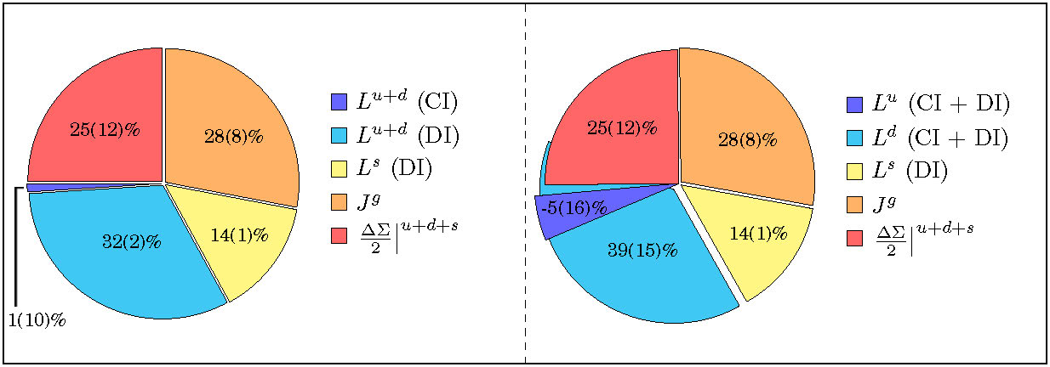
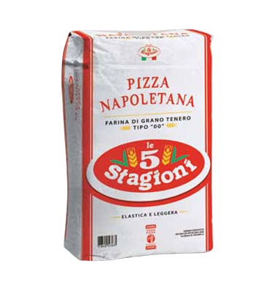
Quark Spin, Orbital Angular Momentum, and Gule Angular Momentum (M. Deka et al, 1312.4816, PRD)
pizza cinque stagioni
These are quenched results so far.

Slide 15
Glue Spin and Helicity ΔG
Jaffe and Manohar -- spin sum rule on light cone
  Not gauge invariant
  Light cone not accessible on the Euclidean lattice.
Manohar – gauge invariant light-cone distribution
  After integration of x, the glue helicity operator is
  Non-local and on light cone
Manohar
X.S. Chen, T. Goldman, F. Wang; Wakamatsu; Hatta, etc.
X. Ji, J.H. Zhang, Y. Zhao; Y. Hatta, X. Ji, Y. Zhao

Slide 16
Glue Spin and Helicity ΔG
X.S. Chen, T. Goldman, F. Wang; Wakamatsu; Hatta, etc.
  Gauge invariant but frame dependent
X. Ji, J.H. Zhang, Y. Zhao; Y. Hatta, X. Ji, Y. Zhao
Gauge invariant decomposition
Infinite momentum frame

Slide 17
Glue Spin and Helicity ΔG
Large momentum limit
  Calculate S_{g} at finite P_{z}
  Match to MS-bar scheme at 2 GeV
  Large momentum effective theory to match to IMF
  Similar proof for the quark and glue orbital angular momenta which are related to form factors in generalized TMD (GTMD)
  (Y. Zhao, KFL, and Y. Yang, arXiv:1506.08832)
Solution of A_{phys} -- related to A in Coulomb gauge

Slide 18
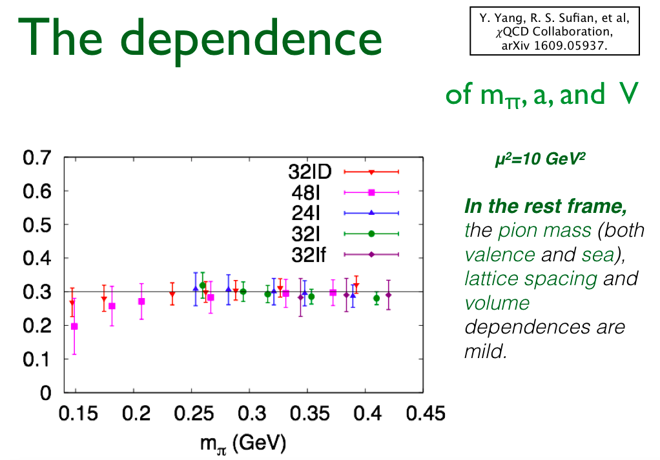

Slide 19
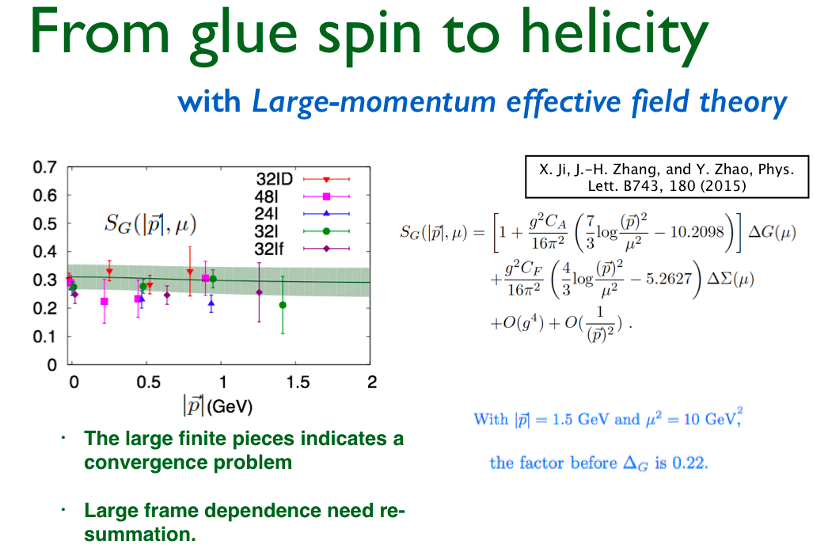

Slide 20
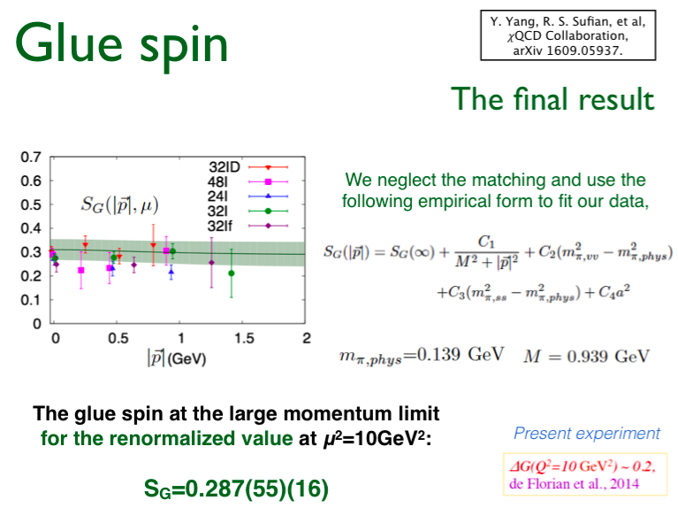
G
PRL 118,102001 (2017) – Physic Viewpoint
S_{G} = 0.251(47)(16)
_______________
-------------------------

Slide 21
Strange quark magnetic moment
Parity-violating ep scattering with radiative correction
R. Sufian et al, 1606.07075
PRL 118, 042001 (2017)
Nature – Ross Young
G_{M}^{S}(0) = - 0.064(14)(9) μ_{N}

Slide 22
Summary and Challenges
Decomposition of proton spin and hadron masses into quark and glue components on the lattice is feasible. Large momentum frame for the proton to calculate glue helicity remains a challenge.
`Proton Spin Crisis’ is likely to be the second (?) example of observable U(1) anomaly.
Glue spin from temporal gauge is being studied.

Slide 23
Hadron Structure with Quarks and Glue
Quark and Glue Momentum and Angular Momentum in the Nucleon

