Slide 1

and forward upgrade
9th Workshop on Hadron physics in China and Opportunities Worldwide, Nanjing, China
Outline: ● Physics Driver ● Detector Design ● Collaboration News ● Summary
Jin Huang (黄进)
Brookhaven National Lab, NY, USA

Slide 2
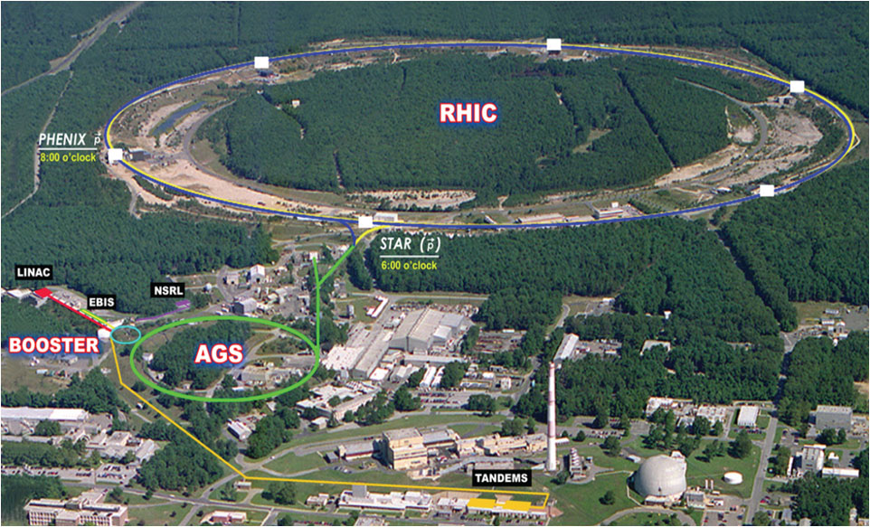
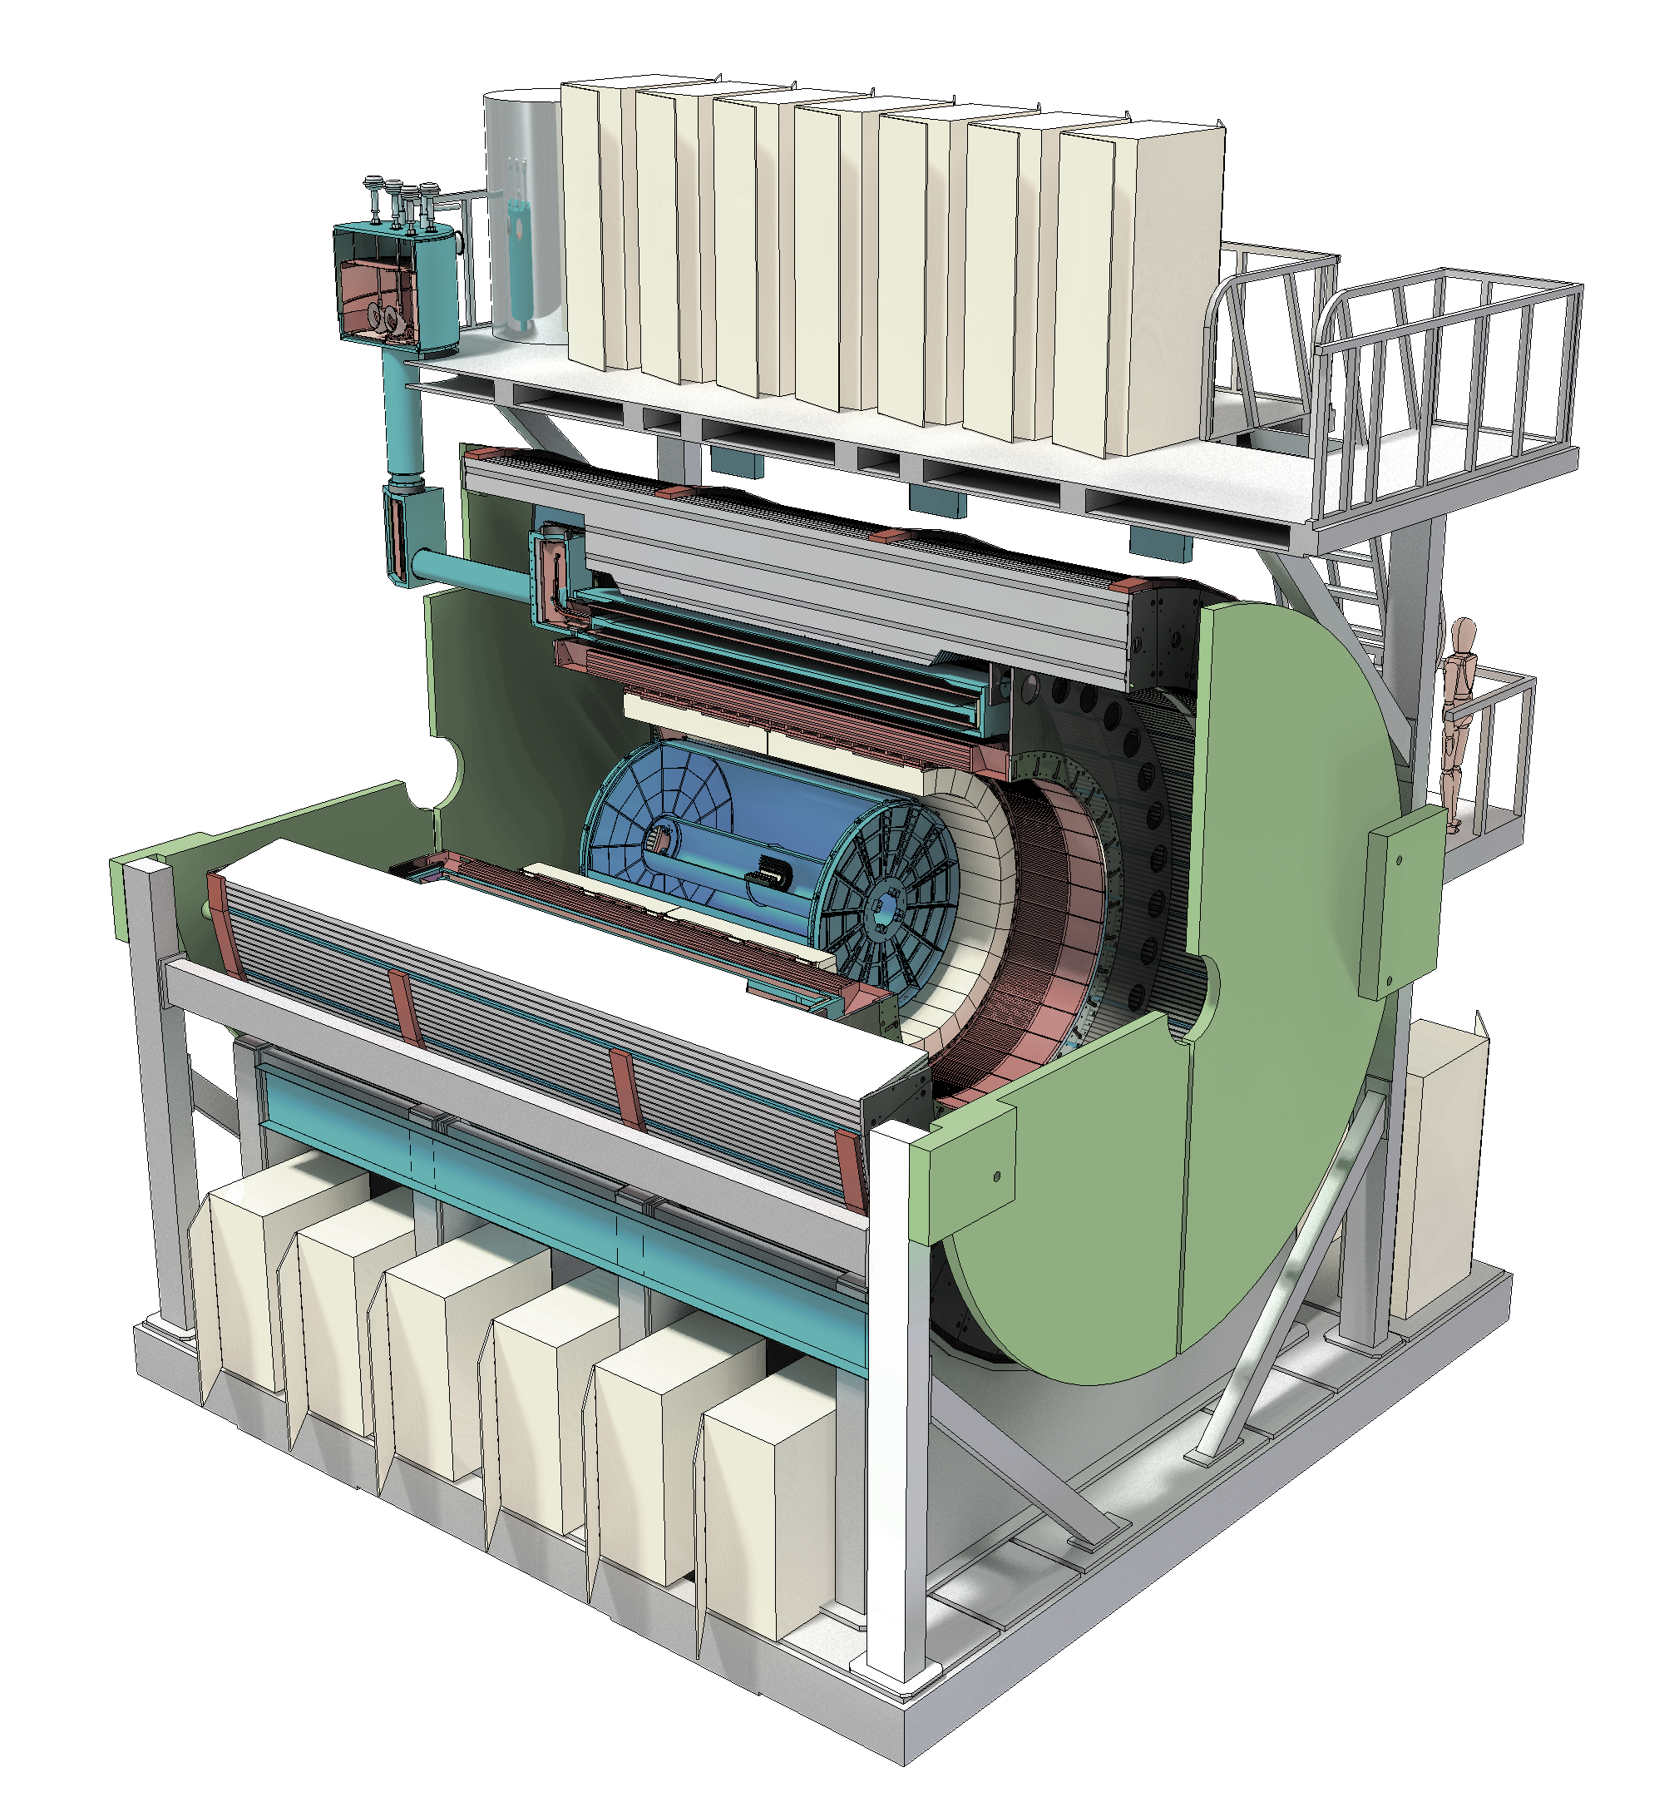

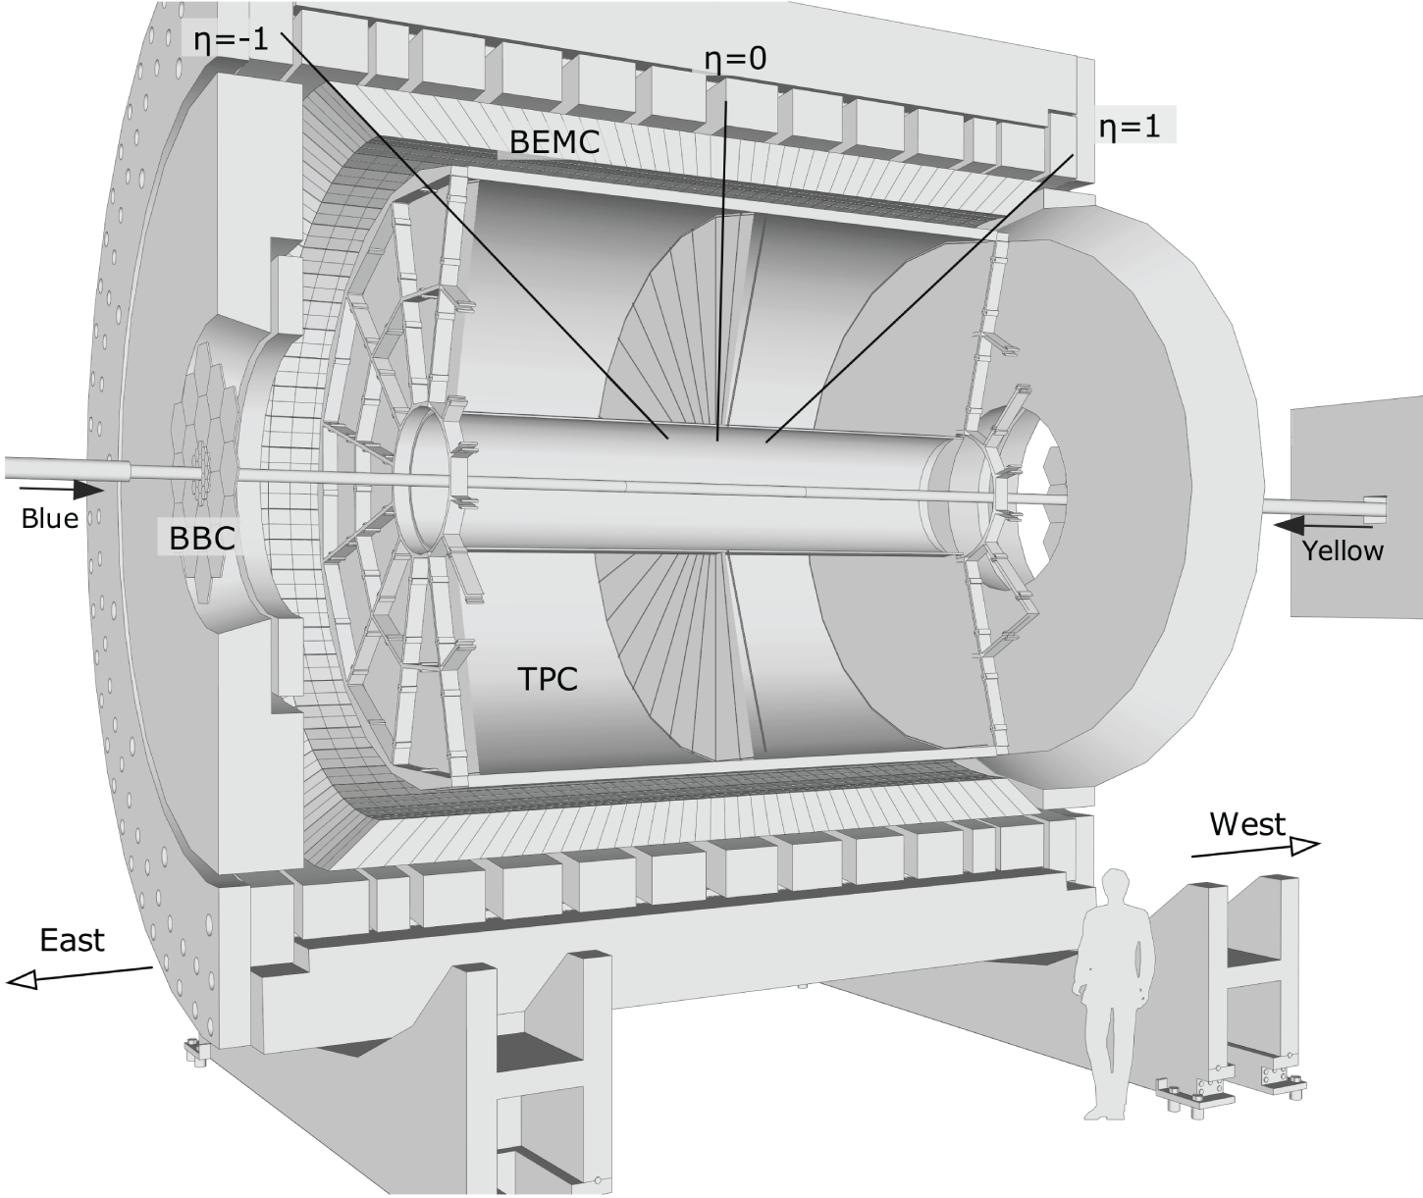
Relativistic Heavy Ion Collider, NY, USA
Bird’s eye view
See also: B. Mueller, Mon
Φ 1.2km
The most versatile hadron collider in the world, and world’s first and only spin-polarized proton collider.
Discovery of Quark Gluon Plasma, non-zero gluon spin, ...
Reached x40 of designed luminosity.
Two major experiments as of today
Pioneering High Energy Nuclear Interaction eXperiment (PHENIX) → sPHENIX
Solenoidal Tracker At RHIC (STAR, J. Zhang, Tue)

Slide 3
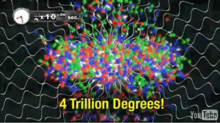
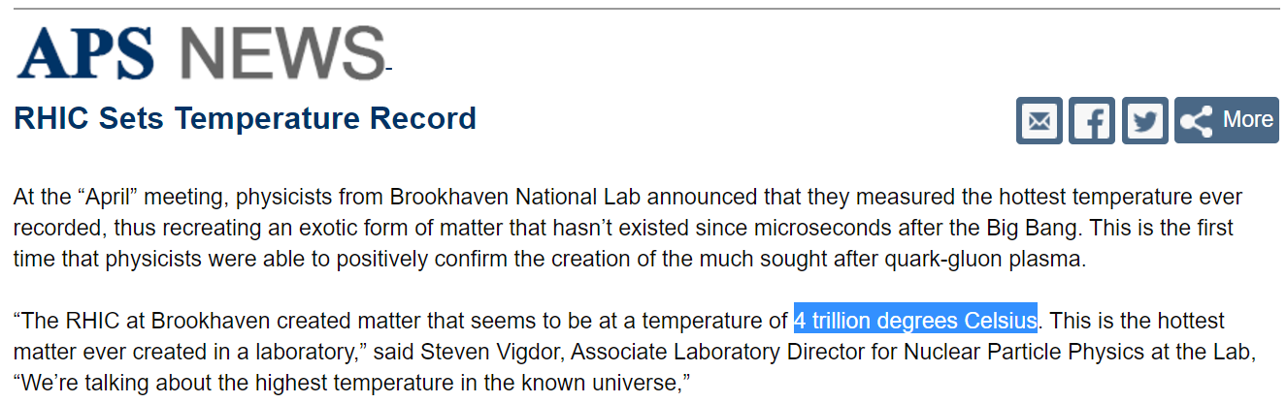
Relativistic Heavy Ion Collider, NY, USA
Bird’s eye view
See also: B. Mueller, Mon
Φ 1.2km
Mar 2010
The most versatile hadron collider in the world, and world’s first and only spin-polarized proton collider.
Discovery of Quark Gluon Plasma
Reached x40 of designed luminosity.
Two major experiments as of today
Pioneering High Energy Nuclear Interaction eXperiment (PHENIX) → sPHENIX
Solenoidal Tracker At RHIC (STAR, J. Zhang, Tue)
PHENIX, Phys. Rev. Lett. 104, 132301

Slide 4
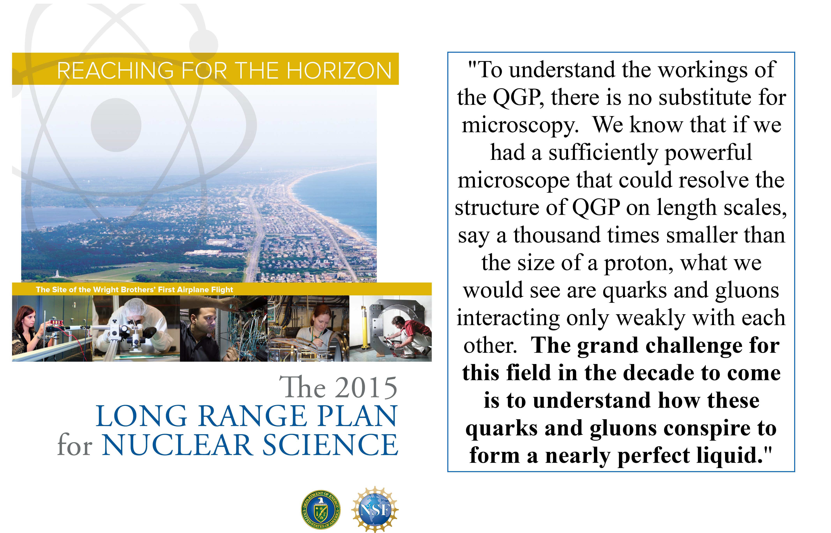
Under standing inner working of QGP

Slide 5
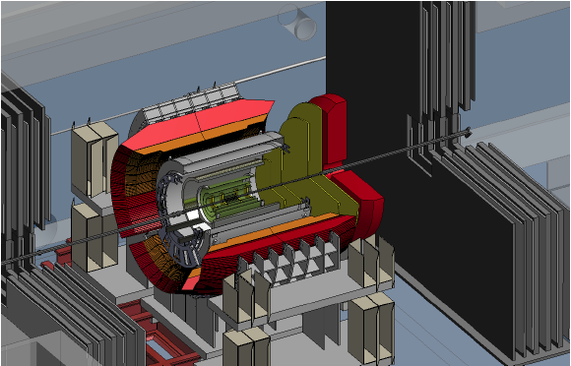
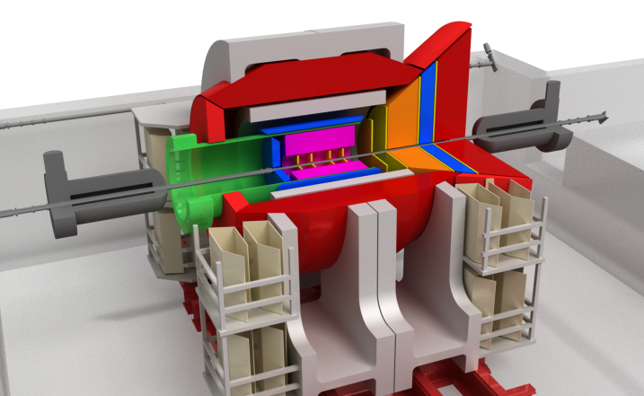
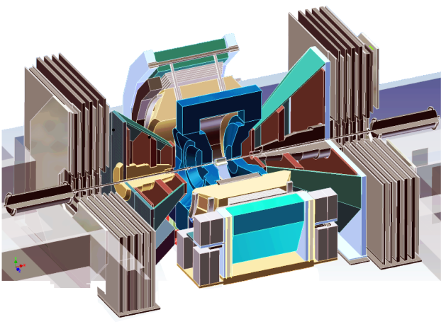
Evolution of the PHENIX Interaction region
PHENIX experiment
An EIC detector
16y+ operation
Broad spectrum of physics (QGP, Hadron Physics, DM)
170+ physics papers with 24k citations
Last run in this form 2016
Comprehensive central upgrade base on BaBar magnet
Rich jet and beauty quarkonia physics program
→ nature of QGP
Possible forward tracking, and calorimeter → Spin, CNM
Path of PHENIX upgrade leads to a capable EIC detector
Large coverage of tracking, calorimetry and PID
Open for new collaboration/new ideas
arXiv:1501.06197 [nucl-ex]
arXiv:1402.1209 [nucl-ex]
~2000
2017→2022, CD-0 @ 2016
>2025
Time
RHIC: A+A, spin-polarized p+p, spin-polarized p+A
EIC: e+p, e+A

Slide 6
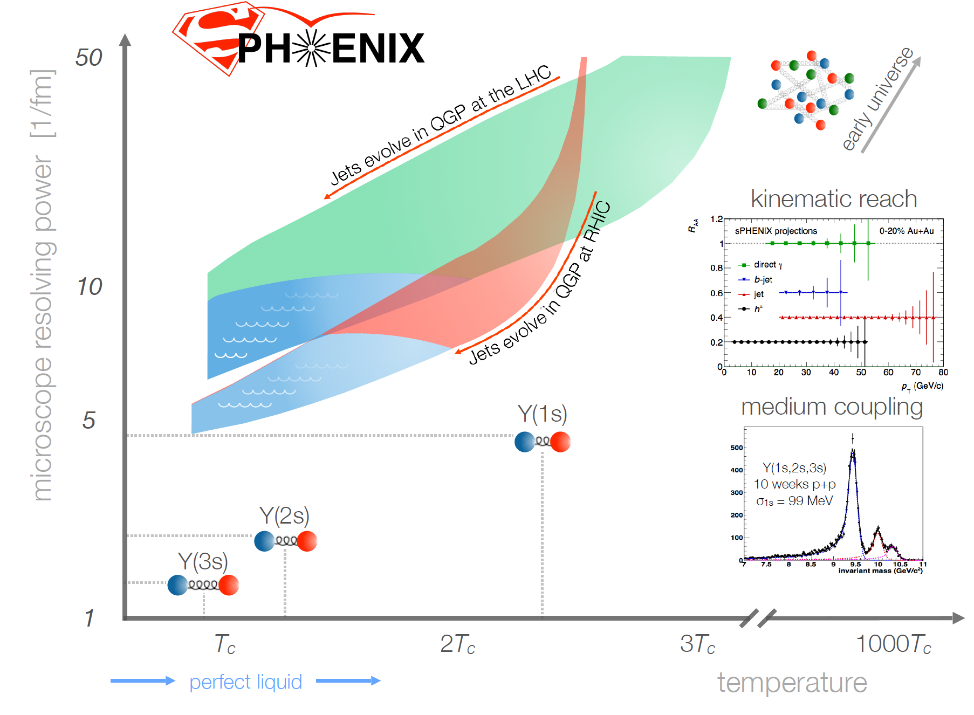
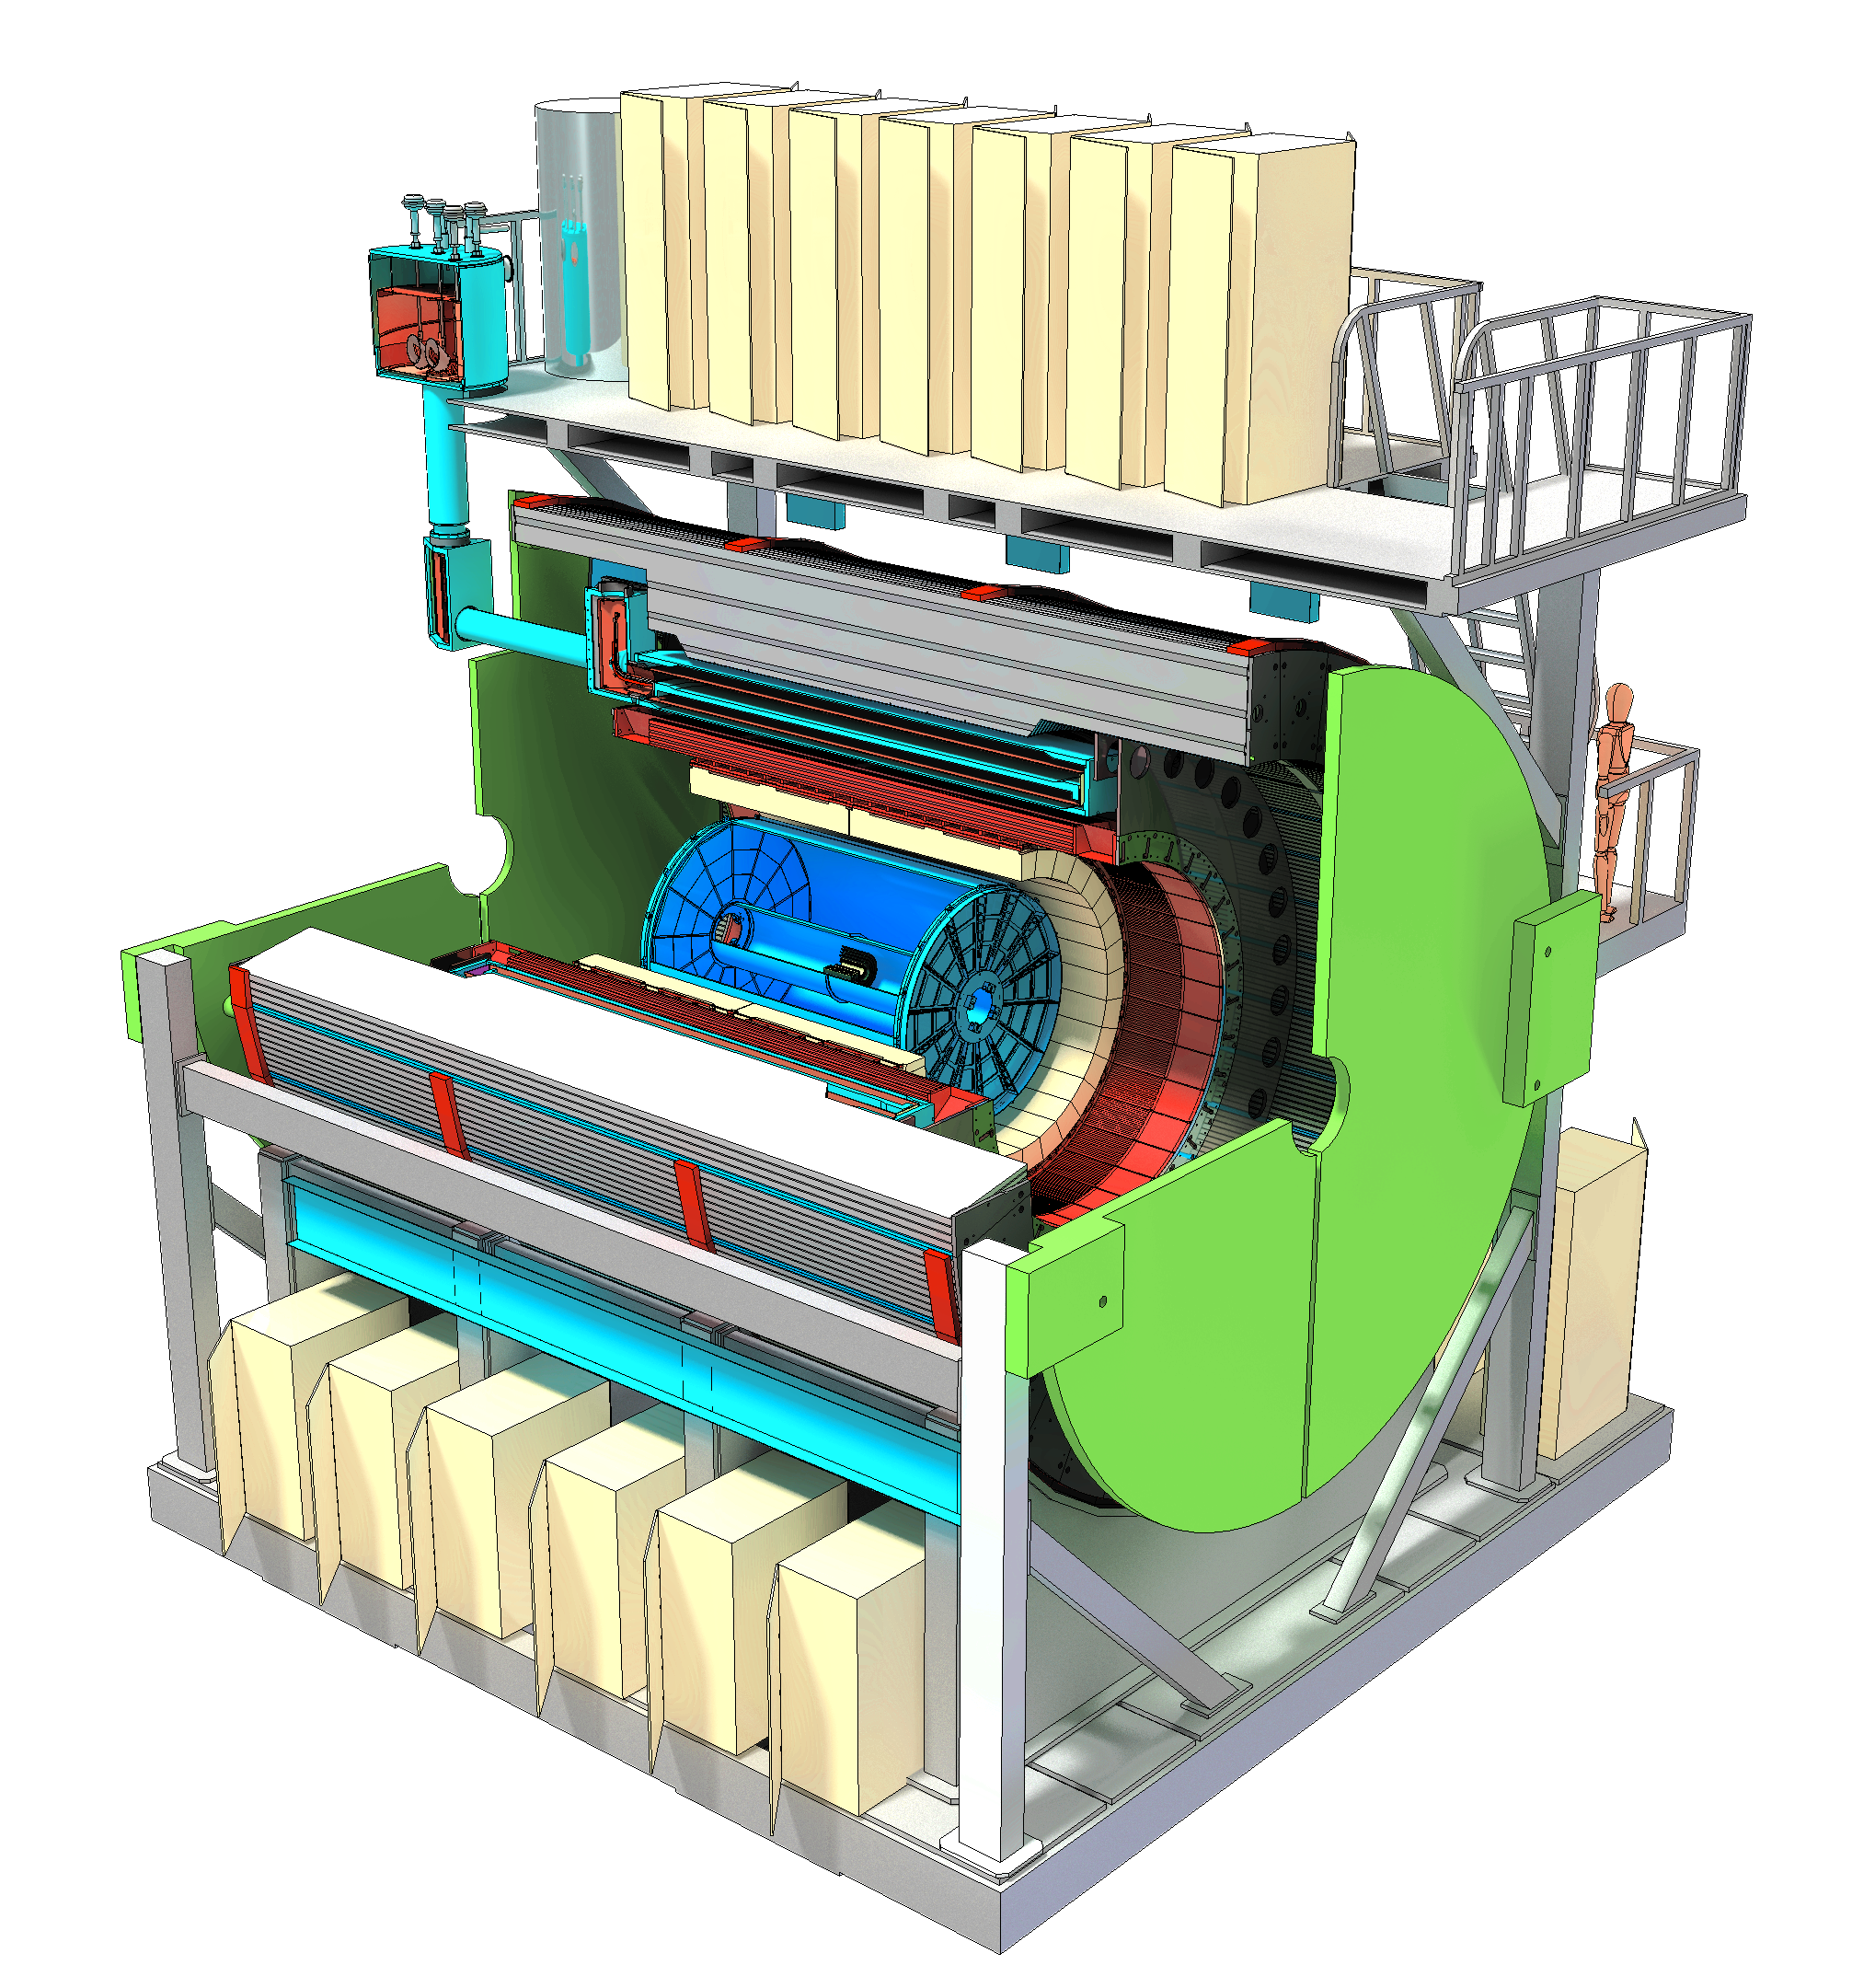
CD-0 Granted Sept 2016, Preparation for CD-1

Slide 7
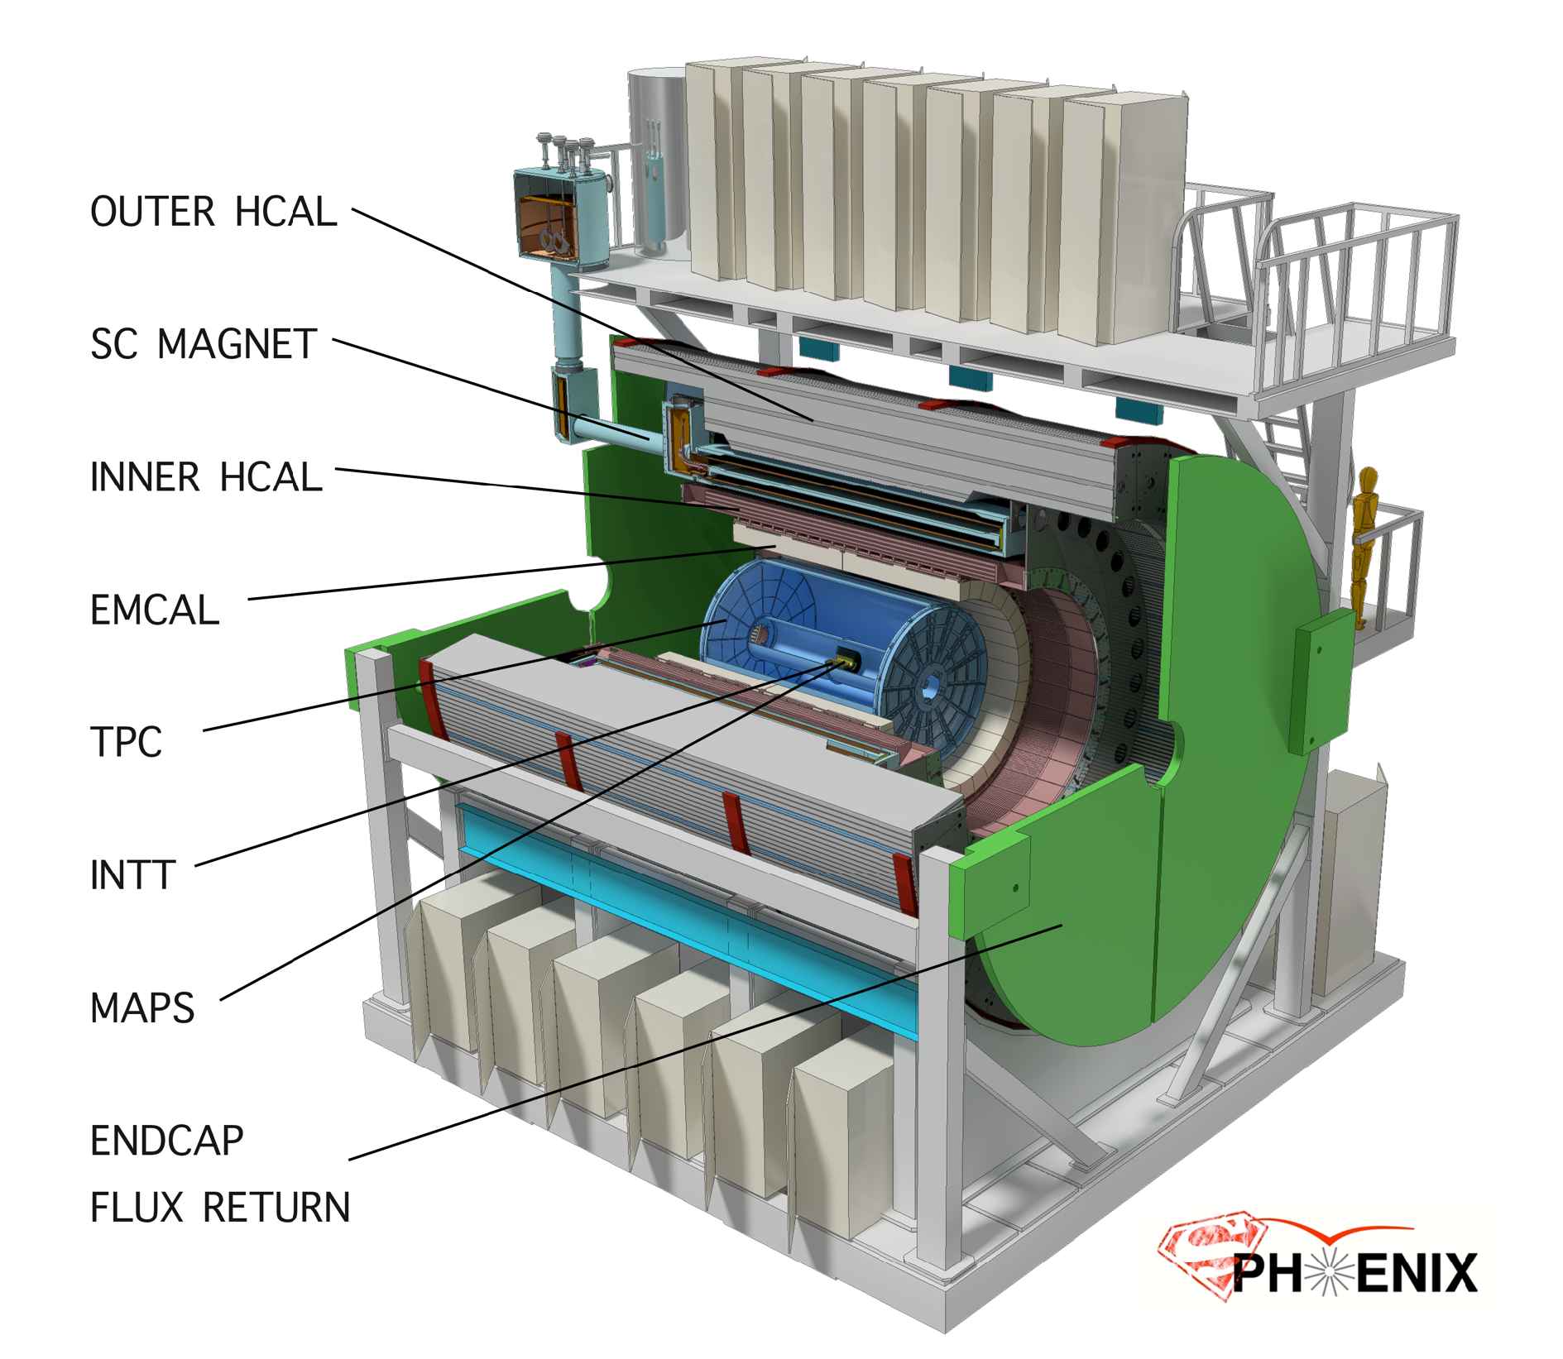
15 kHz trigger
10 GB/s data logging
Space preserve for
Particle ID
See M. Chiu, Friday
Detector
CD-0 Sept 2016
Construction Phase Jul 2018
Ready for Beam Jan 2022

Slide 8
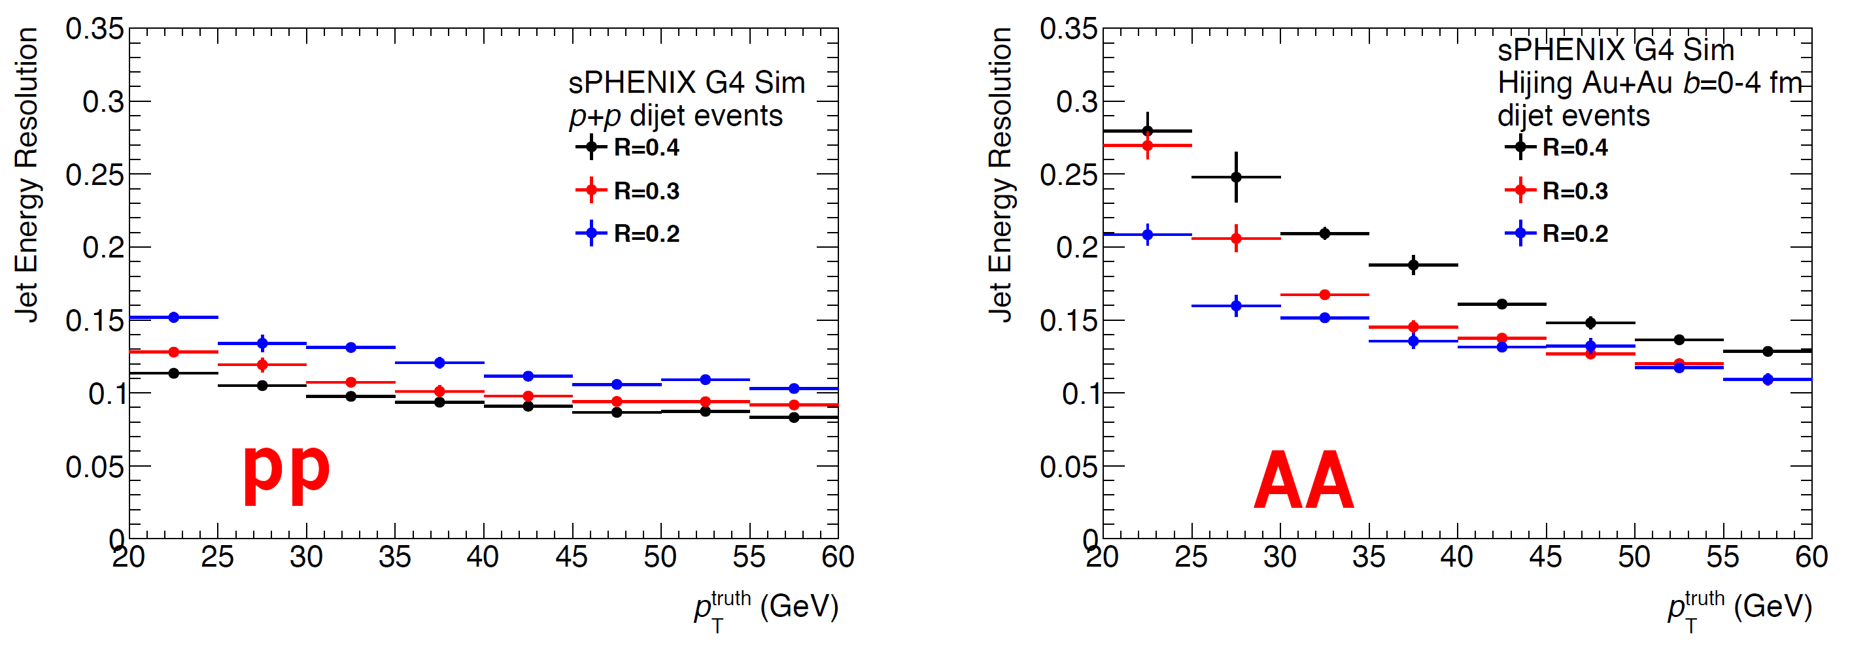
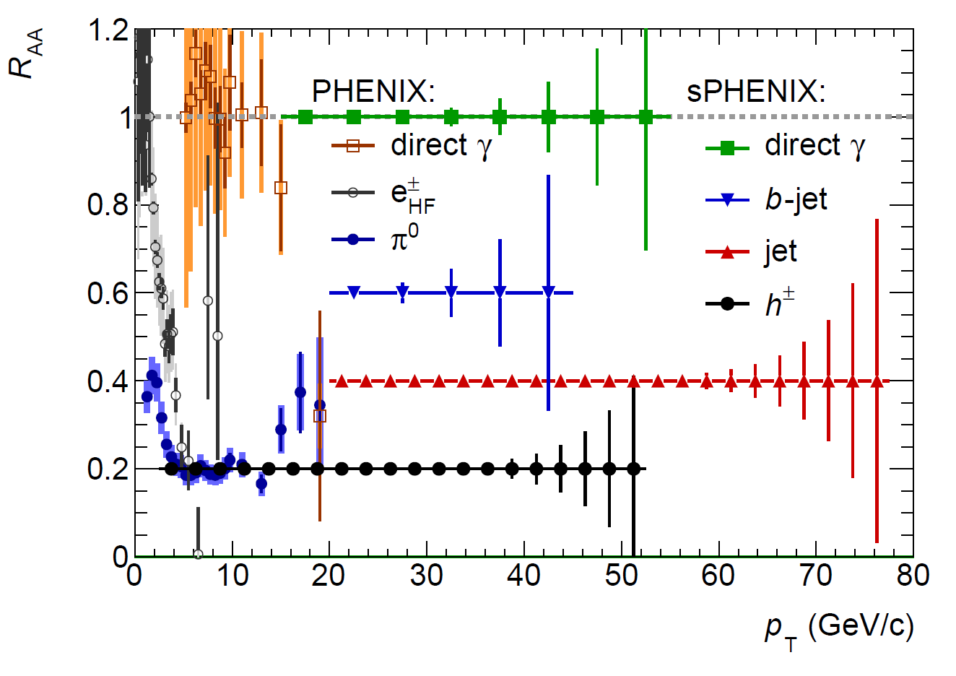
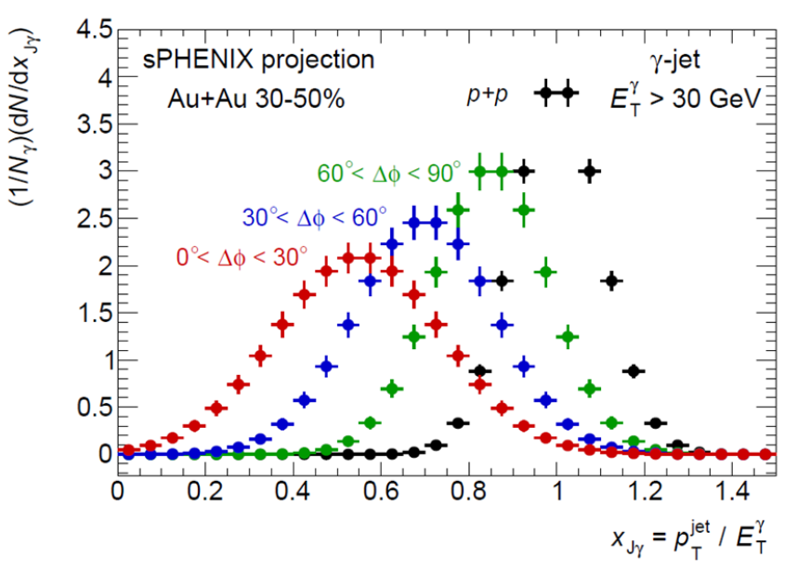
Precision calorimetry jet and photon

Slide 9
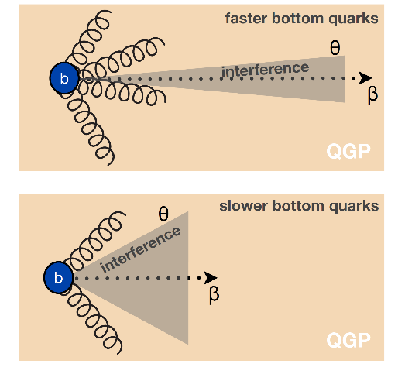
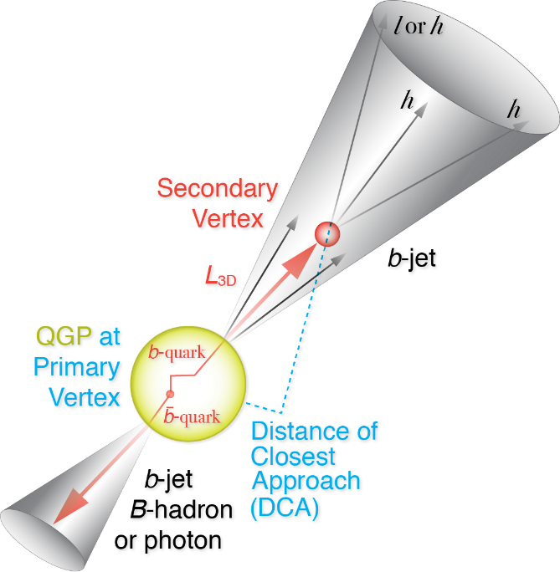
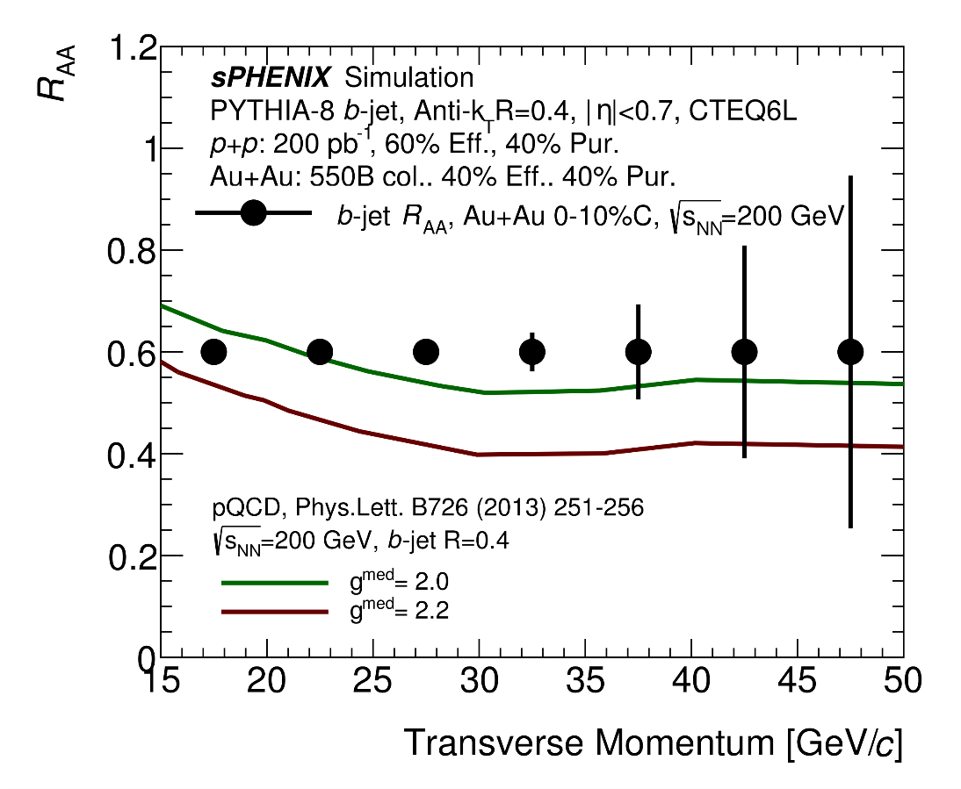
b-quark jet as probe of QGP
b-jet + light jet:
differential sensitivity to radiative energy loss
VS collisional energy loss.

Slide 10
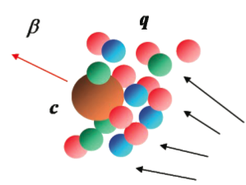

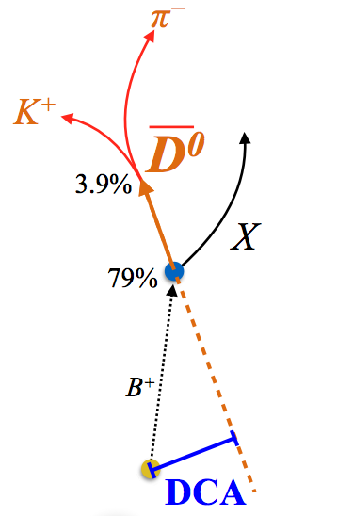
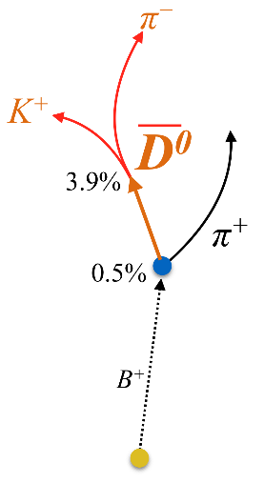
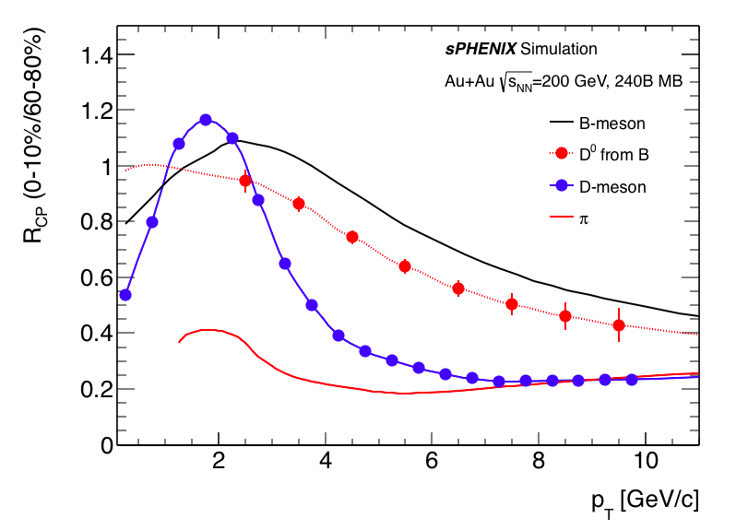
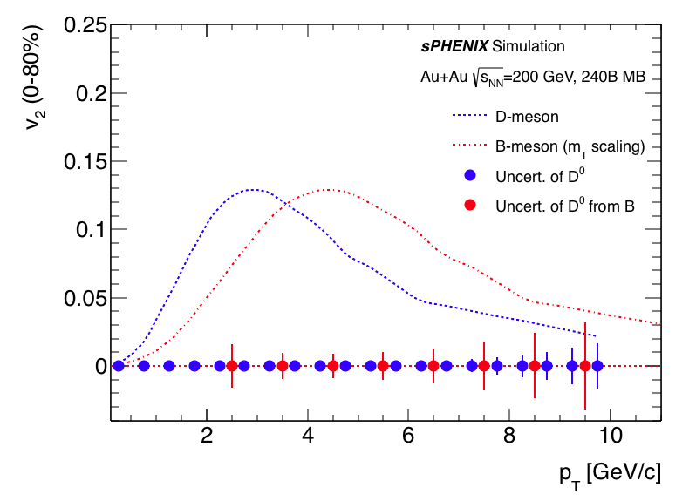
Precision open bottom meson
“Brownian” motion
→ Langevin simu.
b
drag
fluctuations
Diffusion coefficient D_{HQ}
B-meson program: p_{T} 2-10 GeV/c, precisely determine the bottom quark collectivity → clean access to D_{HQ}

Slide 11
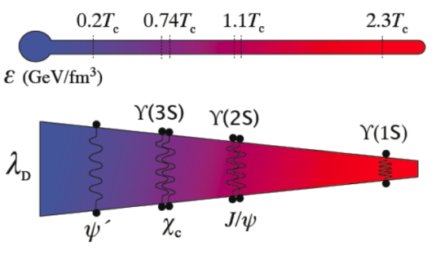
Upsilon spectroscopy
ϒ(3s)-0.78fm
ϒ(2s) – 0.56fm
Courtesy from A. Mocsy
ϒ(1s) – 0.28fm
Thermometer of QGP via clean separation of three Upsilon states (M_{ee} < 100 MeV/c²)

Slide 13
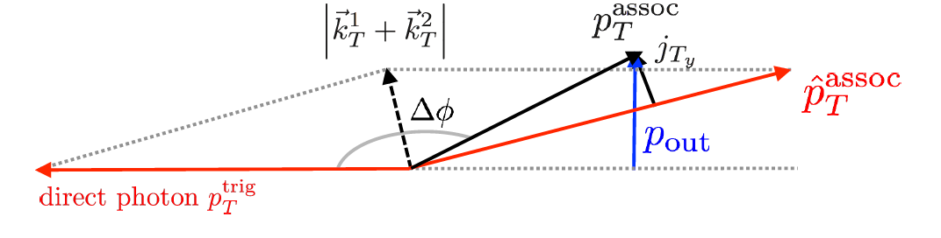
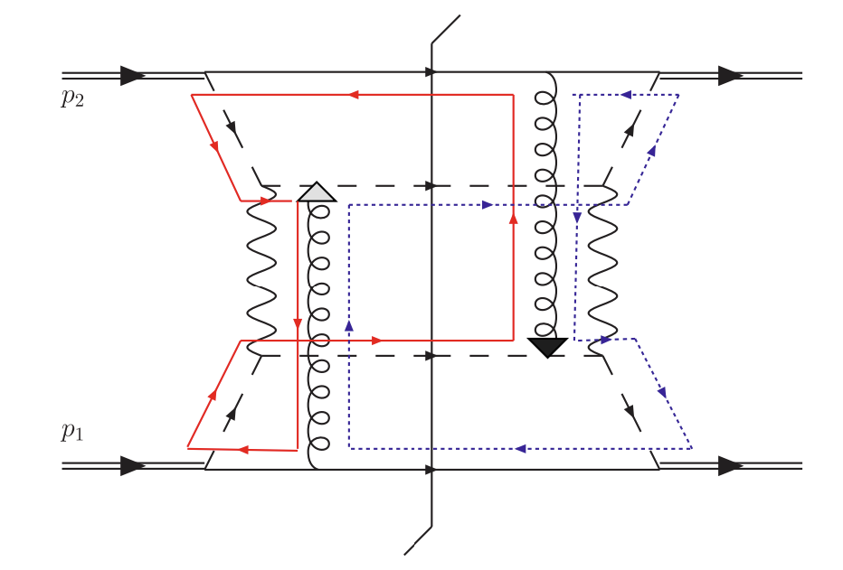
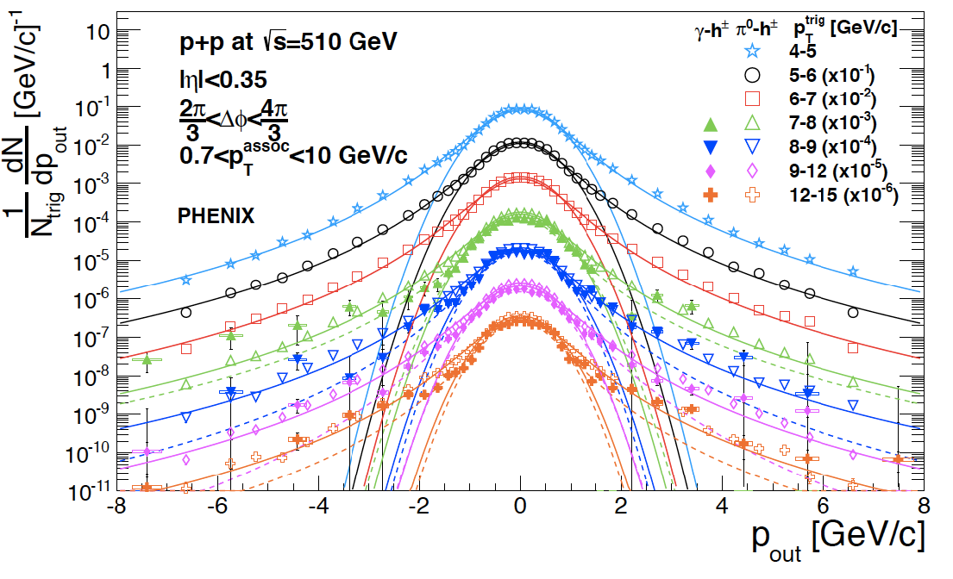
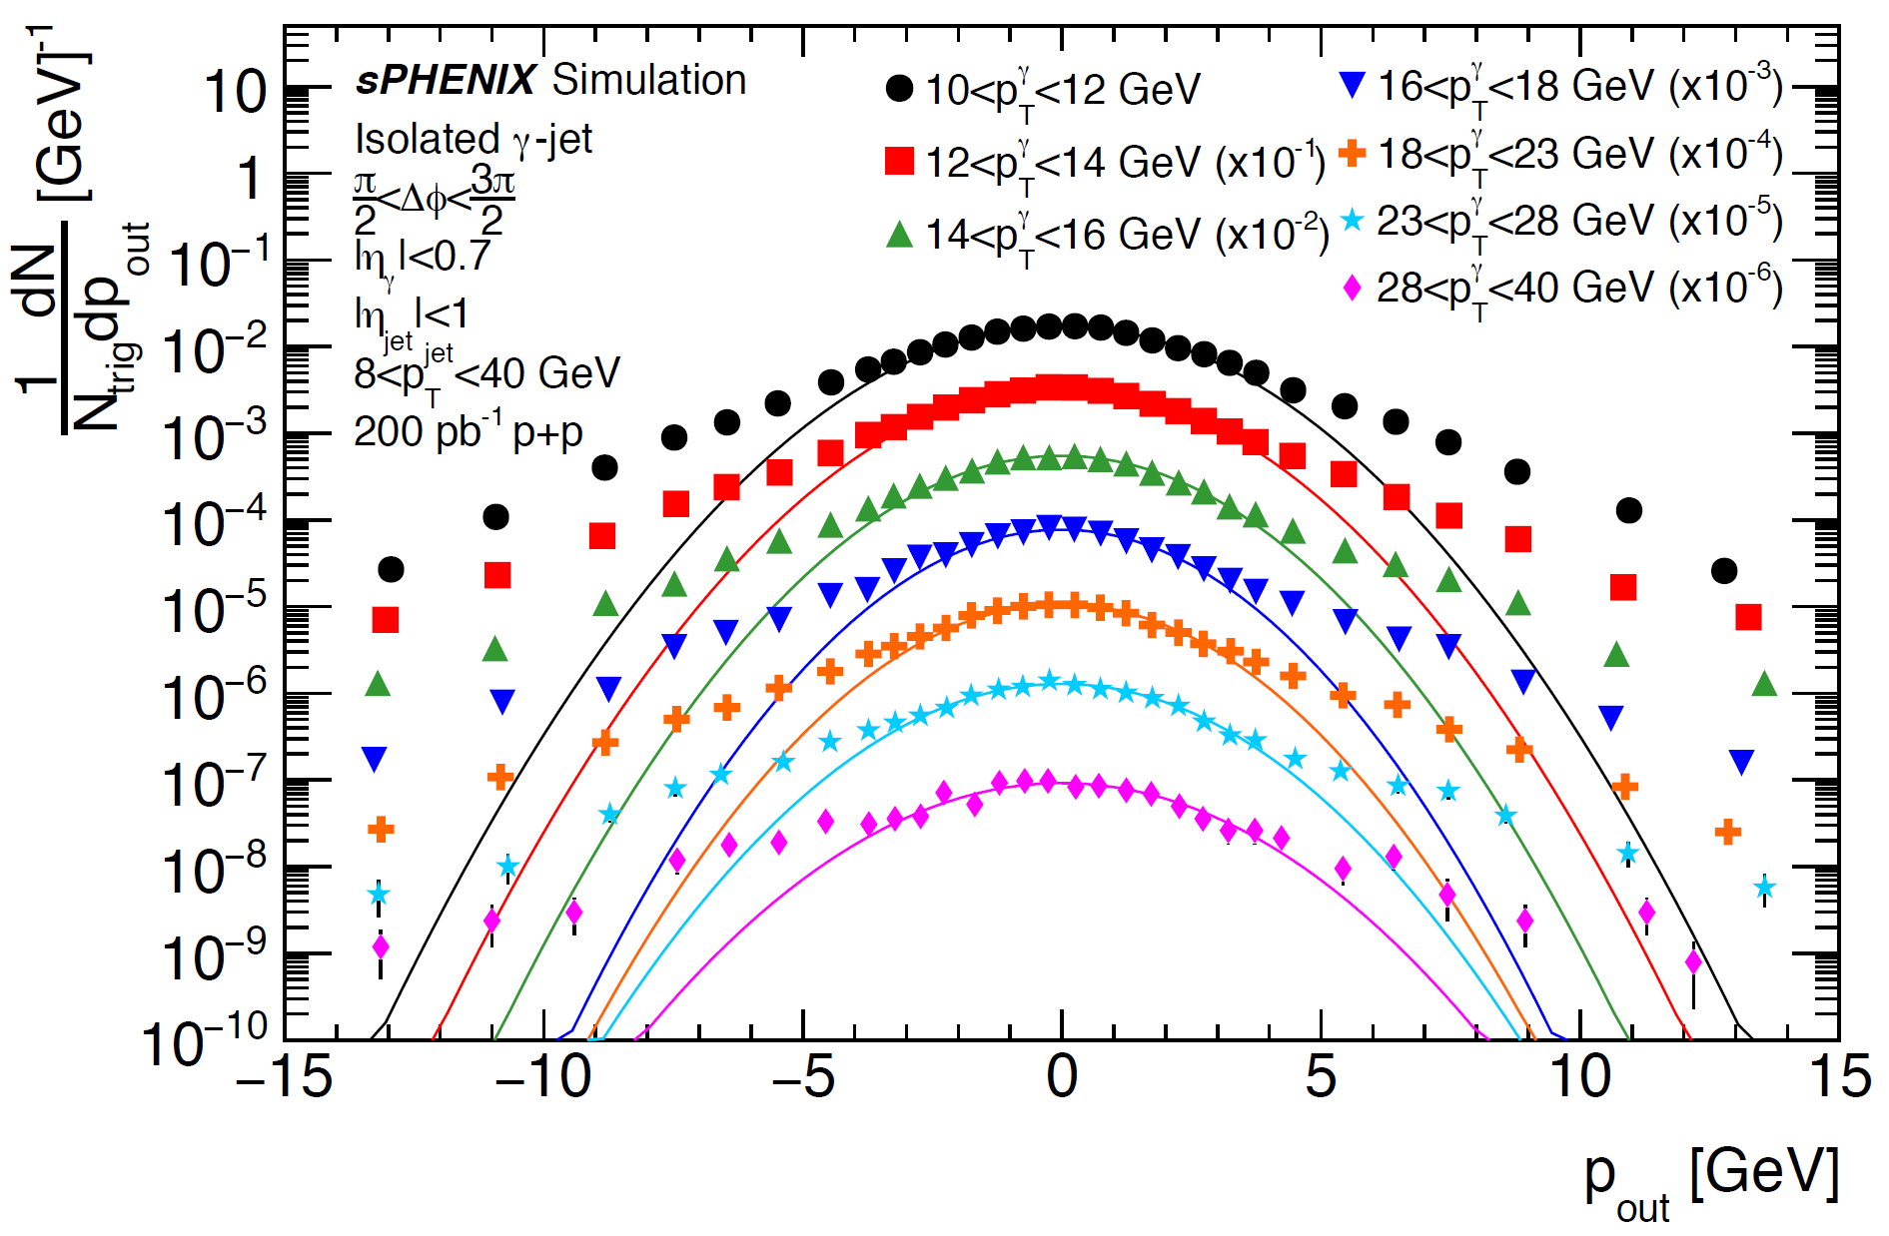
Hadronic physics opportunities with sPHENIX
Hadron final states in p+p not factorized in TMD framework: non-Abelian nature of gluon field
Exploring the size of this effect in p+p → γ+h in PHENIX. Extending to p+p → γ+jet in sPHENIX.
What will be the scale-dependence? Spin dependence?
p
Direct photon-hadron
q/g
Histogram p_{out}
q/g
Small scale, ~Λ_{QCD}
p
Large scale, ~Q²
PHENIX Data, Phys.Rev. D95 (2017) no.7, 072002
sPHENIX Projection, γ+jet

Slide 14
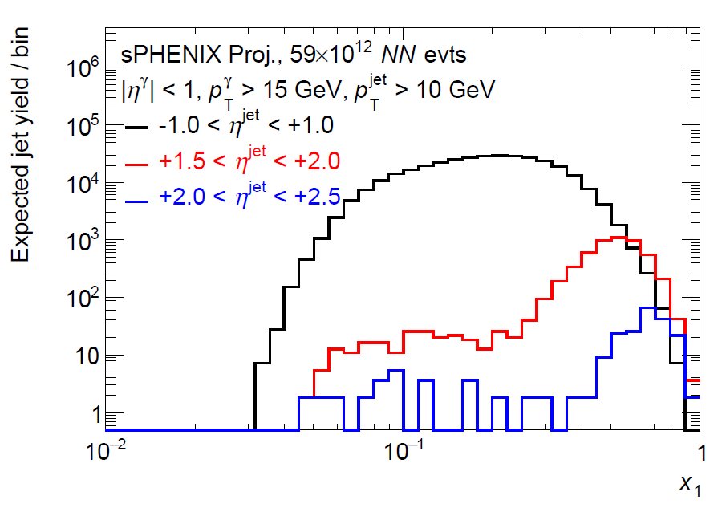
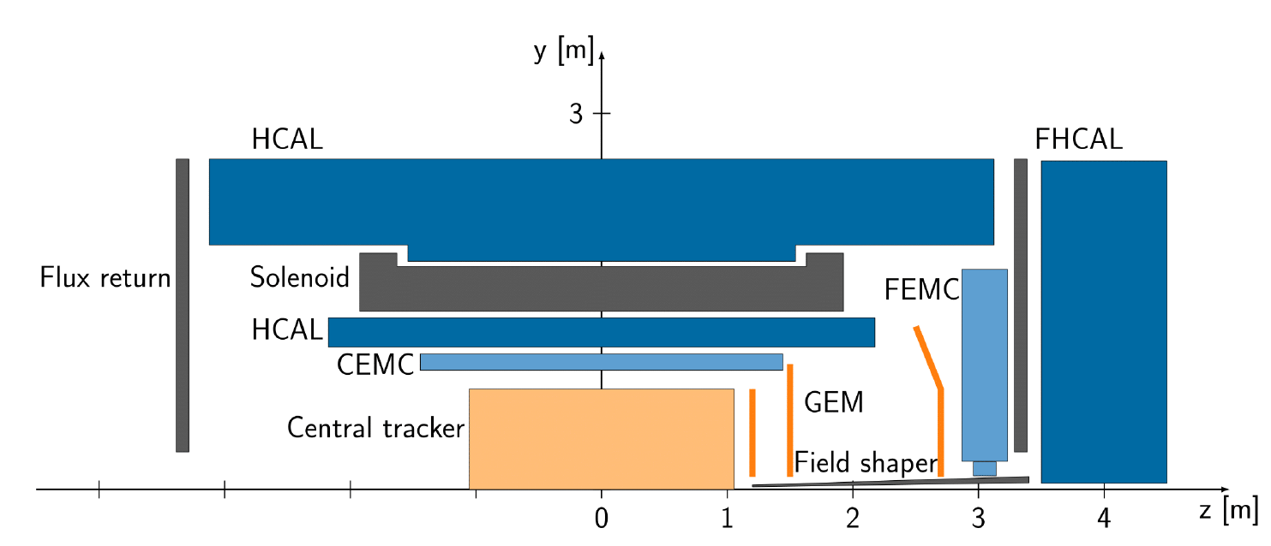
Forward upgrade for sPHENIX
RHIC cold-QCD community is also pushing for an forward tracking + calorimetry upgrade @ sPHENIX or STAR (J. Zhang, Tue)
LOI for forward upgrade was submitted to RHIC PAC 2017
Tracking + Calorimetry leads to joint coverage of -1<η<4
sPHENIX forward upgrade:
  Transverse spin
  Cold nuclear matter
  Longitudinal evolution of QGP
  And more ...
arXiv:1602.03922

Slide 15
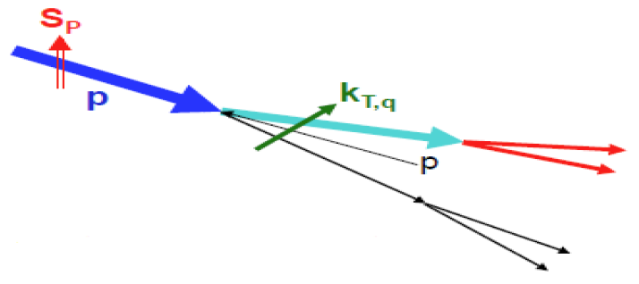
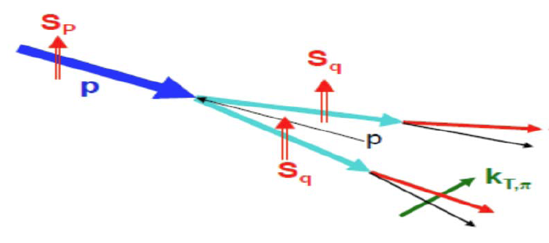
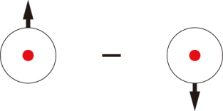
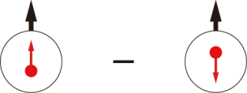
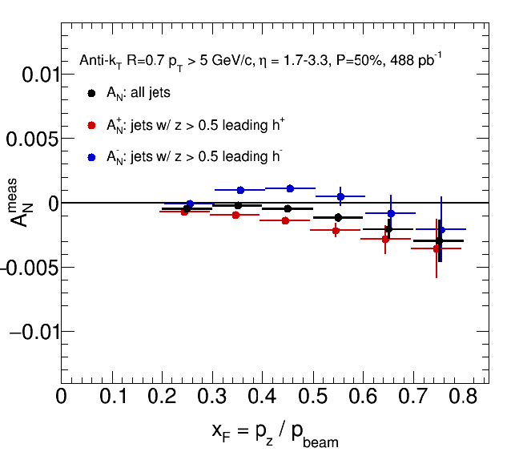
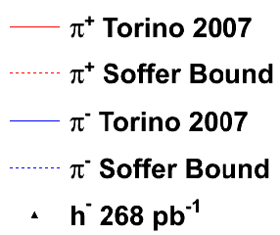
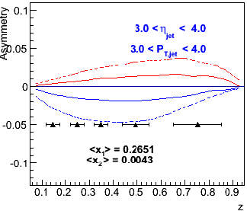
Forward jet → origin of transverse A_{N}
Charge-track tagged jet asymmetry
→ Access Sivers effect
Charge-track asymmetry in jet
→ Access Transveristy @ large x
sPHENIX simulation
p↑ + p → jet (h±) + X
√s = 510 GeV
sPHENIX simulation
p↑ + p → jet (h±) + X, √s = 510 GeV
Check universality of Transversity @ SIDIS

Slide 16
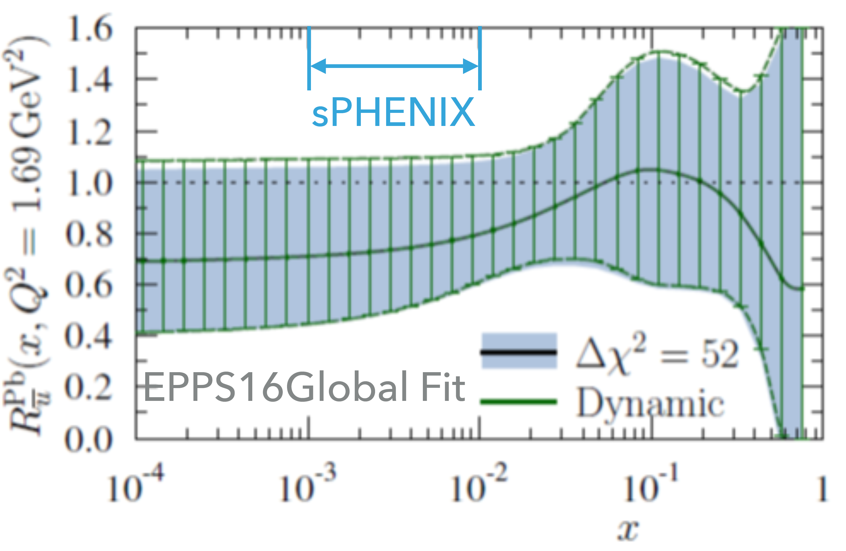
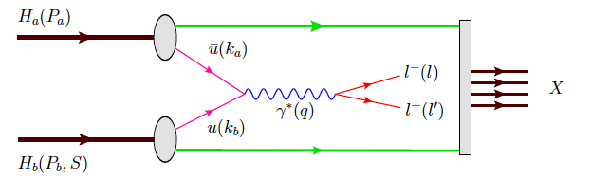
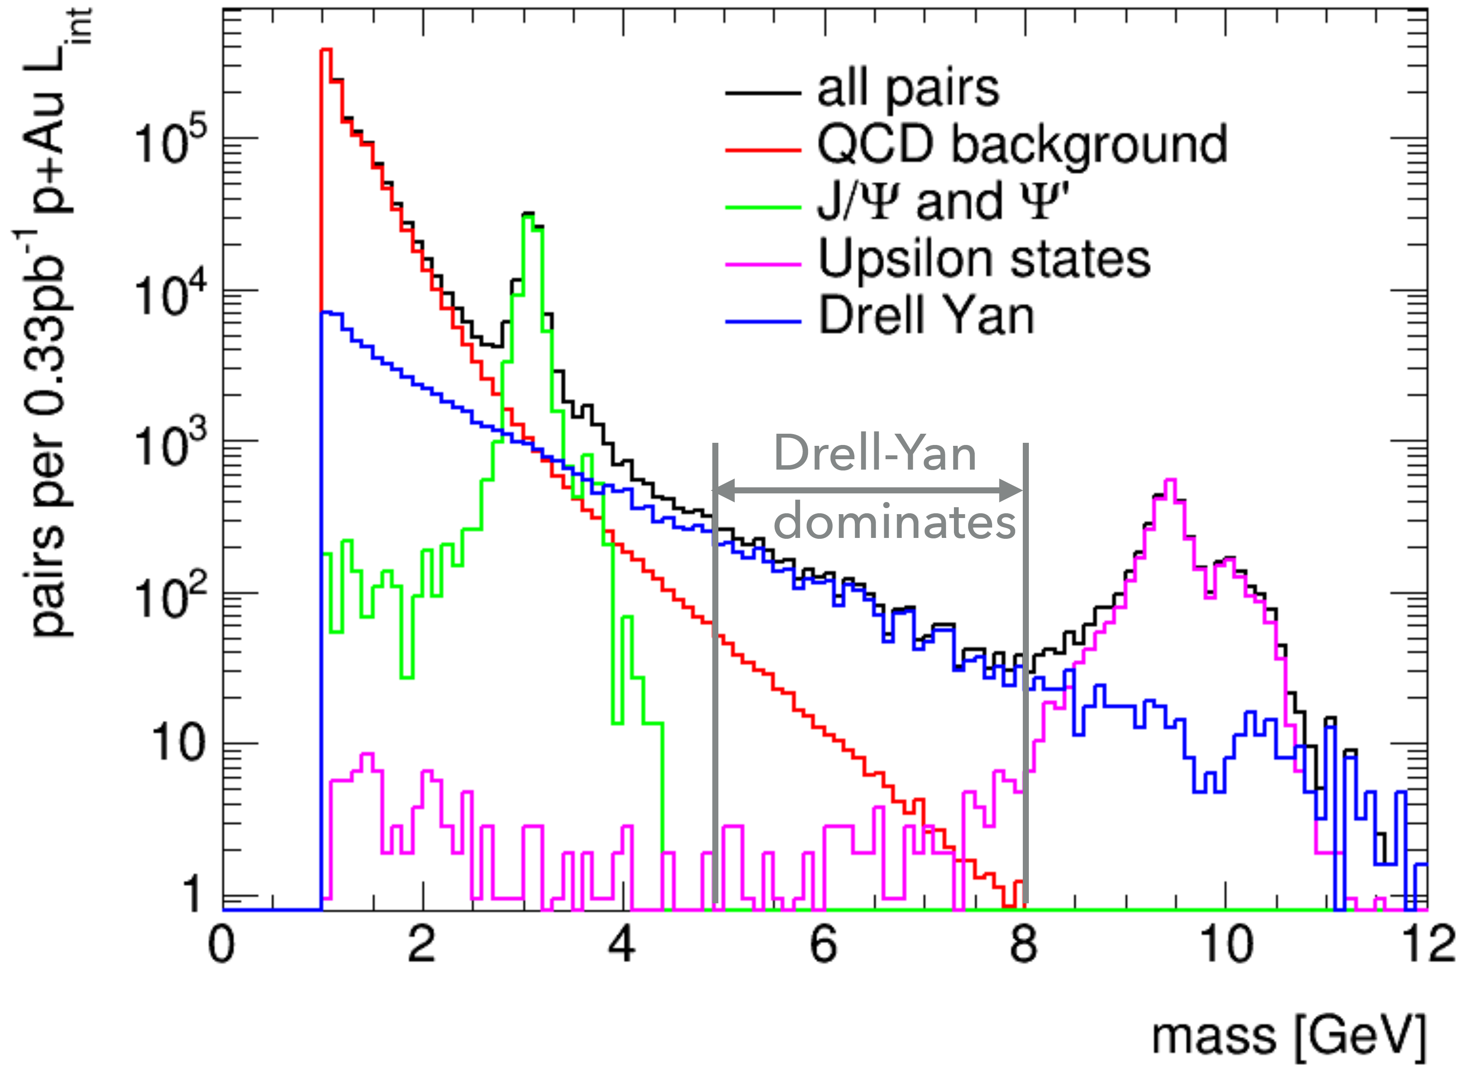
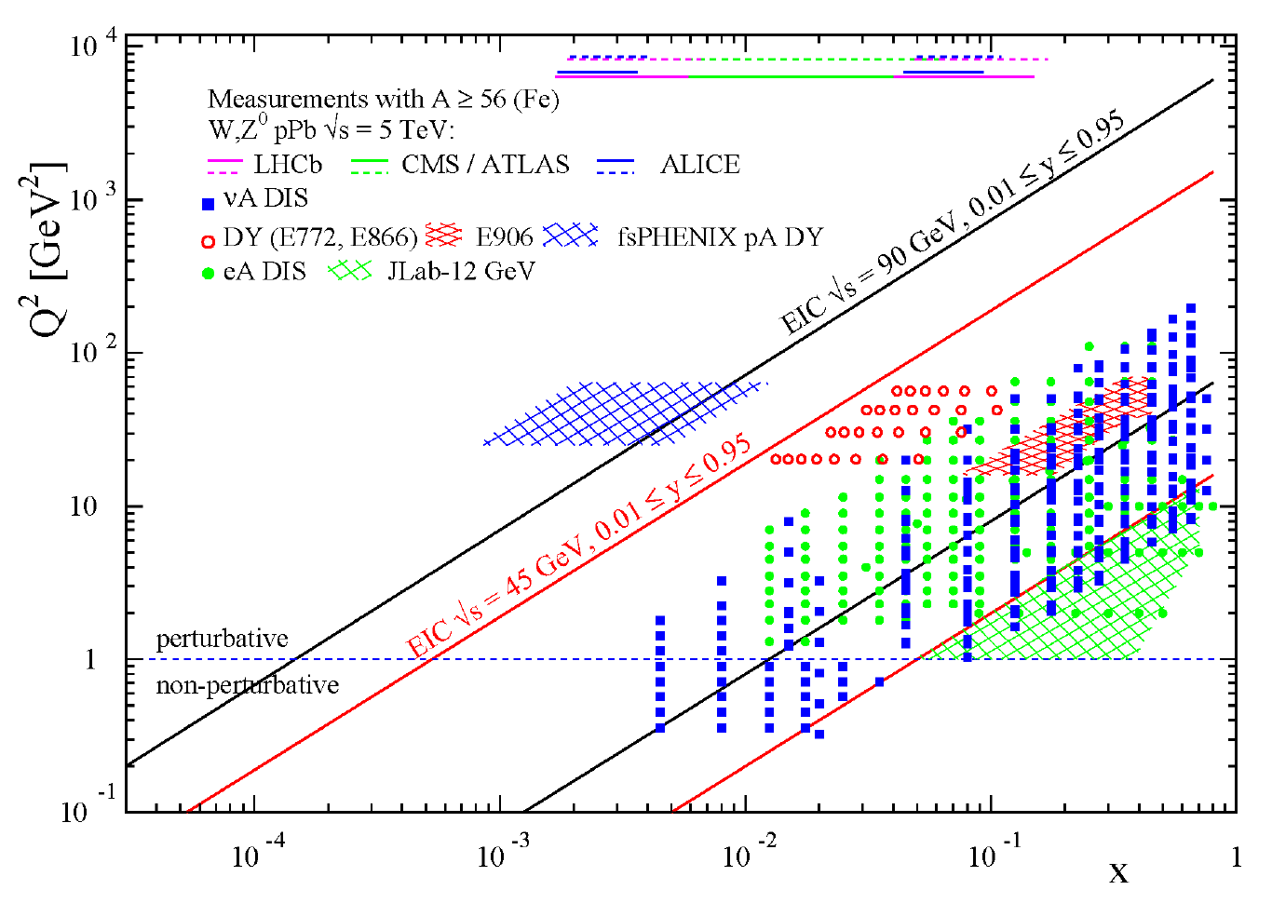
Forward DY
u-bar quark in nuclear
DY in p+A provides clean access to sea quark distribution
→ gluon in nuclei
fsPHENIX measure DY via di-electron final states
Benefit from continuous and large calorimetry + tracking coverages

Slide 17
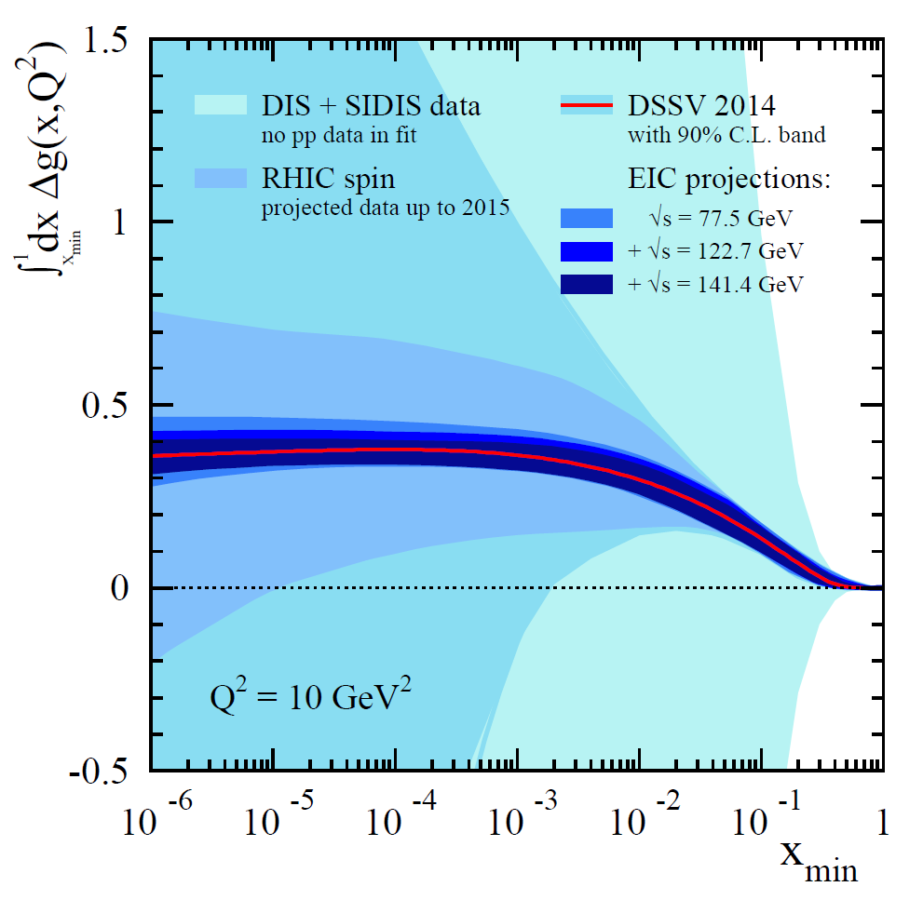
An EIC detector based on sPHENIX
-1<η<+1 (barrel) : sPHENIX + DIRC/TOF
-4<η<-1 (e-going) :
High resolution calorimeter + Aerogel RICH
+1<η<+4 (h-going) :
  1<η<4 : GEM tracker + Gas RICH
  1<η<2 : Aerogel RICH
  1<η<5 : EM Calorimeter + Hadron Calorimeter
Along outgoing hadron beam: ZDC and roman pots
Working title: “ePHENIX”
LOI: arXiv:1402.1209
Cost: 75 M$ including contingency
This is an evolving concept
Updating concept as sPHENIX and
detector R&D refines
Ping down landscape of gluon spin
US-EIC physics: Z. Meziani, Mon Afternoon

Slide 18
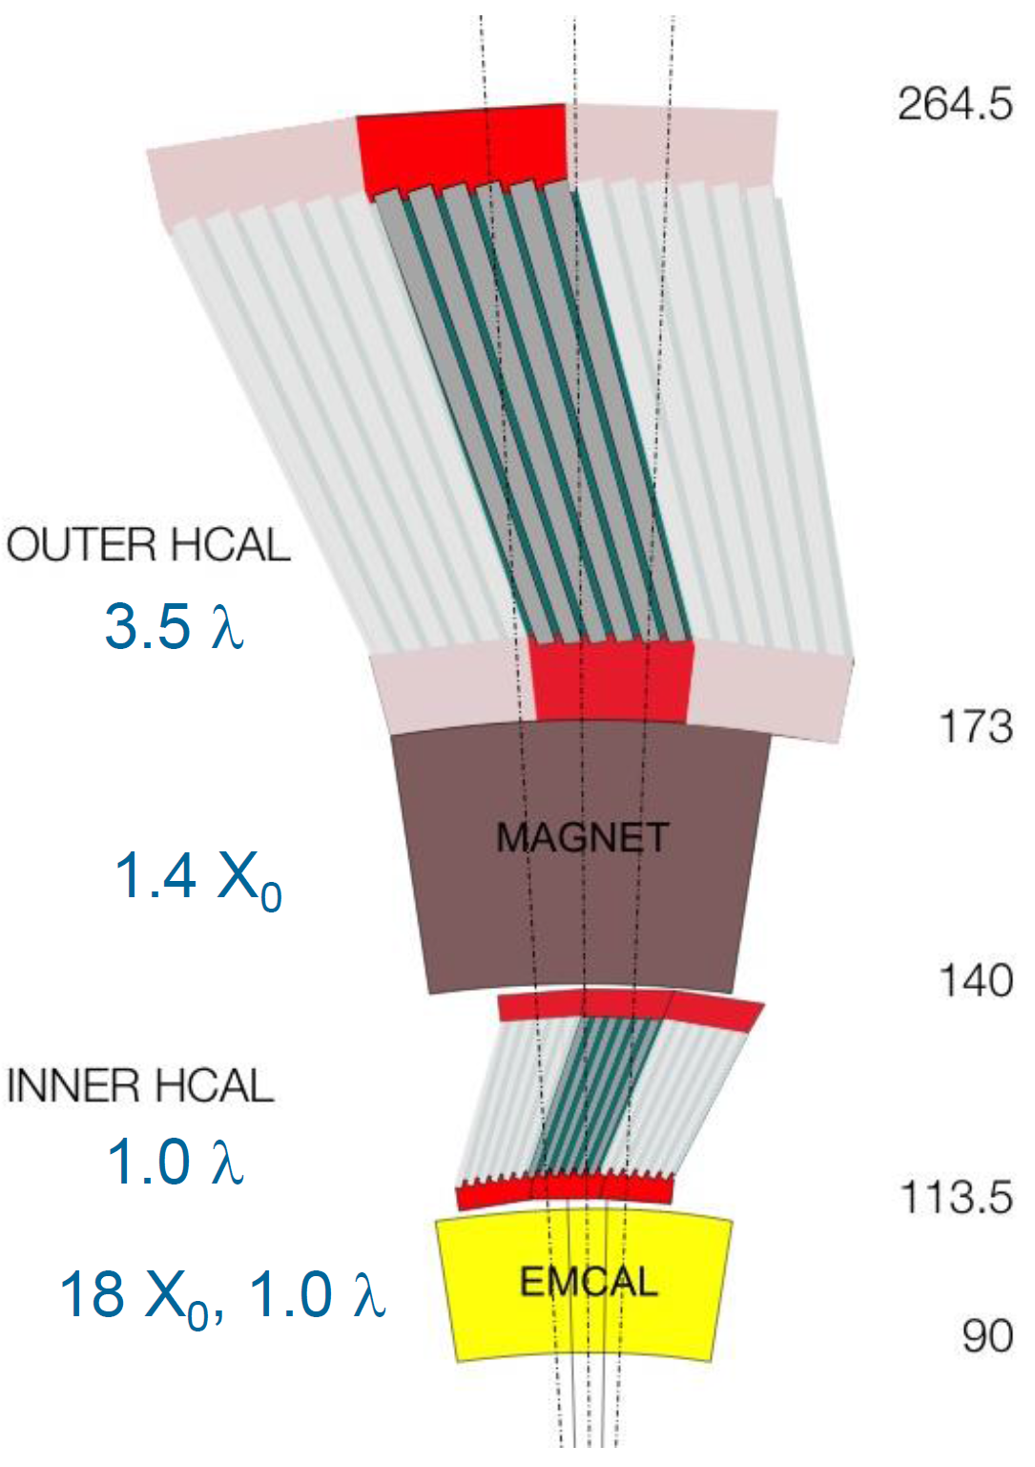
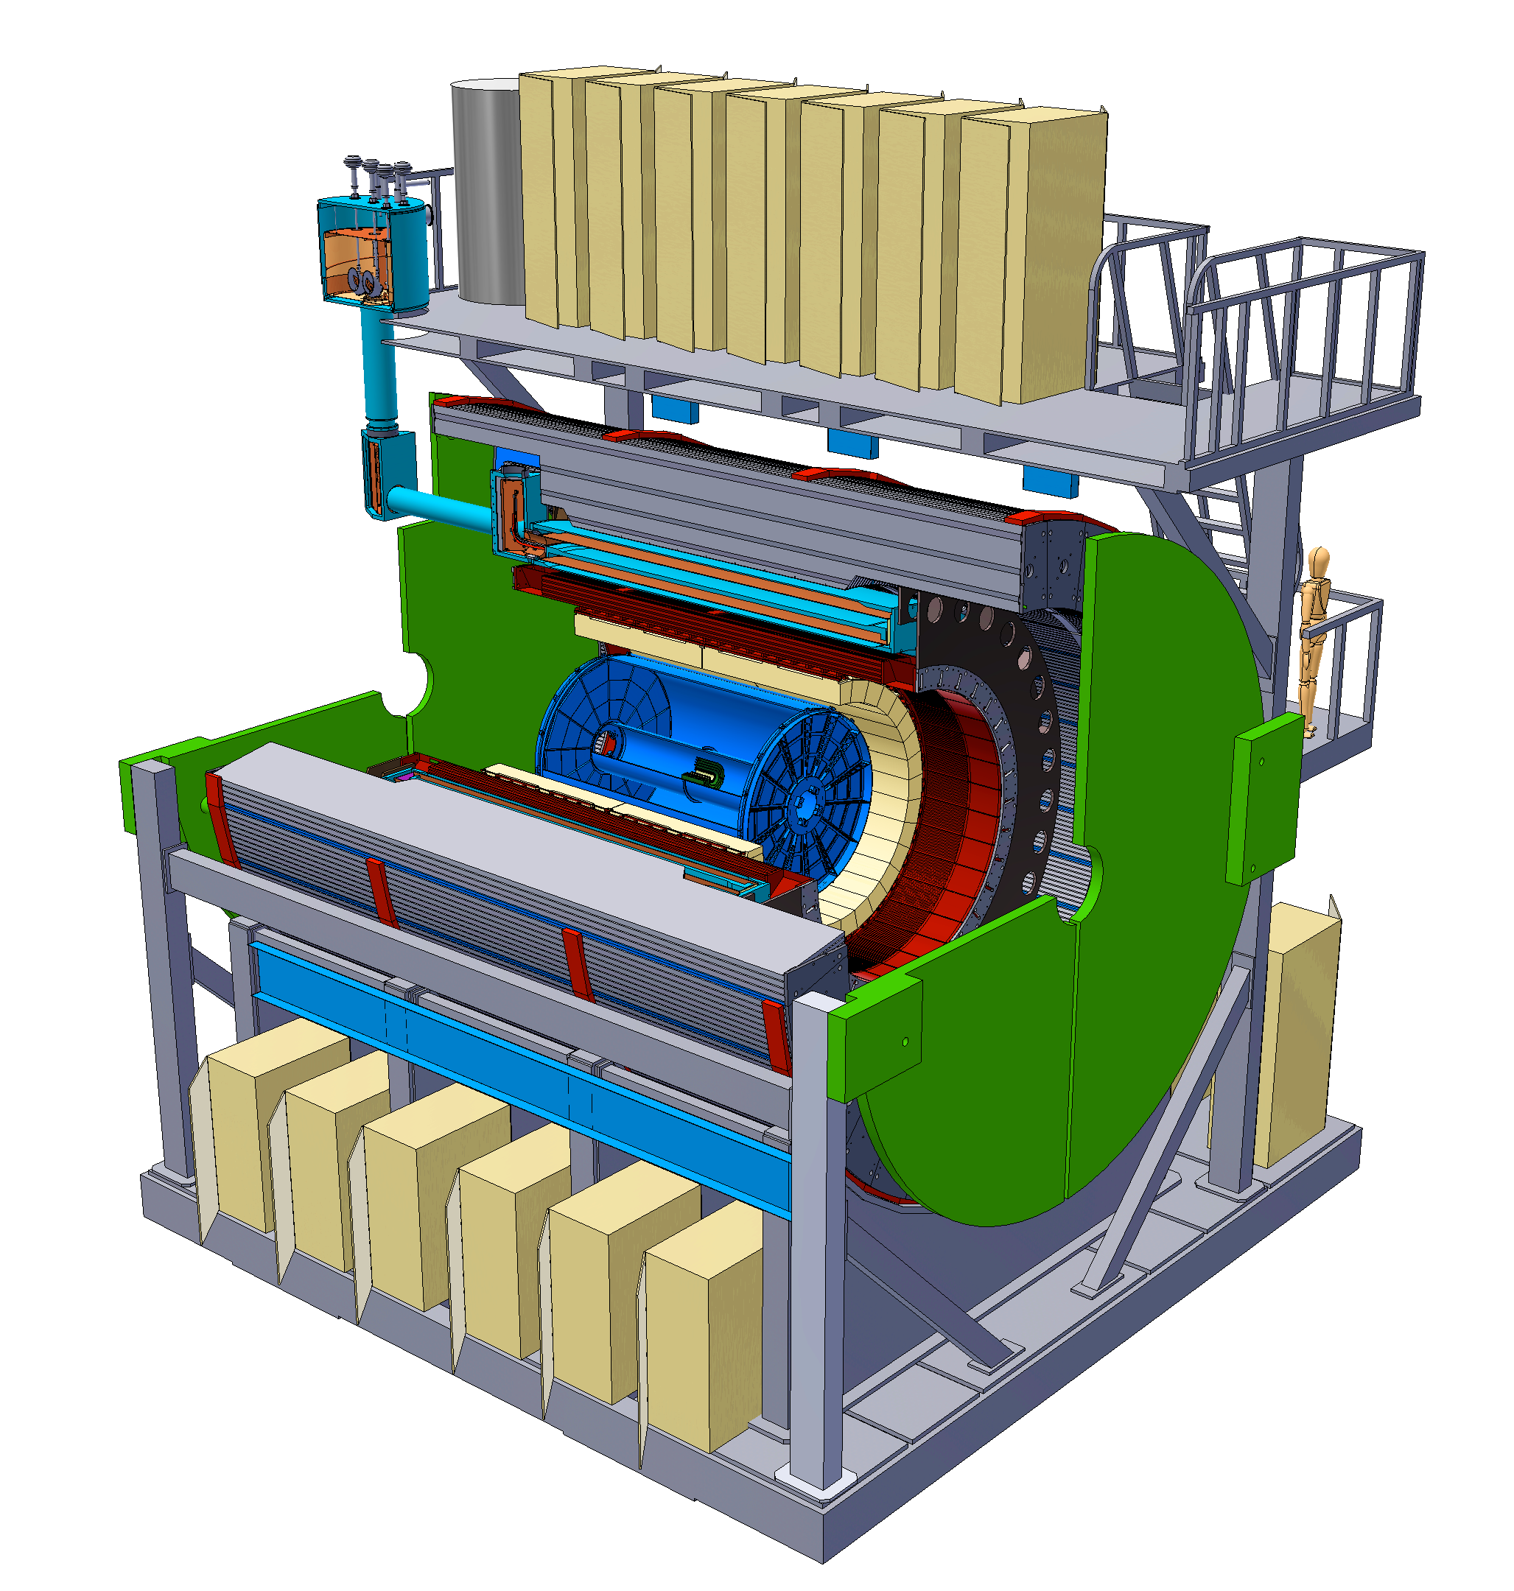
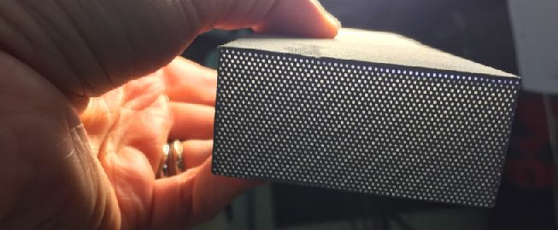
Detector highlights
Radius (cm)
|η|<1.1
B_{z} = 1.4 T
EMCal SPACAL module

Slide 19
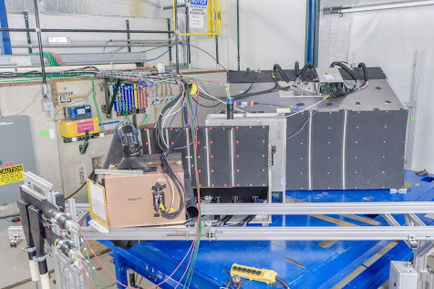
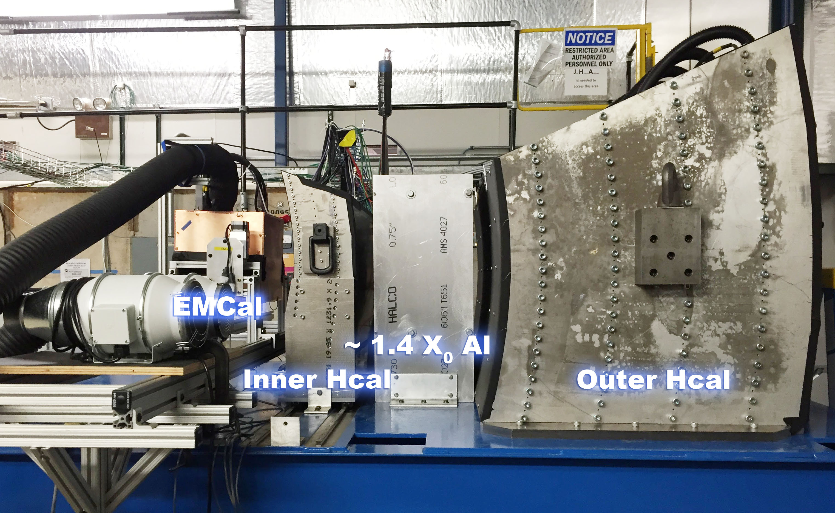
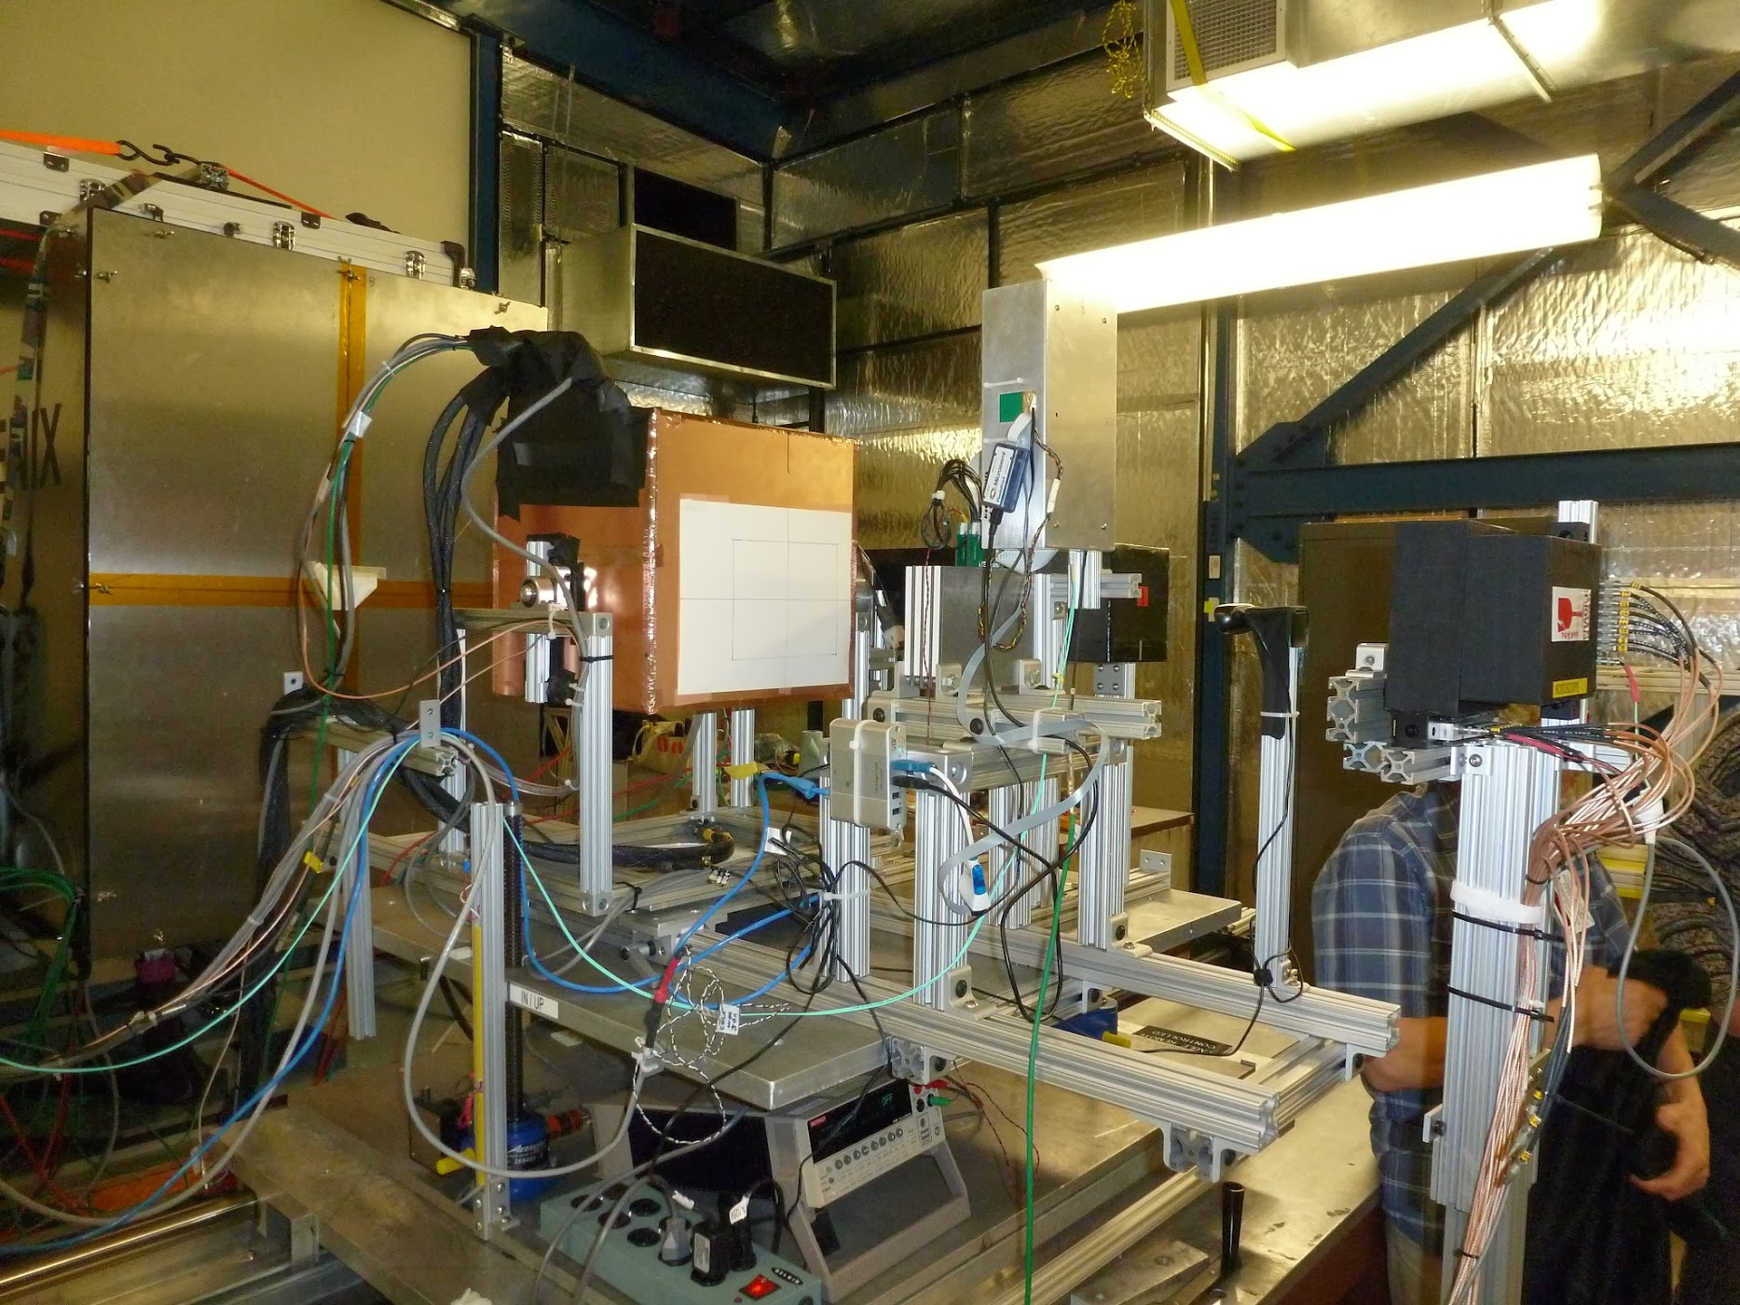
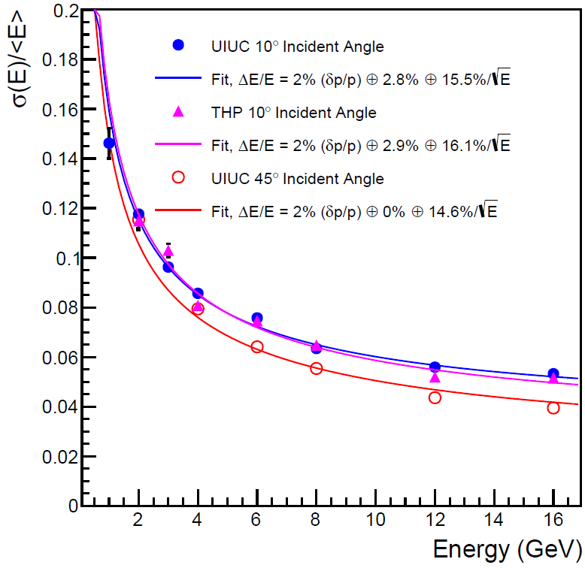
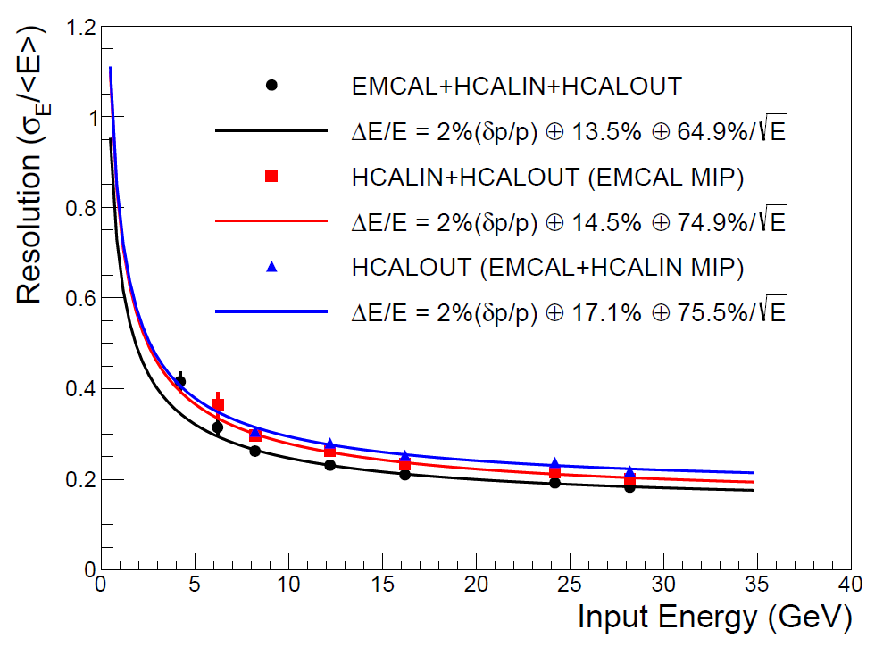
Calorimeters beam tests
February 2014
Proof of principle
February 2016: η~0 prototype
February 2017: η~0.9 prototype
Electron
Energy resolution
arXiv:1704.01461
Pion
Energy resolution
arXiv:1704.01461
sPHENIX beam test data
sPHENIX beam test data

Slide 20





Super conducting magnet
1.4 Tesla magnet, Ф = 2.8 m, L = 3.8 m Previously used in BaBar @ SLAC
Moved to BNL in Feb 2015
Successful cold low field test in 2016
On-going full field test
Preparing full field test @ BNL

Slide 21




Tracking
Inner tracking:
MAPS pixel (3-layer) + strip silicon (4-layer)
DCA< 50um for p_{T}>1 GeV/c, <10 um for p_{T}>10 GeV/c
Possible stave production @ CCNU
Outer tracking:
Continues readout TPC @ 1 Tbps, FPGA based data reduction
Low diffusion, high ion mobility Ne-CF₄ gas + Quad GEM + mini pads
RδФ< 200 um
δp/p < 2% for p_{T}<10 GeV/c
sPHENIX simulation
sPHENIX simulation
Full tracking simulation in 0-4 fm Au+Au collisions

Slide 22


Forward tracking
Forward tracking by shaping central field for forward use
Inner tracking (η = 3-4):
  High rate and resolution requirement
  COMPASS-like GEM (R<30 cm) RδФ= 50-70 µm
Outer tracking (η = 1-3):
  Segments & vertex via central tracker
  SoLID-like GEM (R~100 cm) RδФ= 100 µm.
  Alternative: MicroMegas or sTGC
Design tracking in analytical estimation → confirmation with full Geant4 simulation

Slide 23





Full detector simulation + reconstruction
Open source @ : https://github.com/sPHENIX-Collaboration/
sPHENIX Geant4 display of p_{T}=30 GeV/c B⁺-hadron
Design to Simulation
Inner tracker (MVTX and INTT) _
_ MVTX Ladders modeled in details

Slide 24


Simulation of EIC detector addition to sPHENIX
US-EIC physics: Z. Meziani, Mon Afternoon
e-going GEMs
-4.0<η<-1
TPC
-1<η<+1
DIRC
-1<η<+1
h-going GEMs
1<η<2
gas RICH
1<η<4
Aerogel RICH
1<η<2
Geant4 model of detectors
inside field region
TPC
GEMs
e⁻
p/A
eGEM
IP
RICH
Space for Aerogel RICH
-3<η<-1
Fringe field
1.5 T main field
Fringe field
Tracking, with precision displaced vertex in |η|<2
Calorimeters (H-Cal cover η > -1)
AeroGel&Gas RICHs
+AeroGel RICH
TPC+DIRC
p/A
TOF (M. Chui, Friday)
e⁻
η

Slide 25



Evolving upgrade concepts
arXiv:1501.06197
CD-0 approval
CDR in preparation
To RHIC PAC 2017
arXiv:1402.1209

Slide 26

Evolving sPHENIX collaboration
sPHENIX collaboration is a new scientific collaboration. Four collaboration meetings.
& 30+ people via phone bridge

Slide 27


Welcome to join the collaboration
Growing collaboration, 64 institutions as of today
Welcoming more Chinese collaborators!
Many opportunities to contribute: in physics program and in detector R&D/construction

Slide 28
Summary
sPHENIX: Study QGP with precision jet and beauty quarkonia @ RHIC
  Completing scientific mission @ RHIC
Hadronic physics opportunities in sPHENIX and proposed forward detector upgrade
  Complementarity of hadronic collisions and DIS, e.g. JLab, COMPASS, EIC
sPHENIX received CD-0 approved, in preparation for CD-1.
Planned data taking start 2022.
sPHENIX detector has advanced design.
  Forward upgrade and EIC: many opportunities for joint detector R&D
Growing collaboration
Welcome more Chinese institutions to join the sPHENIX collaboration

Slide 29

Thank you for your attention!
Credit to sPHENIX collaboration:

