Slide 1

Dark Matter Indirect Searches
Yu-Feng Zhou
Institute of Theoretical Physics, CAS
9th workshop on hadron physics in China and opportunities worldwide

Slide 2
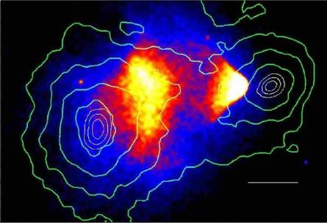
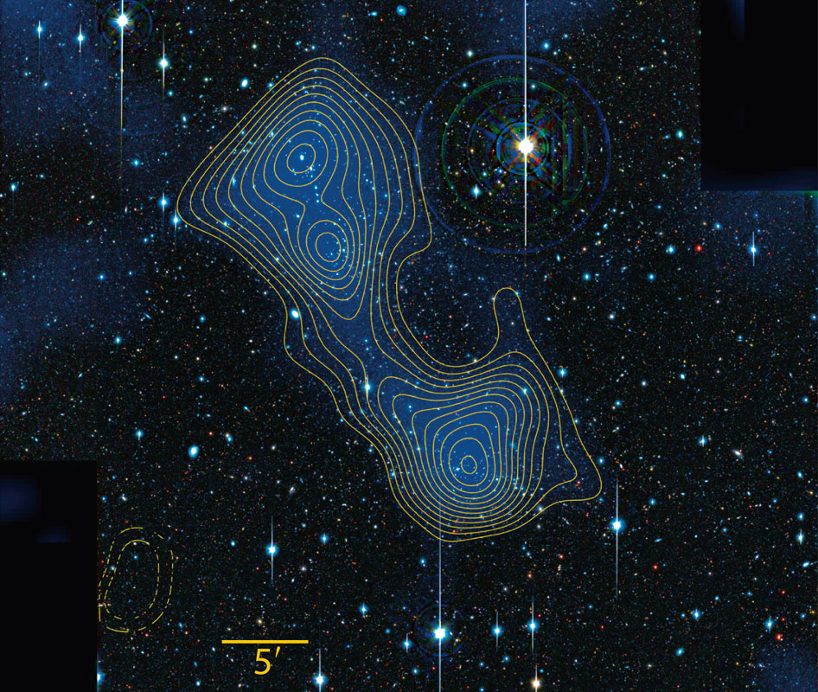
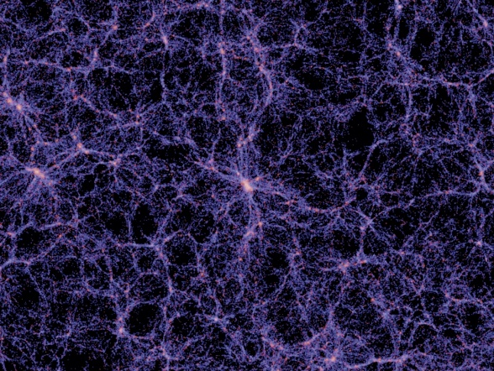
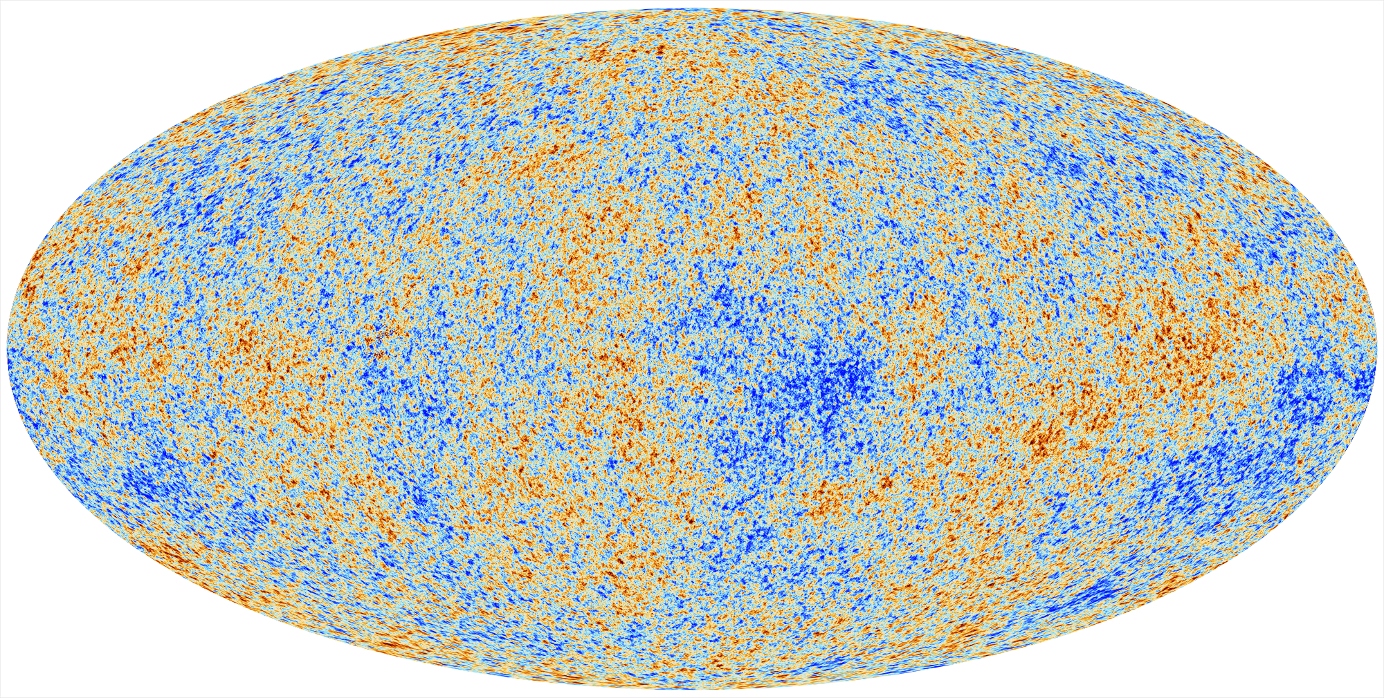
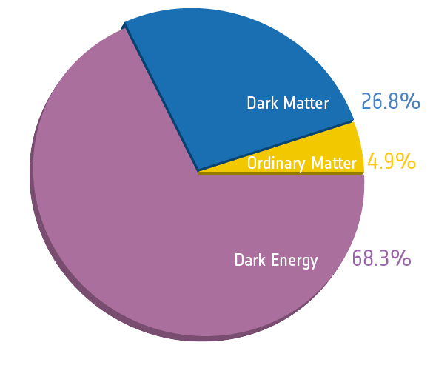
暗物质存在的天文观测证据
1E0657-558
Rotation curves
Bullet clusters
Filaments
Tucker,etal, APJ,496,L5(1998)
J.P. Dierich etal, 1207.8089, Nature
CMB anisotropy
Large scale structure
Millennium Simulation
Planck, arXiv:1303.5062
暗物质的存在已获海量天文观测数据支持，但其不属于任何标准模型中的已知物质，
理解暗物质属性是当代物理学面临的一大挑战！

Slide 3
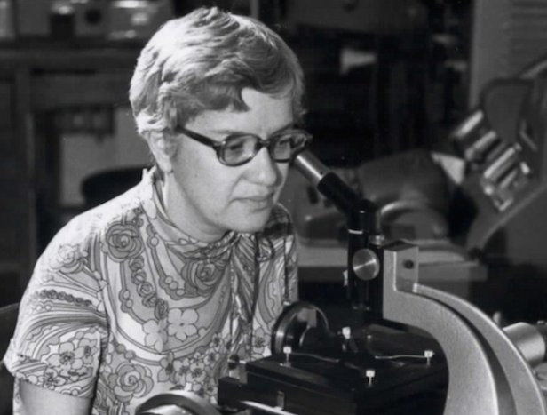
Dark Matter: the World of Unknown
"In a spiral galaxy, the ratio of dark-to-light matter
is about a factor of ten. That's probably a good number for
the ratio of our ignorance-to-knowledge. We're out of kindergarten, but only in about third grade."
—Vera Rubin (1928-2016)
Need new ideas !

Slide 4
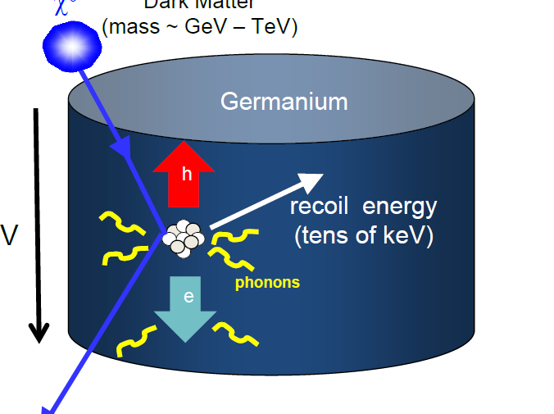
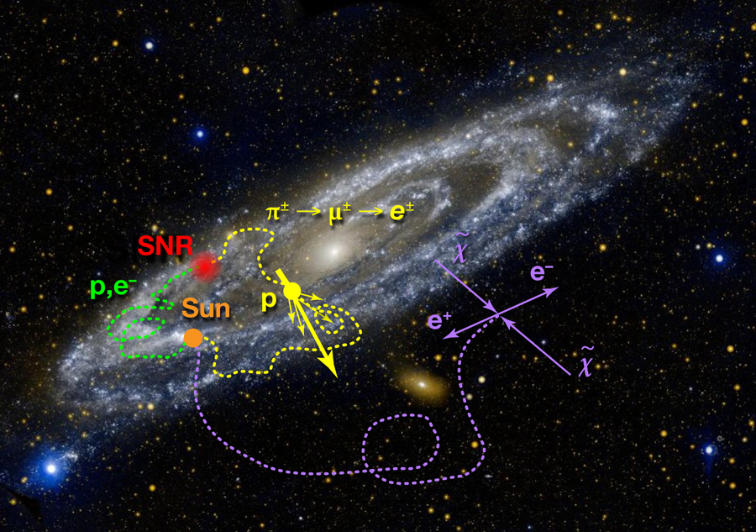
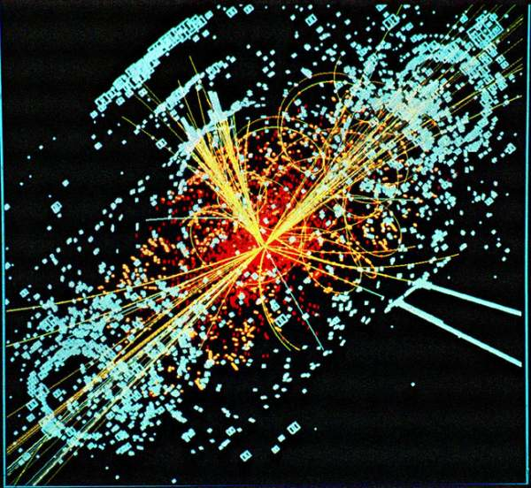
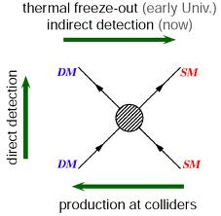
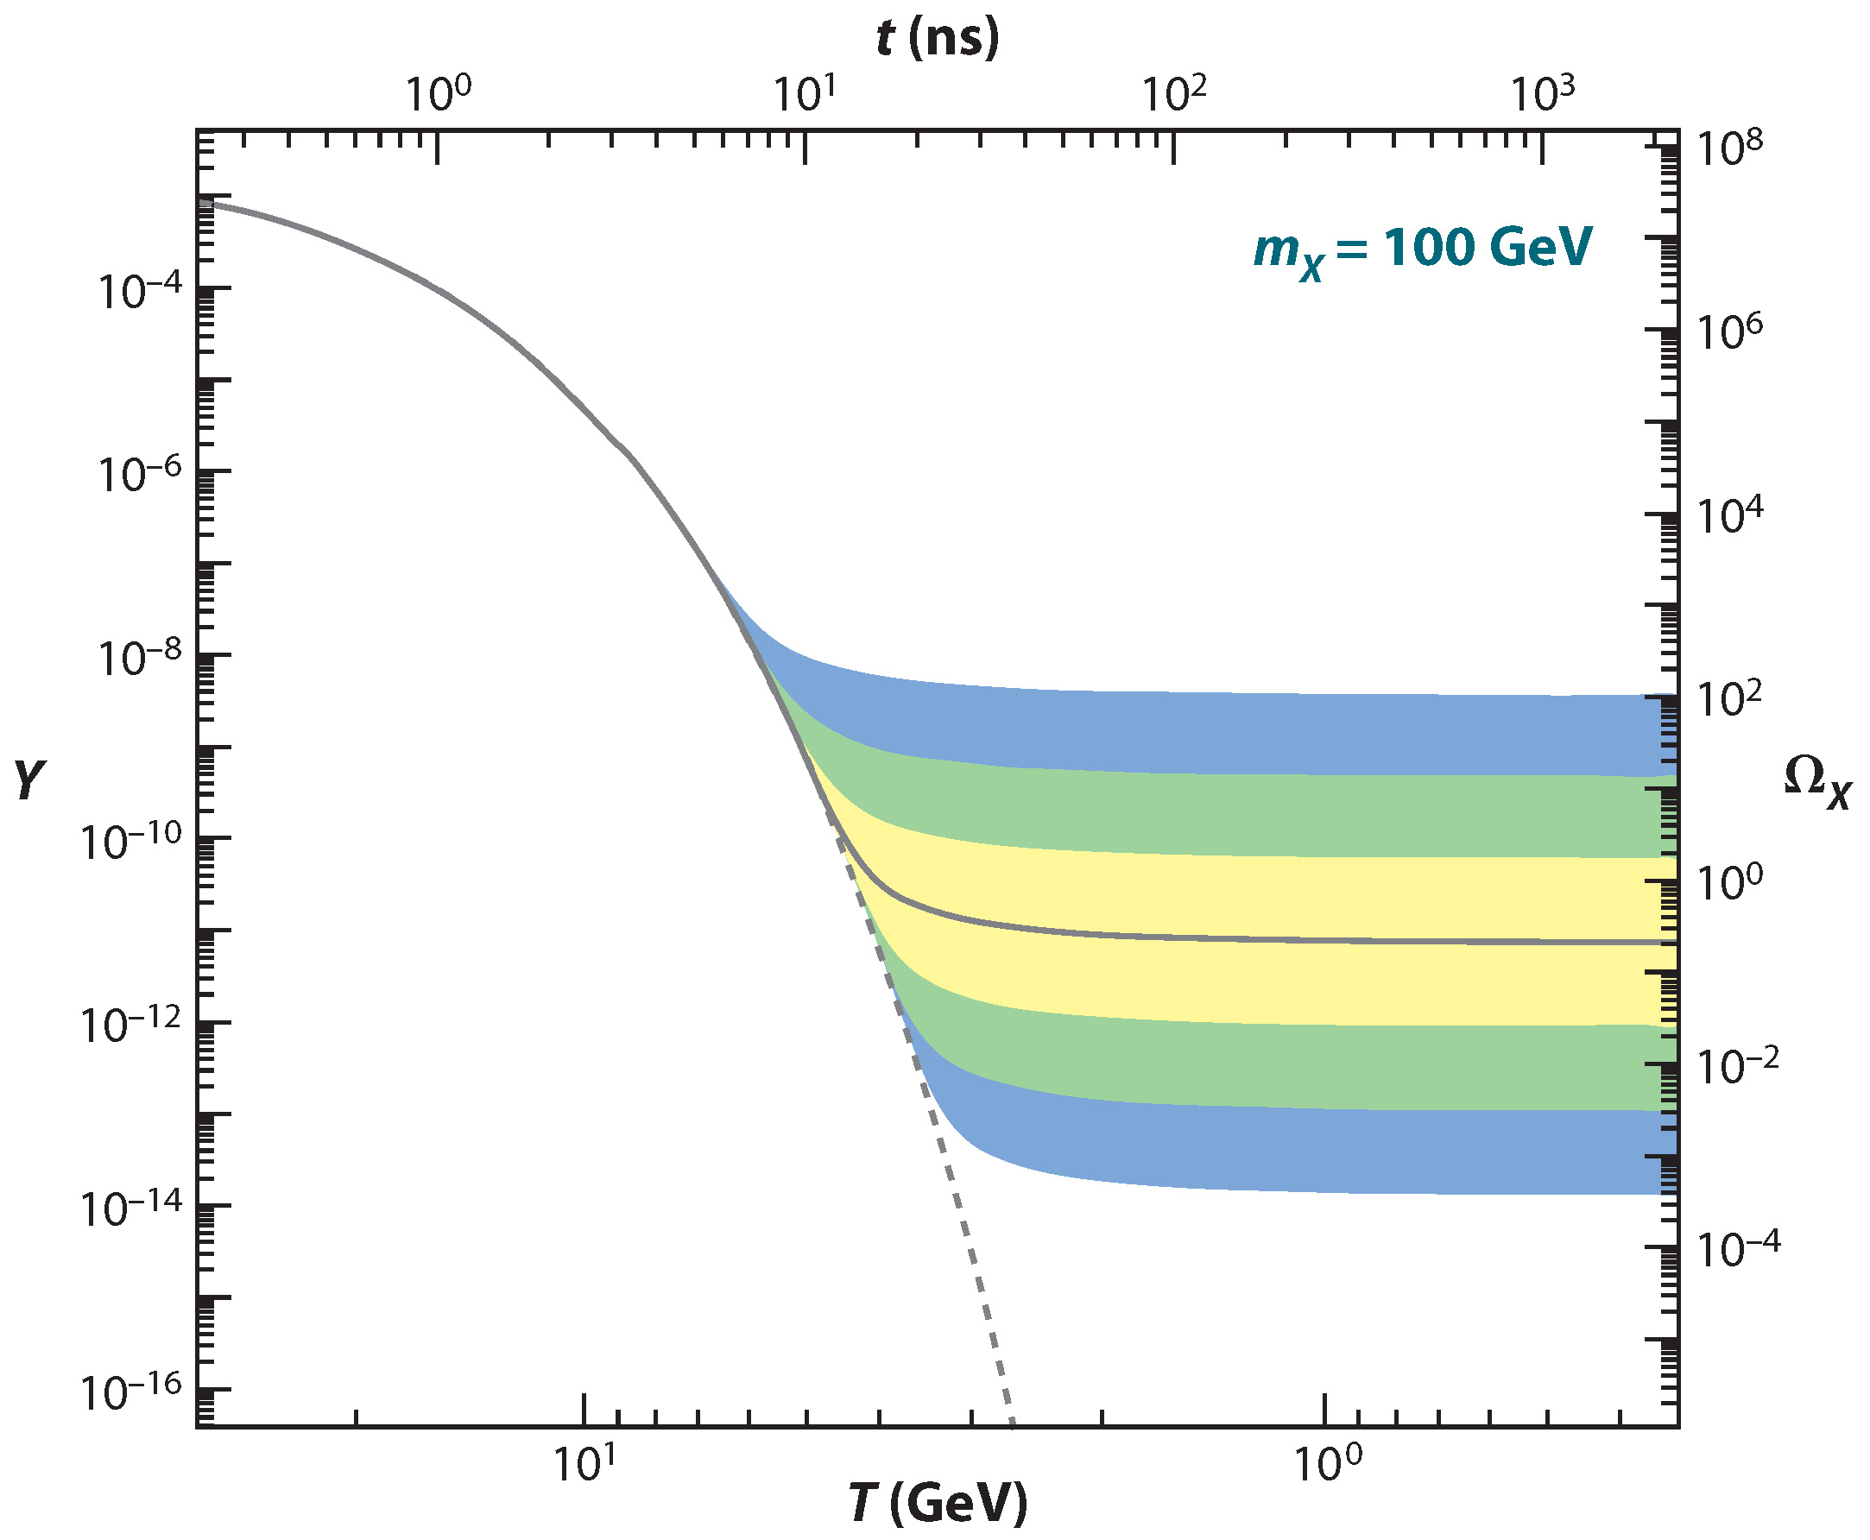
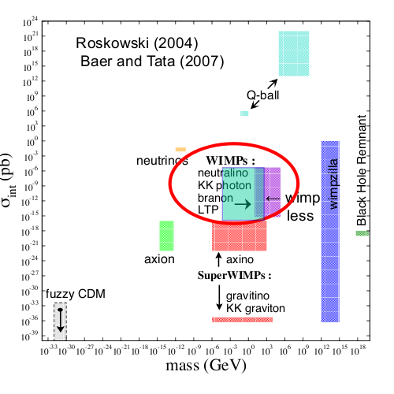
Beyond the gravitational interaction of DM ?
DM is likely to interact with SM particles (weakly)
Direct searches
Indirect searches
Collider searches
WIMPs miracle

Slide 5
DM candidates
Astrophysics
MACHOS
Primordial black holes
Particle physics
Cosmological defects (Q-ball)
WIMPs (LSP, LTP, KK-photon)
WIMPless
SuperWIMPs (Axiono, KK-gravition)
Sterile neutrinos
Axions
Fuzzy DM
Weakly Interacting Massive Particles (WIMPs)
Particle physics independently predicts WIMPs
WIMPs just have the right thermal relic density
WIMPs are testable by the current exp.

Slide 6
各种探测手段的关系
DM
SM
Effective description
DM
SM
DM
DM
DM
DM
DM
SM
SM
DM
DM
SM
SM
SM
SM
DM
DM
DM
直接探测
间接探测
对撞机探测
天文学观测

Slide 7
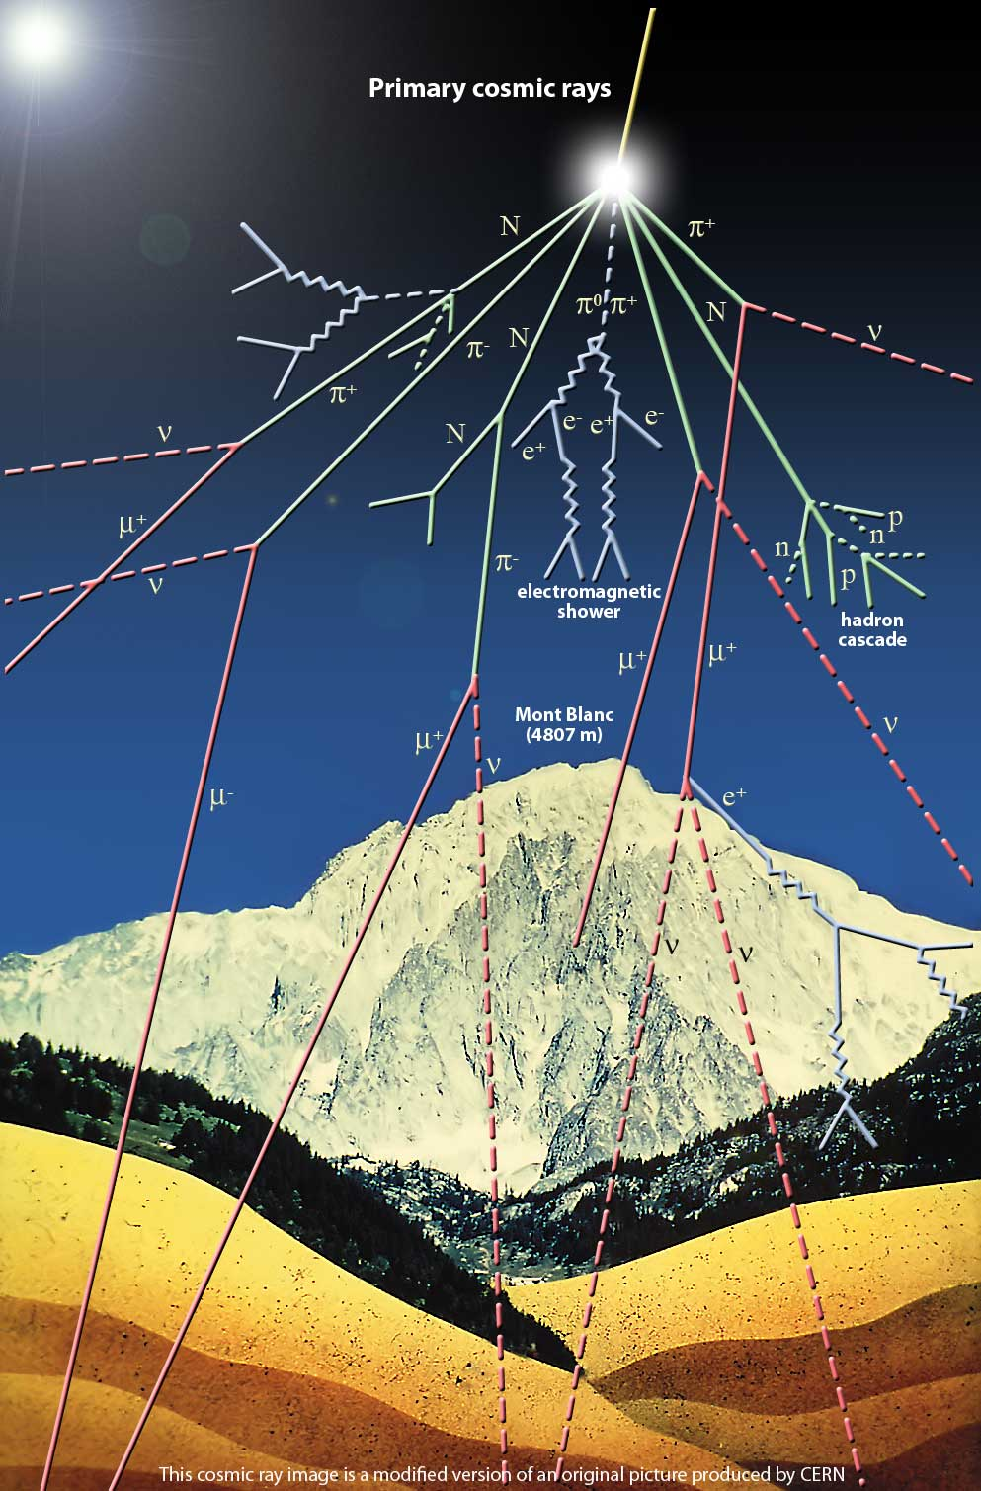
DM direct (underground) searches
Advantages
can probe DM interaction directly
can probe the relative motion of DM particle
(annual modulation)
can probe DM particles whichdo not annihilate or decay (e.g asymmetric DM)
controlled backgrounds (lab exp.)
Challenges
tiny signals (cross sections)
require astrophysics inputs (e.g. local DM density, velocity) which are largely uncertain
Interpretation is model (target) dependent:
contact interactions, elastic scattering, isospin-conserving interaction, etc.,

Slide 8
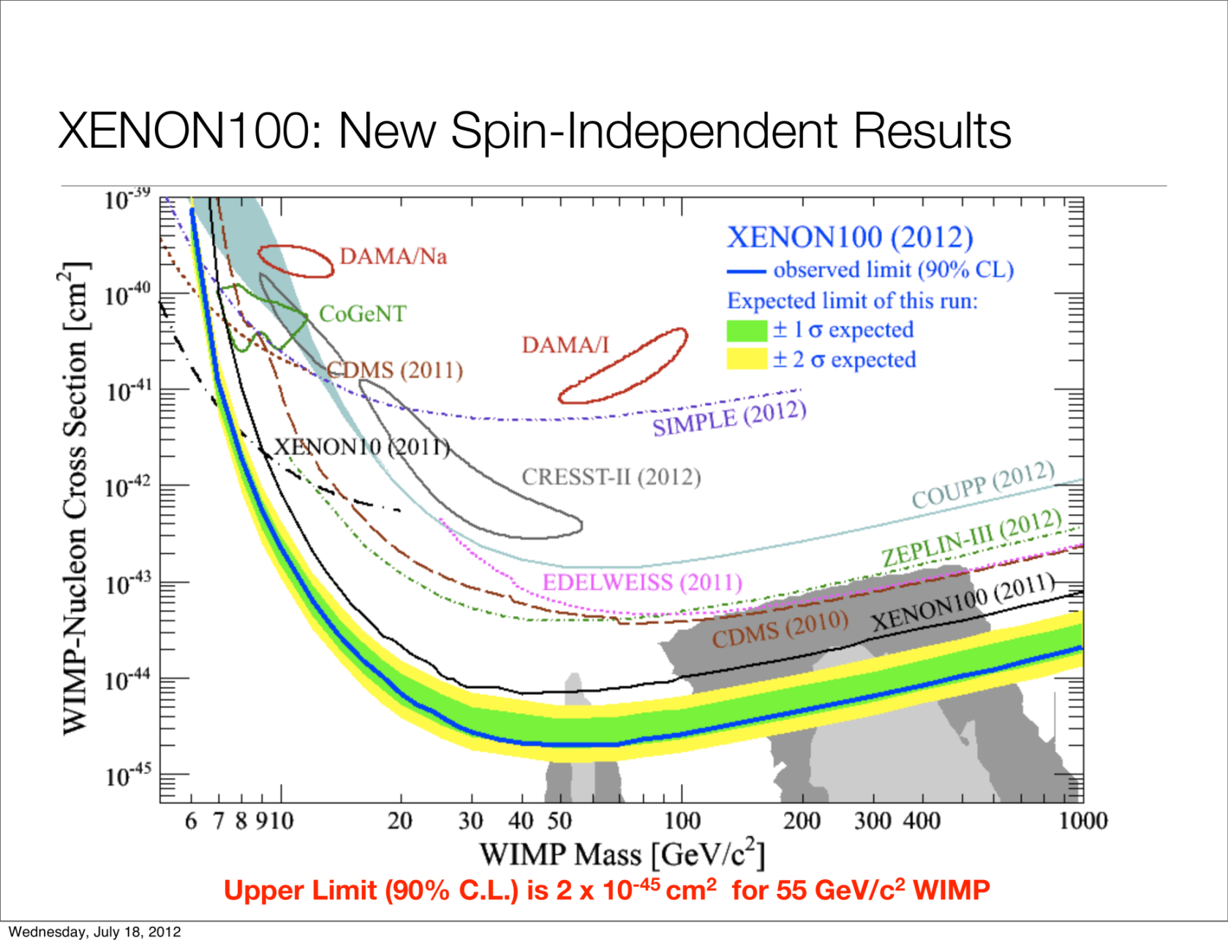
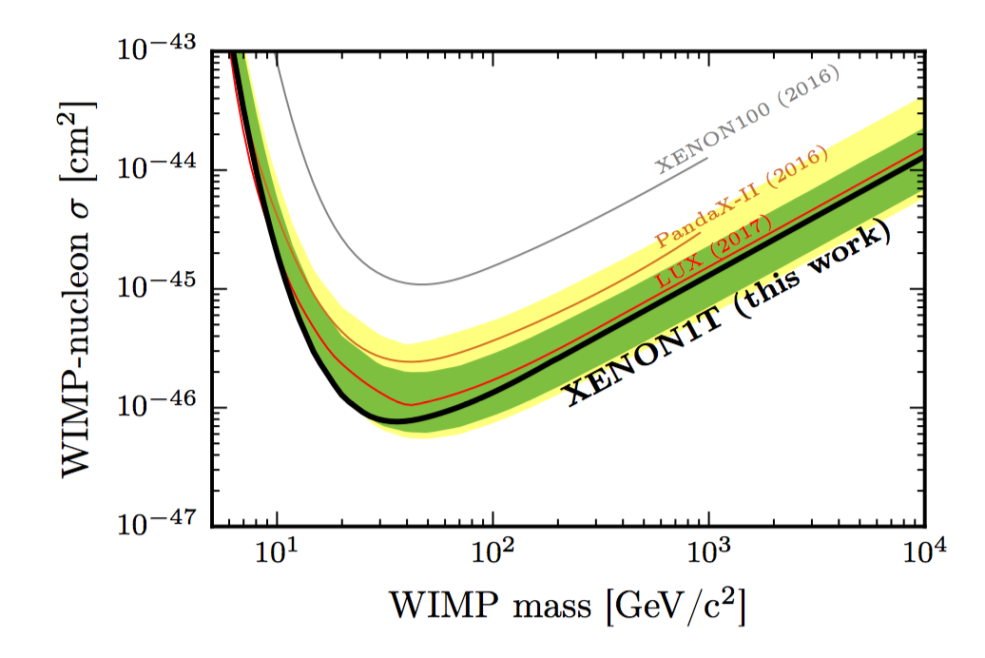
Current status (DM-nucleon scattering)
Not necessarily means WIMPs ruled out
(no direct connection to thermal relic density)

Slide 9
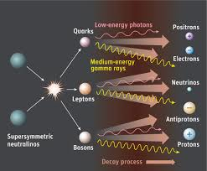
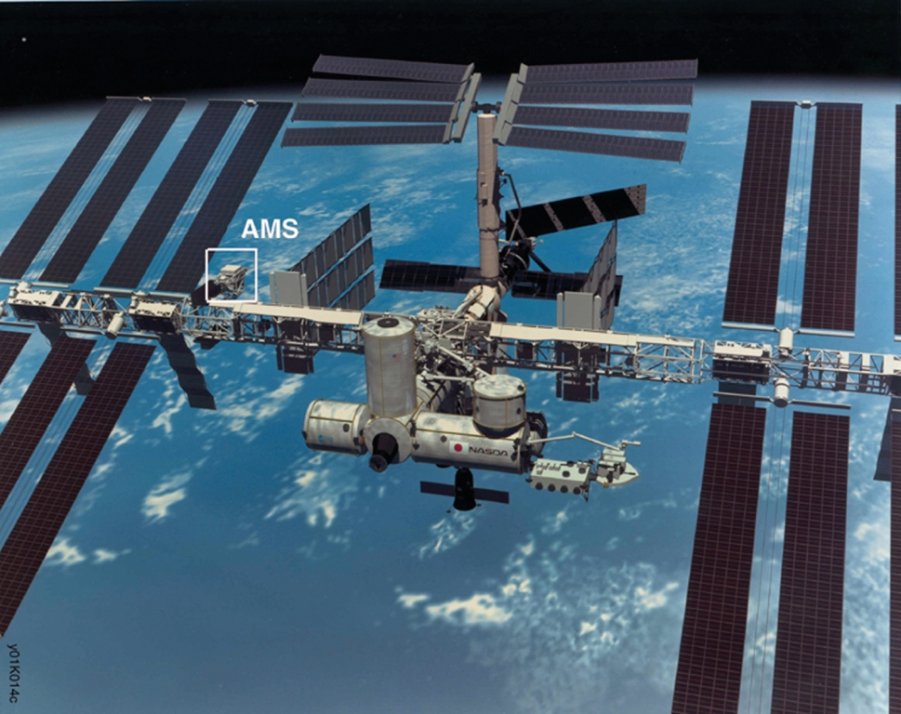
Overview: DM indirect searches
Advantages
Can probe DM annihilation/decay, important to understand the origin of DM.
Tiny signals enhanced by huge volume of the DM halo
Many observables: CR leptons, hadrons, photons in multi-wave lengths. Both energy spectra and morphology can be measured
Challenges
“backgrounds” not well understood, difficult to distinguish “signal” and “background”
Information lost after propagation (for charged CRs)
- spectrum change du to E-dependent propagation, convection, re-acceleration, E-loss
- anisotropic source -->almost isotropic signals
Significant uncertainties in theoretical predictions
e.g. model of CR propagation, distribution of ISM,
interaction cross sections, Solar modulation

Slide 10
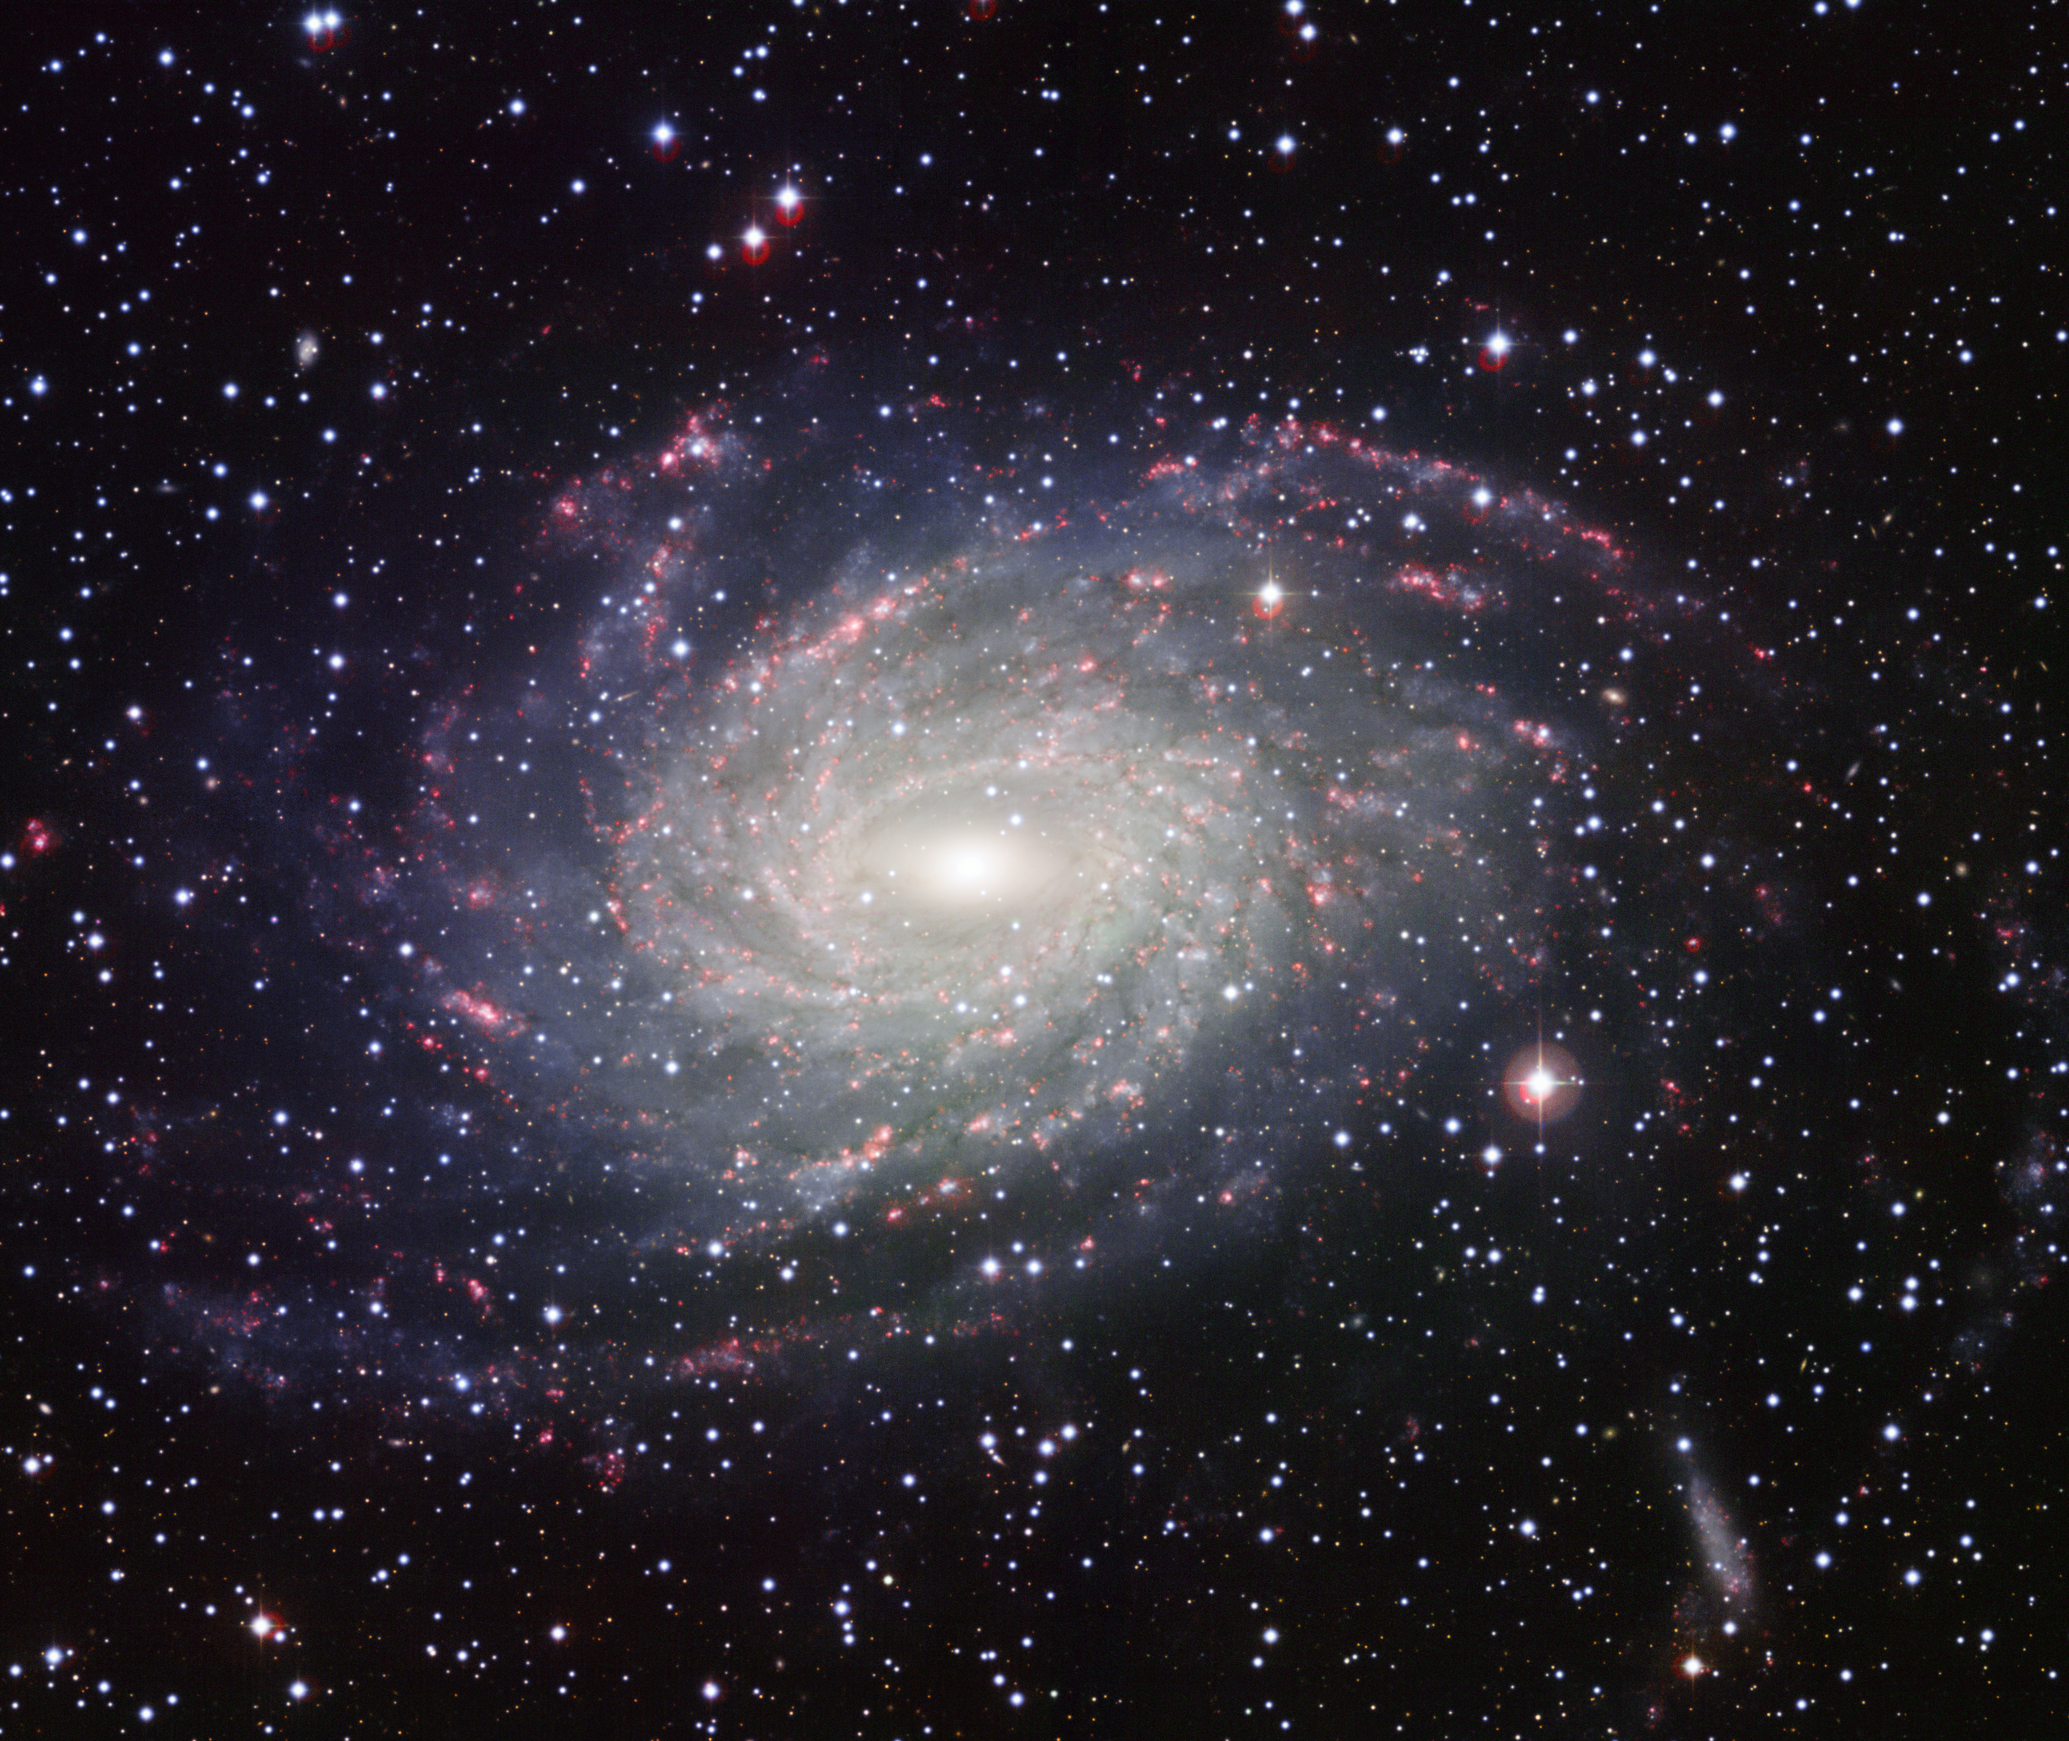
A CR electron takes ~a million year to reach the Earth
Sources
Interstellar medium
SNRs
PWNe
Solar modulation
Solar CR source
ISM
ISRF
B-field
Galaxy
e⁺,p⁻,γ,ν
DM
e⁺,p⁻,γ,ν
Sun
Diffusion model
Z_{h}
Galactic wind V_{c}
R_{h}
Galactic disk
Sun

Slide 11
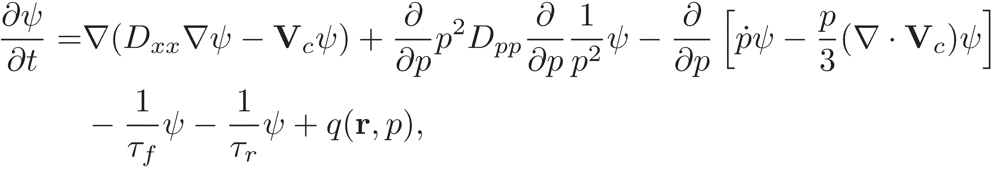
Cosmic-ray transportation equation
diffusion
convection
E-loss
reaccelaration
spallation
decay
source
Sources of CRs
Primary sources from SNR, pulsars
Primary sources from WIMP
Secondary source from CR fragmentation
Processes in Propagation
Diffusion (random B field)
Convection (galactic wind)
Reacceleration (turbulence)
Energy loss: Ionization, IC, Synchrotron,
bremsstrahlung
Fragmentation (inelastic scattering)
Radioactive decay (unstable species)
Solar modulation
Uncertainties
Distribution of primary sources
Parameters in the diffusion equation
Cross sections for nuclei fragmentation
Distribution of B field
Distribution of gas
Approaches
Semi-analytical, two-zone diffusion model.
Numerical solution using realistic
astrophysical data.
GALPROP/Dragon code

Slide 12
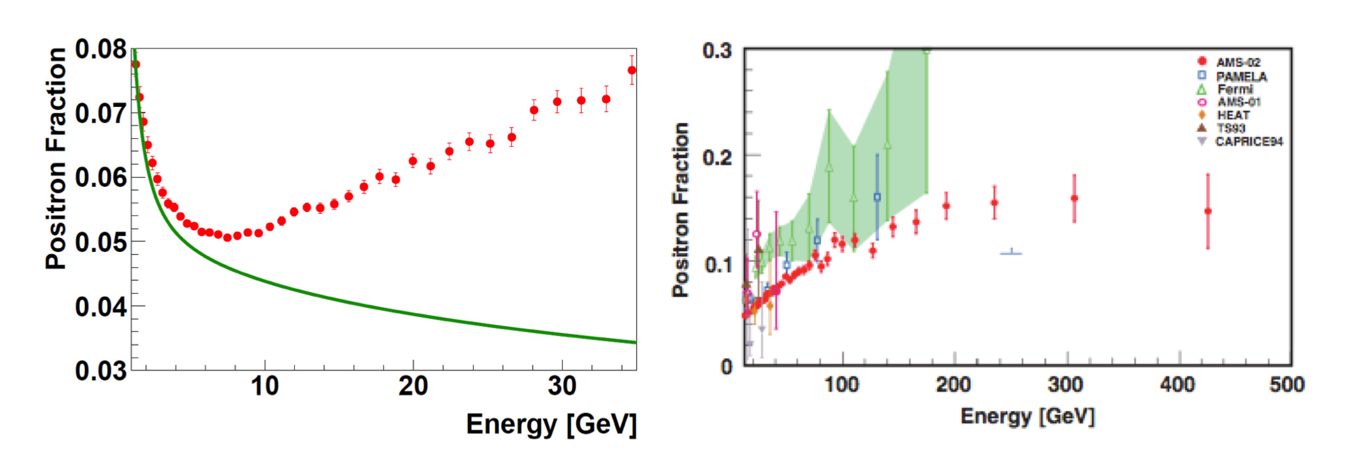
CR positron anomaly
Positron fraction
AMS-02 Phys.Rev.Lett. 113 (2014) 121102
A rise in positron fraction (flux) is well-established (PAMELA, Fermi-LAT, AMS-02)
Viable explanations: PWN, SNR, DM and unconventional secondary sources
Models with modified propagation constrained by AMS-02 B/C data
Upper limits on dipole anisotropies not stringent enough to
distinguish DM and astrophysical (PWNe, SNRs) sources
Ferm-LAT gamma-ray data (also Planck ) strongly disfavor DM annihilation with or
w/o Sommerfeld Enhancement

Slide 13
DM explanations
Large annihilation cross section (boost fac 100-1000)
Leptonic finally states (not quarks, gauge bosons)

Slide 14
Constraints from dwarf galaxies
Dwarf galaxy limit: 2μ
Dwarf galaxy limit: 2τ
PLANK limits
Fermi limits from dSphs
Only DM annihilating into muon-final states are consistent with the dSphs limit
H.B.Jin, Y.L.Wu, YFZ, arXiv:1410.0171,JCAP

Slide 15
Constraints from CMB
Sommerfeld enhancement makes the case even worse
Planck 2015

Slide 16
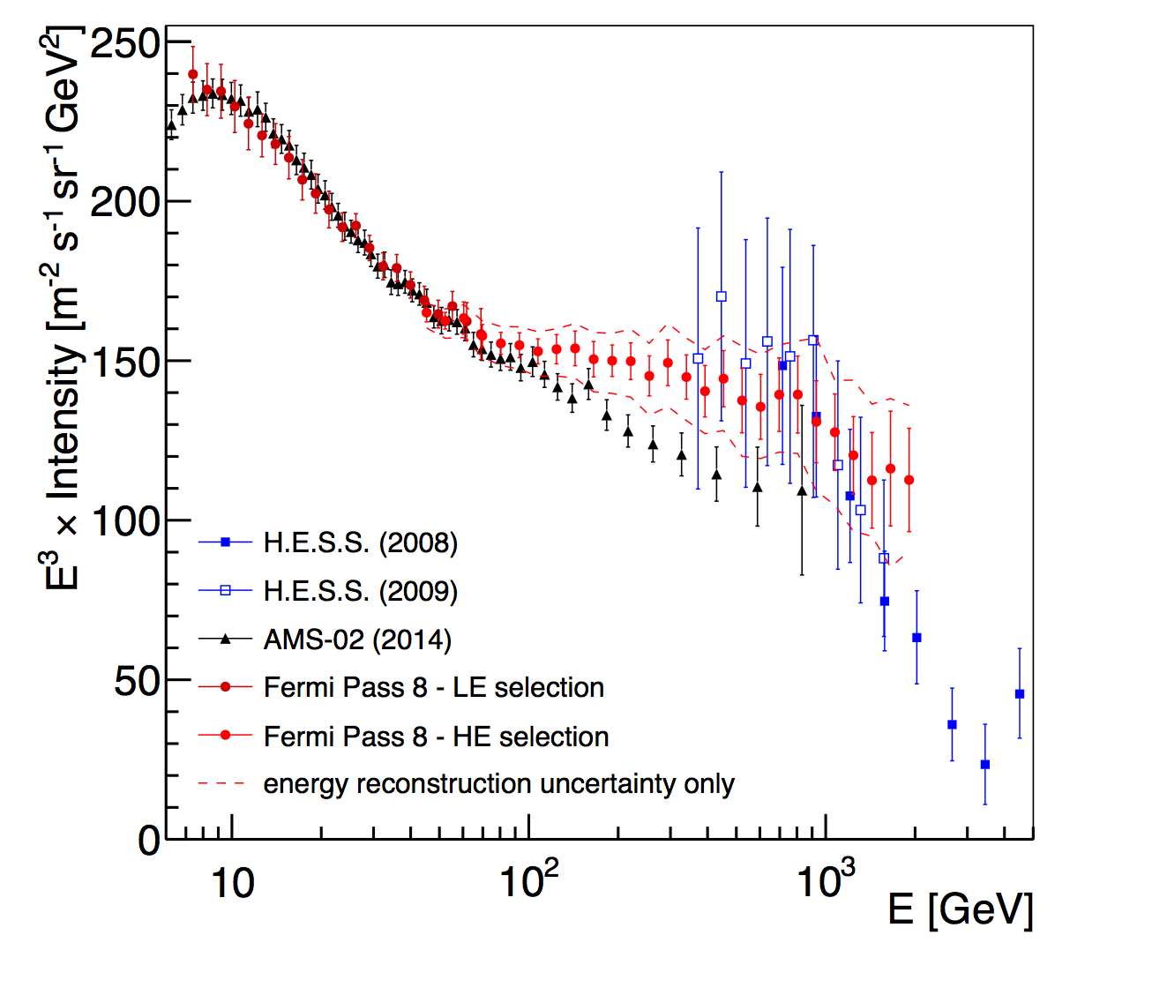
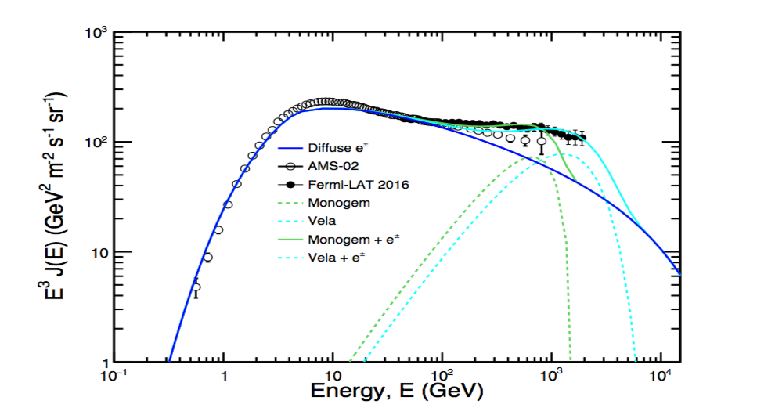
Anomaly in CR electrons ?
The property of primary electrons (background) not well understood
acceleration (in SNR and PWNe)
propagation (cooling through ICS, synchrotron radiation)

Slide 17
Astrophysical explanations(need m nearby sources)
electrons
positrons
SNR
Pulsar
SNR (local)
Pulsar
Secondary
Secondary
electrons+positrons
positron fraction
SNR
SNR (local)
Pulsar
Secondary
Pulsar
Secondary
Require multiple nearby sources
Mauro etal, 1402.0321

Slide 18
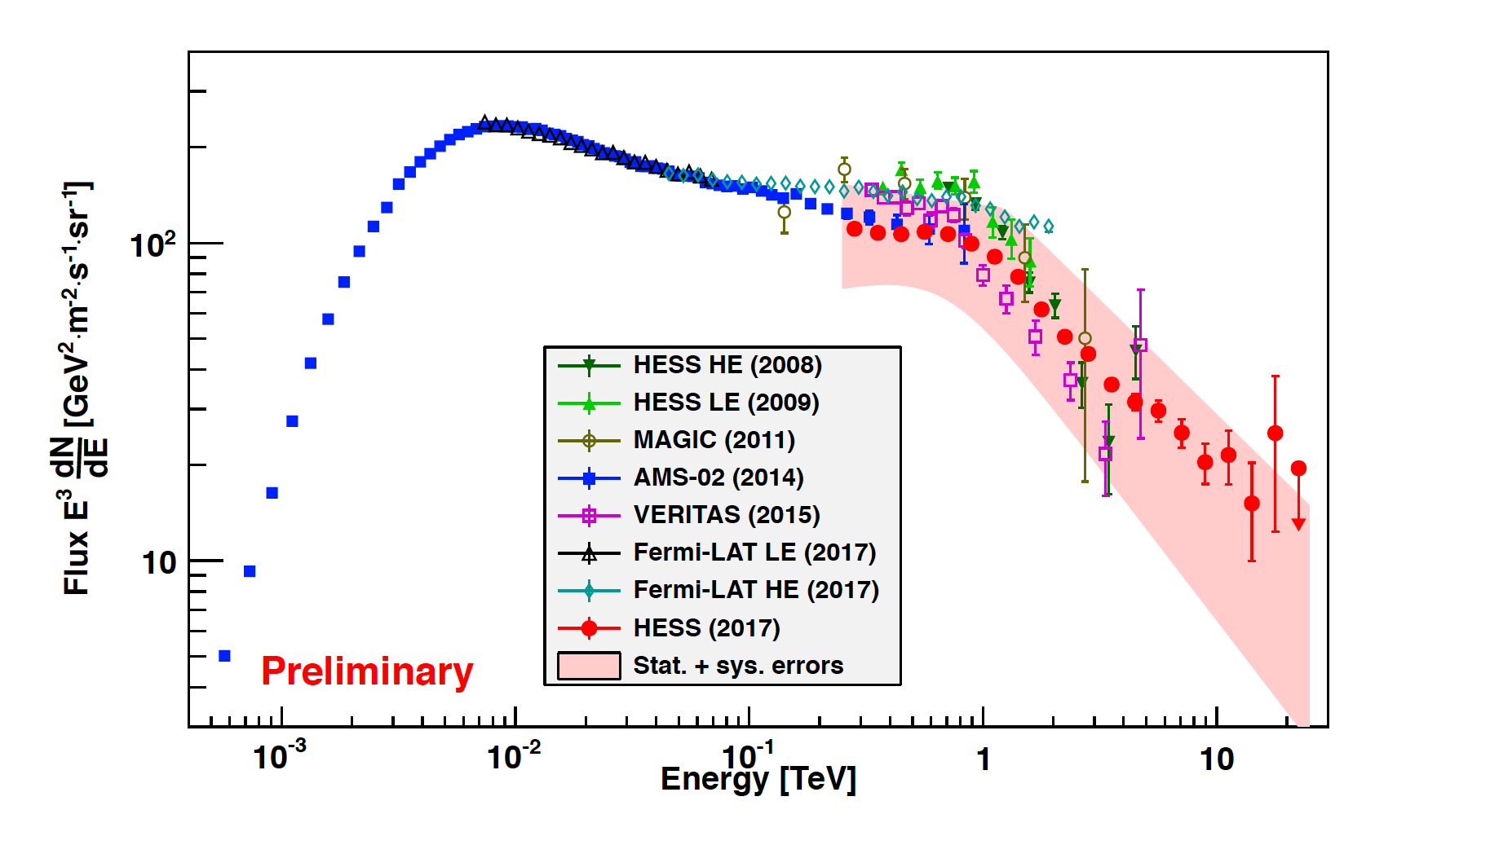
NEXT: CR electrons above TeV
large exposure
good energy reconstruction
high e/p separation power
AMS02, Fermi, DAMPE
HESS, MAGIC, VERITAS
Space-based exp.
Ground exp.
large exposure

Slide 19
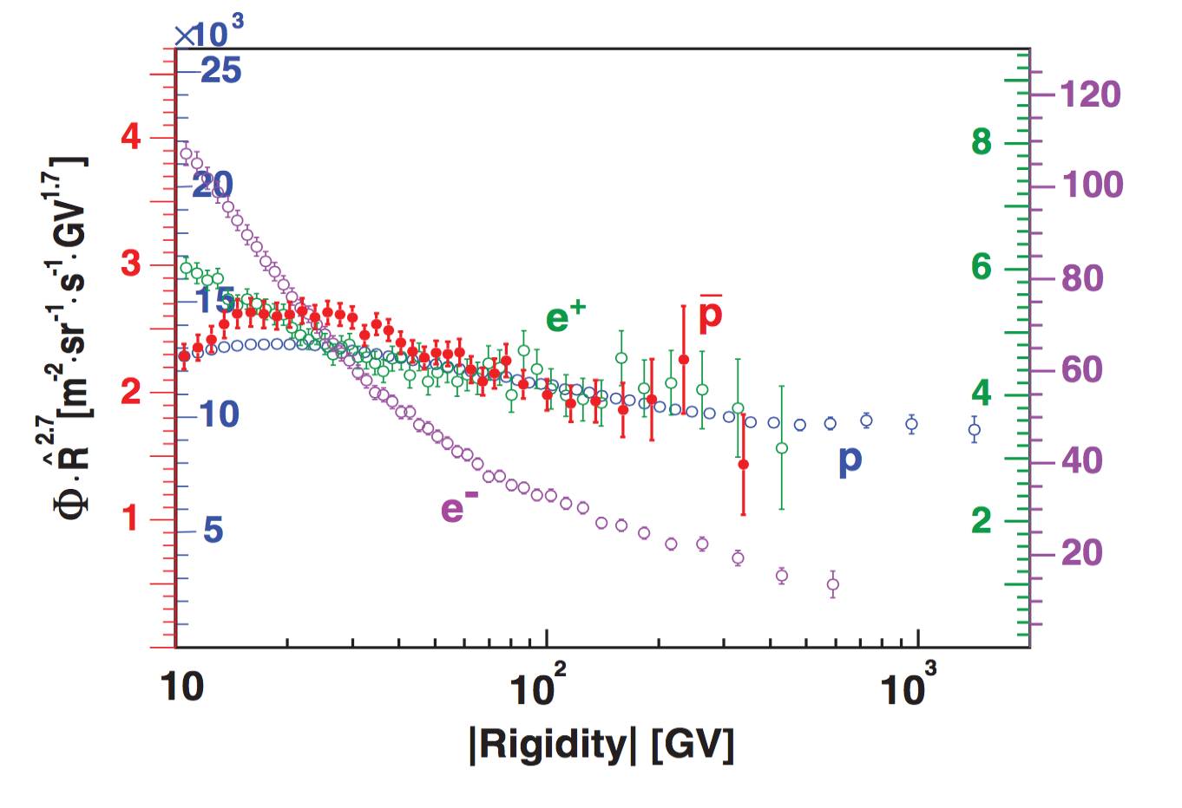
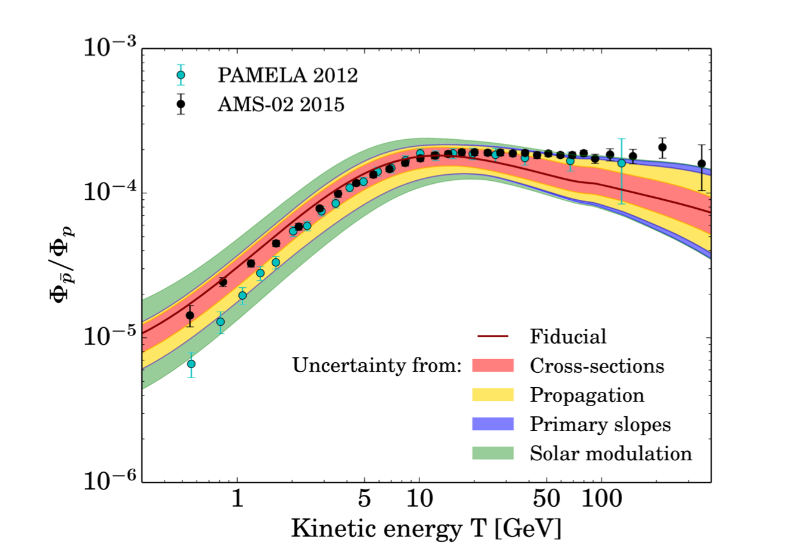
High-energy CR antiprotons
CR antiprotons
PWNe unlikely to contribute
SNRs still possible source
Cooling is less important , compared with CR electrons.
More sensitive to propagation parameters and DM profile
AMS-02 data roughly consistent with background
AMS02 (2016)
Giesen, 1504.04276
H.B.Jin, Y.L.Wu, YFZ arXiv:1504.04601, PRD

Slide 20
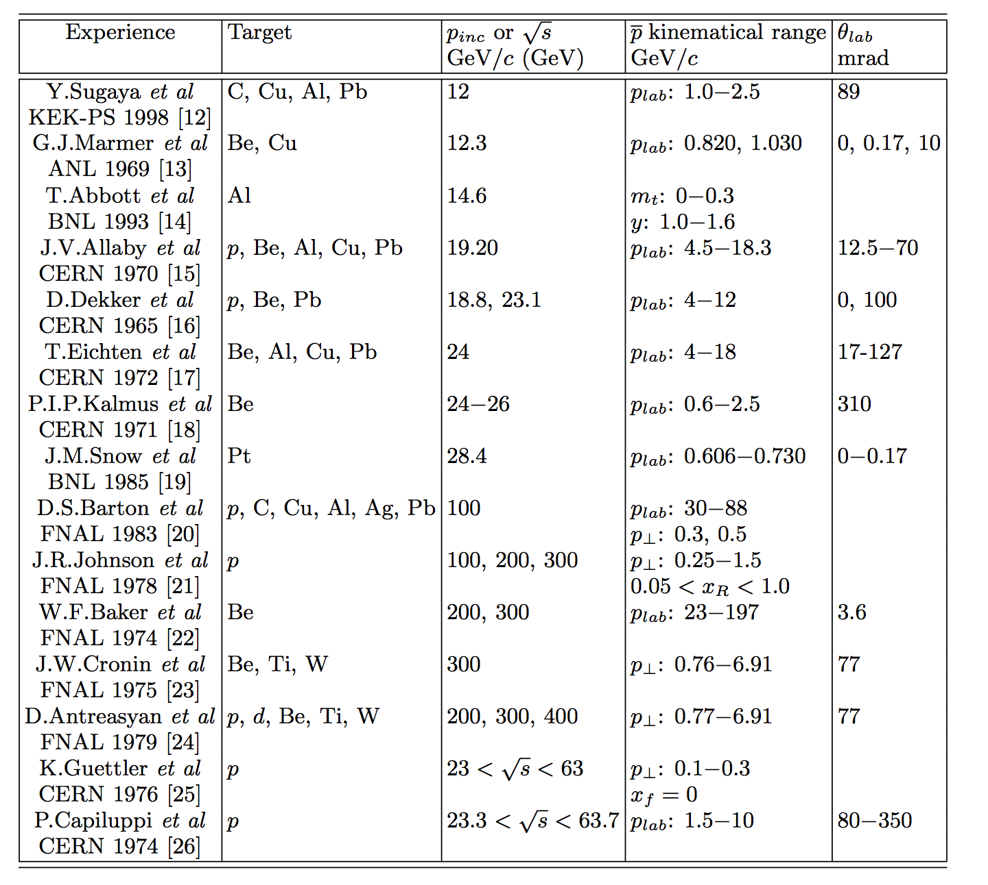
pp, pA cross section data are quite old（1969-1998）
Duperray, astro-ph/0305274
数据一致性低，整体拟合误差大：χ²／dof >4

Slide 21
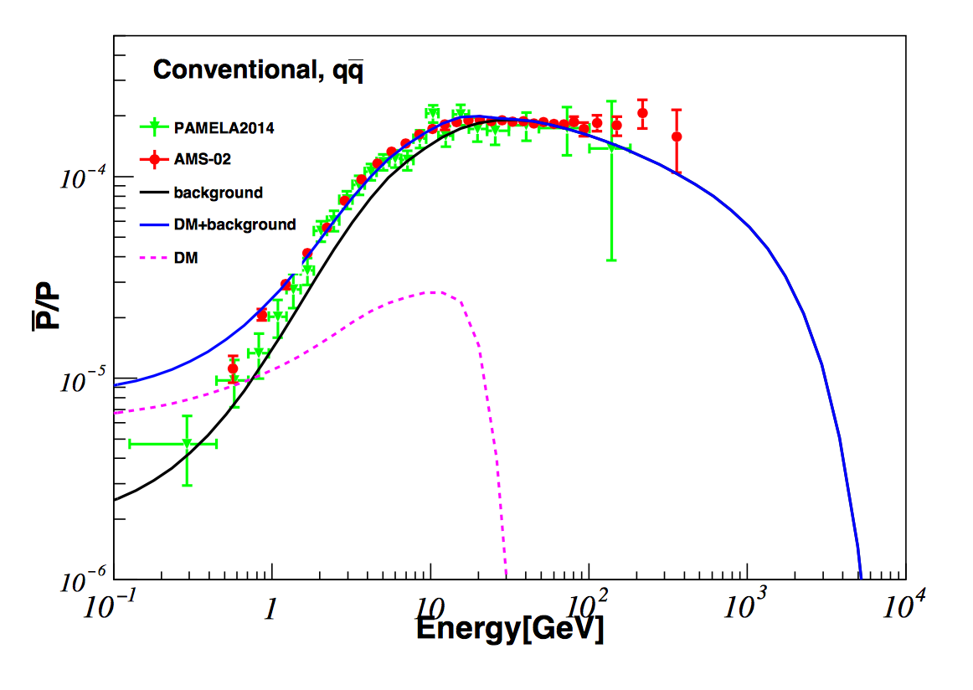
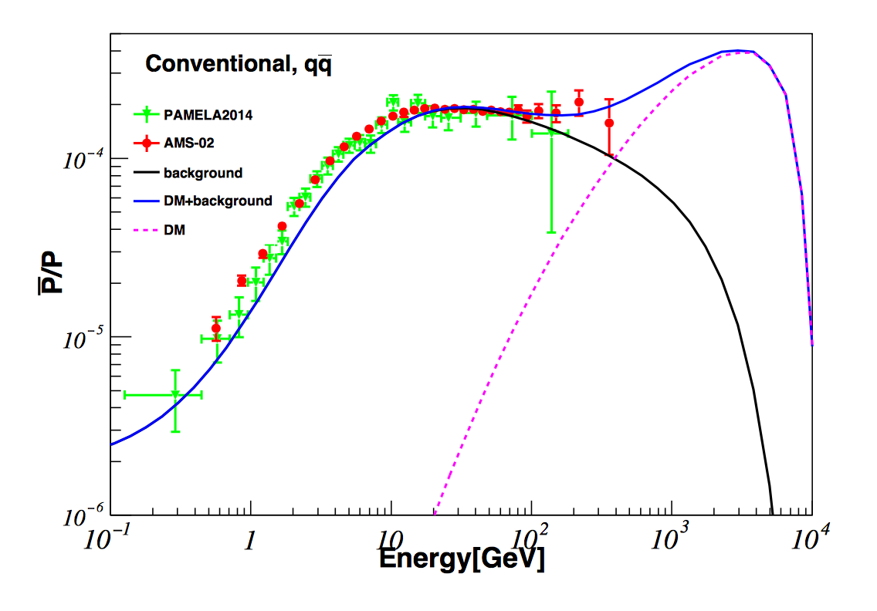
Possible excess and DM interpretation
High energy excess ?
Low energy excess ?
H.B.Jin, Y.L.Wu, YFZ arXiv:1504.04601, PRD
Low energy excess: 40-50 GeV DM to 2b, thermal cross section, consistent with GC γ excess
High energy excess: 10 TeV DM annihilation into 2W, 2b, boost factor ~10-100
Giesen, 1504.04276; Ibe 1504.05554;
Hamaguchi, 1404.05937; Lin, 1504.07230
Chen, 1504.07848; Chen,1505.00134
H.B.Jin, Y.L.Wu, YFZ arXiv:1504.04601, PRD

Slide 22
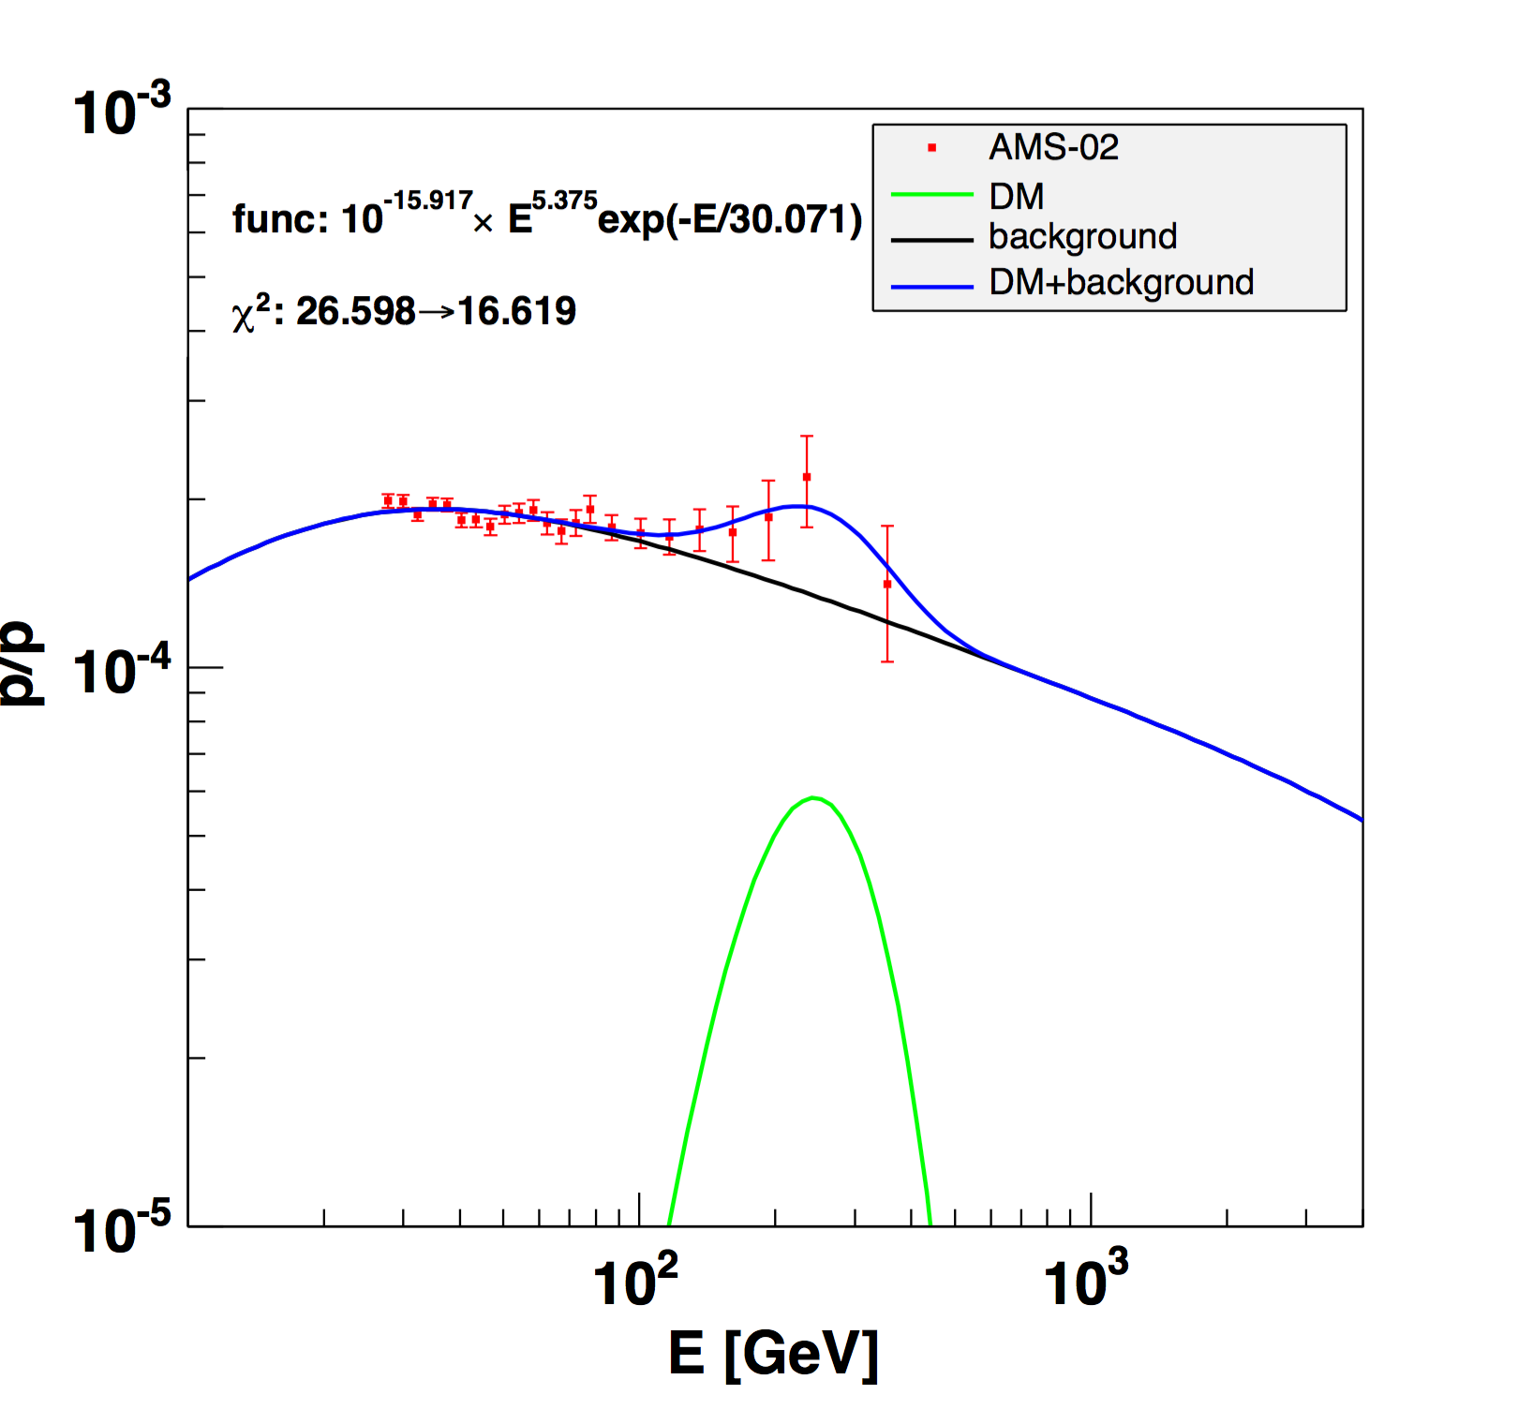
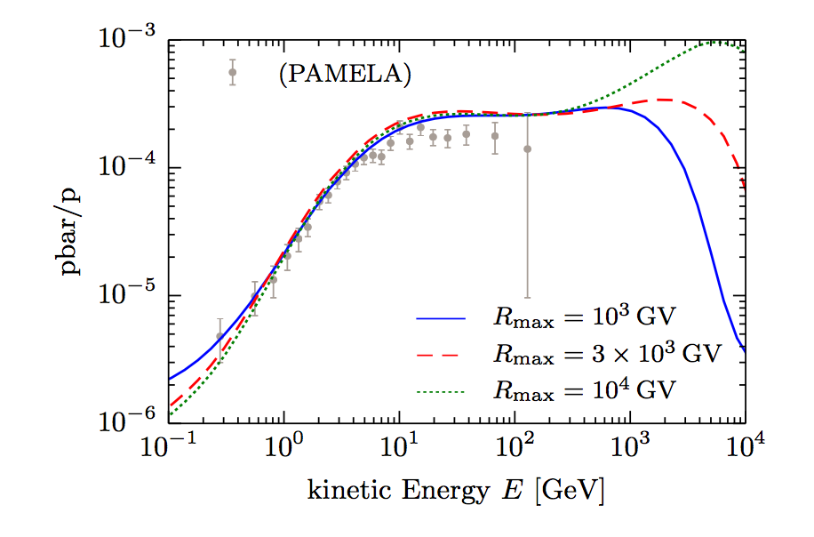
Need a sharp bump
PL with cut off
SNRs
Conventional DM
Implications
The spectral feature can be well-fitted with a power law spectrum with a cut off, typical significance 2.5—3 sigma.
Pulsars are unlikely to produce energetic antiprotons.
SNRs can produce secondary antiprotons but with a flat (or smooth rising) spectrum.
DM direct annihilation (DMDM→f fbar→pbar +X) predicts a broad bump, too smooth to explain the excess in a narrow energy range.
X.J.Huang, Y.L.Wu, YFZ, arXi:1611.01983, PRD

Slide 23
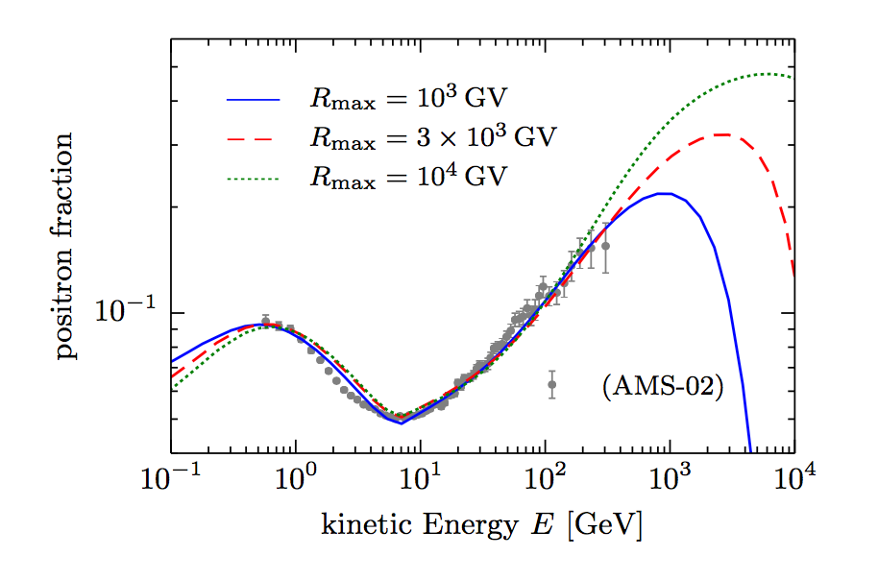
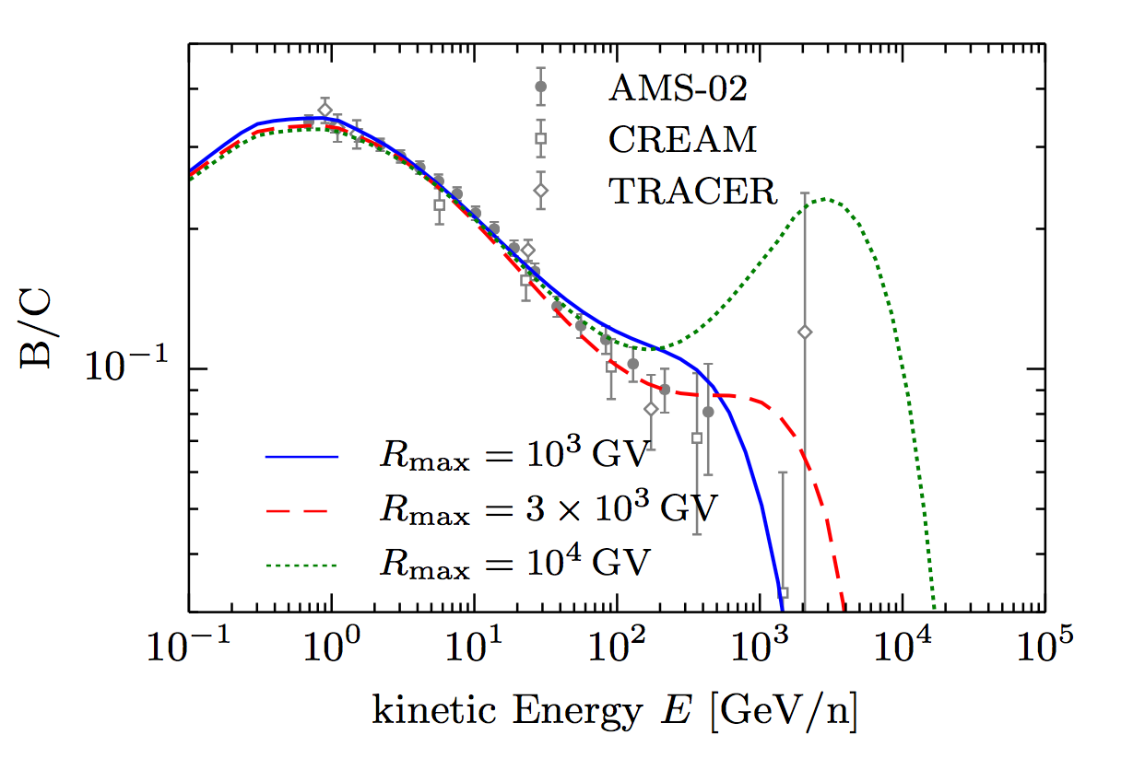
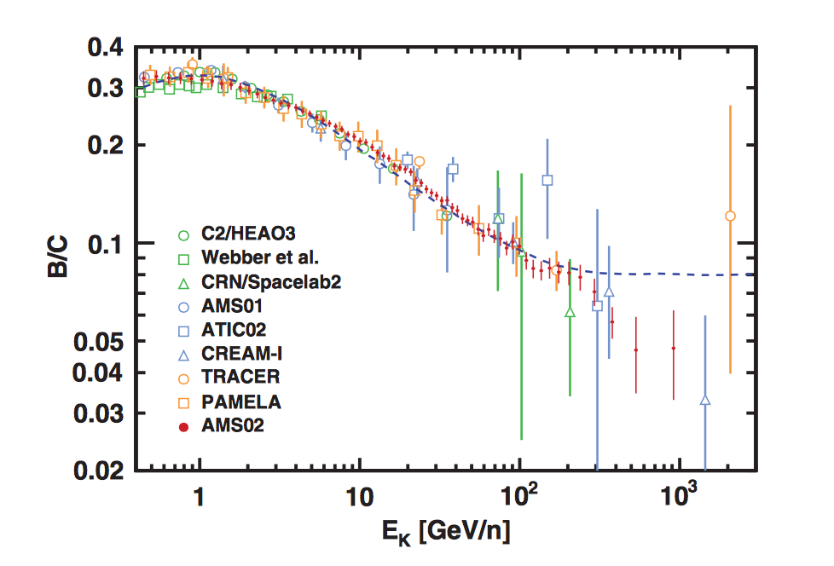
SNR cannot give rise to a sharp bump
SNRs can in principle explain the rising of both the positrons and antiprotons,
but also predicts a (incorrect) rise in B/C

Slide 24
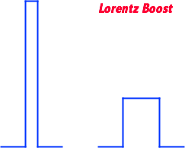
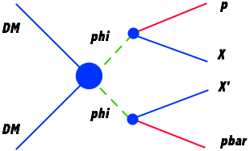
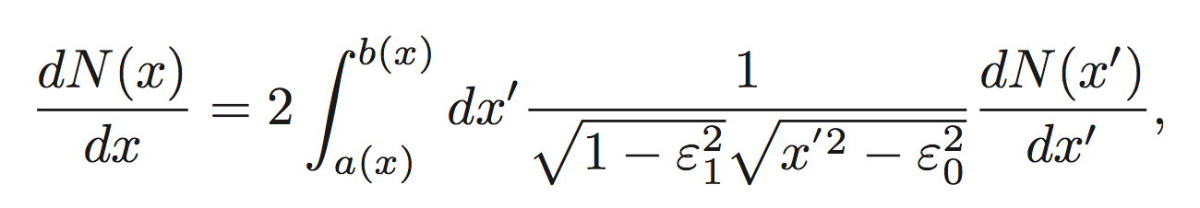
Sharp structure from DM annihilation through light mediators
phi rest-frame
DM CM frame

Slide 25
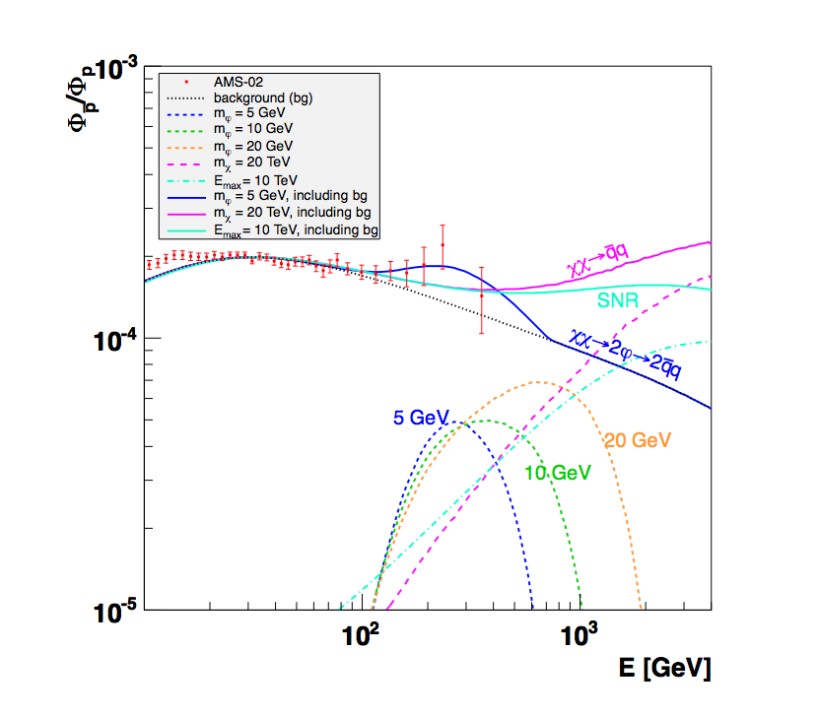
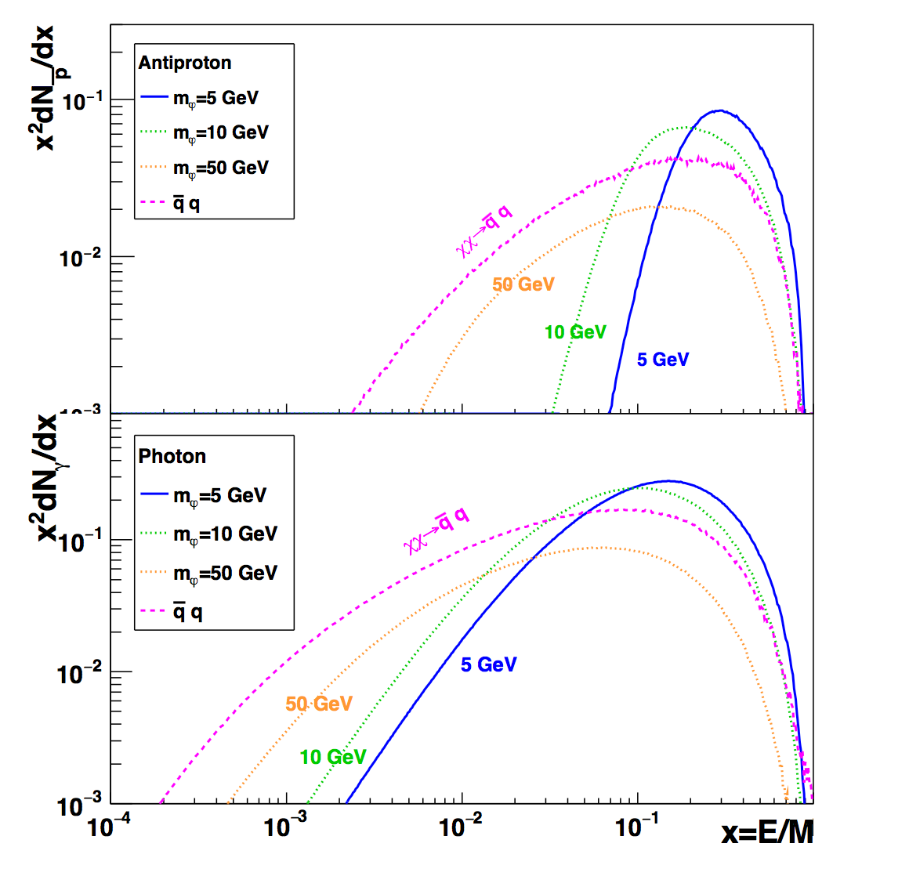
The narrow bump (if confirmed) will favor DM explanation and disfavor the astrophysical explanations
Future AMS-02 antiproton data will be crucial in distinguish different mechanisms
X.J.Huang, Y.L.Wu, YFZ, arXi:1611.01983, PRD

Slide 26
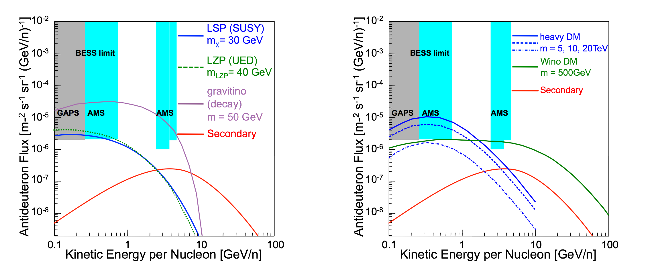
NEXT: anti-deuteron/anti-helium ?
Call for AMS-03 ?
Low event rate but also low background

Slide 27
Summary
DM indirect searches require deeper understanding of both particle physics and astrophysics.
The CR positron anomaly can be explained by both DM (constrained by gamma-ray data) and astrophysical sources (PWN, SNR etc), consistent explanation involving electrons is challenging.
CR antiprotons is a more important probe DM, as astrophysical sources are unlikely to large contributions.
The AMS-02 data show a hint of a structure at high energy region which (if confirmed) will favor DM explanations.
Future high energy CR data (above 1 TeV for both electrons and antiprotons) will be crucial for the DM searches

Slide 28
Thank you !

Slide 29
future
Exp. | Target | Location
DAMPE | e⁺/e⁻, photons | satellite | Calorimeter
CALET | e⁺/e⁻ | ISS | Calorimeter
CTA | photons | ground | ACT
GAMMA400 | photons | satellite | Pair Telescope
GAPS | antideuterons | balloon | TOF, X-ray, Pion detection
HAWC | Photons, e⁺/e⁻ | Sierra Negra | Water Cherenkov Air Shower Surface Array
PINGU | neutrinos | Antarctica | Ice Cherenkov

Slide 30
Non-gravitational self-interacting DM
Peter, 1208.3026
central density of DM halo
Ellipticity of DM halo

Slide 31
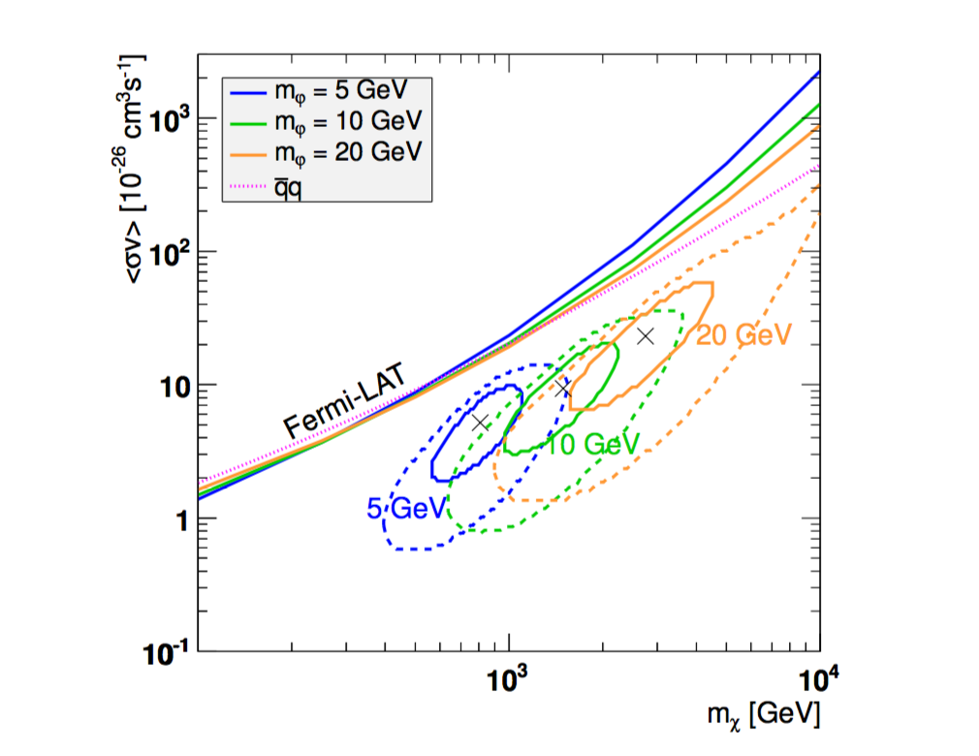
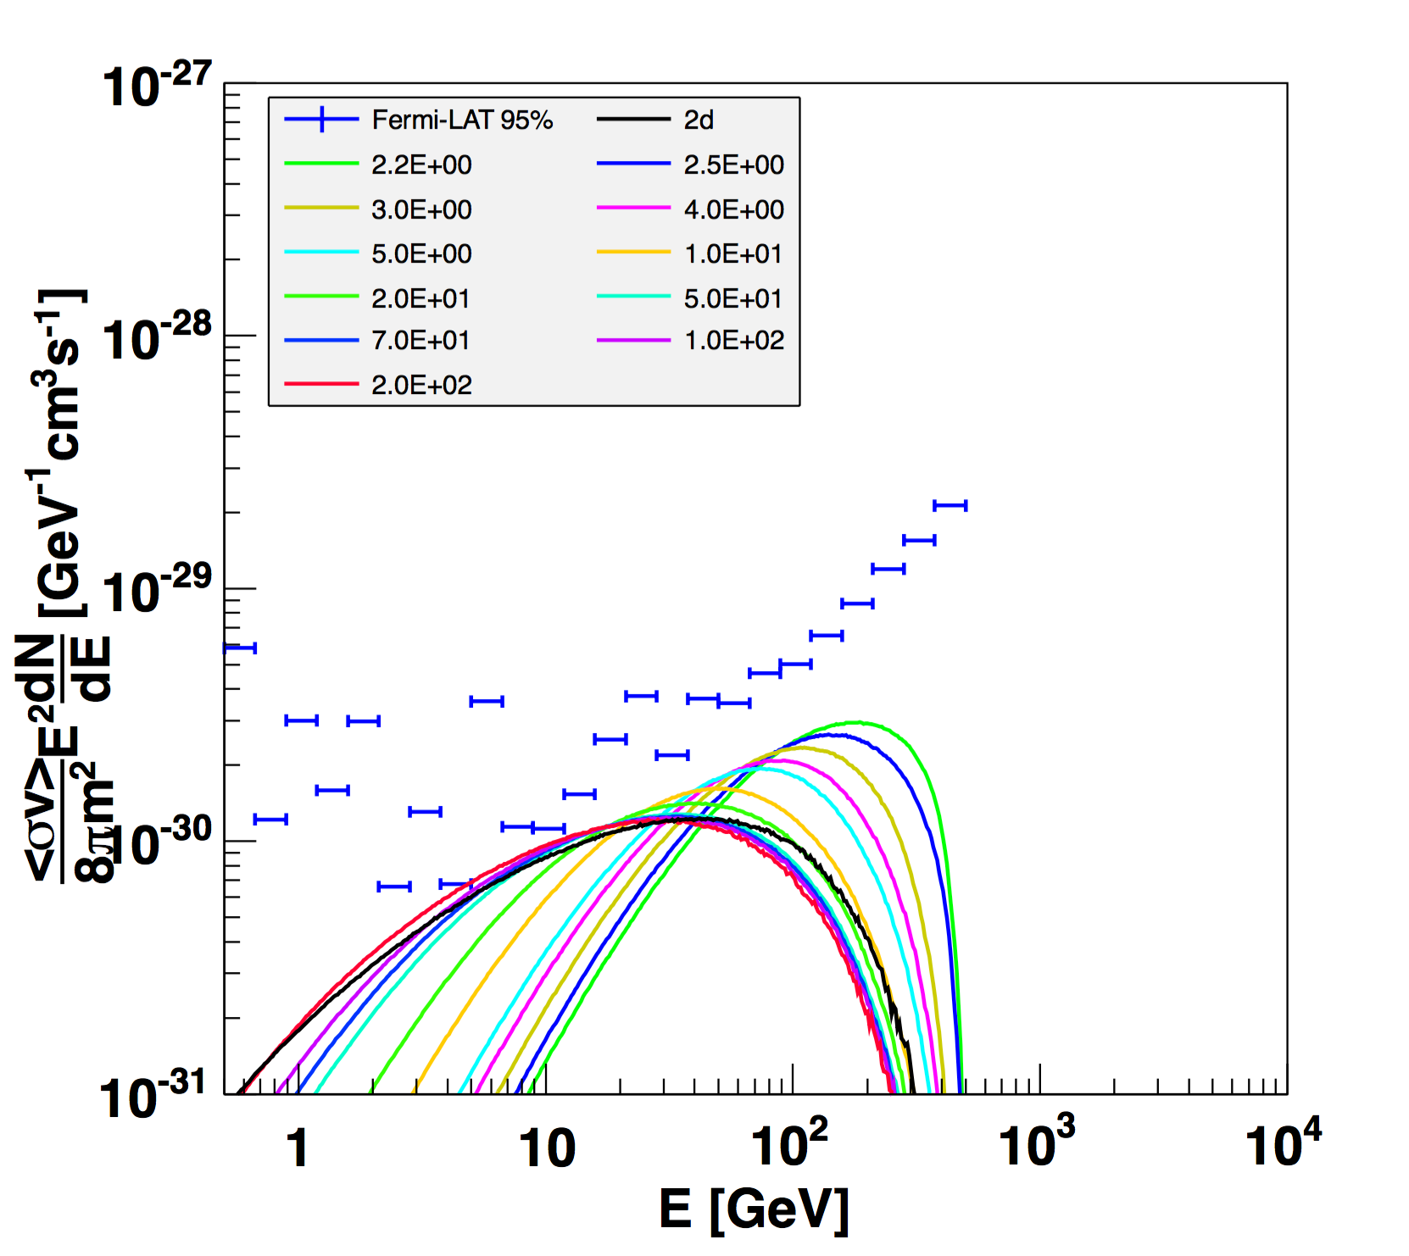
Limits from dwarf galaxies
Fermi-LAT sets limits per energy bin, sensitive to the spectral shape
X.J.Huang, Y.L.Wu, YFZ, arXi:1611.01983, PRD

