Slide 1
HOM coupler design
---loop type v.1
Hongjuan Zheng
20161122

Slide 2
Transmission line model

Slide 3
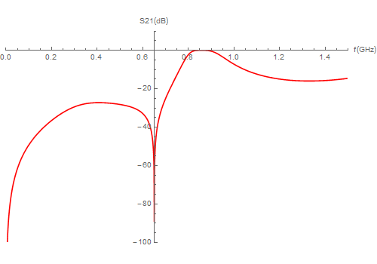
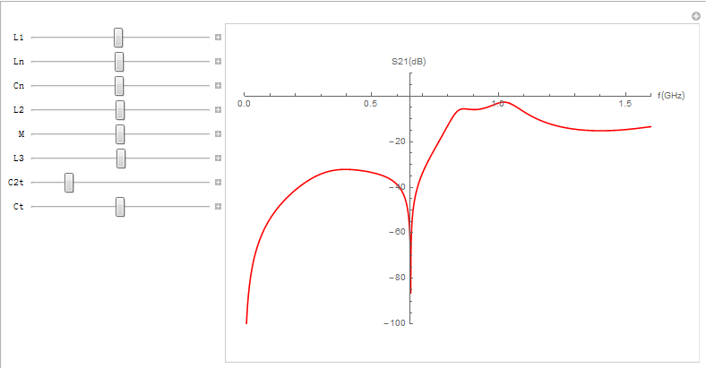
Transmission line equivalent circuit results
Values for the transmission line equivalent circuit：
l1=13.644cm, l2=1cm, l3=5.566cm, Ln=20.79nH, Cn=2.884pF, M=3.77nH, C2t=1.465pF, Ct=5.716pF, Z1=83.23 Ω, Zt=96.6 Ω, Z=50 Ω
Outer diameter of the coupling tube is 80 mm. Inner diameter of the coupling tube is 16 mm.

Slide 4
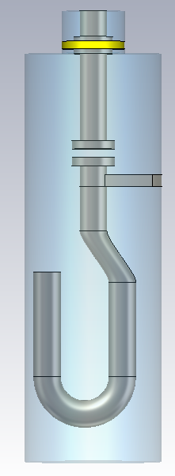
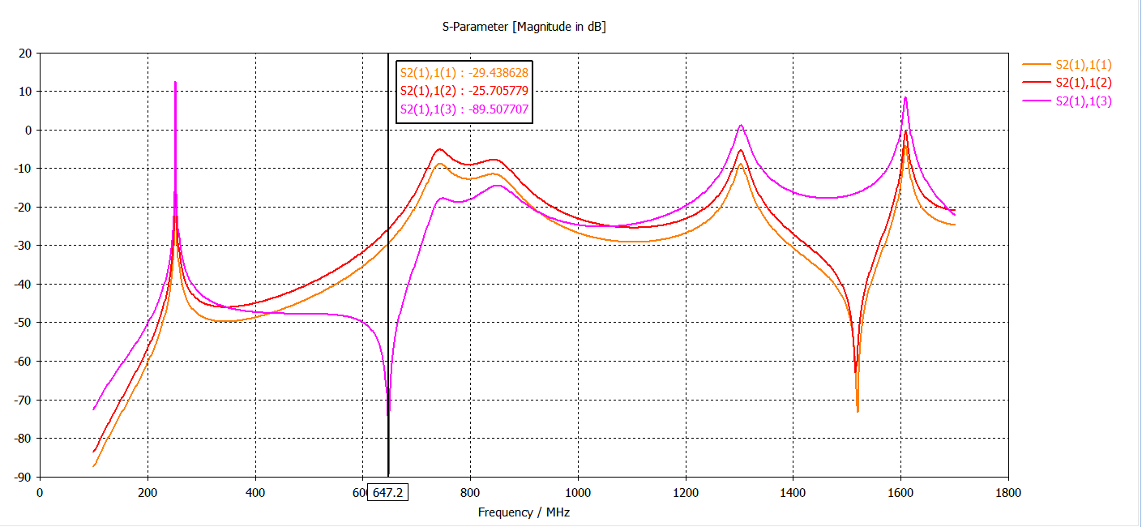
3D simulations
TLM for electric coupling
TLM for magnetic coupling
Notch filter
3D model
S2(1),1(1)&S2(1),1(2): TE11-TEM
S2(1),1(3): TM01-TEM

Slide 5
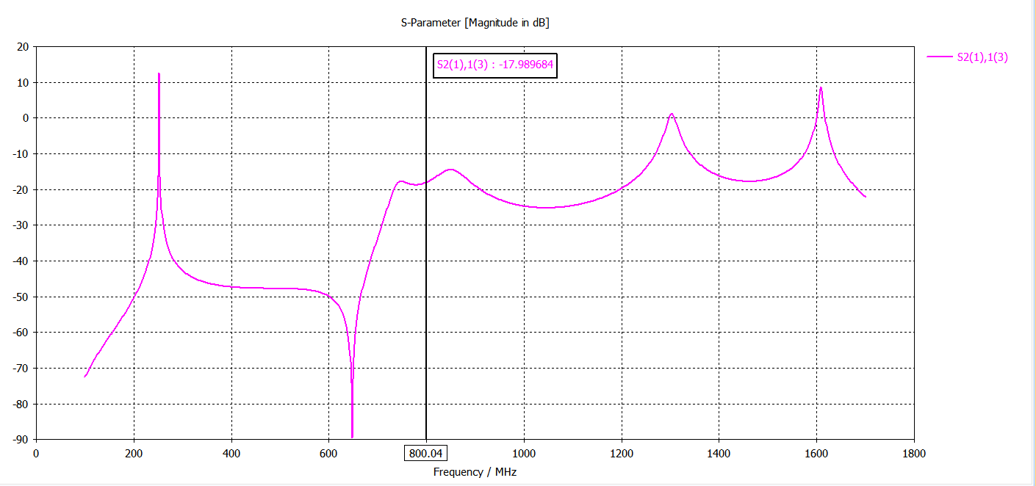
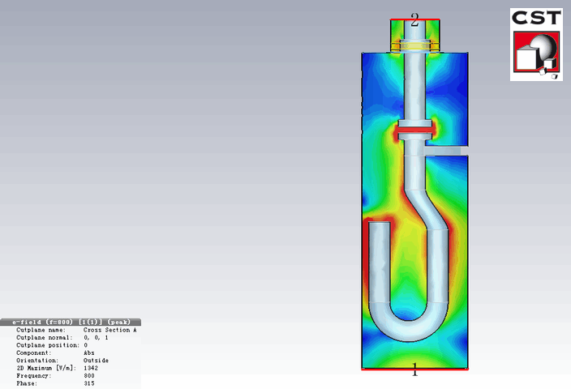
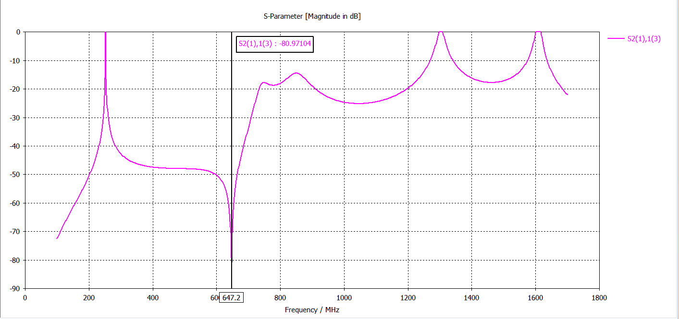
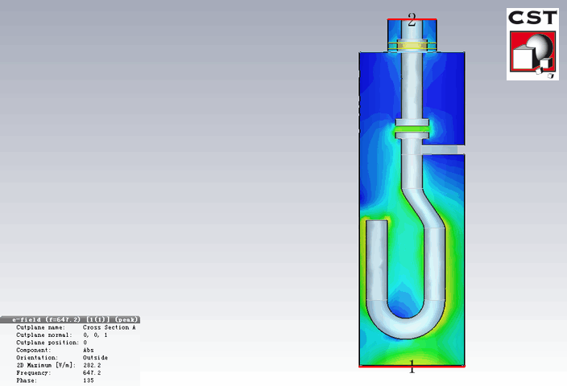
3D model
f=800 MHz
f=647.2 MHz

Slide 6
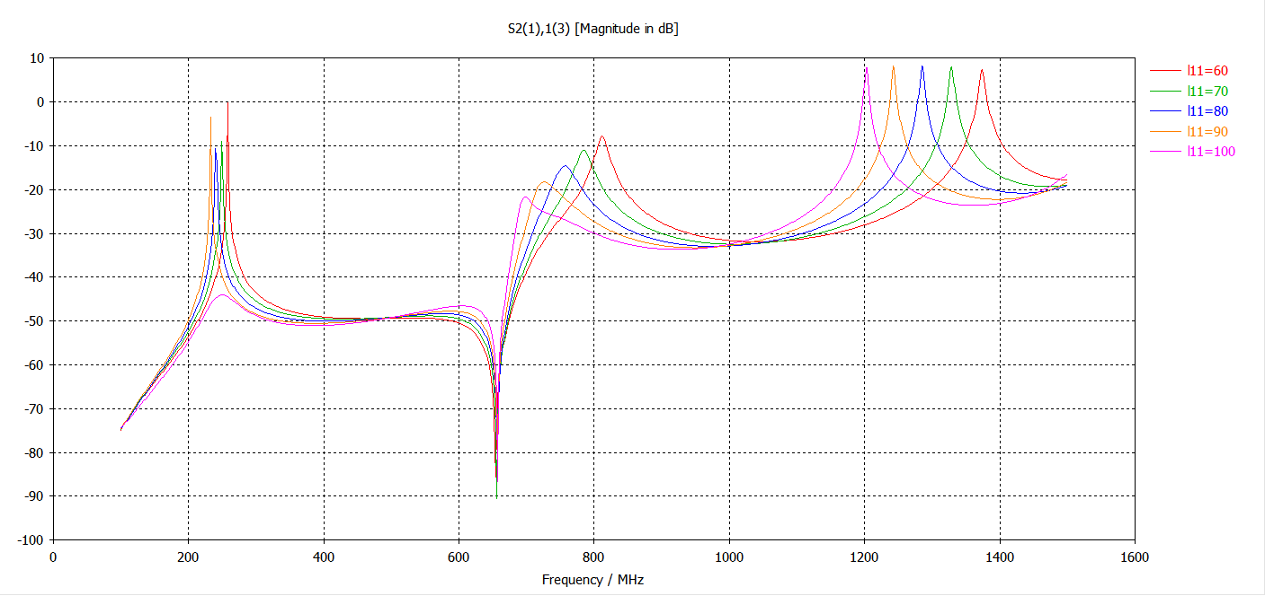
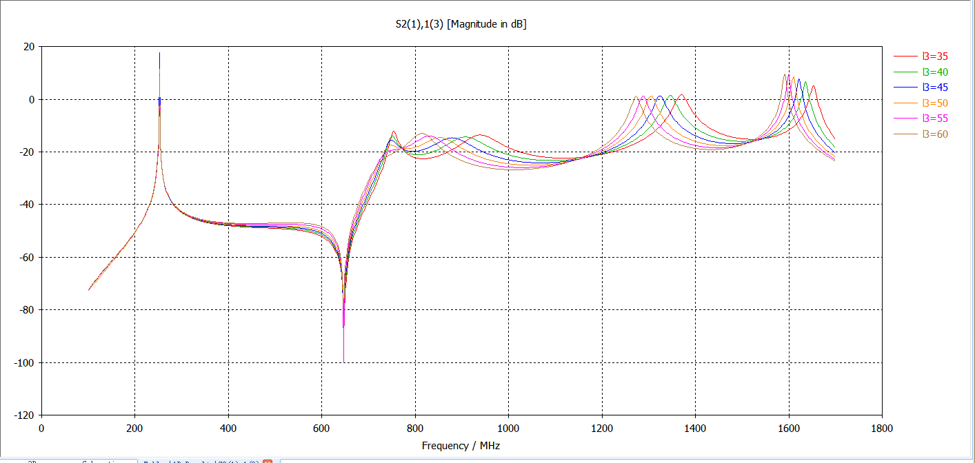
3D model
l11
l3

Slide 7
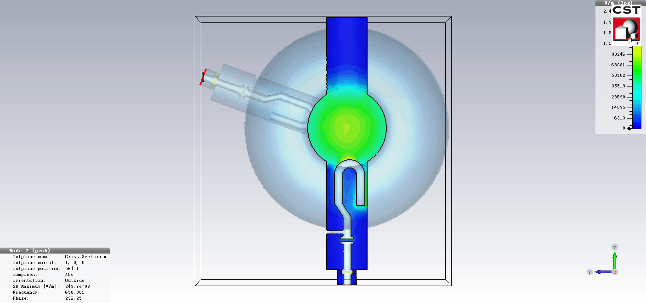
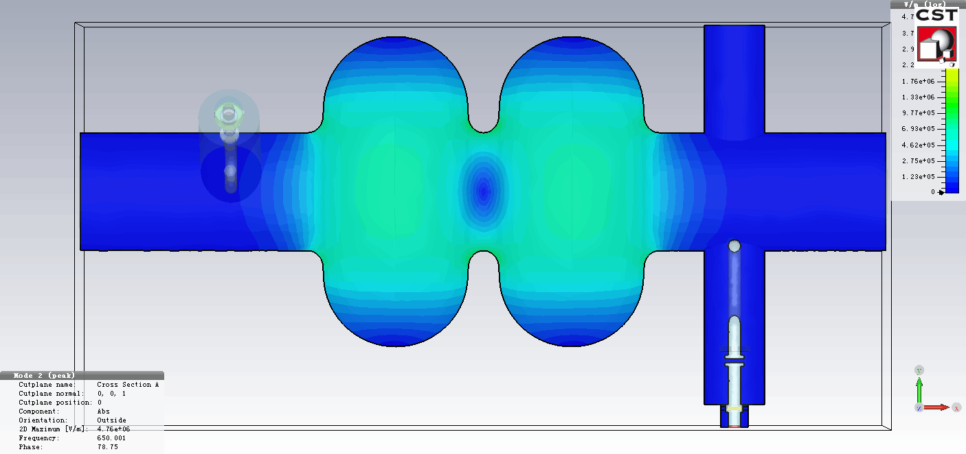
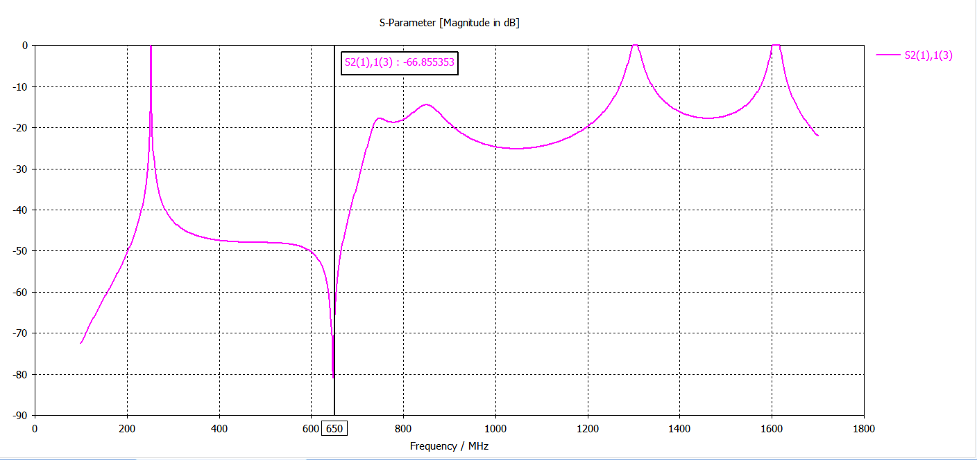
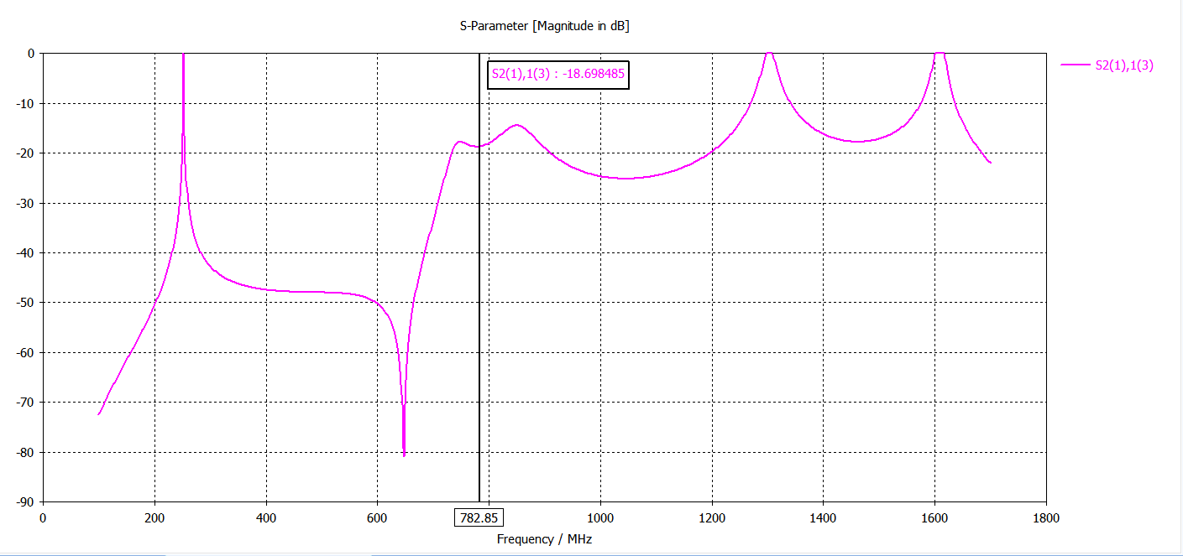
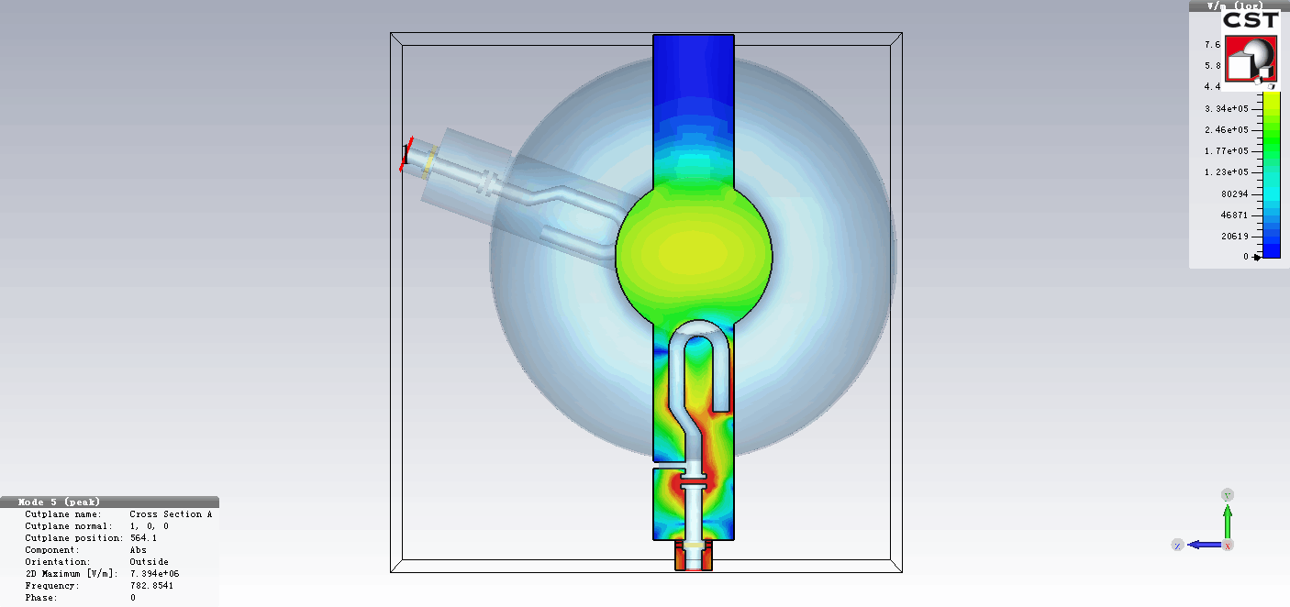
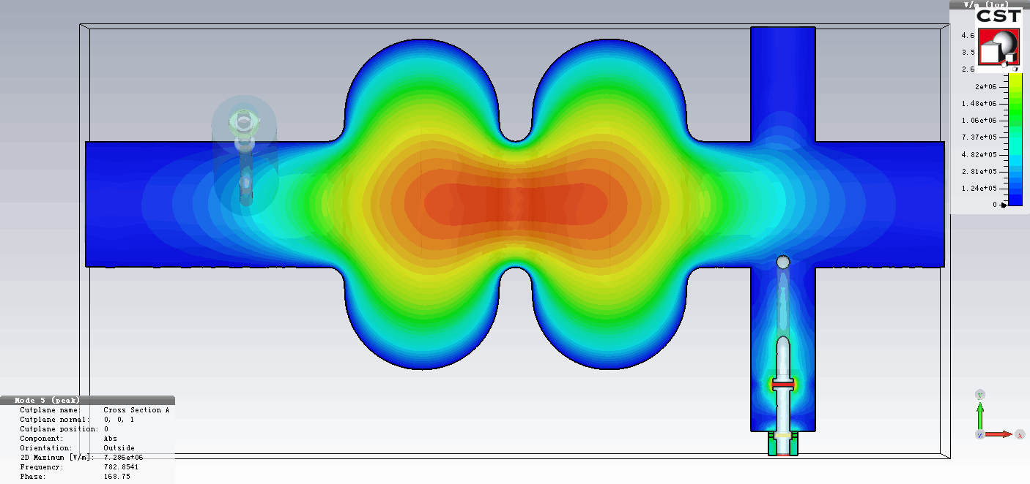
3D model with cavity
f=650 MHz TM010-π mode, Qe=1.1E+9
Qe ≈ 1E+10 → S21 ≈ -90 dB
f=782.85 MHz TE111-π/2 mode , Qe=5.7E+3

Slide 8
Qe with HOM couplers & Qe threshold-v.1
Beam parameters (wangdou20160918)
Qe (CST) is the result with HOM couplers.
The other 3 Qe values are stand for the threshold for different design.
For H design, the Qe for the TM011 TM110-π/2 mode can not meet the requirement.
For H design, the Qe for the TM110-π/2 mode can not meet the requirement.
The damping for TE111 mode is perfect.
Not include the frequency spread influence!!!

Slide 9
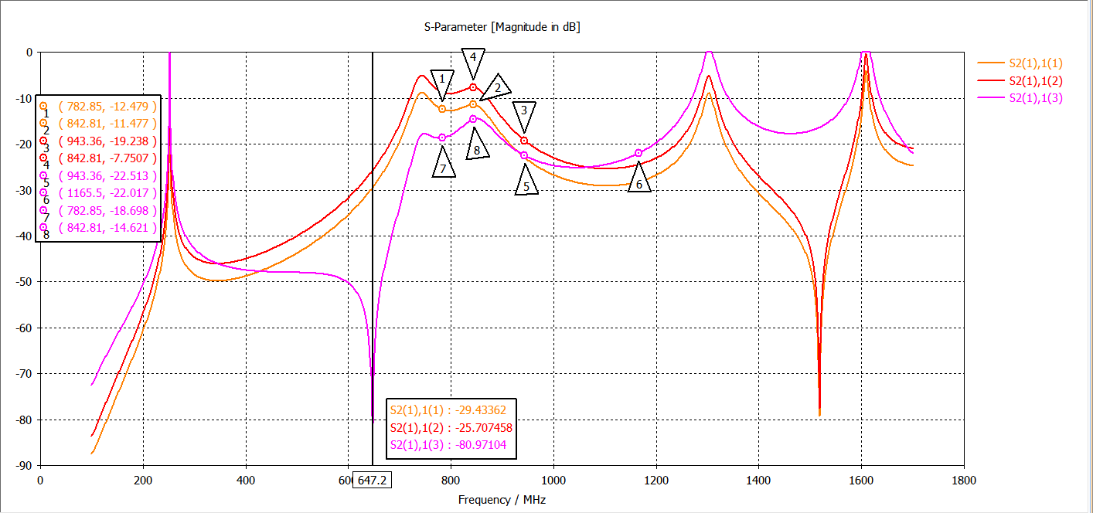
3D simulations
TM110
TE111
TM011
Notch filter bandwidth = 920 kHz
Improve the notch filter performance!

Slide 10
Conclusion
The damping for TE111 mode is perfect.
The broadband damping results can meet the requirement.
Need to improve the notch filter performance.
Next
Improve the notch filter performance.
Thermal analysis.
Mechanical design.
Multipacting.
…….

