Slide 1
Computing at CEPC
Xiaomei Zhang
On behalf of CEPC software & computing group
Nov 6, 2017

Slide 2
Content
Progress on software framework and management
Distributed computing status for R&D phase
New technologies explored for future challenges
Summary

Slide 3
Software management
git has been used for distributed version control
CMake is used as main compiling management tool
cepcenv toolkit is being developed to simplify
Installation of CEPC offline software
Set-up of CEPC software env, easy usage of CMake
A standard software release procedure is in plan, will include
Auto integration test
Physics validation
Final data production

Slide 4
Software framework
Current CEPC software uses Marlin, adopted from ILC
CEPC software group are built, including current CEPC software group, IHEPCC, SDU, SYSU, JINR……for future CEPC software framework
Consider uncertain official support of Marlin, future CEPC software framework are investigated
Several existing framework are studied
Gaudi is preferred with wider community, possible long-term official support, more experts available in hand, keep improved with parallel computing
International review meeting is in consideration for final decision of framework
 | Marlin | Gaudi | ROOT | ART | SNiPER
User Interface | XML | Python, TXT | Root script | FHiCL | Python
Community | ILC | Atlas, BES3, DYB,LHCb | Phenix, Alice | Mu2e, NOvA, LArSoft, LBNF | JUNO, LHAASO

Slide 5
Computing requirements
CEPC is expected to have very large data volume in its data taking period, comparable to LHC and BelleII
Not doubt one single data center can’t meet challenges
Distributed computing is the best way to organize worldwide resources from CEPC collaborations and other possible ways
In current R&D phase, CEPC simulation needs at least 2K dedicated CPU cores and 1PB each year
Currently no direct funding to meet requirements, no dedicated computing resources
500TB storage in Lustre locally, but close to full
Distributed computing becomes the main way to collect free resources for its massive simulation on this stage

Slide 6
Distributed computing
First prototype of distributed computing system for CEPC have been built up in 2014
The system have considered current CEPC computing requirements, resource situation and manpower
Use existing grid solutions as much as possible from WLCG
Keep system as simple as possible for users and admins
Now the distributed computing is taking full tasks of CEPC massive simulation almost three years
Completed simulation of 120M signal events, 4 Fermions and 2 Fermions SM background events with 165TB produced

Slide 7
Resource
Active Site: 6 from England,Taiwan, China Universities(4)
QMUL from England and IPAS from Taiwan plays a great role
Cloud technology used to share free resource from other experiments in IHEP
Resource: ~2500 CPU cores, shared resources with other experiments
Resource types include Cluster, Grid ,Cloud
Network: 10Gb/s to USA and Europe, to TaiWan and China University
Joining LHCONE is in plan to future improve international network connection
Site Name | CPU Cores
CLOUD.IHEP-OPENSTACK.cn | 96
CLOUD.IHEP-OPENNEBULA.cn | 24
CLOUD.IHEPCLOUD.cn | 200
GRID.QMUL.uk | 1600
CLUSTER.IPAS.tw | 500
CLUSTER.SJTU.cn | 100
Total (Active) | 2520
QMUL: Queen Mary University of London
IPAS: Institute of Physics, Academia Sinica
Notes:
Job input and output directly from remote SE

Slide 8
Current computing model
With limited manpower and small scale, make current computing model as simple as possible
IHEP as central site
Event Generation(EG) and analysis, small scale of simulation
Hold central storage for all experiment data
Hold central database for detector geometry
Remote sites
MC production including Mokka simu + Marlin recon
Data flow
IHEP -> Sites, stdhep files from EG distributed to Sites
Sites -> IHEP, output MC data directly transfer back to IHEP from jobs
In future, with more resources and tasks, it will be extended to multi-tier infrastructure, avoid single-point failure with multi data servers……

Slide 9
Central grid services in IHEP (1)
Job management uses DIRAC (Distributed Infrastructure with Remote Agent Control)
Hide complexity from heterogeneous resources
Provide global job scheduling service
Central SE built up based on StoRM
Lustre /cefs as its backend
Frontend provide SRM, HTTP, xrootd access
Export and share experiment data with sites
Lustre: /cefs
CVMFS S0
DIRAC
WMS
StoRM
CVMFS S1
Cluster/grid Site
Cloud Site
Job
Data
Software

Slide 10
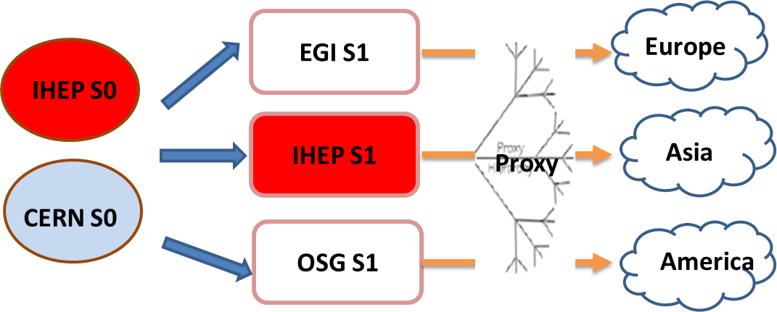
Central grid services in IHEP (2)
CEPC VO (Virtual Organization) built for user authentication in grid
VOMS server hosted in IHEP
Software distribution via CVMFS (CernVM File System)
CVMFS Stratum0(S0) and Stratum1(S1) created in IHEP
Simple squid proxy spread among sites
Plan to have S1 in Europe and U.S. to speed up software access outside China
CNAF S1 have synchronized IHEP S0

Slide 11
Production status (1)
400M massive production events is planned to simulate this year
11 types of 4 fermions and 1 type of 2 fermions have already finished in distributed computing
zzorww_h_udud and zzorww_h_cscs are both simulated and reconstructed
Others only do reconstruction
30M events have been successfully produced since March
But we still have a hard work to do, need more resources to complete
 | Final State | Simulated Events
4 Fermions | zz_h_utut | 419200
 | zz_h_dtdt | 1135600
 | zz_h_uu_nodt | 481000
 | zz_h_cc_nots | 482800
 | ww_h_cuxx | 1709400
 | ww_h_uubd | 100000
 | ww_h_uusd | 205800
 | ww_hccbs | 100000
 | ww_h_ccds | 60600
 | zzorww_h_udud | 3970000
 | zzorww_h_cscs | 3970000
2 Fermions | e2e2 | 14908000
Total |  | 27542400

Slide 12
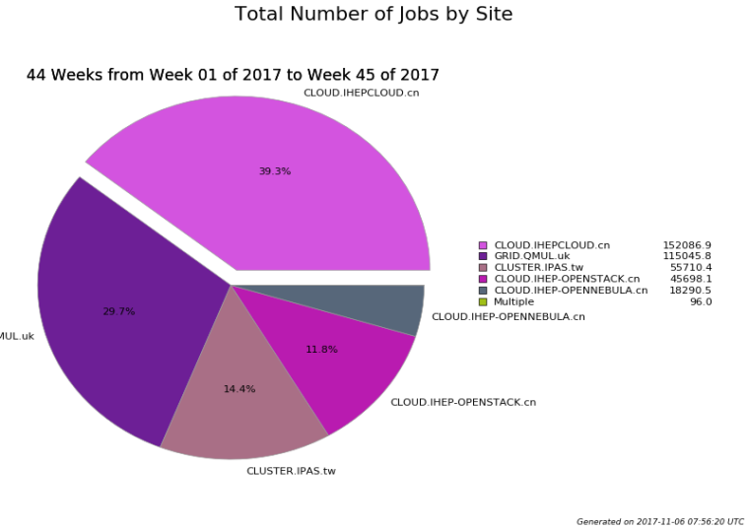
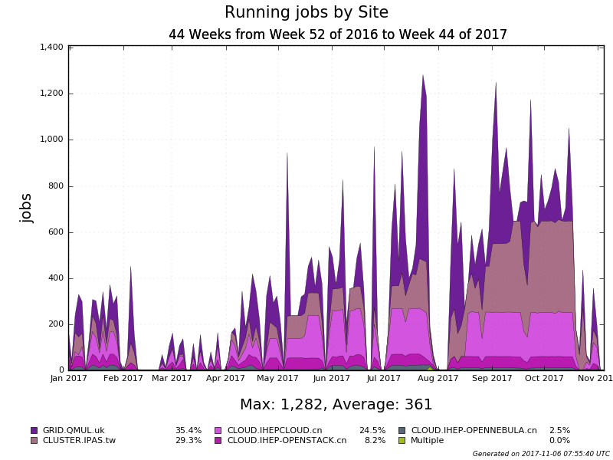
Production status (2)
Totally 385K CEPC jobs processed in 2017, 5 sites joined
Cloud in IHEP contribute 50%, QMUL site 30%, IPAS site 15%
The peek resource used is ~1300 CPU cores, the average is only ~400 CPU cores
Sites are busy with other local tasks in some periods
The system is running well, but need more resources to join us
WLCG has more than 170 sites, we encourage more sites to join us!

Slide 13
New technologies explored
Besides the running system for current R&D, more new technologies are being explored to meet with future software needs and possible bottlenecks
Elastic integration with private and commercial cloud
Offline DB access with frontier/squid cache technology
Multi-core for parallel computing
HPC federation with DIRAC
Data federation based on Cache for faster data access
……

Slide 14
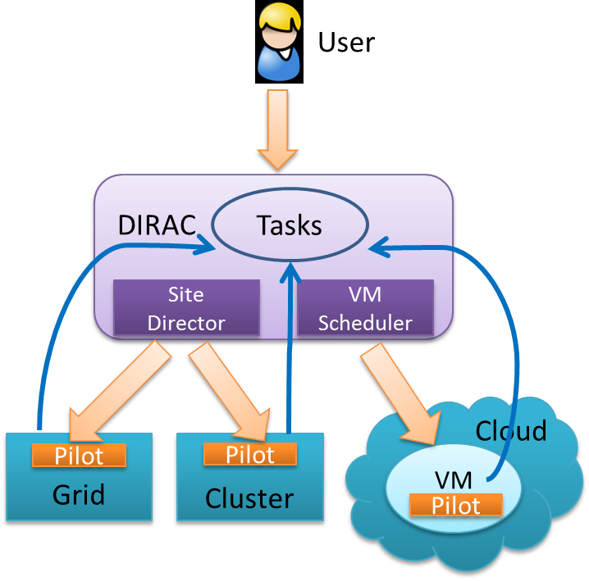
Elastic cloud integration
Cloud already becomes a popular resource in HEP
Private cloud has been well integrated in CEPC production system
Cloud resource can be used in an elastic way according to real CEPC job requirements
All the Magic is done with VMDIRAC, extension to DIRAC
Commercial cloud would be a good potential resource for urgent and CPU-intensive tasks
With the support of Amazon AWS China region, trials have been done successfully with CEPC “sw_sl” simulation jobs
Current network connection can support 2000 in parallel
The same logic implemented with AWS API
The cost of producing 100 CEPC events
is about 1.22 CNY

Slide 15
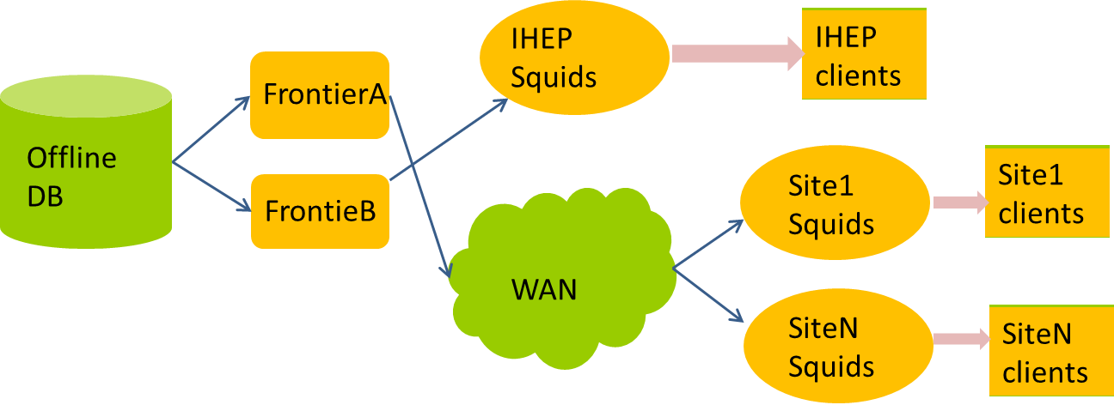
FroNtier/squid for offline DB access
For current scale, only one central database used
Would be a bottleneck with bigger scale of jobs
FroNtier/Squid based on Cache tech is considered
FroNtier detect changes in DB and forward changes to squid cache
Good release pressure of central servers to multi-layer caches
Status
Testbed has been set up, more close work with CEPC software needed to provide transparent interface to CEPC users

Slide 16
Multi-core supports
Multi-process/thread is being considered in CEPC software framework
Best explore multicore CPU architectures and improve performance
Decrease memory usage per core
Multi-core scheduling in distributed computing system is being studied
Testbed has been successfully set up
Two ways of multi-core scheduling with different pilot modes are investigated
Tests showed that scheduling efficiency of multi-core mode is lower than that of single-mode, need to be improved

Slide 17
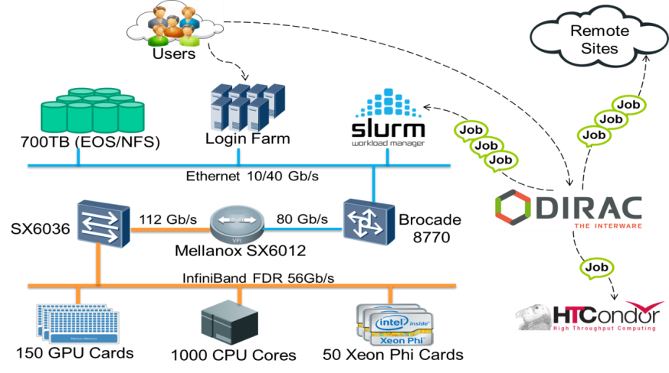
HPC federation
HPC resource becomes more and more important in HEP data processing
Already used in CEPC detector design
Many HPC computing centers are being built up in recent years among HEP data centers
IHEP, JINR, IN2P3……
HPC federation with DIRAC is in plan to build a “grid” of HPC computing resources
Integrate HTC and HPC resources as a whole

Slide 18
Summary
Software management and framework are in progress
Distributed computing is working well for current scale of resources
But it still need more sites to join for current tasks of CEPC massive simulation
More advanced techs are investigated to meet future challenges and potential bottleneck
Thank QMUL and IPAS for their contributions
Here we would like to encourage more sites to join in distributed computing!

Slide 19
Thank you!

