Slide 1
HTS Magnet R&D at BNL
Ramesh Gupta
November 17, 2017

Slide 2
Recent HTS Magnet Programs at BNL
Demonstration of HTS/LTS hybrid common coil dipole
Use more expensive HTS where field is high and less expensive LTS (Nb₃Sn and/or NbTi) where field is low (part of PBL/BNL STTR program)
High Field (25 T), Large Aperture (100 mm) HTS Solenoid
HTS subjected to high field and high stresses
Part of “Dark Matter Axion Search Program” at IBS, Korea. This magnet must be a reliable user magnet
BNL has the largest and the most versatile HTS magnet program in any US lab

Slide 3
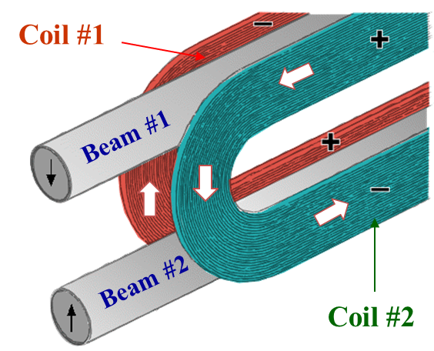
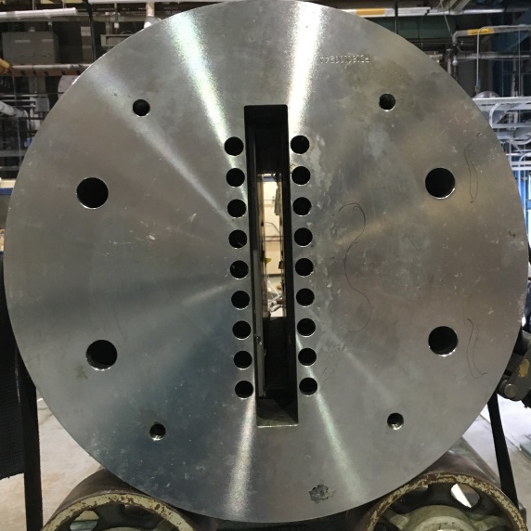
Unique BNL Common Coil Dipole
Common coil 2-in-1 dipole design with simple racetrack coils that are common to both apertures
Record demonstration of “React & Wind” technology
Structure specifically designed to provide a large open space (31 mm wide, 338 mm high)
New racetrack coils can be inserted in the magnet without requiring any disassembly or reassembly
New insert coils become an integral part of the magnet. Coil tests become magnet tests
Rapid-turn-around (<2 years), lower cost approach (allowed HTS/LTS hybrid dipole (<2 years, <1M$)
Empty space

Slide 4
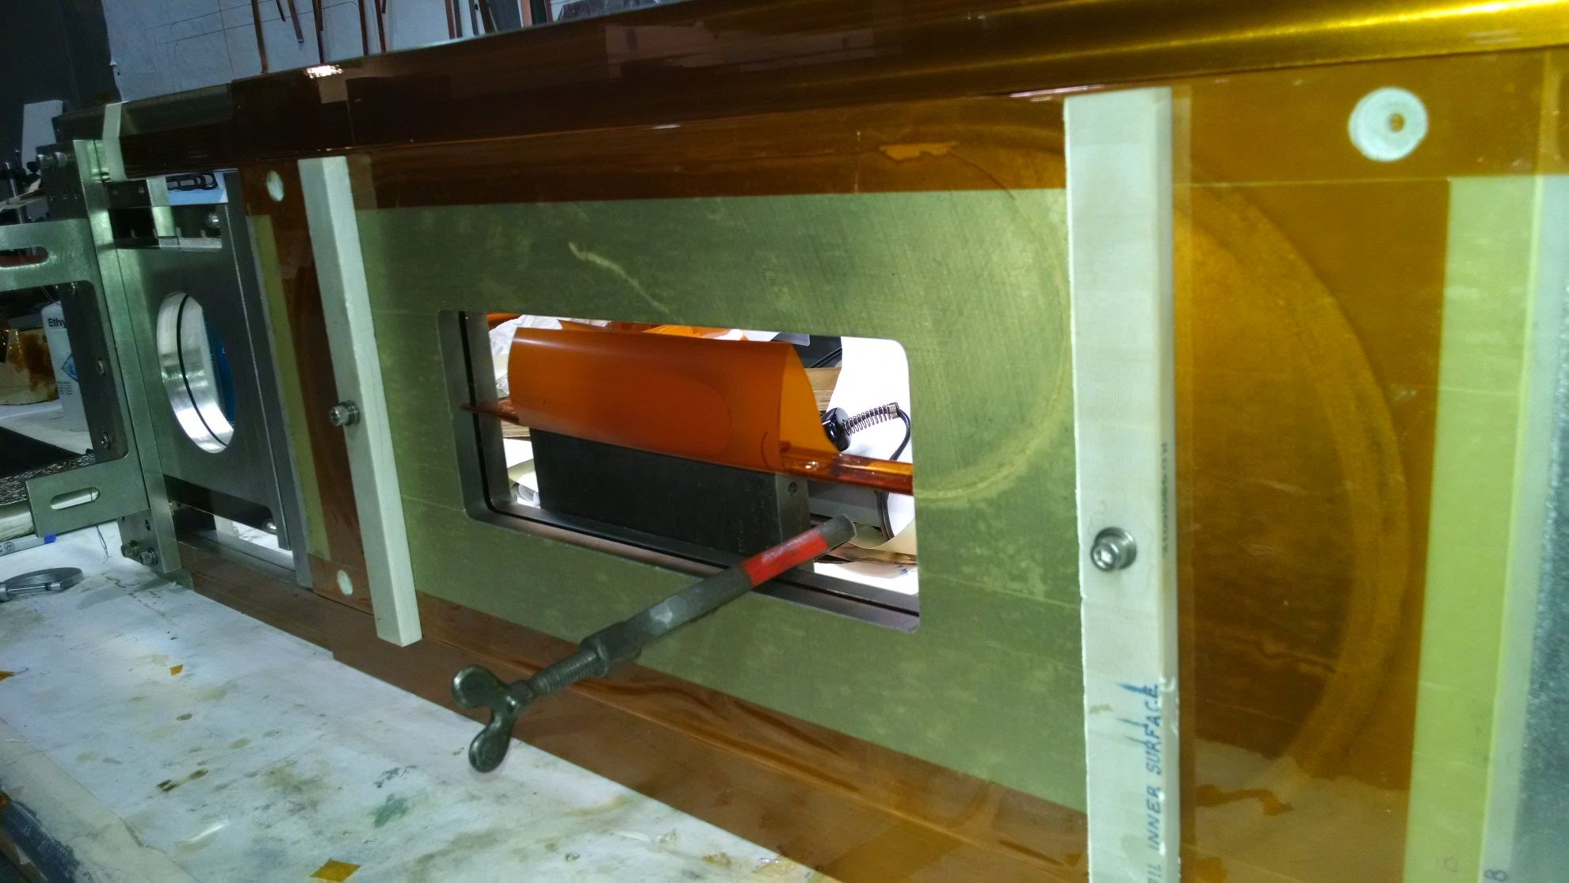
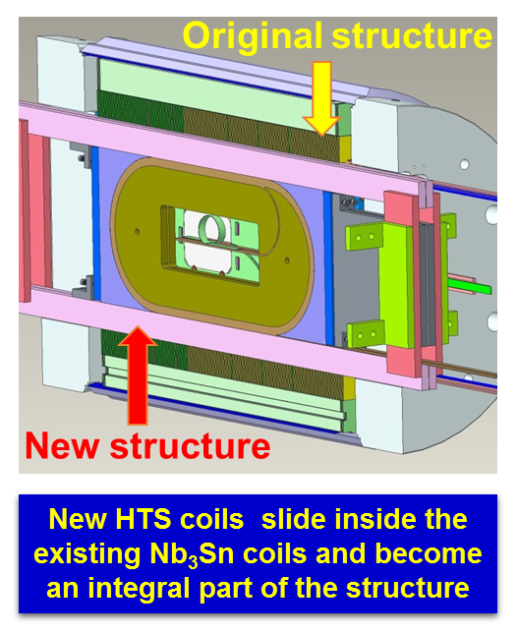
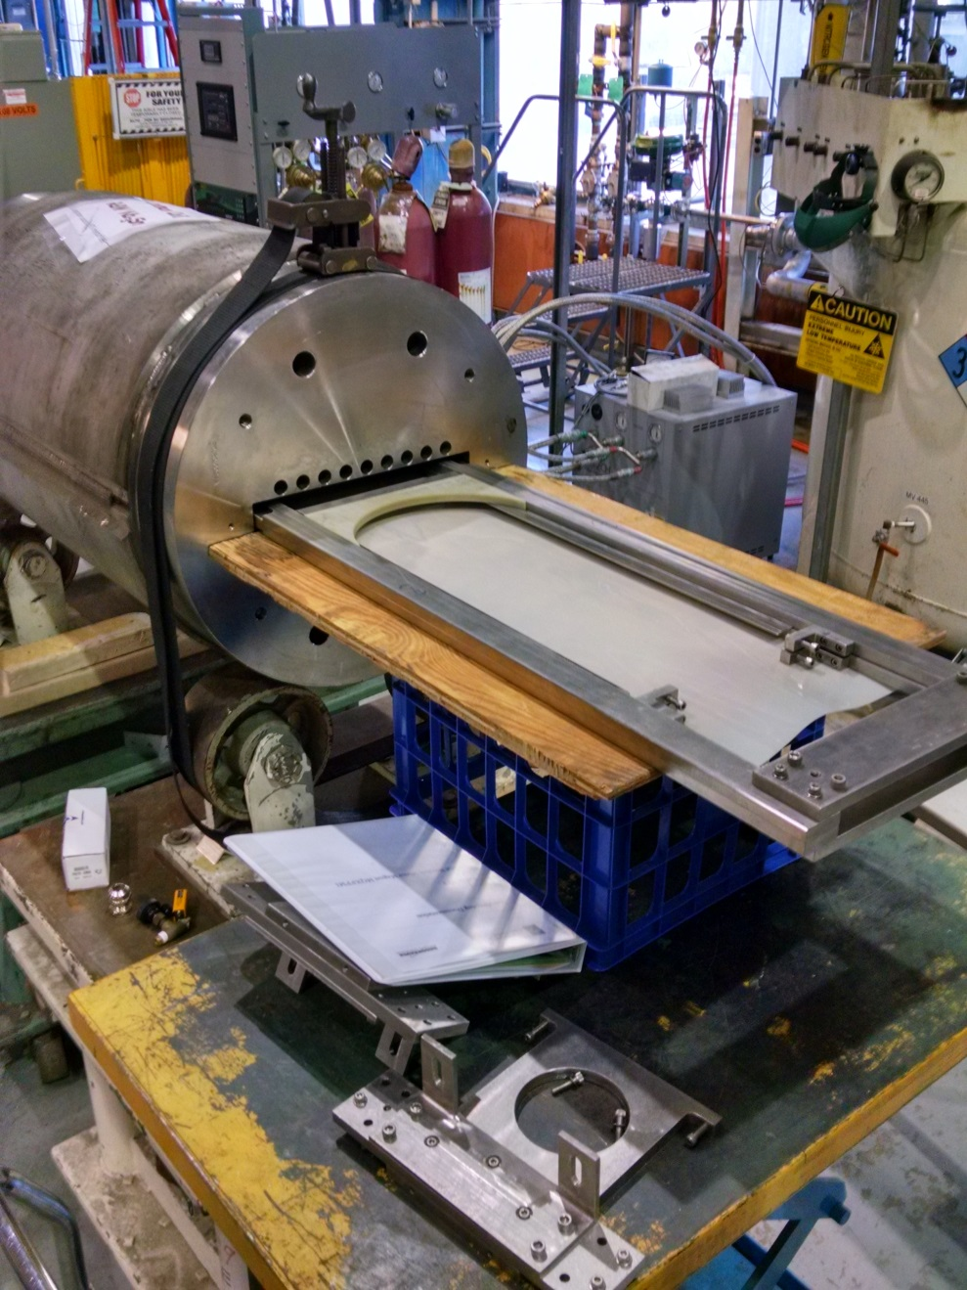
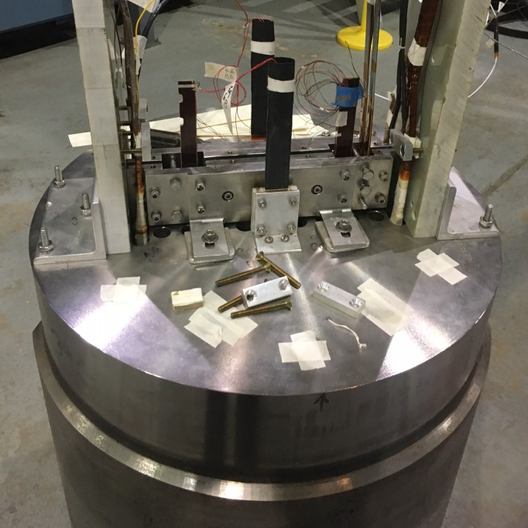
HTS/LTS Hybrid Dipole Structure
Design
A pair of HTS insert coils
Insert coils in Empty space

Slide 5
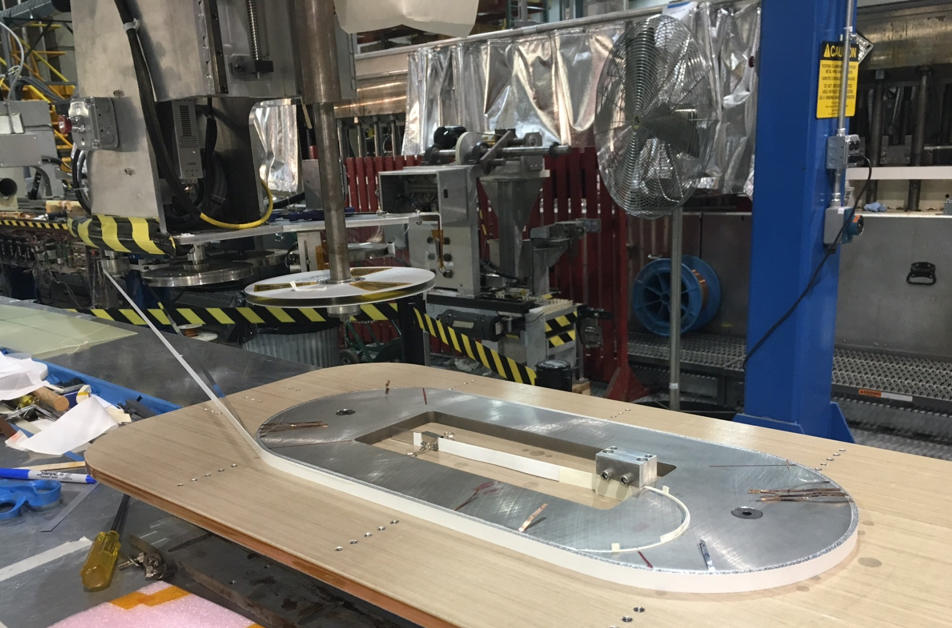
HTS Coil Winding (two coils wound)
Conductor:
12 mm ASC tape
Insulation:
Nomex
Two coils used ~300 meters of 4 mm equivalent

Slide 6
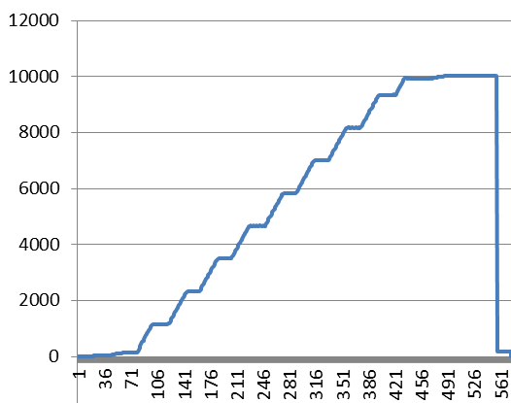
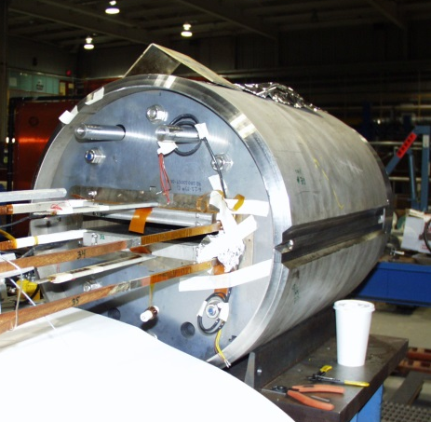
Retest of Nb₃Sn Common Coil Dipole After a Decade
Short Sample: 10.8 kA (reached during 2006 test)
Retest: No quench to 10 kA (>92% of short sample)
~9.5T@10kA
Worked well when tested again after a decade
Current (A)
Was a display piece of Nb₃Sn “React & Wind” technology for dipole

Slide 7
HTS/LTS Hybrid Dipole Quench Test Results

Slide 8
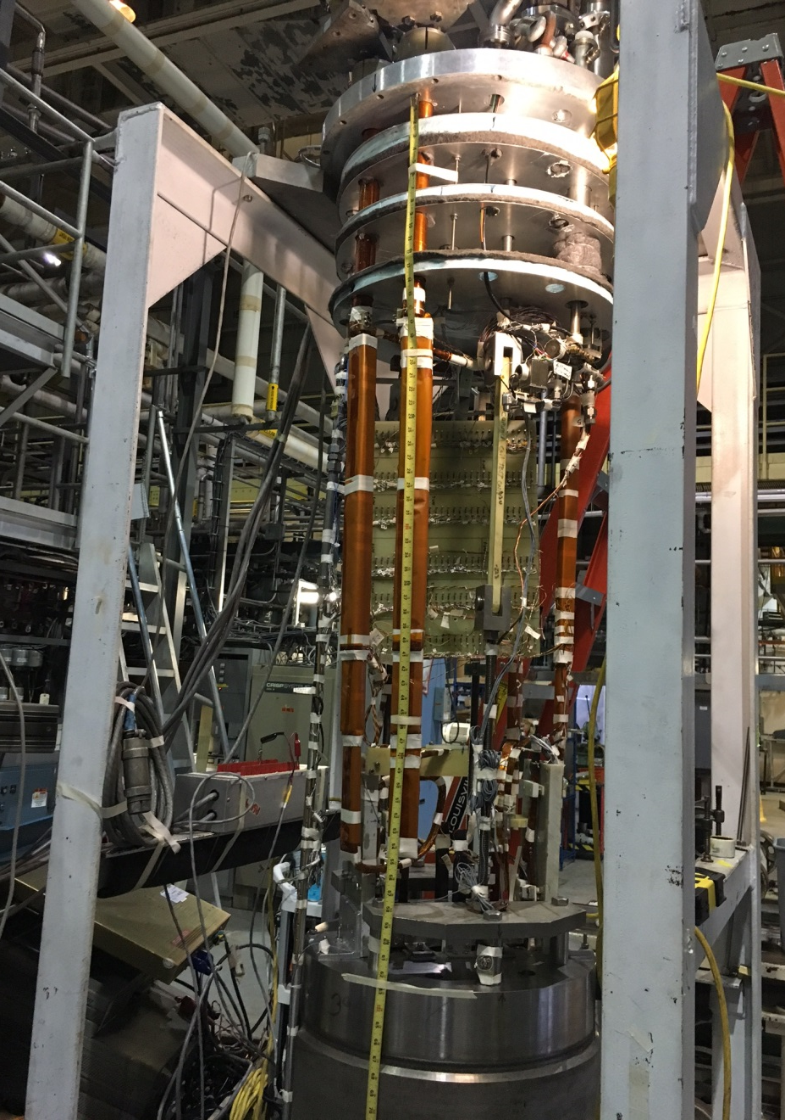
Challenges with the HTS/LTS Hybrid Dipole
Large coupling between HTS/LTS coils
Maximum current in HTS: ~800 A
Maximum current in Nb₃Sn: ~10 kA
Protection of the HTS coils at 4 K
Quench protection of HTS coils in HTS/LTS hybrid configuration
Questions:
Can HTS coil survive quenches without significant degradation?
Can HTS coils be operated like the LTS coils?

Slide 9
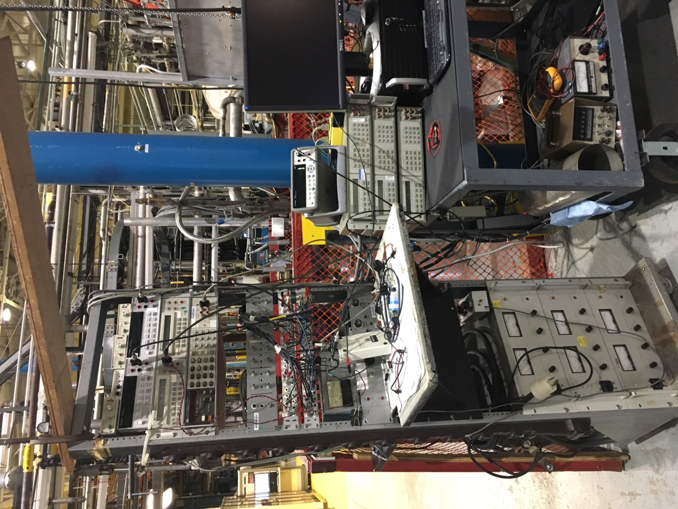
HTS/LTS Hybrid Operation and Quench Protection
HTS & LTS powered separately
Common quench platform; fast energy extraction from both coils
Quench detection response time: < 5 msec
Coil current interruption: < 10 micro-second after detection
HTS coil shut-off: a few msec
High power IGBT switches
Electronic threshold for quench detection: ~100 micro-volts
HTS Quench threshold : 5 mV
HTS coils were actually tested in more brutal conditions: ~200 mV (like LTS coils)

Slide 10
HTS coils operated like LTS coils
Significant voltage in HTS coils: >0.2 Volts
Coil Voltage (V)

Slide 11
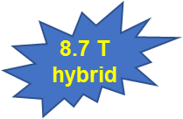
Operation of HTS/LTS Hybrid Dipole
(HTS coils ramped-up in different fields of Nb₃Sn coils)
Encouraging Results:
HTS coils were ramped to quench, just like LTS coils
No degradation in HTS coils despite a number of quenches
Significant demonstration. 8.7 T may be the highest field HTS/LTS hybrid dipole magnet
Performance limited by the leads (not by coils)
~14 T possible with new HTS tapes, in favorable direction

Slide 12
High Field, Large Aperture HTS Solenoid for Axion Dark Matter Search

Slide 13
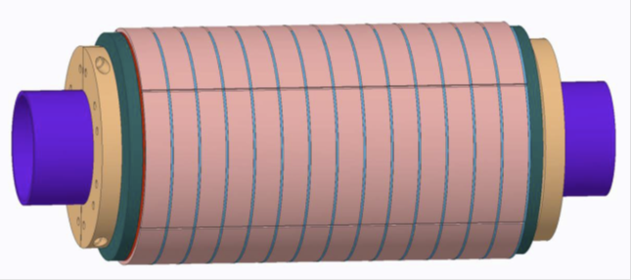
Requirements for the IBS Solenoid
High Field : 25 T (must use HTS)
Large Volume: 100 mm bore, +/-100 mm long
Stresses: J X B X R
Field quality: ~10%
Ramp-up time: up to 1 day
Relaxed field quality and slow charging
User magnet: robust design, large Margin

Slide 14
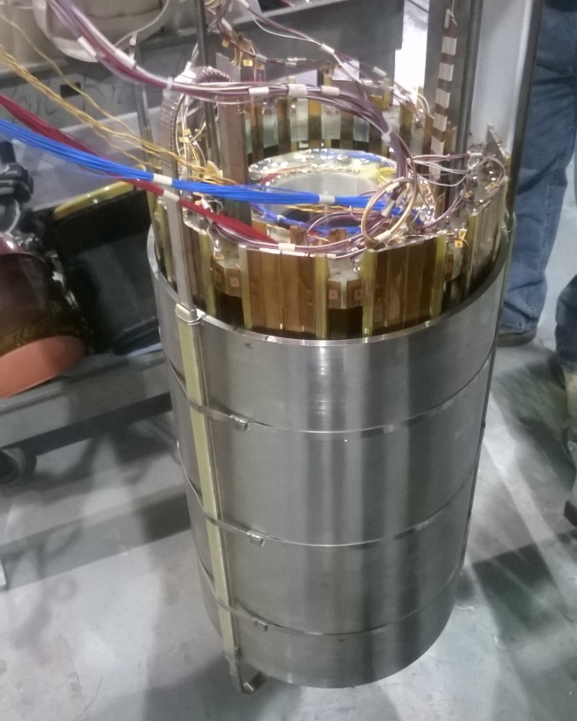
BNL Experience with a Similar Solenoid
HTS Solenoid for SMES
Field: 25 T@4 K
Bore: 100 mm
Stored Energy: 1.7 MJ
Hoop Stresses: 400 MPa
Conductor: HTS (2G)
HTS tape (ReBCO) used:
~6 km, 12 mm wide from SuperPower
Reached a critical field at 27 K: 12.5 T
Expected field at 27 K
New record for magnets operating over >10 K in similar solenoid
Test terminated after arcing in the leads

Slide 15
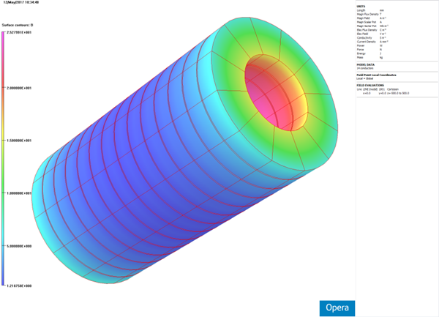
Design Choices for IBS Solenoid
No Insulation Coil (no between the turns)
Bypasses current from one turn to the next turn in the event of a quench
Takes benefit of the relaxed field quality and slow charging time
Single Layer Design
In “No Insulation” case, there could be an unbalanced force situation between the two layers when the current is bypassed
Conductor: High Field, High Strength, 12 mm wide 2G ReBCO Tape
50 μm Hastelloy, 20 μm copper, advanced pinning
Critical Current Margin : ~50% @4K
High performance at high fields
Need ~10 km of 12 mm wide tape
Stress/Strain Margin : ~50%
B_{max}: 25.2 T
Healthy electrical and mechanical margin

Slide 16
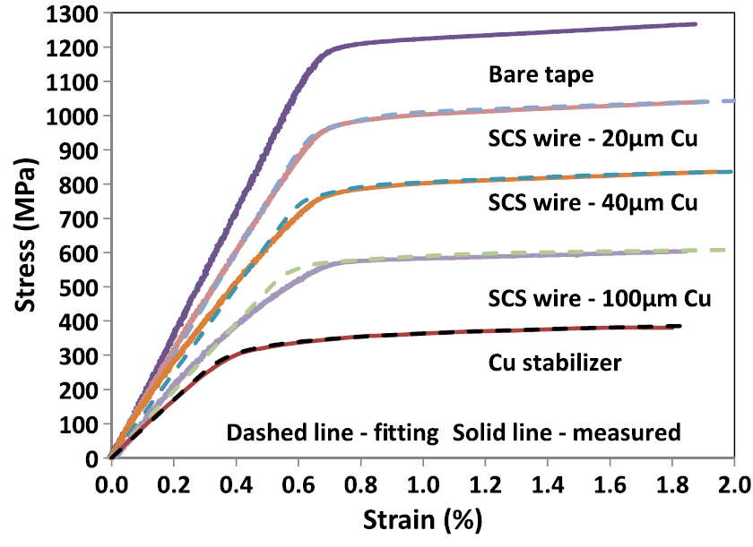
Mechanical Properties of the Conductor (1)
Transverse Load:
load on the wide face of conductor
Requirement of Azimuthal stresses of ~500 MPa is met with 2G Tape having
50 micron Hastelloy
and 20 micron Copper
Courtesy: SuperPower

Slide 17
Mechanical Properties of the Conductor (2)
Conductor must also meet high load (200 MPa) on the narrow side
New Apparatus to Apply 300 MPa Load Design
Requirement of ~200 MPa on the narrow face of the tape must be verified as no such is data available
Initial results are positive

Slide 18
No Insulation Coil Construction and Test Results

Slide 19
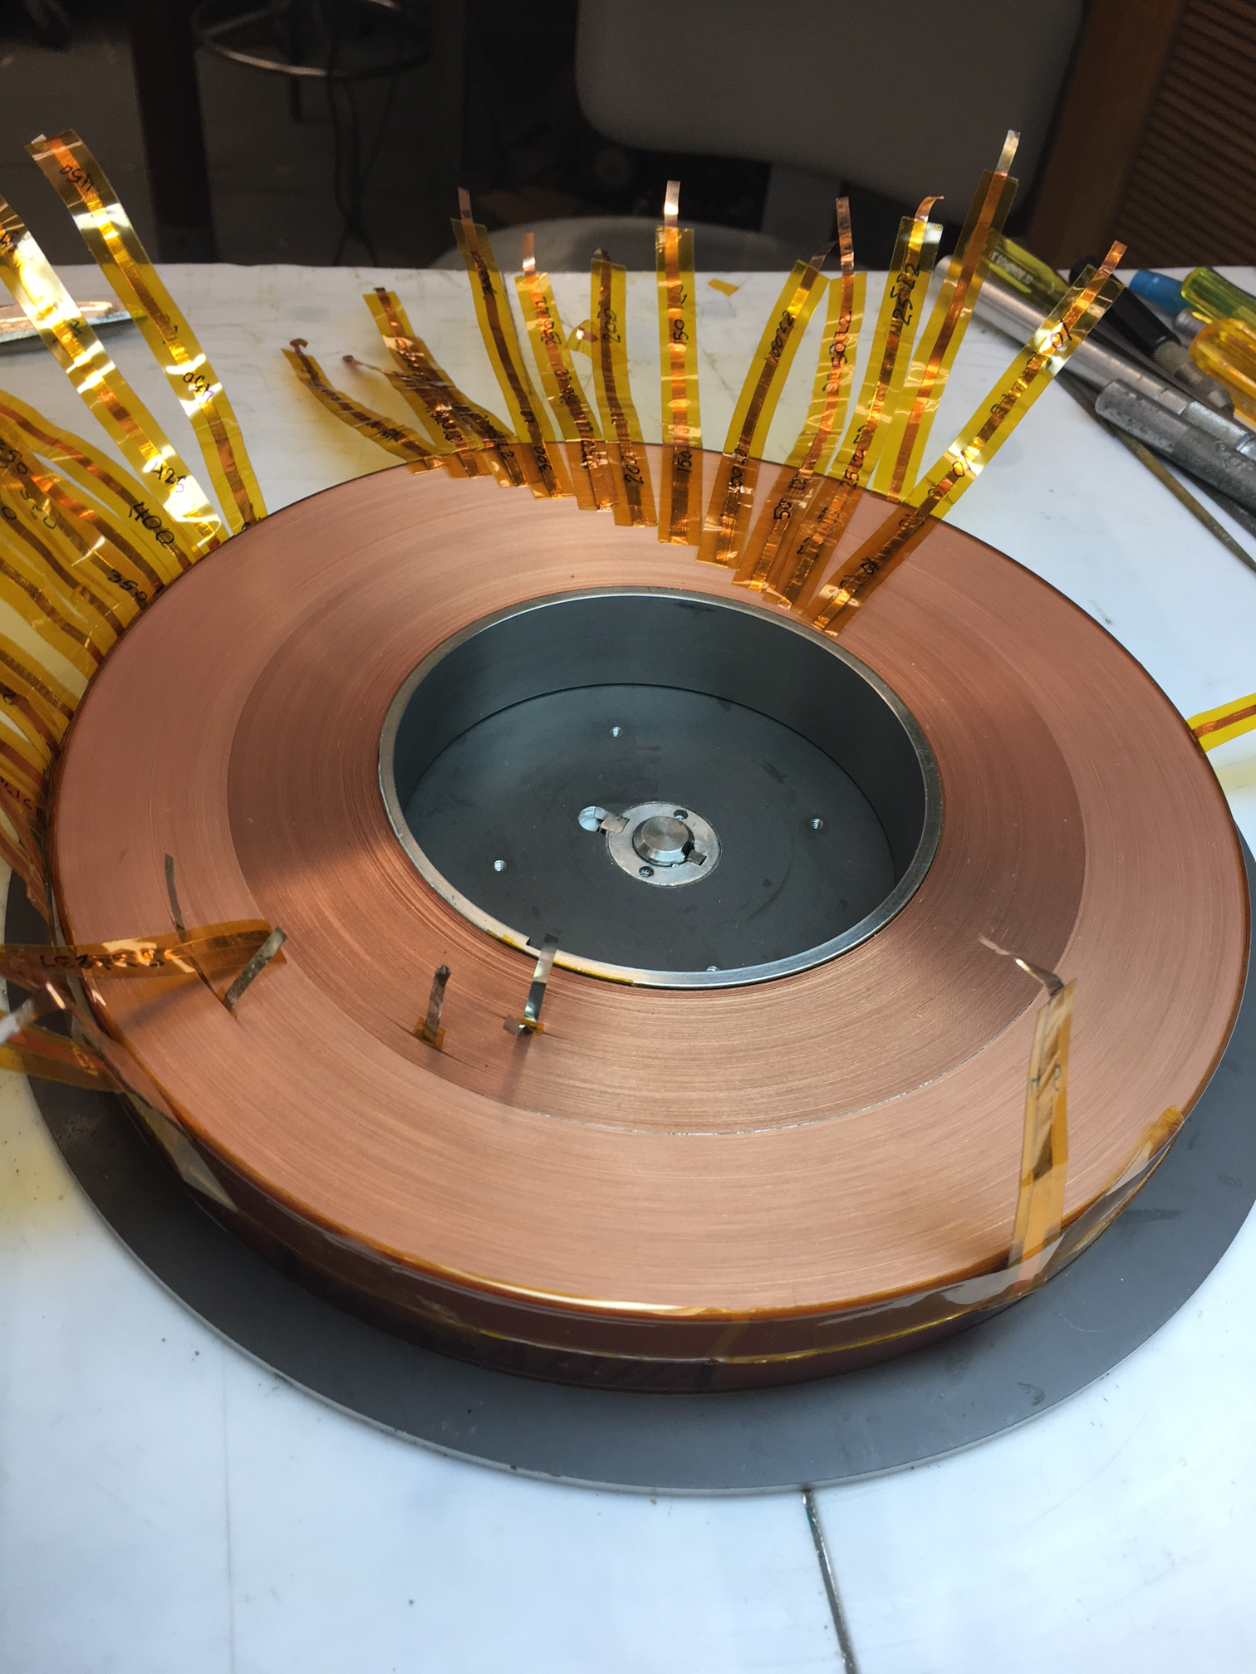
No Insulation Double Pancake Coils
To obtain data and 4 K test experience with large “NI” coil early on, a coil wound with ~550 m of 12 mm wide ReBCO tape
i.d. = 100 mm
o.d. = 220 mm
Turns = 971
Significant instrumentation and 3 heaters for simulated defects

Slide 20
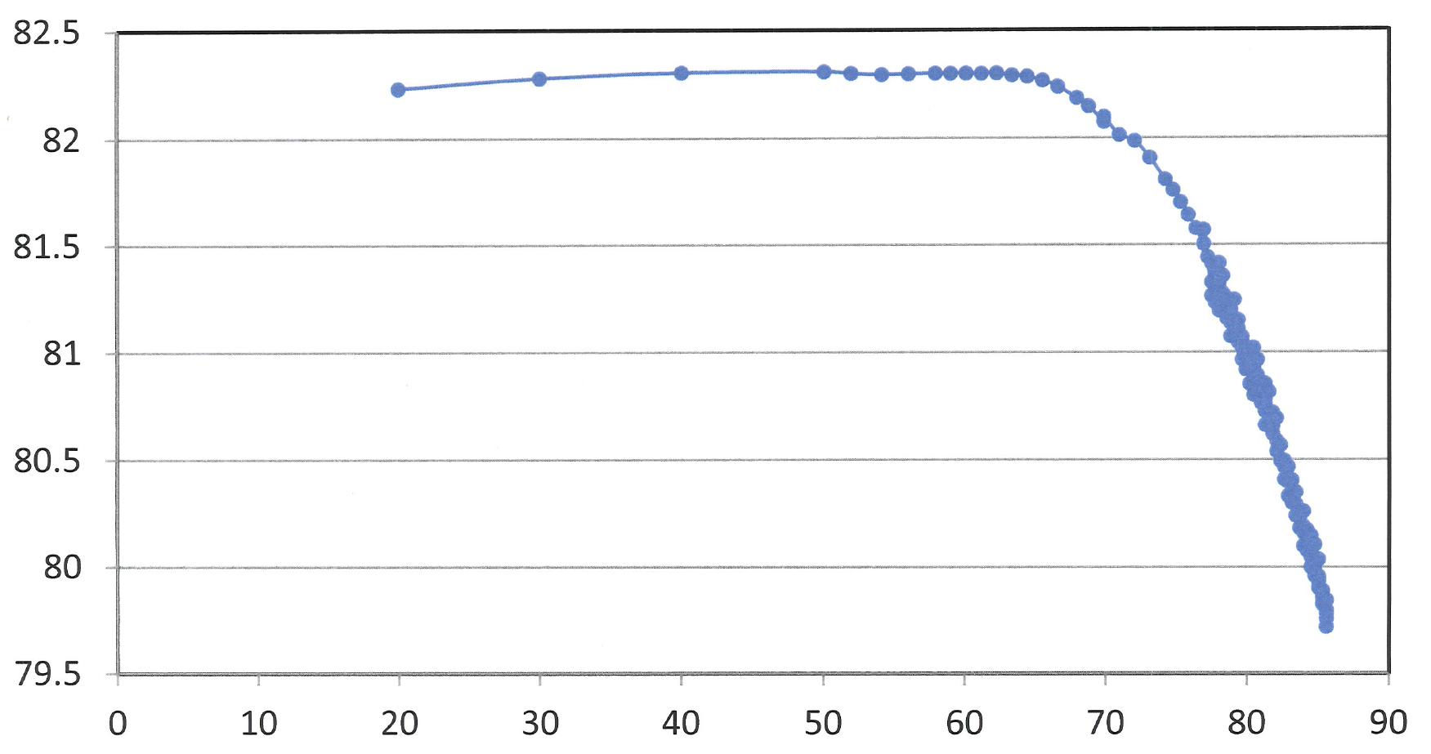
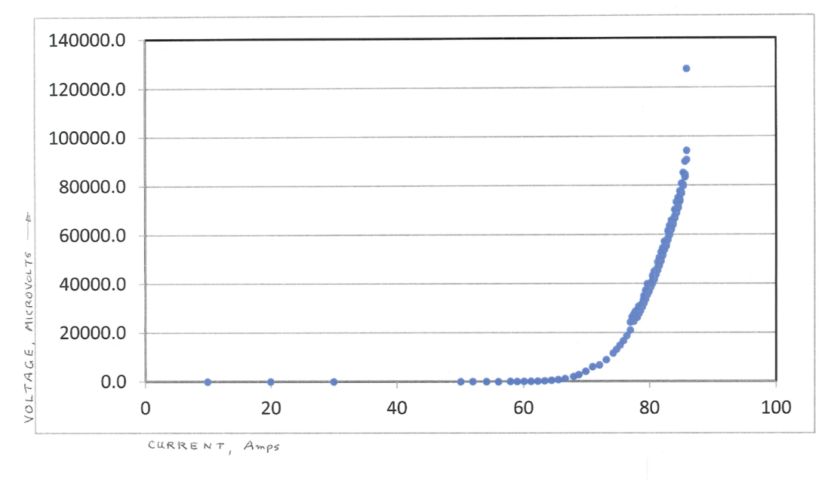
Transfer Function Vs. Current in No Insulation Coils
Over Current
Reduction in Transfer Function implies that the effective number of turns are decreasing
V-I curve
Current (A)

Slide 21
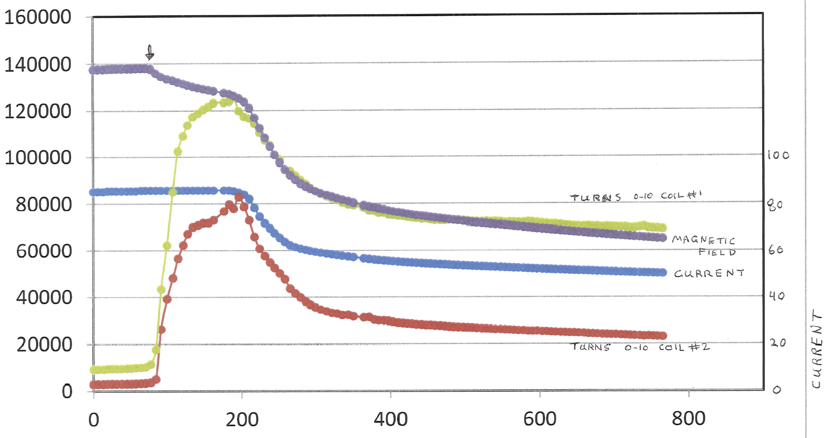
B, V and I in No Insulation Coil at Thermal Runaway
Thermal Runaway
B
V₁
I
Current limited by PS
V₂
Next: 4K measurements
Time (seconds)

Slide 22
Summary
Encouraging Test Results of HTS/LTS Hybrid Dipole
Many LTS type quenches in HTS coils with no degradation
A robust rapid-turn-around, low-cost test facility
Insert coils become an integral part of the magnet
High Field, large aperture HTS solenoid program gives an experience in dealing with the high stress HTS magnets

