Slide 2
Beam-beam weak-strong simulations for LHC and HL-LHC
Nikos Karastathis
CERN
Acknowledgements:
F. Antoniou, G. Arduini, S. Fartoukh, R. de Maria, Y. Papaphilippou, D. Pellegrini
our OP & MP Colleagues and all the LHC@Home volunteers!
International Workshop on High Energy Circular Electron Positron Collider
06/11/2017
IHEP, Beijing, China

Slide 3
Introduction
Beam-beam effects are responsible for the largest part of “losses” at LHC!
  The BB potential quickly becomes non-linear as the amplitude of the particle is increased...
  ... but we want to stay at collisions for as long as effectively possible. Well... it is a collider!
LHC is a complex machine!
  Non-linear magnet elements, fringe fields, two states of energy regime, etc
  Can my simulations drive the machine performance during its operation?
Dynamic Aperture within the Weak-Strong Approximation:
The strong beam generates the fields while the weak beam just probes them, without reciprocal perturbation
➔ computationally easier, while captures adequately all the necessary beam dynamics

Slide 4
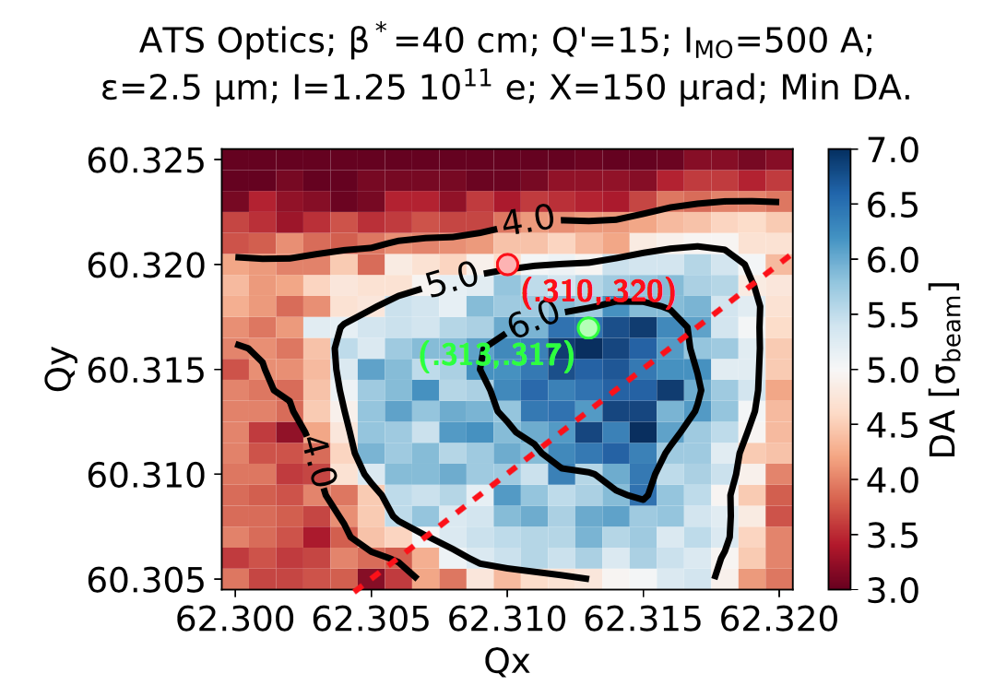
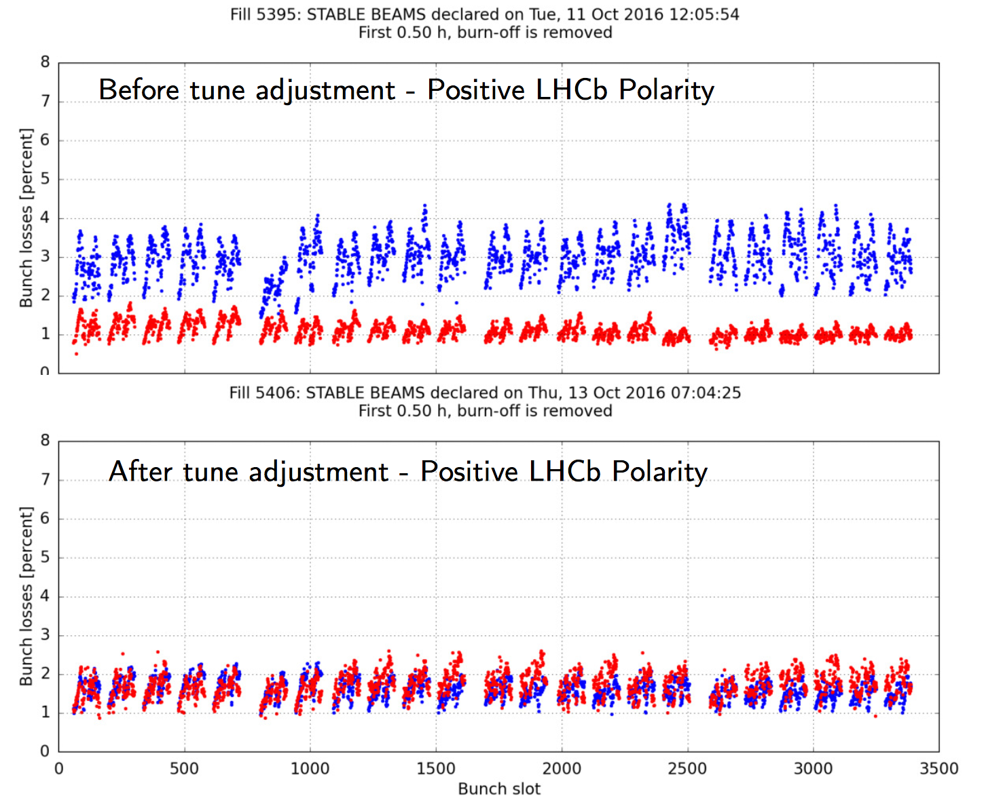
Setting the Stage: DA Scans
Dynamic Aperture Scans (MAD➔SixTrack):
  Choose the machine model (lattice, optics, etc);
  Specify the available parameter space;
  Choose two parameters to study their correlations in terms of DA;
  Fix the rest of the parameters to a constant value for the scan;
  “Time evolution” can be folded in by evolution of the “fixed” parameters (i.e. Intensity evolution, emittance evolution etc).
DA multi-parametric response: Tool to assist in performance optimization by defining a target DA & identifying and approaching the limits
  Operational experience is fed back
The non-linear nature of higher order machine multipoles, the beam-beam force, etc can be comfortably accommodated by the DA description.
Is this perfect?
  Tracking for 1M turns is only ~90s of machine time
  The initial longitudinal action is fixed
  No diffusion information...
No, but captures all the necessary dynamics!

Slide 5
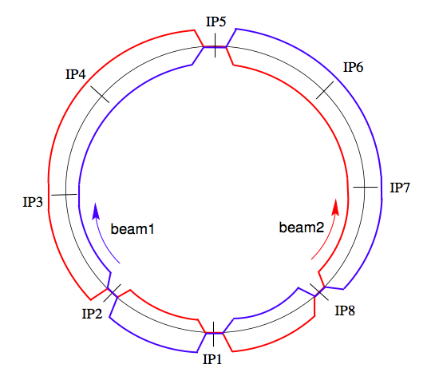
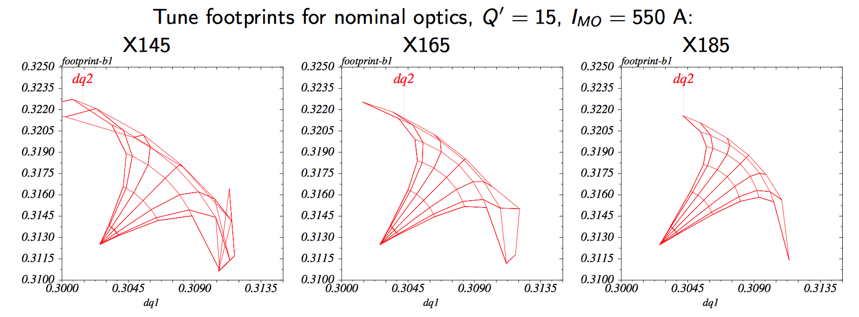
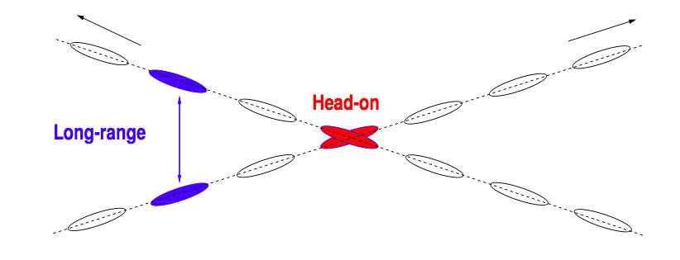
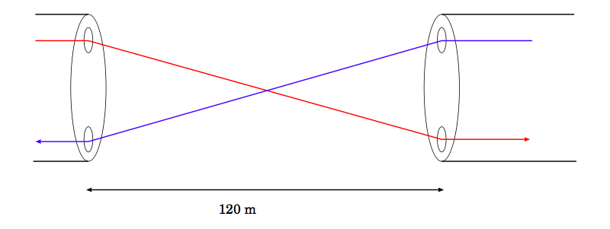
LHC Crossing Scheme
CMS
Two counter rotating beams in two separate rings…
RF
DUMP
(H)
come into collision using separation bumps at the 4 main IP
Cleaning
  ATLAS, CMS: experiments requiring high luminosity
  ALICE, LHCb: lower luminosity
(V)
(H)
Collider Performance : Luminosity
(V)
LHCb
ALICE
ATLAS
To increase performance, assuming constant
brightness, I could…
Reduce β*
Reduce φ
But can I?
➔ Dynamic Aperture Simulations
as Lifetime indicator

Slide 6
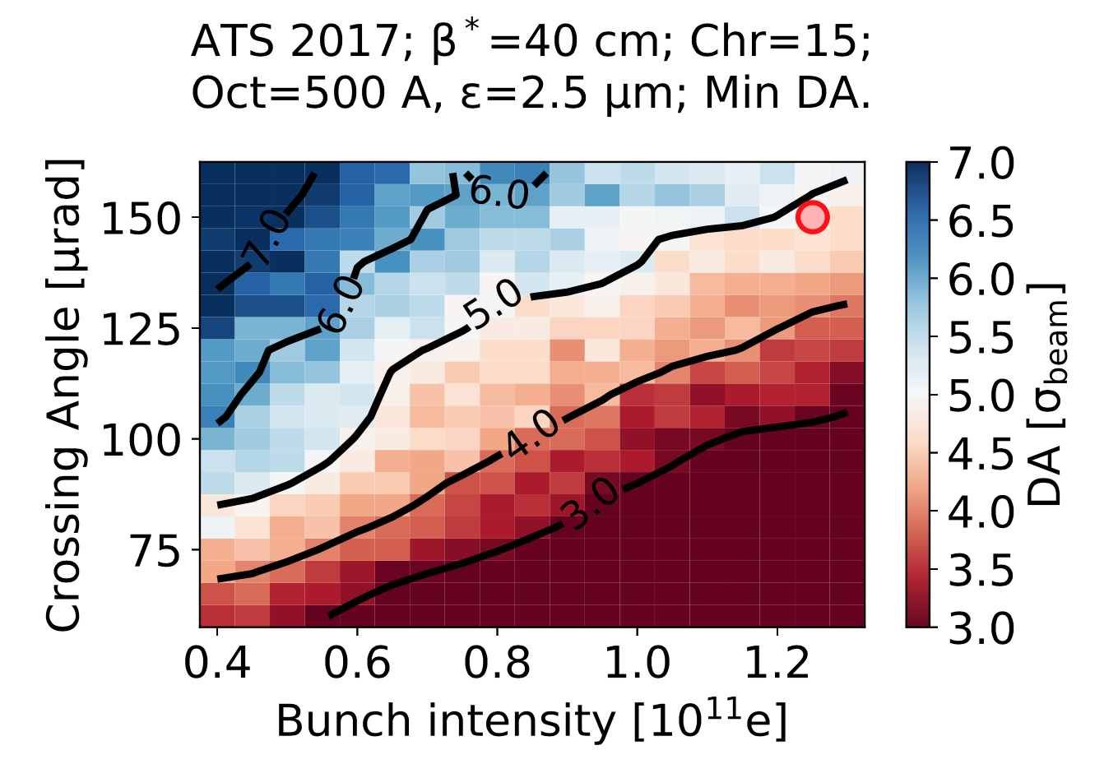
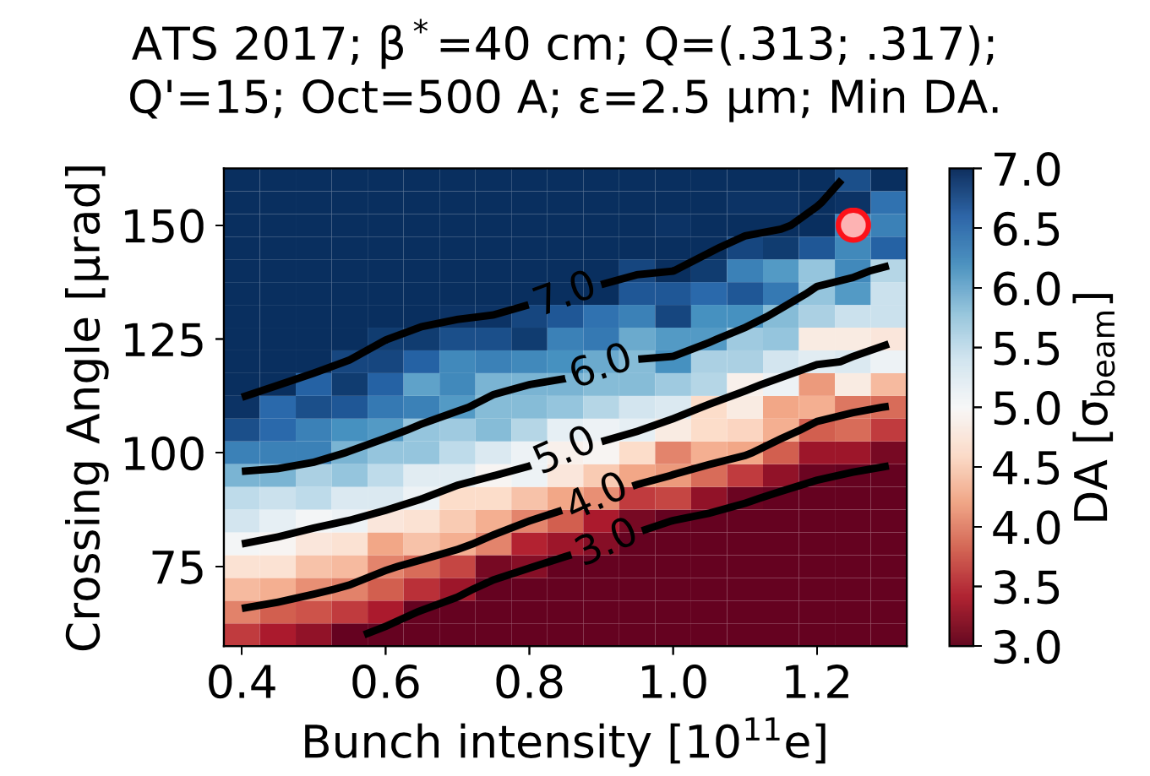
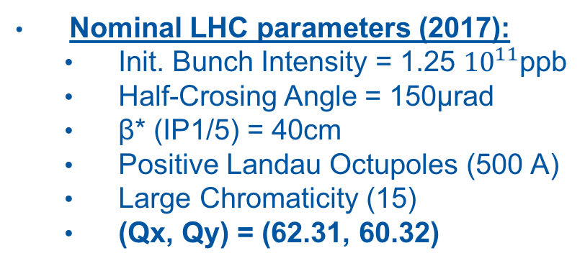
Which crossing for my intensity?
Nominal LHC parameters (2017):
  Init. Bunch Intensity = 1.25 ${10}^{11}$ppb
  Half-Crosing Angle = 150μrad
  β* (IP1/5) = 40cm
  Positive Landau Octupoles (500 A)
  Large Chromaticity (15)
  (Qx, Qy) = (62.31, 60.32)
Optimized Tune LHC:
  (Qx, Qy) = (62.313, 60.317)
  ➔ Margin to push for performance

Slide 7
What about 30cm β*?
At the nominal working point, 30cm β* was very tight
With the tune adjustment, 30cm totally feasible with 175μrad
175μrad
150μrad are within reach (no change)
Based on operational experience could even push for 140μrad at start of the fill!
  ➔ tested during operation
150μrad
How can I push more?

Slide 8
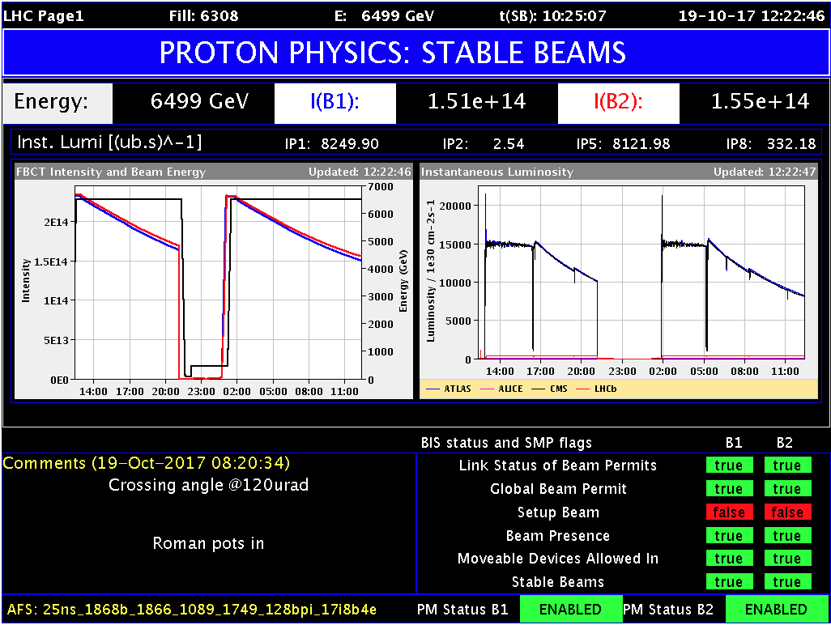
Crossing Anti-Levelling

Slide 9
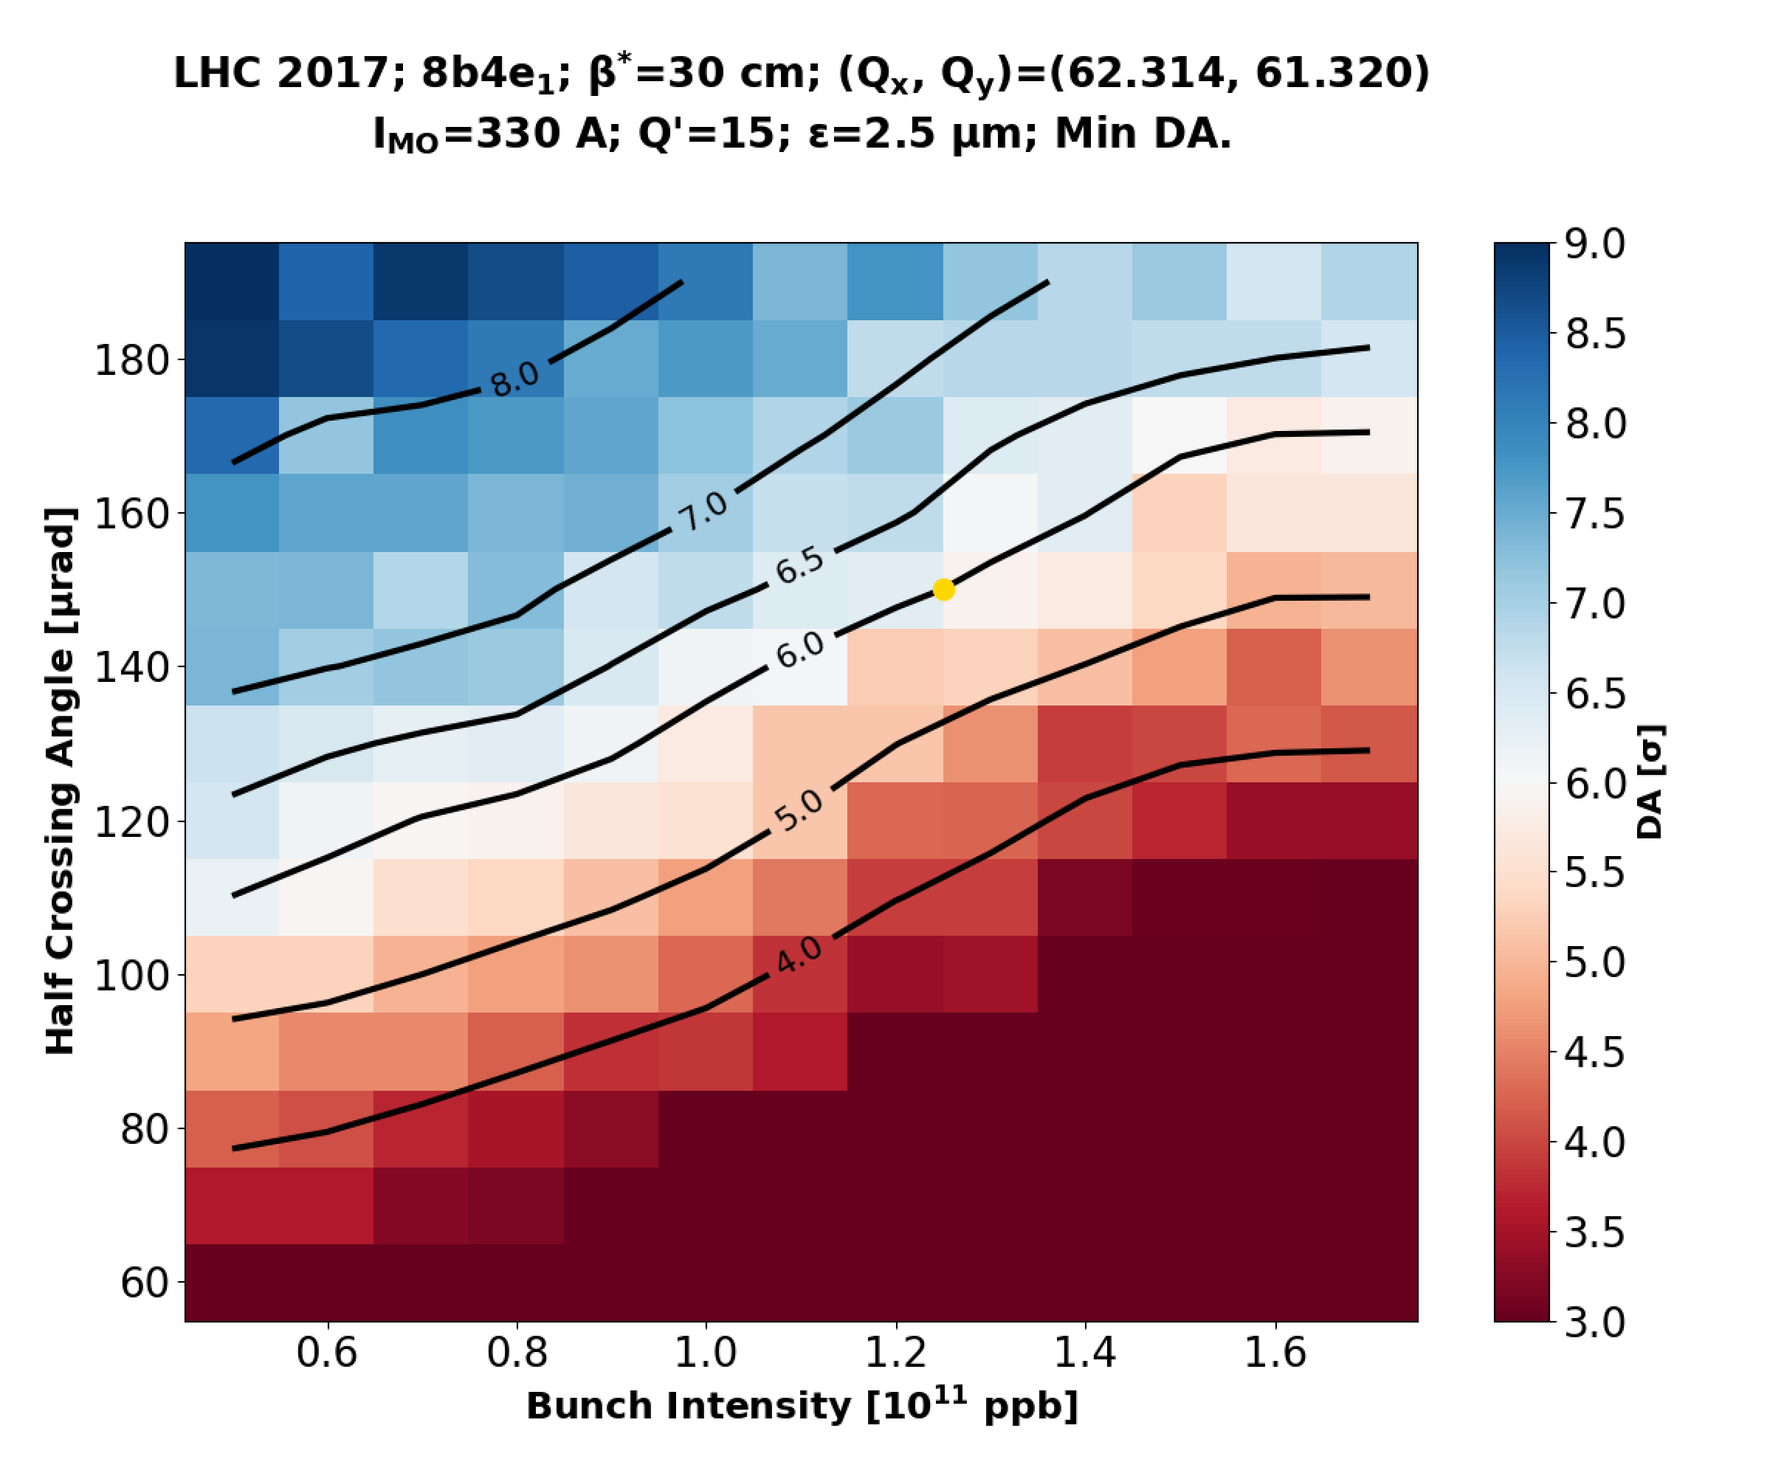
Crossing Anti-Levelling

Slide 10
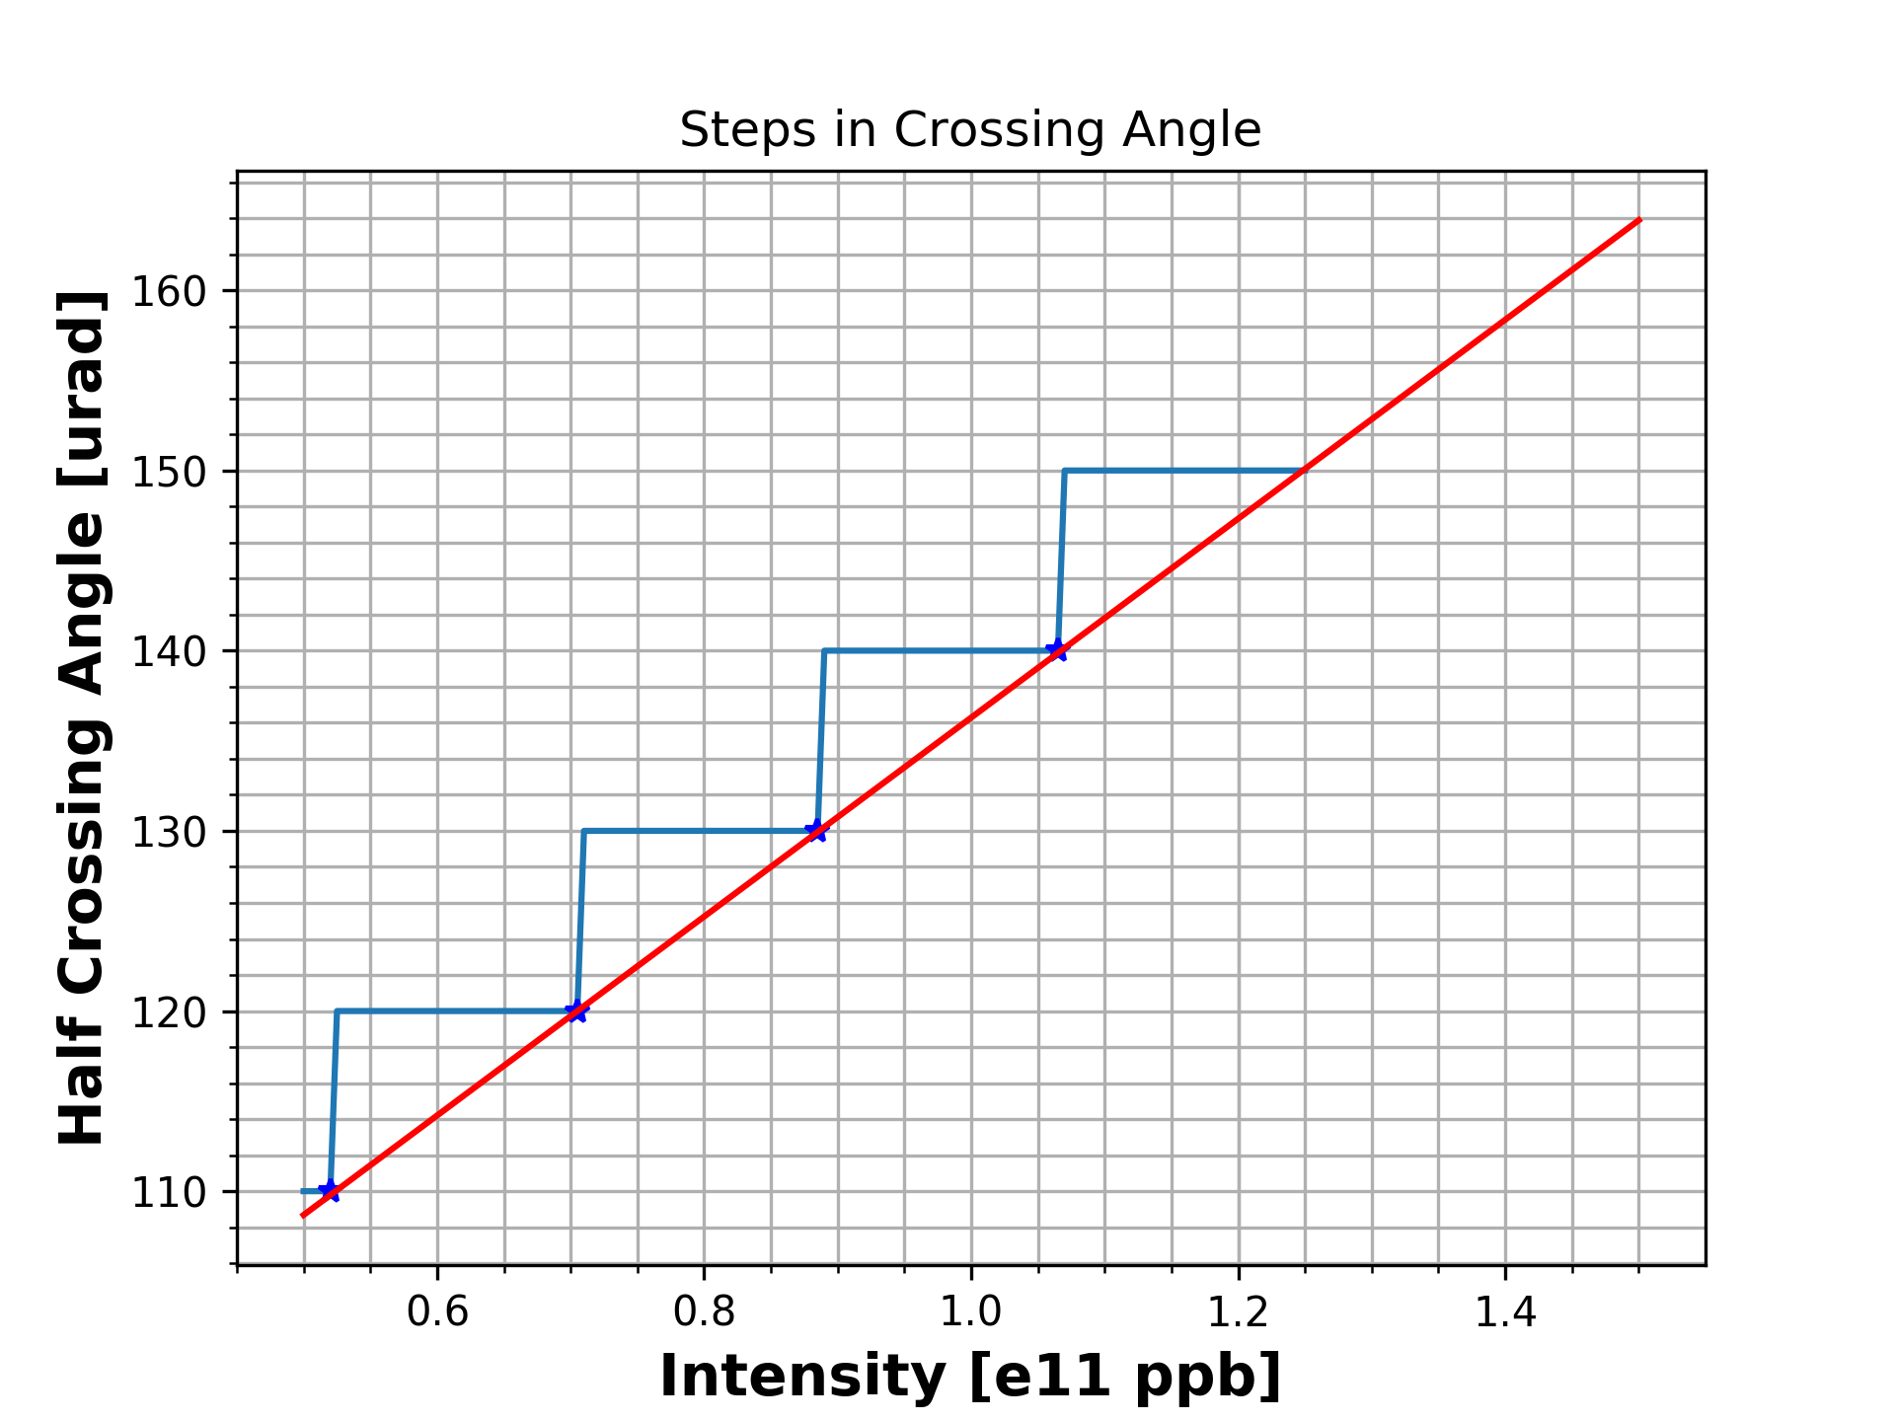
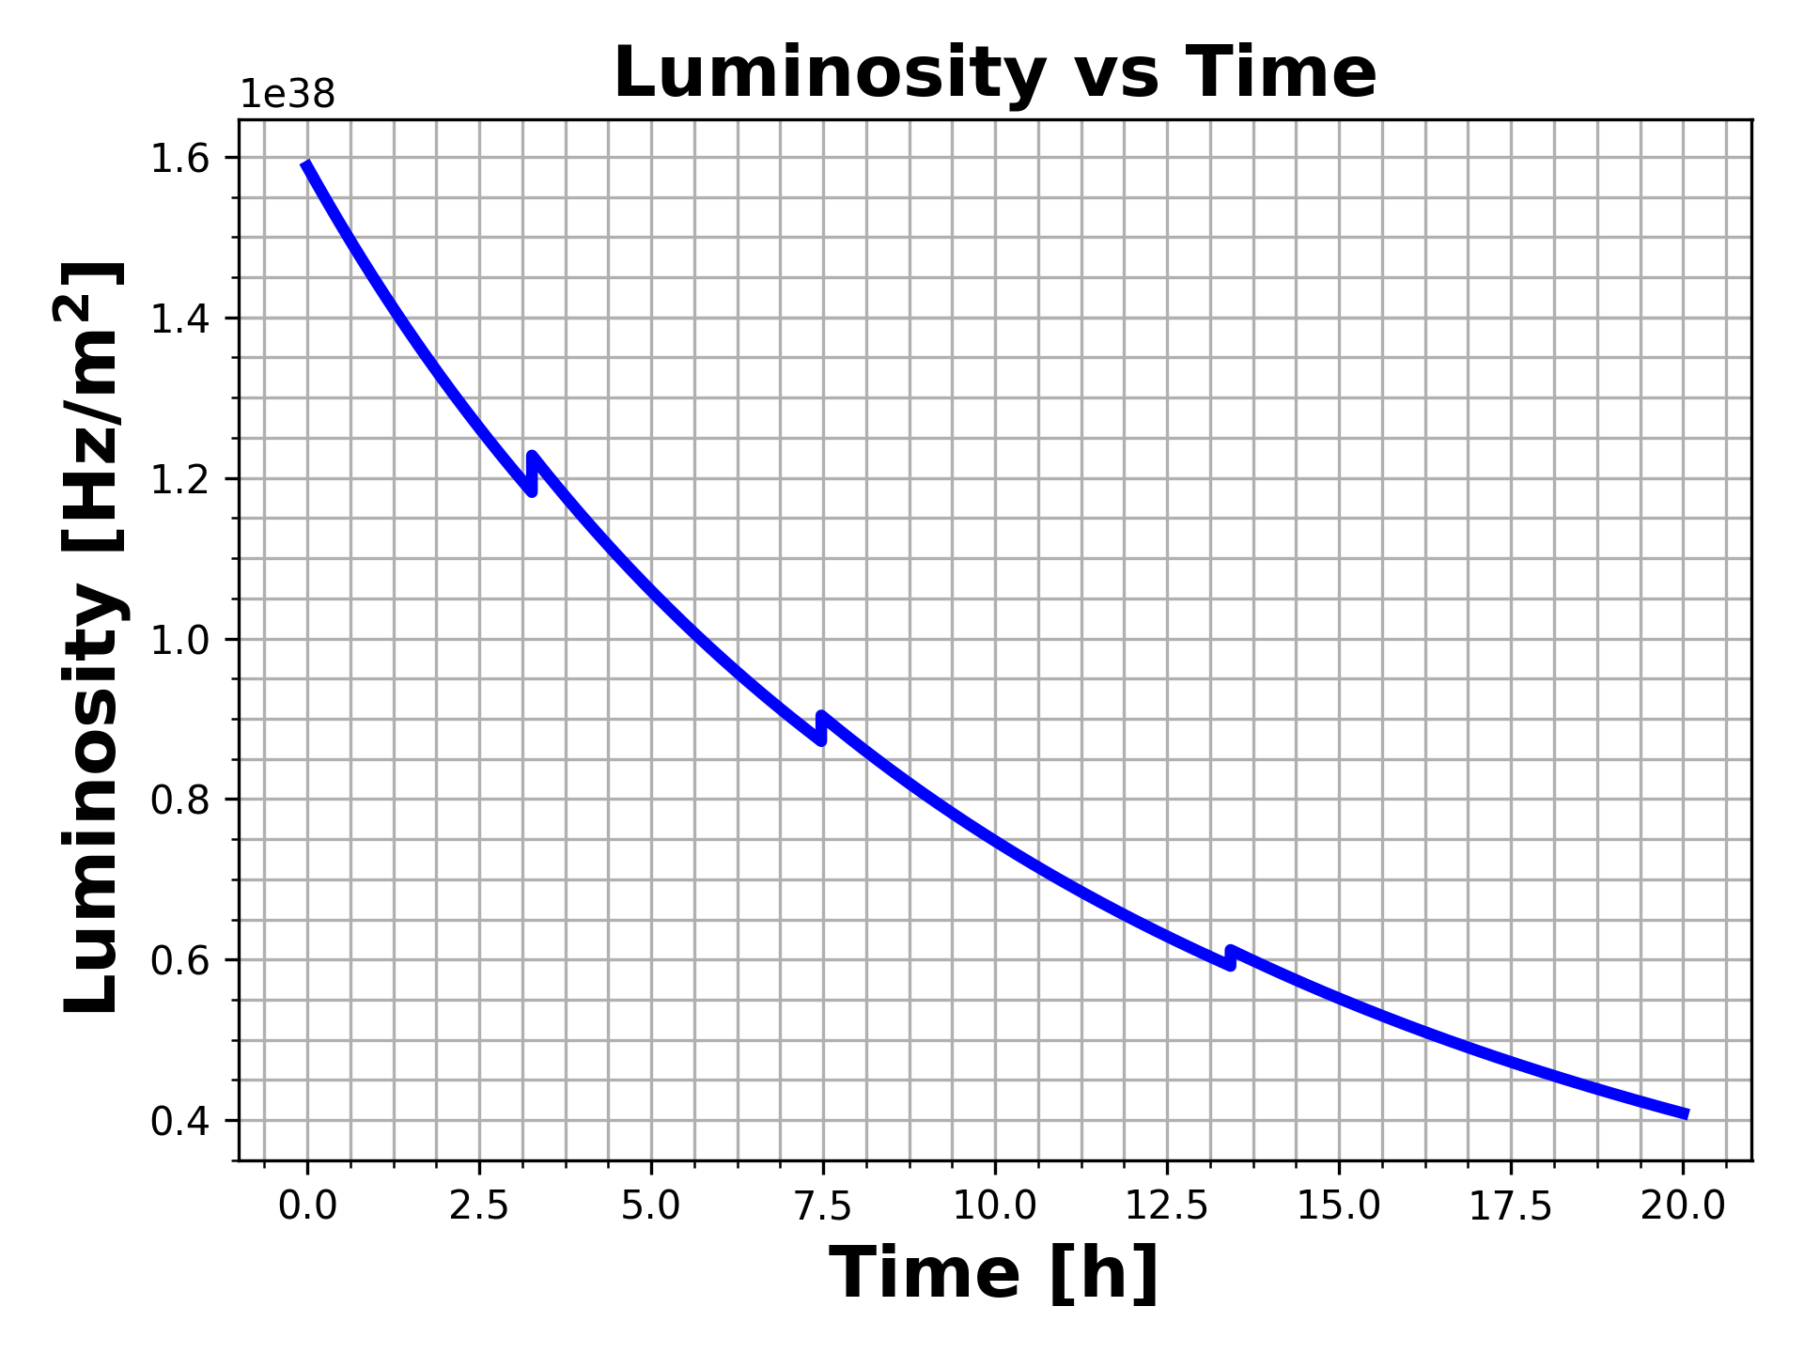
Crossing Anti-Levelling
With careful steps, gain in integrated luminosity of ~3-5% for 10h in Stable Beams

Slide 11
Crossing Anti-Levelling

Slide 12
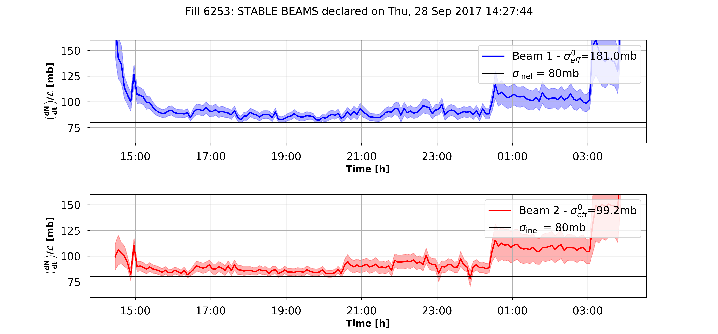
Crossing Anti-Levelling
110μrad
100μrad
When you are in a regime with reduced DA beam lifetime suffers and losses appear!
Careful handling is required, but experience on changing the crossing angle in operation is very valuable for the future...

Slide 14
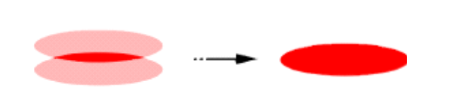


HL-LHC Era: Adaptive Levelling
HL-LHC TDR:
“Both the consideration of energy deposition by collision debris in the interaction region magnets, and the necessity to limit the peak pile-up in the experimental detector, impose an a priori limitation upon peak luminosity. The consequence is that HL-LHC operation will have to rely on luminosity levelling."
Levelling Scenarios:
  So far LHC has successfully operated levelling by separation.
  HL-LHC design includes the installation of crab cavities around the IR1/IR5.
  The size of the luminous region can be modified by changing the β* at the IP.
✔︎
✔︎
✔︎
Levelling Proposal:
  “Adaptive Levelling Scenario”
    Depending on the time within the fill (during levelling, i.e. bunch intensity) and driven by the available DA, adapt the crossing angle and β* at the interaction points to keep the target 5 Hz/cm/cm.

Slide 15
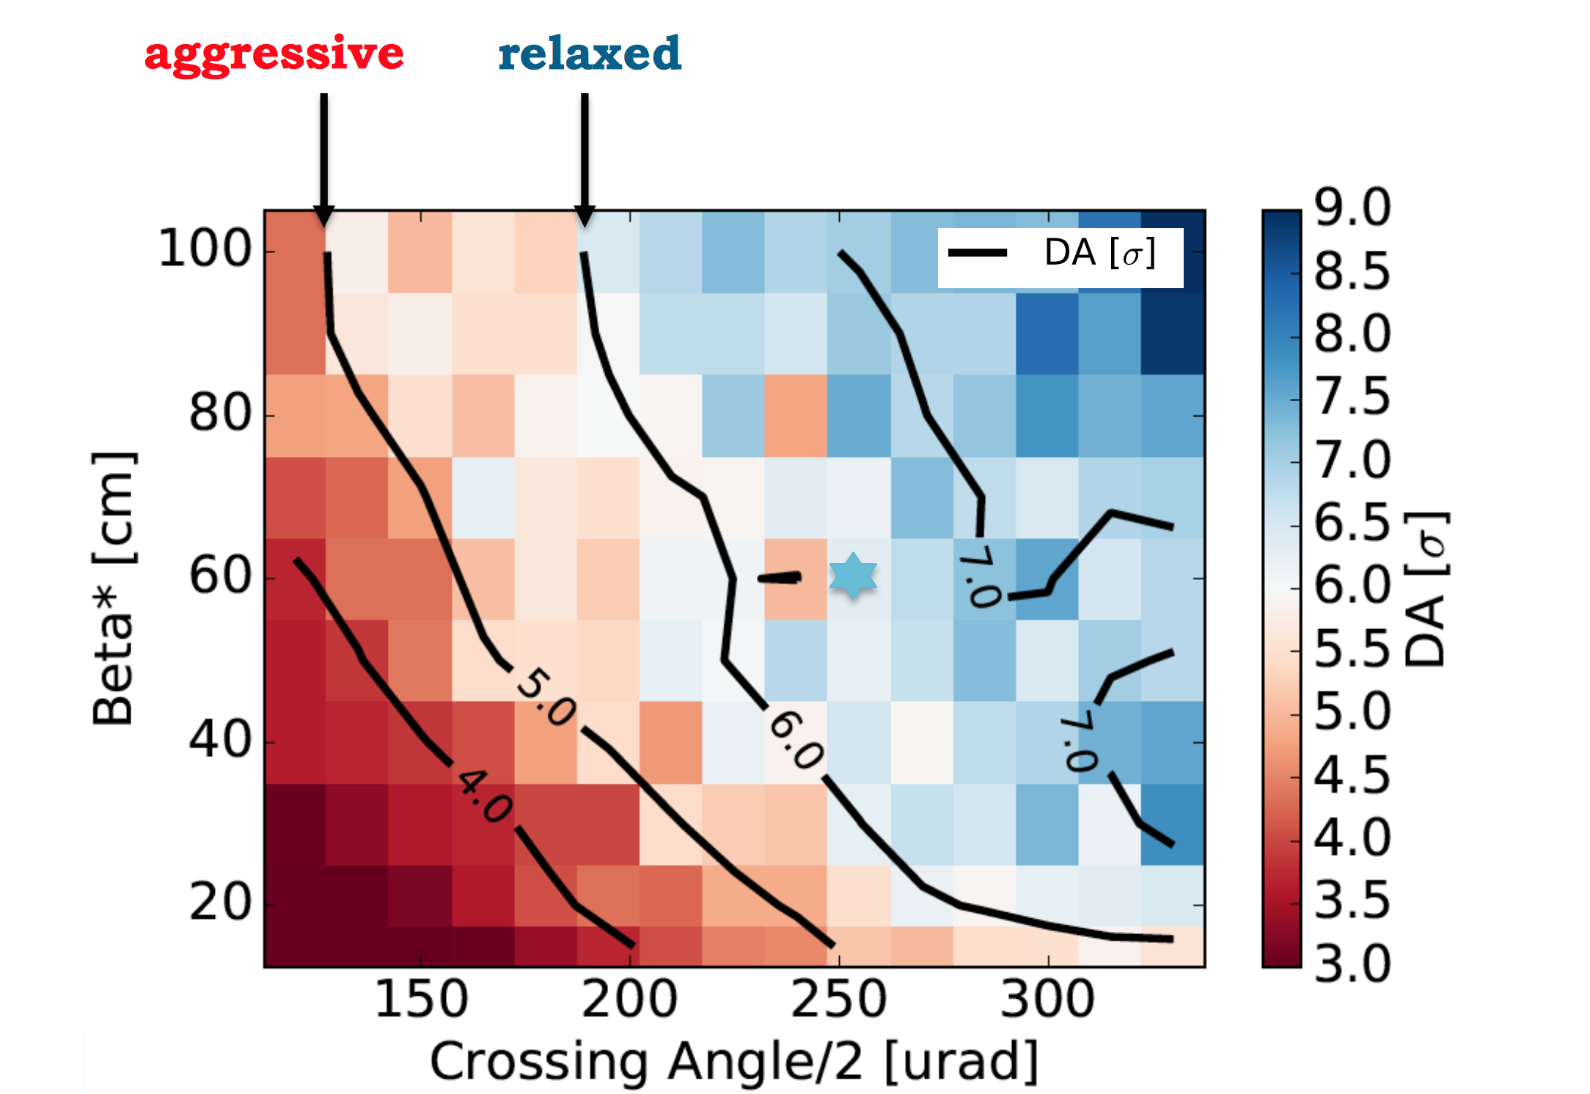
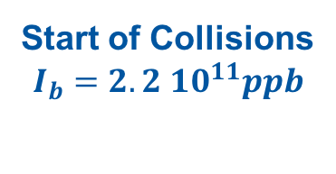
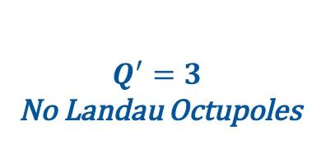
Adaptive Levelling
Min DA Scan for Half Crossing Angle and β* at the start of the collisions.
Start of Collisions
$$I_{b}=2.2 {10}^{11}ppb$$
$$Q^{′}=3$$
No Landau Octupoles

Slide 16
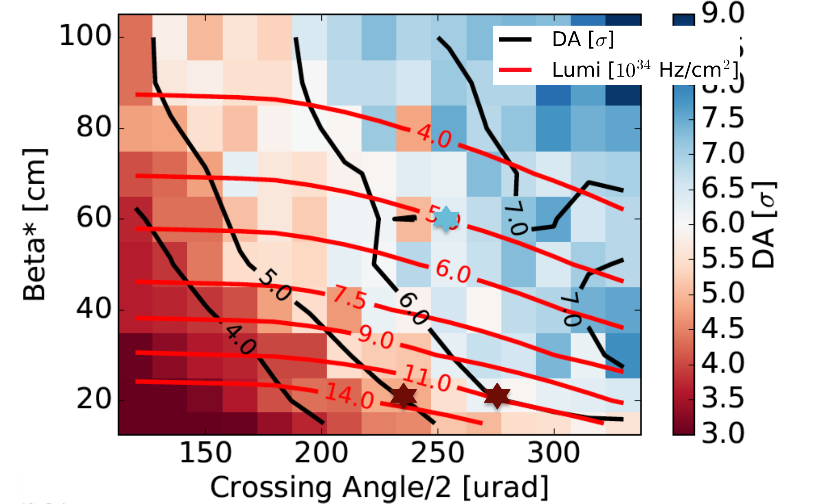
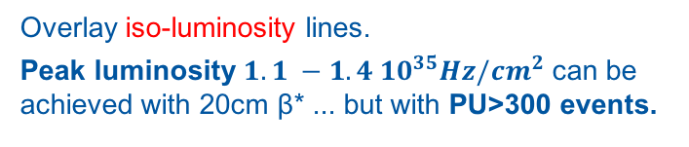
Adaptive Levelling
Overlay iso-luminosity lines.
Peak luminosity ${1.1 −1.4 10}^{35}Hz/{cm}^{2}$ can be achieved with 20cm β* ... but with PU>300 events.
Start of Collisions
$$I_{b}=2.2 {10}^{11}ppb$$
$$Q^{′}=3$$
No Landau Octupoles

Slide 17
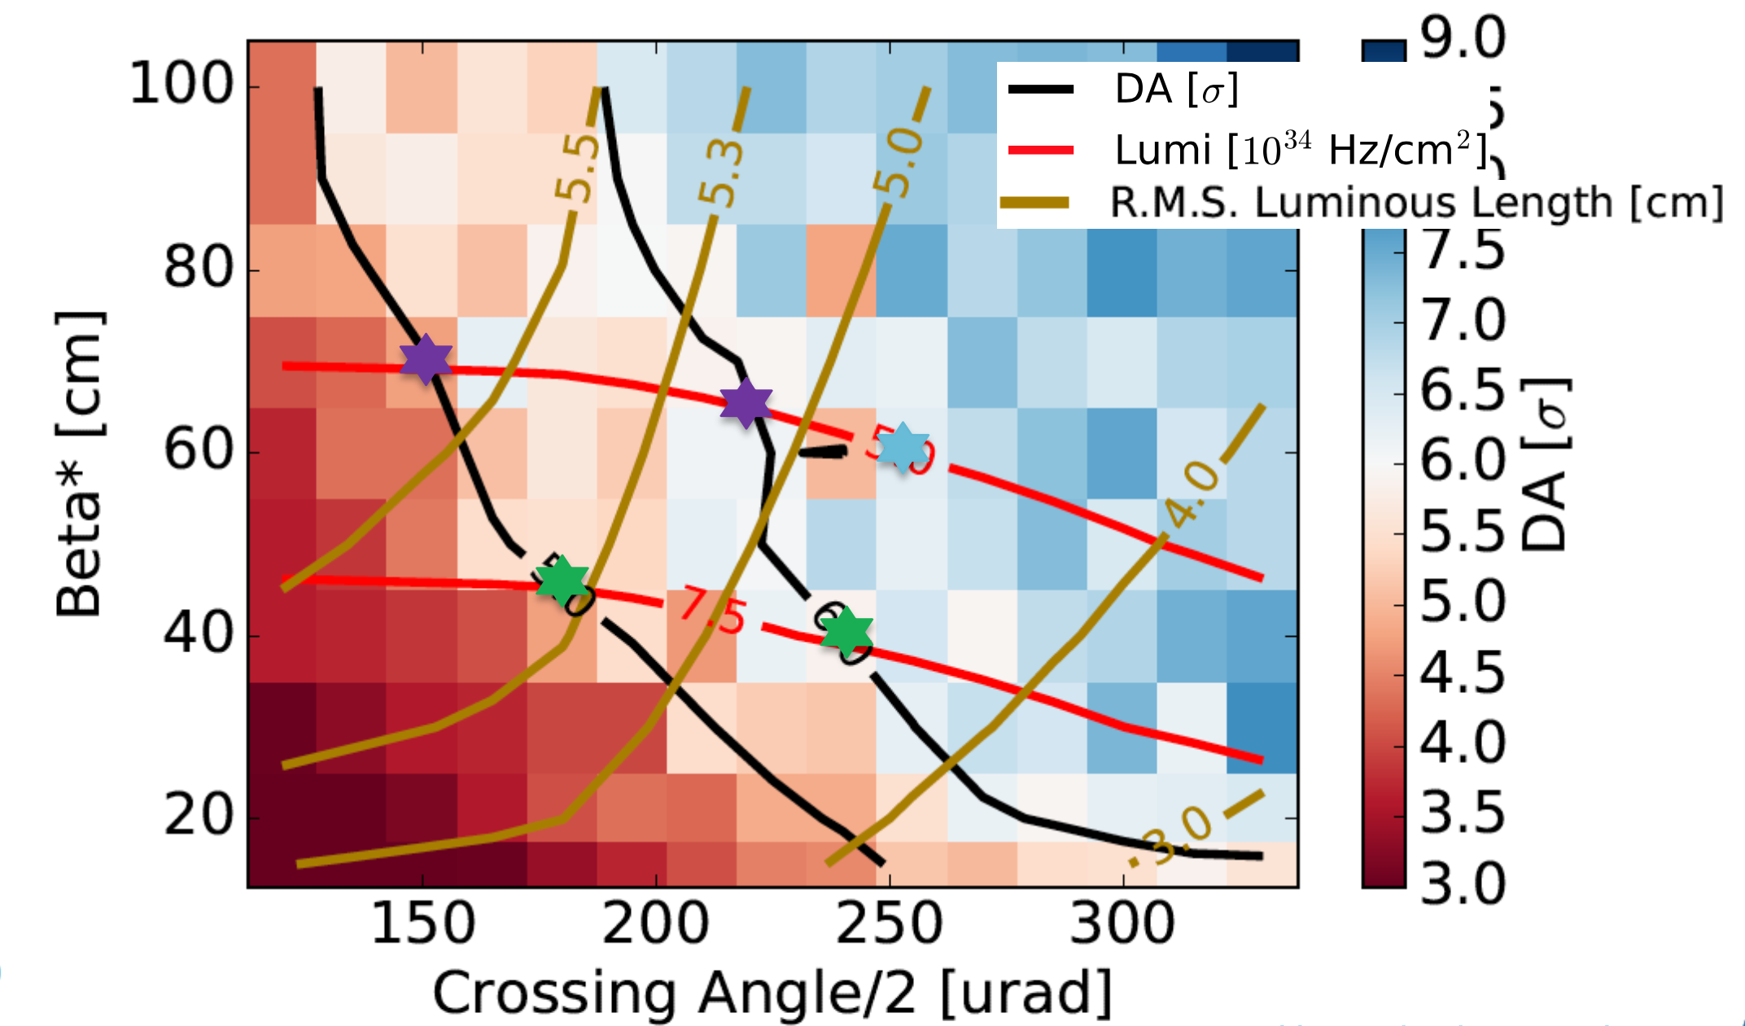
Adaptive Levelling
Overlay iso-length of luminous region lines.
Reduction of crossing angle at constant luminosity enables the reduction of PU density (increase of luminous region) and triplet irradiation.
Start of Collisions
$$I_{b}=2.2 {10}^{11}ppb$$
$$Q^{′}=3$$
No Landau Octupoles

Slide 18
Adaptive Levelling
Time evolution can be folded in in terms of bunch intensity.

Slide 19
Adaptive Levelling

Slide 20
Adaptive Levelling
Following the intersection of the iso-luminosity and iso-DA lines one can define a levelling path

Slide 21
Adaptive Levelling – What do I gain?
Comparing:
Constant crossing at 510μrad
Adaptive scenario of 6σ DA
Adaptive scenario of 5σ DA
Assuming a cross-section of 80mb
In terms of crossing angle, I can operate with less voltage in the crab cavities (max crabbing 380μrad).
In terms of β* delayed exit from the levelling (here: 20cm target, design: 15cm).

Slide 22
Adaptive Levelling – What do I gain?
This provides me with a bit of gain in terms of integrated luminosity.
  Bit more if I continue with “anti-levelling” after the levelling is finished.
... while the experiments are recording data comfortably at a reduced pileup density.

Slide 23
Overview
Weak-strong simulations are heavily used to estimate the long term conditions in the presence of beam-beam for a given configurations;
  Fast, reliable, accurate thanks to the continuous development & extension of computational frameworks & infrastructure
  Identify margins ➔ construct operational scenarios
The excellent LHC performance and the operational experience allows to push the beam and machine parameters to extract more luminosity, eg:
  2017: ATS & reducing β* ➔ increased performance
  2017: crossing angle anti-levelling ➔ increased performance
The knowledge and experience gained are propagated in the HiLumi LHC era, e.g:
    Adaptive levelling scenario ➔ increased performance

Slide 24
Thank you for your attention!

Slide 26
SPARE SLIDES

Slide 27
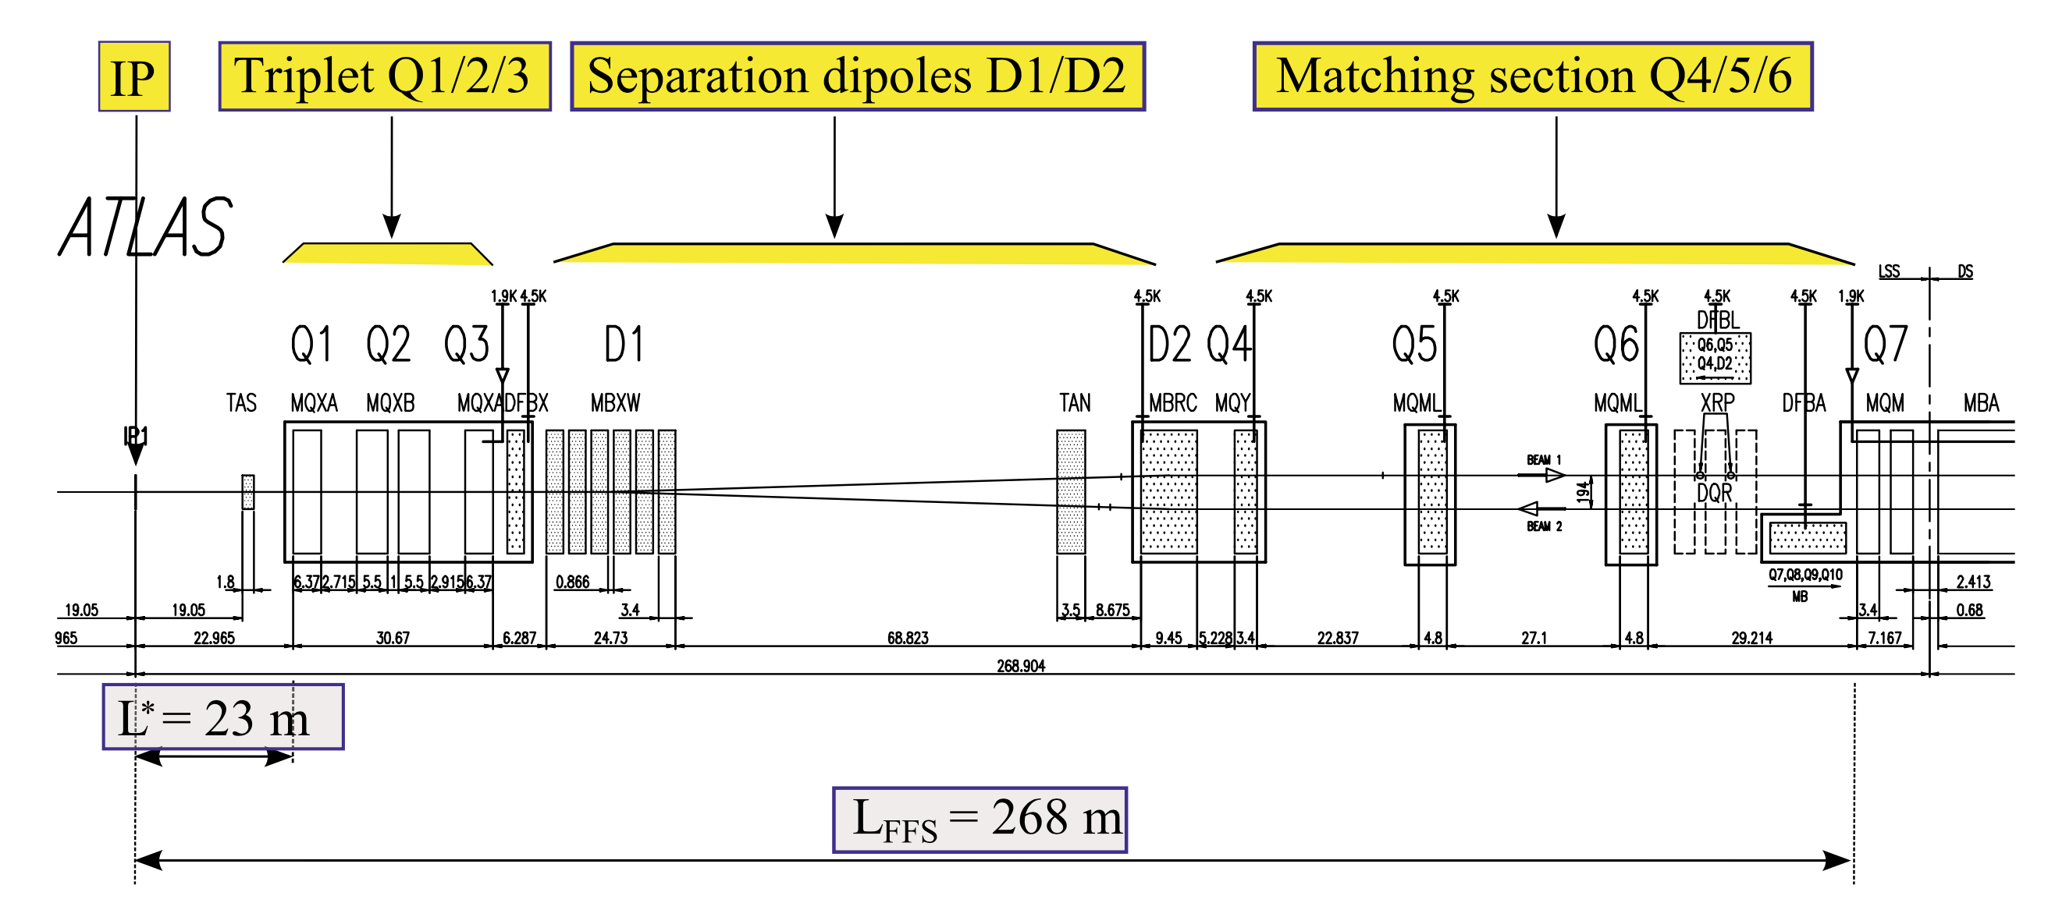
IR1

Slide 28
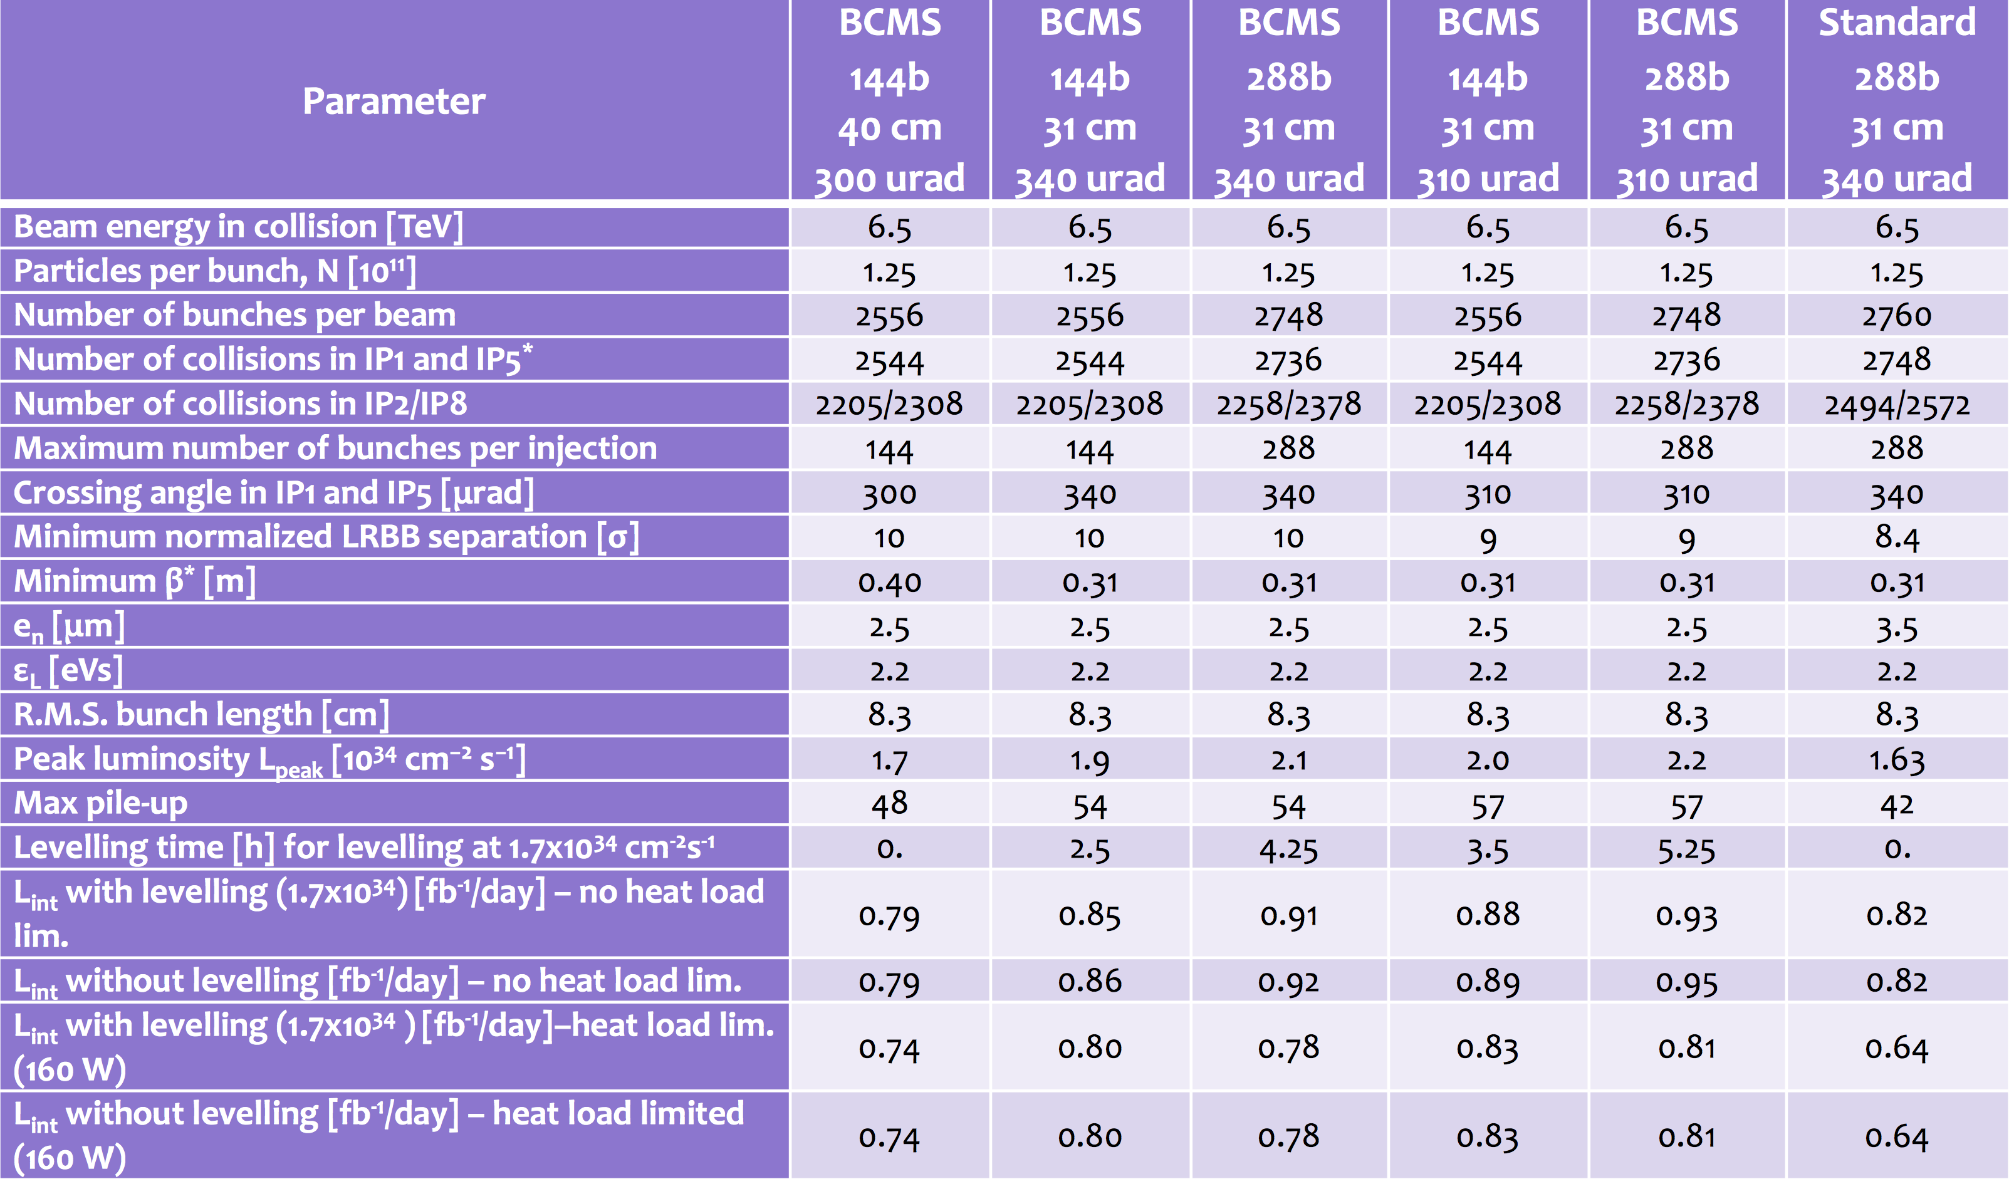
2017 Settings

Slide 29
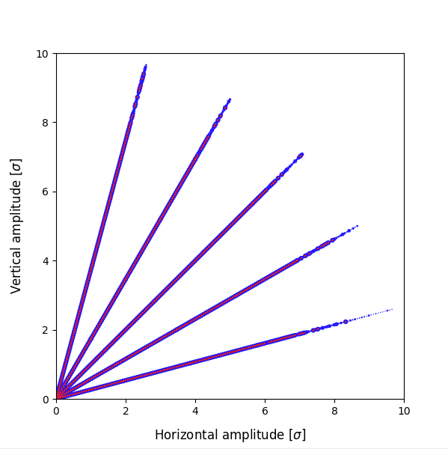
Setting the Stage: DA Scans
Which Tools & How?
  The geometry and basic optics are generated using MADX;
  The tracking is done in SixTrack
    Particles (weak beam) are tracked through the lattice under the impact of the external fields;
    The particles are uniformly distributed in terms of amplitude... (here: 2σ-10σ);
    ... and laying on a number of angles (here: 5 angles);
    … the longitudinal initial conditions of the weak beam are fixed;
    The particles are tracked for a number of turns (here: 1M), with the view to find the survival at 1M turns ➔ DA;
    The final result is quoted in terms of rms transverse beam size units (LHC: protons ~ round beams).
Is this perfect?
  Tracking for 1M turns is only ~90s of machine time
  The initial longitudinal action is fixed
  Beam phase space distribution is not taken into account, no diffusion information
No.
... but it captures all the relevant
aspects of beam dynamics

Slide 30
Which crossing for my intensity?
I would need 175μrad to have the same normalized separation at the start of the fill
For β*=30cm and nominal tune gives me DA < 5σ
175μrad
150μrad

Slide 31
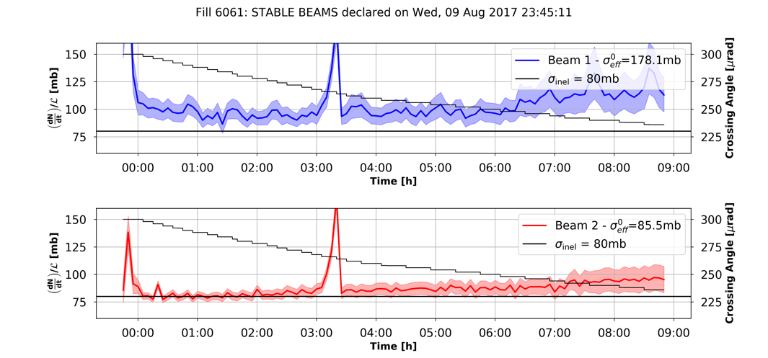
Continuous crossing

