Slide 1
Beam-Beam Effect &
Dynamic Aperture Optimization at CEPC
Y. Zhang Y. WANG D. Wang H. Geng
CEPC Workshop, Nov. 6-8, 2017
Many Thanks: K. Ohmi(KEK), D. Shatilov(BINP), J. Qiang(LBNL), K. Oide(KEK), D. Zhou(KEK)

Slide 2
Beam-Beam

Slide 3
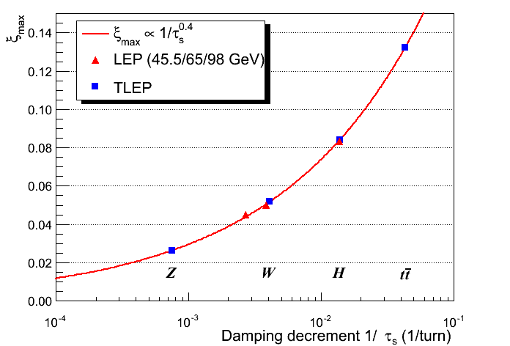
CEPC-H
CEPC-W
CEPC-Z
the damping rate per beam-beam interaction

Slide 4
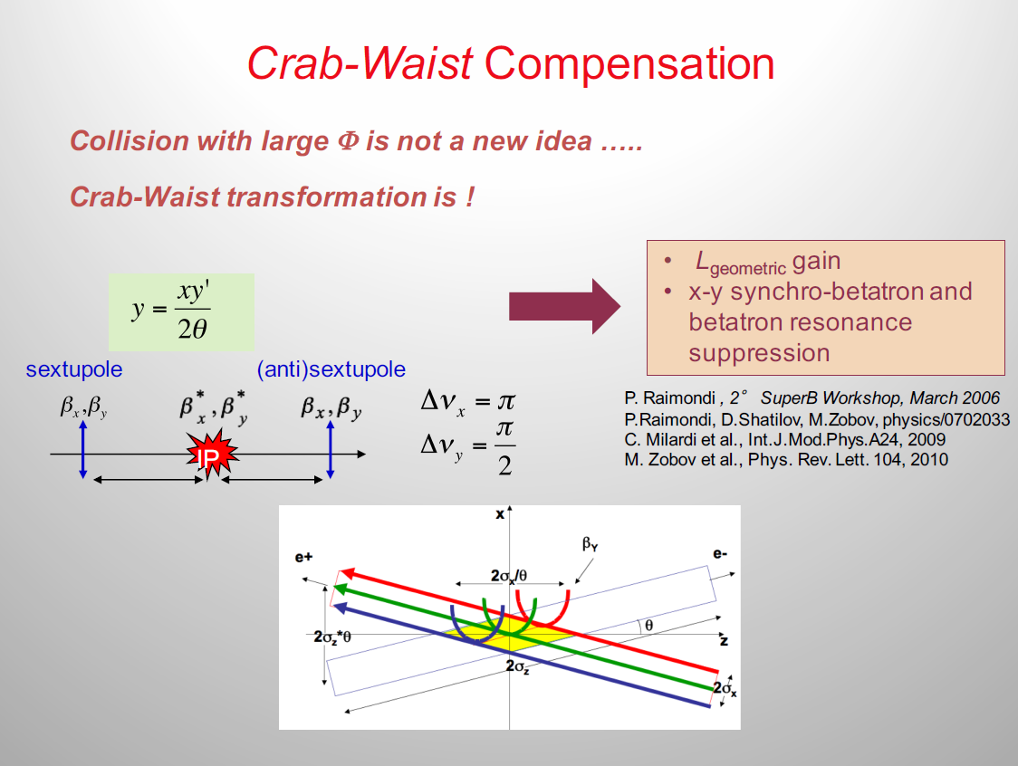
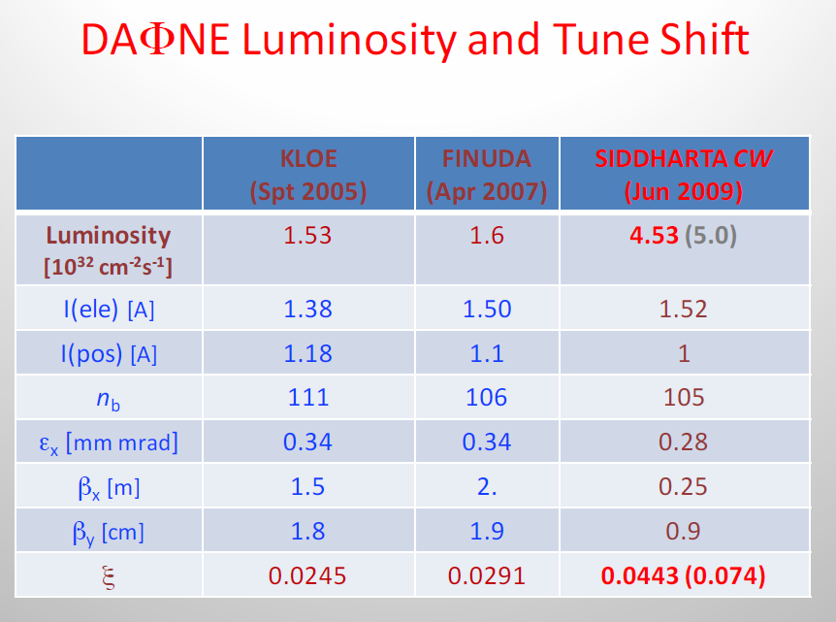

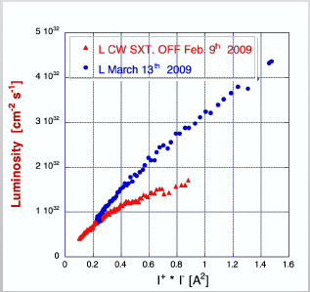
C. Milardi

Slide 5
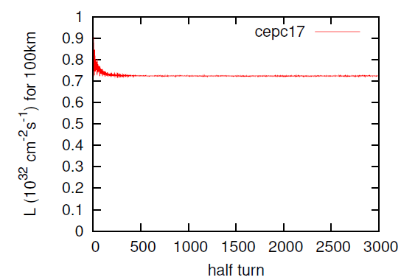
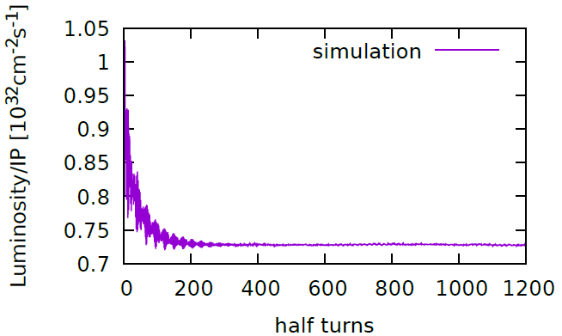
Beam-Beam Code Check - CEPC (1)
K. Ohmi

Slide 6
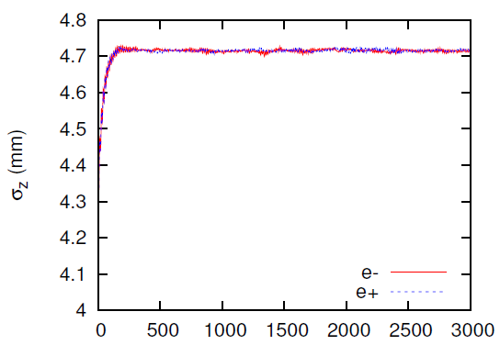
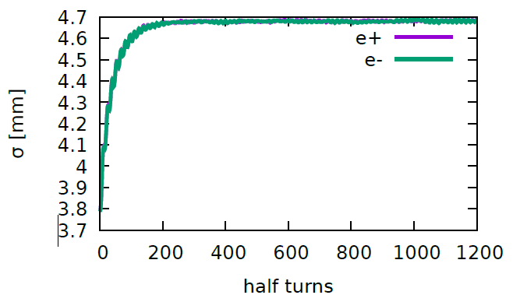
Beam-Beam Code Check - CEPC (2)
K. Ohmi

Slide 7
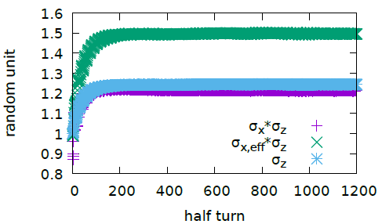
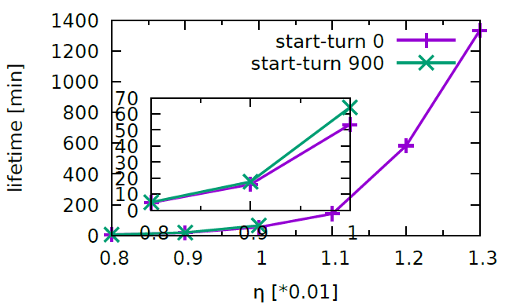

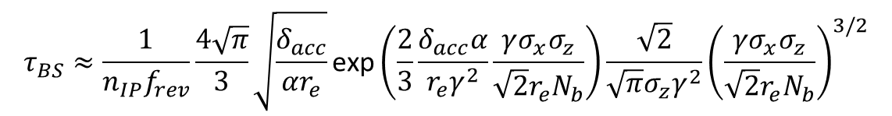
Beamstrahlung lifetime estimated by the loss particle number
Lifetime is shorter if loss particle number is counted from very beginning
$$τ_{BS}≈\frac{1}{n_{IP}f_{rev}}\frac{4\sqrt{π}}{3}\sqrt{\frac{δ_{acc}}{αr_{e}}}\text{exp}\left(\frac{2}{3}\frac{δ_{acc}α}{r_{e}γ^{2}}\frac{γσ_{x}σ_{z}}{\sqrt{2}r_{e}N_{b}}\right)\frac{\sqrt{2}}{\sqrt{π}σ_{z}γ^{2}}{\left(\frac{γσ_{x}σ_{z}}{\sqrt{2}r_{e}N_{b}}\right)}^{3/2}$$
[V. Telnov, Phys. Rev. Letters 110 (2013) 114801]
D. Shatilov and M. Zobov, ICFA BD newsletter no. 37, p99

Slide 8
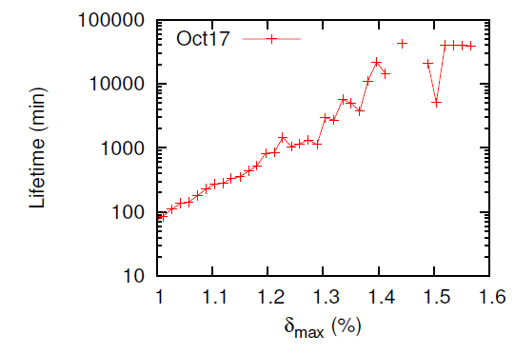
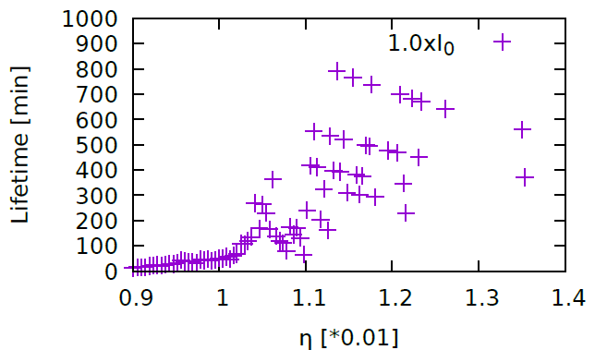
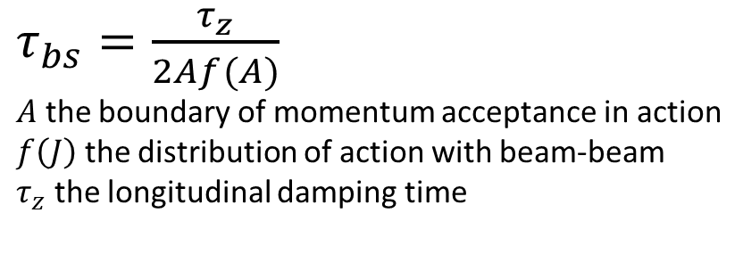

Beamstrahlung lifetime estimated by beam tail
$τ_{bs}=\frac{τ_{z}}{2Af(A)}$
$A$ the boundary of momentum acceptance in action
$f\left(J\right)$ the distribution of action with beam-beam
$τ_{z}$ the longitudinal damping time
K. Ohmi
$$\int_{0}^{∞}{dJ f\left(J\right)=1}$$
K. Ohmi, Weak-Strong
Strong-Strong

Slide 9
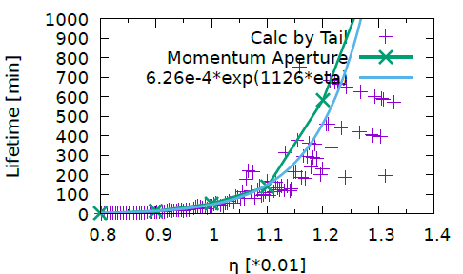
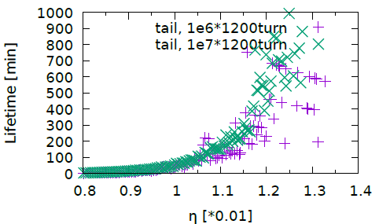
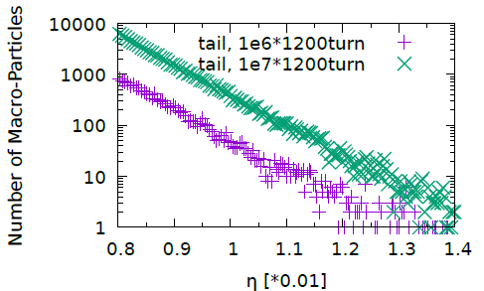
Beamstrahlung lifetime
Comparison of two methods
Two methods coincides well
1e6*1200 turn is accurate enough to estimate 100min lifetime by tail

Slide 10

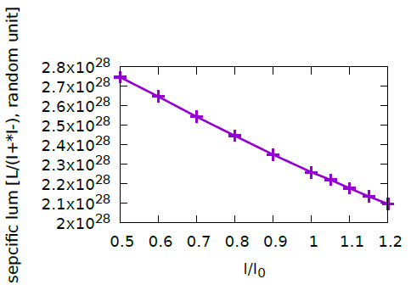
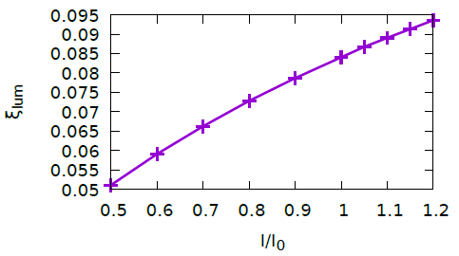
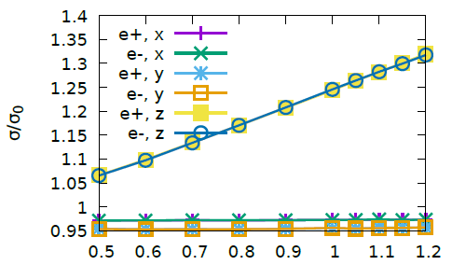
Higgs: different bunch current (symmetric)

Slide 11
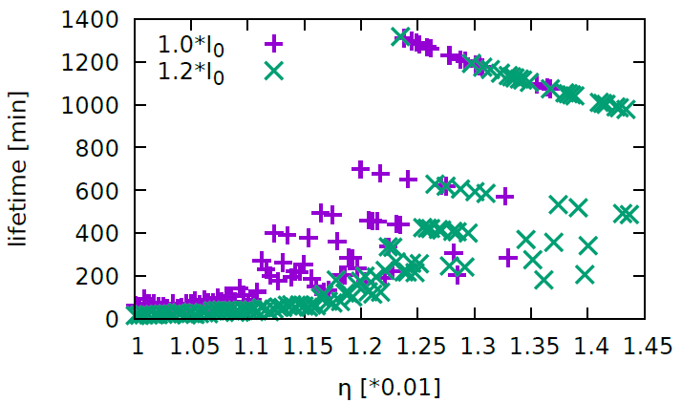
Beamstrahlung Lifetime (symmetric)

Slide 12
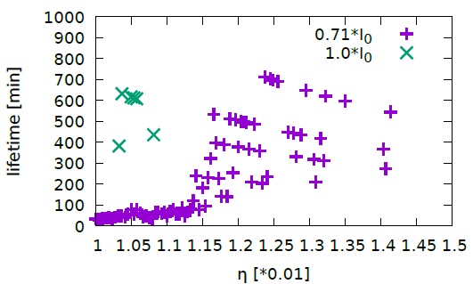
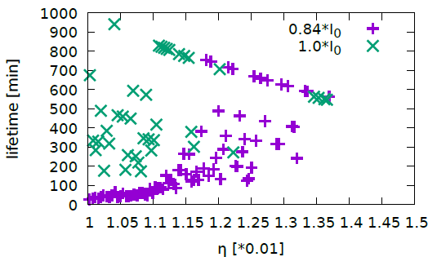
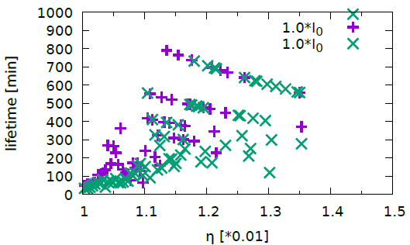
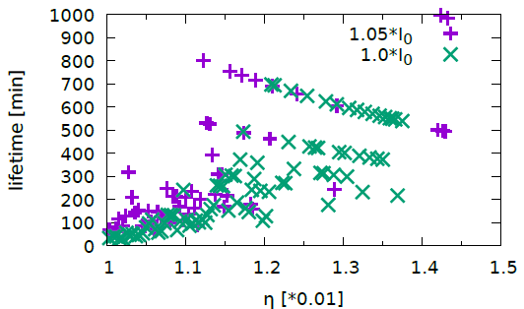
Higgs: unequal bunch current (1)

Slide 13
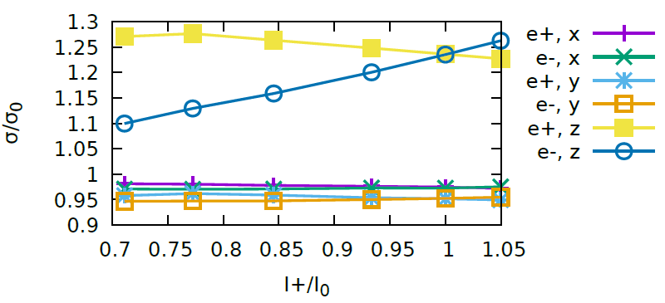
Higgs: unequal bunch current (2)
I₋ =I₀

Slide 14
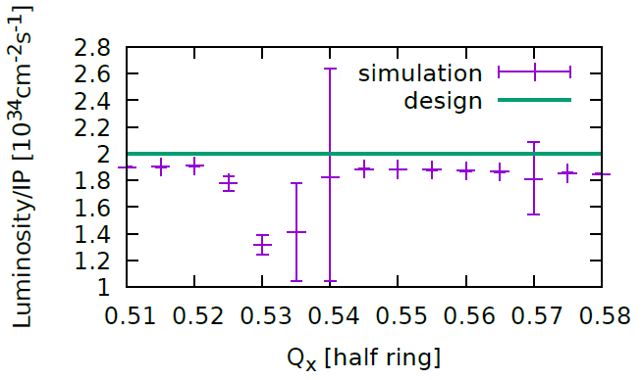

Tune Scan
$Q_{y}=$0.61, $Q_{s}=0.035$
The error bar shows the turn-by-turn luminosity difference.

Slide 15
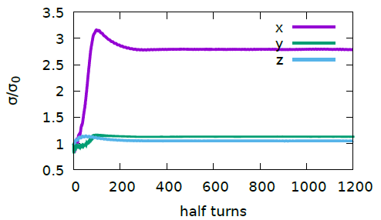
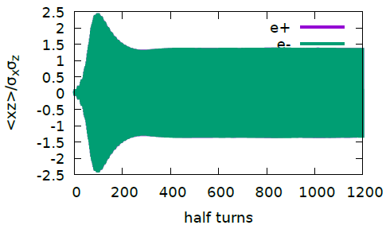
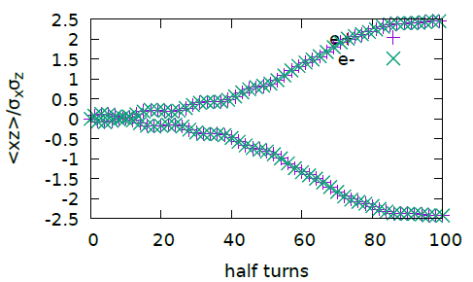
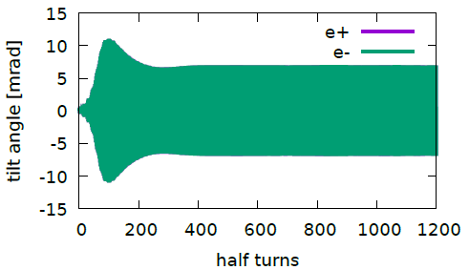
X-Z instability @(0.535,0.61)
K. Ohmi and etal., DOI:10.1103/PhysRevLett.119.134801

Slide 16
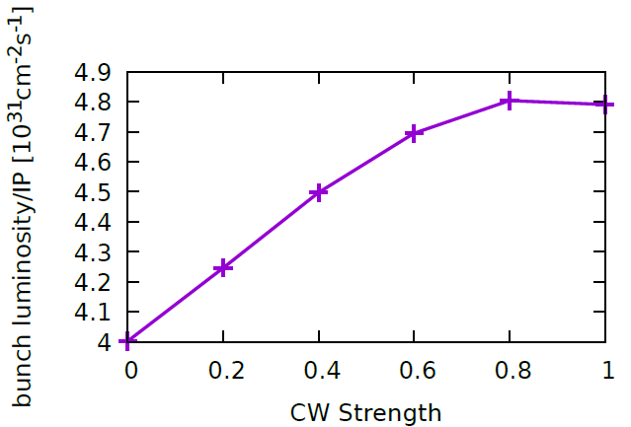
Crab Waist Strength

Slide 17
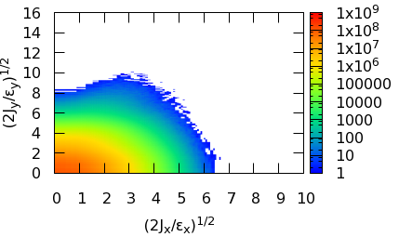
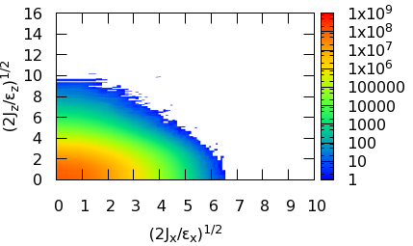
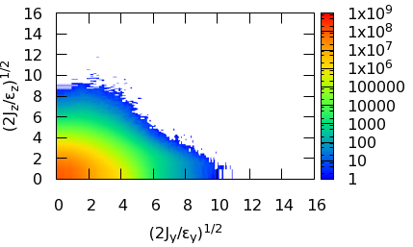
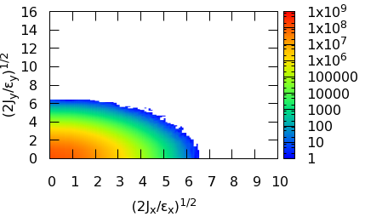

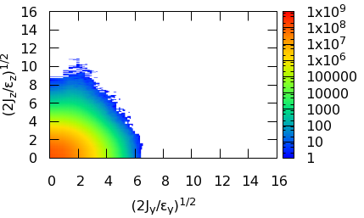
Crab Waist Strength
Crab waist mainly helps to suppress the vertical blowup
CW=0
CW=0
CW=0
CW=1
CW=1
CW=1

Slide 18
Dynamic Aperture

Slide 19
MODE:
Multi-Objective optimization by Differential Evolution
The parallel algorithm is referencing to J. Qiang(IPAC’13)
Initialize the population of parameter vectors
Generate the offspring population using the above differential evolution algorithm
Find the non-dominated population, which are treated as the best solutions in DE to generate offspring
Sorting all the population, select the best NP solution as the parents
Return to step 2, if stopping condition not met

Slide 20
CEPC DA Optimization Knobs
50 knobs in total
IR sextupoles: (10)
Arc Sextupole (32)
Phase advance (8)

Slide 21
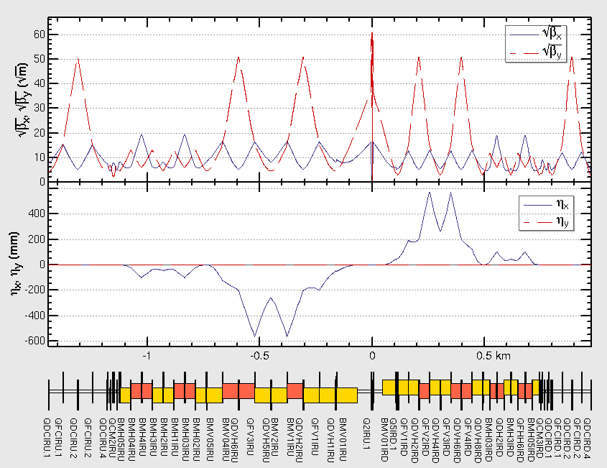
IR knobs
Main Chromaticity Sextupoles (2)
Neighbor weaker sextupole to correct finite length effect
(2)
A. Bogomyagkov, ArXiv:0909.4872
Sextupole to correct higher order chromaticity in vertical direction (1)
Y. Cai, PRAB.19.111006
Different strength between Upstream and Downstream of IP.
10 knobs in IR.

Slide 22
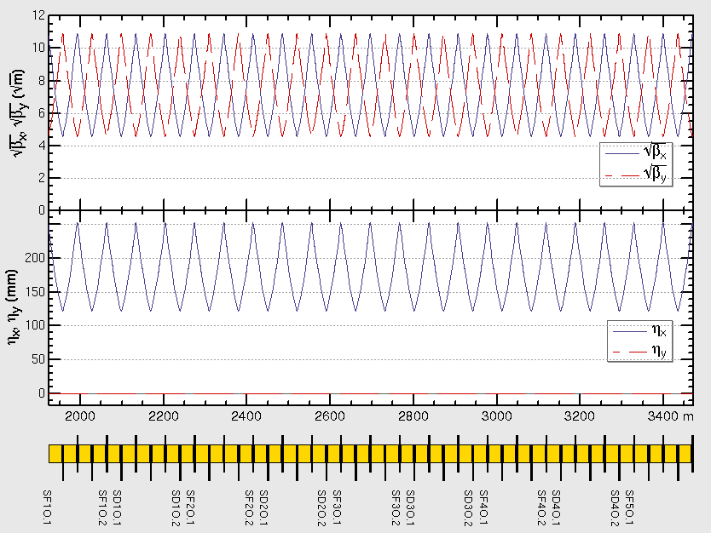
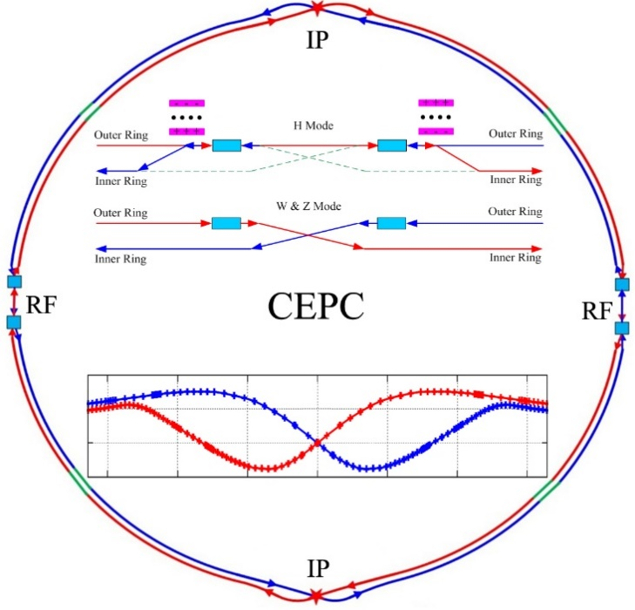

Arc sextupole
90/90 FODO
Non-interleave sextupole scheme
4 SF + 4 SD sextupole configurations in one arc section
7 sub-period in in one arc section，
4 arc section in half ring
Total knobs: 32
$$φ_{x}=10π$$
$$φ_{y}=10π$$
1
1
2
3
4
5
6
7
8
1
2
3
4

Slide 23

Phase Advance Tuning
1
Phase tuning section
2
10 knobs in x/y direction
Keep tune fixed
Only 8 free knobs
3
4
Phase tuning section
5

Slide 24
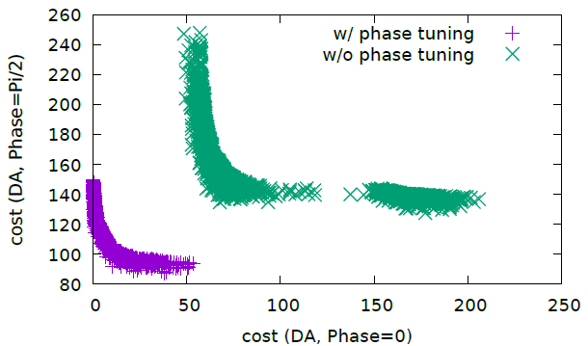
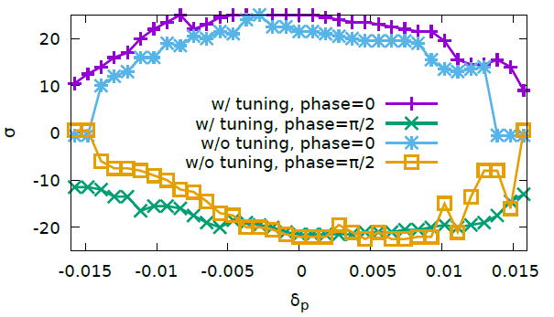
Contribution from phase advance
Notes:
Pcmst-3-cont-slurm

Slide 25
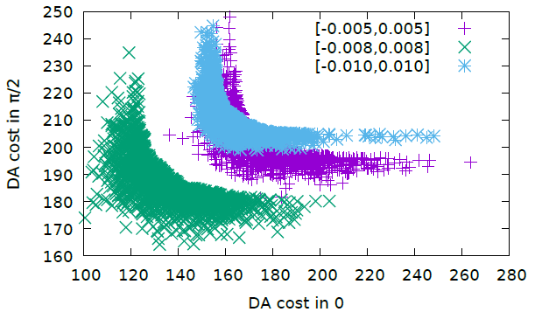
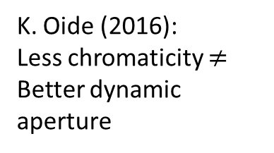
Different Chromaticity Constraint
Half ring tune control:
Qx in (0.52, 0.58)
Qy in (0.58, 0.64)
In our normal optimization, we prefer to control the tune in the maximum momentum offset (0.006~0.008)
The final optimum momentum acceptance is about 0.016.
K. Oide (2016):
Less chromaticity $≠$ Better dynamic aperture

Slide 26

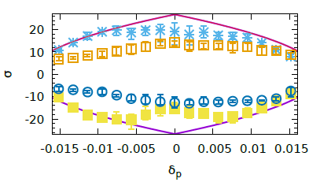
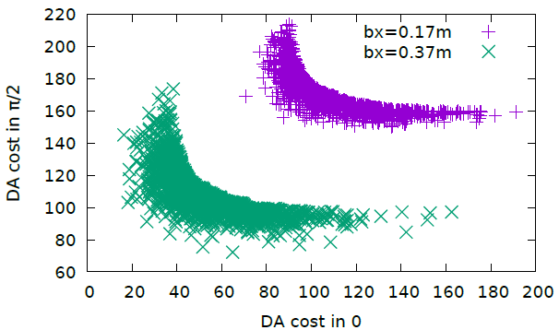
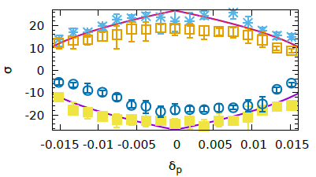
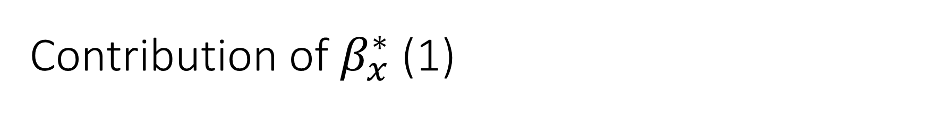
Contribution of $β_{x}^{∗}$ (1)
Bx=0.17m
Bx=0.37m

Slide 27


Contribution of $β_{x}^{∗}$ (2)

Slide 28


Effect of Synchrotron Radiation in Quadrupoles
FODO Arc - Horizontal
IR QD0 – Vertical
K. Oide, PRAB 19.111005
Maximum momentum deviation
$Δp=\frac{α_{z}}{πν_{s}J_{z}}R_{Q}n^{2}ε_{x}exp(−\frac{α_{z}}{4ν_{s}})$
$n≡Δx/σ_{x}$
$R_{Q}=\frac{2\sqrt{2}}{θ_{c}^{2}}\left(\frac{\sqrt{2}+1}{l_{QF}}+\frac{\sqrt{2}−1}{l_{QD}}\right)$
$α_{Z}$ and $J_{Z}$, the synchrotron damping rate and longitudinal damping partition number. $l_{QF,QD}$ the lengths of the quadrupoles.
A. Bogomyagkov (BINP), FCC-ee, Z

Slide 29




Momentum deviation versus amplitude
DA Objective:
$$\left|δ\right|+Ax^{2}+B=η_{rf}$$
This could explain why the DA with (FLUC) is flat versus $δ$
For example, if we want to achieve $20σ@δ=0$, the DA should be also about $20σ@δ=0.01$
Notes:
Cmst-3-clip1-400t

Slide 30

Suppress noise of DA result with radiation fluctuation
DA is tracked with different initial phase: $\left(0,\frac{π}{2},π,\frac{3π}{2}\right)$ for different energy
10 more times survey for on-momentum particle is tracked, and the minimum value is treated as the on-momentum DA
Tracked DA result will be clipped to ensure DA at large momentum deviation will be less than that at small deviation
Only two objective: min-DA of $\left(0,π\right)$ and min-DA of $\left(\frac{π}{2},\frac{3π}{2}\right)$

Slide 31



On Momentum Dynamic Aperture (CEPC-Higgs)
Initial Phase: 0
Initial Phase: Pi/2
100 samples are tracked. 200 turns are tracked.
Synchrotron motion, synchtron radiation in dipoles, quads and sextupoles, tapering, Maxwellian fringes, kinematical terms, crab waist are included.

Slide 32



Off momentum Dynamic Aperture
W/O Optimization
Momentum Acceptance: 0.017
Error bar means min and max
90% survival
100 samples. Radiation fluctuation is included. 0.3% emittance coupling. 200 turns are tracked.

Slide 33


Crab Waist
IP Downstream: K2 = 0.69 m⁻²
IP Upstream: K2 =-0.69 m⁻²
90% survival
CW=0
CW=1.0

Slide 34
Crosstalk between Beam-Beam & Lattice

Slide 35

DA with Beam-Beam
90% survival plot
Beam-Beam Off
Beam-Beam On

Slide 36






Lattice, if crab-waist scheme work
1000 particles
5000 half-turn
CW sext off
CW sext off
CW sext off
CW sext on
CW sext on
CW sext on

Slide 37



Lattice + Beamstrahlung
1000 particles
5000 half-turn
OFF
OFF
OFF
On
On
On
1e3 particles
1e5 half-turn

Slide 38



Lattice + Beamstrahlung + Qrad
1e3 particles
1e5 half-turn
OFF
OFF
OFF
On
On
On

Slide 39



Strong-Strong .vs.
Lattice + Beamstrahlung + Qrad
Strong-Strong
1e6 particles
1e3 half-turn
Strong-Strong
Strong-Strong
Lattice
1e3 particles
1e5 half-turn
Lattice
Lattice

Slide 40

Lifetime: (1)
Lattice + Beamstrahlung + Qrad

Slide 41



Lifetime: (2)
Lattice + Beamstrahlung + Qrad
40min: 16$σ_{y}$
Momentum Acceptance: 1.2% -> 1.5%

Slide 42

Summary
The beam-beam effect is evaluated by comparing with built machines and is considered reasonable
Beam-beam code has been developed and cross checked for large Piwinski angle collision and beamstrahlung effect
Different bunch population and asymmetric bunch current collision shows that the machine design has enough margin
The beam-beam effect has been studied by strong-strong simulation, which shows >200min with momentum acceptance 1.2%
The new x-z instability could be suppressed by proper working point
All effects (exception: error, solenoid) is included in the dynamic aperture survey
DA achieved: 20$σ_{x}$*20$σ_{y}$, 1.7% momentum acceptance for Higgs
Weak strong simulation(beamstrahlung) + lattice + SR Fluctuation shows tail growth in vertical and longitudinal direction.
The study shows that dynamic aperture should >16$σ_{y}$(40min), Momentum acceptance >1.5%(200min)

