Slide 1
Conceptual Design of CEPC Interaction Region Superconducting Final Focus and Anti-solenoid Magnets
Yingshun Zhu
Accelerator Center, Magnet Group
Institute of High Energy Physics, Chinese Academy of Sciences
2017.11.7
International workshop on CEPC

Slide 2
Outline
Introduction
Design of superconducting quadrupole magnet QD0
Design of superconducting quadrupole magnet QF1
Design of superconducting anti-solenoid
R&D plan
Summary

Slide 3
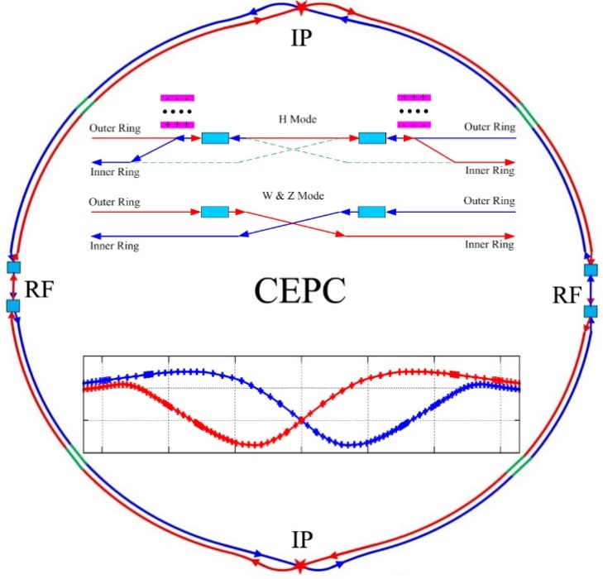
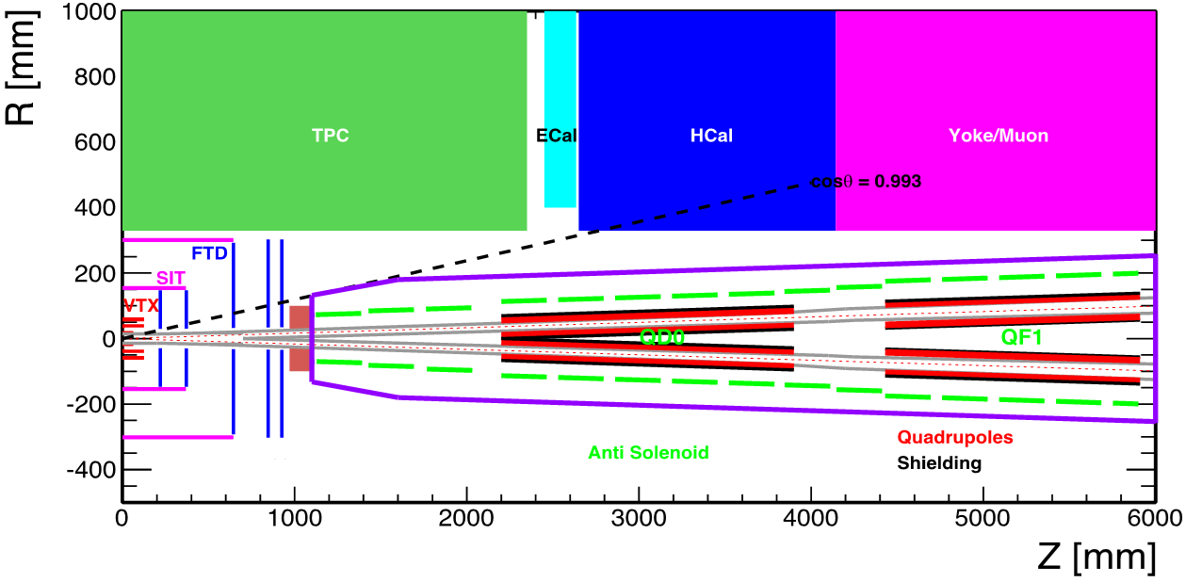
Introduction
CEPC is a Circular Electron Positron Collider with a circumference about 100 km, beam energy up to 120 GeV proposed by IHEP.
Most magnets needed for CEPC Accelerator are conventional magnets.
Compact high gradient final focus quadrupole magnets are required on both sides of the collision points in interaction region of the CEPC double ring.
Sketch of CEPC main ring
CEPC MDI layout

Slide 4
The requirements of the two type quadrupoles (QD0 and QF1) are based on the L* of 2.2 m, beam crossing angle of 33 mrad in the interaction region.
QD0 and QF1 magnets are designed to be twin aperture quadrupole magnets. They are operated full inside the field of the Detector solenoid magnet with a central field of 3.0 T.
To minimize the effect of the longitudinal detector solenoid field on the accelerator beam, anti-solenoids before QD0, outside QD0 and QF1 are needed, so that the total integral longitudinal field generated by the detector solenoid and accelerator anti-solenoid is zero.
Table 1: Requirements of CEPC Interaction Region quadrupole magnets
Magnet | Central field gradient (T/m) | Magnetic length (m) | Width of GFR (mm) | Minimal distance between two aperture beam lines (mm)
QD0 | 151 | 1.73 | 19.15 | 72.61
QF1 | 102 | 1.48 | 29.0 | 146.20

Slide 5
In addition, the field distribution of net solenoid field should also meet the requirements from the accelerator beam dynamics.
Furthermore, the MDI layout imposes strict boundary conditions on the longitudinal and transerve dimensions of the accelerator magnets.
Taking into account the high field strength of twin aperture quadrupole magnet, high central field of anti-solenoid, and the limited space, superconducting technology base on NbTi conductor will be used for Interaction Region superconducting quadrupole magnets and anti-solenoids.

Slide 6
Design of superconducting quadrupole magnet QD0
The final focus QD0 is a double aperture superconducting magnet. The minimum distance between two aperture centerlines is only 72.61 mm, so very tight radial space is available.
The design of QD0 is based on two layers cos2θ quadrupole coil using Rutherford cable without iron yoke. The four coils are clamped with the collars made of stainless steel.
In the field calculation, it is assumed that the magnetic field harmonics in the good field region are required to be smaller than 3×10⁻⁴.
2D magnetic field calculation is performed using OPERA. After optimization, the field quality in each aperture is very good.

Slide 7
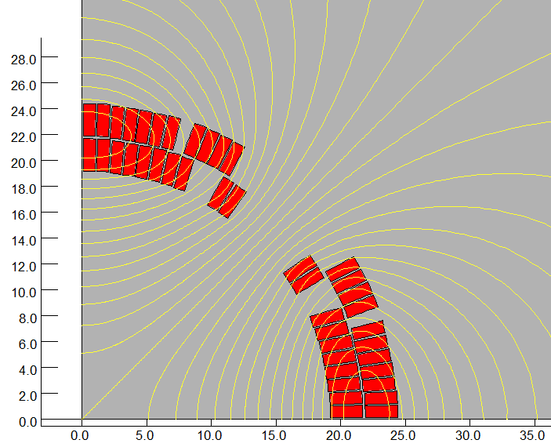
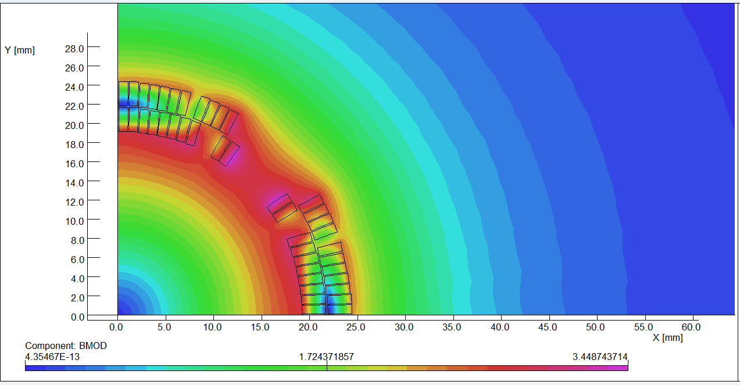
The QD0 single aperture coil cross section is optimized with four coil blocks in two layers separated by wedges, and there are 21 turns in each pole.
The excitation current is 2700A, and I_{op}/_{Ic}<70%.
Magnetic flux density distribution
2D flux lines

Slide 8
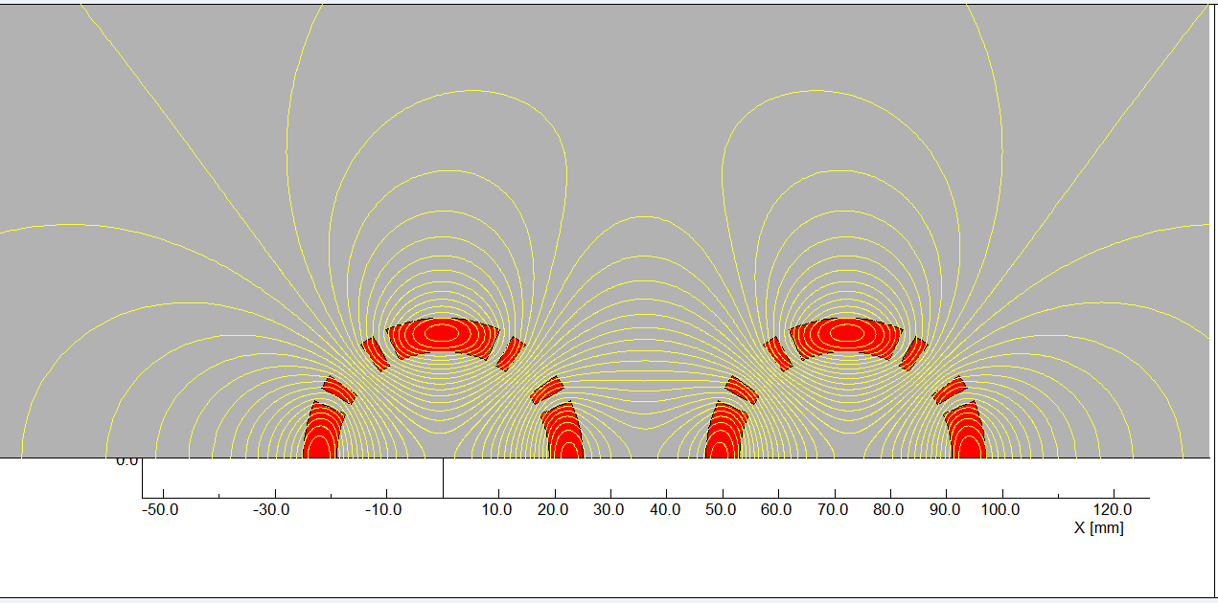
The field in one aperture is affected due to the field generated by the coil in another aperture. Field cross talk of the two apertures is studied.
Table 2: 2D field harmonics (unit, 1×10⁻⁴)
n | B_{n}/B₂@R=9.6mm
2 | 10000
6 | -0.7
10 | -0.4
14 | -0.08
Flux lines of two aperture coils

Slide 9
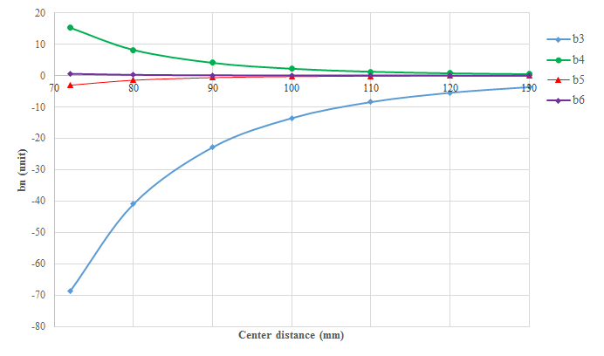
Multipole field in one aperture as a function of aperture central distance is shown below (2D calculation):
Multipole field in one aperture as a result of field cross-talk

Slide 10
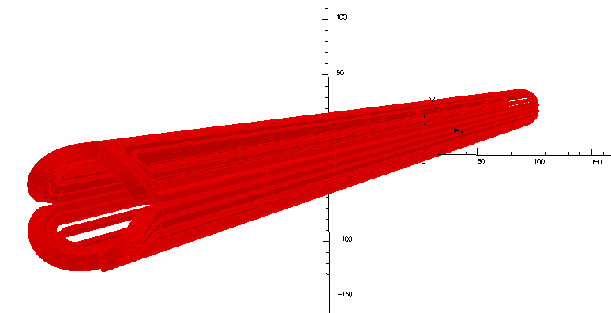
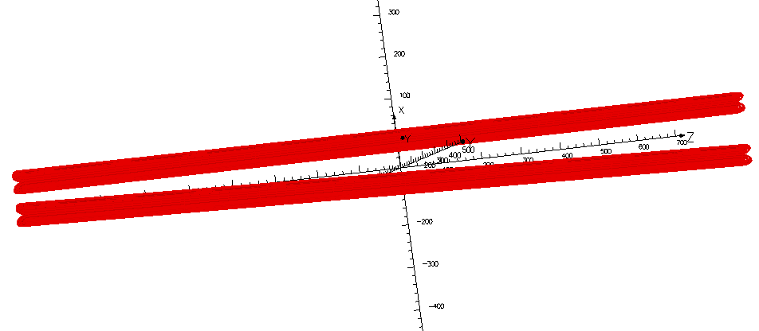
QD0 coils are simplified and modelled in OPERA-3D.
Firstly the field quality in the single aperture is calculated, and then the multipole fields induced by the field cross talk of the two apertures are obtained.
Single aperture coil
Two aperture coils

Slide 11
The calculated multipole field contents in one aperture with the twin aperture layout:
Table 3: 3D field harmonics（unit, 1×10⁻⁴）
n | B_{n}/B₂@R=9.6 mm
2 | 10000.0
3 | -20.09
4 | 3.700
5 | -0.625
6 | -0.170
7 | -0.0156
8 | 3.35E-03
9 | -2.1E-04
10 | -0.0529
11 | 7.91E-05
12 | -2.0E-04

Slide 12
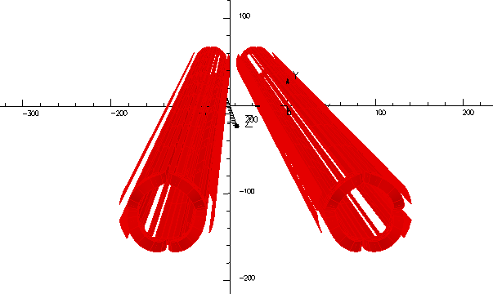
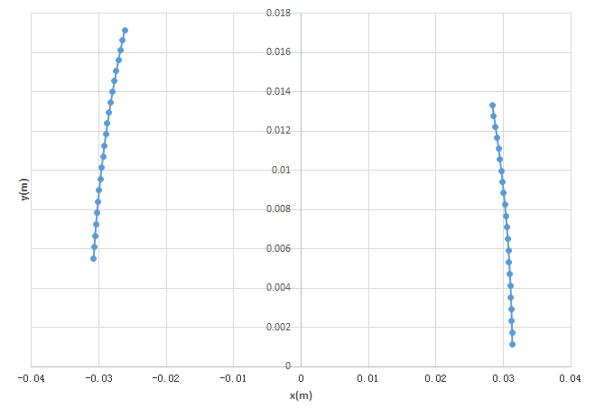
One layer of shield coil is introduced just outside the quadrupole coil to improve the field quality.
The shield coil is not symmetric within each aperture, but the shield coils for two apertures are symmetric.
The conductor for the shield coil is round NbTi wire with 0.5 mm diameter, and there are 22 turns in each pole.
Shield coil layout (half)
Quadrupole+Shield coil

Slide 13
Table 4: Integrated field harmonics in one aperture with shield coil (1×10⁻⁴)
n | B_{n}/B₂@R=9.6 mm
2 | 10000.0
3 | 0.113
4 | 1.0529
5 | -0.5088
6 | -0.4647
7 | -0.1132
8 | -0.016
9 | -0.011
10 | -0.0535
11 | -0.00067
12 | 9.01E-05
It can be seen that the calculated integrated field quality in the aperture with shield coils is very good.

Slide 14
Design parameters of QD0:
Table 5: Design parameters of QD0
Magnet name | QD0
Field gradient (T/m) | 151
Magnetic length (m) | 1.73
Coil turns per pole | 21
Excitation current (A） | 2700
Shield coil turns per pole | 22
Shield coil current (A） | 95
Coil layers | 2
Conductor size (mm) | Rutherford NbTi-Cu Cable, width 3 mm, mid thickness 0.95 mm, keystone angle 1.6 deg
Stored energy (KJ) | 20.0
Inductance (H） | 0.0055
Peak field in coil (T) | 3.5
Coil inner diameter (mm) | 40
Coil outer diameter (mm) | 53
X direction Lorentz force/octant (kN) | 58
Y direction Lorentz force/octant (kN) | -120

Slide 15
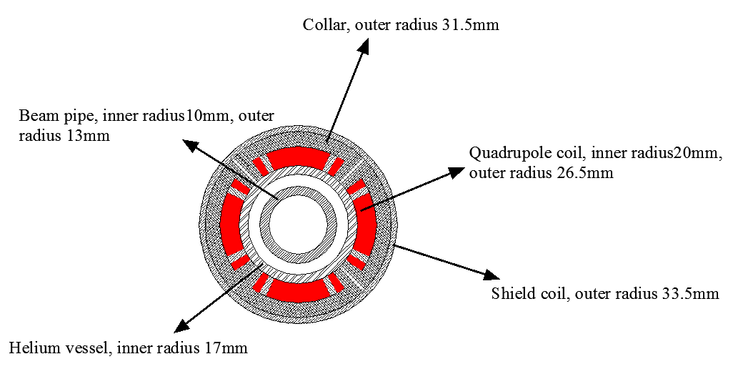
Magnet Layout of QD0:
(Space for skew quadrupole coil is reserved)
Single aperture QD0

Slide 16
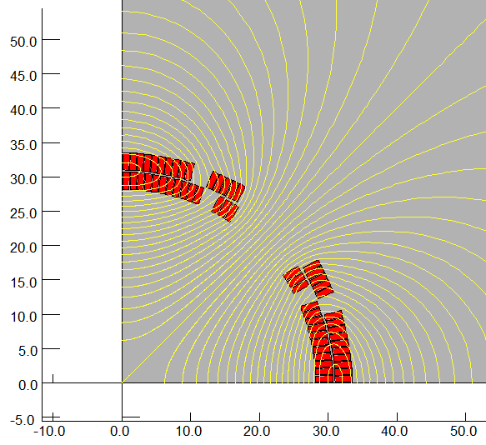
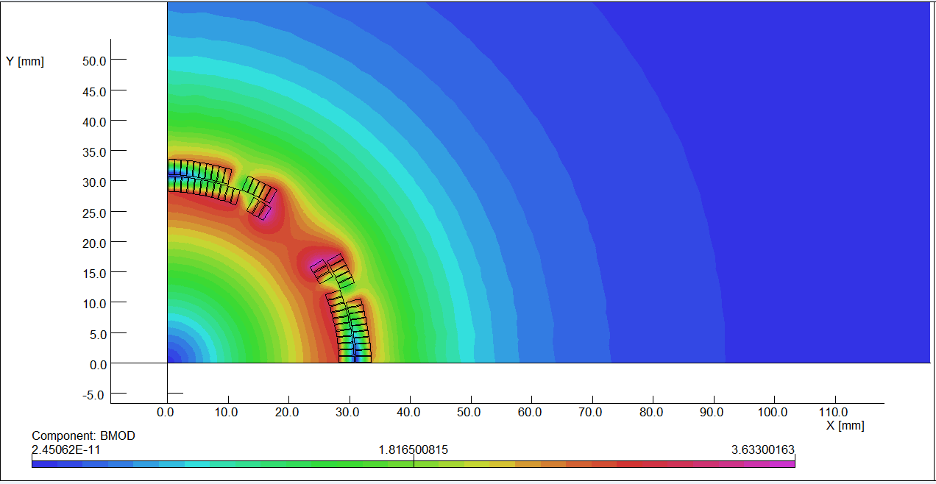
Design of superconducting quadrupole magnet QF1
The design of QF1 magnet is similar to the QD0 magnet. The used Rutherford cable is the same to that of QD0.
Since the distance between the two apertures in QF1 is much larger than QD0, the field cross talk is not serious as QD0.
After optimization, the QF1 coil consists of four coil blocks in two layers separated by wedges, and there are 29 turns in each pole.
2D flux lines (One quarter cross section)
Magnetic flux density distribution

Slide 17
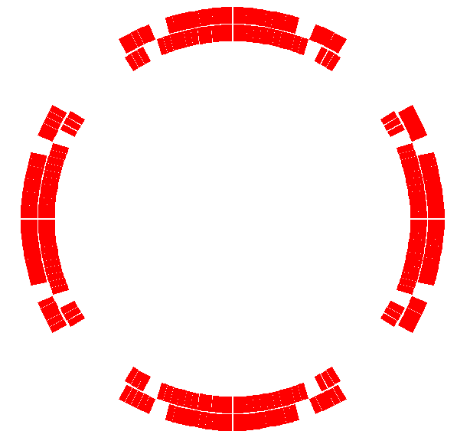
Table 6: 2D field harmonics of QF1 (unit, 1×10⁻⁴)
n | B_{n}/B₂@R=14.5mm
2 | 10000
6 | 1.86
10 | -0.75
14 | 0.005
Coil cross section of single aperture QF1

Slide 18
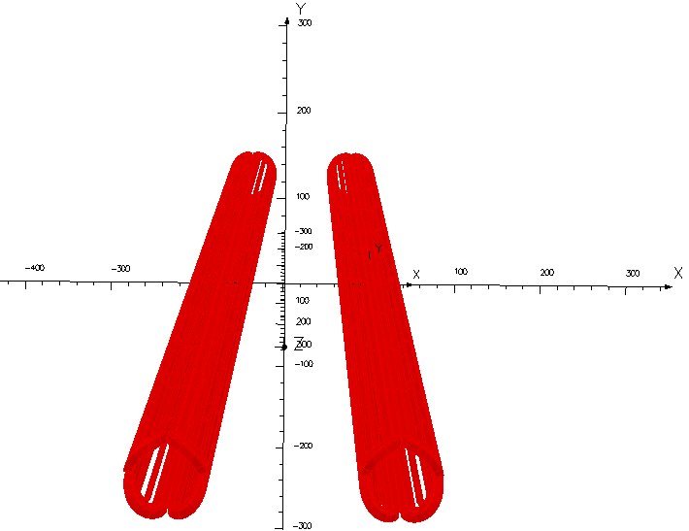
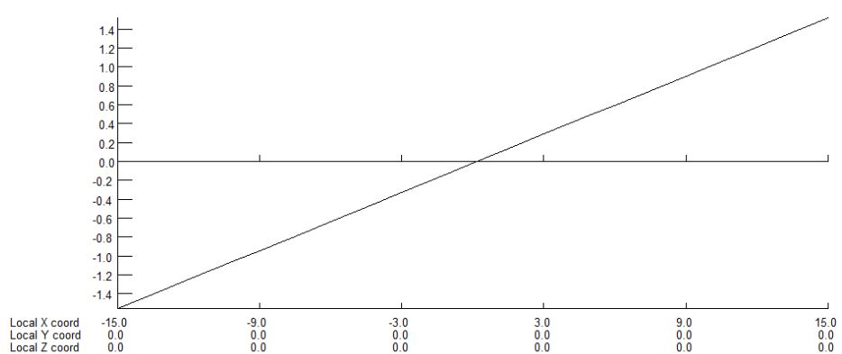
QF1 coils are simplified and modelled in OPERA-3D.
Firstly the field quality in the single aperture coil is calculated, then the multipole fields induced by the field cross talk of the two apertures are obtained.
B_{y} along x
Two aperture coils

Slide 19
The calculated multipole field contents in one aperture with the twin aperture layout are:
Using the similar shield coil design as QD0, the field quality in QF1 will be improved and the sextupole field can be reduced to be smaller than 3 unit.
Table 7: 3D field harmonics of QF1 (unit, 1×10⁻⁴)
n | B_{n}/B₂@R=14.5 mm
2 | 10000.0
3 | -6.442
4 | 0.9492
5 | -0.1263
6 | -1.852
7 | -2.4E-03
8 | 6.02E-04
9 | 2.32E-04
10 | 0.6403
11 | 3.97E-04
12 | -3.1E-04

Slide 20
Design parameters of QF1:
Table 8: Design parameters of QF1
Magnet name | QF1
Field gradient (T/m) | 102
Magnetic length (m) | 1.48
Coil turns per pole | 29
Excitation current (A） | 2630
Coil layers | 2
Conductor size (mm) | Rutherford NbTi-Cu Cable, width 3 mm, mid thickness 0.95 mm, keystone angle 1.6 deg
Stored energy (KJ) | 32
Inductance (H） | 0.009
Peak field in coil (T) | 3.7
Coil inner diameter (mm) | 56
Coil outer diameter (mm) | 69
X direction Lorentz force/octant (kN) | 65
Y direction Lorentz force/octant (kN) | -145

Slide 21
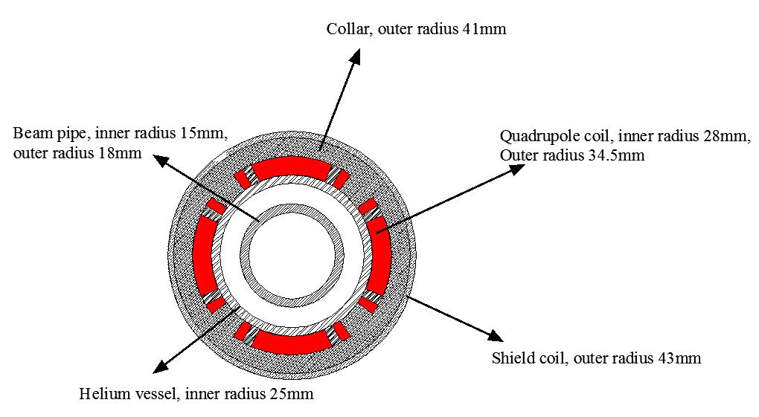
Magnet Layout of QF1:
(Space for skew quadrupole coil is reserved)
Single aperture QF1

Slide 22
Design of superconducting anti-solenoid
The design requirements of the anti-solenoids in the CEPC Interaction Region are summarized below:
1) The total integral longitudinal field generated by the detector solenoid and anti-
solenoid coils is zero.
The longitudinal field inside QD0 and QF1 should be smaller than a few
hundred Gauss at each longitudinal position.
The distribution of the solenoid field along longitudinal direction should meet
the requirement of the beam optics for vertical emittance.
The angle of the anti-solenoid seen at the collision point satisfies the Detector
requirements.
The design of the anti-solenoid fully takes into account the above requirements. The anti-solenoid will be wound of rectangular NbTi-Cu conductor.

Slide 23
The magnetic field of the Detector solenoid is not constant, and it decreases slowly along the longitudinal direction.
In order to reduce the magnet size, energy and cost, the anti-solenoid is divided into a total of 20 sections with different inner coil diameters.
These sections are connected in series, but the current of some sections of the anti-solenoid can be adjusted using auxiliary power supplies if needed.
The anti-solenoid along longitudinal direction:
1) 3 sections, from IP point to QD0;
2) 9 sections, QD0 region;
3) 7 sections, QF1 region;
4) 1 section, after QF1 region.

Slide 24
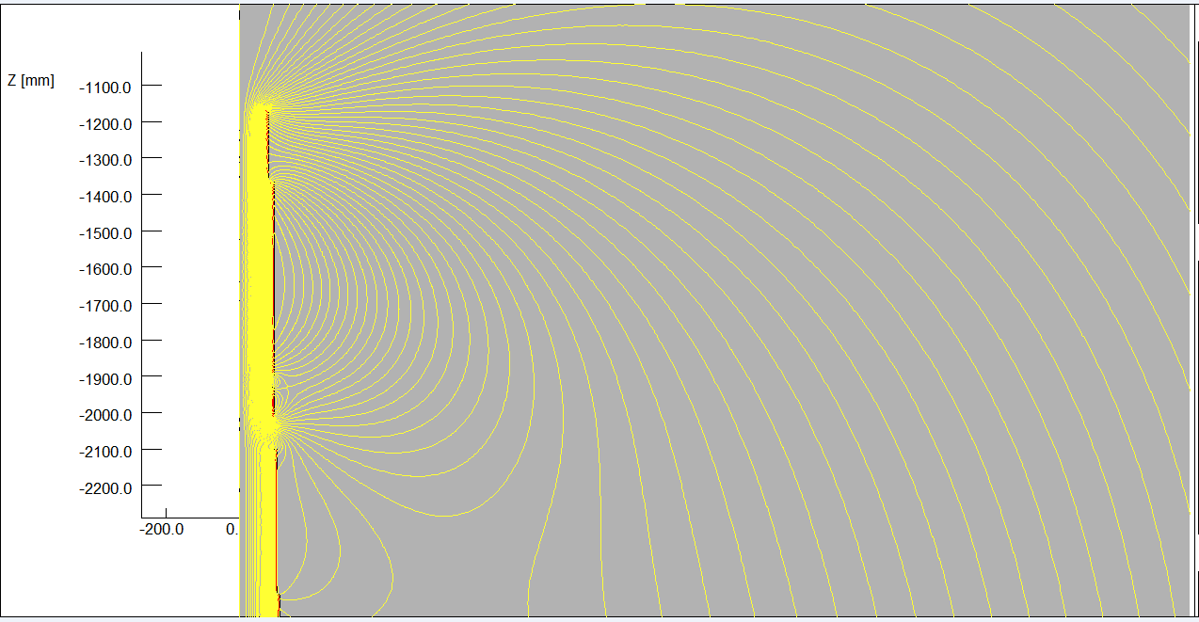
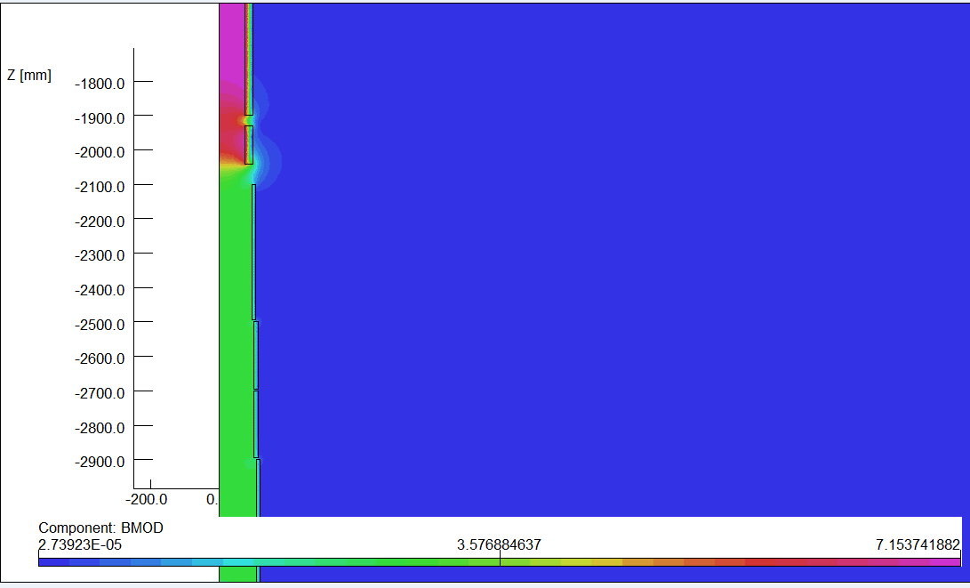
Magnetic field calculation and optimization is performed using axi-symmetric model in OPERA-2D.
The central field of the first section of the anti-solenoid is the strongest, with a peak value of 7.15T.
2D flux lines
Magnetic flux density distribution

Slide 25
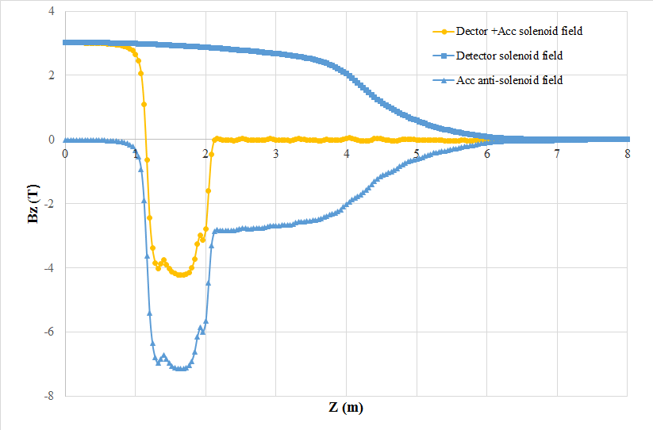
Combined field of Anti-solenoid and Detector solenoid.
The net solenoid field inside QD0 and QF1 is mainly smaller than 300 Gs.
The combined field distribution of anti-solenoid and Detector solenoid well meets the requirement of beam dynamics.

Slide 26
Design parameters of Anti-solenoid:
Table 9: Design parameters of Anti-solenoid
Magnet name | Anti-solenoid before QD0 | Anti-solenoid QD0 | Anti-solenoid after QD0
Central field（T） | 7.15 | 2.8 | 1.8
Magnetic length（m） | 1.1 | 1.73 | 1.98
Conductor (NbTi-Cu) | 4×2mm | 4×2mm | 4×2mm
Coil layers | 12 | 6 | 4/2
Excitation current（kA） | 2.2 | 2.2 | 2.2
Stored energy (KJ) | 330 | 185 | 64
Inductance（H） | 0.24
Peak field in coil (T) | 7.4 | 2.9 | 1.9
Number of sections | 3 | 9 | 8
Solenoid coil inner diameter (mm) | 120 | 190 | 314
Solenoid coil outer diameter (mm) | 196 | 262 | 390
Total Lorentz force F_{z} (kN) | -78 | -11 | 89
Cryostat diameter (mm) | 500

Slide 27
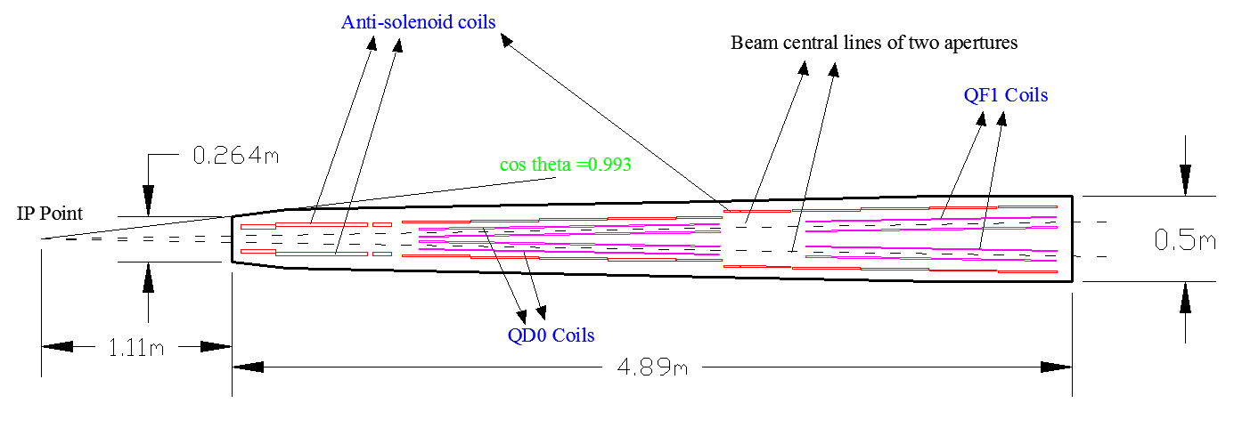
Since the field of the last section of anti-solenoid is very low, to reduce the length of the cryostat, the last section of anti-solenoid is designed as room-temperature.
The superconducting QD0, QF1, and anti-solenoid coils are in the same cryostat, and the schematic layout is shown below (tungsten not included):
Schematic layout of QD0, QF1, and anti-solenoid

Slide 28
R&D plan
In the R&D stage of CEPC project, superconducting prototype magnets for the Interaction Region will be developed in two steps:
Development of double aperture superconducting quadrupole
prototype magnet QD0;
2) Development of combined function superconducting prototype
magnet including QD0, QF1 and anti-solenoids.

Slide 29
The key technical issues of the prototype superconducting magnets to be studied and solved in the R&D are listed below:
1) Magnetic and mechanical design of the superconducting quadrupole magnet and
anti-solenoids with very high field strength and limited space.
2) Fabrication technology of small size Rutherford cable with keystone angle.
3) Fabrication procedure of the twin aperture quadrupole coil with small diameter.
4) Fabrication procedure of the anti-solenoids with many sections and different
diameters.
5) Assembly of the several coils including QD0, QF1 and anti-solenoids.
6) Development of the long cryostat for the combined function SC magnet.
7) Development of magnetic field measurement system for small aperture long
superconducting magnet.
8) Development of quench protection system for combined function SC magnet.
9) Cryogenic test and field measurement of the small aperture long SC magnet.

Slide 30
Summary
It is challenging to develop high strength superconducting magnets in CEPC Interaction Region.
Conceptual design of superconducting magnets in CEPC Interaction Region has been performed.
Cross talk effect between two apertures in QD0 can be reduced to be acceptable (integrated field quality).
The anti-solenoid is divided into a total of 20 sections with different inner coil diameters, with a max central field of 7.15T.
Prototypes superconducting magnets in CEPC Interaction Region are proposed, and the R&D has started .

Slide 31
Thanks for your attention!
International workshop on CEPC

