Slide 1
Summary on SPPC Accelerators
Jingyu Tang
Nov. 6-8, 2017,
International Workshop on CEPC, IHEP, Beijing

Slide 2
Talks on SPPC Accelerators
Two talks in the plenary sessions:
  Jingyu Tang for SPPC CDR Status
  Qingjin Xu for SPPC Superconducting Magnets
Three parallel sessions
  Accelerator Physics: 6 talks
  Superconducting magnets: 6 talks (2 remote)
  Diverse subjects: 6 talks
One topical discussion session
  Discussion on cryogenic temperature
International speakers: 9

Slide 3
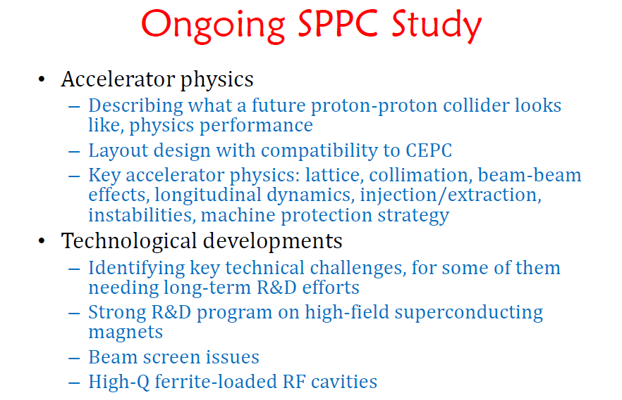
SPPC General Progress
Jingyu Tang
(IHEP)
Briefing the ongoing studies
New members and collaborations

Slide 4
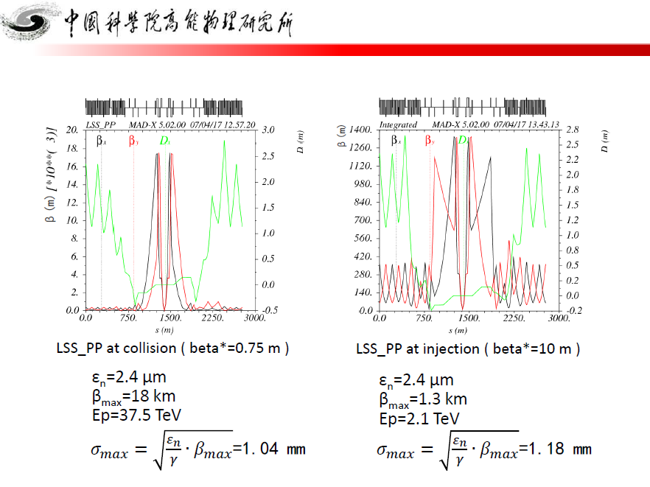
Progress of SPPC lattice design
(100 Km - 12 T – 75 TeV)
Yukai Chen (IHEP)
Layout, lattice (arc, DS, IP), dynamic aperture

Slide 5
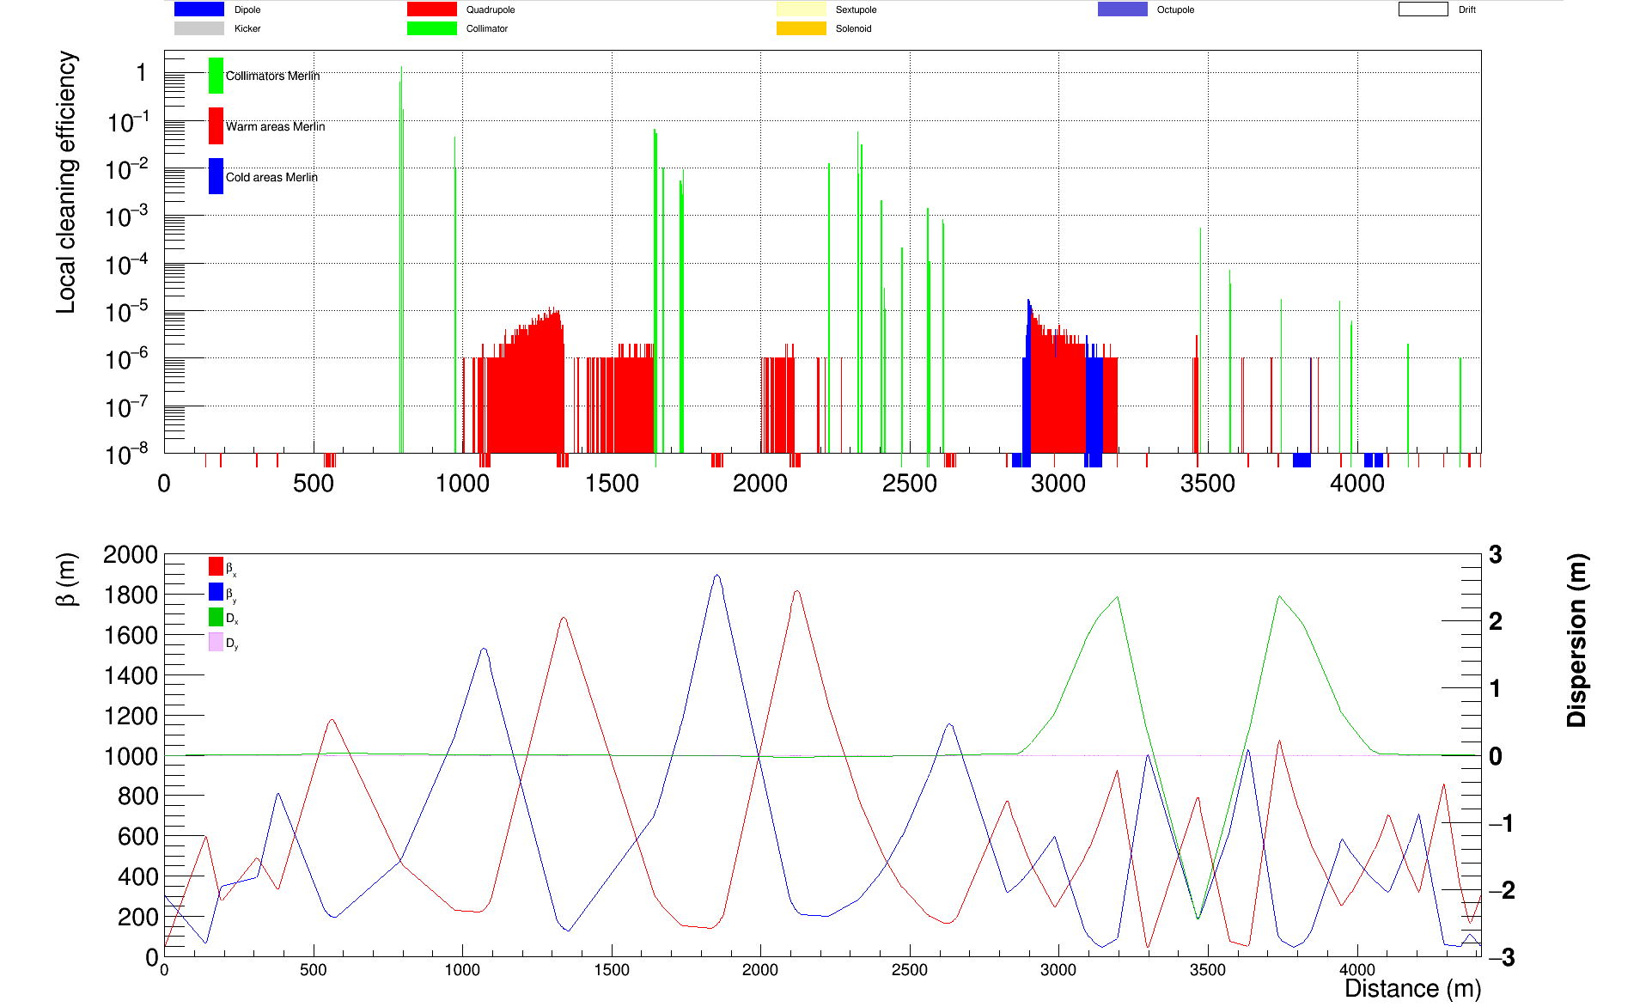
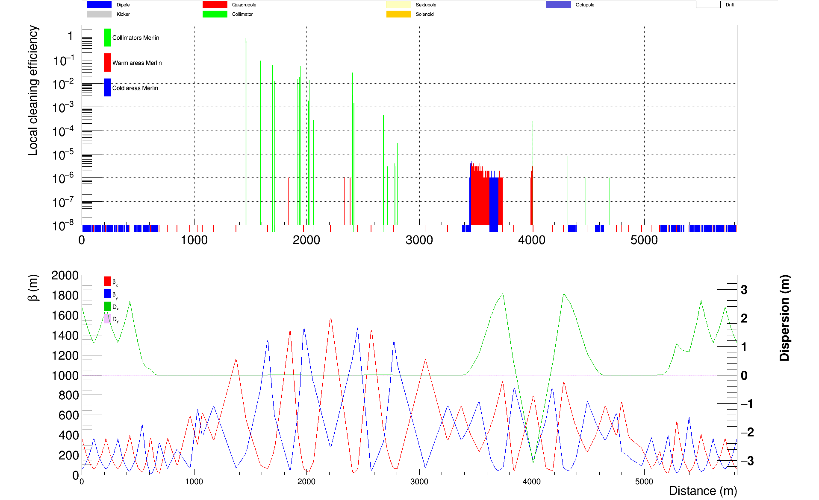
Progress in collimation study
Jianquan Yang (IHEP)
Simulations for two schemes of betatron collimation (RT magnets or SC magnets)
Simulations on radiation deposit in collimators and magnets

Slide 6
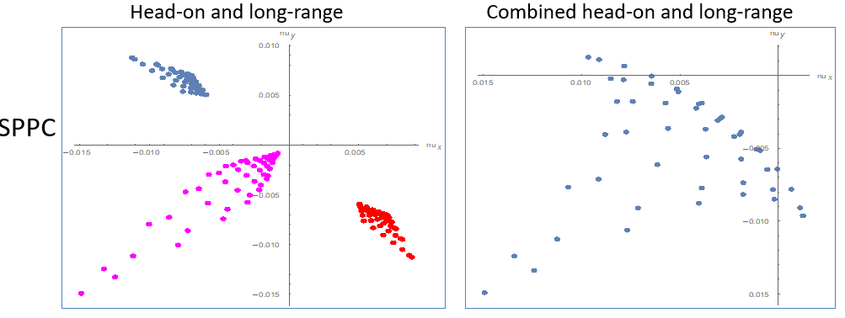
Beam-beam effects in SPPC
K. Ohmi (KEK)
The study was mainly performed by a student
Studied subjects
  Weak-strong Beam-beam simulation for SPPC.
  HH/HV crossing and without crossing. No long range
  2-IP HH crossing with long range (82 locations)
  2-IP HV crossing with long range (82 locations)
  Tune shift and beam-beam resonances

Slide 7
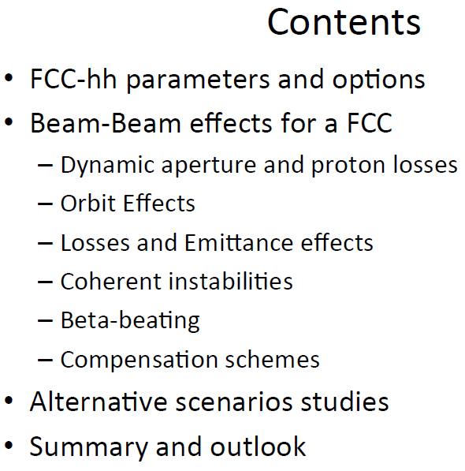
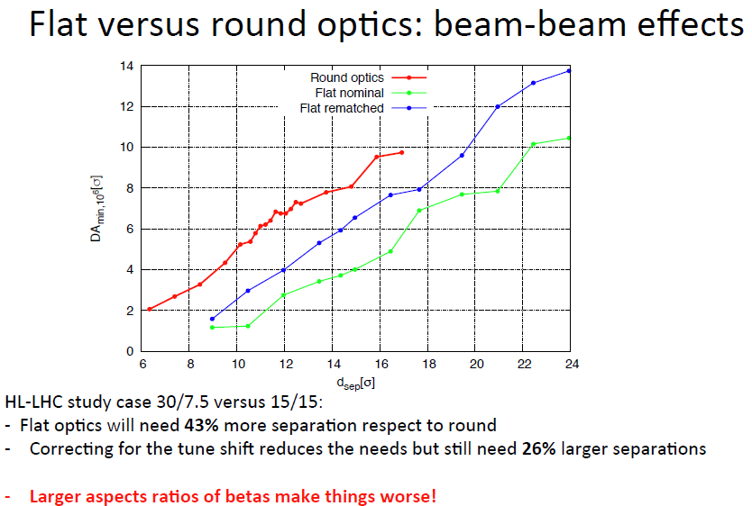
Beam-beam studies for future circlar hadron colliders
Tatiana Pieloni
(EPFL)

Slide 8
Beam-beam weak-strong simulations for LHC and HL-LHC
Nikos Karastathis
(CERN)
Weak-strong simulations are heavily used to estimate the long term conditions in the presence of beam-beam for a given configurations;
  Fast, reliable, accurate thanks to the continuous development & extension of computational frameworks & infrastructure
  Identify margins ➔ construct operational scenarios
The excellent LHC performance and the operational experience allows to push the beam and machine parameters to extract more luminosity, eg:
  2017: ATS & reducing β* ➔ increased performance
  2017: crossing angle anti-levelling ➔ increased performance
The knowledge and experience gained are propagated in the HiLumi LHC era, e.g:
    Adaptive levelling scenario ➔ increased performance

Slide 9
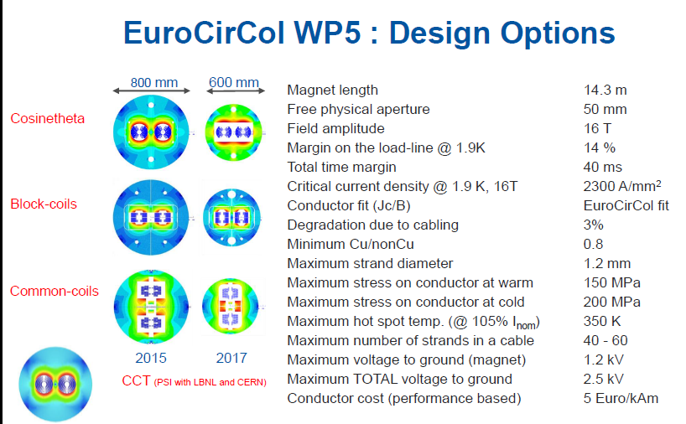
The 16 T Magnets Program for the FCC
Davide Tommasini
(CERN)
CERN Strategy
Full exploitation of the LHC:
successful operation of the nominal LHC until end 2023
construction & installation of LHC upgrades: LIU (LHC Injectors Upgrade) and HL-LHC
Scientific diversity programme serving a broad community:
ongoing experiments and facilities at Booster, PS, SPS and their upgrades (HIE-ISOLDE, ELENA)
participation in accelerator-based neutrino projects outside Europe (presently
mainly LBNF in the US) through CERN Neutrino Platform
Preparation of CERN’s future:
vibrant accelerator R&D programme exploiting CERN’s strengths and uniqueness
(including superconducting high-field magnets, plasma wakefield acceleration, etc.)
design studies for future high-energy accelerators: CLIC, FCC (includes HE-LHC)
future opportunities of diversity programme: Physics Beyond Colliders Study Group

Slide 10
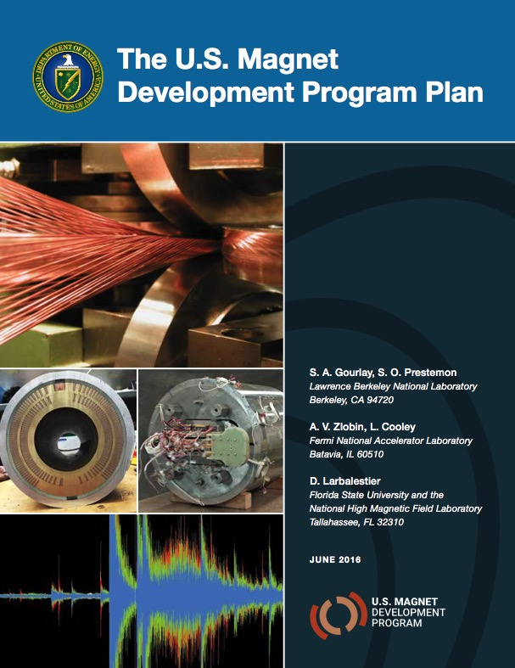
The US Magnet Development Program
Soren Prestemon
(LBNL)
Context for high field accelerator magnet R&D
  Motivation
  P5 and the Accelerator R&D Subpanel recommendations
The US Magnet Development Program
  How we are structured
Technical status of each area
  Progress and current status
  Corresponding roadmap within the MDP plan

Slide 11
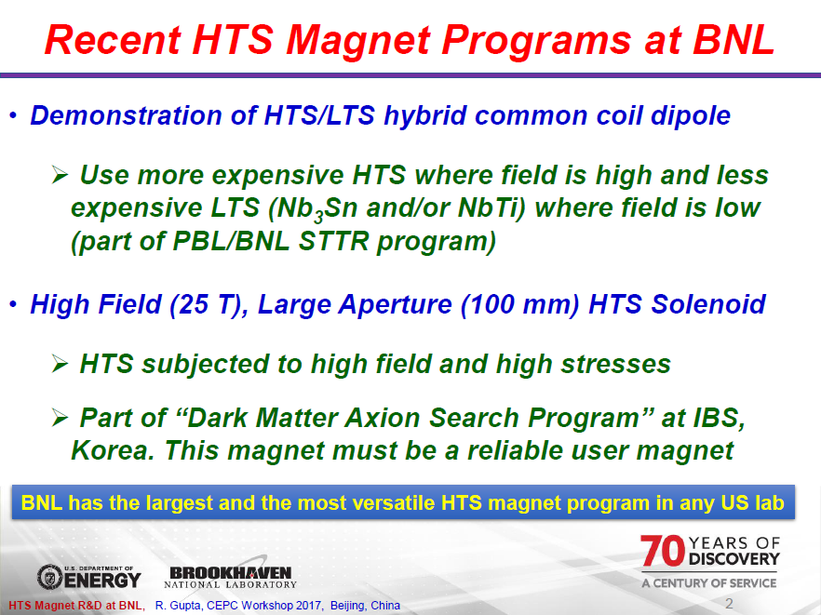
HTS Magnet R&D at BNL
Ramesh Gupta
(BNL)

Slide 12
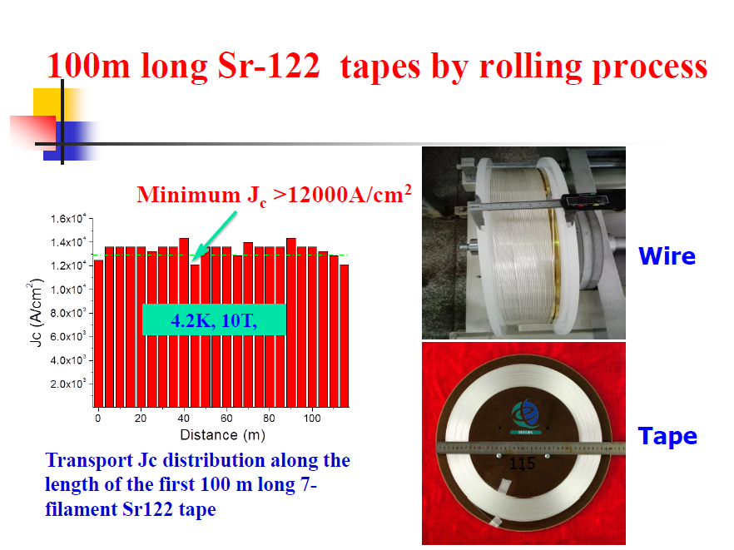
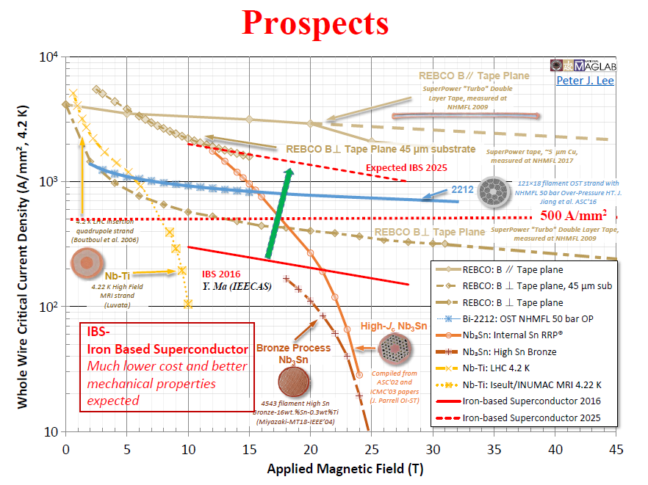
IBS superconductor R&D and plan
Xianping Zhang (IEE, CAS)
It reports the world-first IBS 100-m wires

Slide 13
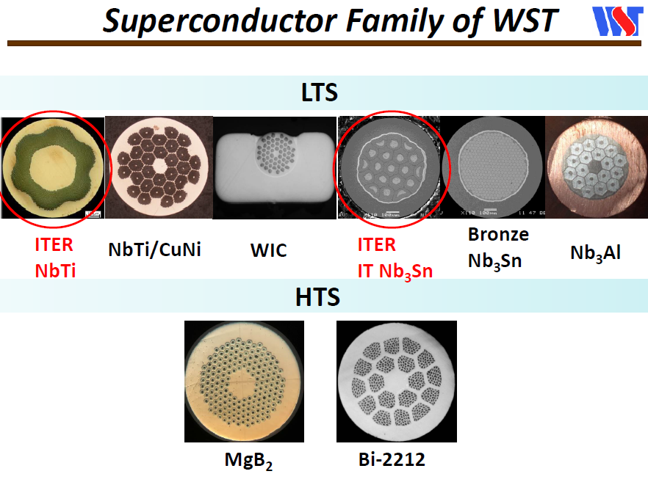
Advanced superconductors developed at WST
Jianfeng Li
(WST)
WST(NIN) has a long history of over 50 years in the R&D of superconducting materials.
WST contributed 174 ton NbTi strand and 35 ton Nb₃Sn strand for ITER.
LTS: Continue the production of MRI wire.
Pursuing higher performance strand for fusion and accelerators.
Low cost, flexibility and efficient service.
HTS: process improvement for long length and performance stability.

Slide 14
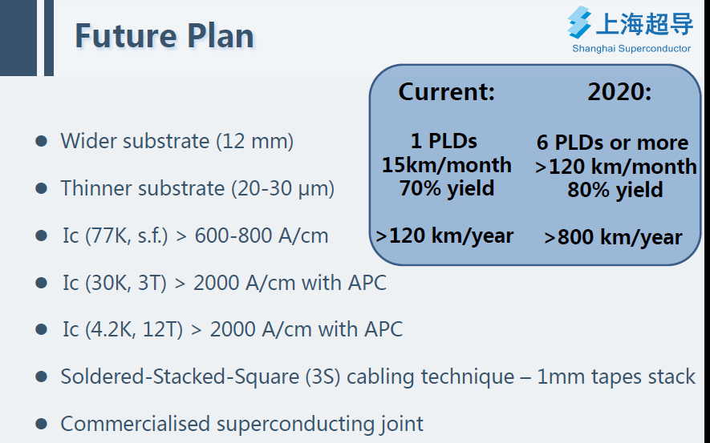
Progress of 2G HTS Wires Development in Shanghai Superconductor
Yue Zhao
(SSTC)
They have good share of 2G HTS market

Slide 15
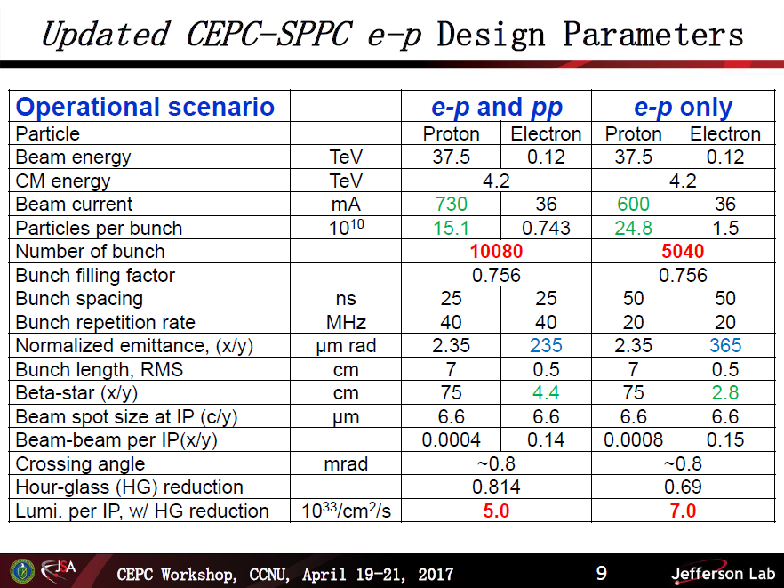
e-p Collisions at CEPC-SPPC: Design Concept Update
Yuhong Zhang (JLAB)
Introduction
CEPC-SPPC Design Update and Impact on e-p Collisions
Design Considerations
New CEPC-SPPC e-p Parameters
More Design Considerations
Staging
Summary

Slide 16
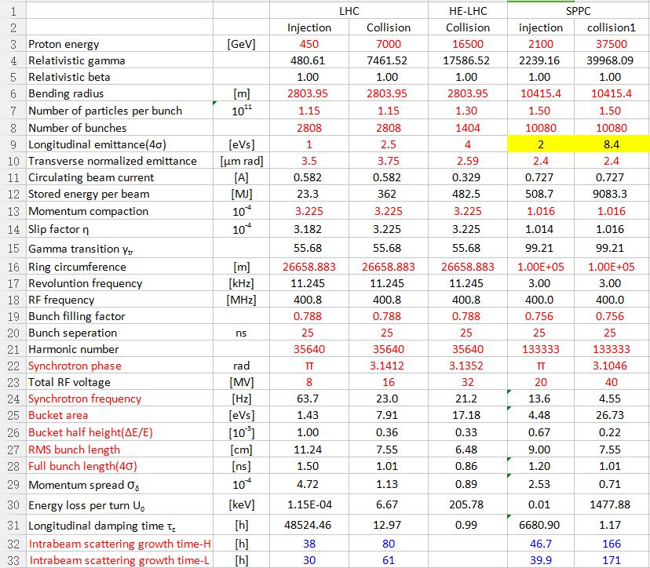
Longitudinal beam dynamics for SPPC accelerator chain
Linhao Zhang (IHEP)
Survey of LHC longitudinal dynamics
Parameter design of SPPC longitudinal dynamics
Preliminary consideration of longitudinal dynamics of SPPC injector chain
Summary

Slide 17
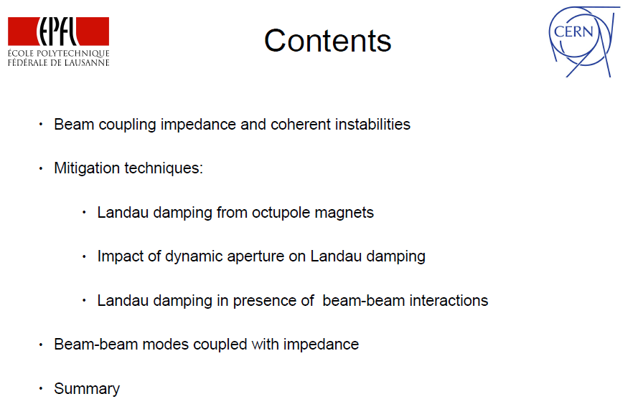
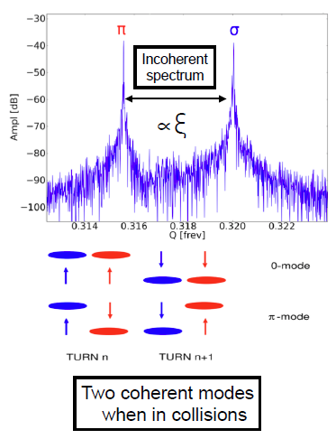
Transverse beam stability and Landau damping in hadron colliders
C. Tambasco (EPFL)

Slide 18
Cryogenic temperature for SPPC
Alexander Krasnov (BINP)
SPPC uses HTS magnets, potentially higher temperature for cold bore
Vacuum pumping is related to the cryogenic temperature
Subjects:
  Vacuum requirements
  Role of surface and radiation
  Cold beam pipe. Hydrogen accumulation. PSD
  Equations for residual dynamic gas density prediction
  CB and BS temperatures
  FCC BS new proposal
  NEG coating
  Solution with NEG application
  Activation, surface impedance

Slide 19
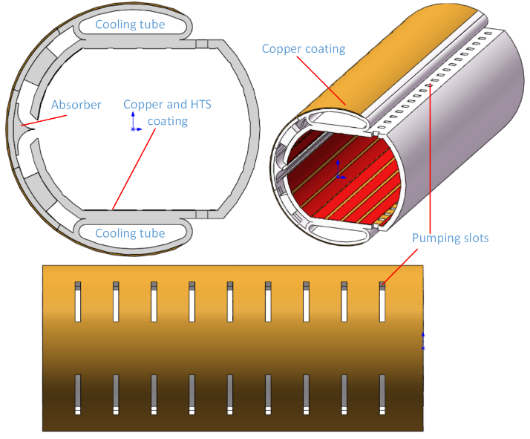
YBCO-coated Beam Screen for SPPC Bending Magnets
Kun Zhu (PKU)
Introduction
SPPC beam screen issues
YBCO-coated beam screen design
Experimental consideration
  Magnetic field distortion and attenuation
  Electron cloud mitigation
  Measurement of wall surface impedance at cryogenic temperature
  Measurement of distortion of an external magnetic field
Conclusion

Slide 20
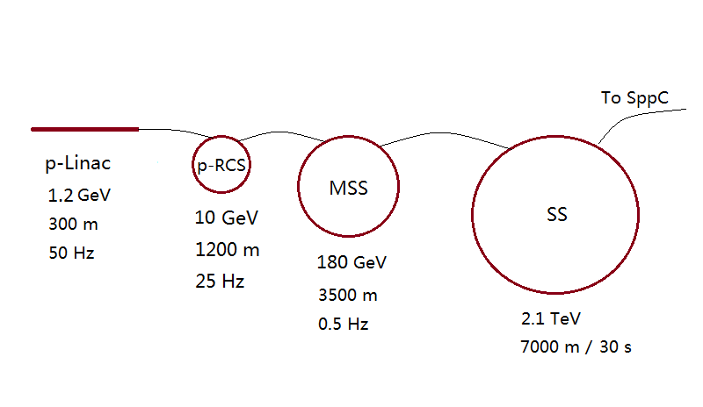
SPPC injector chain design update
Yuanrong Lu (PKU)
Design updates for the SPPC injector accelerators, especially: p-linac, MSS, SS
325MHz
650MHz
Ion
LEBT
RFQ
MEBT1
CH-DTL
MEBT2
Spoke
Spoke
Elliptical
Elliptical
0.05MeV
3.0MeV
20MeV
160MeV
1200MeV

Slide 21
Special Session
-- Discussion on the cold bore temperature
Chair: Jingyu Tang
Major participants: A. Krasnov, H.Y. Dong, S.P. Li, Q.J. Xu, K. Zhu, Y.D. Liu
Question raised
  All-HTS magnets are planned for SPPC, in principle, higher cryogenic temperature for magnets can be considered (LHC: 1.9K), to save the cost of cryogenics
  Main concern is the vacuum pumping where the temperature is critical
  Following earlier discussions among the beam (e.g. April Workshop)
Conclusions:
  Three possible solutions: 1) traditional BS solution with cold bore temperature <3.6 K; 2); 2) cryosobers with independent choice of magnets temperature (4-8 K); 3) separation of beam vacuum with magnet vacuum, use NEG coating
Very productive discussions!

Slide 22
Thanks to all the speakers and contributors for the nice work and presentations!
And also the participants in the discussions

