Slide 1
CEPC accelerator physics
Chenghui Yu
for CEPC team
Nov.6, 2017

Slide 2
Outline
Physics goals and collider parameters
Physics design of CEPC
Linac → Booster → Collider ring
Summary

Slide 3
Physics goals of CEPC
Electron-positron collider (45.5, 80, 120 GeV)
  Higgs Factory
    Precision study of Higgs (m_{H}, J^{PC}, couplings)
    Looking for hints of new physics
    Luminosity > 2.0×10³⁴cm⁻²s⁻¹
  Z & W factory
    Precision test of standard model
    Rare decays
    Luminosity > 1.0×10³⁴cm⁻²s⁻¹

Slide 4
Key parameters of CEPC
100km circumference, double ring collider with 2 IPs
Matching the geometry of SPPC as much as possible
Adopt twin-aperture quadrupoles and dipoles in the ARC
Detector solenoid 3.0T with length of 7.6m while anti-solenoid 7.2T
Maximum gradient of quadrupole 151T/m (3.7T in coil)
Tapering of magnets along the ring
Two cell & 650MHz RF cavity
Two dedicated surveys in the RF region for Higgs and Z modes
Maximum e+ beam power 30MW & e- 30MW
Crab-waist scheme with local X/Y chromaticity correction
Common lattice for all energies.

Slide 5
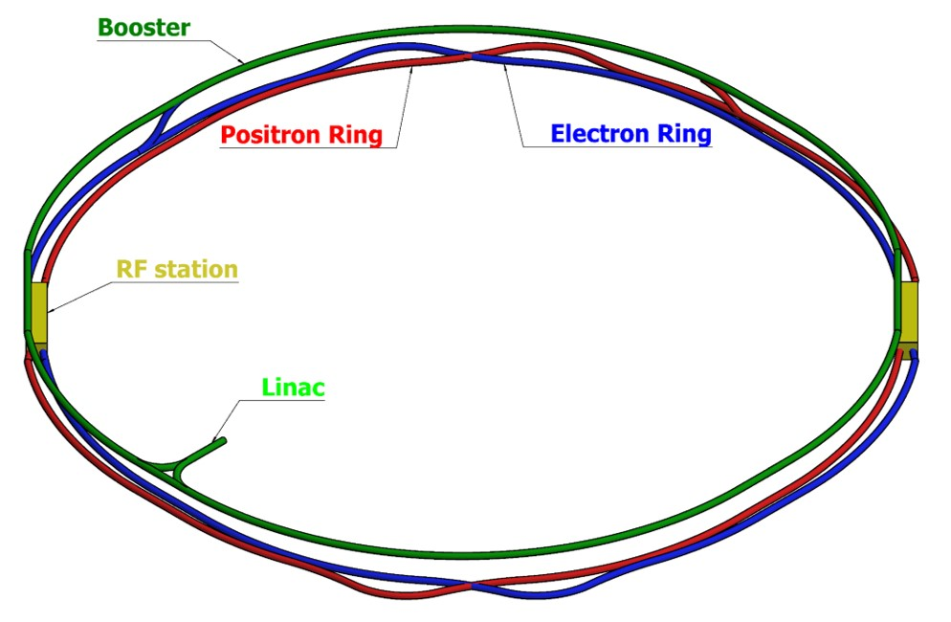
Physics design of CEPC Linac → Booster → Collider ring

Slide 6
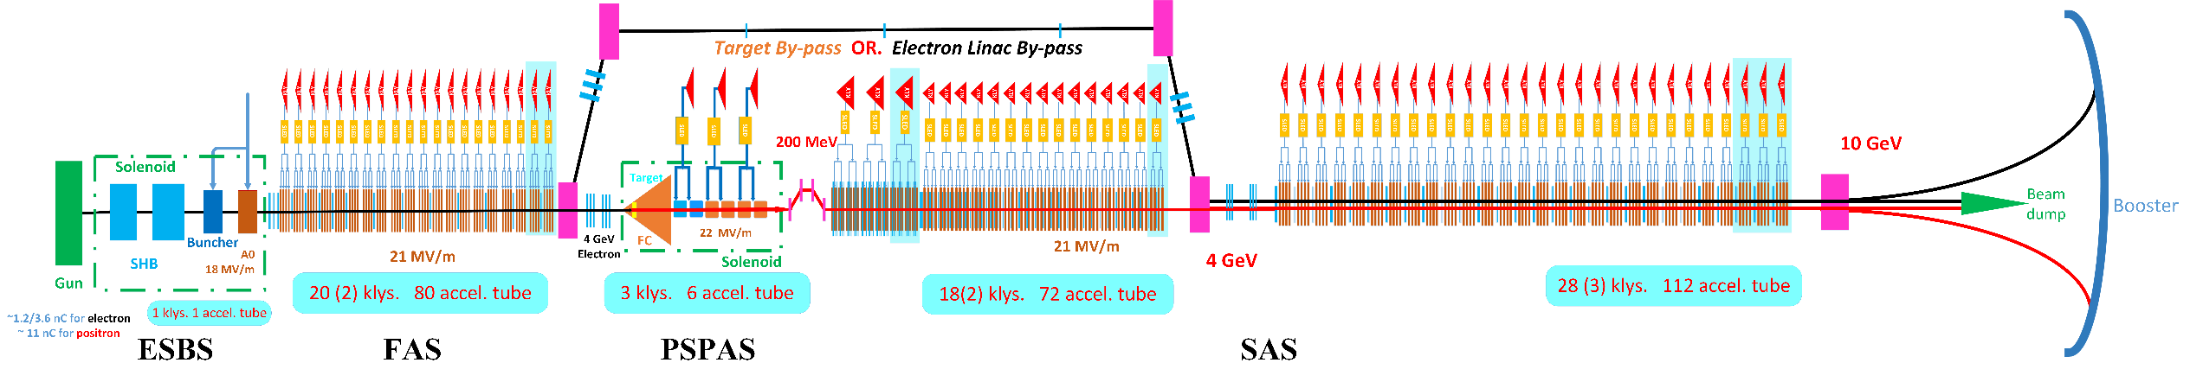
Physics design of CEPC Linac
1200m
Parameter | Symbol | Unit | Baseline | Designed
e⁻ /e⁺ beam energy | E_{e-}/E_{e+} | GeV | 10 | 10
Repetition rate | f_{rep} | Hz | 100 | 100
e⁻ /e⁺ bunch population | N_{e-}/N_{e+} |  | > 6.25×10⁹ | 1.9×10¹⁰ / 1.9×10¹⁰
 |  | nC | > 1.0 | 3.0
Energy spread (e⁻ /e⁺ ) | σ_{e} |  | < 2×10⁻³ | 1.5×10⁻³ / 1.2×10⁻³
Emittance (e⁻ /e⁺ ) | ε_{r} | nm⋅ rad | < 300 | 5 / 120
e⁻ beam energy on Target |  | GeV | 4 | 4
e⁻ bunch charge on Target |  | nC | 10 | 10

Slide 7
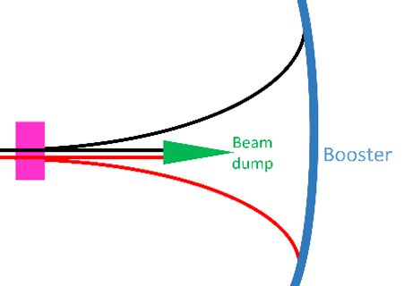
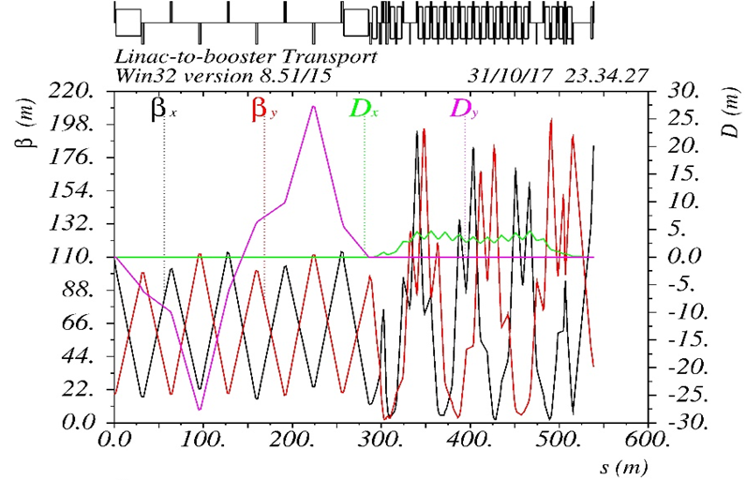
Physics design of CEPC Transport Line 1
550m
0 ~ -100m
Transfer efficiency 99%

Slide 8
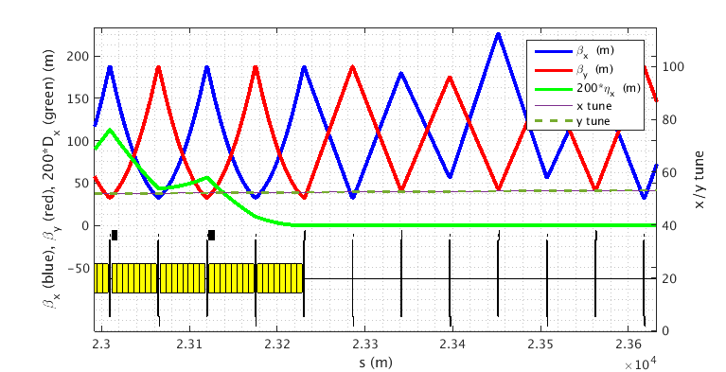
Physics design of CEPC Booster
Injection energy 10GeV
FODO cells with 90 degrees phase shift
The diameter of the inner aperture is selected as 55mm due to limitation of impedance.
The beam lifetime should be higher than 14min (3% particle lose) according to the duration before extraction. The definition of BSC is 2(3 σ +5mm) which is the basic requirement.

Slide 9
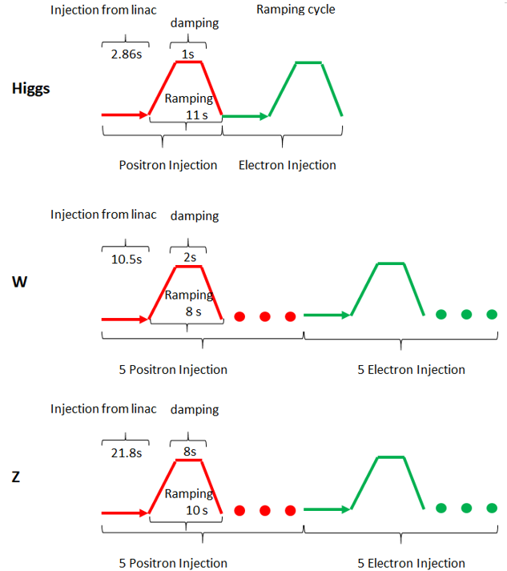
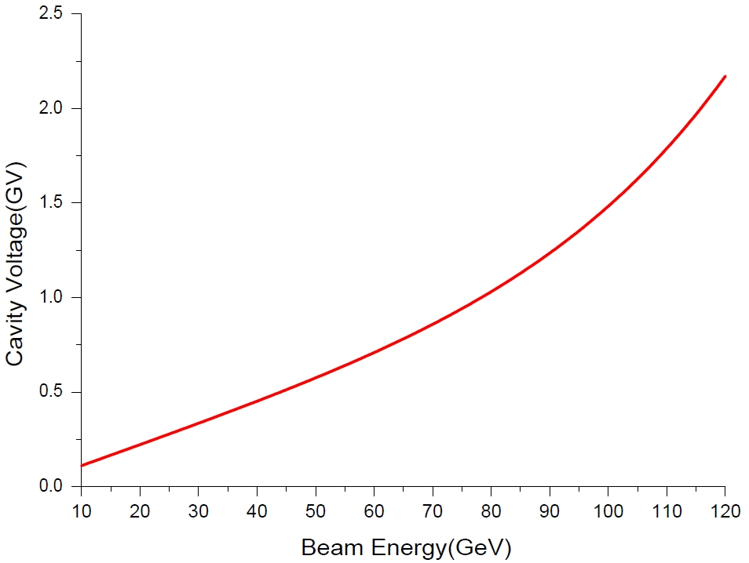
Physics design of CEPC Booster
Injection time structure
28s
185s
30Gauss @ 10GeV
Eddy current effect
318s

Slide 10
Physics design of CEPC Booster
 | Higgs | W | Z
Injection Energy (GeV) | 120 | 80 | 45.5
Bunch number | 286 | 1044 | 2180
Bunch Charge (nC) | 0.62 | 0.173 | 0.077
Beam Current (mA) | 0.532 | 0.542 | 0.504
Beam current threshold due to TMCI (mA) | 0.803
Number of Cycles | 1 | 5 | 5
Current decay | 3% | 3% | 3%
Ramping Cycle (sec) | 10 | 6 | 2
Injection time (sec) | 28 | 185 | 318
Collider Lifetime (hour) | 0.33 | 3.5 | 7.4
Injection frequency (sec) | 37 | 383 | 811
Transfer efficiency is 92% if beam lifetime is 14min.

Slide 11
Errors Setting
Physics design of CEPC Booster
Error studies
 | Dipole | Quadrupole | Sextupole | Corrector
Transverse shift X/Y (μm) | 100 | 100 | 100 | 100
Longitudinal shift Z (μm) | 150 | 150 | 150 | 150
Tilt about X/Y (mrad) | 0.1 | 0.2 | 0.2 | 0.2
Tilt about Z (mrad) | 0.05 | 0.2 | 0.2 | 0.2
Nominal field | 1e-3 | 1e-3 | 1e-3 | 1e-2
 | Accuracy (m) | Tilt (mrad) | Gain | Offset after BBA(mm)
BPM | 1e-5 | 10 | 5% | 1e-3

Slide 12
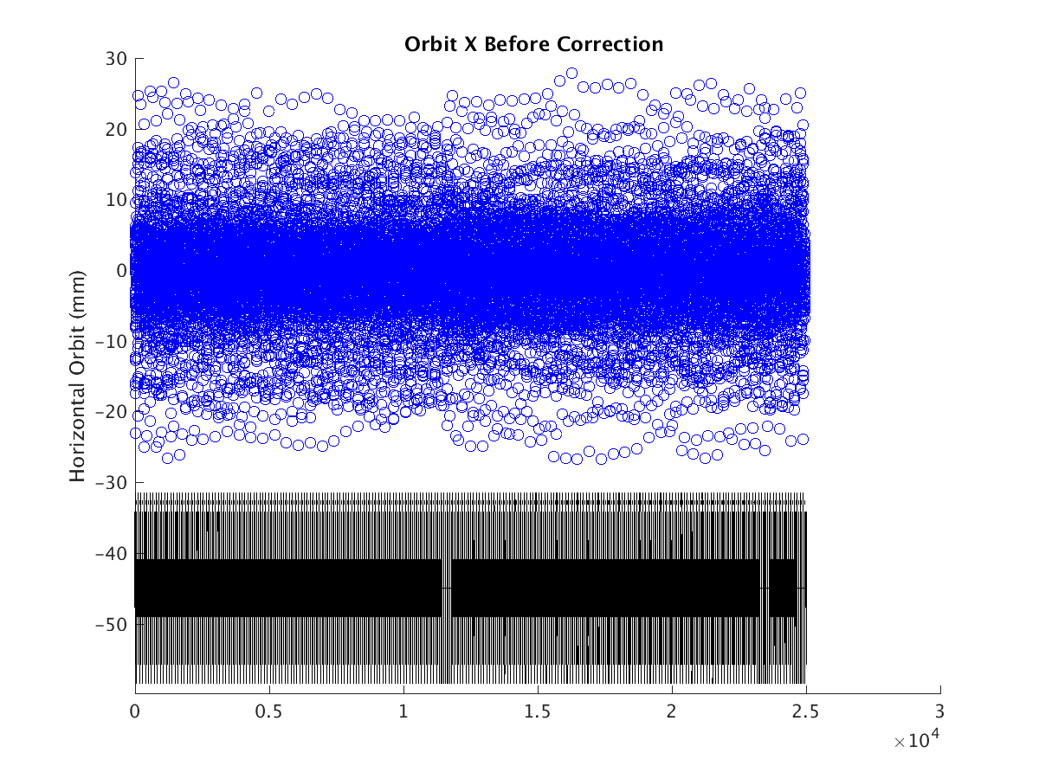
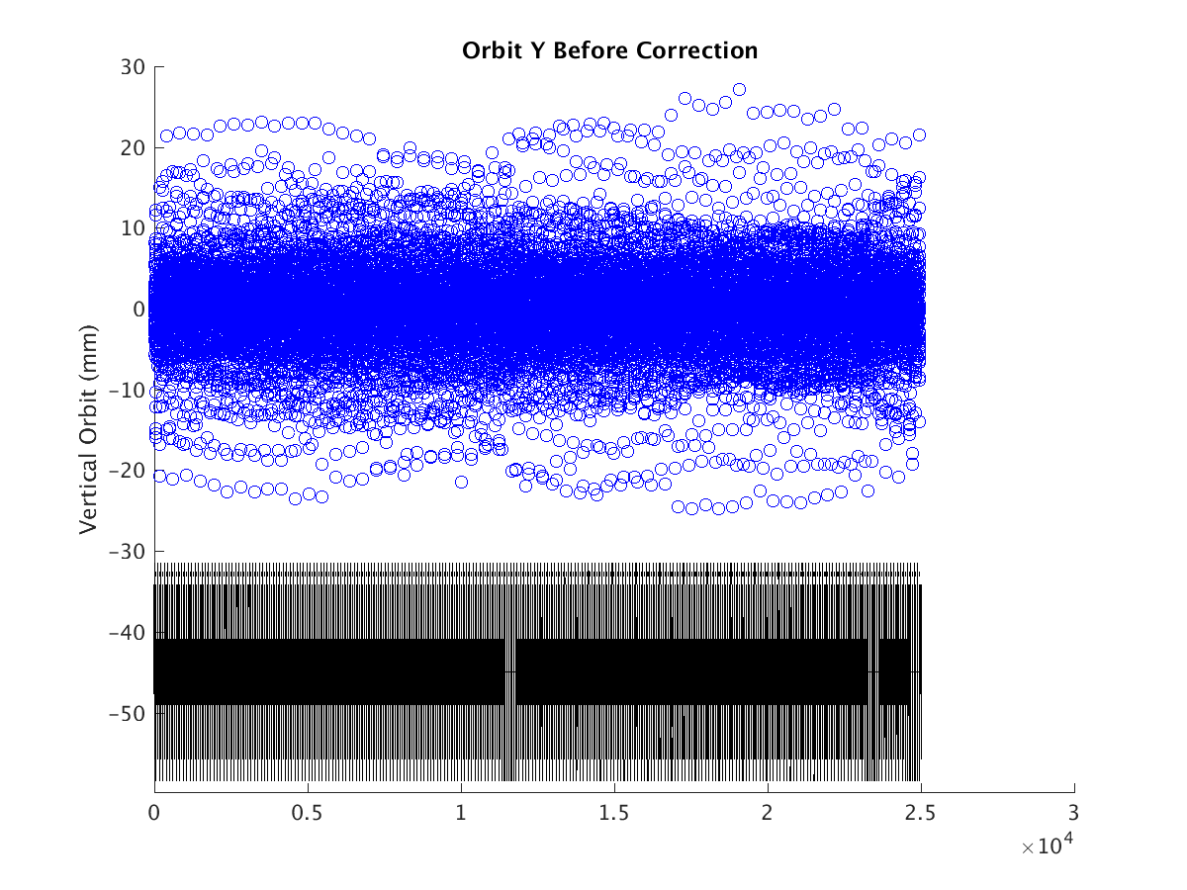
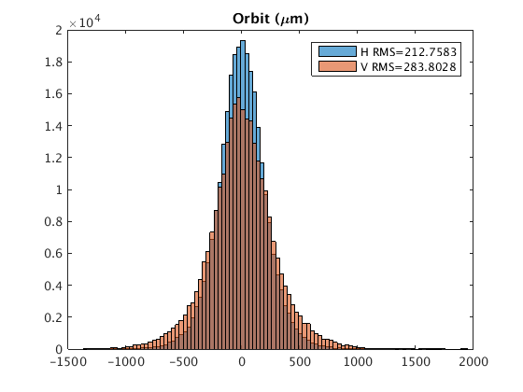
Orbit with errors
Physics design of CEPC Booster
Horizontal Corrector: 48 correctors +856 BTs
Vertical Corrector : 904 correctors
BPM : 904*2
Orbit within the beam stay clear
“First turn trajectory” is not necessary
Hor. 0.2mm Ver. 0.3mm

Slide 13
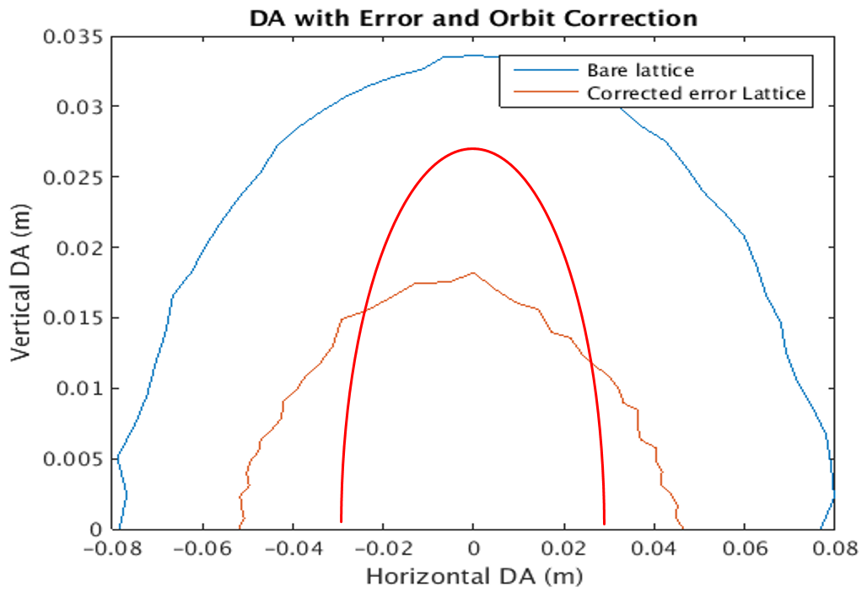
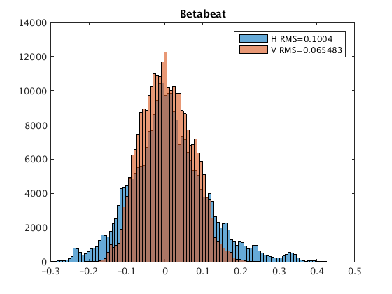
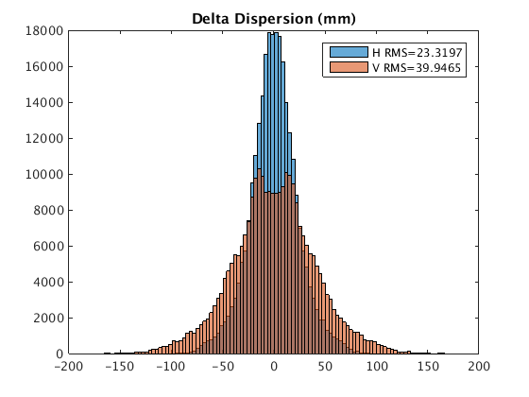
Beta Beating, Emittance and Dynamic Aperture with errors
Physics design of CEPC Booster
  Nearly half of bare lattice, ±50mm* ±18mm, without optics correction, satisfy requirement
  Emittance growth is less than 10% for the simulation seeds
Satisfy the requirement of injection and beam lifetime
Skew quadrupoles are needed to control the coupling
βx/βy=188/33m
ε=300nm: 2(6σ_{x} +5mm) / 2(4σ_{y} +5mm)
ε=120nm : 2(9σ_{x} +5mm) / 2(6σ_{y} +5mm)
Hor. 10% Ver. 6.5% Hor. 0.023m Ver. 0.04m

Slide 14
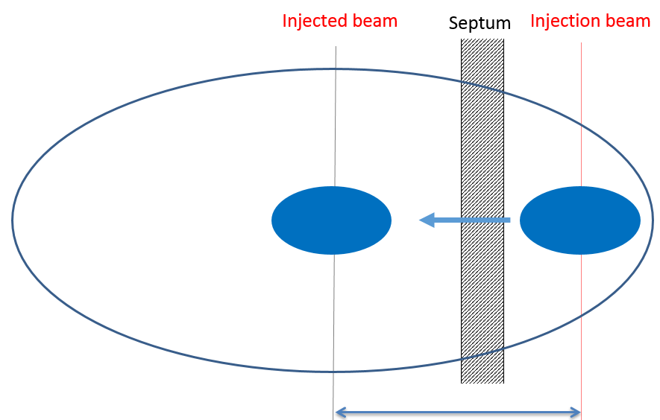
Physics design of CEPC Booster
On-axis injection and extraction
Damping time 87s
e+ and e- beams are injected from outside of the booster ring
Horizontal septum is used to bend beams into the booster
A single kicker downstream of injected beams kick the beams into the booster orbit
Extraction is the opposite procedure

Slide 15
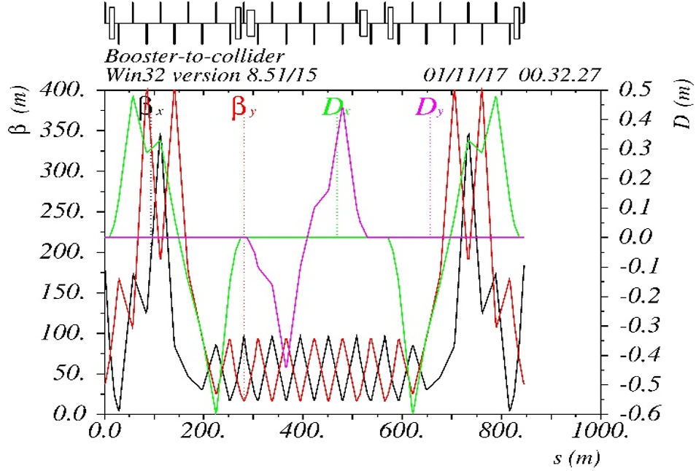
Physics design of CEPC Transport Line 2
480m
1.5m
Transfer efficiency 99%
The total transfer efficiency > 90% (99%*92%*99%)
Satisfy the requirement of topup operation for H, W and Z

Slide 16
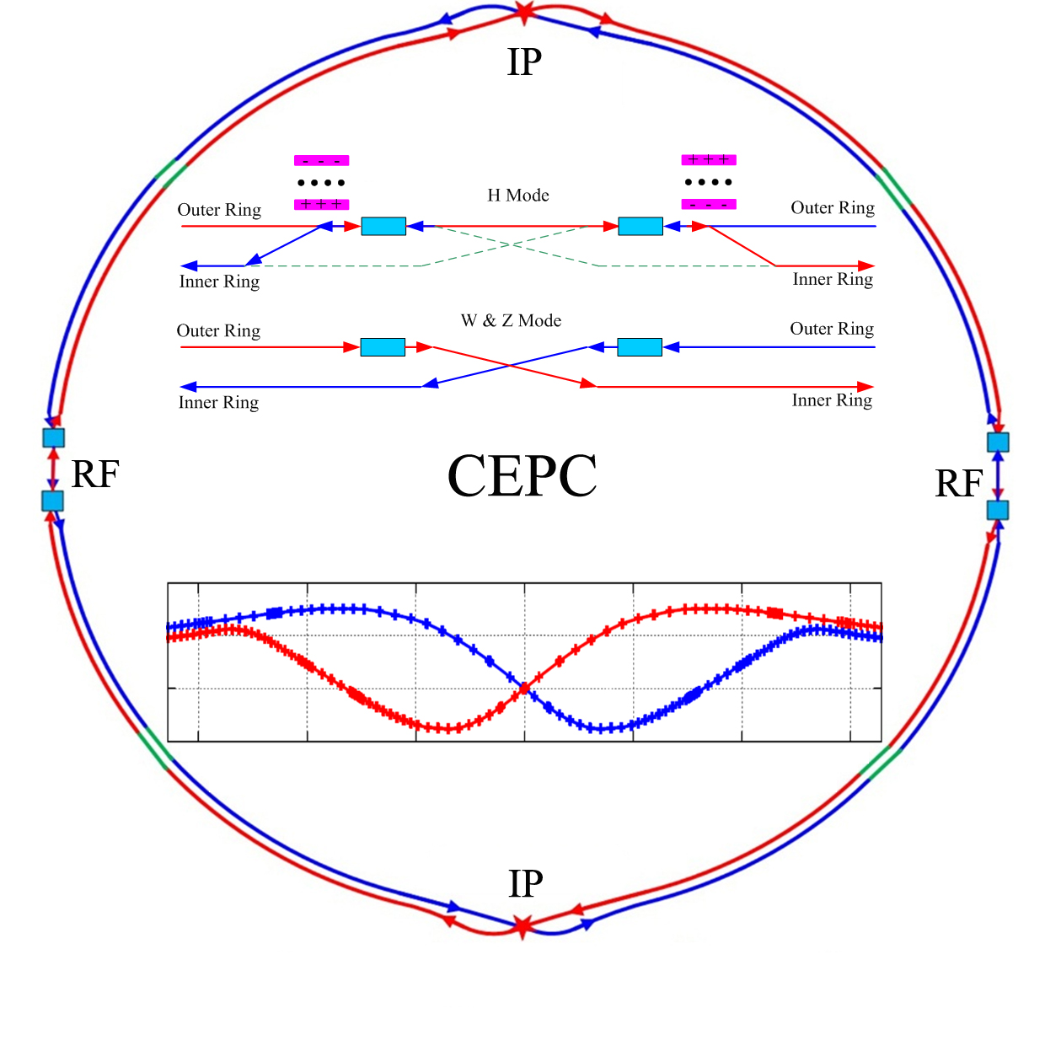
Physics design of CEPC Collider ring
The geometry of CEPC is compatible with the SPPC as much as possible

Slide 17
Parameters of CEPC collider ring
 | Higgs | W | Z
Number of IPs | 2
Energy (GeV) | 120 | 80 | 45.5
Circumference (km) | 100
SR loss/turn (GeV) | 1.68 | 0.33 | 0.035
Crossing angle (mrad) | 33
Piwinski angle | 2.75 | 4.39 | 10.8
N_{e}/bunch (10¹⁰) | 12.9 | 3.6 | 1.6
Bunch number | 286 | 5220 | 10900
Beam current (mA) | 17.7 | 90.3 | 83.8
SR power /beam (MW) | 30 | 30 | 2.9
Bending radius (km) | 10.9
Momentum compaction (10⁻⁵) | 1.14
β_{IP} x/y (m) | 0.36/0.002
Emittance x/y (nm) | 1.21/0.0036 | 0.54/0.0018 | 0.17/0.0029
Transverse σ_{IP} (um) | 20.9/0.086 | 13.9/0.060 | 7.91/0.076
ξ_{x}/ξ_{y}/IP | 0.024/0.094 | 0.009/0.055 | 0.005/0.0165
RF Phase (degree) | 128 | 134.4 | 138.6
V_{RF} (GV) | 2.14 | 0.465 | 0.053
f _{RF} (MHz) (harmonic) | 650
Nature bunch length σ_{z} (mm) | 2.72 | 2.98 | 3.67
Bunch length σ_{z} (mm) | 3.48 | 3.7 | 5.18
HOM power/cavity (kw) | 0.46 (2cell) | 0.32(2cell) | 0.11(2cell)
Energy spread (%) | 0.098 | 0.066 | 0.037
Energy acceptance requirement (%) | 1.21
Energy acceptance by RF (%) | 2.06 | 1.48 | 0.75
Photon number due to beamstrahlung | 0.25 | 0.11 | 0.08
Lifetime due to beamstrahlung (hour) | 1.0
Lifetime (hour) | 0.33 (20 min) | 3.5 | 7.4
F (hour glass) | 0.93 | 0.96 | 0.986
L_{max}/IP (10³⁴cm⁻²s⁻¹) | 2.0 | 4.1 | 1.0

Slide 18
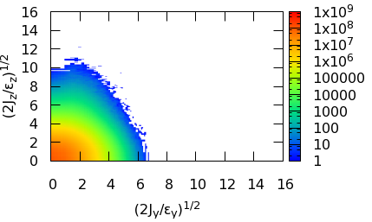
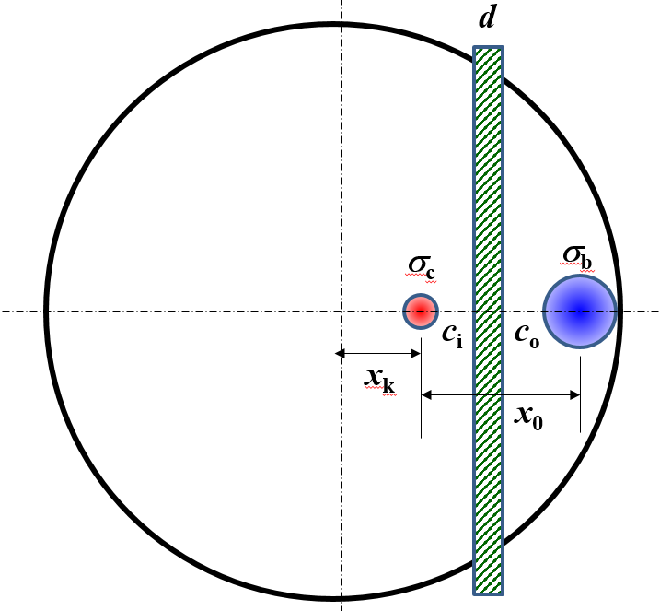
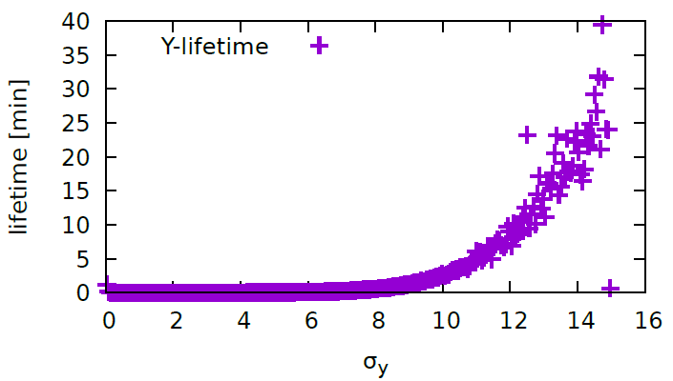
Physics design of CEPC Collider ring
The definition of beam stay clear
To satisfy the requirement of injection: BSC > 16 σ_{x} @ Higgs
To satisfy the requirement of beam lifetime after collision BSC > 16σ_{y}
BSC_x =±(20σ_{x} +3mm), BSC_y =±(30σ_{y} +3mm), While coupling=1%
Beam tail distribution
with full crab-waist
BSC>16 σ_{x}
BSC>16 σ_{y}

Slide 19
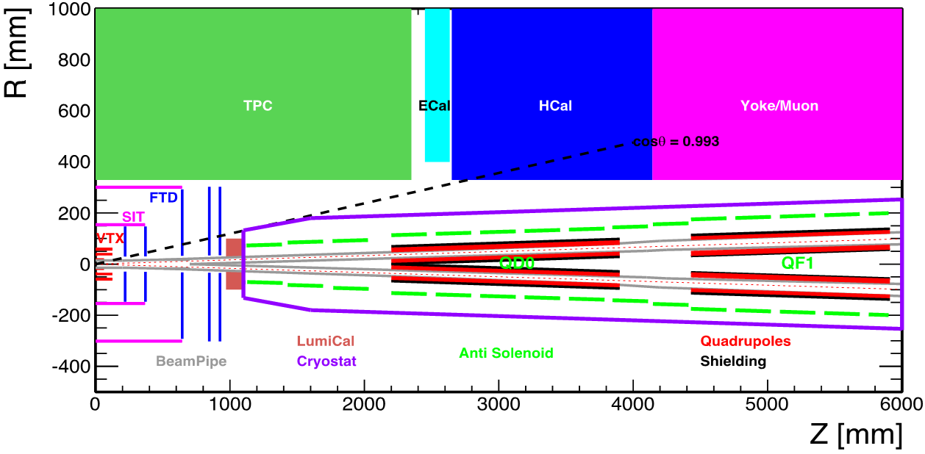
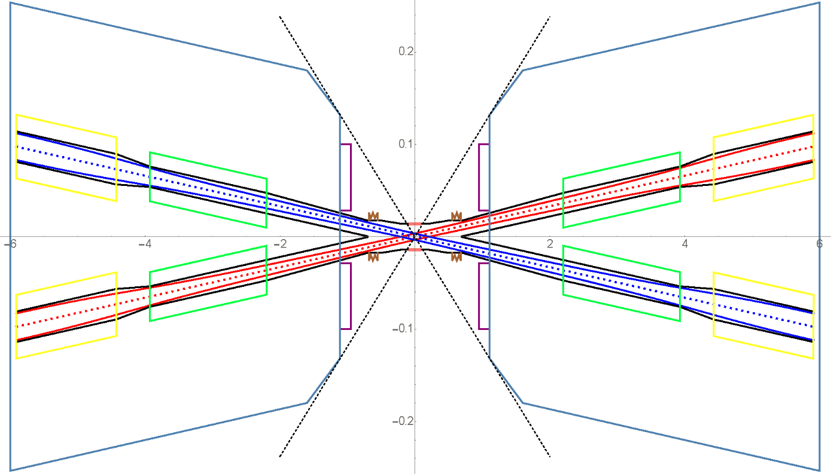
Physics design of CEPC Collider ring
The design of interaction region
✓ L*=2.2m, θc=33mrad, βx*=0.36m, Detector solenoid=3.0T
  Lower strength requirements of anti-solenoids (~7.2T)
  Enough space for the SC quadrupole coils in two-in-one type (Peak field 3.7T & 151T/m) with room temperature vacuum chamber
  The control of SR power from the superconducting quadrupoles.

Slide 20
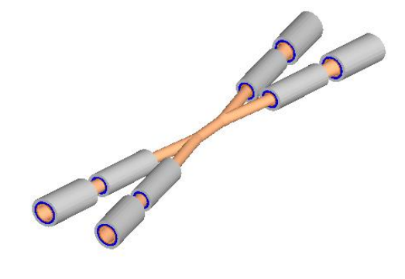
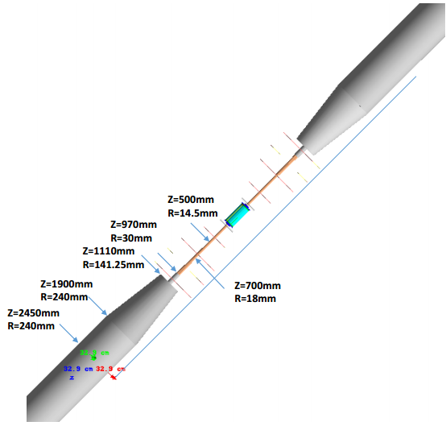
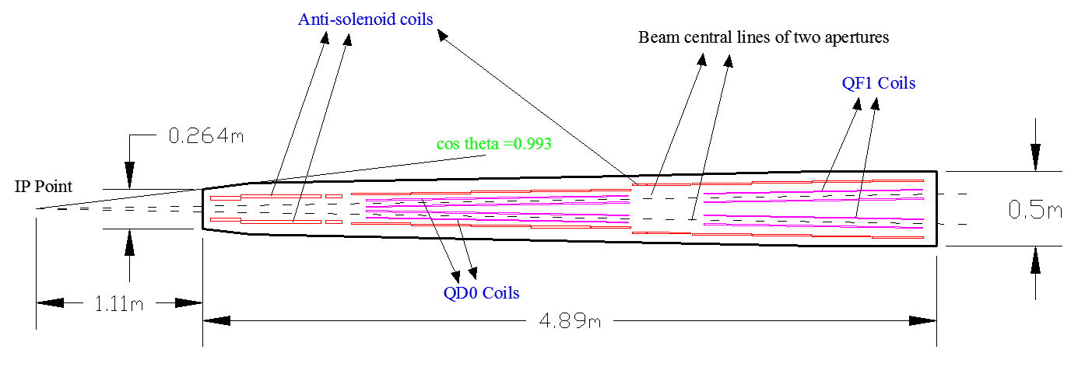
Physics design of CEPC Collider ring
The design of interaction region
Without tungsten shield.

Slide 21
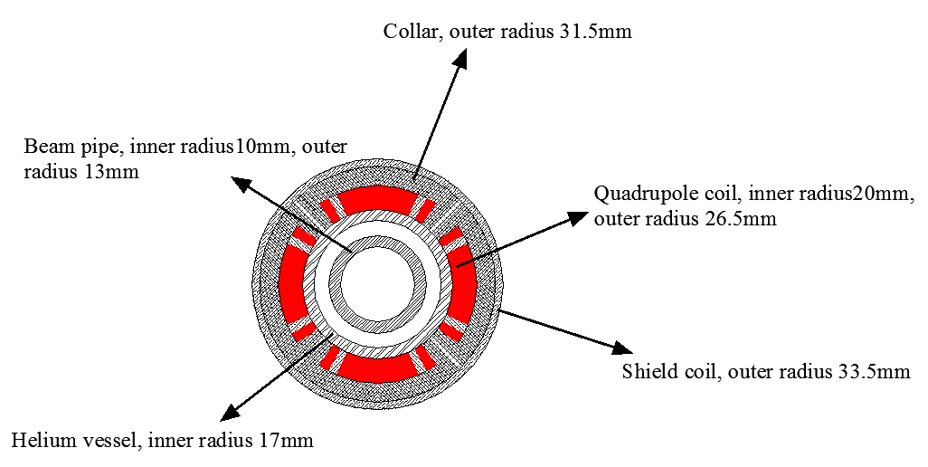
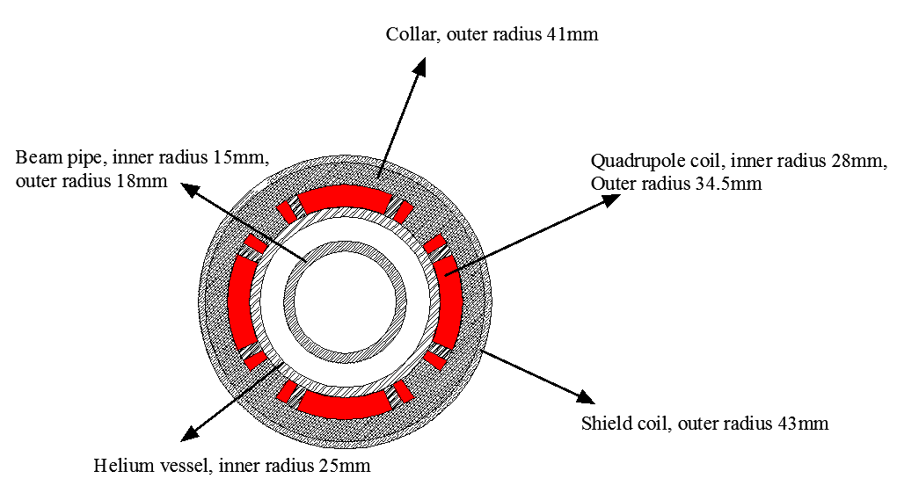
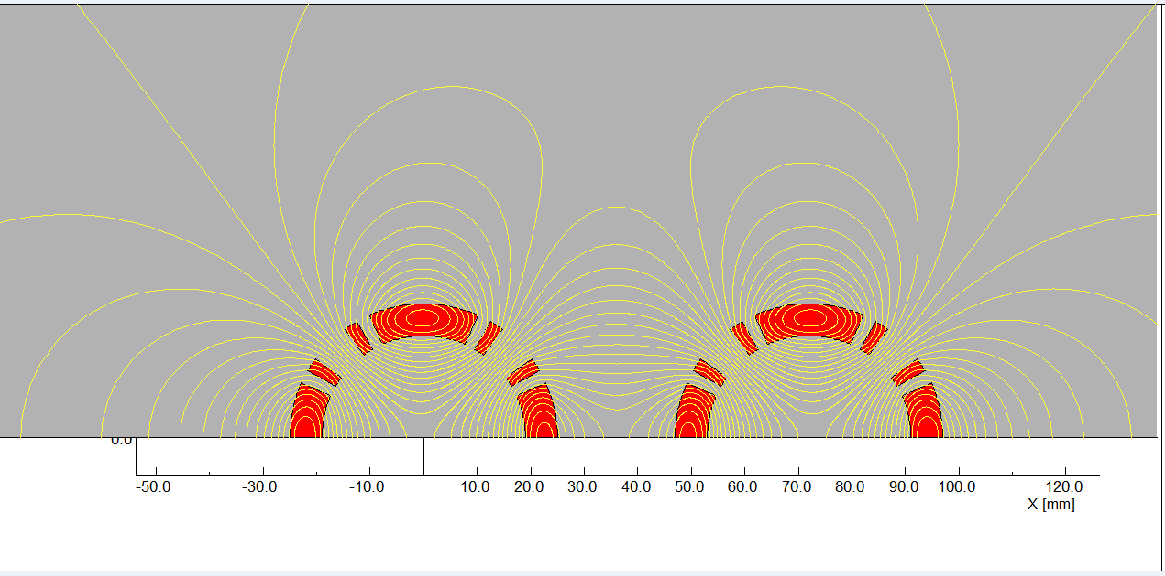
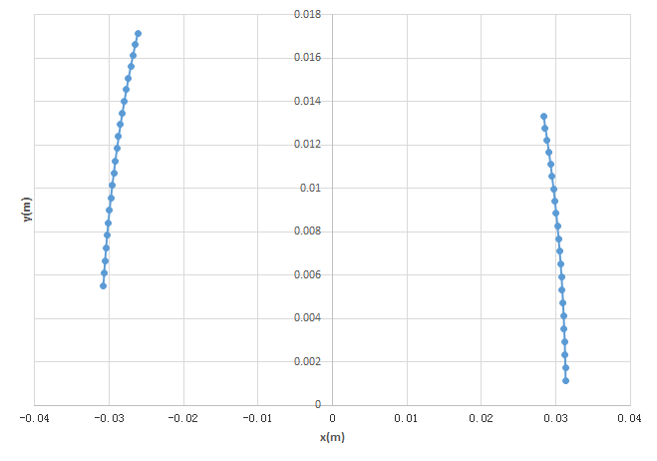
Physics design of CEPC Collider ring
The design of interaction region
Rutherford NbTi-Cu Cable
Single aperture of QD0
(Peak field 3.5T)
Single aperture of QF1
(Peak field 3.7T)
Room-temperature vacuum chamber with a clearance gap of 4 mm
harmonics of integral field（×10⁻⁴）
Magnet | Central field gradient (T/m) | Magnetic length (m) | Width of Beam stay clear (mm) | Min. distance between beams centre (mm)
QD0 | 151 | 1.73 | 19.15 | 72.61
QF1 | 102 | 1.48 | 29.0 | 146.20
n | B_{n}/B₂@R=9.6 mm
2 | 10000.0
3 | 0.113106
4 | 1.052949
5 | -0.50883
6 | -0.46465
7 | -0.11318
8 | -0.01595
9 | -0.01112
10 | -0.05347
11 | -0.00067
12 | 9.01E-05
Shield coil in the apertures
Design of superconducting QF and QD coils

Slide 22
Physics design of CEPC Collider ring
The design of interaction region
3T & 7.6m
Anti-solenoid | Before QD0 | Within QD0 | After QD0
Central field（T） | 7.2 | 2.8 | 1.8
Magnetic length（m） | 1.1 | 1.73 | 1.98
Conductor (NbTi-Cu) | 4×2mm | 4×2mm | 4×2mm
Coil layers | 12 | 6 | 4
Excitation current（kA） | 2.2 | 1.7 | 1.2
Stored energy (KJ) | 330 | 185 | 64
Inductance（H） | 0.136 | 0.13 | 0.09
Peak field in coil (T) | 7.4 | 2.9 | 1.9
Number of sections | 3 | 9 | 7
Solenoid coil inner diameter (mm) | 120 | 190 | 314
Solenoid coil outer diameter (mm) | 196 | 262 | 390
Total Lorentz force F_{z} (kN) | -78 | -11 | 89
Cryostat diameter (mm) | 500
∫B_{z}ds within 0~2.12m. Bz < 460Gauss away from 2.12m with local cancellation structure
The skew quadrupole coils are designed to make fine tuning of Bz over the QF&QD region instead of the mechanical rotation.

Slide 23
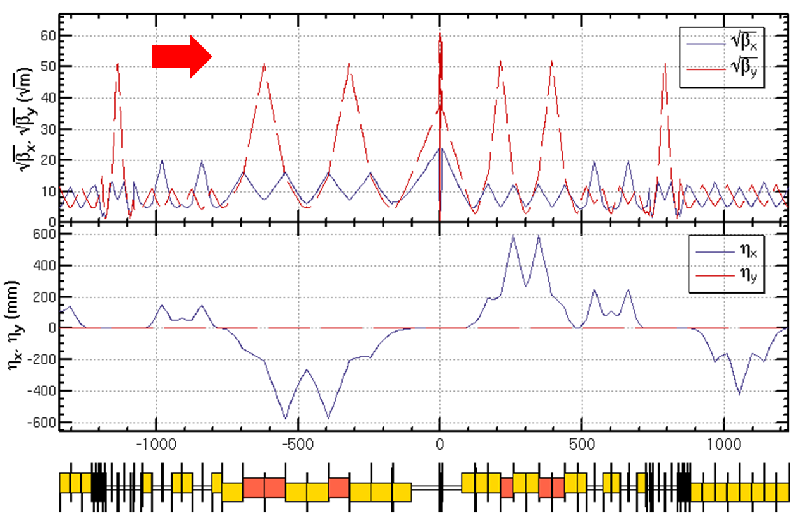
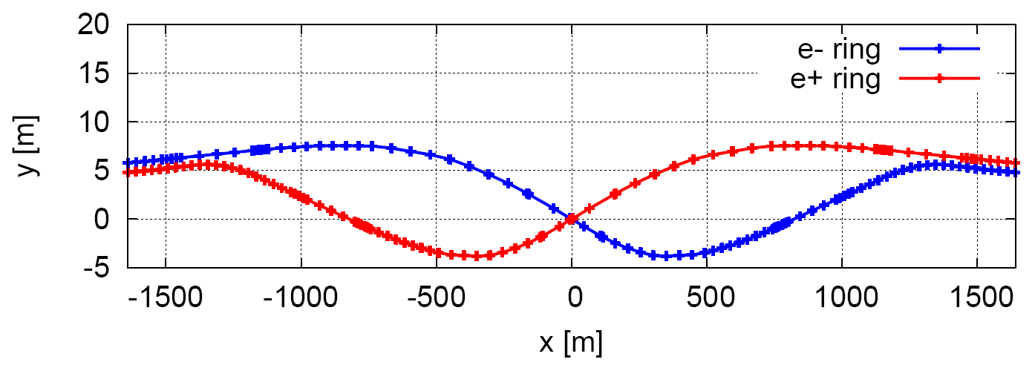
Physics design of CEPC Collider ring
The design of interaction region
Survey and Lattice
~4km
Crab-waist scheme with local chromaticity correction

Slide 24
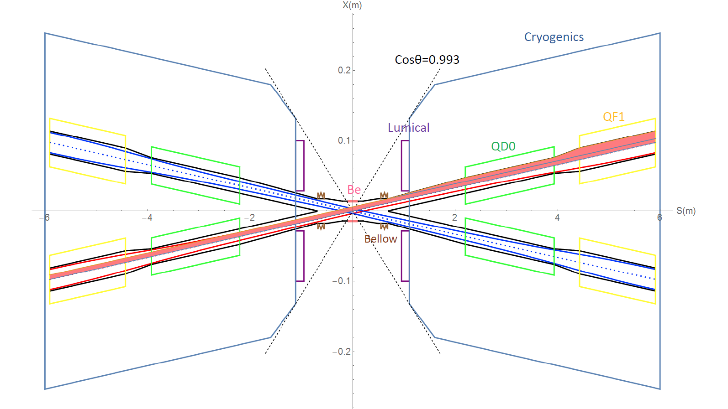
Physics design of CEPC Collider ring
The design of interaction region
The central part is Be pipe with the length of 14cm and inner diameter of 28mm.
IP upstream: Ec < 100 keV within 400m. Last bend(66m)Ec < 47 keV
IP downstream: Ec < 300 keV within 250m, first bend Ec < 95 keV
Reverse bending direction of last bends
Background control & SR protection

Slide 25
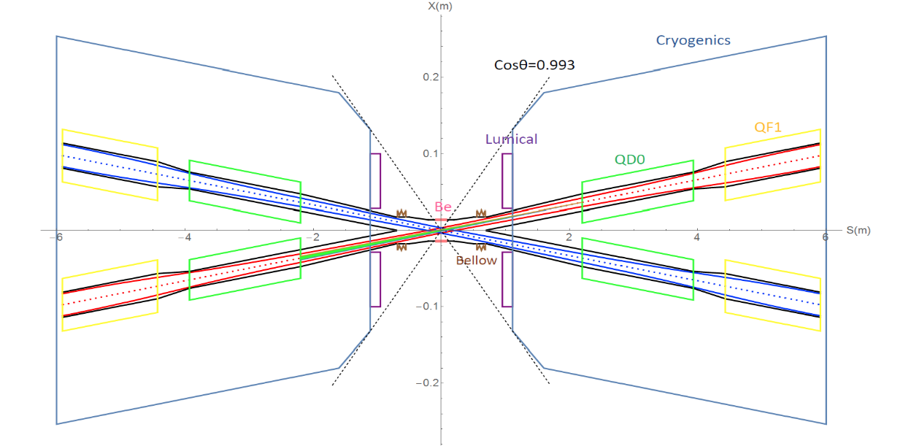
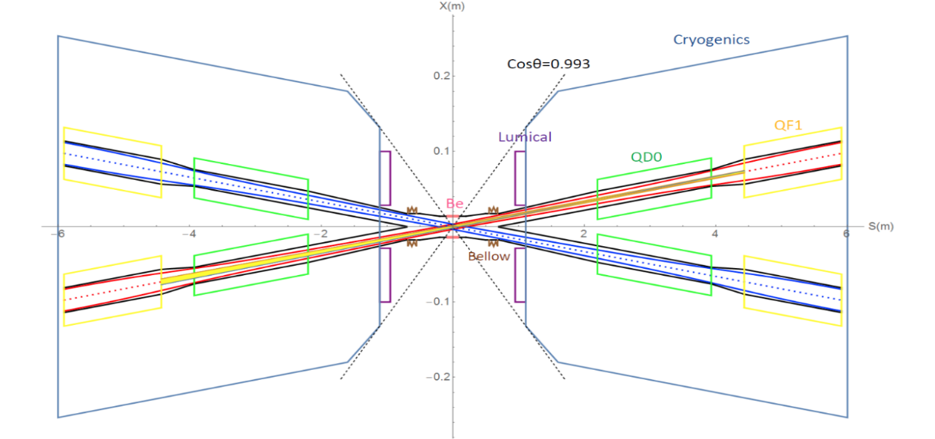
Physics design of CEPC Collider ring
The design of interaction region
The total SR power generated by the QD magnet is 603W in horizontal and 157W in vertical. The critical energy of photons is about 1.3 MeV. SR power is 186W in vertical and the critical energy of photons is about 423keV.
The total SR power generated by the QF1 magnet is 1387W in horizontal and 30W in vertical. . The critical energies of photons are about 1.5MeV and 189keV in horizontal and vertical.
No SR hits directly on the beryllium pipe. SR power contributed within 10σ_{x} will go through the IP.

Slide 26

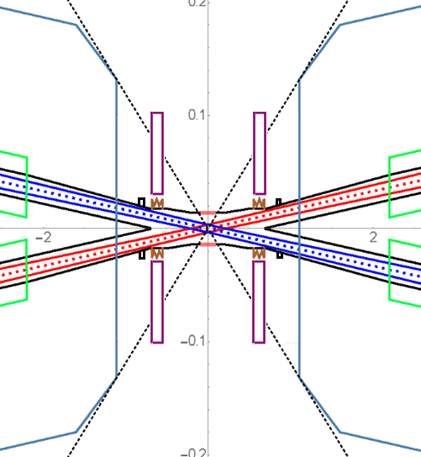
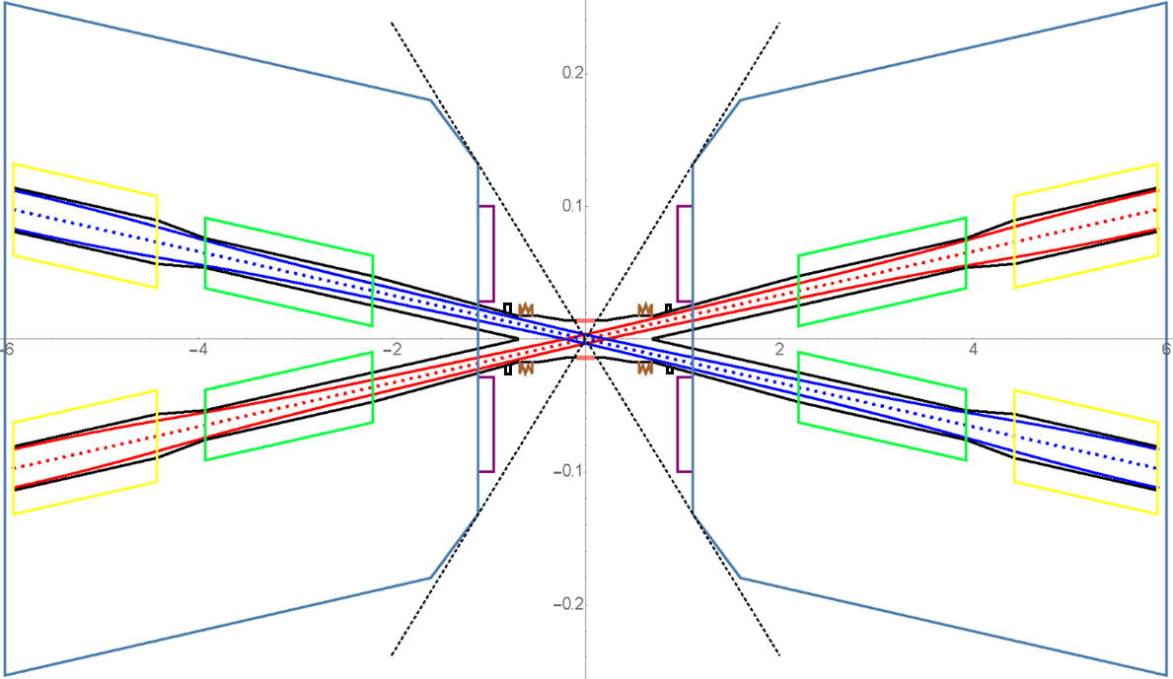
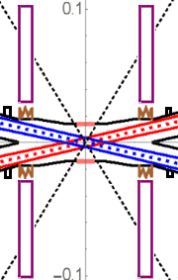
Physics design of CEPC Collider ring
The design of interaction region
Assembly (preliminary)
1, IP Chamber
3, SC Magnet and Vacuum chamber (remotely)
4, Move Lumical back and attach to the cover of cryostat with alignment holes (remotely)
2, Bellows and Lumical (remotely)

Slide 27
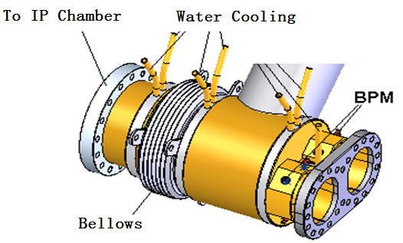
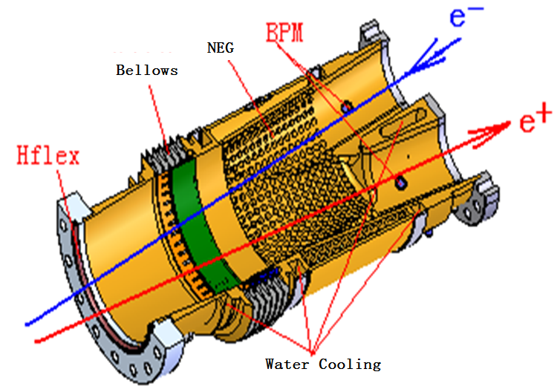
Physics design of CEPC Collider ring
The design of interaction region
Crotch region design (preliminary)
Helicoflex

Slide 28
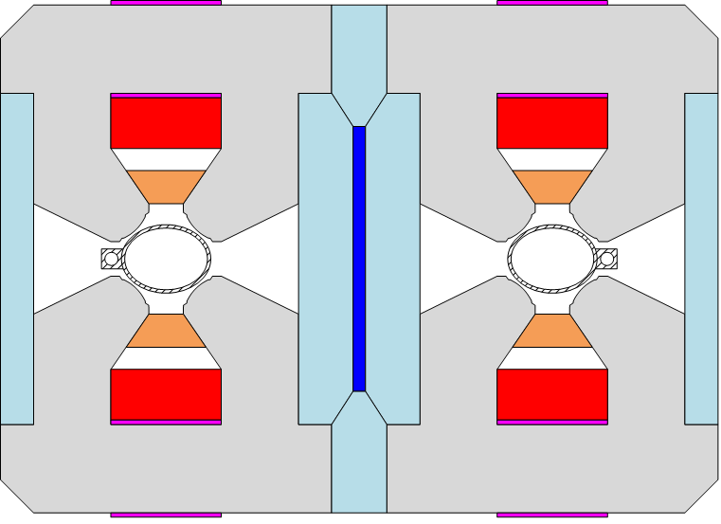
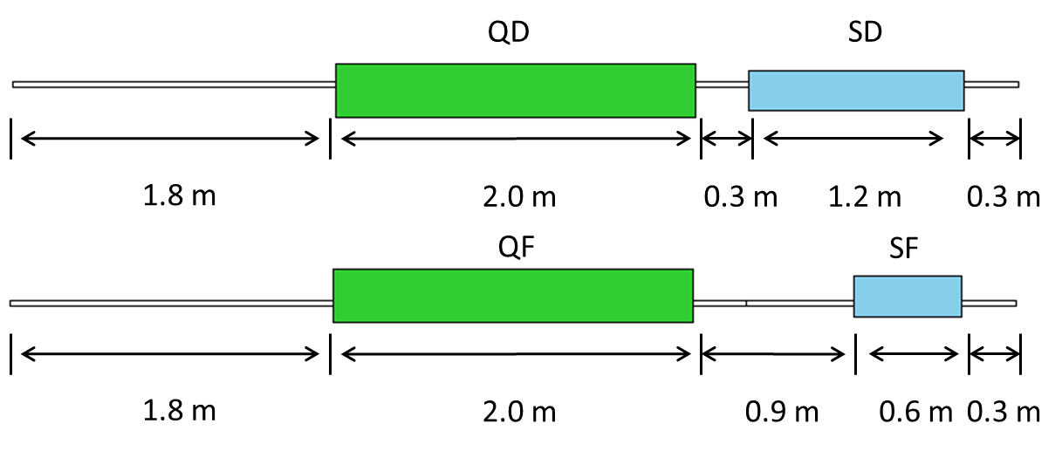
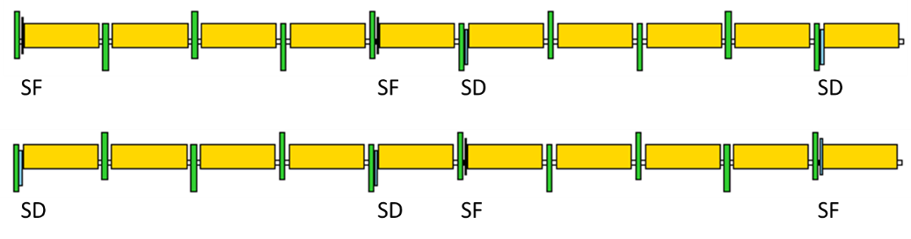
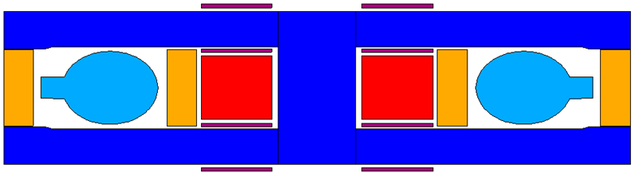
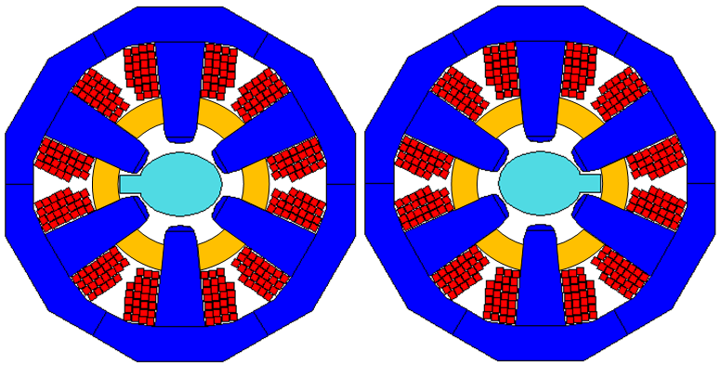
Physics design of CEPC Collider ring
The ARC region
  Distance of two ring is 0.35m to adopt twin-aperture Q & B magnets.
  FODO cell, 90°/90°, non-interleaved sextupole scheme

Slide 29
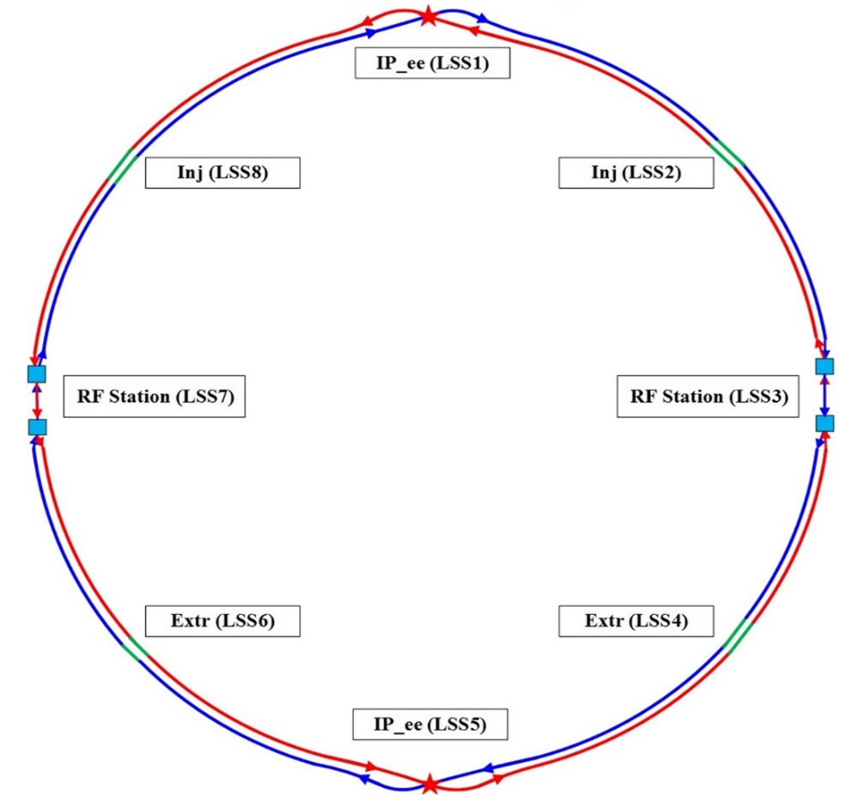
Physics design of CEPC Collider ring
The RF region
  Common cavities for Higgs mode, bunches filled in half ring for e+ and e-.
  Independent cavities for W & Z mode, bunches filled in full ring.
  The outer diameter of RF cavity is 1.5m. Distance of two ring is 1.0m.
Z mode:
Bunch spacing > 25ns
10900 bunches: 28ns

Slide 30
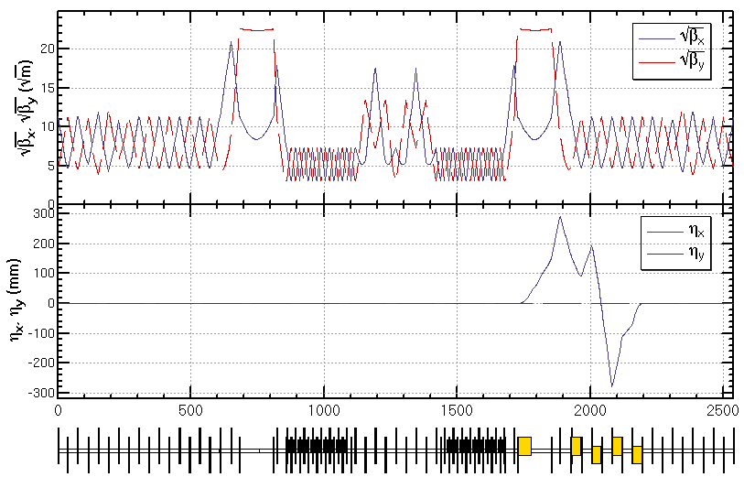
Physics design of CEPC Collider ring
The RF region
  Low beta functions in the RF region to reduce the instabilities caused by RF cavities. For Z mode, due to the limitation of HOM 466mA can be chosen before the installation of the dedicated RF cavity.
~1.0km
RF cavities RF cavities
Esep=1.8 MV/m , Lsep=50m

Slide 31
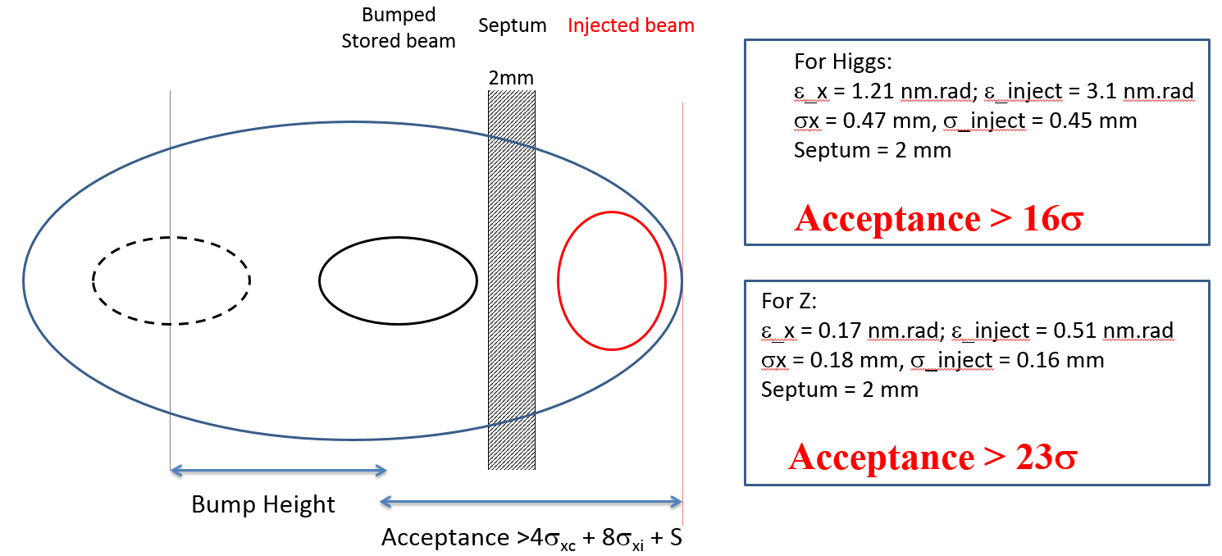
Physics design of CEPC Collider ring
The injection

Slide 32
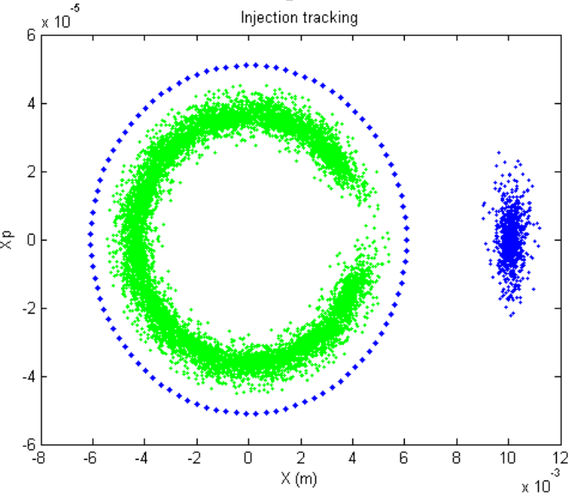
Physics design of CEPC Collider ring
The injection
Injected Beam
Circulating Beam
Local bump kickers
Off-axis injection

Slide 33
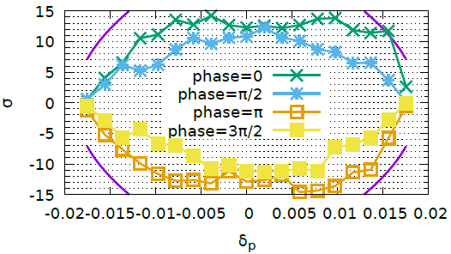
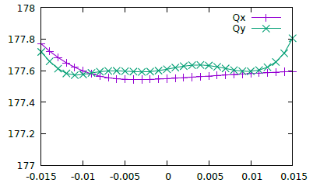
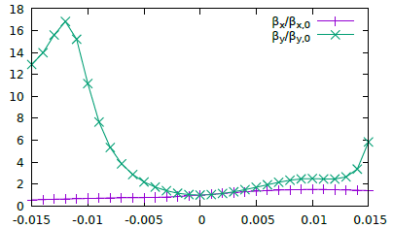


Code: MODE
Physics design of CEPC Collider ring
Dynamic aperture optimization
Crab waist=100%
SAD is used
200 turns tracked
100 samples
IR sextupoles + 32 arc sextupoles
(Max. free various=254)
Damping at each element
RF ON
Radiation fluctuation ON
Sawtooth on with tapering
The requirements
Minimum DA of 100 samples. 0.3% coupling. 200 turns.
$$16σ_{x}×16σ_{y} \& 0.015$$
$20σ_{x}×20σ_{y} \& 0.017$@ Higgs without errors
Dynamic Aperture of on-momentum particles

Slide 34




Z mode
Physics design of CEPC Collider ring
Dynamic aperture optimization
Crab waist=100%
SAD is used
3000 turns tracked
IR sextupoles + 32 arc sextupoles
(Max. free various=254)
Damping at each element
RF ON
Radiation fluctuation ON
Sawtooth on with tapering
The requirements
50$σ_{x}×50σ_{y} \& 0.007$@ Z
Minimum DA of 100 samples. 1.7% coupling. 3000 turns.
$23σ_{x}×20σ_{y}$ & 0.004
All effects (exception: errors and solenoid) is included in the dynamic aperture survey.
Dynamic Aperture of on-momentum particles

Slide 35


Physics design of CEPC Collider ring
Beam performance with errors
2968 BPMs, 1502 horizontal and 1460 vertical correctors are used for the orbit correction.
If IR is included, the optics will be very sensitive to the errors. We haven’t find a good solution of optics correction with sextupoles for the whole ring till now.
RMS_{COD} ≈ 24 um (x) and ≈ 38 um (y) along the ring after orbit correction

Slide 36


Physics design of CEPC Collider ring
The impedance and instabilities
Components | Number | R, kΩ | L, nH | Z||/n, mΩ | k_{loss}, V/pC | ky, kV/pC/m
Resistive wall | - | 15.3 | 866.8 | 16.3 | 432.3 | 23.0
RF cavities | 336 | 11.2 | -72.9 | -1.4 | 315.3 | 0.41
Flanges | 20000 | 0.7 | 145.9 | 2.8 | 19.8 | 2.8
BPMs | 1450 | 0.53 | 6.38 | 0.12 | 13.1 | 0.3
Bellows | 12000 | 2.3 | 115.6 | 2.2 | 65.8 | 2.9
Pumping ports | 5000 | 0.01 | 1.3 | 0.02 | 0.4 | 0.6
IP chambers | 2 | 0.2 | 0.8 | 0.02 | 6.7 | 1.3
Electro-separators | 22 | 1.5 | -9.7 | 0.2 | 41.2 | 0.2
Taper transitions | 164 | 1.1 | 25.5 | 0.8 | 50.9 | 0.5
Total |  | 32.9 | 1079.7 | 20.6 | 945.4 | 32.1
At the design bunch intensity, the bunch length will increase 30% and 40% for H and Z respectively. Bunch spacing >25ns will be needed to eliminate the electron cloud instability.

Slide 37
Summary
The physical design can meet the basic luminosity requirements at Higgs and Z. The errors study on the collider ring is still under going.
  The finalization of the beam parameters and the specification of special magnets have been finished. The hardware devices are all reasonable.
  Technology challenges such as low magnetic field in the booster are being studied. The design of a backup injection chain has already been finished with slight higher budget.
  4GeV&100Hz→Booster1 to 36GeV →Booster2 to 120GeV→Collider Ring
The optimization to reduce machine cost and improve the luminosity is always under studying.
A relaxed lattice with very larger dynamic aperture is needed for the errors study and the commissioning of collider ring.

