Slide 1
Alternate Injectors for a Higgs Factory
John Seeman
SLAC National Accelerator Laboratory
November 7, 2017
CEPC-SppC Workshop

Slide 2
Topics
Present CEPC and FCCee Injectors
Layouts
Generic injection requirements
Alternate Injection Possibilities
Basic cost scaling
Design of a full energy PWFA or DWFA Injector
Proposed FACET-II two-stage Wakefield Test Module

Slide 3
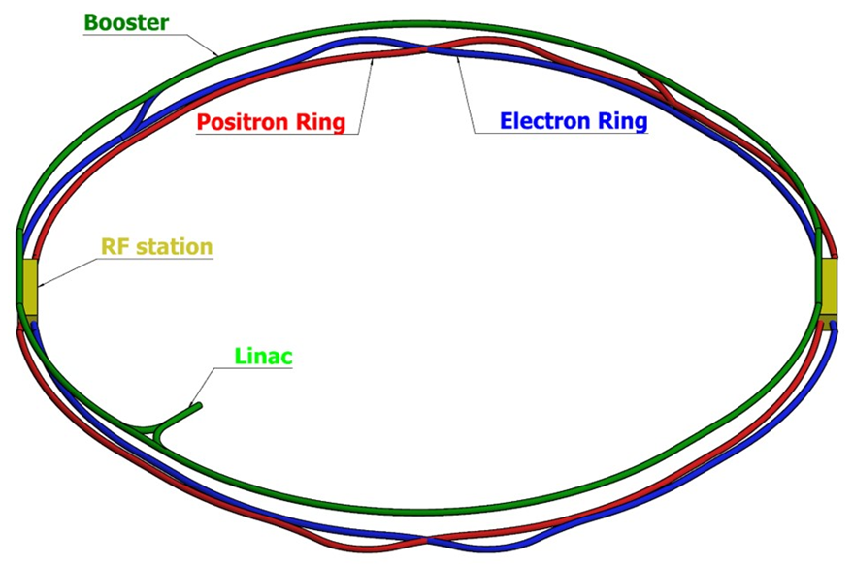
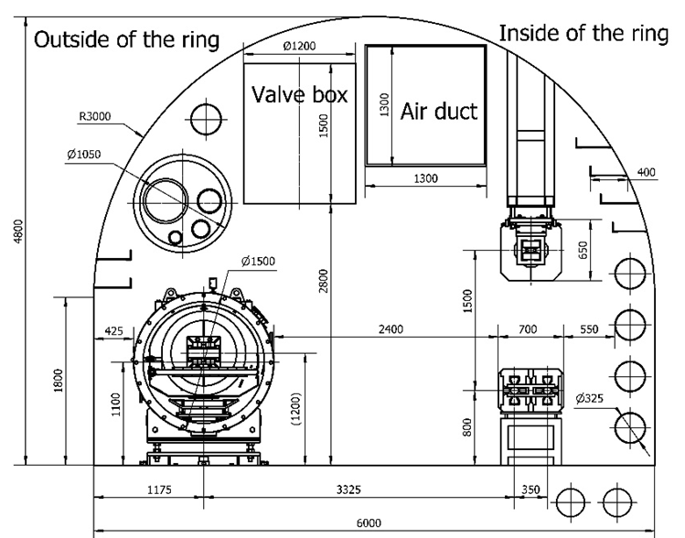
Part 1: CEPC Tunnel Layout Showing Booster Location
Injection Lines

Slide 4
CEPC CDR Parameters showing Main Injection Requirements

Slide 5
FCCee Injector Complex
e+ target
DR

Slide 6
FCCee Collider Parameters (K. Oide, F. Zimmermann …)
Injection
issues

Slide 7
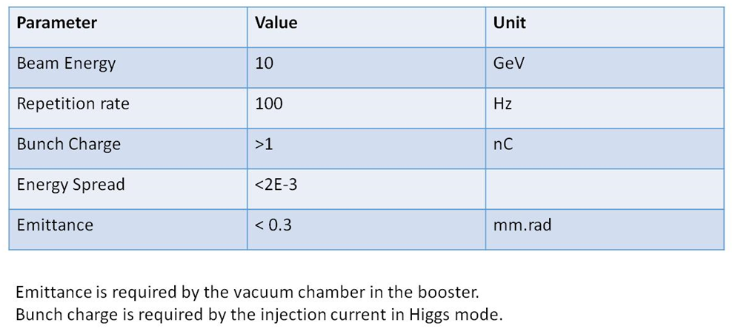
CEPC Injection Requirements (Linac into Booster)

Slide 8
Booster Ring Injector is a Serious Accelerator!
The 100 km booster is a large accelerator with some complicated technologies but overall is mostly conservative.
Issues include :
100 km of complex accelerator components
The booster has more than 2.2 to 10 GeV of SC RF at high power with significant HOMs.
Vacuum chamber issues are modest (SR, eddy currents, heat expansion).
Low field dipole magnet strength (~60 gauss) has issues at 6-10 GeV but fewer at 20 GeV.
Tunnel interferences with collider components (e.g. SCRF, detectors, cryo-distribution)
Potential unintended cross talk to e+e- or pp colliders including radiation.
Beam instabilities at 6-10 GeV could spray radiation on the other accelerators and hardware.
→High cost at 100 km.

Slide 9
Parametric Cost Analysis
The plan is to provide an average parametric cost value for each segment of the injector chain.
The costs are split into “tunnel” and “accelerator” costs.
A cost value per meter were be assigned depending on the difficulty of the technology.
For example, a linac costs more per meter than a transport line. Curved transport more than straight. SC linac is more than Cu.
A linac tunnel cost more per meter than a transport line tunnel because of waveguides, klystrons, and modulators.
When an accelerator shares a tunnel with another accelerator, the main accelerator get the cost of the tunnel and only the incremental costs for the tunnel will be added to the lesser one.
The cost is then calculated by the cost per meter times the length of the accelerator segment.
→ The cost values are only for comparisons of different technologies and do not represent the actual real costs which is more complicated to calculate.

Slide 10
Various 125-175 GeV Injector Types Compared (Parametric)
Base injector at 100 Hz:
(=6 GeV linac+DR+gun+target+injection into the collider rings) (same for all and not included)
Relative parametric cost
Booster (FCCee) (baseline)(175 GeV) 1.0 (Nominal)
Booster (CEPC)(baseline) (125 GeV) 0.9
Full Energy Cu linac (175) 1.2
e- Beam Plasma Wake Field Accelerator PWFA (175) 0.4
e- Beam Dielectric Wake Accelerator DWA (175) 0.38
Laser Wake Field Accelerator LWFA (175) 30.0
e- CLIC (classic) style linac (175) 0.7
Awake (proton driver) PWFA Need ~100 SPSs for 100 Hz rate with 10bpp

Slide 11
Hogan: SLAC Linear Collider Concept in 2014 using PWFA

Slide 12
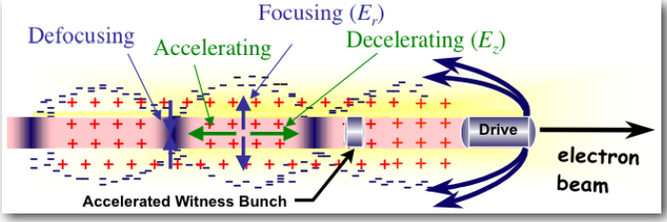
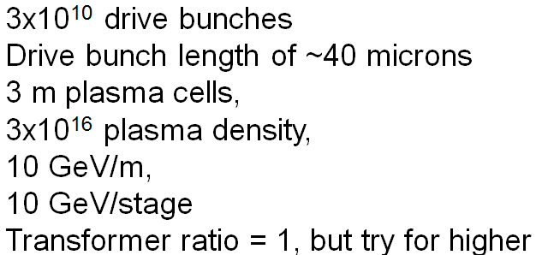
SLAC FACET has accelerated both e- and e+
Electrons
Positrons
(Hollow plasma)
Achieved parameters:

Slide 13
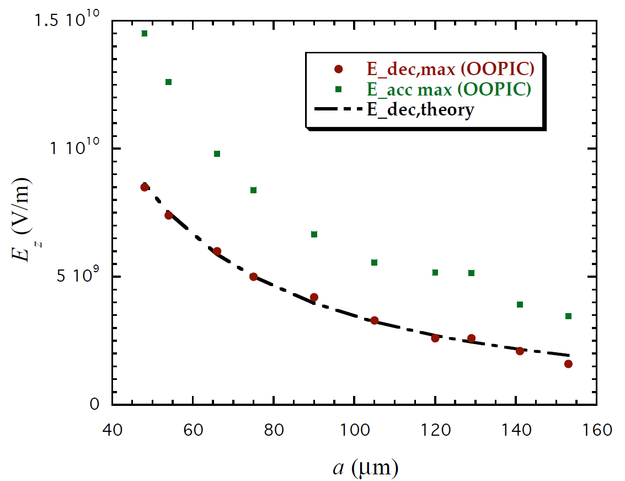
Dielectric Wake Accelerator (O’Shea)
Hollow ceramic tubes with metal outer jacket.
If a= 150 microns and b = 200 microns = 2.8 GeV/m
If a= 225 microns and b = 320= microns = 1.0 GeV/m

Slide 14
DWA Parameters Achieved (~2005)
Need 15 to 30 m long cells to reach 30 GeV gain

Slide 15
PWFA and DWA Injector (Simplified)
Electrons:
Make six bunches longitudinally placed at 30 GeV each from a low emittance gun at a few x 10¹⁰ e- each
1.6 m (5.7 nsec) bunch separation longitudinally
→ One witness (injected bunch per cycle into CEPC/FCCee) and five drive bunches
Positrons:
e+ bunch from the damping ring accelerated to 30 GeV
Make five e- bunches at 30 GeV each a few x 10¹⁰
One e+ witness (injected bunch into CEPC/FCCee) and five drive bunches
Lasers:
Only pre-ionize gas with lasers with no energy put into the beam. (perhaps could do without.)
Acceleration scheme:
Five PWFA or DWA cells at 30 GeV each to reach 180 GeV, per beam

Slide 16
Schematic of Beam PWFA or DWA Injector (Not Optimized)
One Linac makes a witness bunch and several drive bunches (~5) longitudinally and then sequentially use then to accelerate the witness bunch by 30 GeV per PWFA or DWA cells to get to 175 (180) GeV.
Need to longitudinal (phase) slip the drive bunches so that all will catch up with the “witness” bunch that gets accelerated and ultimately injected into one of the main rings.
Need longitudinal distance slips of 1.0 m to 1.5 m (bunch spacing) which is about the distance between acceptable, with reduced transverse wakes, linac buckets.
Δz = θ * Δr
for example Δz = 1 m and Δr = 1 m→ θ = 1 rad
Option 1: Do the phase slipping in the CEPC/FCCee main ring tunnel: then Δz ~ 16,000 m. Way too long!
Option 2: Do the phase slipping in a separate tunnel ρ = 280 m (like SLAC SLC),
= π for Δr = 0.5 m gives Δz = 1.57 m , Length ~ 879 m. Perfect!
Emittance growth at 30 GeV is small with SLC style lattice.

Slide 17
PWFA or DWA Overview
1.4 km
Main FCCee Ring Straights
175 GeV e-
175 GeV e+
Plasma cells or DWA cells
280 m radius
~500 m
6 total arcs
0.5 m apart
6 total arcs
0.5m apart
…
…
e- arcs
e+ and e- drive arcs
e+ one bunch
e- 5 bunches
e- 6 bunches
Bunch
compress
in arcs.
Kicker is a linear ramp.
Linac (30 GeV)

Slide 18
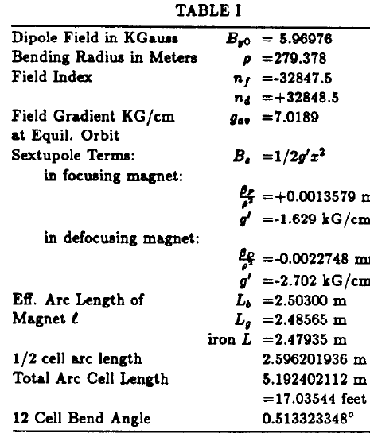
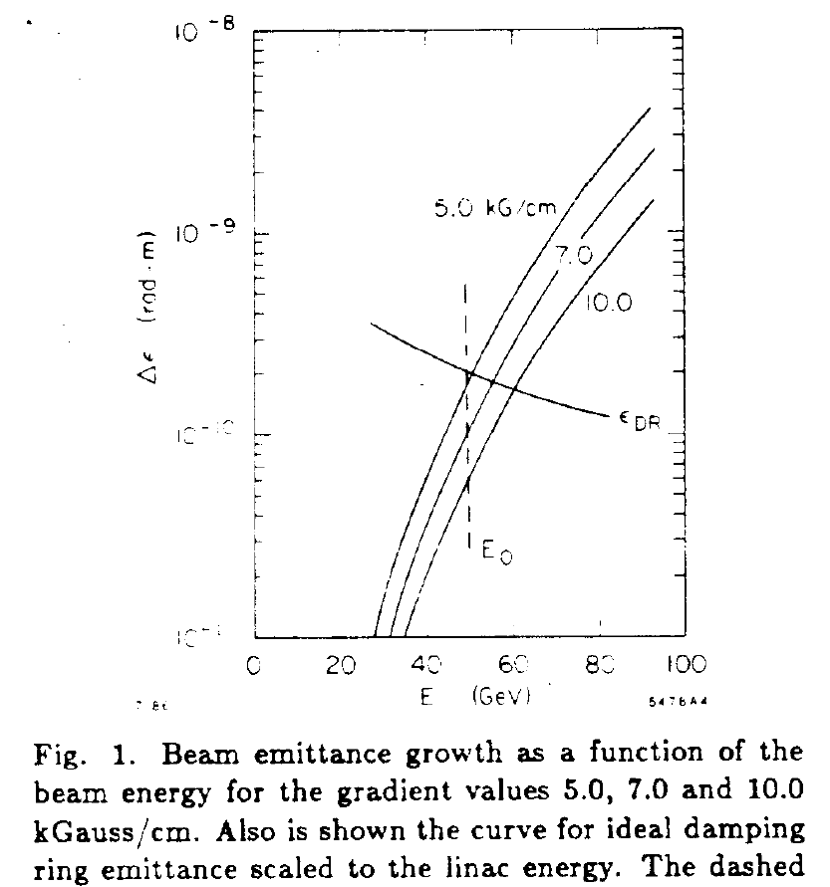
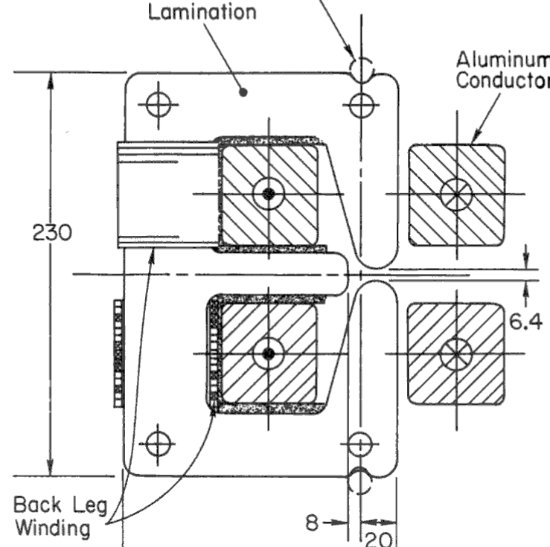
Design very similar to the SLAC SLC Arcs (1988-1998)
280 m radius
Beam

Slide 19
SLAC SLC Arc Installation

Slide 20
Optimum Number of Arcs (Bunches)
E_{f} = E₀ + n ΔE_{c}
E_{f} = final energy = 175 to 180 GeV
E₀ = linac energy
ΔE_{c} = PWFA cell incremental energy
n = number of PWFA cells
n+1 = number of arc transport lines (each side)
E₀ (GeV) (Linac) | n | ΔΕ_{c} (GeV) (PWFA)
44 | 3 | 44
35 | 4 | 35
30 | 5 | 30
25 | 6 | 25
22 | 7 | 22

Slide 21
Accelerating Cells
For PWFA length:
3x10¹⁶ plasma density, 3 m long → 30 GeV each
For DWA:
If a= 200 microns (radius) and b = 300= microns = 1.0 GeV/m →30 m → 30 GeV (It will be shorter if smaller diameter.)
Advantage: Beam sees no direct material.

Slide 22
Rough Hardware of a PWFA/DWFA Injector
Need more Cu linac over base linac = 24 GeV (30-6 GeV):
Need to build 12 transport lines (six per side): 12 lines x 1100 m/line =13 km
Need to build 10 Plasma or DWA cells (5 per side)

Slide 23
What is Next for [CEPC/FCCee] Injector Design using PWFA or DWA
Optimize number of cells.
Linac parameters to make 6 (or n) good bunches.
Bunch length manipulation.
Define arc layout.
Define optics entering and leaving the plasma and dielectric cells.
Beam tolerances in transport and accelerating cells.

Slide 24
An Aside: Why a PWFA or DWA Injector?
Large overall cost savings are expected for CEPC/FCCee if this injector works!
However, the big view:
Jumping into a full 1 TeV scale linear collider using PWFA or DWA is a very big step from the present status. Many technologies have to work. Need to prove the basic technologies are viable and reliable.
A 125-175 injector for CEPC/FCCee with less stringent parameters would be an excellent first step. Most of the technologies will then be proven for a high energy linac collider.
First→ Test at FACET-II!

Slide 25
(New) Proposed Beam Test of a two stage PWFA (+DWA) at SLAC
First:
Complete FACET-II.
Next:
Add a two stage PWFA (and/or DWA) experiment modules.
Try for 30 GeV result starting from 10 GeV bunches at 30 Hz.
Plan:
Make two e- bunches (both with 3 x 10¹⁰) in the linac spaced 5.7 nsec (1.76 m) apart.
First bunch self accelerates its tail (witness) in first plasma cell (few x 10⁹) from 10 to 20 GeV.
Second bunch accelerates the same witness bunch to 30 GeV in second plasma cell.
Measure properties of 30 GeV final witness beam.

Slide 26
Goal: Test Beam Parameters similar to CEPC/FCCee
Two PWFA or DWA stages: 10GeV start + 2 x 10GeV cells = 30 GeV (final)
Goal for output beam parameters (needed for CEPC/FCCee):
30 Hz
30 GeV
Charge per exiting bunch ~ 6 x 10⁹
Charge stability < 2%
Bunch length < 2 mm
Energy spread rms < 0.5 %
Emittance (x,y) < 10 nm-rad
Energy stability < 1 %
Transformer ratio =1.0+

Slide 27
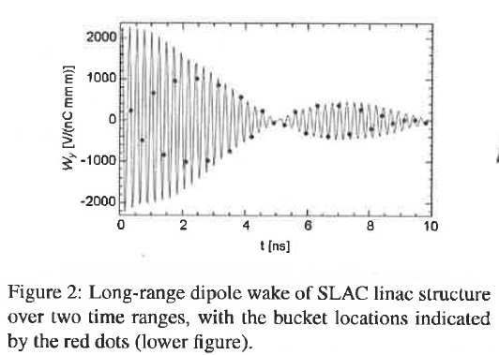
Transverse wakes in SLAC Cu linac for the two bunches
Longitudinal:
The longitudinal wakes are compensated by running the bunches in the Cu linac slightly off crest in the SLED pulse as was done in the SLC. Besides, if the three bunches have somewhat different energies in Sector 20 they can be compensated by adjusting the three transport lines. Different energies may help with transverse wakes.
Tranverse:
Karl Bane has calculated the transverse wakes following a leading bunch. SLAC-PUB-14608 (Dec. 2011). Concluded that 5 nsec spacing is the best. 2.5 nsec worst.
Decker and Sheppard have been studying transverse wakes with two LCLS bunches at 150 pC. Concluded that with carefully adjusted linac transverse bumps, the linac transverse bunches can be compensated with any bunch spacing at 150 pC. (Similar to what Seeman and Decker did for the SLC in ~1990.)
If these do not work then fall back to only 2 drive bunches spaced by 5 nsec or reduce bunch charges.
Plotted (early) path difference is 1.76 m which is 5.86 nsec. → Good distance.

Slide 28
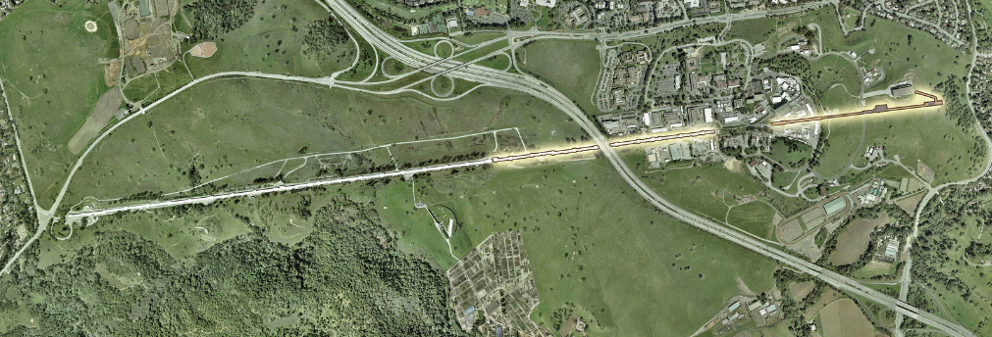
Rough Layout of SLAC Linac showing FACET-II Area
PWFA-DWA test will happen here, if approved.
FACET-II

Slide 29
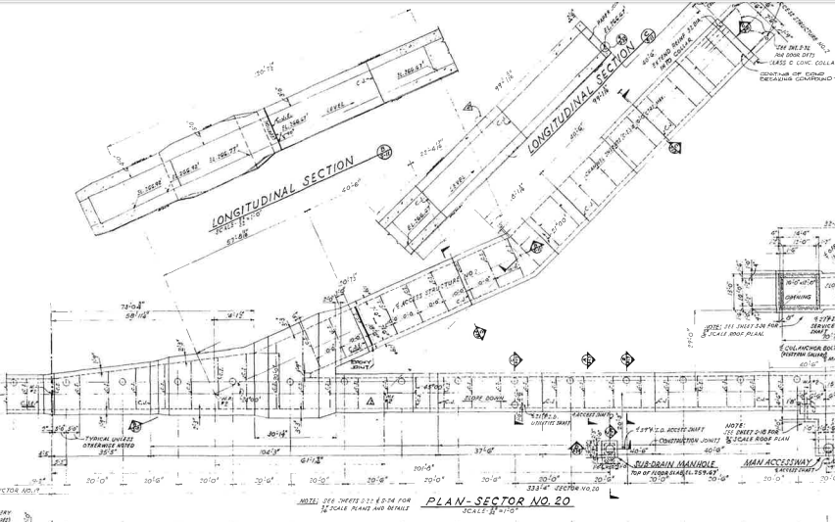
Schematic horizontal trajectories of two bunches (plan view)
1 = linac straight beam
2 = second bunch
= plasma cell
Plasma cell
A
B
FACET Final Focus
2
1
Plasma cell

Slide 30
Six present beam lines in Sector 20 at “A”

Slide 31
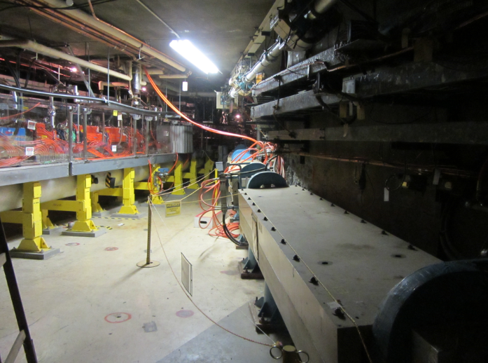
Sector 20 Adit in the tunnel at “B”
FACET-II
Extraction line to positron source

Slide 32
MATLAB: Exact FACET Area including Two Beam Lines
Diagnostics
Path difference in code = 1.76 m
ΔL₁₂ can be adjusted precisely by
component placement.

Slide 33
One kicker will change trajectories of second drive bunch
5.7 nsec
Kicker for trailing bunch
Present kicker has ~25 nsec rise time.

Slide 34
2 nsec Fast kicker (A. Krasnykh et al, SLAC)

Slide 35
SLAC FACET-II PWFA/DWA Test: Future work if approved:
PWFA:
Find the optimum plasma cell parameters.
Arrange plasma/drive parameters to make small witness energy spread.
Beams:
Fine tune beam lines 1 and 2 for paths to the correct length to about 10
microns and be able to tune to these values.
Make beam optics for all beam line transitions to and from plasma cells.
Determine if dipole bends (use segments of SLC arc magnets) can preserve emittances
Investigate tolerance in beam transport (SR, CSR, …)
Work out drive beam dumps.
Work out the longitudinal beam loading and linac RF phases in the Cu
linac.
Plasma cell parameters
See if linac bumps can fix transverse wakes in Cu linac at 5.6 nsec.
Can the FACET-II gun make two 2-4 x 10¹⁰ bunches?
Make a full scale 4 nsec rise time fast kicker.

Slide 36
Thanks for your attention
Inputs from:
K. Bane, J. Sheppard, F-J. Decker (SLAC linac wakes)
X. Cui (CEPC Injection)
W. Chou, J. Gao (CEPC)
M. Hogan (PWFA)
S. Ogur, K. Oide, F. Zimmermann (FCC, injection, costs)
B. O’Shea (DWFA)

