Slide 1
CEPC Injection
Cui Xiaohao, Bian Tianjian, Zhang Chuang
2017/11/07

Slide 2
Contents
1. Injection Systems
2. requirement
3. Injection Process
4. Summary

Slide 3
1. Injection Systems
10 GeV
Linac
Transport line
From Linac
To booster
100 km booster
10 GeV -> 120 GeV
Transport line
From booster
To collider
Booster Dipole field at low energy is only 30 Gauss, Low field Magnet R&D is needed

Slide 4
Geometrical Arrangement
Linac on the ground level
Booster and collider in the same tunnel about 100 m deep
Booster is 1.5 m above the collider
Booster
1.5 m
Collider

Slide 5
Transport lines: Linac to booster
Guiding the beam from Linac to the booster
Beam Energy: 10 GeV
Beam emittance: 300 nm.rad
horizontal bending section and one vertical bending section
Vertical bending section matches the 100m height
Efficiency: > 99%
Linac
Separation
Vertical slope
Horizontal bending
Geometry of the Transport line

Slide 6
Transport lines: booster to collider
Guiding the beam from the booster to collider ring
Beam Energy: 120/80/45 GeV
Beam emittance: 3.1/1.56/0.51 nm.rad
horizontal bending section and one vertical bending section
Vertical bending section matches the 1.5 m height
Efficiency: > 99%
Horizontal Extraction
Vertical Slope
Horizontal Injection
Geometry of the Transport line

Slide 7
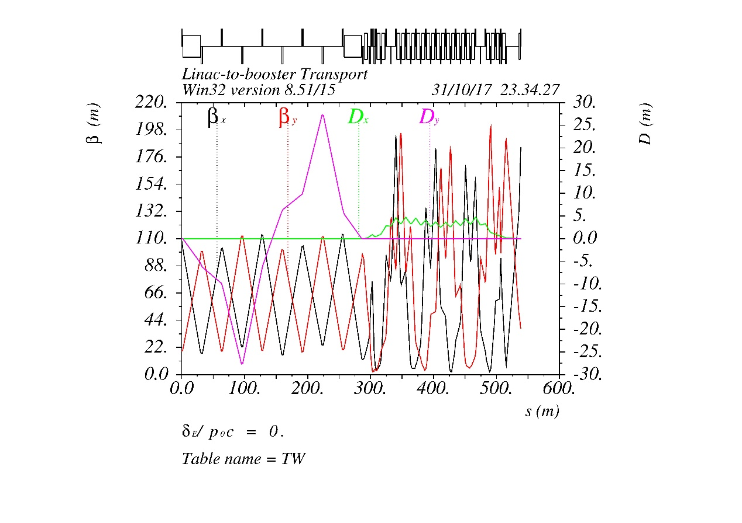
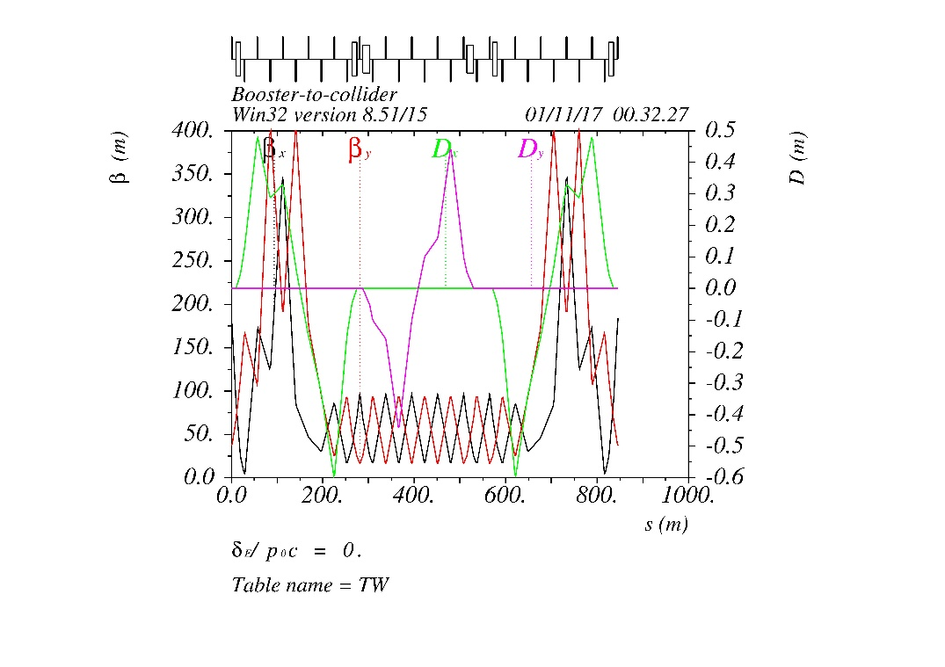
Machine Functions of Two Transport lines

Slide 8
2. requirement
Some parameters of the Collider ring
 | Higgs | W | Z
Energy | 120 | 80 | 45.5
Bunch number | 286 | 5220 | 10900
Beam current (mA) | 17.7 | 90.3 | 83.8
Collider Lifetime | 20 min | 3.5 Hr | 7.4 Hr
3% decay time (sec) | 37 | 383 | 811
3% current (mA) | 0.531 | 2.709 | 2.514
Due to the short lifetime, a Top-up injection is needed and the injection time must be less than that listed above.

Slide 9
Booster current
The current in the booster is limited by the instabilities. For aluminium vacuum chamber, the TMCI current threshold is 0.803 mA. In W, and Z mode, It takes the booster 5 cycles to fill all bunches.

Slide 10
Acceptance
For booster injection: the beam emittance from linac is 300 nm.rad in both x, and y direction. The booster physical aperture is 3 sigma + 5mm.
For collider injection: the beam emittance from booster is 3.1 nm.rad in x, and 1% coupling. The collider dynamic aperture is more than 16 sigma in x, and 6 sigma in y for higgs injection.

Slide 11
Beam parameters from Linac
Parameter | Value | Unit
Beam Energy | 10 | GeV
Repetition rate | 100 | Hz
Bunch Charge | >1 | nC
Energy Spread | <2E-3
Emittance | < 0.3 | mm.rad
Emittance is required by the vacuum chamber in the booster.
Bunch charge is required by the injection current in Higgs mode.

Slide 12
Beam parameters from booster
Parameter | H | W | Z | Unit
Bunch Charge | 0.62 | 0.18 | 0.077 | nC
Ramping Cycle | 10 | 6 | 2 | s
Beam Current | 0.532 | 0.542 | 0.504 | mA
Emittance x | 3.1 | 1.56 | 0.51 | nm.rad
Energy Spread | 0.0966 | 0.064 | 0.037 | %
Efficiency | 92 %

Slide 13
3. Injection process
Injection from Linac to booster
Booster ramping to High Energy
repeat
Booster ramping to Low Energy
Inject from booster to collider

Slide 14
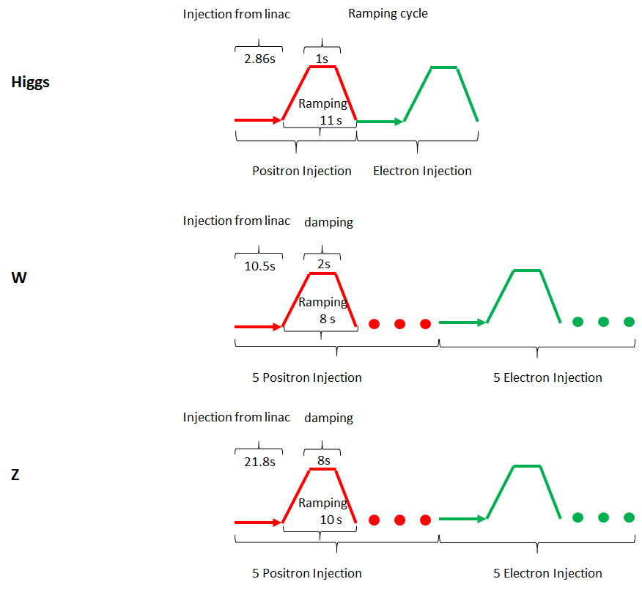
Injection Time Structure:
In W, and Z mode, It takes the booster 5 cycles to fill all bunches
For Z injection, the booster needs 8s at the high energy for beam damping.

Slide 15
Booster injection and Extraction:
X’
Injected beam
Septum
Injecting beam
On axis injection
One septum and one kicker is needed
Extraction is just the oppsite
X

Slide 16
Kickers and Septums:
Booster Injection
Component | Length (m) | Waveform | Deflection angle (mrad) | Field (T) | Beam-Stay-clear
 |  |  |  |  | H(mm) | V(mm)
Septum | 2 | DC | 9.1 | 0.152 | 63 | 63
Kicker | 0.5 | Half_sin | 0.5 | 0.034 | 63 | 63
Booster Extraction
Component | Length (m) | Waveform | Deflection angle (mrad) | Field (T) | Beam-Stay-clear
 |  |  |  |  | H(mm) | V(mm)
Septum | 10 | DC | 10.4 | 0.41 | 20 | 20
Kicker | 2 | Half_sin | 0.2 | 0.04 | 20 | 20

Slide 17
Collider Injection:
X’
Bumped
Stored beam
Septum
2mm
Injected beam
For Higgs:
ε_x = 1.21 nm.rad; ε_inject = 3.1 nm.rad
σx = 0.47 mm, σ_inject = 0.45 mm
Septum = 2 mm
Acceptance > 16 σ
X
For Z:
ε_x = 0.17 nm.rad; ε_inject = 0.51 nm.rad
σx = 0.18 mm, σ_inject = 0.16 mm
Septum = 2 mm
Acceptance > 23 σ
Bump Height
Acceptance >4σ_{xc} + 8σ_{xi} + S

Slide 18
Injection Simulation:
Performed simulations of the injected beam dynamics
Beam distribution in X-X’ phase-space is tracked after injection
Blue distribution: Beam before injection
Green distribution: Beam of the first 10 turns after injection
Dotted line is the acceptance

Slide 19
Kickers and Septums:
Kicker strength
Bump height 20mm,kicker length 2m,then the strength of the kickers are about 200 Gauss
Septum strength
If the Septum is 35m, the strength needed is much higher.
As a result, we tried to use 4 separate septum instead of a single one.
Their magnet strength are: 0.64T, 0.32T, 0.16T, 0.08T and their thickness are 16mm,8mm,4mm,2mm separately.

Slide 20
Booster parameters and filling time
Mode | Higgs | W | Z
Injection Energy (GeV) | 120 | 80 | 45.5
Bunch number | 286 | 1044 | 2180
Bunch Charge (nC) | 0.62 | 0.173 | 0.077
Beam Current (mA) | 0.532 | 0.542 | 0.504
Current threshold due to TMCI | 0.803 | 0.803 | 0.803
Number of Cycles | 1 | 5 | 5
Current decay | 3% | 3% | 3%
Ramping Cycle (sec) | 10 | 6 | 2
Filling time (sec) | 28 | 185 | 318
Injection frequency (sec) | 37 | 383 | 811

Slide 21
4. Summary
A baseline design of the injection systems of CEPC is presented in this talk
The total transmission efficiency of the system is larger than 90% (99%*92%*99%)
It satisfies the Top-Up injection requirements for both Higgs, W, and Z mode.
It also has the ability to fill the collider from empty in a reasonable time.

Slide 22
Thank you!

