Slide 1
SPPC CDR - Status
Jingyu Tang
for the SPPC study group
International Workshop on CEPC, Nov. 6-8, 2017, IHEP

Slide 2
Main topics
About the SPPC CDR study
Collider accelerator physics
Technical issues
Design concepts on the injector chain
Plan for CDR writing
Summary

Slide 3
From CEPC to SPPC
SPPC is the second phase of the project, differing by 10-15 years
Use the same CEPC tunnel to build SPPC, exploring new physics beyond SM and also precision Higgs
Center-of-Mass energy larger than 70 TeV with possible energy upgrade
Keep the e-/e+ rings when adding the SPPC
Collisions possible: pp, e-/e+, ep, pA, eA, AA
Build a new injector chain for SPPC (proton and ions)
Independent physics programs for the accelerators of the injector chain

Slide 4
SPPC main parameters (updated)
Parameter | Unit | Value
 |  | PreCDR | CDR | Ultimate
Circumference | km | 54.4 | 100 | 100
C.M. energy | TeV | 70.6 | 75 | 125-150
Dipole field | T | 20 | 12 | 20-24
Injection energy | TeV | 2.1 | 2.1 | 4.2
Number of IPs |  | 2 | 2 | 2
Nominal luminosity per IP | cm⁻²s⁻¹ | 1.2e35 | 1.0e35 | -
Beta function at collision | m | 0.75 | 0.75 | -
Circulating beam current | A | 1.0 | 0.7 | -
Bunch separation | ns | 25 | 25 | -
Bunch population |  | 2.0e11 | 1.5e11 | -
SR power per beam | MW | 2.1 | 1.1 | -
SR heat load per aperture @arc | W/m | 45 | 13 | -

Slide 5
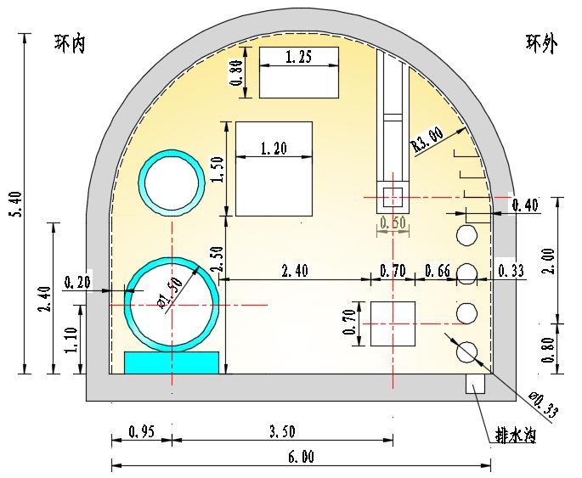
Tunnel cross-section
More space required for CEPC double-ring scheme

Slide 6
CDR Study objectives
SPPC study is focusing on
Describing what a future proton-proton collider looks like, physics performance
Following the CEPC project, try to avoid what will hinder the future upgrading to SPPC, e.g. tunnel circumference and layout
Studying key accelerator physics issues of that scale accelerators, which is also a contribution to the accelerator community, e.g. collimation, beam-beam effects
Identifying key technical challenges, for some of them needing long-term R&D efforts, we should start them as early as possible, e.g. high-field superconducting magnets, beam screen

Slide 7
Considerations on layout
Layout consideration
8 arcs and long straight sections (accepted by CEPC)
Arcs will be traditional FODO based, 6-8 long SC dipoles per half cell, missing dipoles for dispersion suppression
Long straight sections (LSS) are important for pp colliders, here, two IPs, injection, extraction, collimation and RF stations
[Two very long LSSs for collimation and extraction
Perhaps one IP more for A-A and one for e-p]
Detouring detectors: quite challenging, CEPC rings and ee detectors to bypass the SPPC rings and pp detectors, how about AA and ep detectors

Slide 8
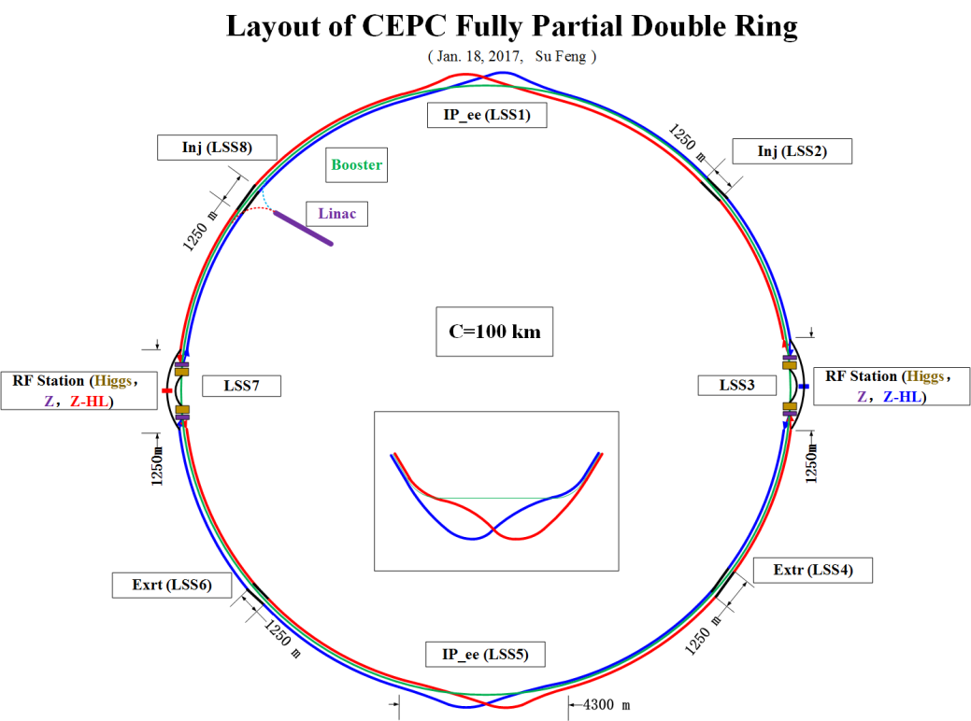
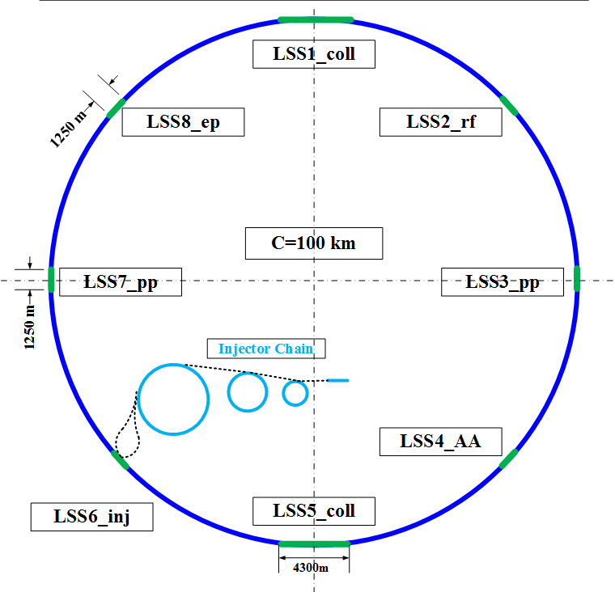
Compatibility between CEPC and SPPC
CEPC first to be built, with potential to add SPPC later
Three machines in one tunnel: e booster, ee double-ring collider, pp double-ring collider
Allow ep collision in the future, to solve the problem in circumference difference (CEPC outside of SPPC)
Layout: 8 long straights and arcs, LHC-like DS lattice, lengths for LSSs
Several rounds of interactions between CEPC and SPPC design teams, tbc
CEPC double-ring layout- 100km
SPPC layout- 100km

Slide 9
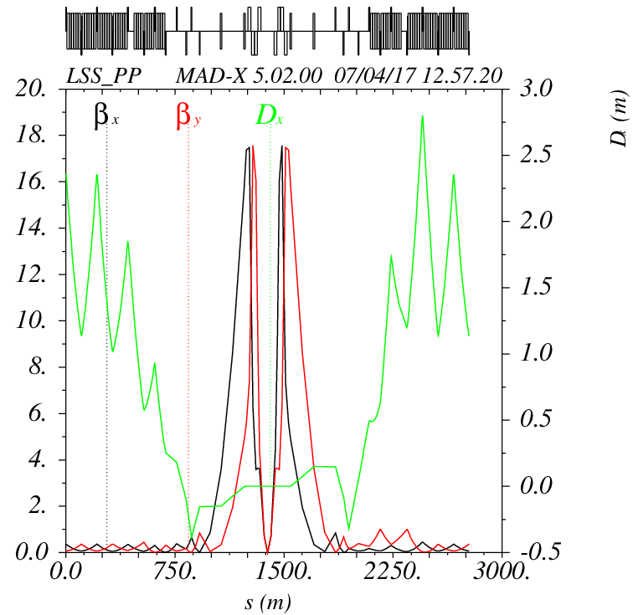
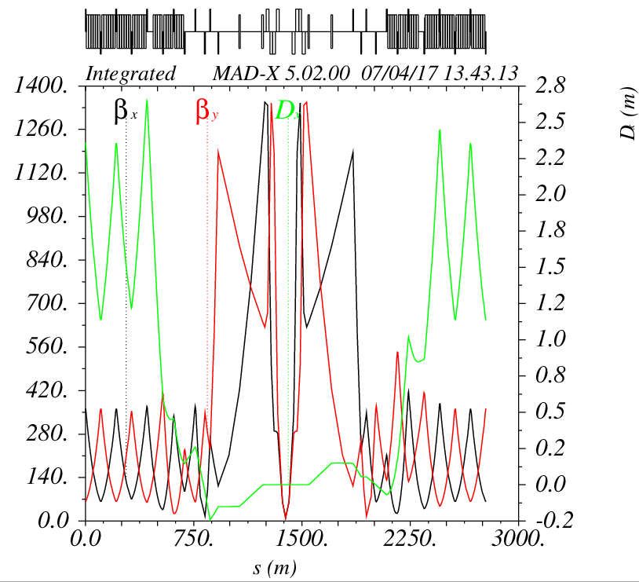
Lattice design
Yukai Chen, Feng Su, Linhao Zhang
Different lattice designs
Different schemes (100 TeV and 75 TeV @100 km)
Lattice at injection and collision
Compatibility between CEPC and SPPC
Arc cells, Dispersion suppressors, insertions
For supporting other studies, e.g. magnets, collimation, dynamic aperture, …
IP: at collision
IP: at injection
Details by Y.K. Chen on SPPC IV

Slide 10
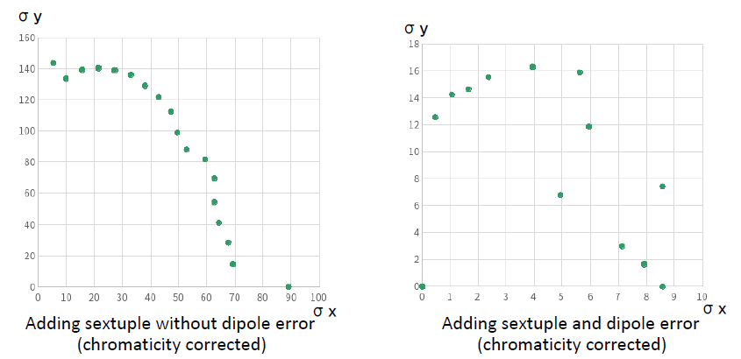
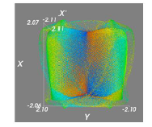
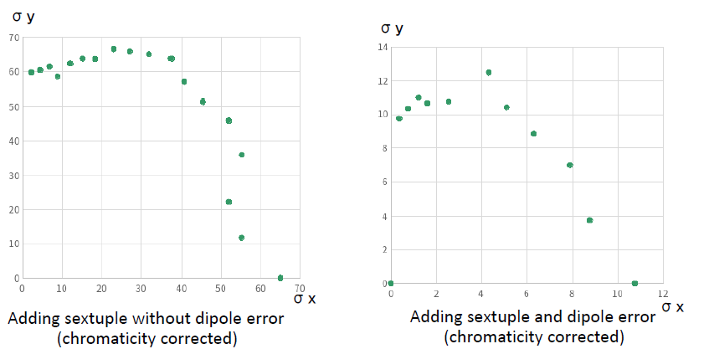
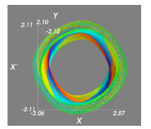
Dynamic aperture study
Yukai Chen, Feng Su, collaborating with F. Schmidt
At collision energy
At injection energy
(Sixtrack code)
For the moment, it is ok, with iterations with magnet design

Slide 11
Longitudinal beam dynamics
Concerns:
Bunch filling schemes
Luminosity leveling schemes
Instabilities
Requirement to the RF systems
Global study with the injector accelerators
Different factors:
IBS effect
Emittance control (shrinking and blow-up)
Bunch preparation in the injector chain
Linhao Zhang
@Injection
@Extraction
Limitation by Transverse Mode Coupling Instability
Details by L.H. Zhang on SPPC IV

Slide 12
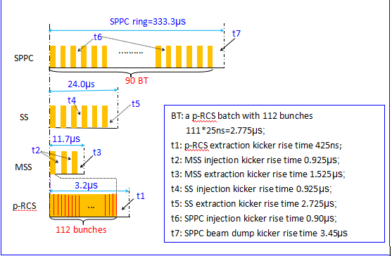
Bunch filling schemes
100 km - 75 TeV -25 ns (also for different SPPC designs)
Bunching filling factor: ~76%

Slide 13
Beam-beam effects
Lijiao Wang, collaborating with K. Ohmi and T. Sen
Beam-beam effect has direct impact to the luminosity
Studying different effects (ongoing)
Head-on interaction
Long-range interaction
Pacman effects
Orbit effects
Coherent beam effects
BB compensation methods (Electron lens, Compensation wires)
New results will be presented by K. Ohmi on SPPC IV

Slide 14
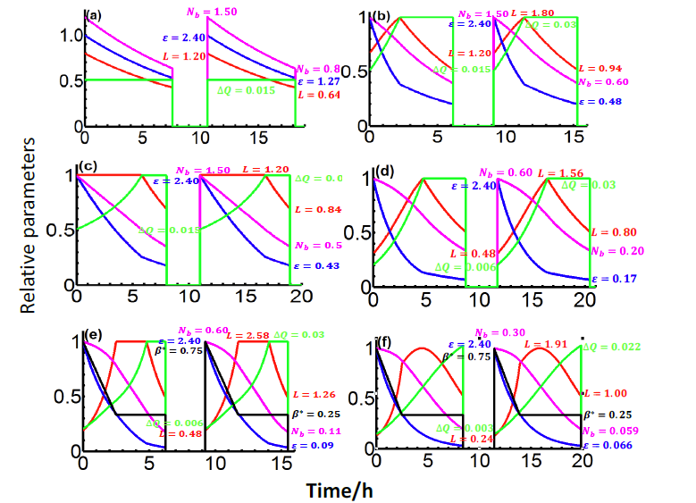
Luminosity Leveling
Increasing the average luminosity by programing the beam collision scenario (controlled emittance shrinking, turnaround time, beta*, B-B parameter, bunch spacing)
Turnaround:
0.8 hrs (min),
2.4 hrs (ave)
ΔQ: 0.03 (max)
Spacing:
25, 10, 5 ns
Beta*:
0.75 m
0.75->0.25m

Slide 15
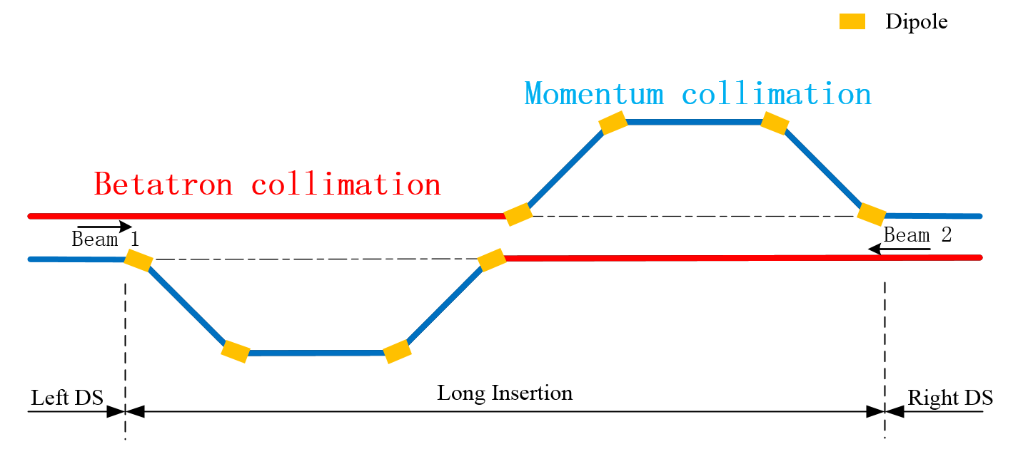
Goals
Collimation study
Ye Zou, Jianquan Yang, collaborating with LAL and LHC
Requirements
SC magnet quench prevention:
Halo particles cleaning
Machine protection: prevent damaging radiation-sensitive devices
Radiation losses concentration: hands-on maintenance
Cleaning physics debris: collision products
Optimizing background: in the experiments
halo diagnostics
Huge stored energy: 9.1 GJ/beam
$${\tilde{η}}_{c}=\frac{τ_{min}·R_{q}}{N_{tot}^{q}}$$
Rq: ~10⁶ protons/m/s
$N_{tot}^{q}$： 1.5×10¹⁵
$τ_{min}$： 0.2 h (10s) /5 h
$${\tilde{η}}_{c}<4.5\text{×}\text{10}\text{−7 }\text{m}\text{−1}$$
Details by J.Q. Yang on SPPC IV

Slide 16
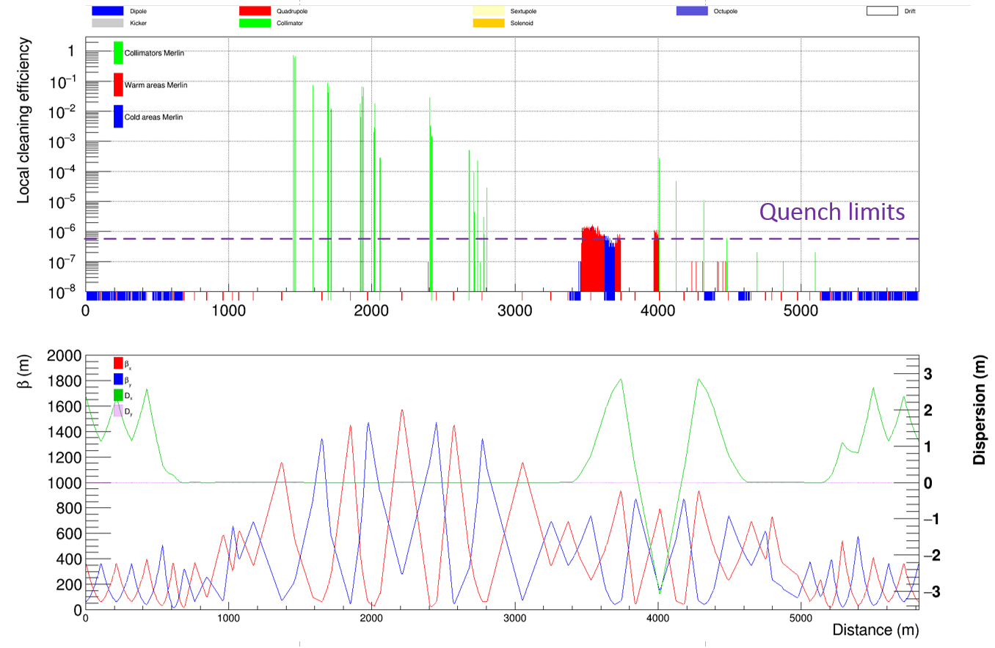
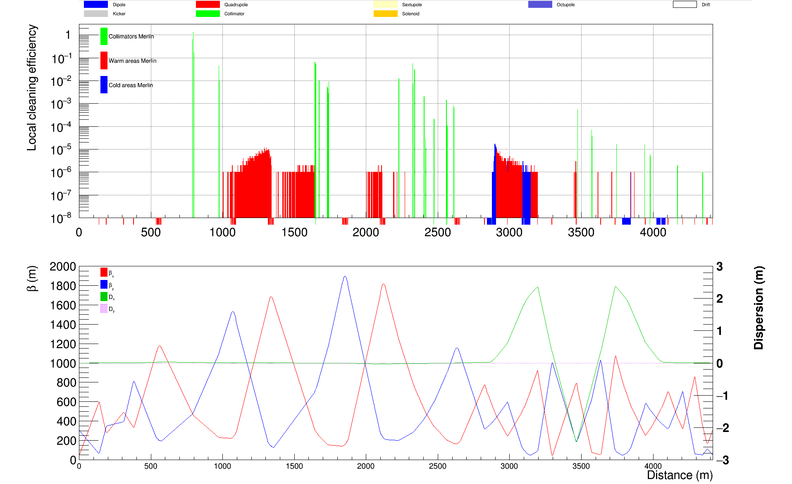
Further developing the concept of combining betatron and momentum collimations in a same long straight section (4.3km)
Recently a new design for the transverse collimation section, by introducing protected large-aperture superconducting magnets and add an additional collimation stage
Simulations show good effect in collimation efficiency
Protection-aid low-field SC quadrupoles workable
With RT magnets in beta-collimation
With SC magnets in beta-collimation

Slide 17
Other undergoing studies
Instabilities: Liu Yudong continues to work on different instabilities, especially EC effects
Injection/extraction: Yang Ye and Li Guangrui continues to work on the topic

Slide 18
Technical challenges and R&D requirements -High field SC magnets
Following the new SPPC design scope
Phase I: 12 T, all-HTS (iron-based conductors)
Phase II: 20-24 T, all-HTS
New magnet design for 12-T dipoles
R&D effort in 2016-2018
Cables, infrastructure
Development of a 12-T Nb3Sn-based twin-aperture magnets (alone, with NbTi, with HTS)
Collaboration
Domestic collaboration frame on HTS (material and applications) formed in October 2016
CERN-IHEP collaboration on HiLumi LHC magnets
Details by Q.J. Xu in plenary and also on SPPC II

Slide 19
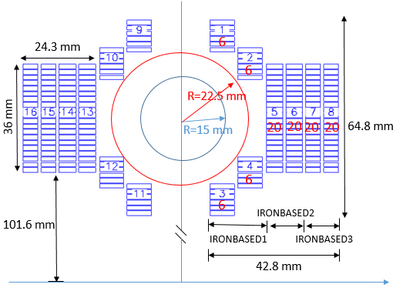
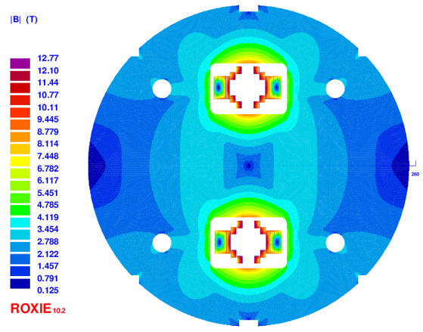
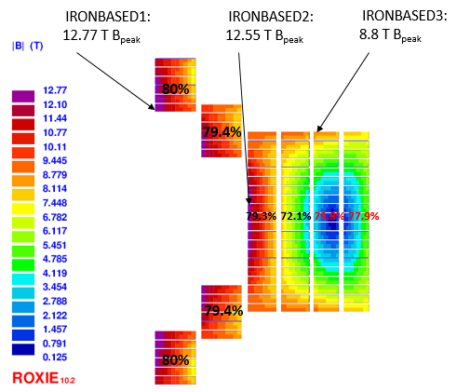
Design of 12-T Fe-based Dipole Magnet
C. Wang, E. Kong (USTC), Q. Xu et al.
Yoke OD
500mm
Table 1: Main parameters of the cables
Cable | Hight | Width-i | Width-o | Ns | Strand | Filament | Insulation
IRONBASED1 | 8 | 1.5 | 1.5 | 20 | IRON-BASED | FE-BASED | 0.15
IRONBASED2 | 5.6 | 1.5 | 1.5 | 14 | IRON-BASED | FE-BASED | 0.15
IRONBASED3 | 5 | 1.5 | 1.5 | 12 | IRON-BASED | FE-BASED | 0.15
Table 2: Main parameters of the strand
Strand | diam. | cu/sc | RRR | Tref | Bref | Jc@ BrTr | dJc/dB
IRON-BASED | 0.802 | 1 | 200 | 4.2 | 10 | 4000 | 111
For per meter of such magnet, the required length of the iron-based strand: 6.08 Km

Slide 20
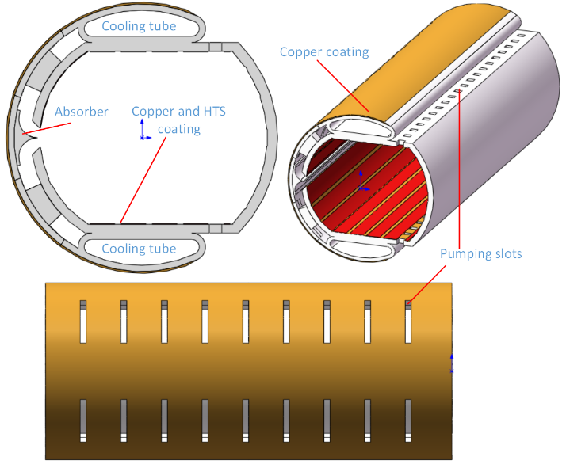
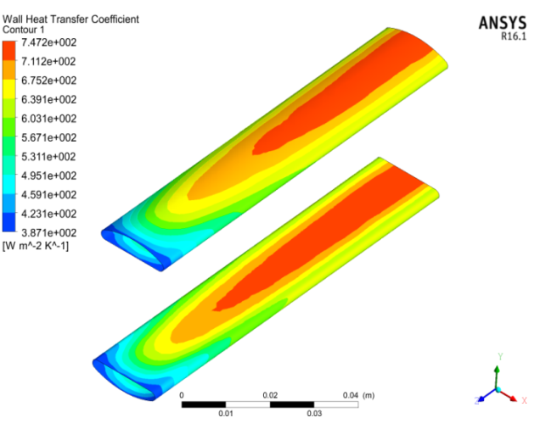
Beam screen study
Details by K. Zhu on SPPC III
Kun Zhu, Pingping Gan
With the new design scope, SR power decreases from 45 W/m to 12.8 W/m, but still very important, and beam screen still a critical issue
Different effects combined: impedance, electron cloud, vacuum, magnet quenches, cooling etc.
Recent work focused on: structure, HTS coating, working temperature, impedance, cooling method

Slide 21
Other important technical challenges
Collimation system: new materials to reduce impedance and tolerate more heat deposit
Very large scale cryogenics system: SC magnets, SRF, beam screens
Sophisticated beam feedback system: to control the emittance heat-up and suppress beam instabilities
Machine protection system: fast detection of abnormal function, reliable beam abort (kickers and septa)
There are also many technical challenges in building high-power injector chain: e.g. RF systems for p-RCS and MSS, fast ramping for SS

Slide 22
Injector chain (for proton beam)
Details by Y.R. Lu on SPPC III
p-Linac: proton superconducting linac
p-RCS: proton rapid cycling synchrotron
MSS: Medium-Stage Synchrotron
SS: Super Synchrotron
Ion beams have dedicated linac (I-Linac) and RCS (I-RCS)

Slide 23
Preliminary design of the injector chain
Accelerator schemes and parameter lists
Preparation of the beam for injection into SPPC: energy, intensity, emittance, bunch pattern, turnaround time
Maximize the performance with modest cost for each accelerator (different settings from service to SPPC)
Pre-conceptual design on each stage:
p-Linac/i-Linac: Yuanrong Lu, Haifeng Li (RFQ, DTL, SC cavities)
p-RCS/i-RCS: Linhao Zhang, Jingyu Tang (parameter design)
MSS: Yang Hong (parameter design, lattice)
SS: Xiangqi Wang, Tao Liu (parameters, lattice, injection/extraction, acceleration)

Slide 24
Major parameters for the injector chain
 | Value | Unit |  | Value | Unit
p-Linac |  |  | MSS
Energy | 1.2 | GeV | Energy | 180 | GeV
Average current | 1.4 | mA | Average current | 20 | uA
Length | ~300 | m | Circumference | 3500 | m
RF frequency | 325/650 | MHz | RF frequency | 40 | MHz
Repetition rate | 50 | Hz | Repetition rate | 0.5 | Hz
Beam power | 1.6 | MW | Beam power | 3.7 | MW
p-RCS |  |  | SS
Energy | 10 | GeV | Energy | 2.1 | TeV
Average current | 0.34 | mA | Accum. protons | 1.0E14
Circumference | 970 | m | Circumference | 7200 | m
RF frequency | 36-40 | MHz | RF frequency | 200 | MHz
Repetition rate | 25 | Hz | Repetition period | 30 | s
Beam power | 3.4 | MW | Protons per bunch | 1.5E11
 |  |  | Dipole field | 8.3 | T

Slide 25
More about the Injector Chain
Injector chain by itself is a very complicated and powerful accelerator system, large enough by a single stage
Totally new, different from LHC or Tevatron (building-up by steps)
No close reference accelerators (scaled up by large factors)
Should be built earlier than SPPC by a few years to allow relatively long-time commissioning stage by stage
Rich physics programs for each stage, e.g.:
p-Linac: producing intense neutrons and muons and rare isotopes for wide research areas
p-RCS and MSS: producing very powerful neutrino beams for neutrino oscillation experiments
Key technical challenges should be identified, so needed R&D program can be pursued (e.g. high-Q ferrite-loaded RF cavities)

Slide 26
Plan on the SPPC chapter in the CDR
Subsection material preparation assignment: November 2017
Material collection will be finished by December 2017 (Jingyu Tang)
First version to the editor: mid-January 2018
Second version to the editor : end-January 2018
Final version to the editor: mid-February

Slide 27
Summary
SPPC - the second phase of CEPC-SPPC, a pre-conceptual design for a 75-TeV pp collider is ongoing, to explore new physics in energy frontier
SPPC will provide wide physics programs, including the collider and the beams from the injector accelerators
Study focusing on a few key accelerator physics issues: lattice, collimation, b-b effects, longitudinal dynamics, instabilities, injection/extraction
Identifying technical challenges to be solved in the next two decades, besides high-field SC magnets and beam screen
Pre-conceptual study on the injector chain is also under way
SPPC chapter writing in the CDR is in progress, first version in January 2018

Slide 28
Thank you for attention!

