Slide 1
Steady State Analysis for the Beam Loading Transient Stability in the Storage Ring RF System
Haipeng Wang
Robert Rimmer, Shaoheng Wang and Jiquan Guo
Thomas Jefferson Lab, Newport News Virginia, USA

Slide 2
Abstract and Outline
The beam aborting, ion clearing gaps or uneven filling bunch train can cause large beam phase transients in the RF cavity control systems such transient can cause luminosity loss for the colliders like EICs (JLEIC or eRHIC) CEPC SppC. Severity of such transient can even cause the beam loss due to the Robinson instability
We have first analyzed the beam stability criteria in the steady state and estimated the transient effects in the Feedback RF controls with a given klystron overhead power
This analytical model combing with other instability criteria has been applied to the RF system design parameters for the JLEIC e-ring, CEPC
Robinson instability analysis for existing storage rings like BECP-II, PEP-II and ALS will be discussed
Beam transient compensation experiment result carried out at BEPC-II in December 6-10, 2016.

Slide 3
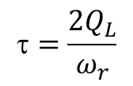
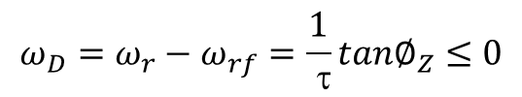


Beam Cavity Interaction (D. Teytelman and F. Pederson)
Cavity optimum detuning for steady beam current loading without a gap, when loading angle tanφ_{L}=0:
$$ω_{D}=ω_{r}−ω_{rf}=\frac{1}{ τ}tan∅_{Z}≤0$$
$$=\frac{2Q_{L}}{ω_{r}}$$
is cavity damping time
Beam Loading
$$\hat{I_{B}}\overset{⇔}{feedback}\hat{V_{c}}$$
$$\hat{I_{B}}↑→\left|ω_{D}\right|↑\sim or> {nω}_{0}\sim \left(lω_{0}+ω_{s}\right)$$
$Z_{c}\left(ω_{rf}+{nω}_{0}\right)\underset{⇔}{interact}I\left(ω_{rf}+{nω}_{0}\right)$
un-even filling patterns
Long. coupled-bunch instability

Slide 4
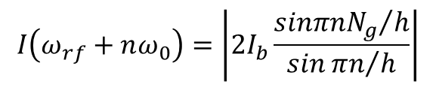
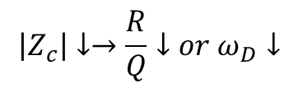
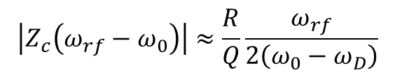
Beam Loading Transient (D. Teytelman and F. Pederson)
Synchronous phase transients:
Uneven filling patterns =>amplitude modulation I_{B}=>beam signal has power at Z_{c}(ω_{rf}-nω₀)=>Amp & pha. Modulation of V_{c}=> changes of long. φ_{s}, σ, and φ_{B}.
Long gap for abort kicker rise time and ion clearing, beam current envelope amplitude and width
$$I\left(ω_{rf}+nω_{0}\right)=\left|2I_{b}\frac{{sinπnN_{g}}/h}{sin{πn}/h}\right|$$
I_{b} is the pre bunch current
$$\left|Z_{c}\right|↓→\frac{R}{Q}↓or ω_{D}↓$$
For ω_{D}<ω₀-2/τ:
$$\left|Z_{c}\left(ω_{rf}−ω_{0}\right)\right|≈\frac{R}{Q}\frac{ω_{rf}}{2\left(ω_{0}−ω_{D}\right)}$$

Slide 5
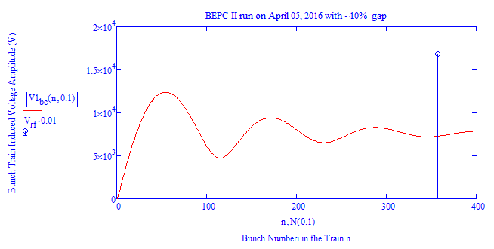

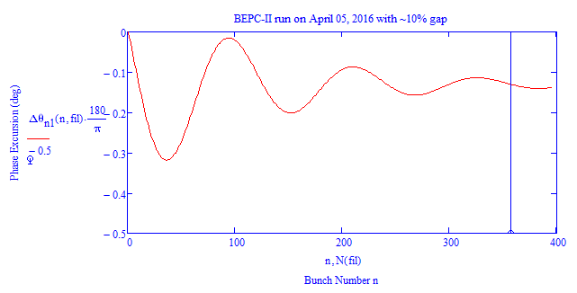
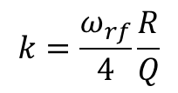
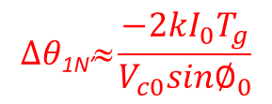
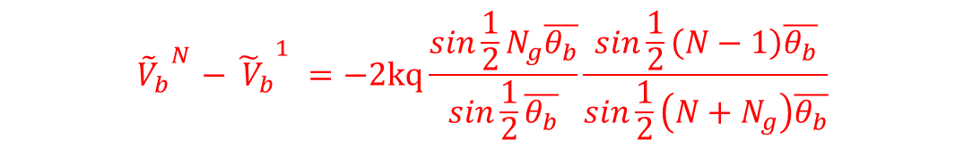
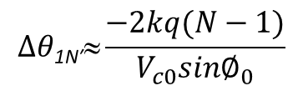
Beam Gap Transient Analysis in Steady State (Kerl Bane etc. [1])
Voltage difference induced across a bunch train:
$${{{{\tilde{V}}_{b}}_{}^{N}−\tilde{ V}}_{b}}_{}^{1}=−2kq\frac{sin\frac{1}{2}N_{g}\overline{θ_{b}}}{sin\frac{1}{2}\overline{θ_{b}}}\frac{sin\frac{1}{2}\left(N−1\right)\overline{θ_{b}}}{sin\frac{1}{2}\left(N+N_{g}\right)\overline{θ_{b}}}$$
This formula can be used for either N>>1 or N_{g}>>1
$$∆θ\text{1}\text{N}\text{′}≈\frac{−2kI_{0}T_{g}}{V_{c0}sin∅_{0}}$$
$$∆θ\text{1}\text{N}\text{′}≈\frac{−2kq(N−1)}{V_{c0}sin∅_{0}}$$
$$k=\frac{ω_{rf}}{4}\frac{R}{Q}$$
for JLEIC
or
for CEPC
Example of BEPC-II run N=357, Ng=39
Example of NLC damping ring N=90 N_{g}=43

Slide 6
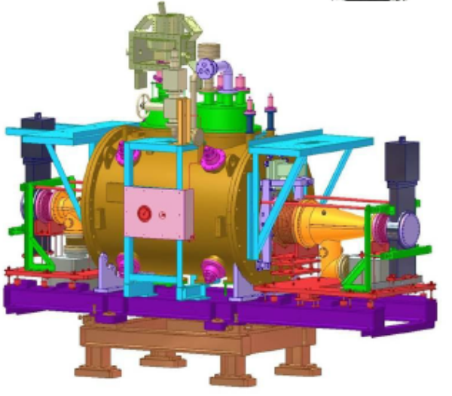
BECP-II: Two Modes of Operation: HEP Collision and SR
Achieved luminosities:
May 29, 2009: 3.3×10³² cm⁻²s⁻¹
April 5, 2016: 1.0×10³³ cm⁻²s⁻¹

Slide 7
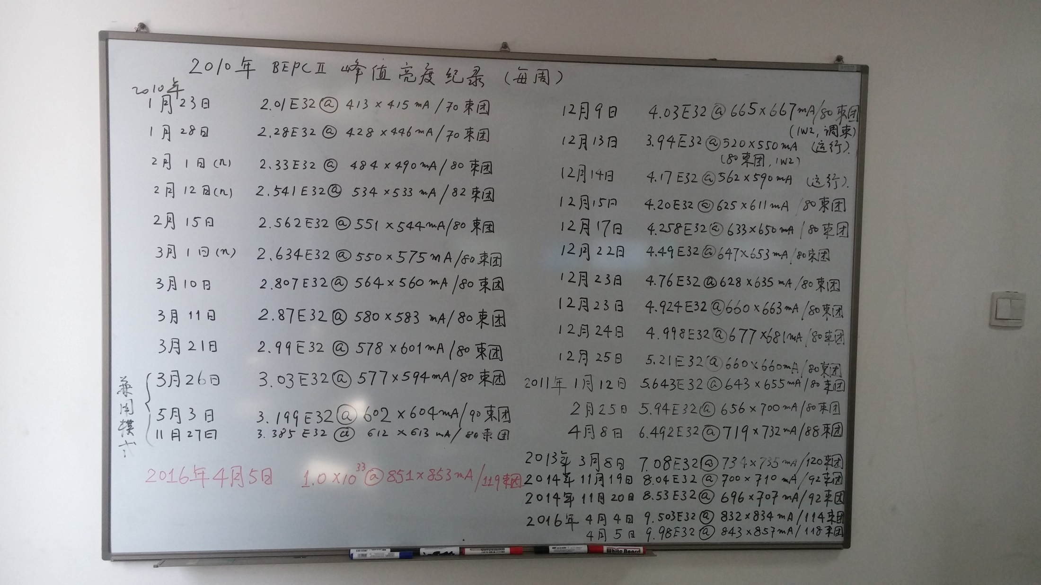
History of BECP-II Machine Bunch Filling Patterns and Luminosities

Slide 8
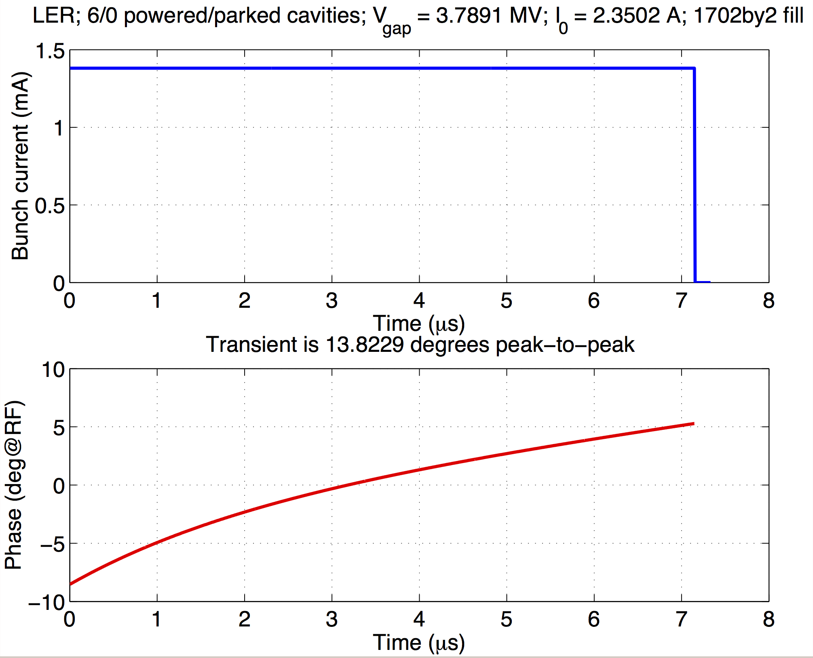
PEP-II type RF system, Strong Gap transient
RF transient from gap is strong, cannot be cancelled by klystron power alone. Need to develop and mitigation strategies ref. [28]

Slide 9
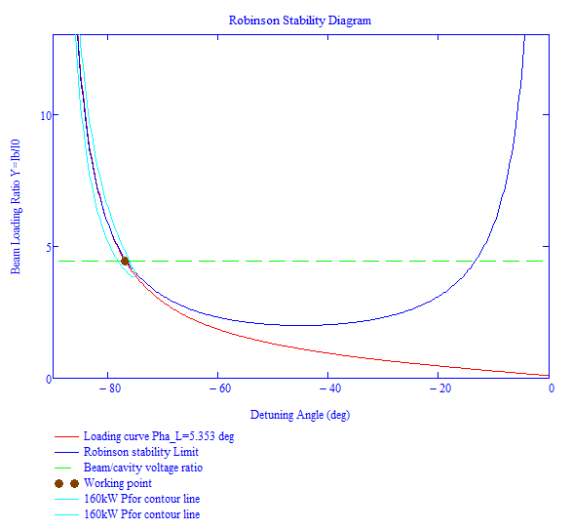
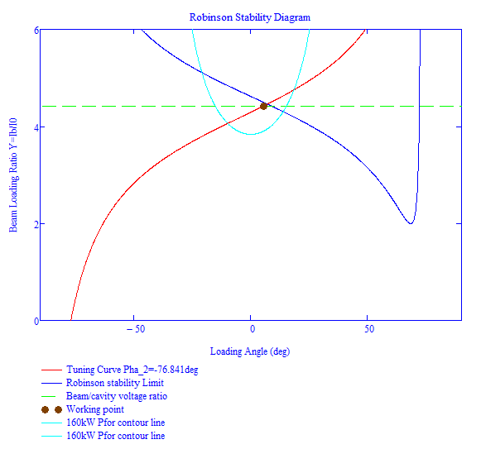
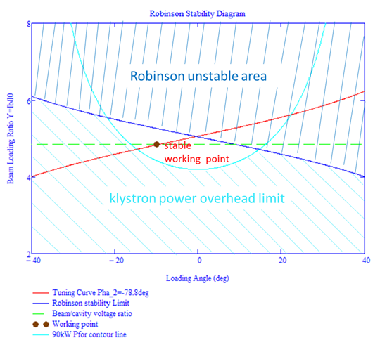
Beam Transient Analysis in Steady State (H. Wang etc [25])
Data example of BEPC-II run at 1.89GeV on April 05, 2016 :

Slide 10
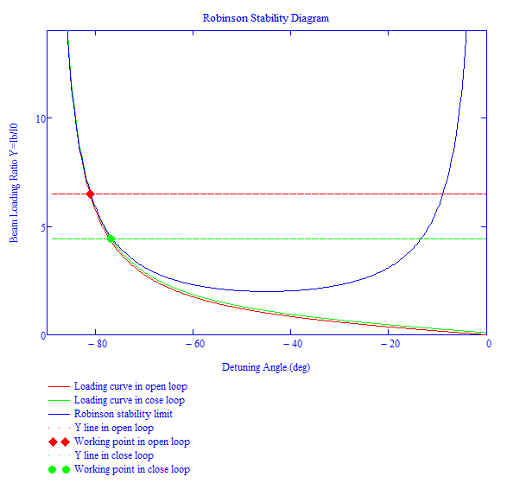
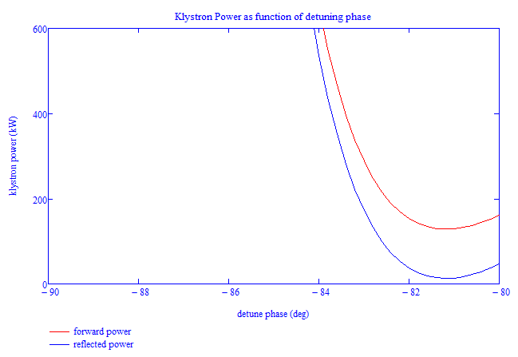
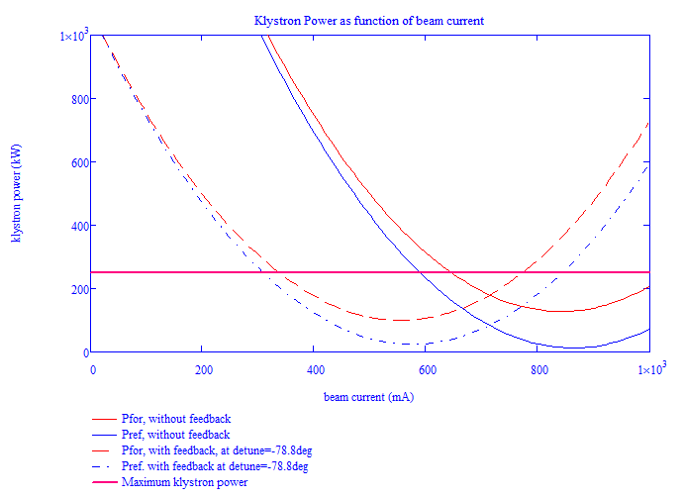
Beam Transient Analysis in Steady State (H. Wang etc [25])
Data example of BEPC-II run at 1.89GeV on April 05, 2016 :

Slide 11
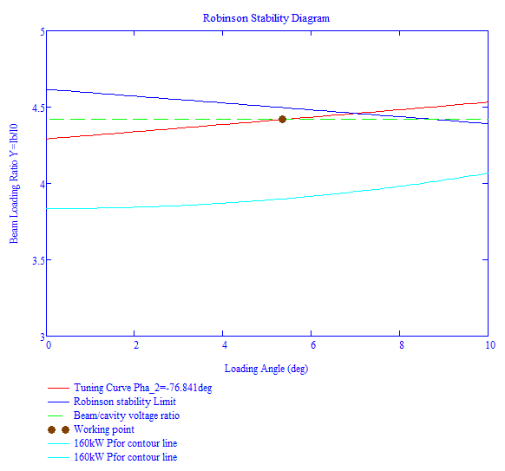
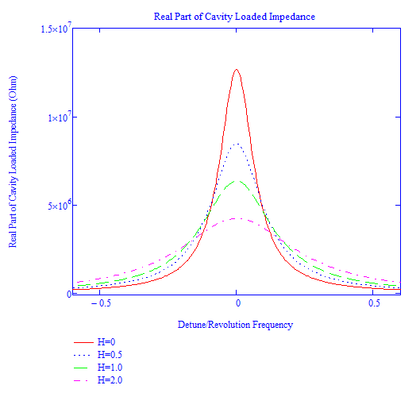
Beam Transient Analysis in Steady State (H. Wang etc [25])
Data example of BEPC-II run at 1.89GeV on April 05, 2016 :
Could we open up the gap to see the loading angle transient?
Robinson stability or power limits?
Increase the DFB gain?
1.65º

Slide 12
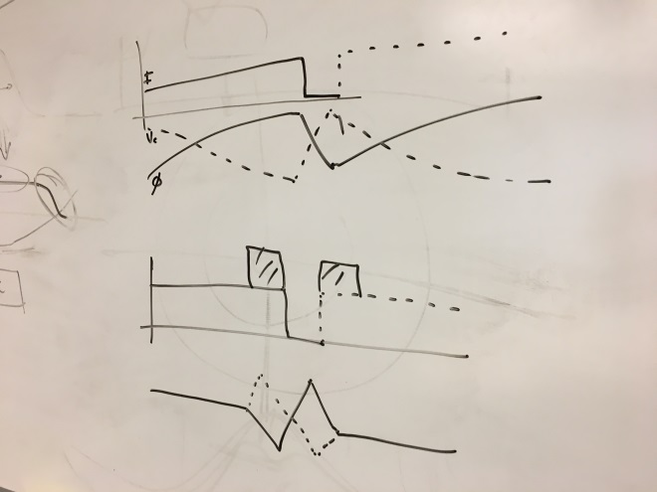
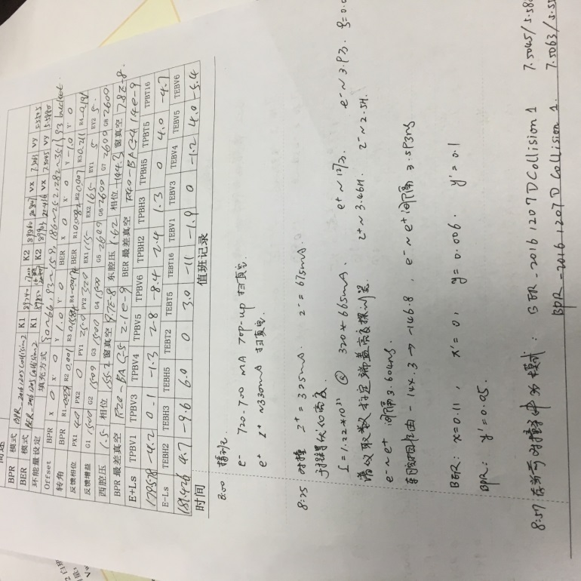
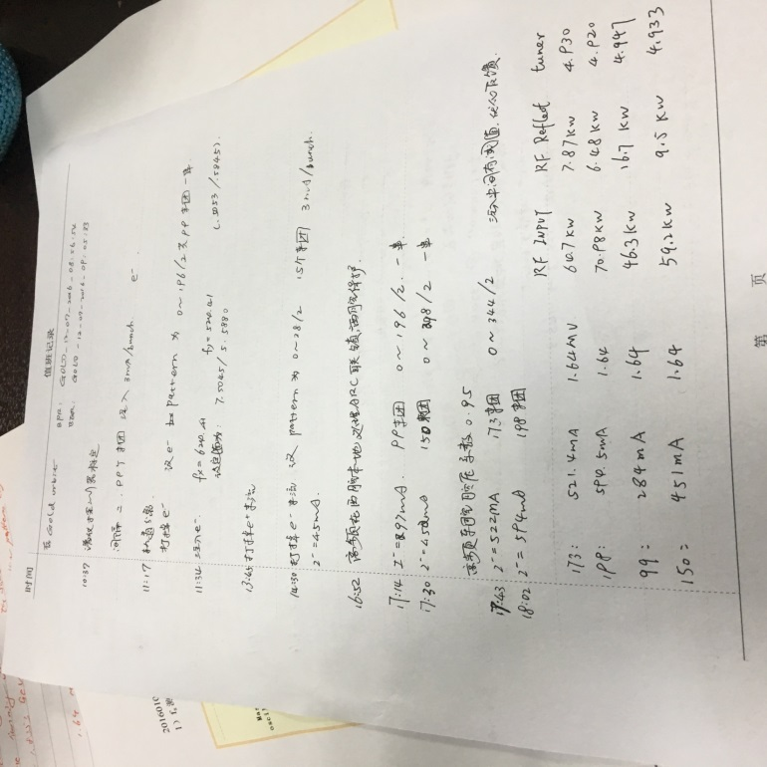
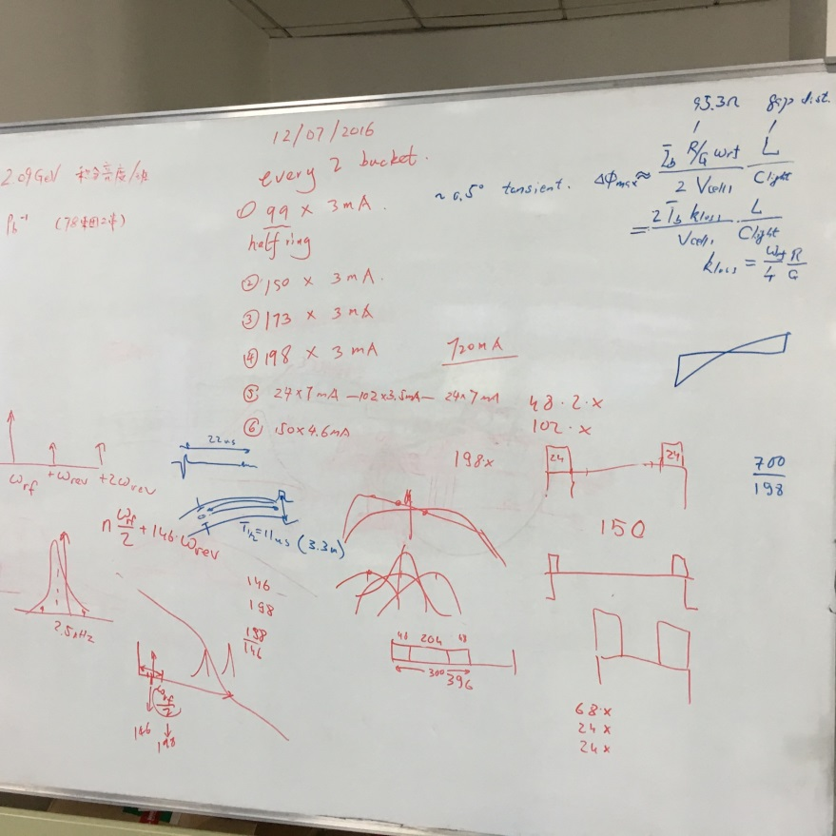
Beam Transient Beam Loading: from Concept, Proposal to Actual Experiment
Proposal by R. Rimmer
On 11/23/2016
J. Byrd , 2001 REF. [7]
Experiment log pages
White board discussion at IHEP for transient beam load experiment schemes
Dec. 2016

Slide 13
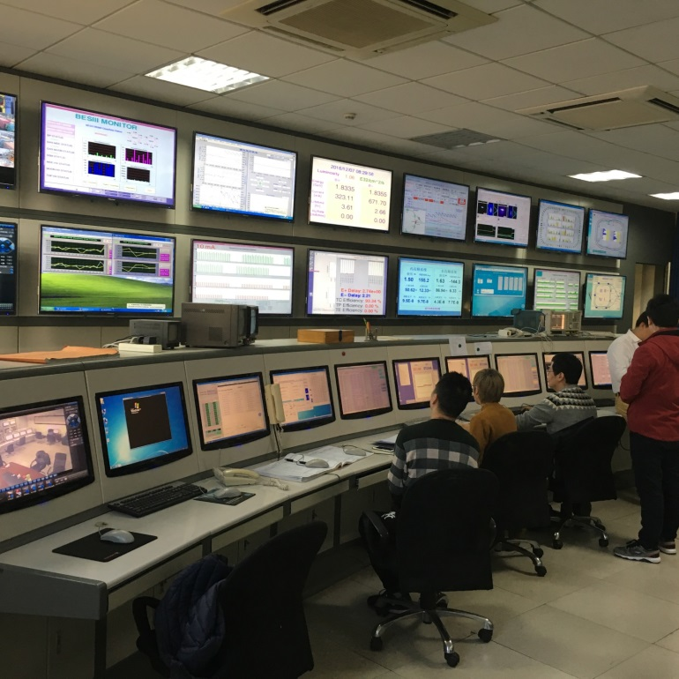
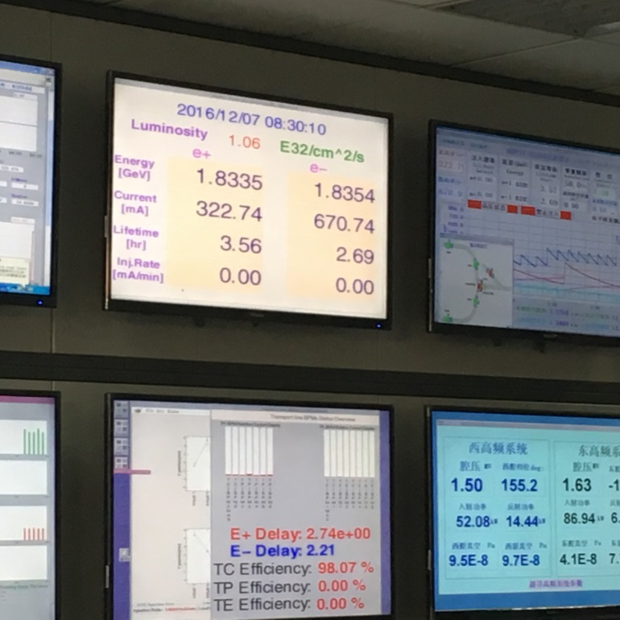
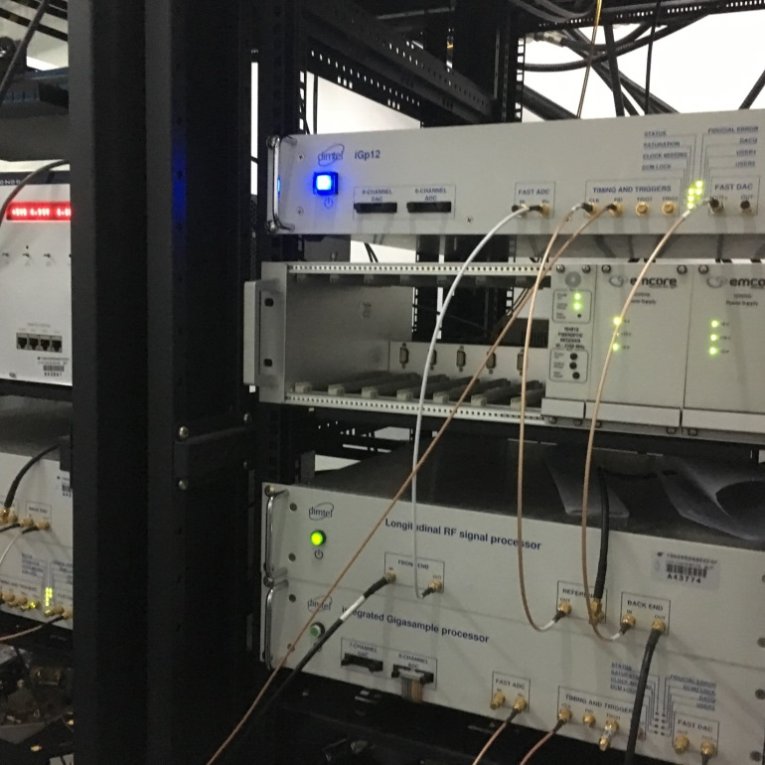
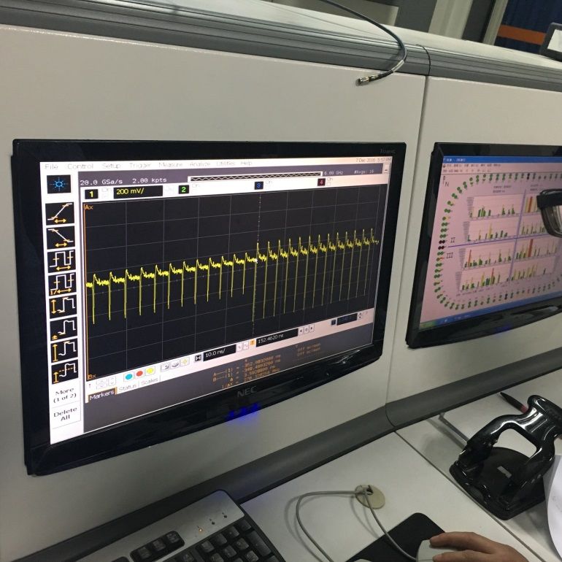
1
2
BEPC Machine Control Center at IHEP
Major machine parameters display screens
Dimtel digital controllers for bunch-by-bunch feedback system
Bunch train signal picked up on BPM and displayed at MCC.
3
4

Slide 14
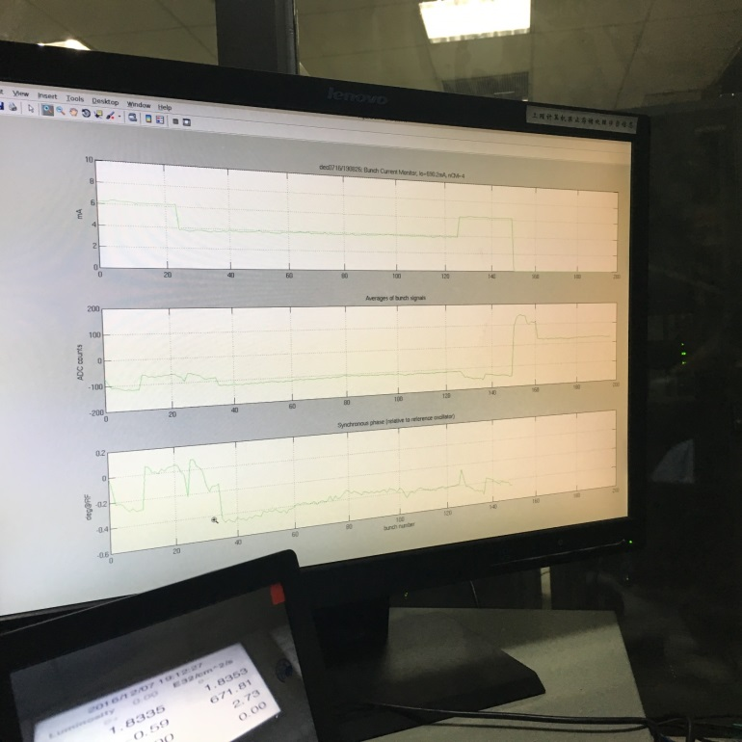
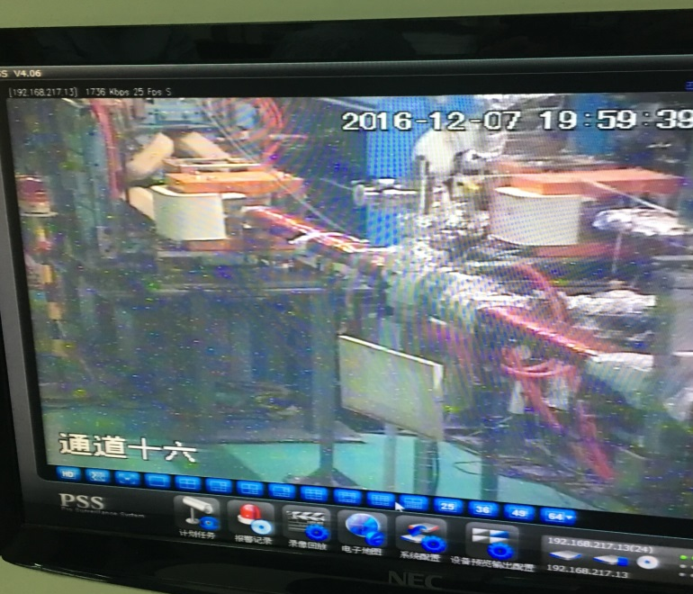
1
iGp12
BECP-II layout here
3
iGp8
2
Dmitry’s feedback system control and transient analysis screens
Button BPM pickup location in the BECP ring
Bunch-by-bunch Pickup/Kicker system triggering signal for beam abort
iGp8: BPM sum for amp. detection DAC with
Long. feedback delay 105 turns to trigger iGp12 for phase detection. Threshold adjustable for the beam aborting

Slide 15
BEPC-II Analog Direct Feedback Loop Setup
BECP-II Direct Feedback analog system from KEK-B
Measured open and close loop transfer functions
Measured direct loop gain by fitting S21 parameters

Slide 16
System model to measure the DF gain and delay

Slide 17
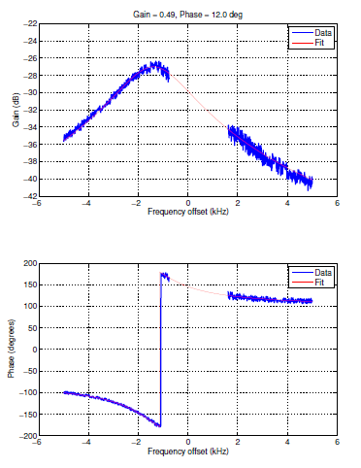
Feedback system calibration for the beam transient experiment
Close loop
Open loop
Q_{L}=251414, nominal Φ_{L}=-21º (not -10º)
Nominal loop gain 0.5 at gain setting=4V

Slide 18
Uniform Fill Pattern with Half Ring Empty
Simulation (red) vs bunch-by-bunch Measurement (blue)

Slide 19
Modulated Train Fill Pattern with Double Charge between Gap
Simulation (red) vs bunch-by-bunch Measurement (blue)

Slide 20
Does Fill Pattern Modulation Work? Yes!
ALS data, April 2017
Modulated fill
Even fill
Phase transient
See Dimetry’s talk next
Reduced transient

Slide 21
Beam Loading Transient Parameters Comparison between Design Machines

Slide 22
Beam Loading Transient Parameters Comparison between Existing Machines

Slide 23
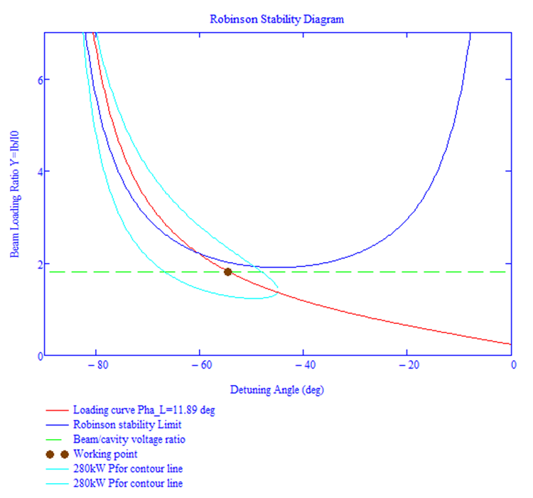
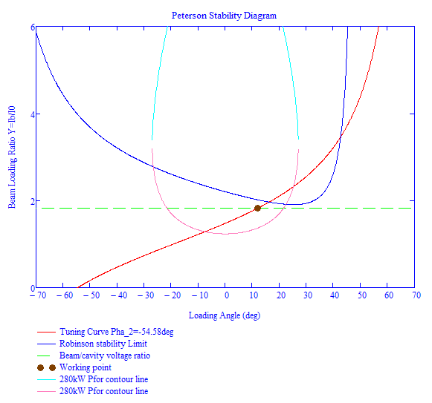
JLEIC E-ring (Upgrade from PEP-II) SRF Cavity for 3GeV Run
3GeV
952.6MHz SRF
0.38MV
φ_{s}=17.7º
I_{b}=1.944A

Slide 24
Summary
Transient beam loadings in an open bunch train gap or a short bunch train a large gap can create a large beam phase transient and voltage variation. Without a fast feedback (or feed forward) or extra stored energy from overhead klystron power or coupling cavity, beam could become unstable in large energy spread or even loss by Robinson instability
Count measures by large fast direct feedback, bunch-by-bunch feedback, feedforward in pulse mode, more klystron overhead (with linear response) power have been analyzed in steady state boundary conditions for the stable region. This tool also provides the RF control system designs for the future storage rings
Enhanced charge densities around the large gap or uneven bunch bucket fillings around short bunch train can mitigate these transient beam loading problems
BEPC-II transient beam loading experiment has provided an excellent test bed for the transient beam loading compensation technique and a benchmark for the steady-state analysis and bunch-by-bunch tracking simulations.

Slide 25
Acknowledgment:
Great thanks to the Institute of High Energy Physics, Beijing for the high priority arrangement of BECP-II’s beam time, particularly Dr. Qin Qing and his staff Yuan Zhang, Junhui Yue, Jianping Dai, Jun Xing and all technical supports to get this experiment running smoothly and efficiently.
Thanks also go to Dr. Dmitry Teytelman for his talent design on his company’s bunch-by-bunch feedback system, instrumentation support and on-line software simulation and analysis to quickly get our experiment results

Slide 26
Backup Slides

Slide 27
References
K. L. F. Bane, K. Kubo, P. B. Wilson, SLAC, Stanford, CA 94309, USA, Compensating the Unequal Bunch Spacings in the NLC Damping Rings, Proceedings of EPAC 1993.
J. M. Byrd etc., Transient Bean loading Effects in Harmonic RF Systems for Light Sources, PRST-AB, Vol 5, 092001 (2002).
D. Briggs, etc., Computer Modelling of Bunch-by-bunch Feedback for the SLAC B-Factory Design, Proceedings of PAC 1991.
http://www-als.lbl.gov/index.php/beamlines/storage-ring-parameters.html Webpage of Advanced Light Source at Berkeley Lab
J. Byrd, Simulation of the ALS Longitudimal Multibunch Feedback System, Proceedings of PAC 1993.
B. Taylor etc., The ALS Storage Ring RF System, Report of LBL-33291/UC-410/LGSGN-125, May 1993.
J. M. Byrd etc., Lifetime Increase Using Passive Harmonic Cavities in Synchrotron Light Sources, PRST-AB, Vol 4, 030701 (2001).
J. Byrd etc., Transient Beam Loading in the ALS Harmonic RF System, Proceedings of EPAC2000, SLAC-PUB-9719.
J. M. Byrd, etc., Commissioning of a Higher Harmonic RF System for the Advanced Light Source, eScholarship of University of California, and LBNL, March 31, 2000.
F. Pederson, A Novel RF Cavity Tuning Feedback Scheme for Heavy Beam Loading, IEEE Trans. on Nuclear Science, Vol. NS-32, No. 5, Oct. 1985.
F. Pederson, IEEE Trans. Nuclear Science, Vol. NS-22, No. 3, June 1975, Proceedings of PAC 1975.
P. Krejcik and F. Pederson etc., RF Feedback for beam Loading Compensation in the SLC Damping Rings, Proceedings of PAC 1993.
R. W. Robinson, CEA, Report No. CEAL-1010, 1964.
G. Krafft etc., Beam Loading Studies at CEBAF, Proceeding of LINAC 1990, Albuquerque, New Mexico, USA

Slide 28
References
D. Boussard, PAC 1991, p2447
Shaoheng Wang, Direct Feedback, unpublished, April, 2015.
S. Heifets and D. Teytelman, PRST-AB 10, 012804 (2007)
H. Wang, S. Wang, Derivation of the constant power contour lines in Robinson stability diagram, Note rewritten on January 13, 2016
P. B. Wilson, SLAC-PUB-6062, March 1993
J. M. Byrd, etc., PRST-AB 5, 092001 (2002)
S. Koscielniak, Robinson-Type Stability Criteria for Beam and Cavity with Delayed, Voltage-proportional Feedback, Particle Accelerators, Vol. 62, pp. 179-214, 1999
J. T. Seeman, SLAC, PAC1999
J. T. Seeman, SLAC, SLAC-PUB-14677, 2008
M. McIntosh, etc. SLAC, SLAC-PUB-10984, July, 2004
H. Wang, etc. Proceedings of IPAC 2016, MOPMY003
D. Teytelman, Dimtel, Inc., San Jose, CA, USA. “Transient beam loading in FCC-ee (Z)”, FCC Week 2017
P. McIntosh, et. al., EPAC 2004, PEP-II RF SYSTEM OPERATION AND PERFORMANCE
Dmitry Teytelman, PAC05, Beam loading compensation for Super B-factories,

Slide 29
JLEIC Electron Ring
Electron Ring Parameters
Norminal Circumference |  | 2255.753 |  | m
Minimum Circumference |  | 2255.438 |  | m
Maxmum Circumference |  | 2256.068 |  | m
Rev Frequency |  | 0.133 |  | MHz
RF frequency |  | 476.3 |  | MHz
Harmonic Number |  | 3584
Radius of Dipole |  | 110.452 |  | m
Dipole Bend Angle |  | 2.801 |  | degree
Crossing Angle |  | 81.700 |  | degree
Angle Factor |  | 1.454
Beta Function at RF Cav |  | 25.000 |  | m
Momentum Compaction |  | 2.142E-03
Linear SR Power Limit |  | 10 |  | kW/m
Total SR Power Limit |  | 10 |  | MW
Electron Ring Operation Parameters
Energy | 3 | 4 | 5 | 6 | 7 | 8 | 9 | 10 |  | GeV
Energy Loss per Turn | 0.114 | 0.362 | 0.883 | 1.830 | 3.391 | 5.785 | 9.267 | 14.124 |  | MeV
SRpower/ring (= power to beam) | 0.34 | 1.08 | 2.65 | 4.30 | 6.17 | 8.17 | 10.00 | 10.00 |  | MW
SR power per unit length | 0.34 | 1.08 | 2.62 | 4.26 | 6.11 | 8.09 | 9.91 | 9.91 |  | kW/m
Energy Spread | 2.73E-04 | 3.64E-04 | 4.55E-04 | 5.46E-04 | 6.37E-04 | 7.28E-04 | 8.19E-04 | 9.10E-04
Trans. SR Damping Time | 394.62 | 166.48 | 85.24 | 49.33 | 31.06 | 20.81 | 14.62 | 10.65 |  | mSec
Long. SR Damping Time | 197.31 | 83.24 | 42.62 | 24.66 | 15.53 | 10.41 | 7.31 | 5.33 |  | mSec
Beam Average Current | 3.000 | 3.000 | 3.000 | 2.350 | 1.819 | 1.412 | 1.079 | 0.708 |  | A
Bunch Length | 12.0 | 12.0 | 12.0 | 12.0 | 12.0 | 12.0 | 12.2 | 15.6 |  | mm
Vpeak, Total | 0.76 | 1.82 | 3.59 | 6.28 | 10.13 | 15.38 | 21.71 | 21.69 |  | MV
Vgap, 1K2C | 0.38 | 0.45 | 0.45 | 0.63 | 0.63 | 0.76 | 0.79 | 0.79 |  | MV
Vgap, 1K4C | 0.00 | 0.00 | 0.00 | 0.00 | 0.00 | 0.40 | 0.47 | 0.47 |  | MV
Gradient, 1K2C | 1.21 | 1.44 | 1.43 | 2.00 | 2.01 | 2.42 | 2.51 | 2.51 |  | MV/m
Gradient, 1K4C | 0.00 | 0.00 | 0.00 | 0.00 | 0.00 | 1.26 | 1.49 | 1.49 |  | MV/m
Syn. Phase | 8.7 | 11.5 | 14.2 | 16.9 | 19.6 | 22.1 | 25.3 | 40.6 |  | degree
Syn. Tune | 0.017 | 0.023 | 0.029 | 0.035 | 0.041 | 0.047 | 0.052 | 0.045
Cavity Number, Total | 2 | 4 | 8 | 10 | 16 | 24 | 34 | 34
Klystron Number | 1 | 2 | 4 | 5 | 8 | 10 | 13 | 13
Loading Angle ψL | 0.0 | 0.0 | 0.0 | 0.0 | 0.0 | 0.0 | 0.0 | 0.0 |  | degree
PowerToBeam per Cavity, 1K2C | 171.61 | 271.18 | 331.03 | 430.16 | 385.44 | 404.89 | 363.97 | 363.90 |  | kW
PowerToBeam per Cavity, 1K4C | 0.00 | 0.00 | 0.00 | 0.00 | 0.00 | 210.96 | 215.54 | 215.62 |  | kW
Cavity Wall Loss Power, 1K2C | 20.64 | 29.50 | 28.76 | 56.41 | 57.26 | 83.06 | 89.16 | 89.03 |  | kW
Cavity Wall Loss Power, 1K4C | 0.00 | 0.00 | 0.00 | 0.00 | 0.00 | 22.55 | 31.27 | 31.26 |  | kW
Reflected Power, 1K2C | 6.29 | 15.47 | 39.97 | 9.80 | 3.34 | 1.25 | 6.89 | 6.83 |  | kW
Reflected Power, 1K4C | 0.00 | 0.00 | 0.00 | 0.00 | 0.00 | 12.89 | 2.34 | 2.35 |  | kW
Forward Power Per Cavity, 1K2C | 198.53 | 316.15 | 399.76 | 496.37 | 446.04 | 489.20 | 460.02 | 459.76 |  | kW
Forward Power Per Cavity, 1K4C | 0.00 | 0.00 | 0.00 | 0.00 | 0.00 | 246.41 | 249.14 | 249.22 |  | kW
Total RF Power | 0.397 | 1.265 | 3.198 | 4.964 | 7.137 | 9.798 | 12.267 | 12.263 |  | MW
Robinson Instability Y, 1K2C | 1.47 | 1.54 | 1.56 | 0.87 | 0.56 | 0.43 | 0.42 | 0.28
Robinson Instability Y, 1K4C | 0.00 | 0.00 | 0.00 | 0.00 | 0.00 | 0.83 | 0.72 | 0.47
Tuning Angle ψ, 1K2C | -55.5 | -56.5 | -56.5 | -39.9 | -27.8 | -21.8 | -21.0 | -12.0 |  | degree
Tuning Angle ψ, 1K4C | 0.0 | 0.0 | 0.0 | 0.0 | 0.0 | -37.5 | -33.0 | -19.7 |  | degree
δf 1K2C | -86.72 | -89.89 | -90.04 | -49.70 | -31.34 | -23.83 | -22.88 | -12.61 |  | kHz
δf 1K4C | 0.00 | 0.00 | 0.00 | 0.00 | 0.00 | -45.73 | -38.64 | -21.28 |  | kHz
Injection Time with 2 ts | 23.68 | 13.32 | 8.52 | 4.64 | 2.64 | 1.57 | 0.95 | 0.50 |  | min
Loop Gain of Direct Feedback | 4.00 | 3.00 | 3.00 | 3.00 | 3.80 | 3.00 | 2.00 | 2.00
Cavity Parameters
CavityActiveLength |  | 0.31 |  | m
Cavity Insertion Length |  | 1.125 |  | m
Geometric Factor |  | 170.8
R/Q |  | 233.3
Qzero |  | 3.00E+04
Shunt Impedance |  | 7.00E+00 |  | MΩ
Coupling Beta |  | 6.5

Slide 30
JLEIC Ion Ring
Momentum Compaction |  | 6.413E-03
Bunch Length |  | 12 |  | mm
CavityActiveLength |  | 0.157 |  | m
Cavity Insertion Length |  | 1.91 |  | m
temperature |  | 2 |  | K
BCS Resistance |  | 8.91 |  | nΩ
Residual Resistance |  | 4.39 |  | nΩ
Surface Resistance |  | 13.3 |  | nΩ
Geometric Factor |  | 217.02
R/Q |  | 105.2
Qzero |  | 1.63E+10
Shunt Impedance |  | 1.72E+06 |  | MΩ
Cavity Gradient Limit |  | 8 |  | MV/m
Cavity Klystron Ratio |  | 8
 | Proton Ring Operation Parameters |  |  |  |  |  |  |  |  |  | Lead ion
Energy | 20 | 30 | 40 | 50 | 60 | 70 | 80 | 90 | 100 | GeV | 40 | GeV/u
gamma | 22.3 | 33.0 | 43.6 | 54.3 | 64.9 | 75.6 | 86.3 | 96.9 | 107.6 |  | 44.1
Current | 0.50 | 0.50 | 0.50 | 0.50 | 0.50 | 0.50 | 0.50 | 0.50 | 0.50 | A | 0.50 | A
Harmonic Number | 7174 | 7170 | 7168 | 7168 | 7168 | 7168 | 7168 | 7168 | 7168
RF frequency | 952.65 | 952.64 | 952.56 | 952.65 | 952.70 | 952.73 | 952.75 | 952.76 | 952.77 | MHz |  | MHz
Rev Frequency | 0.13279 | 0.13286 | 0.13289 | 0.13290 | 0.13291 | 0.13291 | 0.13292 | 0.13292 | 0.13292 | MHz
Energy Spread | 3.00E-04 | 3.00E-04 | 3.00E-04 | 3.00E-04 | 3.00E-04 | 3.00E-04 | 3.00E-04 | 3.00E-04 | 3.00E-04 |  | 3.00E-04
Phase Slip Factor | 4.40E-03 | 5.49E-03 | 5.89E-03 | 6.07E-03 | 6.18E-03 | 6.24E-03 | 6.28E-03 | 6.31E-03 | 6.33E-03 |  | 5.90E-03
Vpeak | 6.23 | 11.64 | 16.63 | 21.44 | 26.16 | 30.83 | 35.46 | 40.0688 | 44.66 | MV | 42.27 | MV
Syn. Phase | 0.00 | 0.00 | 0.00 | 0.00 | 0.00 | 0.00 | 0.00 | 0.00 | 0.00 | degree | 0.00 | degree
Vgap | 0.78 | 0.73 | 1.04 | 0.89 | 1.09 | 0.96 | 1.11 | 1.25 | 1.12 | MV | 1.06 | MV
Gradient | 4.95 | 4.62 | 6.61 | 5.68 | 6.93 | 6.12 | 7.04 | 7.96 | 7.10 | MV/m | 6.72 | MV/m
Syn. Tune | 0.040 | 0.049 | 0.053 | 0.055 | 0.055 | 0.056 | 0.056 | 0.057 | 0.057 |  | 0.053
Forward Power | 27.47 | 24.00 | 49.01 | 36.21 | 53.89 | 42.09 | 55.69 | 71.11 | 56.54 | kW | 50.65 | kW
Cavity Power | 0.4 | 0.3 | 0.6 | 0.5 | 0.7 | 0.5 | 0.7 | 0.9 | 0.7 | W | 0.7 | W
Reflected Power | 27.47 | 24.00 | 49.01 | 36.20 | 53.89 | 42.09 | 55.69 | 71.11 | 56.54 | kW | 50.65 | kW
Coupling Beta | 3.11E+05 | 3.11E+05 | 3.11E+05 | 3.11E+05 | 3.11E+05 | 3.11E+05 | 3.11E+05 | 3.11E+05 | 3.11E+05 |  | 3.11E+05
δf | -32.2 | -34.4 | -24.1 | -28.0 | -23.0 | -26.0 | -22.6 | -20.0 | -22.4 | kHz | -23.7 | kHz
Qext | 5.24E+04 | 5.24E+04 | 5.24E+04 | 5.24E+04 | 5.24E+04 | 5.24E+04 | 5.24E+04 | 5.24E+04 | 5.24E+04 |  | 5.24E+04
Qloaded | 5.24E+04 | 5.24E+04 | 5.24E+04 | 5.24E+04 | 5.24E+04 | 5.24E+04 | 5.24E+04 | 5.24E+04 | 5.24E+04 |  | 5.24E+04
Active Cavity Number | 8 | 16 | 16 | 24 | 24 | 32 | 32 | 32 | 40 |  | 40
Total RF Power | 0.22 | 0.38 | 0.78 | 0.87 | 1.29 | 1.35 | 1.78 | 2.28 | 2.26 | MW | 2.0 | MW

Slide 31
JLEIC Electron Ring

Slide 32
JLEIC Electron Ring

Slide 33
JLEIC Electron Ring

Slide 34
JLEIC Electron Ring

Slide 35
JLEIC Electron Ring

Slide 36
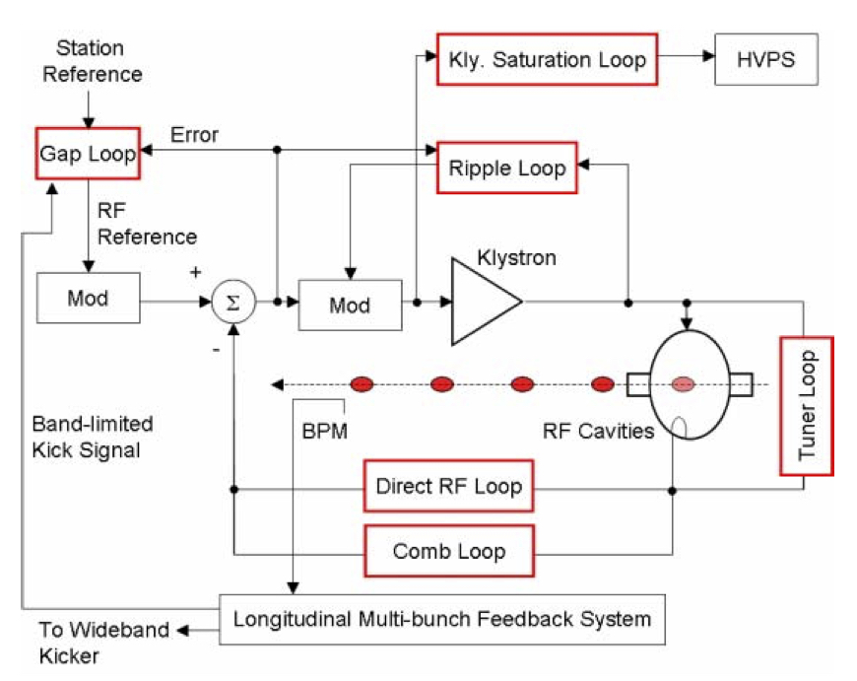
PEP-II type RF system
PEP-II digital LLRF system had many advanced features, which need to be recreated in a current and sustainable hardware platform ref. [27]

Slide 37
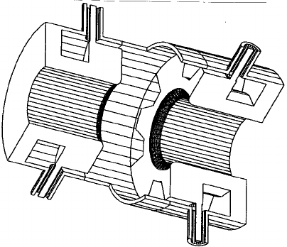
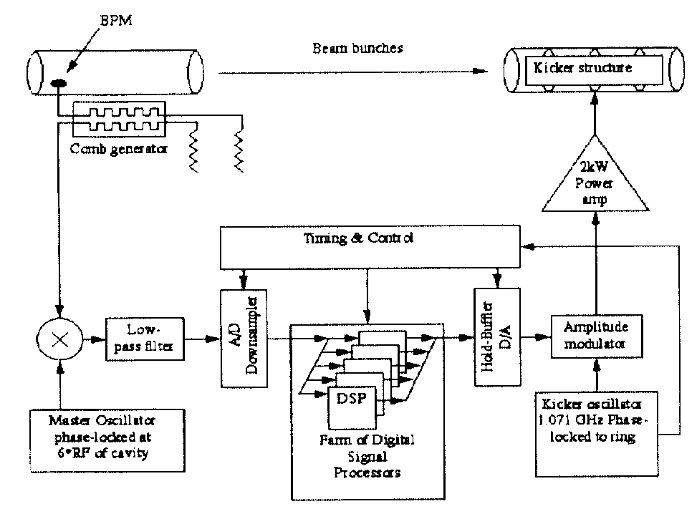
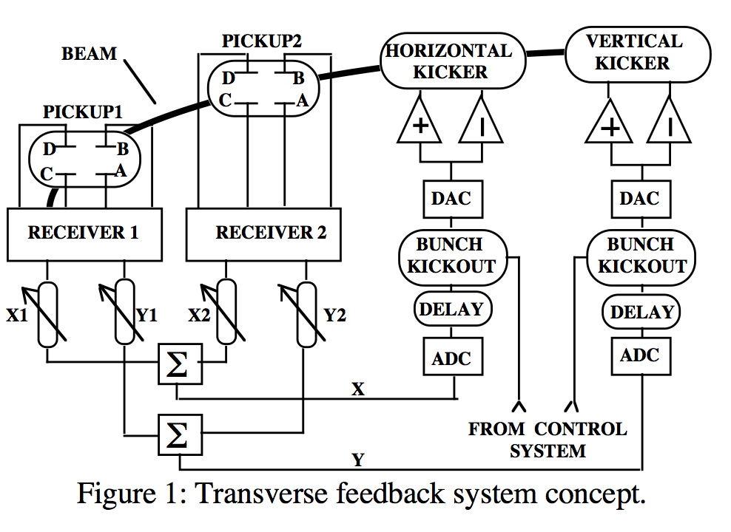
PEP-II type CB feedback systems
PEP-II feedback systems allowed running above threshold
Similar systems are now commercially available
JLEIC needs a high level system design and performance simulation
Reliable high-power kickers are needed
Figure 2: Longitudinal Feedback system concept

Slide 38
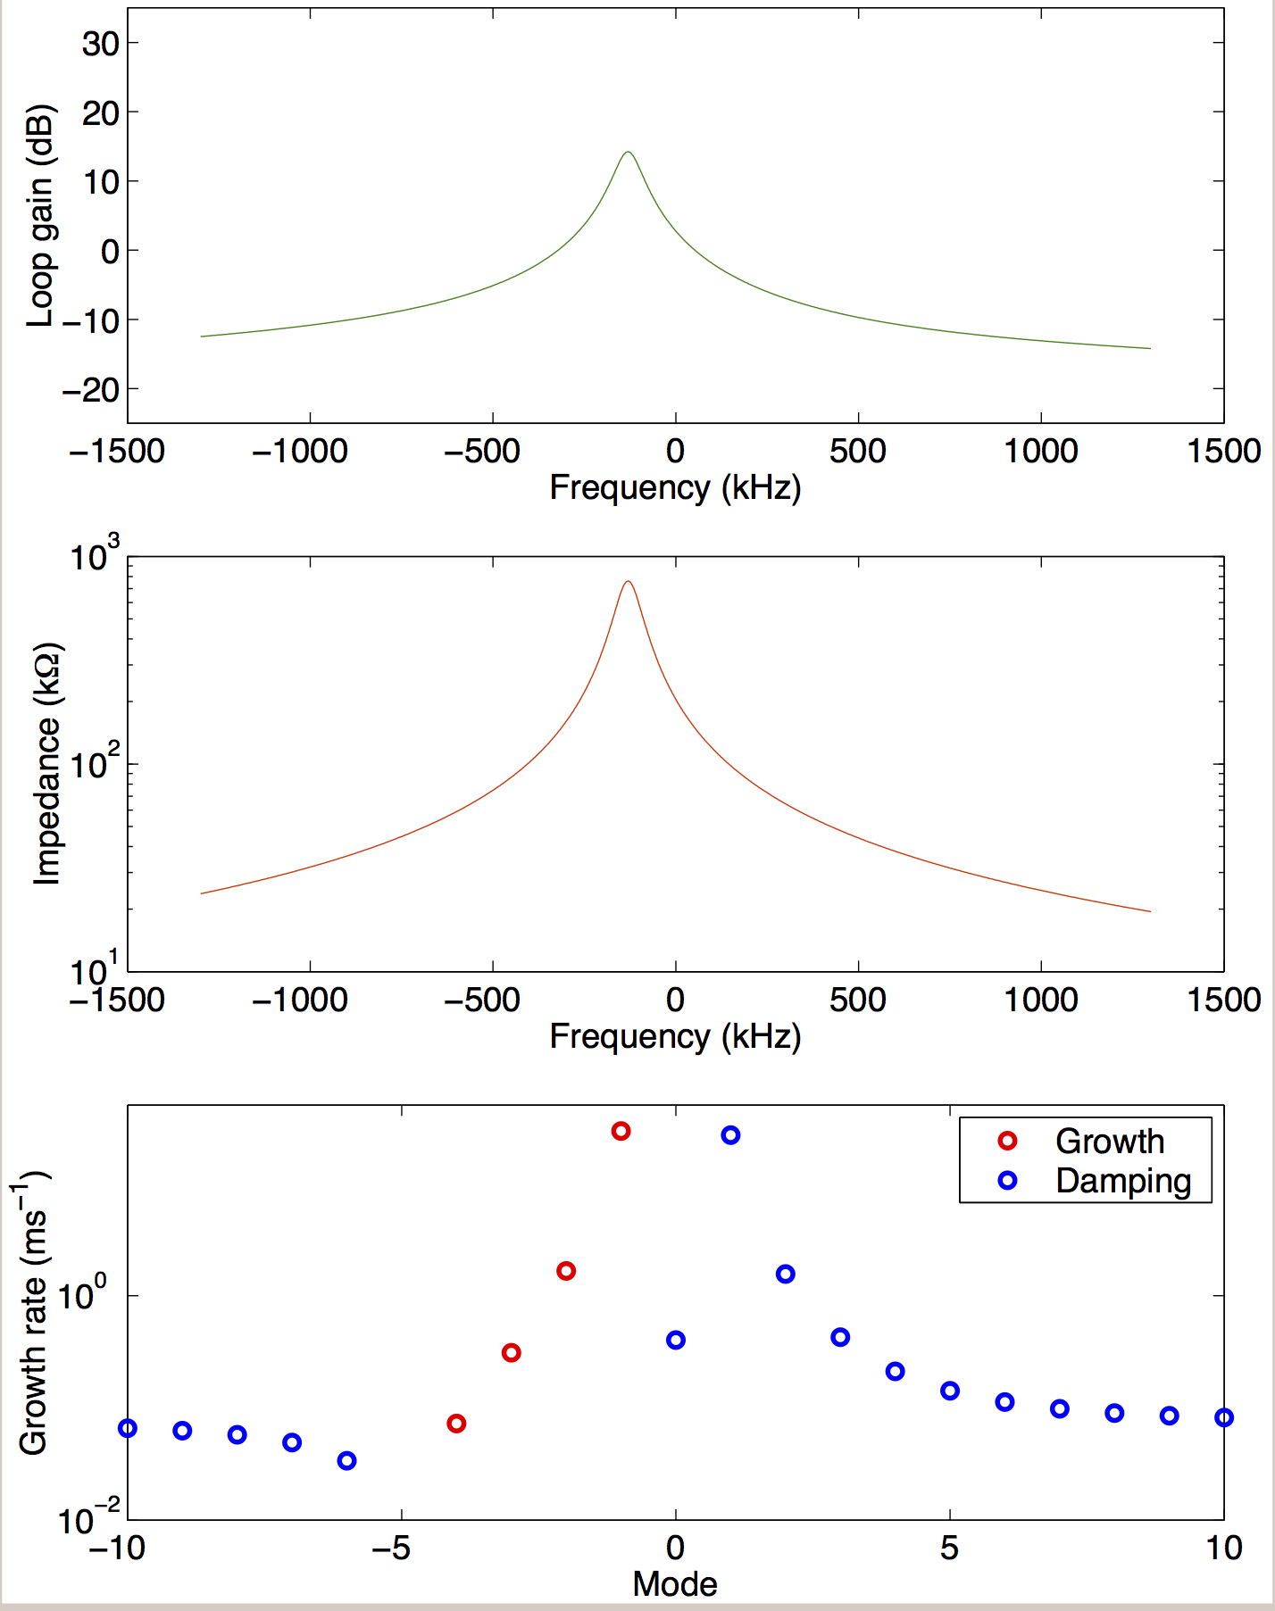
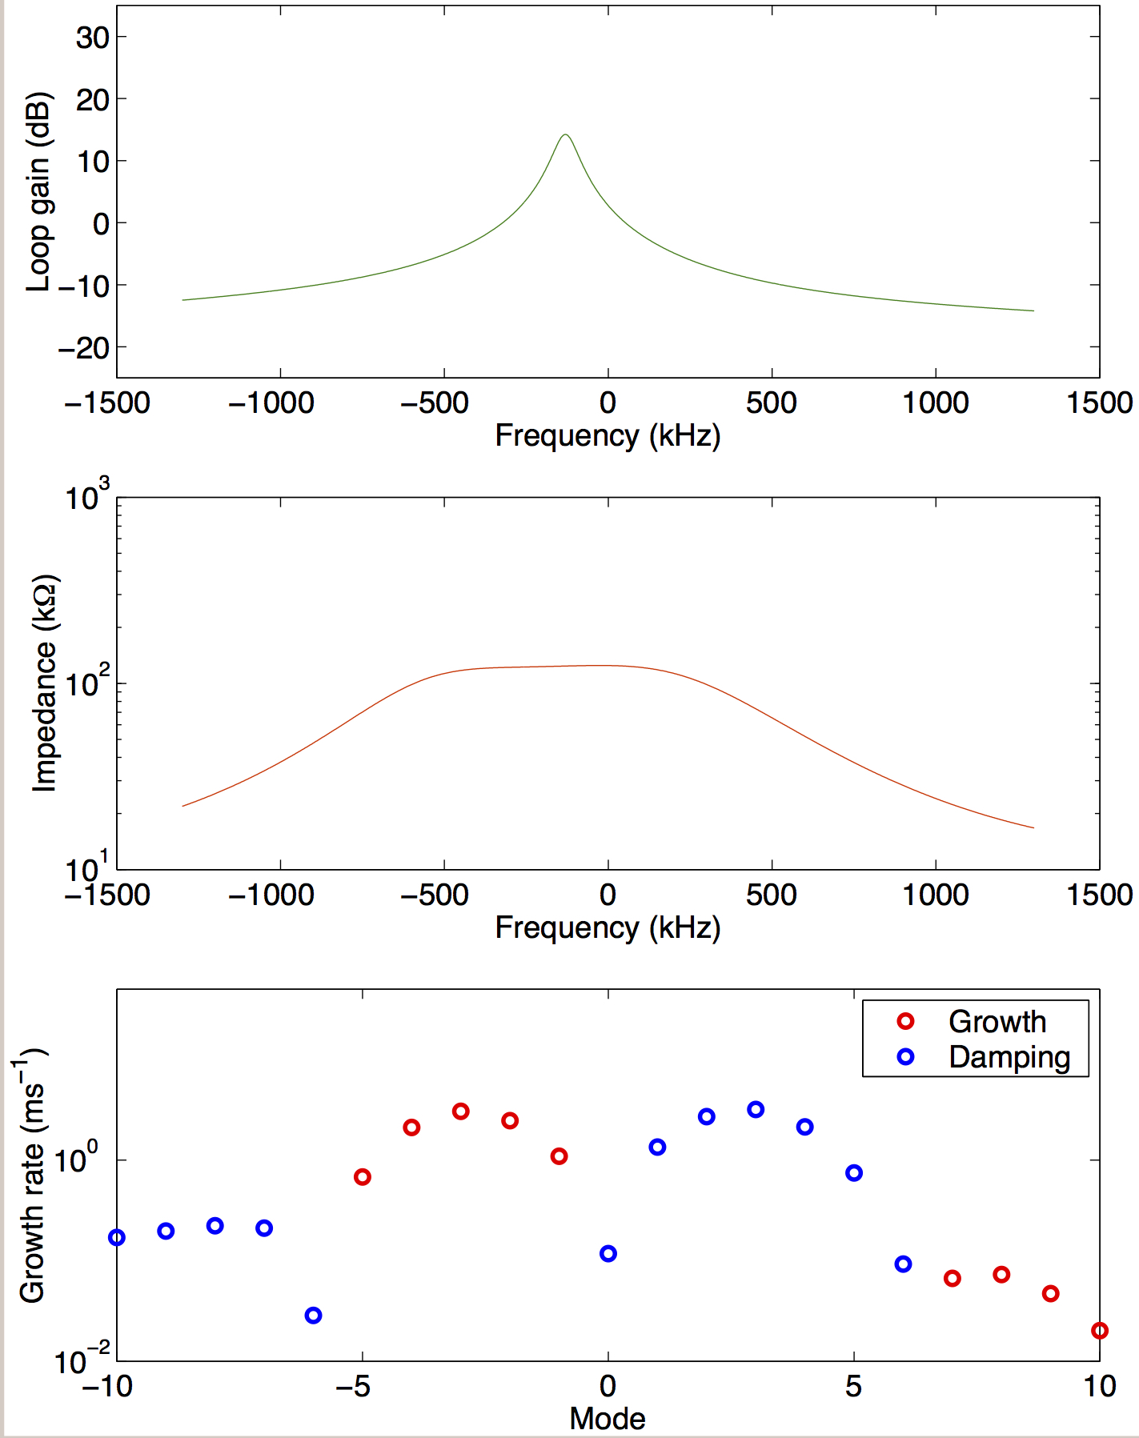
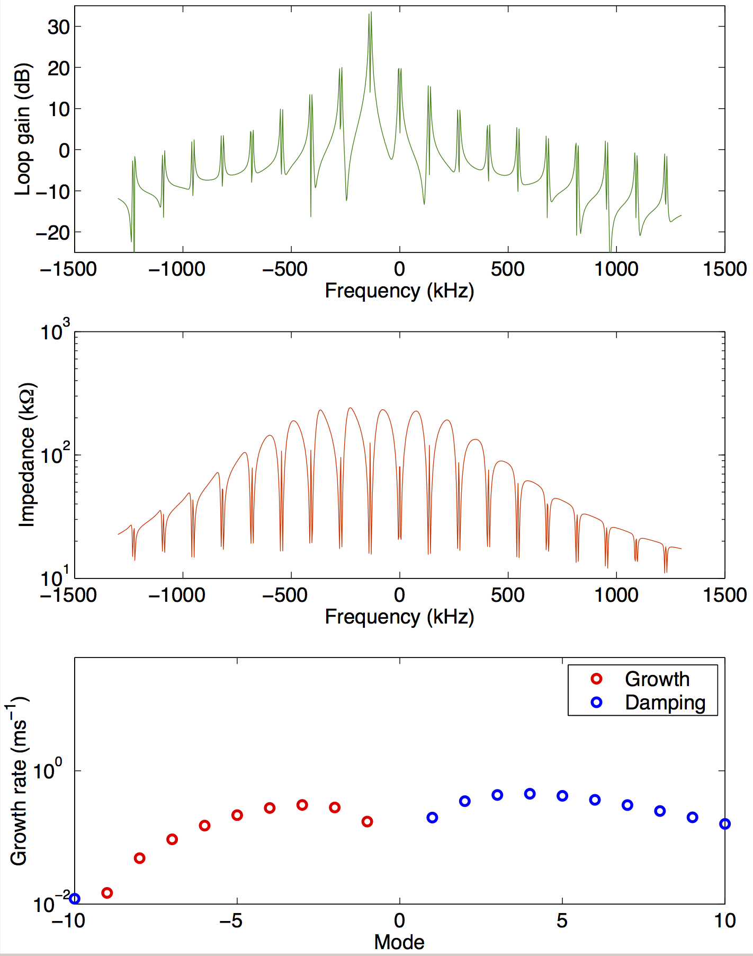
PEP-II type RF system
PEP-II type digital LLRF system must have additional loops for comb filter, klystron equalization and ripple, low mode LFB, gap loop, saturation loop, etc.
Beam loading compensation for Super B-factories, Dmitry Teytelman, PAC05
Cavity detuned for beam loading
Direct loop on
Comb loop on

