Slide 1
The US Magnet Development Program
Soren Prestemon
Director
US Magnet Development Program
Lawrence Berkeley National Laboratory

Slide 2
Outline
Context for high field accelerator magnet R&D
  Motivation
  P5 and the Accelerator R&D Subpanel recommendations
The US Magnet Development Program
  How we are structured
Technical status of each area
  Progress and current status
  Corresponding roadmap within the MDP plan
Summary

Slide 3
Advanced superconducting accelerator magnet technology is critical for a future collider
A large Hadron collider entails...
A high intensity proton source,
Fast-cycling magnets for the injection chain,
New magnets - probably high-field
A new tunnel
  Exception: HE-LHC could reach Ecm=33TeV with 20T dipoles…
Barletta
Dominant cost drivers for an pp collider: Magnets and tunnel
Cost/performance is the critical metric

Slide 4
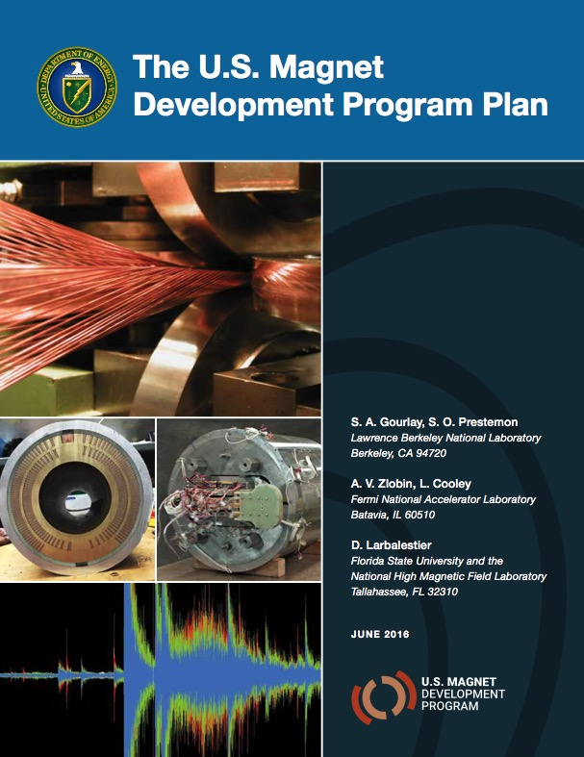
The US HEP Superconducting Magnet Programs are now integrated into the US Magnet Development Program
HEPAP Accelerator R&D Subpanel recommendations
A program for high-field
accelerator magnet development funded by the DOE Office of High Energy Physics

Slide 5
The management structure of the MDP is clearly defined and the program is fully functioning
Technical Advisory Committee
Andrew Lankford, UC Irvine – Chair
Davide Tommasini, CERN
Akira Yamamoto, KEK
Joe Minervini, MIT
Giorgio Apollinari, FNAL (LARP/Hi-Lumi)
Mark Palmer, BNL
MDP Management Group
S. Prestemon, LBNL
G. Velev, FNAL
L. Cooley, FSU
S. Gourlay, LBNL
D. Larbalestier, FSU
A. Zlobin, FNAL

Slide 6
Technical areas have leads who are responsible for coordination and planning
Magnets | Lead
Cosine-theta 4-layer | Sasha Zlobin
Canted Cosine theta | Diego Arbelaez
Bi2212 dipoles | Tengming Shen
REBCO dipoles | Xiaorong Wang
Nb₃Sn
HTS
Conductor R&D
Cond Proc and R&D | Lance Cooley
Technology area | LBNL lead | FNAL lead
Modeling & Simulation | Diego Arbelaez | Vadim Kashikhin
Training and diagnostics | Maxim Martchevsky | Stoyan Stoynev
Instrumentation and quench protection | Emmanuele Ravaioli | Thomas Strauss
Material studies – superconductor and structural materials properties | Ian Pong | Steve Krave
Technology development

Slide 7
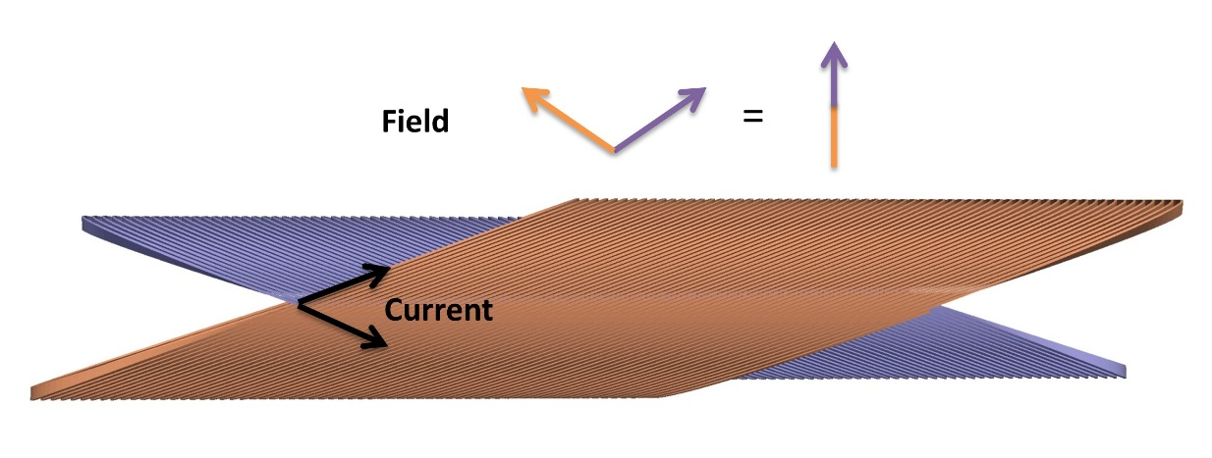
We have initiated a two-prong approach to high field dipoles to explore the limits of Nb₃Sn
A reference design based on a 4-layer cosine-theta magnet utilizing high-performance Nb₃Sn
A path to explore innovative designs
  Starting with the canted cosine-theta (CCT), a different paradigm that integrates mechanical structure internally

Slide 8
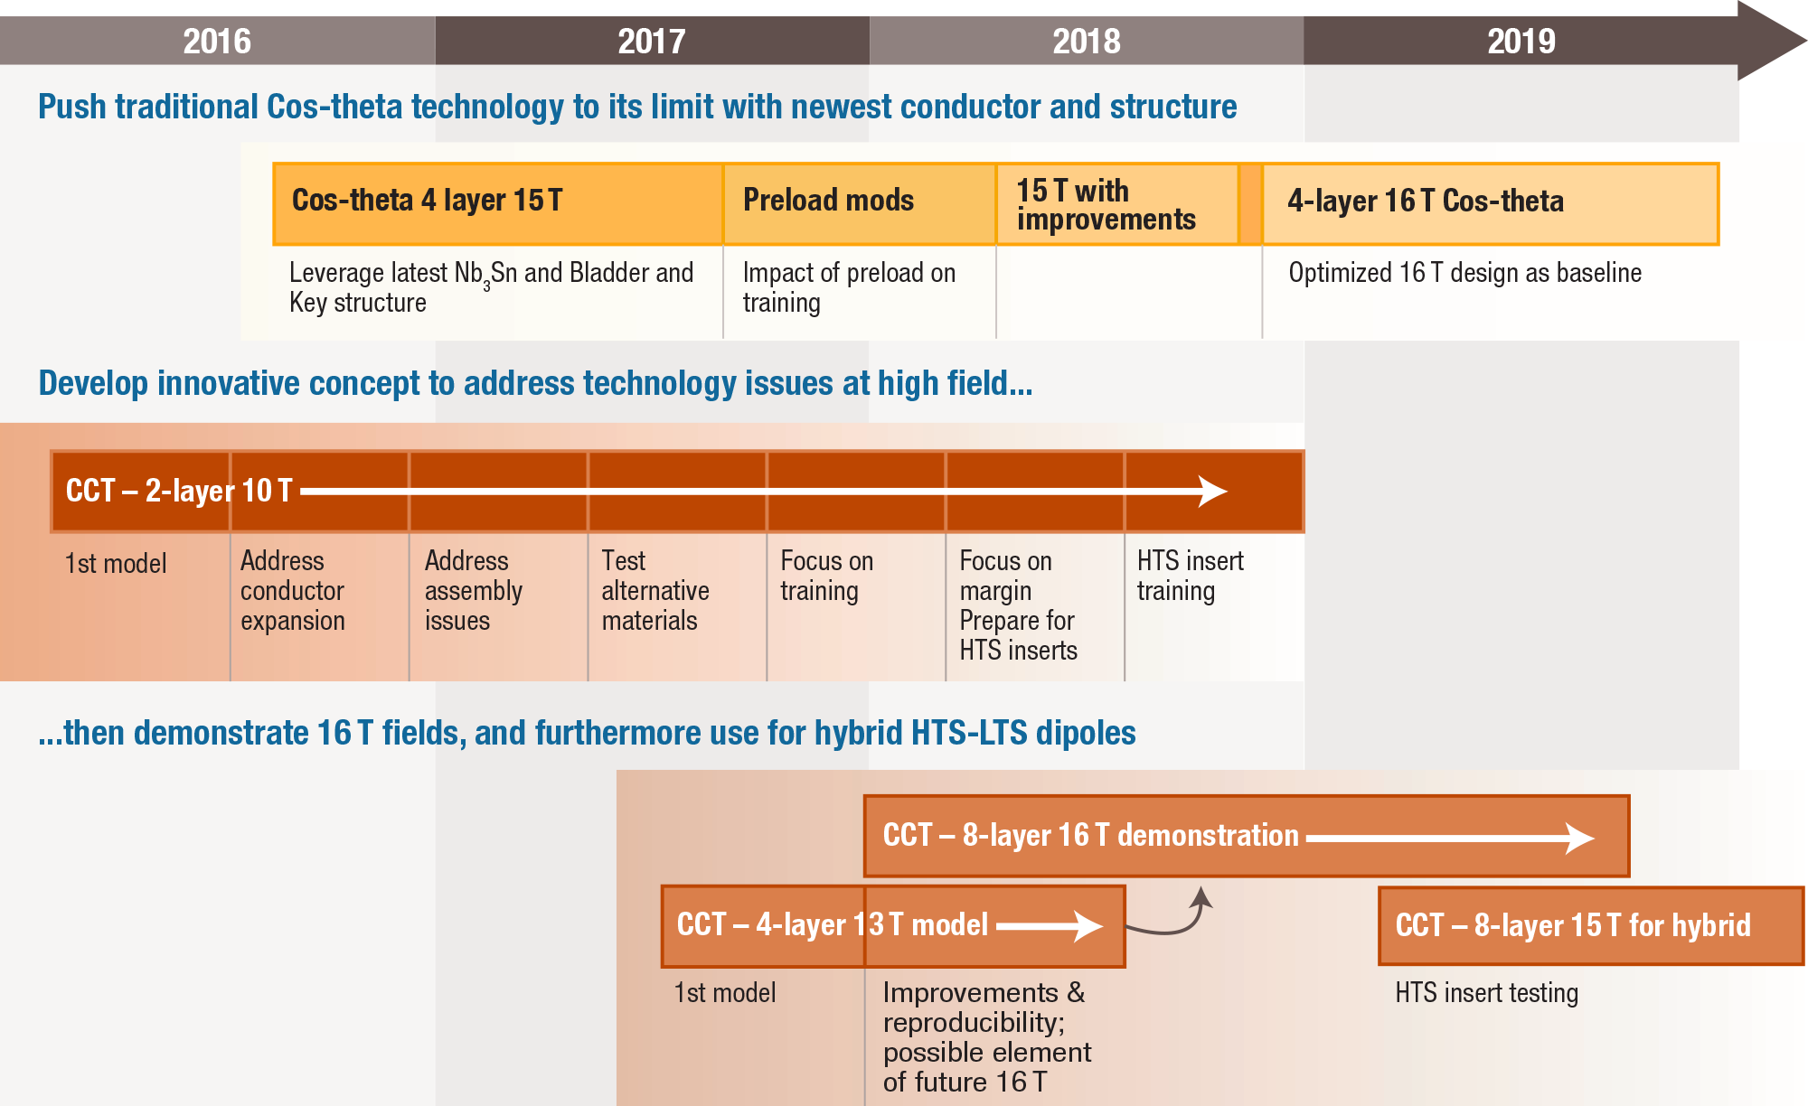
Overview of the Nb₃Sn Milestone Plan,
Highlighting the Cos(θ) Reference Magnet Development and the Innovation Route with CCT

Slide 9
The Cosine-theta 4-layer magnet is proceeding well at FNAL, with 3 outer layer coils completed, mechanical model currently being tested
Zlobin et al. MT25
Kokkinos et al. MT25
Outer coil winding
Novel coil layout addressing midplane stresses and field quality
Coil parts provided by CERN
Traces by LBNL/FNAL

Slide 10
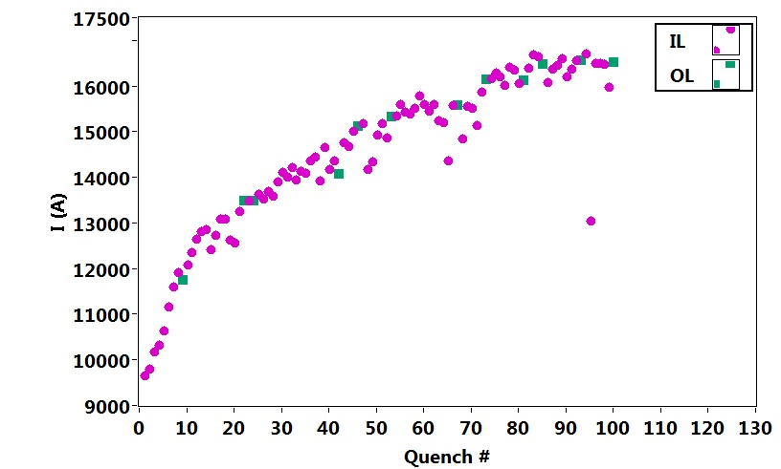
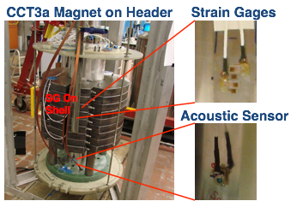
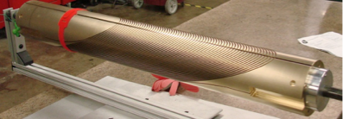
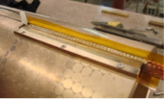

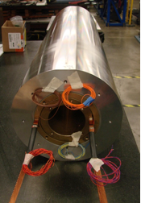
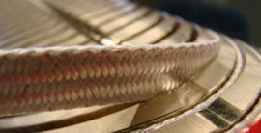
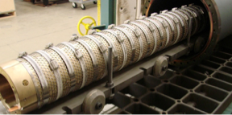
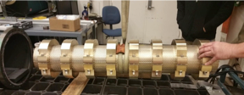
The CCT program is proceeding to systematically address technical issues
Arbelaez et al., MT25
Marchevsky et al., MT25
Magnet testing with a breadth of diagnostics
Brouwer et al., MT25
Auchmann et al., MT25
Reached 86% short sample
Terabytes of acoustic data
Mandrel fabrication developed at LBNL, now done by industry
Fabrication of Nb3Sn/NbTi joints
Assembly into an Al shell
Coil winding: <1 day/layer
VPI using simple, scalable tooling
Reaction: simple, scalable tooling
Reaction of second layer; could be done together with other layers

Slide 11
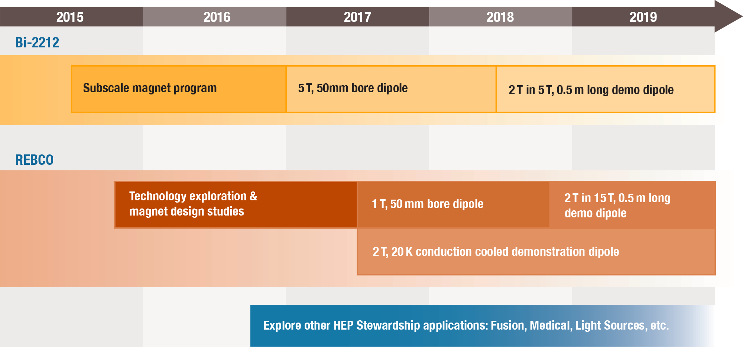
Overview of the HTS Milestone Plan,
Highlighting the Bi-2212 Magnet Development and the REBCO Magnet Development

Slide 12
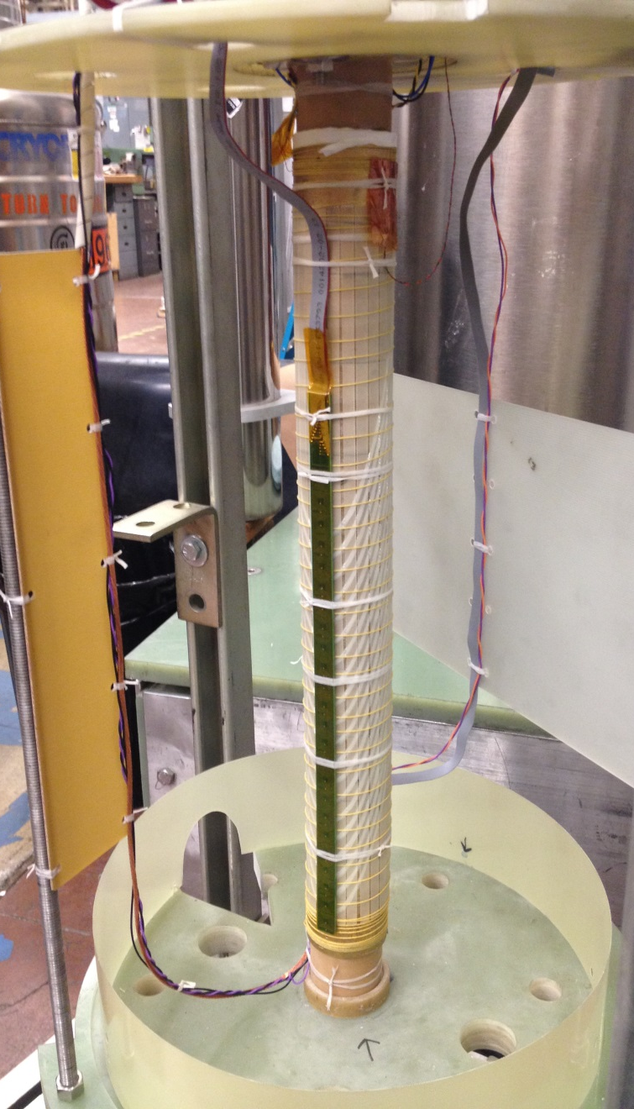
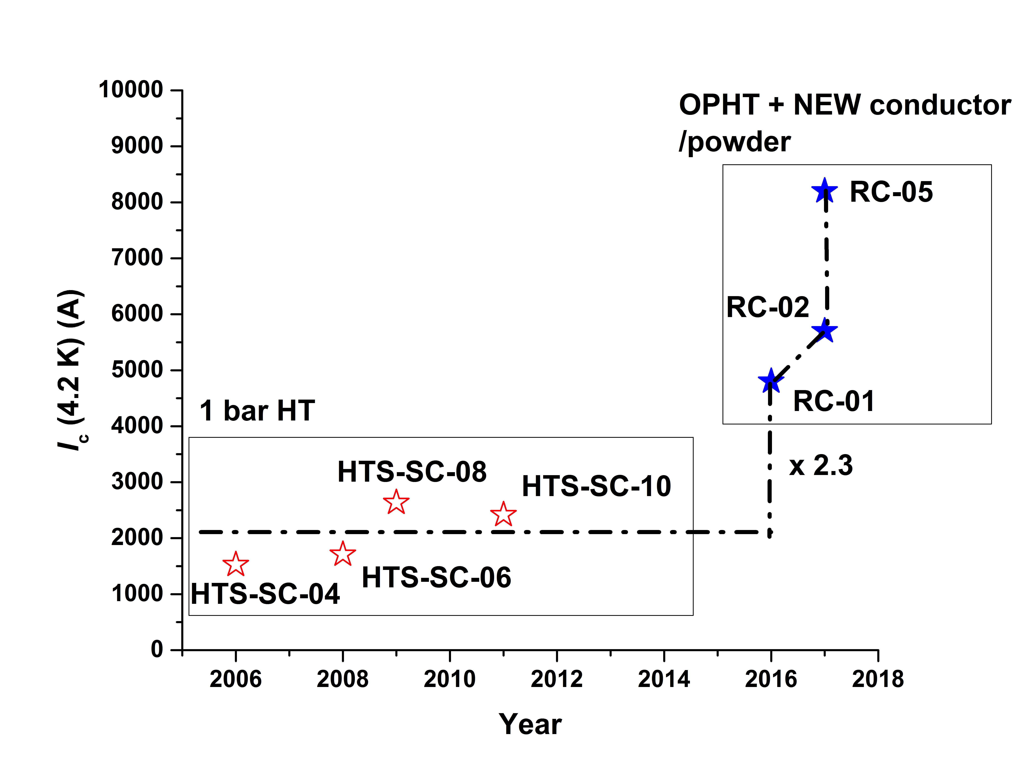
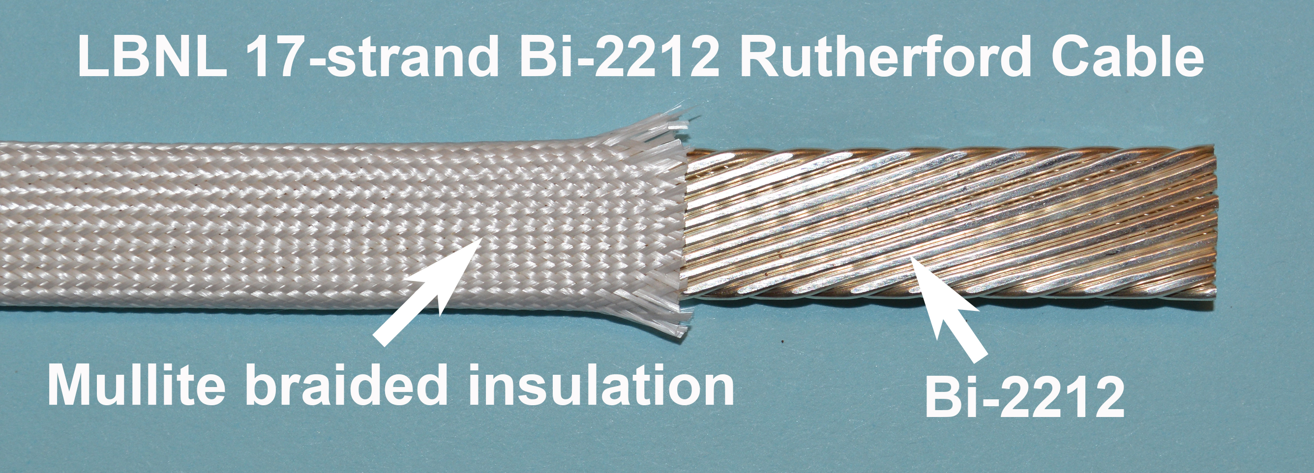
Significant progress on the Bi2212 HTS magnet front:
Leveraging overpressure boost in magnet configurations
Bi2212 accelerator magnets:
Dramatic improvements in conductor properties in last couple of years
Racetrack & CCT coils fabricated and pushed to their electrical, mechanical, and quench limits
Solenoids teaching us much as well

Slide 13
REBCO program developing quickly: conductor and cable characterization, magnet design and prototyping underway
Courtesy
Danko Van Der Laan,
Advanced Conductor Technologies, Inc.
C0b wound with wire #2
1000 A @ 77 K and
12400 A @ 4.2K,
Peak Je = 1198 A/mm²

Slide 14
Backbone of the Program: Magnet Science and Development of Underpinning Technologies
Areas of focus:
Training studies
Modeling
Diagnostics, quench detection, protection
Develop infrastructure, e.g. insert testing
New materials – insulation, impregnation and structural
Design comparison and cost analysis to guide program
Improvements/advances from this part of the program are then integrated into the Nb₃Sn and HTS magnets

Slide 15
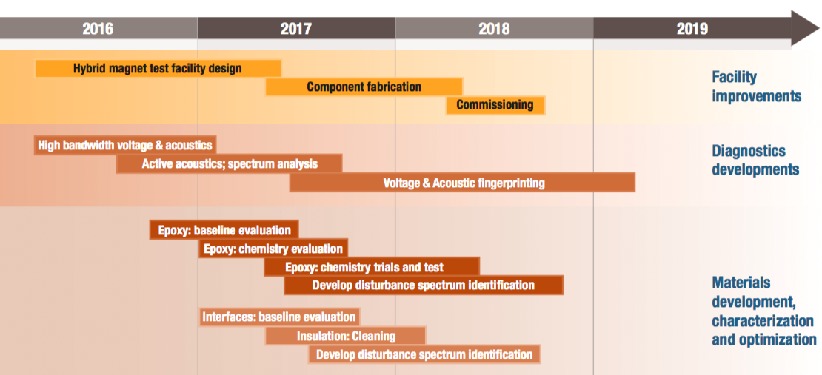
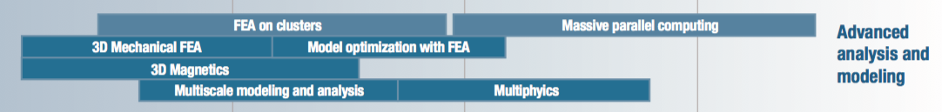
Overview of the Technology Development Milestone Plan, which Feeds the Nb₃Sn and HTS Magnet Program Elements

Slide 16
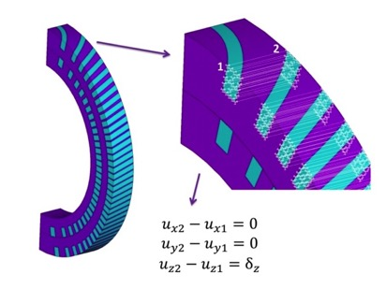
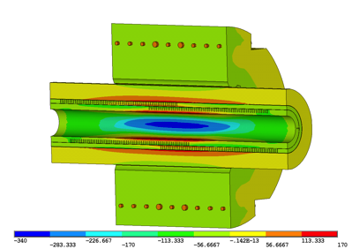
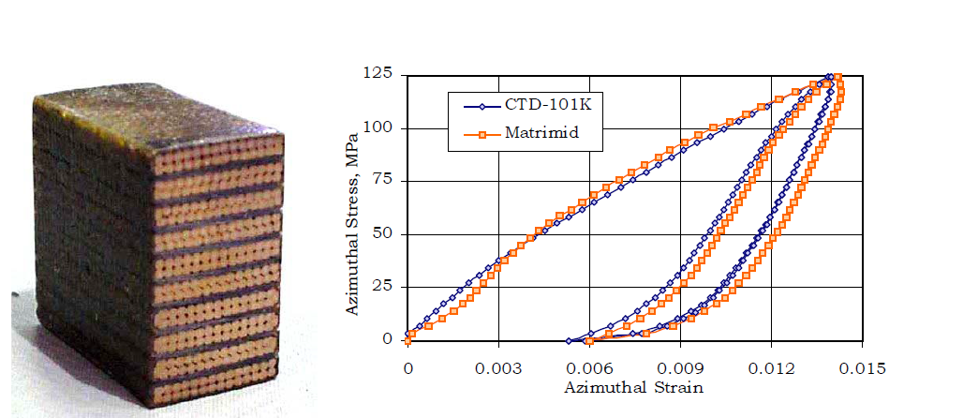
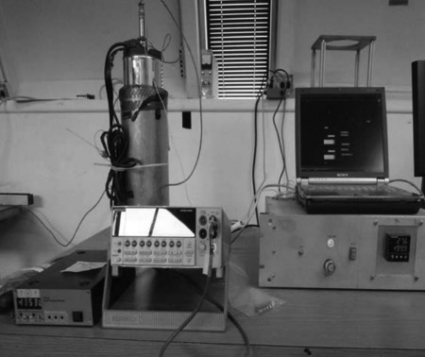
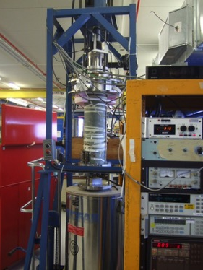
Numerous technology advances are essential to address the high field magnet challenge
See Brouwer et al., MT25
Full 3D simulations – utilizing the computing cluster Lawrencium at LBNL
Periodic Model
Full Model
Ten-stack measurements provide critical materials properties
FNAL PPD and “low temperature loader”

Slide 17
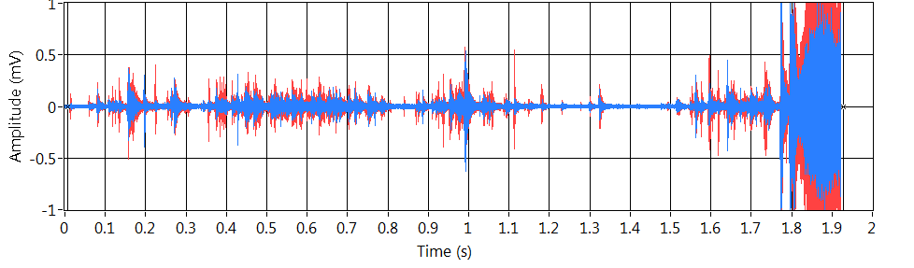

Advanced diagnostics are providing new and critical insight into the mechanisms of training and magnet performance
Marchevsky et al., MT25; EUCAS 17
Warm-bore quench antennas
Acoustic emissions as detectors
Acoustic emissions for localization
“Axial-Field Magnetic Quench Antenna for the Superconducting Accelerator Magnets”, M. Marchevsky, A. R. Hafalia, D. Cheng, S. Prestemon, G. Sabbi, H. Bajas, G. Chlachidze, IEEE Trans. Appl. Supercond. 25, 9500605 (2015), DOI: 10.1109/TASC.2014.2374536

Slide 18
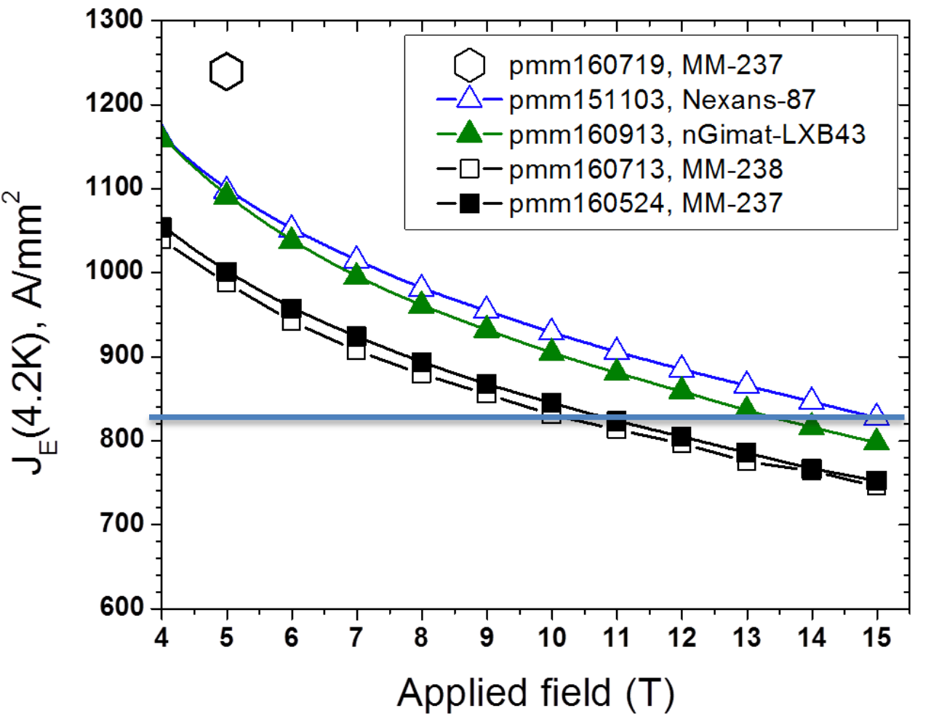
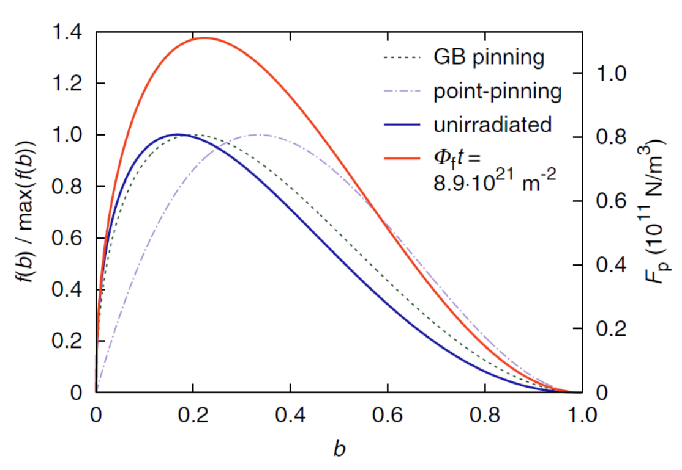
Superconducting Materials Procurement and R&D is Critical for Program Success
Sanabria et al., MT25
Push performance limits of Nb₃Sn and HTS conductors
Performance of today’s state of the art Nb₃Sn is the results of long term HEP investment in conductor R&D
Lombardo et al., MT25
Nb₃Sn
Bi2212
Lee et al., EUCAS
Tarantini et al., EUCAS
Impressive J_{E} improvements through OP processing and advances in powder…
Leverage existing wire/architecture…
Investigate novel routes to improved pinning…
Trociewitz et al. MT25
Larbalestier et al. MT25
Jiang et al EUCAS
David et al. EUCAS
Baumgartner et al
Sci Rep 5 10236 (2015)

Slide 19
The MDP is an active program focused on advancing high-field LTS and HTS accelerator magnet technology for future pp colliders
We have…
  an MDP Plan that lays out our goals and a roadmap for achieving them, fully aligned with the P5 report and the HEPAP Accelerator R&D Subpanel report
  established an excellent Technical Advisory Committee to provide guidance on our program
  identified individuals who will lead and coordinate efforts within the program
  organized our first yearly workshop to work through the program, identify technical issues, and provide input for budgets moving forward
Our focus now is delivering on our near term goals –
  making the Cosine-theta 4-layer magnet a success – potential new record field
  progressing through technical issues with the CCT to see if potential can be achieved
  making real dipoles from HTS and integrating them with LTS
  procuring sufficient conductors for the program, and identifying opportunities for conductor R&D

Slide 20
Backup slides

Slide 21
Cost-effective high-field superconducting magnets are essential for a future collider
R&D

Slide 22
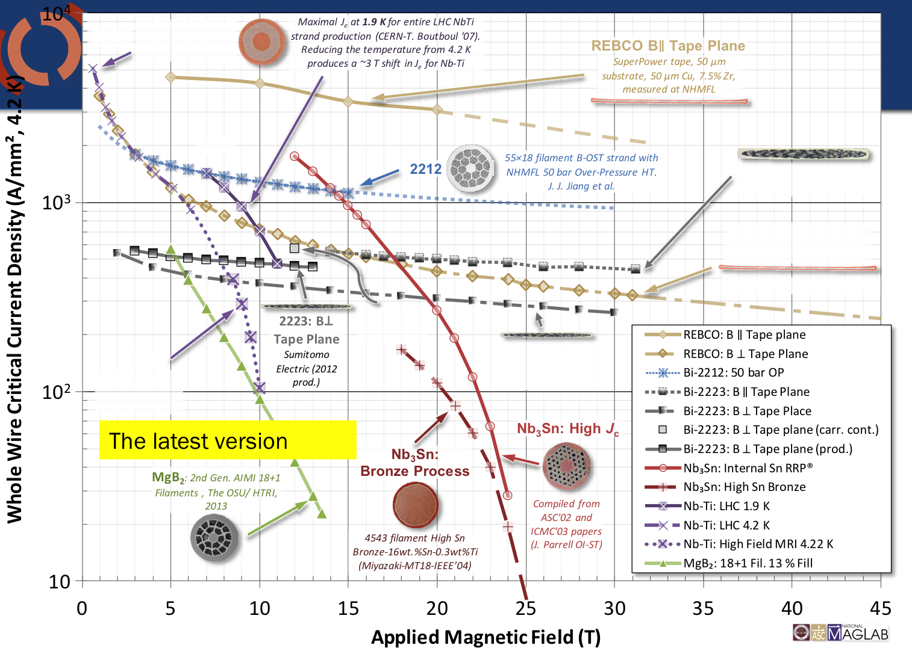
Exciting advances in HTS properties, but cost remains a major hurdle
Notes:
- Explain Je.

Slide 23
The Program is guided by Driving Questions… related to performance
What is the nature of accelerator magnet training? Can we reduce or eliminate it?
What are the drivers and required operation margin for Nb₃Sn and HTS accelerator magnets?
What are the mechanical limits and possible stress management approaches for Nb₃Sn and 20 T LTS/HTS magnets?
What are the limitations on means to safely protect Nb₃Sn and
HTS magnets?

Slide 24
The Program is guided by Driving Questions…related to cost
Can we provide accelerator quality Nb₃Sn magnets in the range
of 16 T?
Is operation at 16 T economically justified? What is the optimal
operational field for Nb₃Sn dipoles?
What is the optimal operating temperature for Nb₃Sn and
HTS magnets?
Can we build practical and affordable accelerator magnets with
HTS conductor(s)?
Are there innovative approaches to magnet design that address the
key cost drivers for Nb₃Sn and HTS magnets that will shift the cost optimum to higher fields?

Slide 25
The Program is guided by Driving Questions… related to conductor development
What are the near and long-term goals for Nb₃Sn and HTS conductor development? What performance parameters in Nb₃Sn and HTS conductors are most critical for high field accelerator magnets?

