Slide 1


International Workshop on High Energy Circular Electron Positron Collider
6-8 November 2017
The 16 T Magnets Program for the FCC
D.Arbelaez¹¹, B.Auchmann¹, H.Bajas¹, M.Bajko¹, A.Ballarino¹, E.Barzi¹⁰, G.Bellomo², M. Benedikt¹, S.Izquierdo Bermudez¹, B.Bordini¹, L.Bottura¹, L.Brower¹¹, M.Buzio¹, B.Caiffi⁵, S.Caspi¹¹, M.Dhalle³, M.Durante⁴, G. de Rijk¹, P.Fabbricatore⁵, S.Farinon⁵, P.Ferracin¹, P.Gao³, S.Gourlay¹¹, M.Juchno¹¹, V.Kashikhin¹⁰, F.Lackner¹, C.Lorin⁴, M.Marchevsky¹¹, V.Marinozzi², T.Martinez ⁶, J.Munilla⁶, I.Novitski¹⁰, T.Ogitsu⁷, R.Ortwein¹, J.Perez¹, C.Petrone¹, S.Prestemon¹¹, M.Prioli¹, J.M.Rifflet⁴, E.Rochepault¹, S.Russenschuck¹, T.Salmi⁸, F.Savary¹, D.Schoerling¹, M.Segreti⁴, C.Senatore⁹, M.Sorbi², A.Stenvall⁸, E.Todesco¹, F.Toral⁶, A.P.Verweij¹, S.Wessel³, F.Wolf¹, A.V.Zlobin¹⁰
Davide Tommasini
1.CERN, 1211 Geneva, Switzerland; 2.INFN, 20133 Milano, Italy; 3.Twente University, 7500 Twente, Netherlands; 4.CEA, 91400 Saclay, France; 5.INFN, 16146 Genova, Italy; 6.CIEMAT, 28040 Madrid, Spain; 7.KEK, 305-0801 Tsukuba, Japan; 8.Tampere University, 33100 Tampere, Finland; 9.University of Geneva, 1211 Geneva, Switzerland; 10.FNAL, Batavia IL 60510, USA; 11.LBNL, Berkeley, CA 94720, USA

Slide 2
Outline
Introduction
Overview
Conclusion

Slide 3
CERN Strategy is based on 3 pillars
Full exploitation of the LHC:
successful operation of the nominal LHC until end 2023
construction & installation of LHC upgrades: LIU (LHC Injectors Upgrade) and HL-LHC
Scientific diversity programme serving a broad community:
ongoing experiments and facilities at Booster, PS, SPS and their upgrades (HIE-ISOLDE, ELENA)
participation in accelerator-based neutrino projects outside Europe (presently
mainly LBNF in the US) through CERN Neutrino Platform
Preparation of CERN’s future:
vibrant accelerator R&D programme exploiting CERN’s strengths and uniqueness
(including superconducting high-field magnets, plasma wakefield acceleration, etc.)
design studies for future high-energy accelerators: CLIC, FCC (includes HE-LHC)
future opportunities of diversity programme: Physics Beyond Colliders Study Group
Important milestone: next update of the European Strategy for Particle Physics (ESPP)
to be completed in May 2020

Slide 4
A new machine is a 50 years adventure
LHC (Large Hadron Collider)
1983 First studies for the LHC project
1988 First magnet model (feasibility)
1994 Approval of the LHC by the CERN Council
1996-1999 Series production industrialisation
1998 Declaration of Public Utility & Start of civil engineering
1998-2000 Placement of the main production contracts
2004 Start of the LHC installation
2005-2007 Magnets Installation in the tunnel
2006-2008 Hardware commissioning
2008-2009 Beam commissioning and repair
2010-2035… Physics exploitation
2010 – 2012 Run 1 ;7 and 8 TeV
2015 – 2018 Run 2 ; 13 TeV
2021 – 2023 Run 3 (14 TeV)
2024 – 2025 HL-LHC installation
2026 – 2035… HL-LHC operation

Slide 5
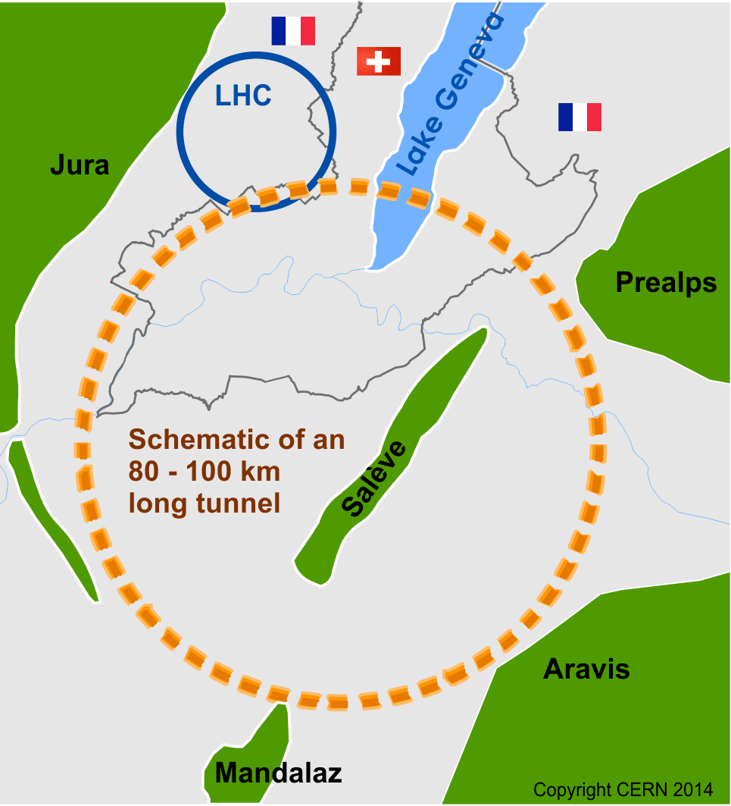
Future Circular Collider Study (FCC)
International FCC collaboration (CERN as host lab) to study:
pp-collider (FCC-hh) → main emphasis, defining infrastructure requirements
100 km tunnel infrastructure in Geneva area, site specific
e⁺e⁻ collider (FCC-ee), as potential first step
p-e (FCC-he) option, integration one IP, FCC-hh & ERL
HE-LHC with FCC-hh technology
~16 T ⇒ 100 TeV pp in 100 km

Slide 6
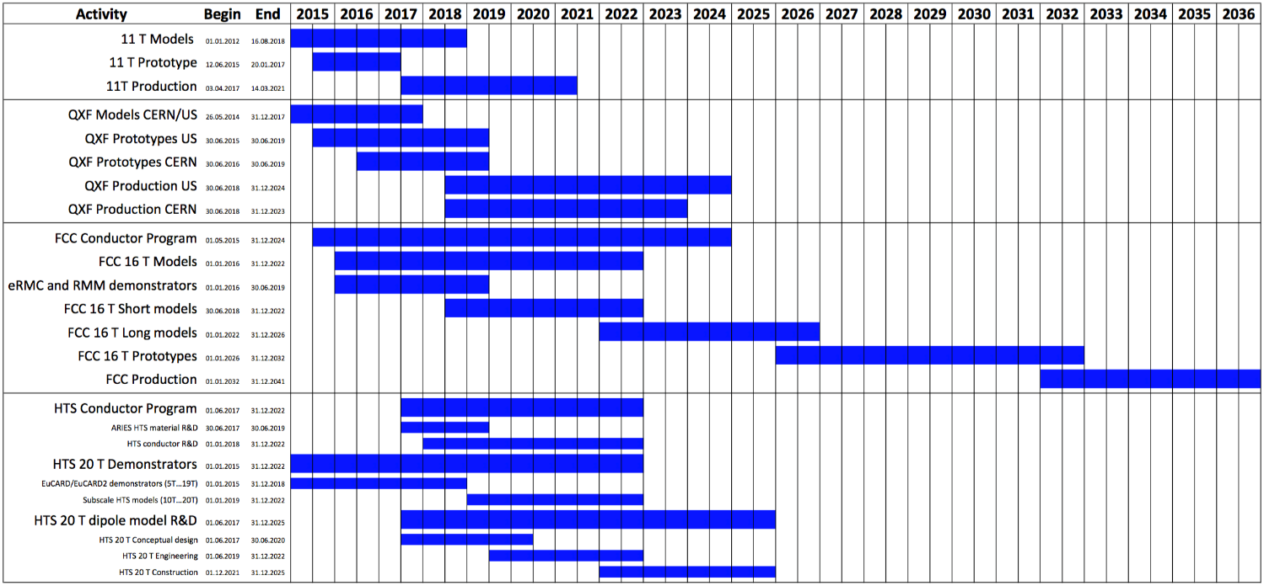
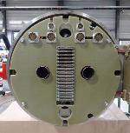
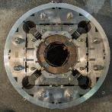
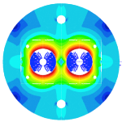
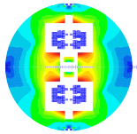
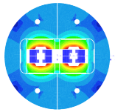
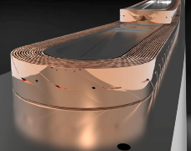
Timeline
LS2
LS3
11T program (LS2)
QXF program (LS3)
FCC 16T program
HTS 20T program
ReBCO
NbTi
HTS is only in its infancy, but is the disruptive high-field magnet technology of the future
  Requires high-tech R&D, spanning from material science to electromechanical engineering
  It is the high-risk/high-return investment of the future

Slide 7
The 16 T Magnets Program
A Future Circular Collider (FCC), or an energy upgrade of the LHC (HE-LHC), would require bending magnets operating at up to 16 T.
This is about :
twice the magnetic field amplitude produced by the Nb-Ti magnets of the LHC
5 T higher than the field produced by the Nb3Sn magnets for HILUMI-LHC
Can, these magnets, be feasible in «accelerator quality»*?
If yes, at which cost?
* margin, construction including alignmnent, field quality, protection in a circuit

Slide 8
Overview of activities until 2023
FCC Conceptual Design Report (to be delivered by end 2018)
Feed the CDR with one reference option, including cost model, plus a description of alternative options.
Conductor
Procurement of up to 1.5 t of conductor/year to feed models and demonstrators
Increase of J_{c} up to FCC target (1500 A/mm² @ 4.2 K, 16 T)
Comprehensive electro-mechanical characterization of the conductor.
R&D Magnets
Design, Manufacture & Test of ERMC and RMM Magnets.
Identify and implement required technological R&D (wound conductor, splices, impregnation …)
Model magnets
Design, Manufacture & Test of Model Magnets

Slide 9



16 T Development Programs
    EuroCirCol WP5
    feed the FCC CDR with design and cost model of 16 T magnets
    FCC 16 T Magnet Development, supporting:
    conductor development & procurement
    R&D magnets and associated development
    model magnets
    US Magnet Development Program (will be covered by Soren Prestemon)
    initially focused to a 14-15 T cosine-theta magnet (2017-2018)
    also exploring a canted cosine-theta option, in a first step possibly as an insert to the outer layers of the 14-15 T magnet above

Slide 10
EuroCirCol WP5 (H2020-INFRADEV-1-2014-1)
Explore design options for a 16 T accelerator dipole
Feed the FCC-CDR with a baseline magnet, including cost
Japan
KEK
WP 5
Three options* are being considered:
Block coils (CEA)
Common coils (CIEMAT)
Cosinetheta (INFN)
*A fourth option (canted costheta) is being considered in the frame of a Swiss contribution to the FCC
A specific feature of this program is that the different design options are being considered with the same specification and analysis tools so that they can be compared relatively to each other.
Finland
TUT
Netherlands
UT
France
CEA
CERN&UNIGE
Italy
INFN
Spain
CIEMAT

Slide 11
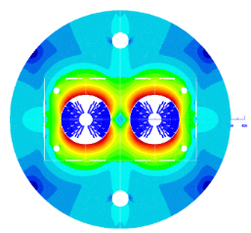
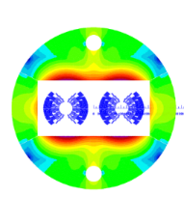
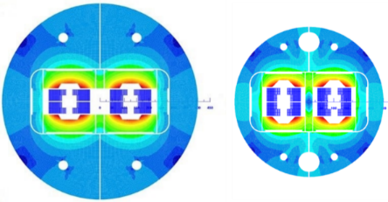
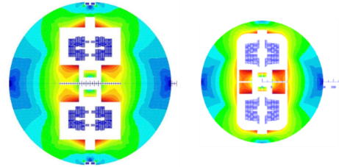
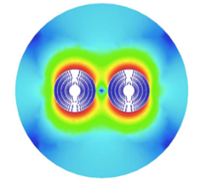
EuroCirCol WP5 : Design Options
800 mm 600 mm
Magnet length 14.3 m
Free physical aperture 50 mm
Field amplitude 16 T
Margin on the load-line @ 1.9K 14 %
Total time margin 40 ms
Critical current density @ 1.9 K, 16T 2300 A/mm²
Conductor fit (Jc/B) EuroCirCol fit
Degradation due to cabling 3%
Minimum Cu/nonCu 0.8
Maximum strand diameter 1.2 mm
Maximum stress on conductor at warm 150 MPa
Maximum stress on conductor at cold 200 MPa
Maximum hot spot temp. (@ 105% I_{nom}) 350 K
Maximum number of strands in a cable 40 - 60
Maximum voltage to ground (magnet) 1.2 kV
Maximum TOTAL voltage to ground 2.5 kV
Conductor cost (performance based) 5 Euro/kAm
Cosinetheta
Block-coils
Common-coils
2015 2017
CCT (PSI with LBNL and CERN)

Slide 12
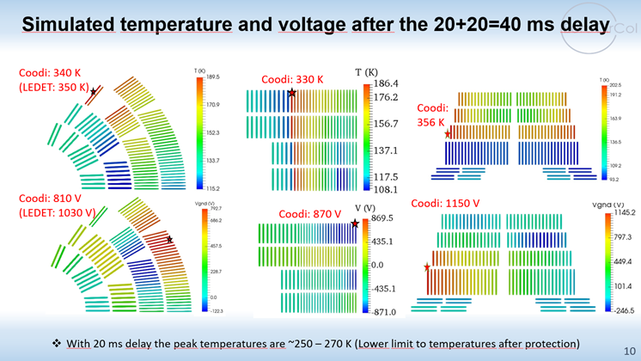
EuroCirCol: Quench Protection

Slide 13
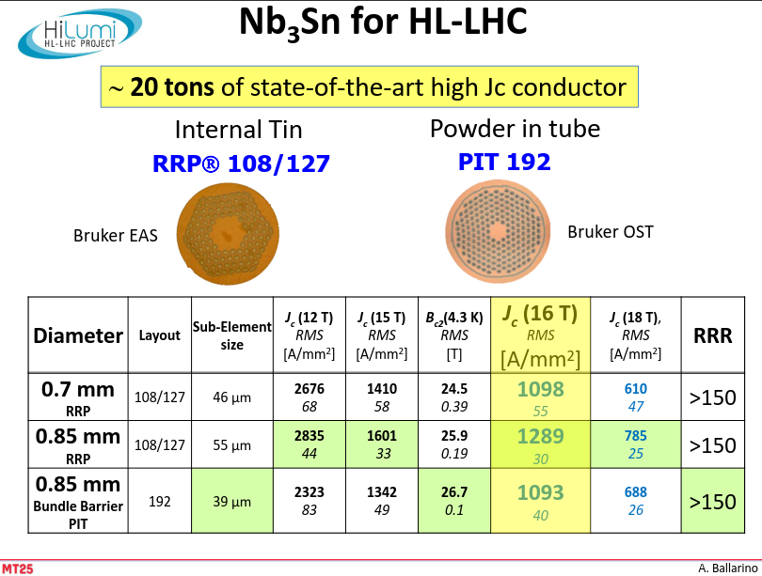
FCC 16 T Magnet Development: Conductor

Slide 14
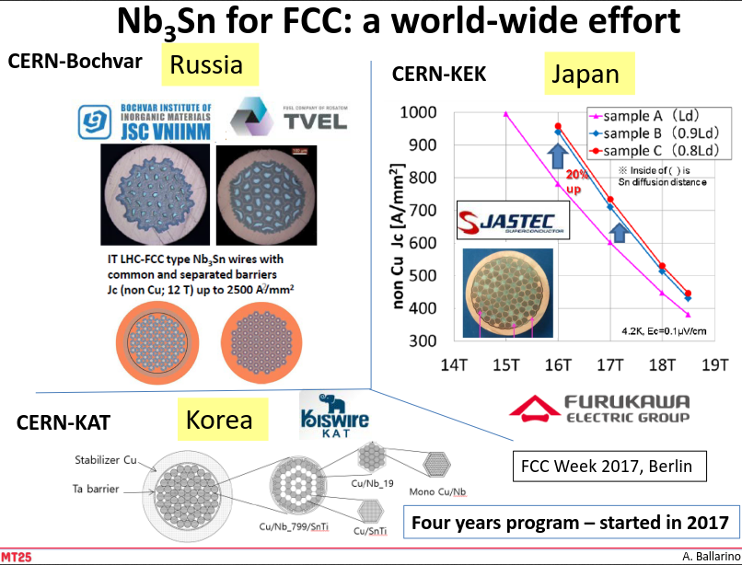
FCC 16 T Magnet Development: Conductor
Initial effort is to achieve J_{c} = 1500 A/mm² at 4.2 K, 16 T
Until 2023, the 16 T development program requires up to 1.5 tons/year

Slide 15
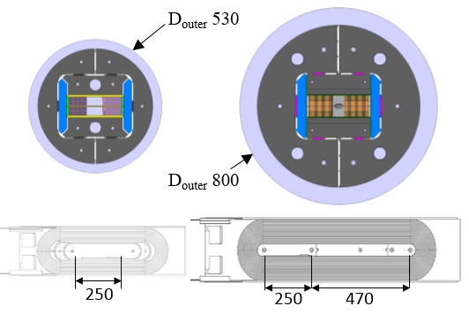
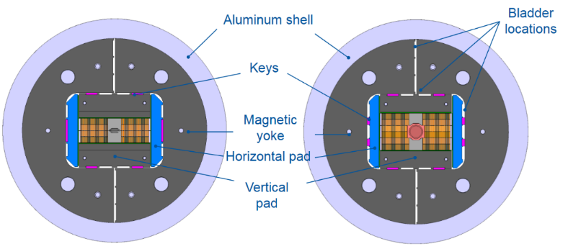
FCC 16 T Magnet Development: R&D Magnets
ERMC (Enhanced Racetrack Model Coil) and RMM (racetrack Model Magnet), non-graded and graded versions
530
800
RMC
ERMC/RMM
RMC
ERMC
RMM
demonstrate the field level with margin and limited/no training
measure and characterize field quality static and dynamic
management of transitions (splices, layer jump, ends …)
study/optimize coil manufacture
explore different loading configurations/strategies

Slide 16
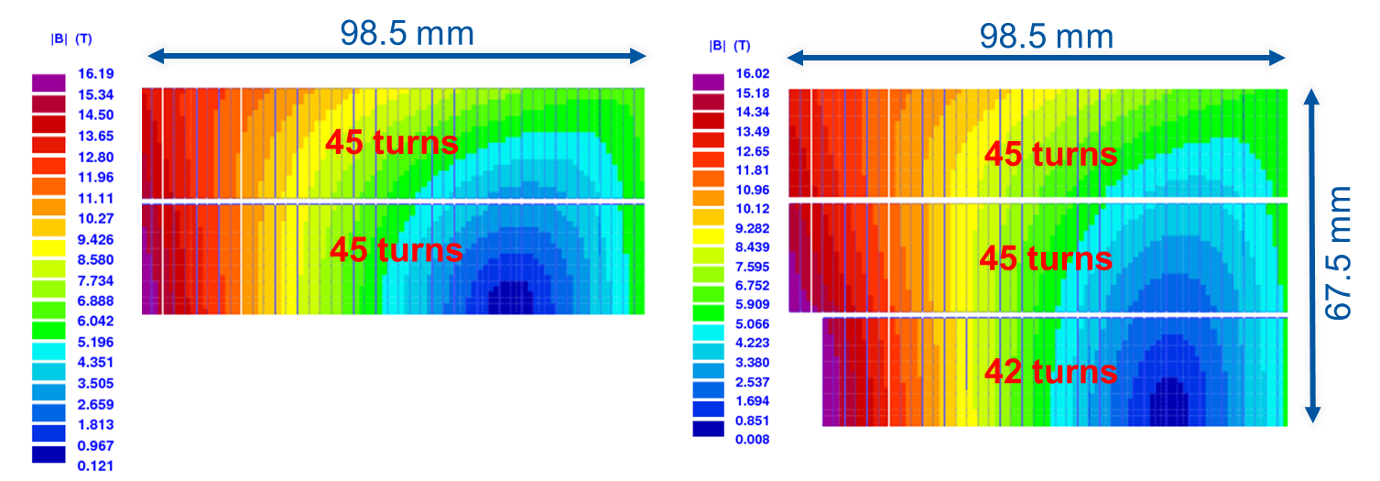
Magnetic Design
ERMC
Two double-layers with 45 turns each wounded around a magnetic pole
B_{p}/B_{o} = 1.097
RMM (ERMC double layers +)
Middle double layer with 42 turns each wound around a titanium closed cavity
Coil aperture radius = 31 mm
Closed aperture radius = 25 mm
B_{p}/B_{o} = 1.097

Slide 17
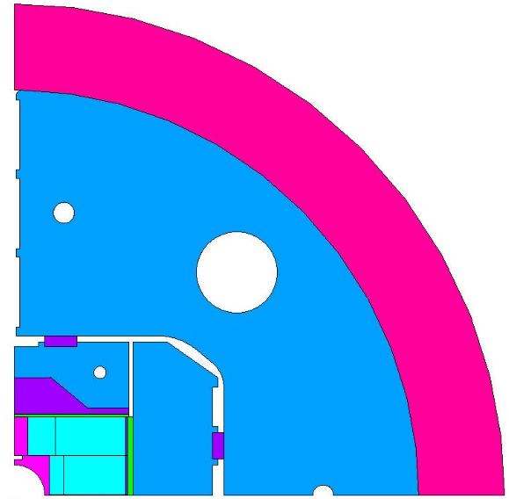
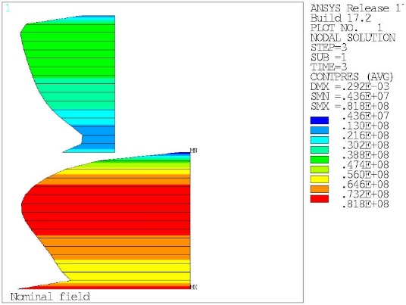
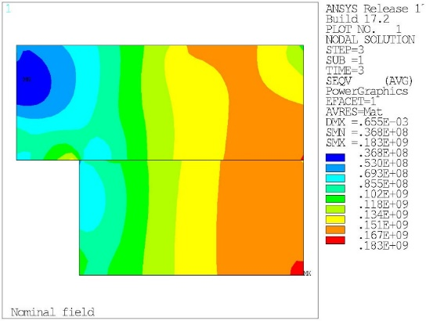
Mechanical Design
Fulfills EuroCirCol Criteria.
  Max. Coil stress = 150 MPa at RT
  Max. Coil stress = 200 MPa at 1.9 K

Slide 18
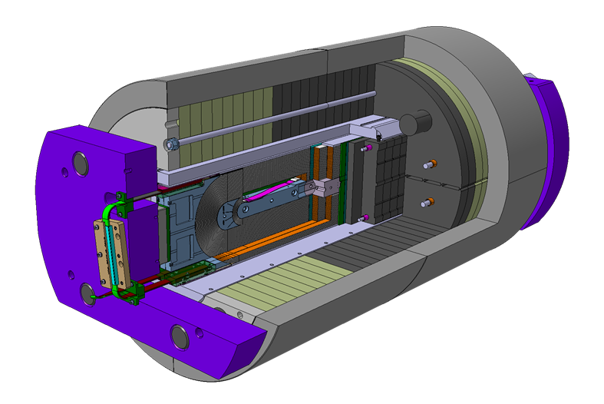
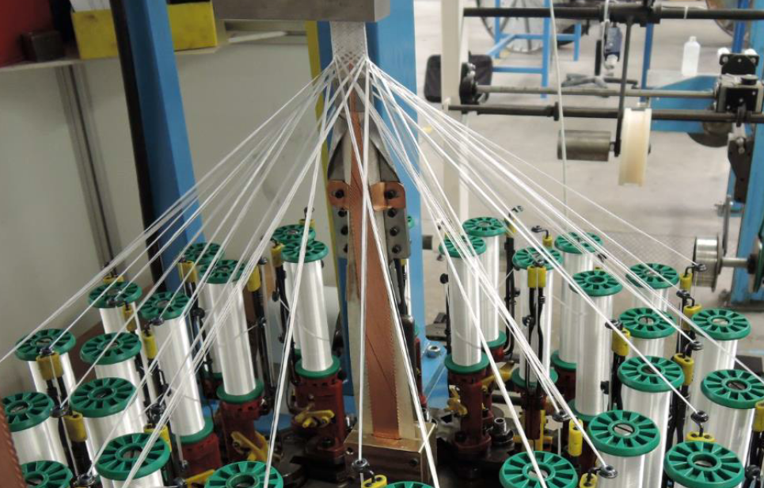
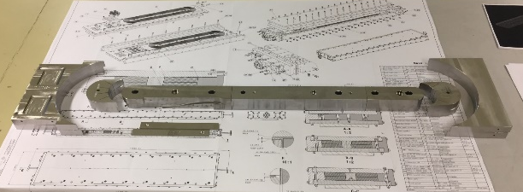
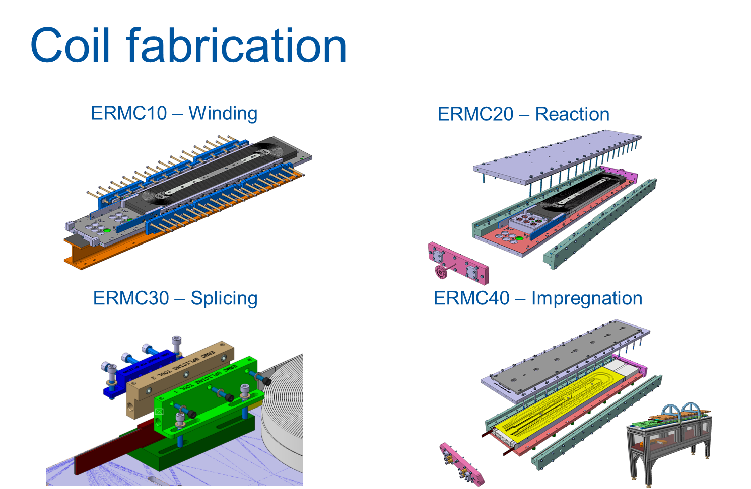
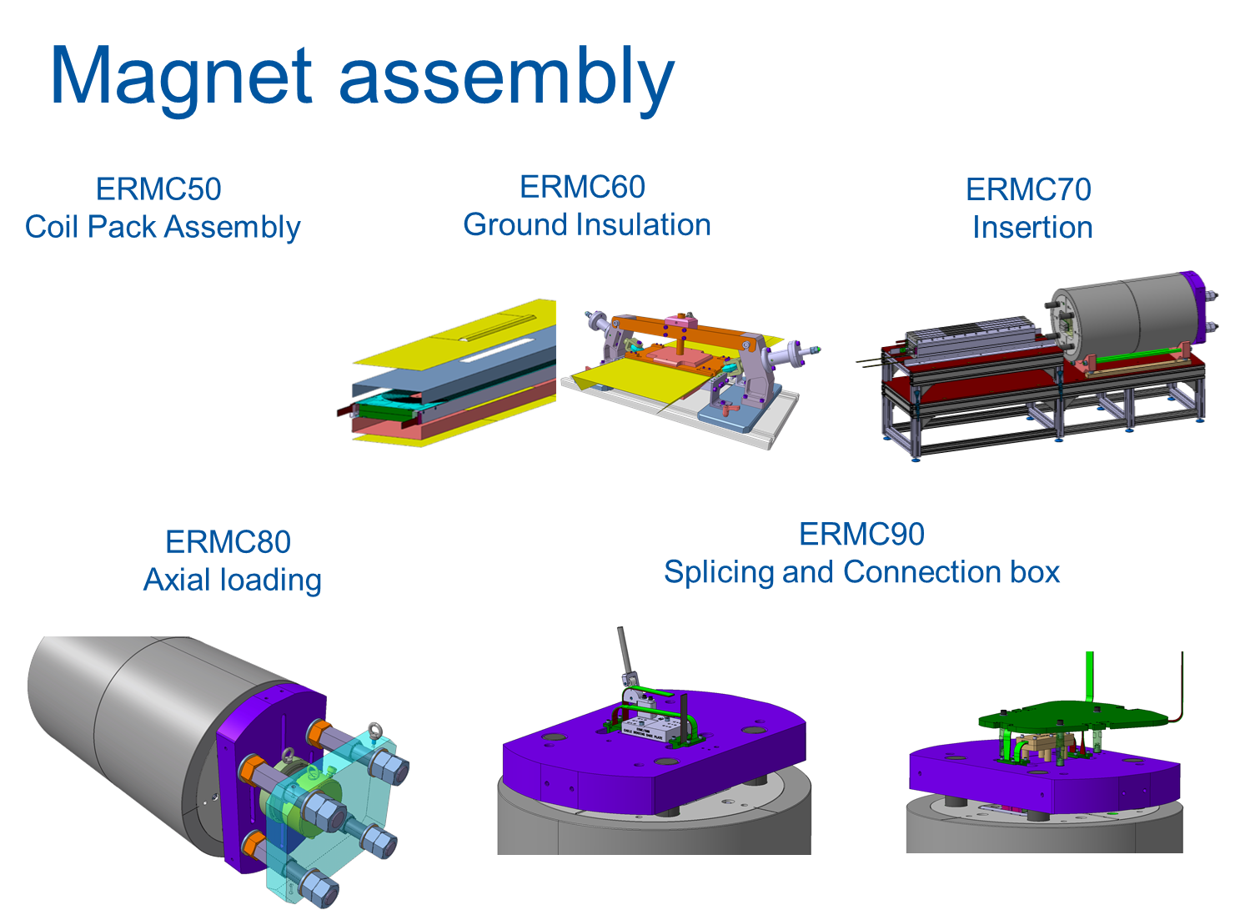
FCC 16 T Magnet Development: R&D Magnets

Slide 19
FCC 16 T Magnet Development: Model Magnets
EuroCirCol shows that more than one design option may work
Each of the options has stronger and weaker points than the others
Furthermore, each of the options can be imagined in different variants
We have now an opportunity to build up a varied experience on Nb3Sn magnets beyond the HILUMI specifications thanks to new initiatives under finalization:
Model magnet at CEA
Model magnet at CIEMAT
Model magnet at INFN
In addition to the work performed in the US, at PSI and at CERN
Start winding the first model magnets in 2019

Slide 20
Conclusion
Accelerator magnets in Nb₃Sn technology are becoming reality in HILUMI.
Still, the distance between 11 T and 16 T is large.
EuroCirCol is animating a both fascinating and effective global collaboration, which is now resulting in new initiatives for the development of model magnets.
The 16 T development program allows the exploration of a wide parameter space and may enable new creative ideas. Directions may include low pre-stress assemblies, low-contraction structural materials, more effective coil fabrication (impregnation, internal and external coil interfaces), better use of the margin.
The contribution of the US MDP is complementing the above efforts and contributing in enriching the sharing of knowledge between laboratories.

Slide 21
Thank you for your attention

