Slide 1
International Linear Collider:
- Technical Status and Prospect -
Akira Yamamoto and Shin Michizono
(KEK/LCC)
Presented at the Int’l Workshop on CEPC, IHEP, 6 Nov., 2017

Slide 2
Outline
Introduction
Technical Status
    Nano-beam technology
    SRF technology
Prospect
    Cost reduction R&Ds
    Scenario for ILC staging at 250 GeV
    ILC to be realized
Summary
A. Yamamoto, 170123

Slide 3

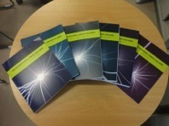
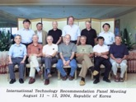
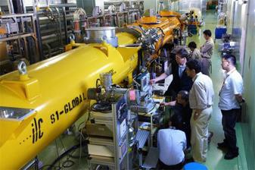
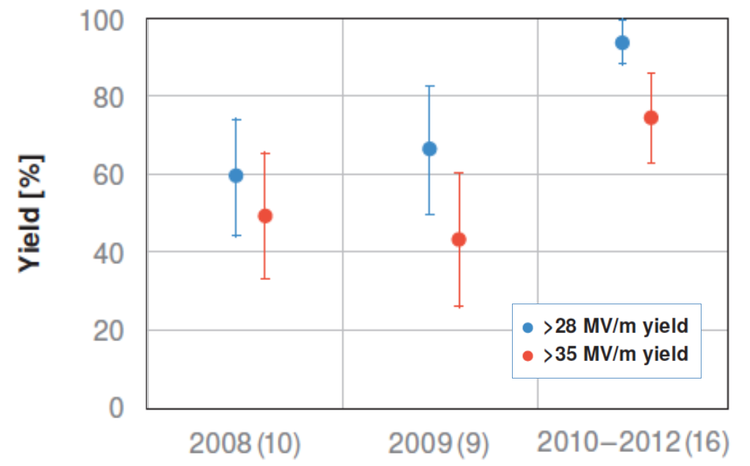
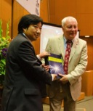
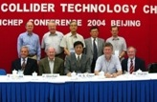
ILC-GDE to LCC
1980’ ~ Basic Study
2004
2006
‘07
‘08
‘09
‘10
‘11
‘12
‘13
‘14
‘15
‘16
‘17
ILC-GDE
LCC
RDR)
TDR
Technical Design Phase
TDR
LHC
SC Technology
selected
European XFEL
LCLS-II

Slide 4
ICFA/LCB/LCC Organization in 2017
FALC
Chair: Brian Browsher
ICFA
Chair: Joachim Mnich
LCB
Chair: Tatsuya Nakada
KEK ILC Promotion
Office
LCC
LCC
Director: Lyn Evans
Deputy
Hitoshi Murayama
CLIC
Collaboration
Public Relations
ILC
Associate Director:
Shin Michizono
CLIC
Associate Director: Steinar Stapnes
Physics & Detectors
Associate Director:
Jim Brau

Slide 5
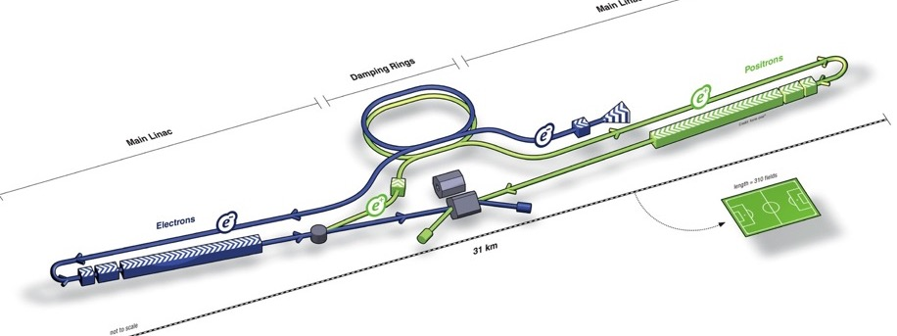
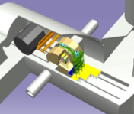
ILC Acc. Design Overview (TDR)
Damping Ring
e- Source
e+ Main Liinac
Physics Detectors
Item | Parameters
C.M. Energy | 500 GeV
Length | 31 km
Luminosity | 1.8 x10³⁴ cm⁻²s⁻¹
Repetition | 5 Hz
Beam Pulse Period | 0.73 ms
Beam Current | 5.8 mA
Beam size (y) at FF | 5.9 nm
SRF Cavity G. Q₀ | 31.5 MV/m Q₀ = 1x10 ¹⁰
e+ Source
e- Main Linac
Key Technologies
Nano-beam
Superconducting RF

Slide 6
ILC Parameters demonstrated
Characteristics | Parameter | Unit | Demonstrated
Nano-bam:
ATF-FF equiv. beam size (y) ILC-FF beam size (y) | 37 (reaching 41 ) 5.9 (correspond. 7) | nm nm | KEK-ATF
SRF:
Average accelerating gradient | 31.5 (±20%) | MV/m | DESY, FNAL, JLab, Cornell, KEK,
Cavity Q₀ | 10¹⁰
(Cavity qualification gradient | 35 (±20%) | MV/m)
Beam current | 5.8 | mA | DESY-FLASH), KEK-STF
Number of bunches per pulse | 1312 |  | DESY
Charge per bunch | 3.2 | nC
Bunch spacing | 554 | ns
Beam pulse length | 730 | ms | DESY, KEK
RF pulse length (incl. fill time) | 1.65 | ms | DESY, KEK, FNAL
Efficiency (RF→beam) | 0.44
Pulse repetition rate | 5 | Hz | DESY, KEK

Slide 7
Outline
Introduction
Technical Status
    Nano-beam technology
    SRF technology
Prospect
    Cost reduction R&Ds
    Scenario for ILC staging at 250 GeV
    ILC to be realized
Summary
A. Yamamoto, 170123

Slide 8
ILC Technical Status in 2017
Key Technologies matured for the project realization !
Nano-beam Technology：
    KEK-ATF2: FF beam size (v): 41 nm at 1.3 GeV (equiv. to 7 nm at ILC）
SRF Technology ：
    European XFEL completed: <G = ~ 30 MV/m> achieved with 800 cavities
    LCLS-II: construction in progress
    US-Japan: Cost Reduction R&Ds in progress, referring “N Infusion” process demonstrated, at Fermilab, for High-Q and High-G
  Prospect:
  Staging, at 250 GeV, proposal to be authorized by ICFA/LCB

Slide 9
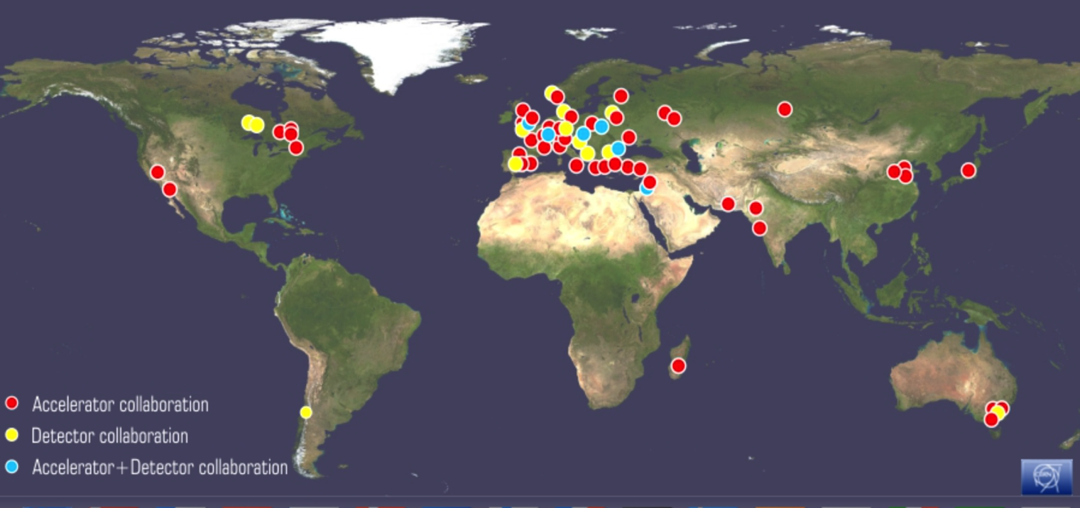
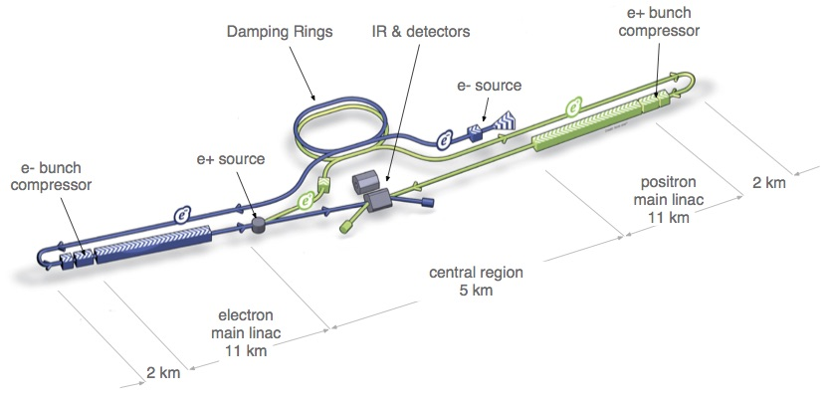
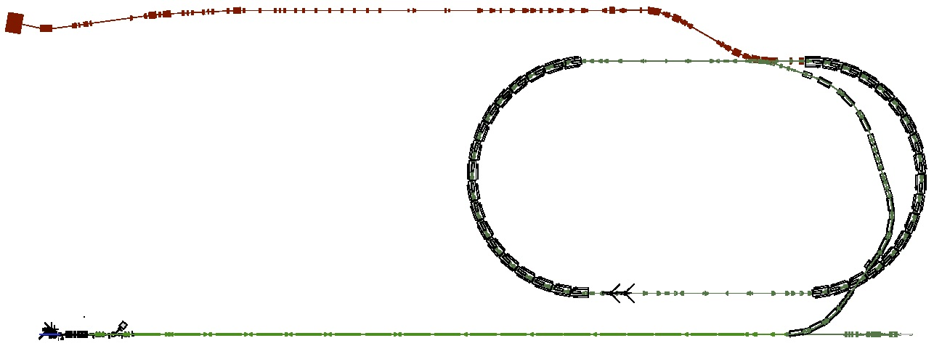
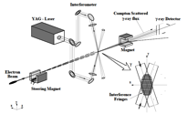
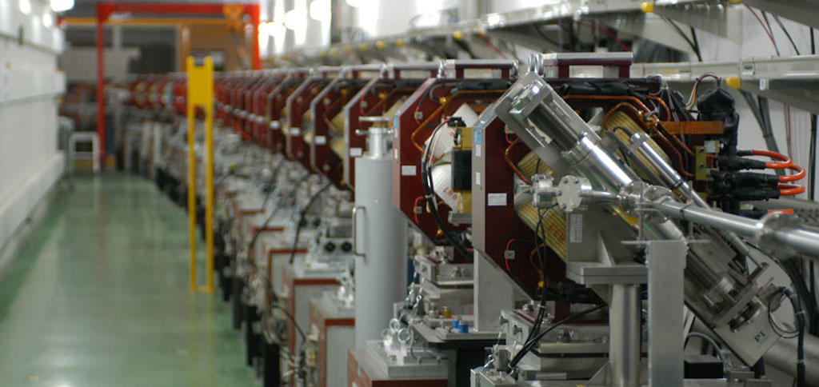
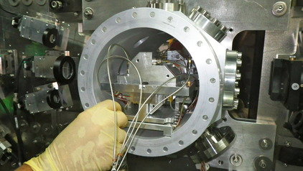
ATF/ATF2 Collaboration
Courtesy, N. Terunuma
Layout of ILC
To develop nano-beam tech.
Key for the luminosity
6 nm beam at IP (ILC)
ATF2: Final Focus Test Beamline
  Goal 1:establish “small beam” tech.
  Goal 2: stabilize “beam position”
Damping Ring (~140m)
Low emittance electron beam
1.3 GeV S-band Electron LINAC (~70m)

Slide 10
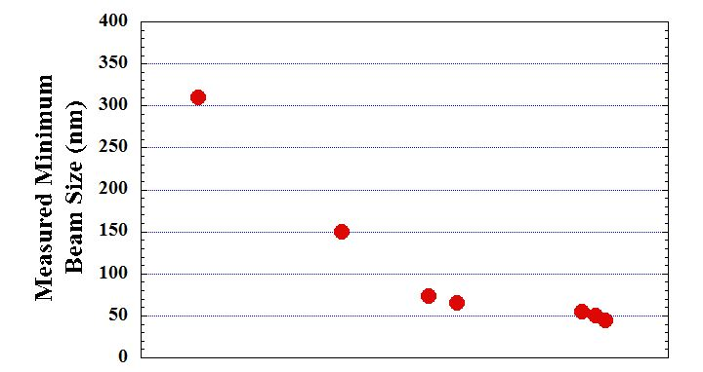
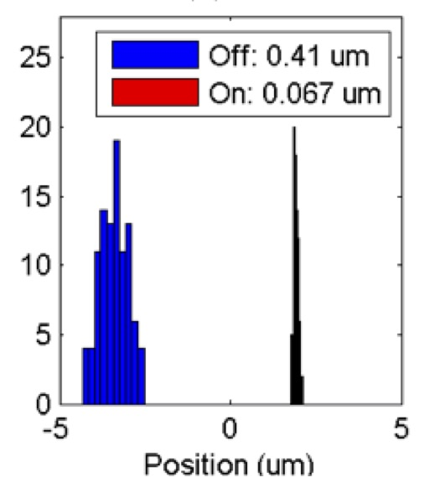
Progress in FF Beam Size and Stability at ATF2
Goal 1:
Establish the ILC final focus method with same optics and comparable beamline tolerances
ATF2 Goal : 37 nm → ILC 6 nm
  Achieved 41 nm (2016)
Goal 2:
Develop a few nm position stabilization for the ILC collision by feedback
FB latency 133 nsec achieved
(target: < 300 nsec)
positon jitter at IP: 410 → 67 nm (2015) (limited by the BPM resolution)
Shintake-monitor upgrade
Dec 2010
QF1 exchanged
Sextupoles exchanged
Earthquake (Mar 2011)
Orbit feedback improved
Feb-Jun 2012
SF5 turned off
May 2014
Dec 2012
Mar 2013
Apr 2014
41 nm, 2016

Slide 11





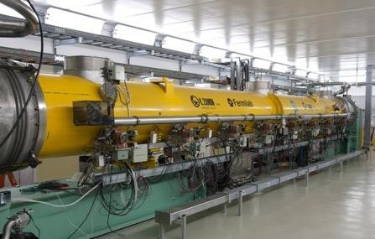
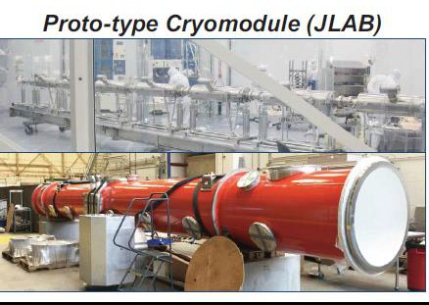
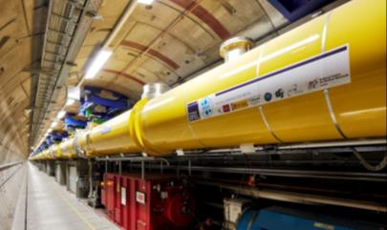
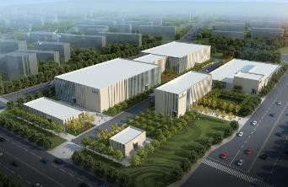
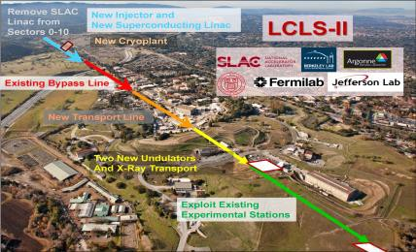
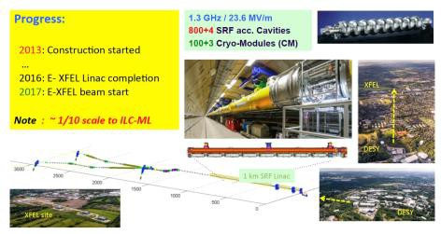
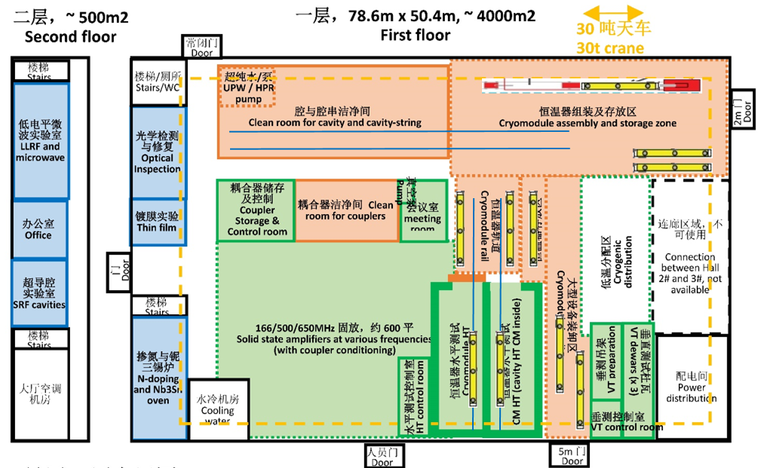
Worldwide SRF Collaboration
CERN, DESY
FNAL/ANL
MSU
IHEP, PKU
TRIUMF
Cornell
JLAB
CEA, CNS-LAL
INFN
KEK
SLAC, LCLS-II
European XFEL
IUAC, RRCAT
Americas, LCLS-II
ILC-SRF technology
Asia,
PAPS@IHEP CFF/STF@KEK

Slide 12
SRF Accelerators Advances
2010 ~
Courtesy, H. Padamsee
Project | Notes | # cavities
CEBAF-JLAB (US) | Upgrade 6.5 GeV => 12 GeV electrons | 80
XFEL-Hamburg (EU) | 18 GeV electrons – for Xray Free Electron Laser – Pulsed) | 840
LCLS-II – SLAC (US) | 4 GeV electrons –CW XFEL (Xray Free Electron Laser) | 300
SPIRAL-II (France) | 30 MeV, 5 mA protons -> Heavy Ion | 28
FRIB – MSU 8US) | 500 kW, heavy ion beams for nuclear astrophys | 340
ESS (Sweden) | 1 – 2 GeV, 5 MW Neutron Source ESS - pulsed | 150
PIP-II–Fermilab (US) | High Intensity Proton Linac for Neutrino Beams | 115
ADS- (China, India) | R&D for accelerator drive system | > 200
Globally Int. Effort |  | > 2000

Slide 13
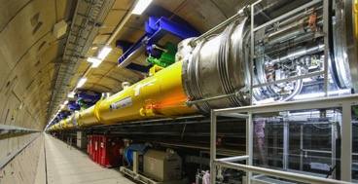

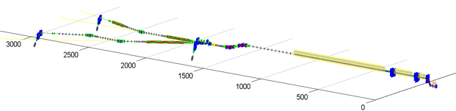
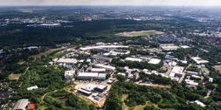

European XFEL, SRF Linac Completed
Courtesy, H. Weise
Progress:
2013: Construction started
…
2016: E- XFEL Linac completion
2017: E-XFEL beam start
1.3 GHz / 23.6 MV/m
800+4 SRF acc. Cavities
100+3 Cryo-Modules (CM)
: ~ 1/10 scale to ILC-ML
1 km SRF Linac
XFEL site
DESY
13

Slide 14
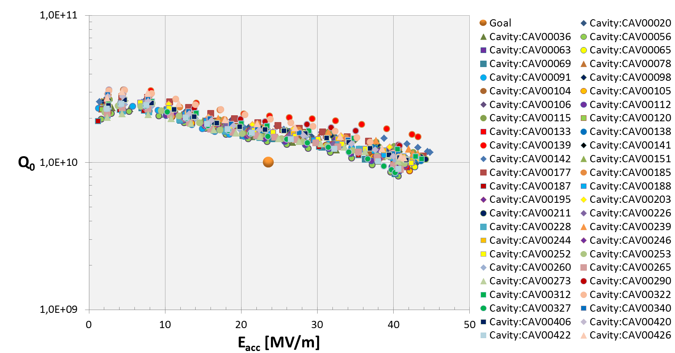
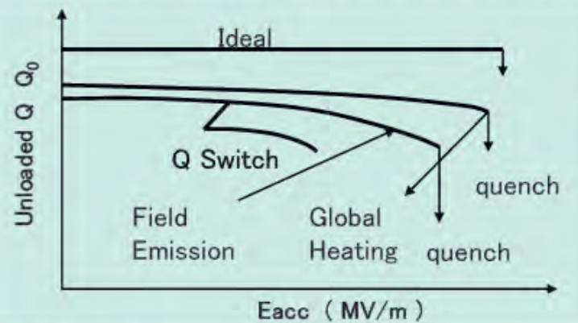
European XFEL: SRF Cavity Performance
Courtesy, D. Reschke , N. Walker, C. Pagani
>10 % (47/420, RI) cavities
exceeding 40 MV/m
After Retreatment:
E-usable: 29.8 ± 5.1 [MV/m]
(RI): E usable 31.2 ± 5.2 [MV/m]), w/ 2nd EP
(EZ): E usable 28.6 ± 4.8 [MV/m]) , w/ BCP ( instead of 2nd EP)

Slide 15
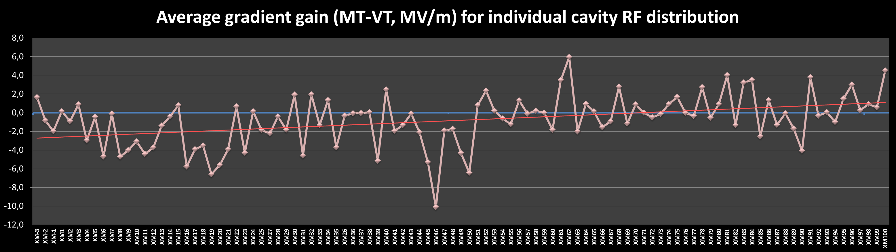
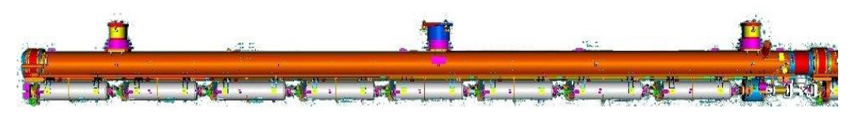





Gradient Performance: Cryomodule v.s. Cavity
Couresy, O. Napoly
New clean
room procedure
CEA Audit
1st sample of 34 series CM
ΔE_{op} = -2.1 MV/m
2nd sample of 19 series CM
ΔE_{op} = -1.7 (-0.9) MV/m
last 47 series CM
ΔE_{op} =+0.5 MV/m
Degradation mitigated through critical efforts during the 100 European XFEL cryomodule assembly. No-degradation achieved.

Slide 16
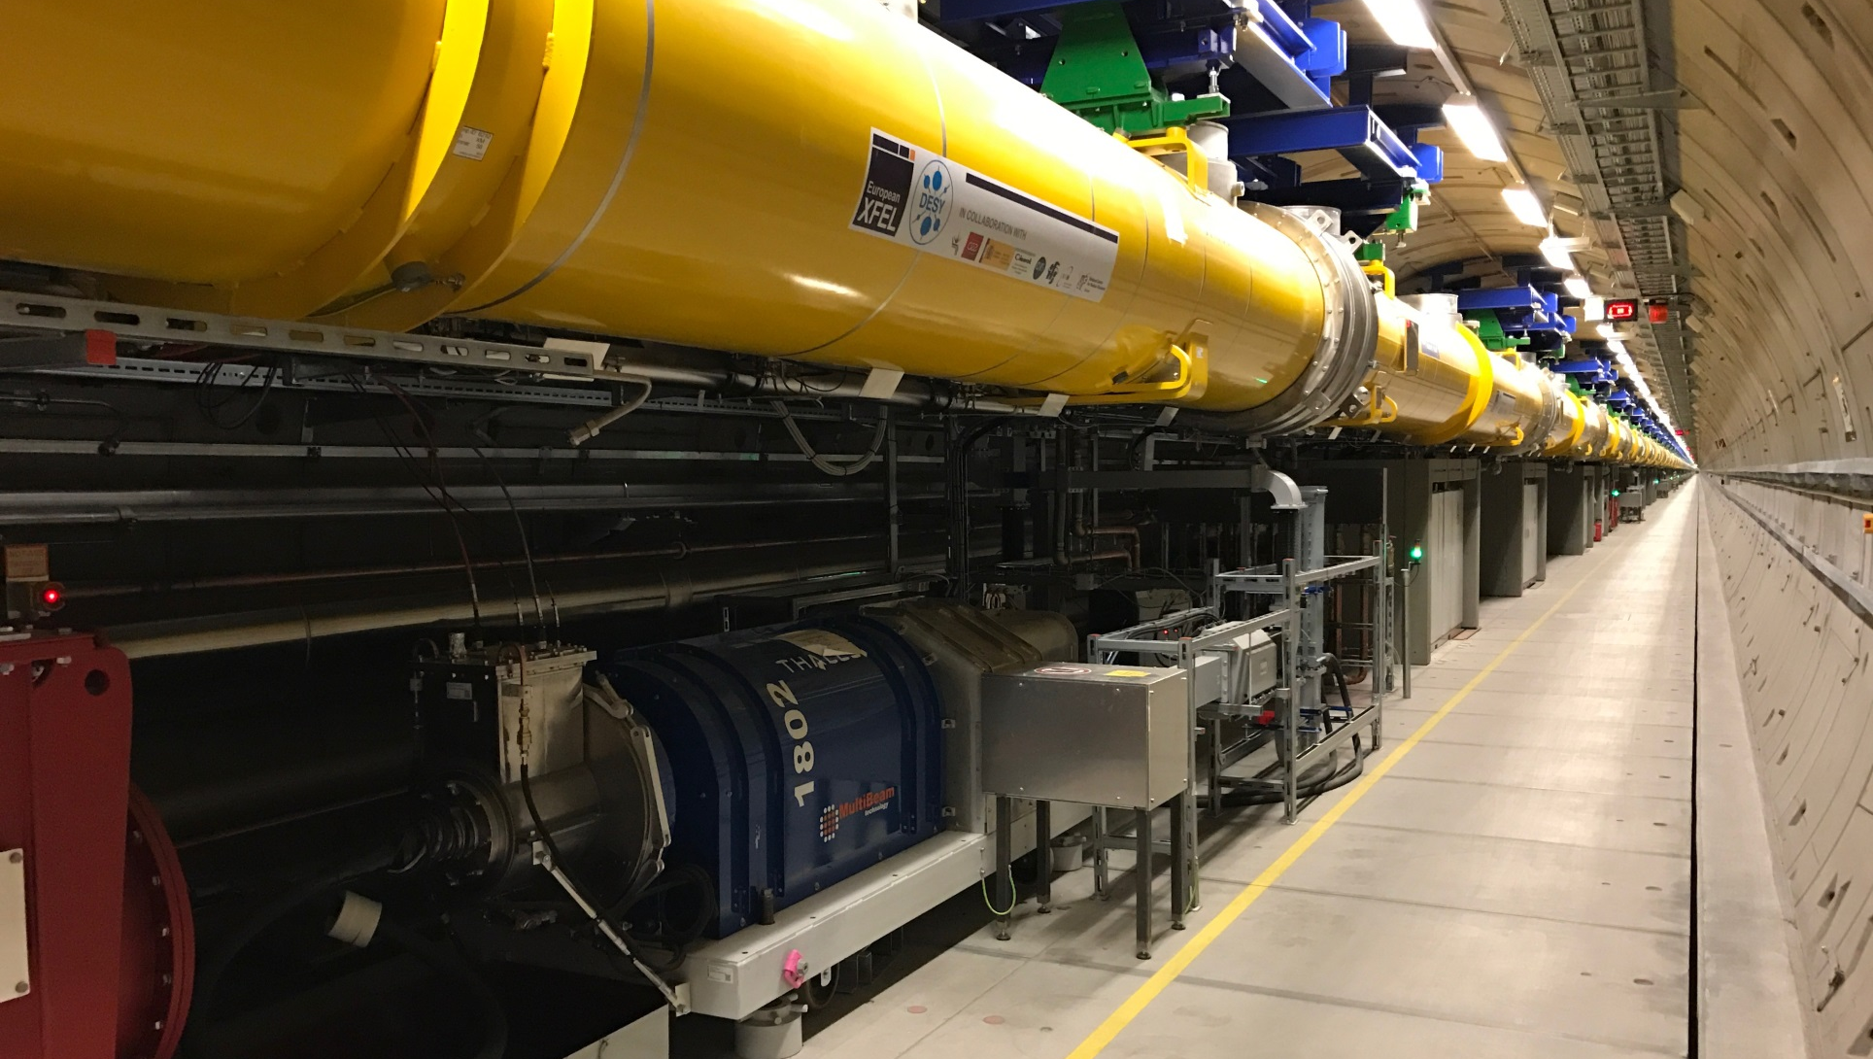
RF Performance as of 28.9.2017
Courtesy, M. Omet
European XFEL SRF Accelerator Commisioning
in progress

Slide 17
Outline
Introduction
Technical Status
    Nano-beam technology
    SRF technology
Prospect
    Cost reduction R&Ds
    Scenario for ILC staging at 250 GeV
    ILC to be realized
Summary
A. Yamamoto, 170123

Slide 18
US-Japan Discussion Group on ILC
Courtesy, Y. Okada, LCWS2017
First meeting on May 25, 2016 at Washington D.C
  Attended by Deputy Director-General, Research Promotion Bureau, MEXT, and Director, Office of Science, DOE.
  Agreed on item of discussion
Working level meeting on August 8, 2016 at ICHEP venue in Chicago
  Attended by Director, Basic Research Promotion Div., MEXT, and Associate Director for HEP, DOE.
  Heard from KEK and FNAL on the proposal of the joint R&D for cost reduction.
Second meeting on October 18, 2016 by video
  Attended by Deputy Director-General, Research Promotion Bureau, MEXT, and Director, Office of Science, DOE.
  Agreed to begin the joint R&D from April 2017.
Discussion group activity continues. The report on ILC Organization and Management is an input to this activity.

Slide 19
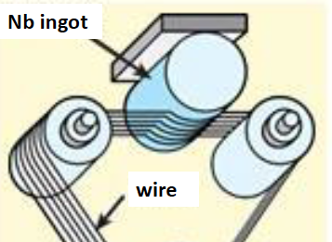
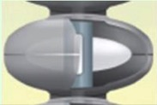
ILC Cost-Reduction R&D in US-Japan Cooperation on SRF Technology, for ~3 years
S. Michizono, S. Belomestnykh
Based on recent advances in technologies;
  Nb materia/sheet preparation
  - w/ optimum RRR and clean surface
  SRF cavity fabrication for high-Q and high-G
  -w/ a new “N Infusion” recipe demonstrated by Fermilab
  Power input coupler fabrication
  - w/ new (low Second. e- emission) ceramic without TiN coating
  Cavity chemical process
  - w/ vertical EP and new chemical (non HF) solution
  Others

Slide 20
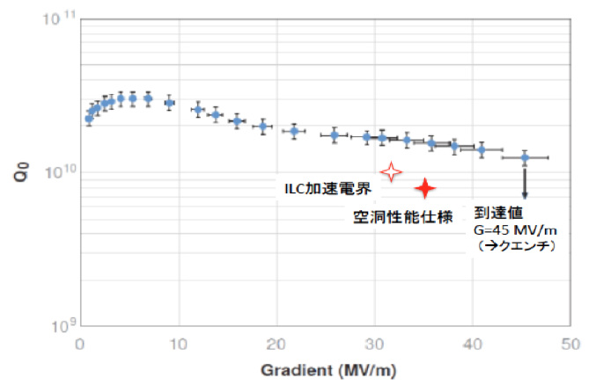
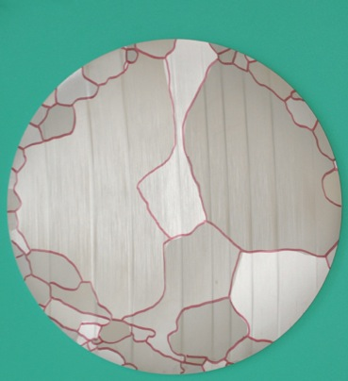
Gradient demonstrated w/ Nb-Sliced
ILC Gradient
Cavity Spec.
45 MV/m
reached
50 mm
Result from DESY

Slide 21
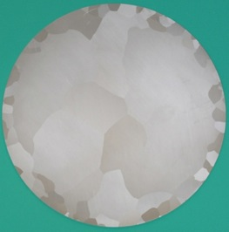
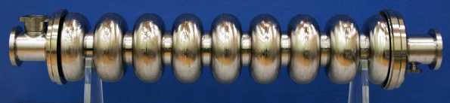
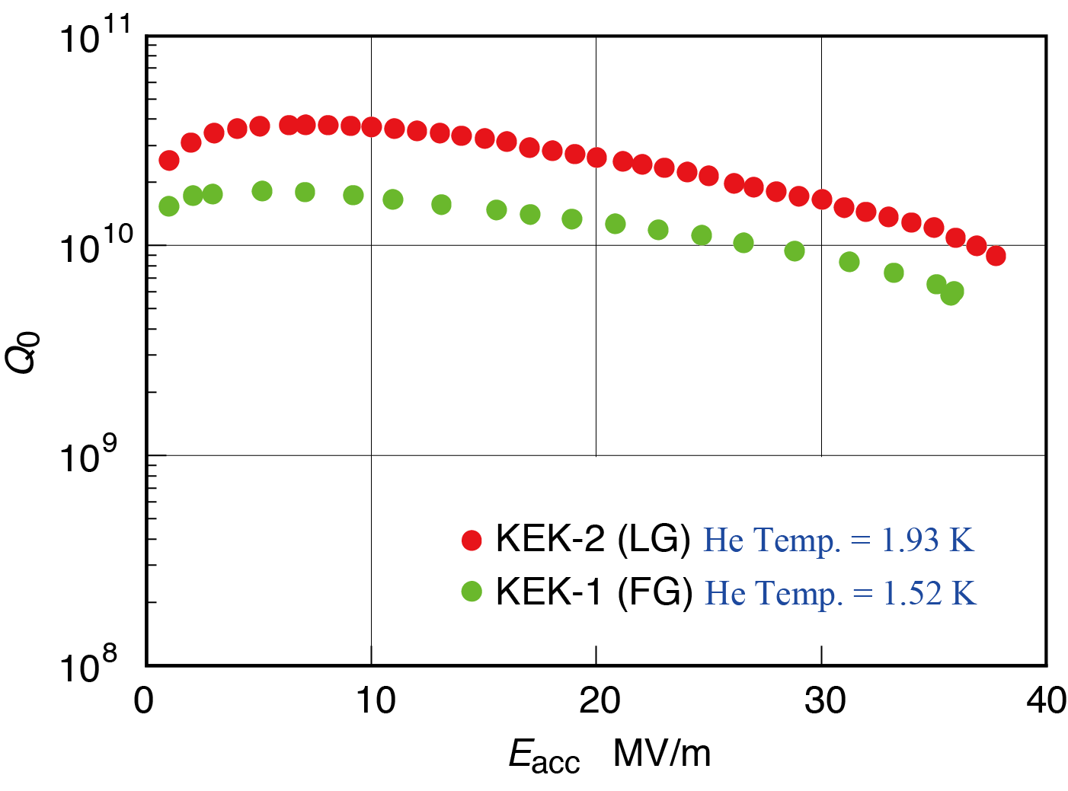
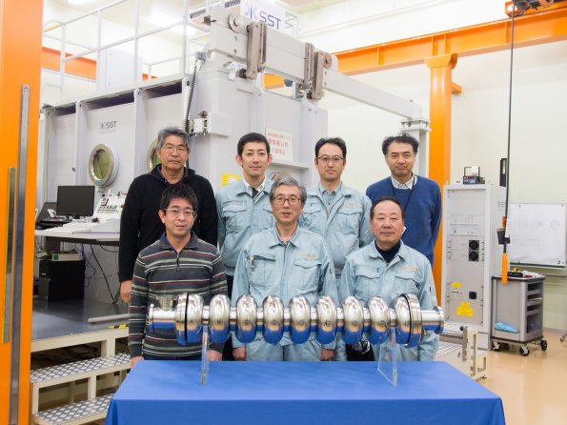
Nb-ingot sliced,L-grain, Cavity
1.3 GHz TESLA-like SRF cavity, using Nb directly sliced
demonstrated:
Ingot sliced Niobium (Tokyo Denkai)
(Dia：260 mm)
38
36

Slide 22

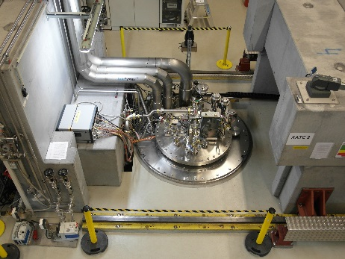
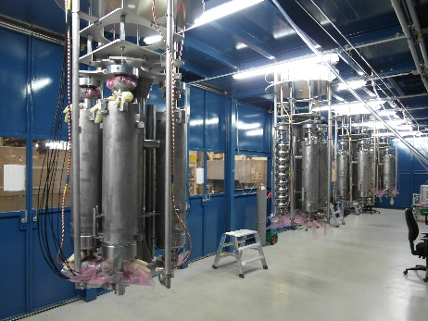
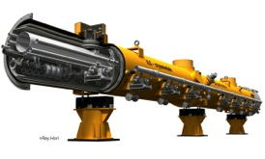
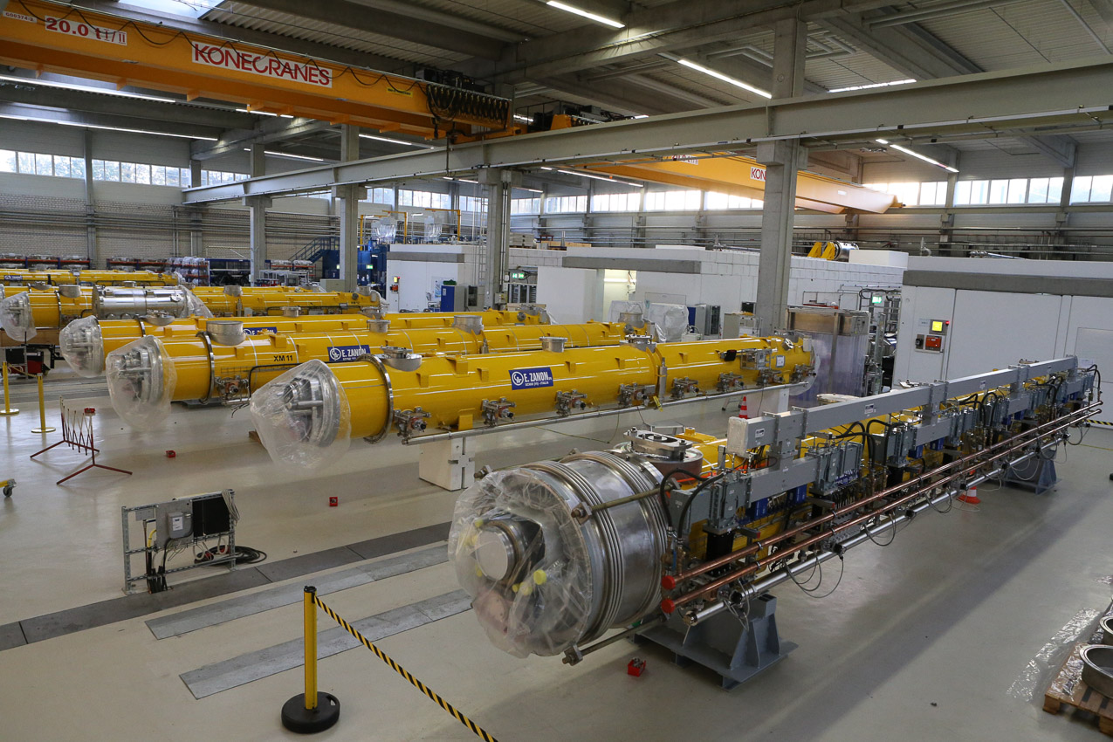
SRF Cavity Fabrication and Qualification
Purchasing Material/Sub-component
Manufacturing Cavity
Processing Surface
Assembling LHe-Tank
Qualifying Cavity, 100 %
Cavity String Assembly
Cryomodule Assembly
Qualifying CMs, 33 + 5 %

Slide 23
Standard Procedure Established
 | Standard Fabrication/Process
Fabrication | Nb-sheet purchasing
 | Component Fabrication
 | Cavity assembly with EBW
Process | EP-1 (~150um)
 | Ultrasonic degreasing with detergent, or ethanol rinse
 | High-pressure pure-water rinsing
 | Hydrogen degassing at > 800 C
 | Field flatness tuning
 | EP-2 (~20um)
 | Ultrasonic degreasing or ethanol (or EP 5 um with fresh acid)
 | High-pressure pure-water rinsing
 | Antenna Assembly
 | Baking at 120 C
Cold Test (vertical test) | Performance Test with temperature and mode measurement
Key Process
Fabrication
Material
EBW
Shape
Process
Electro-Polishing
Ethanol Rinsing or
Ultra sonic. + Detergent Rins.
High Pr. Pure Water cleaning

Slide 24
Standard Procedure Established
 | Standard Fabrication/Process
Fabrication | Nb-sheet purchasing
 | Component Fabrication
 | Cavity assembly with EBW
Process | EP-1 (~150um)
 | Ultrasonic degreasing with detergent, or ethanol rinse
 | High-pressure pure-water rinsing
 | Hydrogen degassing at > 800 C
 | Field flatness tuning
 | EP-2 (~20um)
 | Ultrasonic degreasing or ethanol (or EP 5 um with fresh acid)
 | High-pressure pure-water rinsing
 | Antenna Assembly
 | Baking at 120 C
Cold Test (vertical test) | Performance Test with temperature and mode measurement
Key Process
Fabrication
Material
EBW
Shape
Process
Electro-Polishing
Ethanol Rinsing or
Ultra sonic. + Detergent Rins.
High Pr. Pure Water cleaning
N2 infusion at 120 C directly after heat treatment at 800 C

Slide 25
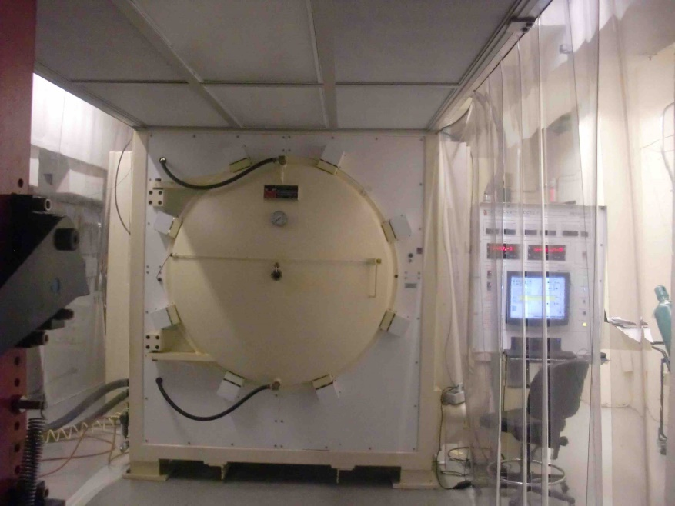
New Surface Process demonstrated at Fermilab, “N Infusion at 120 C”
A. Grassellino, S. Aderhold, TTC-2016
N2 infusion at 120 C directly after heat treatment at 800 C,
Same cavity, sequentially processed, no EP in b/w
Achieved: 45.6 MV/m
Q at ~ 35 MV/m : ~ 2.3e10

Slide 26
Consensus on ILC250 in JAHEP
Courtesy, Y. Okada, LCWS2017
The Japanese HEP community (JAHEP ) set up a subcommittee to deliberate the
scientific significance of the 250GeV ILC. Its report^{(*)} was presented at the JAHEP meeting
in July 2017, and based on its deliberation, JAHEP decided to release a new statement:
“Scientific Significance of ILC and Proposal of its Early Realization in light of the
Outcomes of LHC Run 2 “
(*) http://www.jahep.org/files/JAHEP-ILCstatement-170816-EN.pdf
the scientific significance and importance of ILC has been further clarified considering the current LHC outcomes. ILC250 should play an essential role in precision measurement of the Higgs boson and, with HL-LHC and SuperKEKB, in determining the future path of new physics. Based on ILC250’s outcomes, a future plan of energy upgrade will be determined so that the facility can provide the optimum experimental environment by considering requirements in particle physics and by taking advantage of the advancement of accelerator technologies. It is expected that ILC will lead particle physics well into the 21st century.
To conclude, in light of the recent outcomes of LHC Run 2, JAHEP proposes to promptly
construct ILC as a Higgs factory with the center-of-mass energy of 250 GeV in Japan.
The conclusion was reported to the LCB meeting in August 2017.
This proposal is a core of recommendations in “The final report of the committee on Future Projects of High Energy Physics” recently approved by JAHEP.
(*) http://www.jahep.org/files/ILC250GeVReport-EN-FINAL.pdf

Slide 27




Important Energies in ILC
Integrated Luminosity (ab⁻¹)
HHZ
K. Kawagoe
(modified)
2
Physics confident:
→ Higgs and Top Quark
Learn “everything” about H (125)
Probe dynamics of EWSB
New Physics beyond SM:
Direct or indirect DM searches
Evidence for BSM physics
Hints of a new mass scale
1
HZ
ννH
tt
LEP
reached→
ttH
200
300
400
500
600
E _{cm} (GeV)

Slide 28
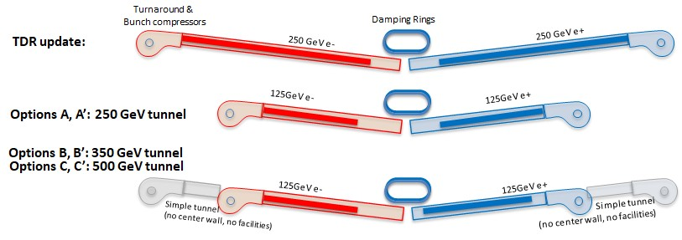
Options for ILC Staging at 250GeV
Options | Gradient [MV/m] | ECM [GeV] | Total ECM Margin | n | Space margin | Reserved tunnel | Total tunnel
TDR update | 31.5 | 500 | 2% | 10 | 1,473 m | 0 m | 33.5 km
Option A |  | 250 | 6% | 6 | 583 m | 0 m | 20.5 km
Option B |  |  |  | 6&8 |  | 3,238 m | 27 km
Option C |  |  |  | 6&10 |  | 6,477 m | 33.5 km
Option A’ | 35 |  |  | 6 | 1,049 m | 0 m | 20.5 km
Option B’ |  |  |  | 6&8 |  | 3,238 m | 27 km
Option C’ |  |  |  | 6&10 |  | 6,477 m | 33.5 km

Slide 29
KEK efforts for the ILC promotion
Courtesy, Y. Okada, LCWS2017
KEK will work closely with LCC and LCB to realize the ILC hosted in Japan.
KEK will cooperate with various sectors/organizations that promote the ILC project vigorously in Japan; Federation of Diet members, the industrial sector (AAA), local sectors, etc.
KEK will provide the ILC Advisory Panel in MEXT with appropriate information to help their timely conclusion.
KEK will promote activities to obtain general understanding by the public and scientific communities.
KEK will cooperate with international physics communities to facilitate discussions between governments and funding authorities.
KEK efforts for the ILC promotion are coordinated at the Planning Office for the ILC headed by KEK-DG.

Slide 30
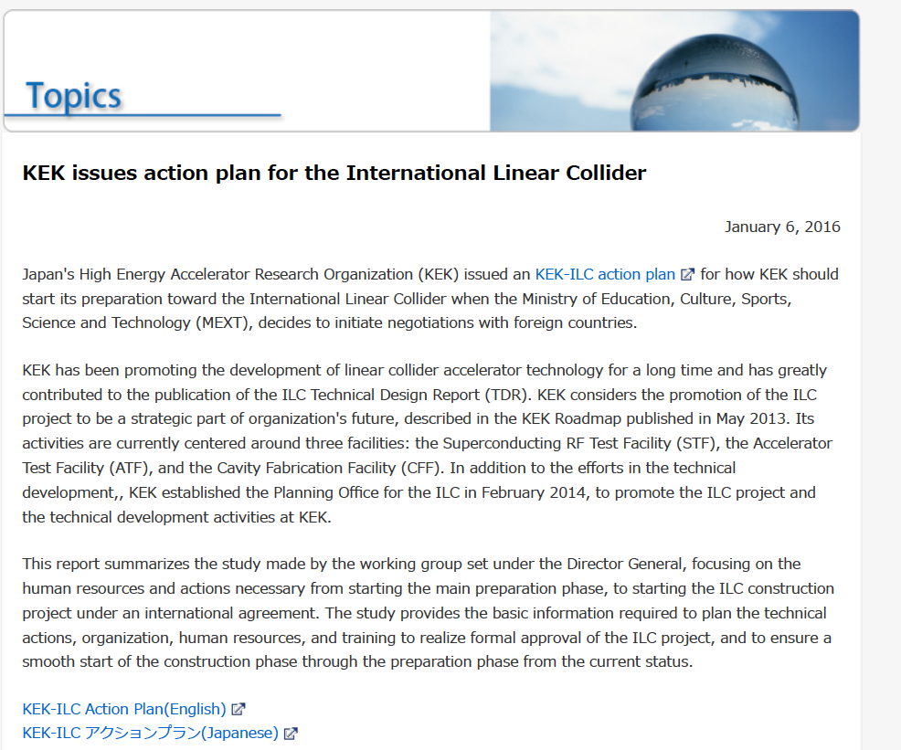
KEK-ILC Action Plan Issued, in Jan. 2016 https://www.kek.jp/en/NewsRoom/Release/20160106140000/
 | Pre-Preparation Stage | Main Preparation Stage
 | present (we are here) | P1 | P2 | P3 | P4
ADI | Establish main parameters | Verify parameters w/ simulations
SRF | Beam acc. with SRF cavity string, Cost Reduction R&D (proposed) | Demonstrate mass-production technology, stability, hub-lab functioning, and global sharing
Nano-beam | Achieve the ILC beam-size goal | Demonstrate the nanobeam size and stabilize the beam position
e+ | Demonstrate technological feasibility | Demonstrate both the undulator and e-driven e+ sources
CFS | Pre-survey and basic design | Geology survey, engineering design, specification, and drawings

Slide 31
Expected decision timeline in Japan
Courtesy, Y. Okada, LCWS2017
At the 7th ILC Advisory Panel in July 2017, items to be considered were listed.
CERN experiment status
The updated plan by the international researchers’ community
Results of external survey researches in FY2017 (regulations/risks concerning ILC, Cost reduction of large international accelerator projects)
If ICFA endorses the plan of ILC 250, these considerations by the Panel can be concluded in half a year timescale.
If the Panel’s conclusion is favorable for pursuing the ILC in Japan, then the next year becomes a real critical time for realization of the ILC.
In parallel, we would like to facilitate discussions between the Japanese Government and foreign partners beyond US-Japan.
Serious discussions need to be started before the next round of future planning of HEP in various regions (ex. Update of the European strategy for particle physics) .

Slide 32
Summary
ILC has been technically matured in key technologies of “Nano-beam” and “Superconducting RF”
The cost reduction is inevitably required, and the R&D is in progress, in a spirit of performance improvement resulting in the cost reduction.
The energy staging at 250 GeV is proposed for quick project realization in global cooperation, and with emphasizing important feature and advantage of the LC’s natural extendability.

Slide 34
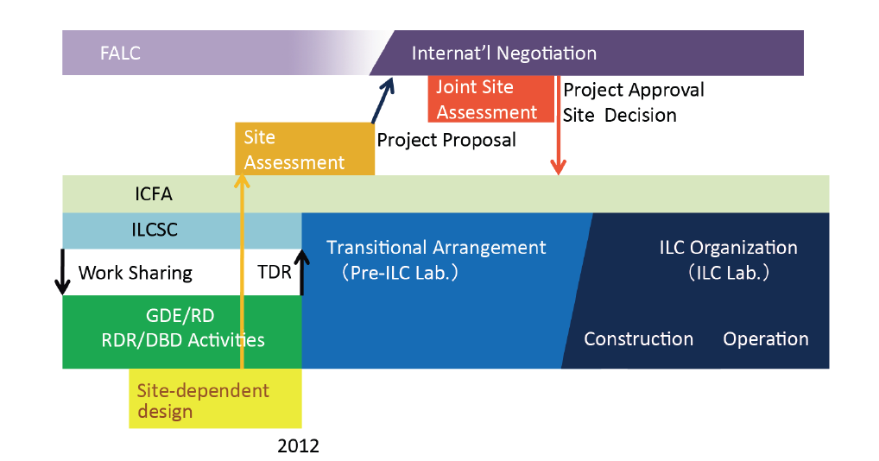
Status and Prospect for ILC
(Pre-Preparation and)
Preparation Phase
(~2+) 4 year
(9 year)
We are here,
In 2017

Slide 35
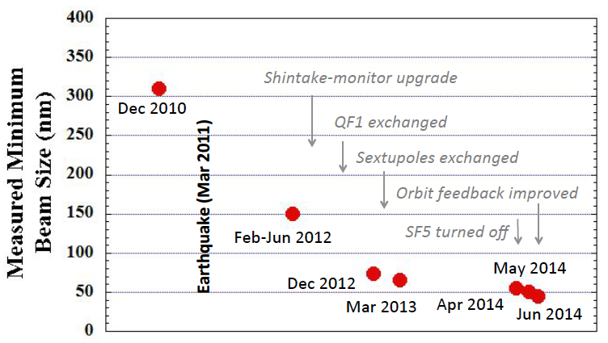
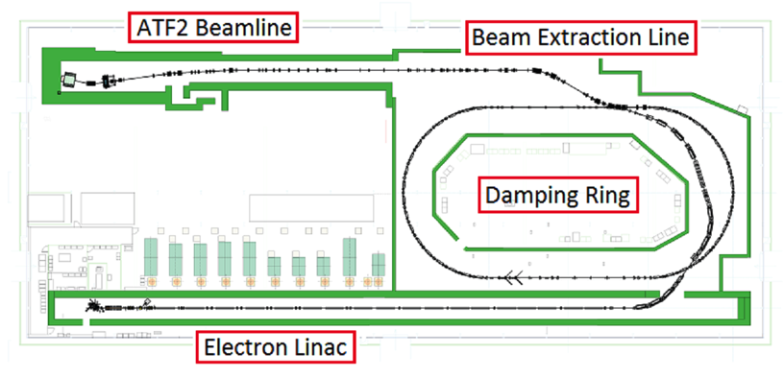
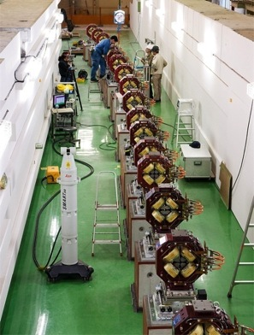
KEK-ATF: Demonstration of “Nano-beam”
ATF (Acc. Test Facility): the same FF beam optics demonstrated at ATF (1.3 GeV)
Beam-size reruied： 5.9nm at 250 GeV (ILC) → 37 nm at 1.3 GeV (ATF)
Progress： ~ 300 nm (in 2010) → ~ 150 nm (in 2012) → ≤ 44 nm (in 2014) realized
 | ILC | AF2
Beam Energy [GeV] | 250 | 1.3
L* (IP to FF) [m] | 4.0 | 1.0
β* [mm] | 0.48 | 0.1
Emittance (v) [pm] | 0.07 | 12
FF Beam Size [nm] | 5.9 | 37
ILC FF beam optics, demonstrated at ATF

Slide 36
European-XFEL cavities statistics data
Maximum Gradient Statistics: VT
Total Number: 832
Before Retreatment (754):
E max 31.4 ± 6.7 [MV/m]
RI (377): E max 33.0 ± 6.5 [MV/m]
EZ (375): E max 29.8 ± 6.6 [MV/m]
After Retreatment (832):
E max 33.1 ± 4.9 [MV/m]
RI (417): E max 34.7 ± 4.4 [MV/m]
EZ (415): E max 31.5 ± 4.9 [MV/m]
Laura Monaco
28.7% cavities retreated

Slide 37

European-XFEL cavities statistics data
ILC TDR assumed VT acceptance > 28MV/m (XFEL >20 MV/m)
Average of 35 MV/m (XFEL: 26 MV/m)
Assumed first-pass yield: 75%
29% cavities retreated to give final yield of 90% >28 MV/m (35 MV/m average)
10% over-production assumed in value estimate
RI results only (ILC recipe)
✔
More re-treatments - but mostly only HPR
Number of average tests/cavity increases from 1.25 to 1.55 (1st+2nd) or
20% over-production or additional re-treat/test cycles
Nick Walker

Slide 38
RF Performance as of 28.9.2017

Slide 39



ILC Candidate Location: Kitakami, Tohoku
High-way
Ofunato
Oshu
Express-
Rail
Kesen-numa
Sendai
Ichinoseki
IP Region

Slide 40




New Baselining of Civil-engineering,
Beam Line

Slide 41

Cryogenics Layout with Further Safety and Conserving He Resource

Slide 42
Further Technical Issues to prepare for the ILC
The. Field | Subject | Global Cooperation
ADI | Optimize Acc. Design and Integration | LCC-ILC-ADI Global Team
SRF | Improve Gradient and Stability Establish three regional contribution Industrialization Hub-lab functioning | TTC: TESLA Tech. Collaboration: Three regional effort and experience EU：European XFEL AMs: LCLS-II AS：KEK-STF as Asian Hub.
Nano-beam | Realize ultra-low emittance (in DR), and nano-beam size and stability at FF | ATF: Acc. Test Facility Collab: - Global collaboration with KEK-centered
E+ Source | Demonstrate thermal balance with rotational target in vacuum | PosiPol Collaboration: Global collaboration
CFS | Establish a site-specific engineering Geological survey and assessment, | LCC-CFS Collaboration - Japan-centered
Management | Establish ILC Pre-Lab Prepare for the ILC Lab. | >> ICFA leading >> Inter-Government Agreement ineviable
Nano-beam
SRF

Slide 43














Staging in TDR
Turnaround & Bunch compressors
Damping Rings
500GeV
TDR:
250 GeV
Scenario1 in TDR: 150 GeV e-
Option A/A’: 125 GeV e-
23
LCWS2017 (Oct. 23,2017)

