Slide 1
High Energy CEPC Injector Based on Plasma Wakefield Accelerator
Wei Lu
Tsinghua University
International Workshop on High Energy Circular Electron-Positron Collider
Nov 6-8, IHEP, Beijing, China

Slide 2
AARG
A joint effort of IHEP and Tsinghua
IHEP
Jie Gao, Yongsheng Huang, Dazhang Li, Dou Wang, Cai Meng, Tianjian Bian, Zhenchao Liu, Yiwei Wang
Tsinghua
Wei Lu, Shiyu Zhou, Yue Ma, Jianfei Hua, Chi-hao Pai, Shuang Liu

Slide 3
Outline
Plasma based wakefield accelerator (PBA)
Key accelerator physics for PBA
Plasma based injector for CEPC
Boundary conditions
Overall concept design
Preliminary design parameters

Slide 4
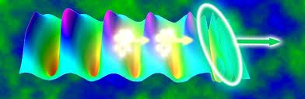
Plasma Based Wakefield Acceleration
Laser or beam Pulse
Trailing beam
Wake
Huge gradient (~100GV/m) + Tiny structures (~10-100um)
T.Tajima and J.M. Dawson PRL (1979) LWFA
P.Chen, J.M. Dawson et.al. PRL (1983) PWFA

Slide 5
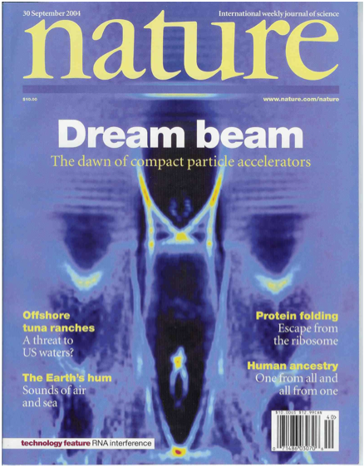
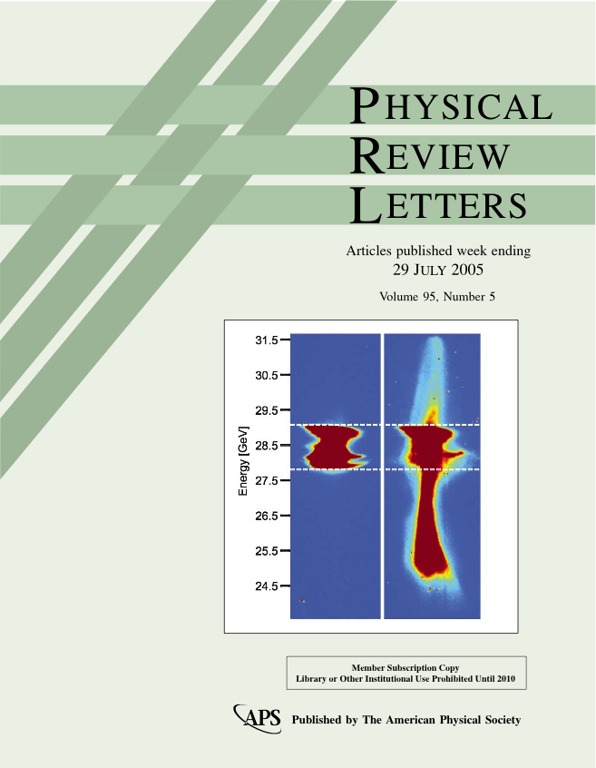
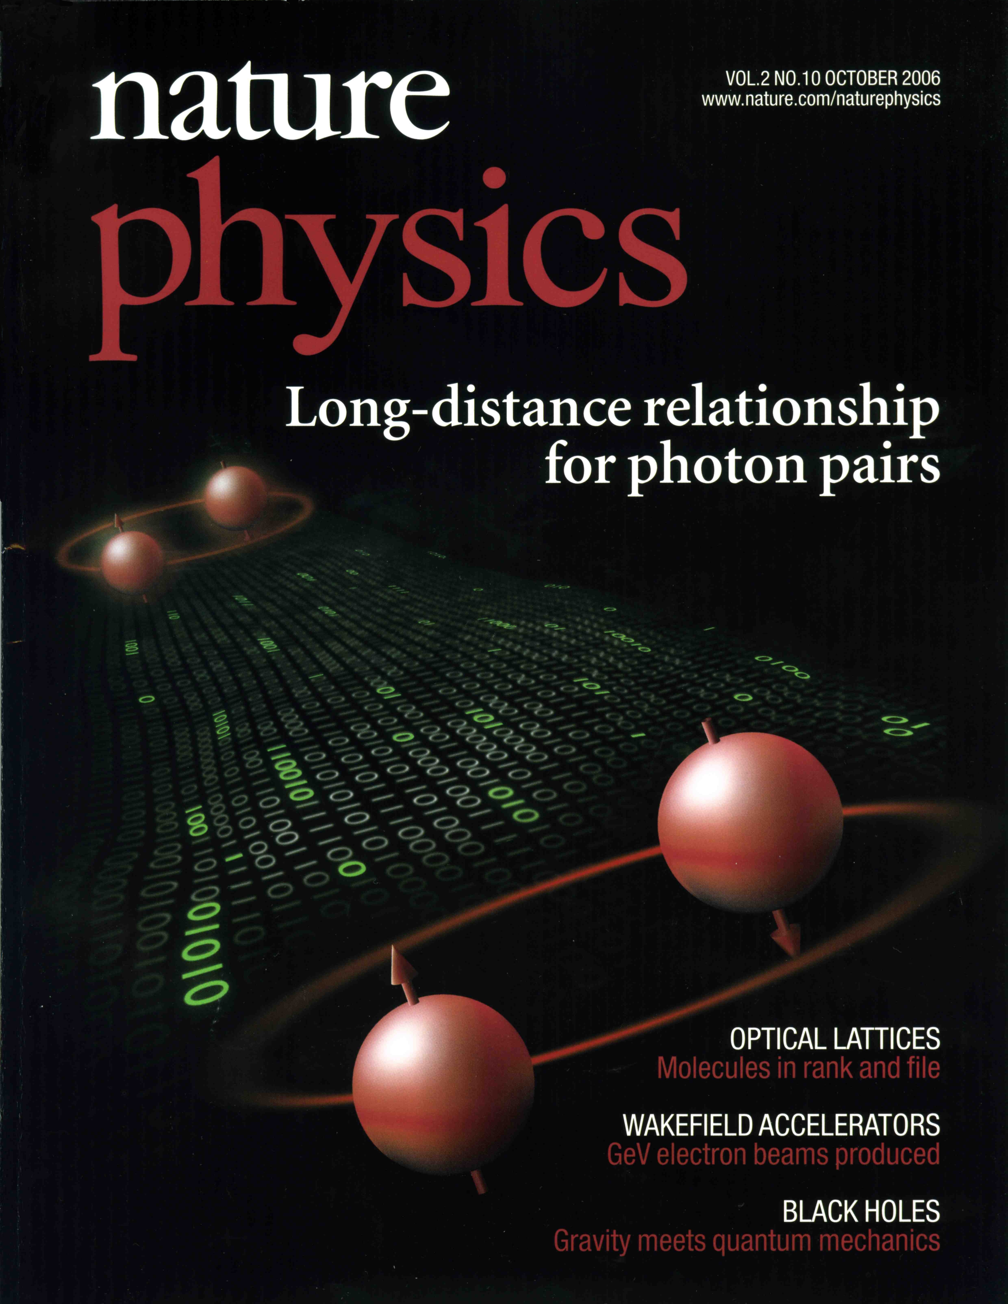

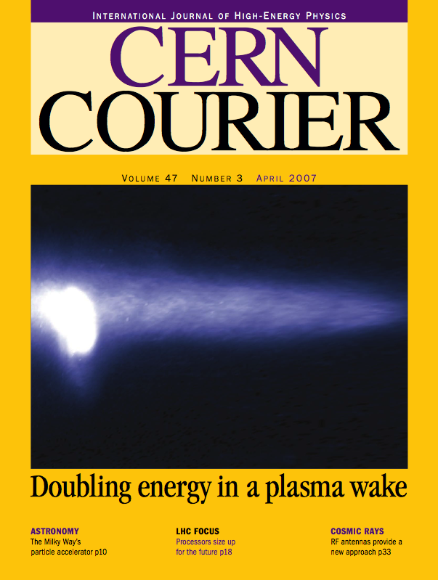
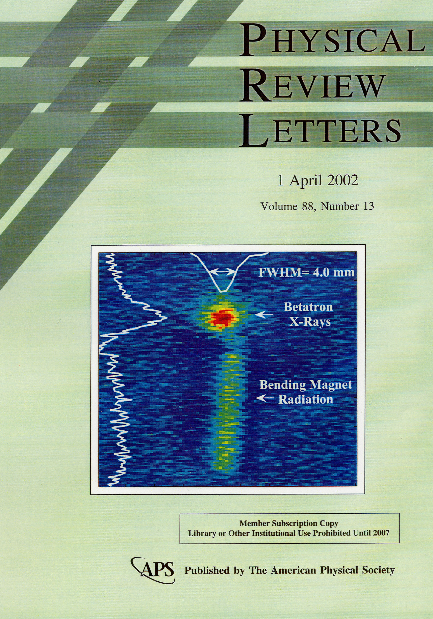
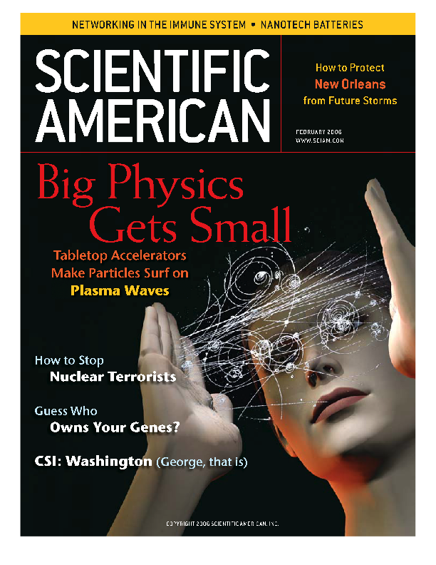
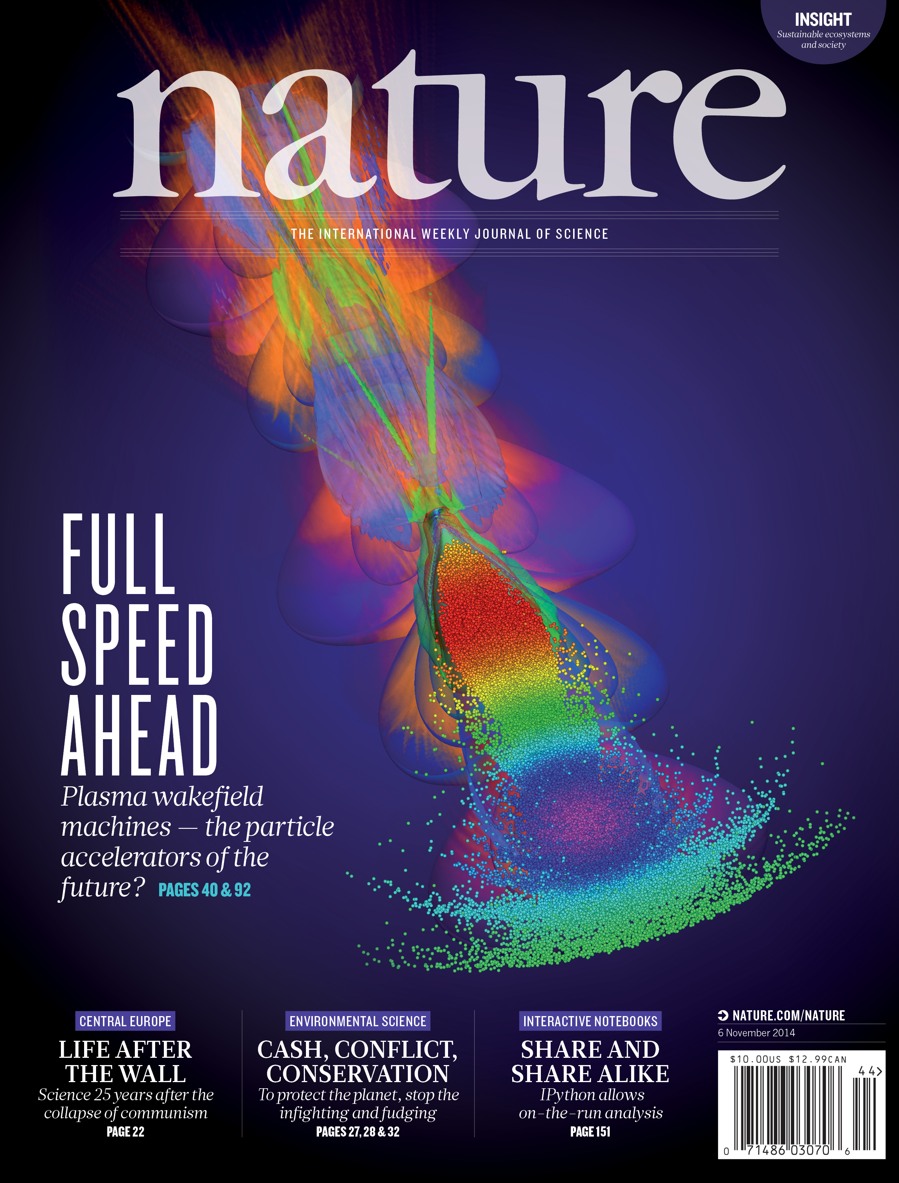
Important progress in past decade

Slide 6
Key physics issues for a plasma accelerator
The structure issue:
Wake excitation for given drivers ……
The energy spread and efficiency issue:
Beam loading, pulse shaping, transformer ratio ……
The stability issue:
Driver evolution, matching, guiding, instabilities ……
The injector issue:
Self-injection, wave breaking, controlled injection ….
The overall design and staging issue:
Parameter optimization for a plasma based accelerator to match the requirements of beam parameters,staging,external injection ….

Slide 7
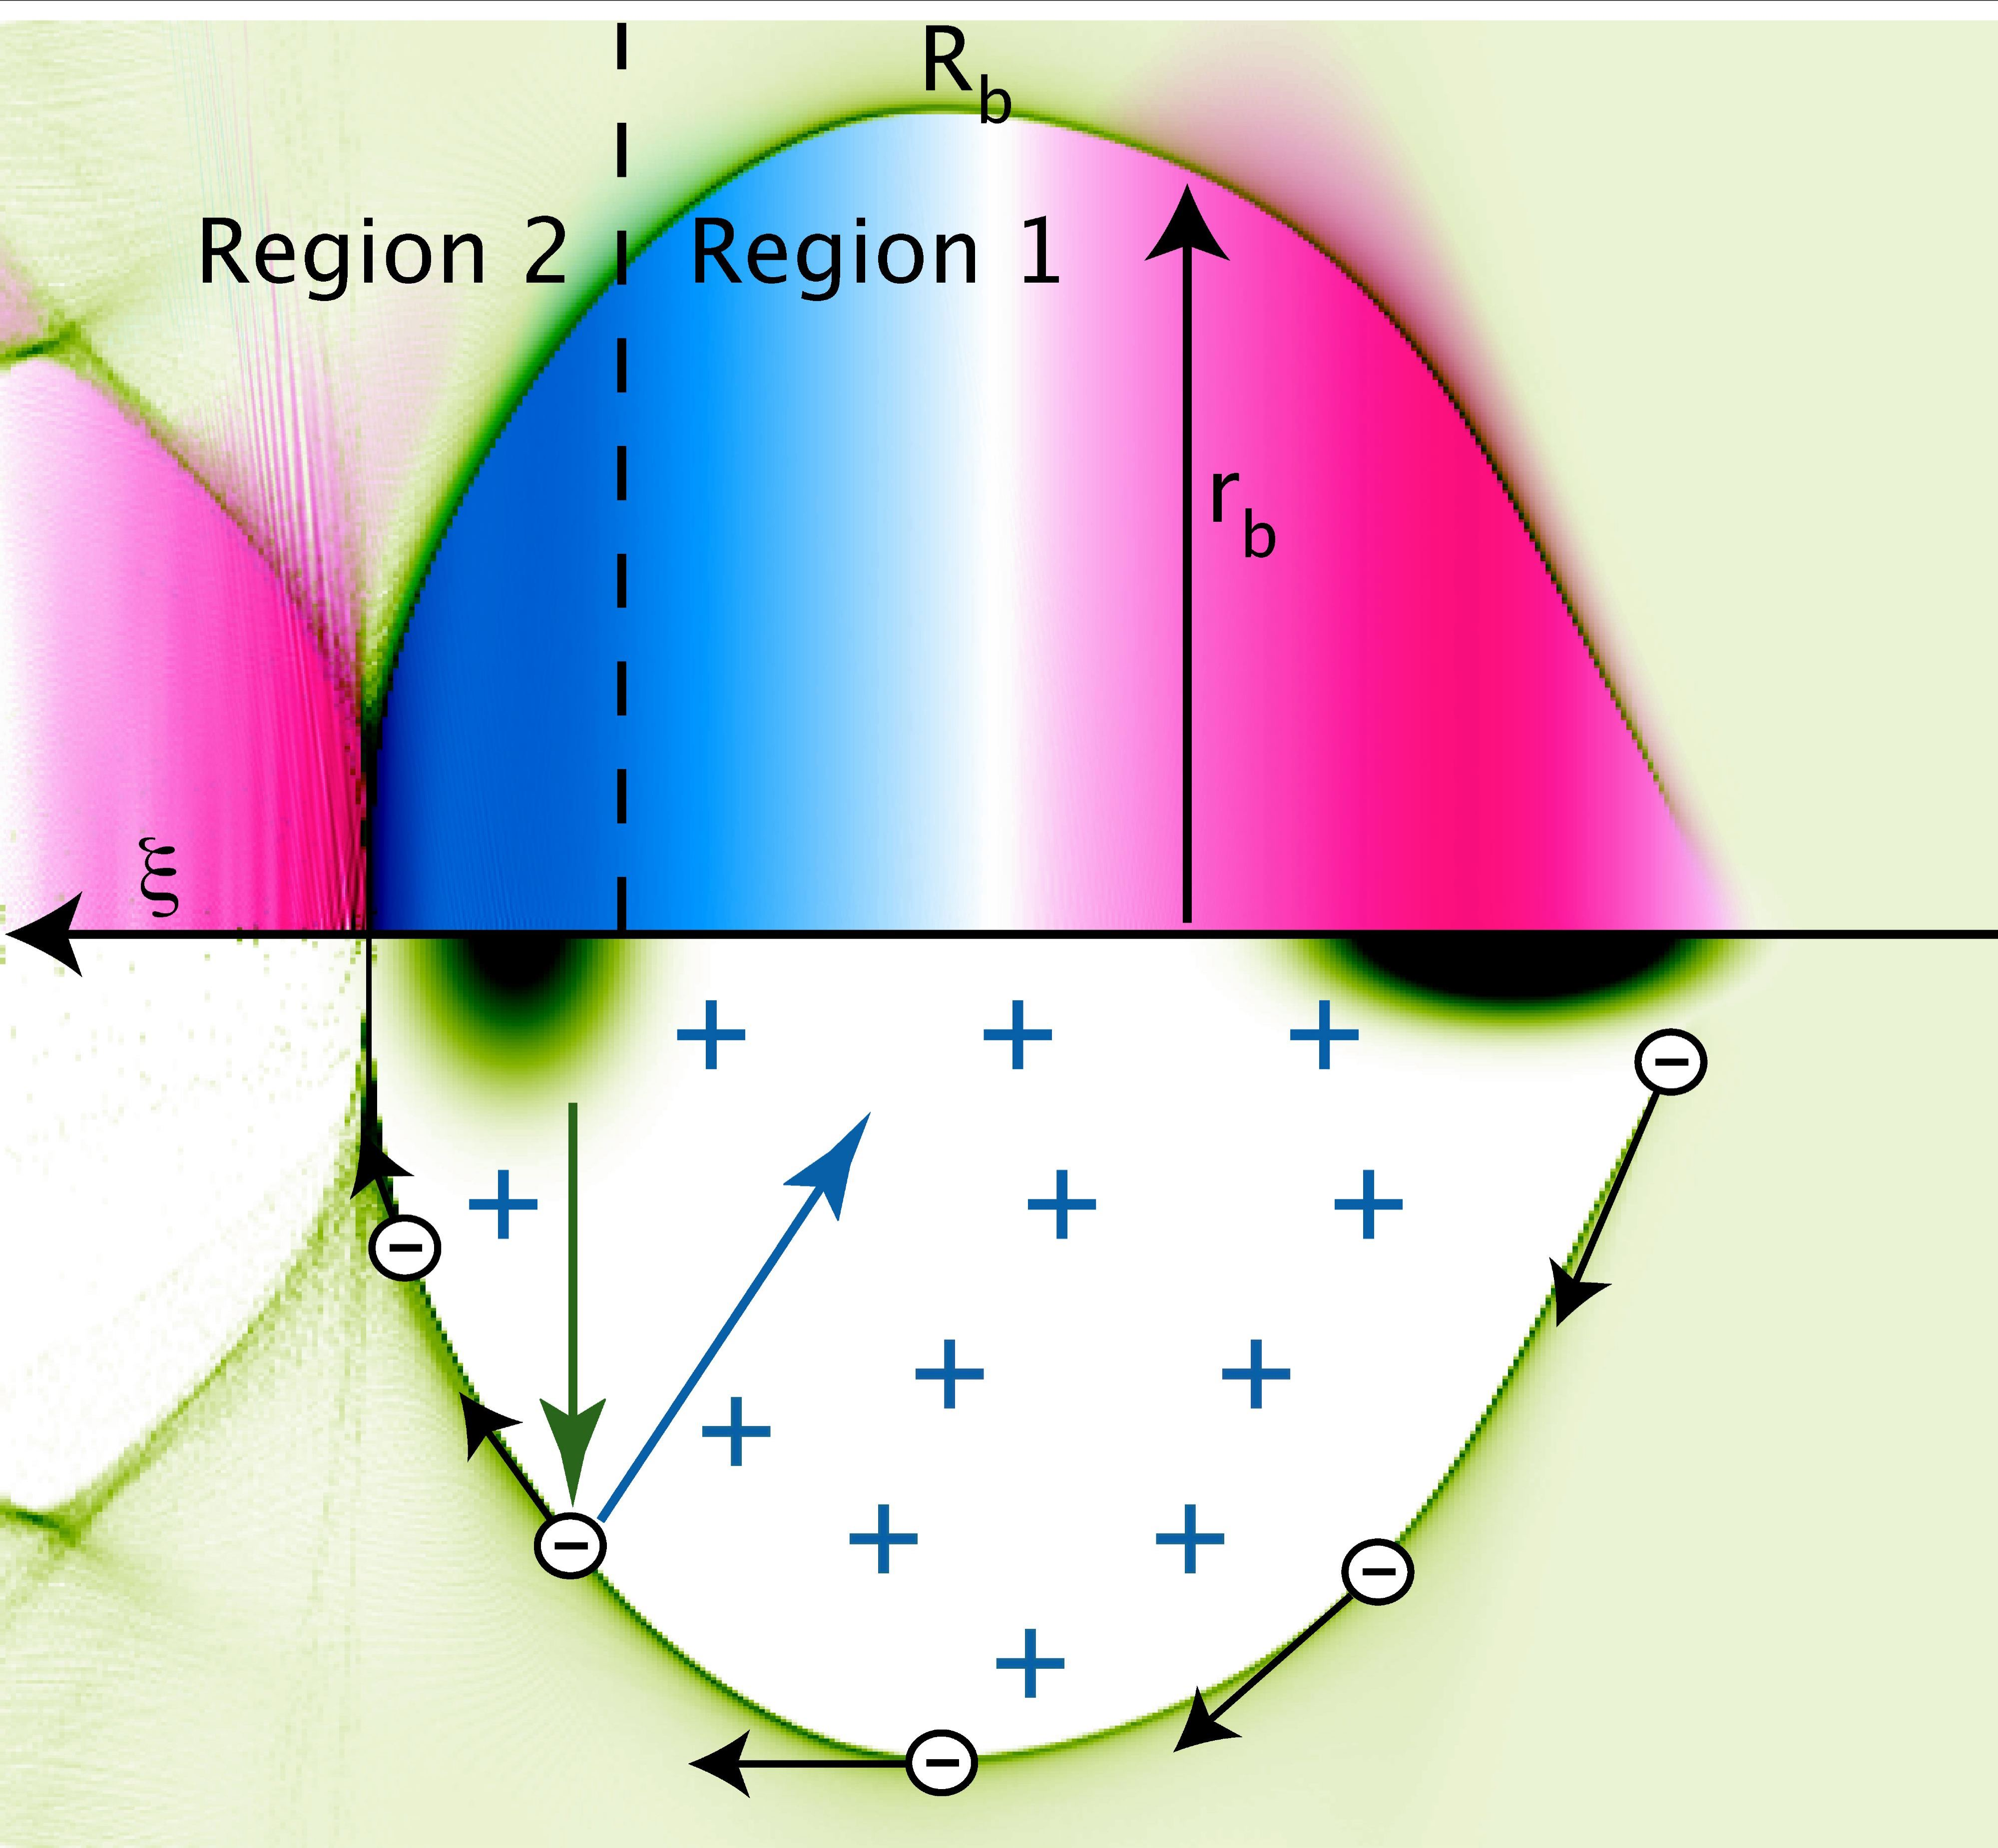
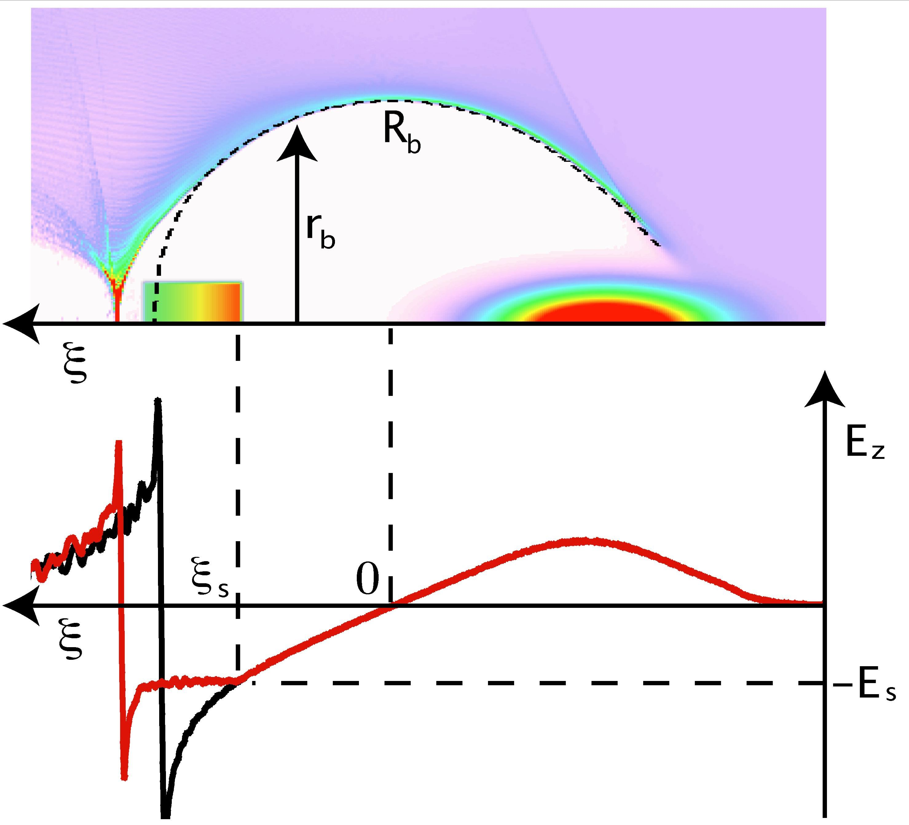

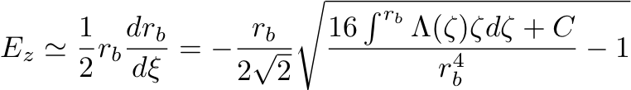

Beam loading efficiency and energy spread
High efficiency (near 100%) + Uniform acceleration
M. Tzoufras,W. Lu et al., PRL (2008), PoP [invited] (2009)

Slide 8
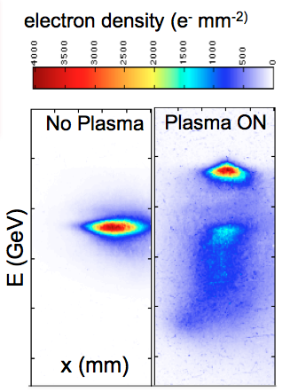
Verified through Experiment
30-50% energy conversion efficiency

Slide 9
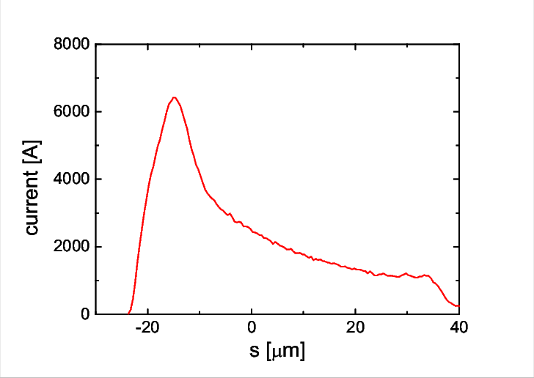
High Transformer Ratio PWFA
Transformer ratio: R = E⁺/E⁻
E⁻
E⁺
Parameters | Value
Peak current | 6.3 kA
Beam length | ~200 fs
Initial energy | 1.5 GeV
Lower Drive Beam Energy
High efficiency
TR=5
1% energy spread
Lu et al., PAC 2009, Huang et al., IPAC17

Slide 10
Plasma Based Injector for CEPC
The boundary condition
Overall concept design
Driver/trailer beam generation through Photo-injector
HTR PWFA with good stability (single stage TR=3-4, Cascaded stage 6-12, high efficiency)
Positron generation and acceleration in an electron beam driven PWFA using hollow plasma channel (TR=1)

Slide 11
CEPC Pre-CDR/CDR Linac Requirement
Parameter | Symbol | Unit | Pre-CDR | CDR
e⁻ /e⁺ beam energy | E_{e-}/E_{e+} | GeV | 6 | 10
Repetition rate | f_{rep} | Hz | 50 | 50
e⁻ /e⁺ bunch population | Ne-/Ne+ |  | 2×10¹⁰ | 6.25×10⁹
 |  | nC | 3.2 | 1.0
Energy spread (e⁻ /e⁺ ) | σ_{E} |  | <1×10⁻³ | <2×10⁻³
Emittance (e⁻ /e⁺ ) | ε_{r} | mm⋅ mrad | <0.3 | <0.3
e⁻ beam energy on Target |  | GeV | 4 | 4 (2)
e⁻ bunch charge on Target |  | nC | 10 | 10

Slide 12
Boundary Conditions
Beam average power (kW 100Hz)
Beam charge per-bunch ( nC)
Beam energy spread (0.2%)
Beam geometric emittance (<0.3mm mrad)
Positron generation and acceleration

Slide 13
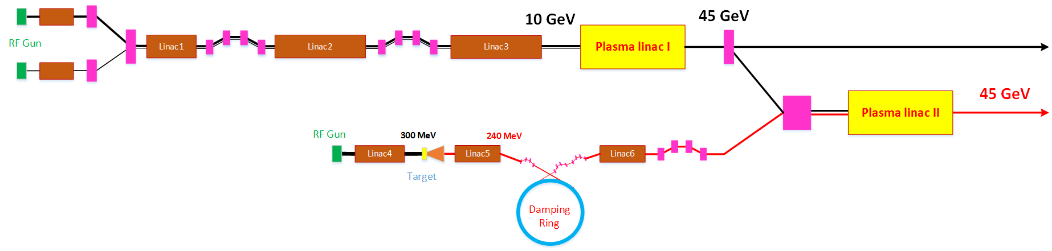
Overall Concept Design based on single stage HTR PWFA (TR=3.5)
By Cai Meng et al.

Slide 14
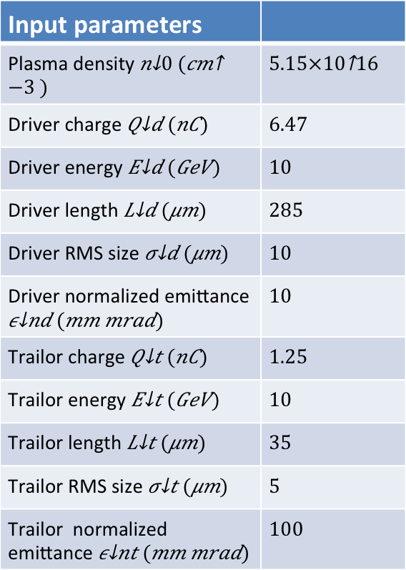
HTR PWFA parameter design (TR=3.55)
Input parameters
Plasma density
Driver charge
Driver energy
Driver length
Driver RMS size
Driver normalized emittance
Trailor charge
Trailor energy
Trailor length
Trailor RMS size
Trailor normalized emittance
By Shiyu Zhou

Slide 15
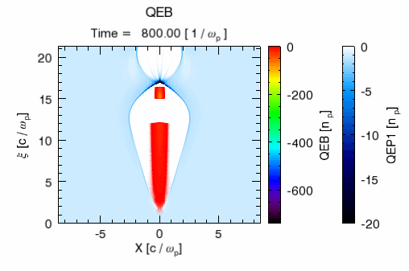

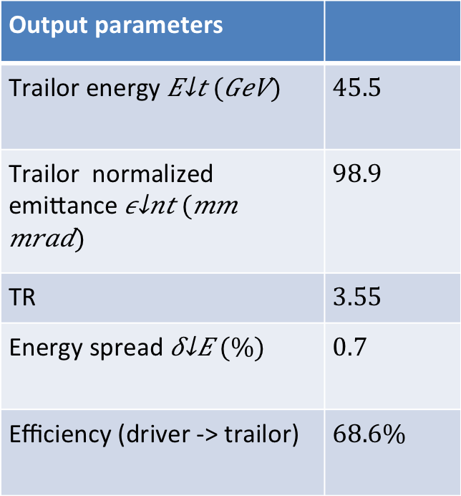
HTR PWFA simulation (TR=3.55)
Output parameters
Trailor energy
Trailor normalized emittance
TR
Energy spread
Efficiency (driver -> trailor)
Plasma length $\sim 1.9m$

Slide 16
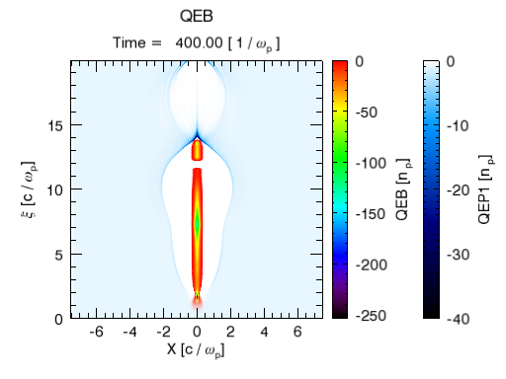
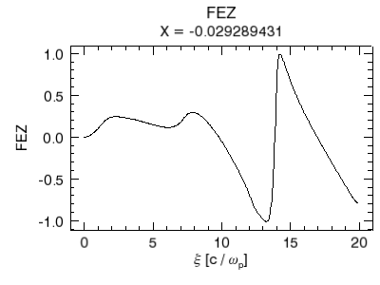

7nC Shaped bunch by S-band photo-injector and LINAC
0.28
-0.98
Simulation data by Zhen Wang of SINAP
$$TR=3.5$$

Slide 17
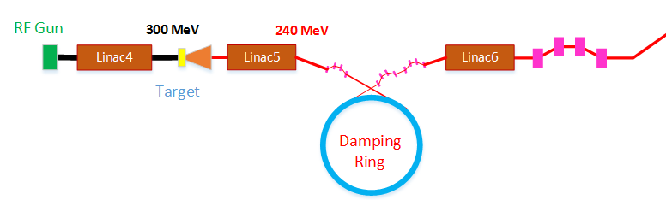
Positron generation
Damping ring | DR V1.0
Energy (MeV) | 240
Circumference （m） | 20
Bending radius (m) | 1.7
B0 (T) | 0.47
U0 (keV/turn) | 0.17
Damping time x/y/z (ms) | 185/185/93
δ0 (%) | 0.016
ε0 (mm.mrad) | 6
Nature σz (mm) | 3
Extract σz (mm) | 1.8
εinj (mm.mrad) | 2400
εext x/y (mm.mrad) | 819/815
δinj /δext (%) | 1 /0.13
Storage time (ms) | 100
RF parameters
RF frequency (MHz) | 500
RF voltage (MV) | 0.8
Energy acceptance by RF(%) | 1.8
harmonic | 33
Lattice parameters
FODO length (m) | 1.2
Phase per cell | 60°
Dipole length (m) | 0.46
Dipole strength (T) | 0.47
Quadrupole length (m) | 0.11
Quadrupole strength (m⁻²) | 15
By Dou Wang

Slide 18
Positron compression
 | BC I | BC II | BC III
Initial energy (MeV) | 240 | 240 | 1300
δinj (%) | 0.13 | 1.95 | 1.58
Initial σz (um) | 1800 | 220 | 50
f_{RF} (MHz) | 2856 | 2856 | 5712
Voltage(GV) | 0.14 | 5.0 | 36
φ_{RF} (度) | 90 | 77.8 | 86.6
R₅₆ (mm) | 92 | 13.9 | 2.5
Final energy(MeV) | 240 | 1300 | 3400
δext (%) | 1.95 | 1.58 | 2.0
final σz (um) | 220 | 50 | 15
Compression ratio：
BCI：8.2
BCII：4.4
BCIII: 3.3

Slide 19
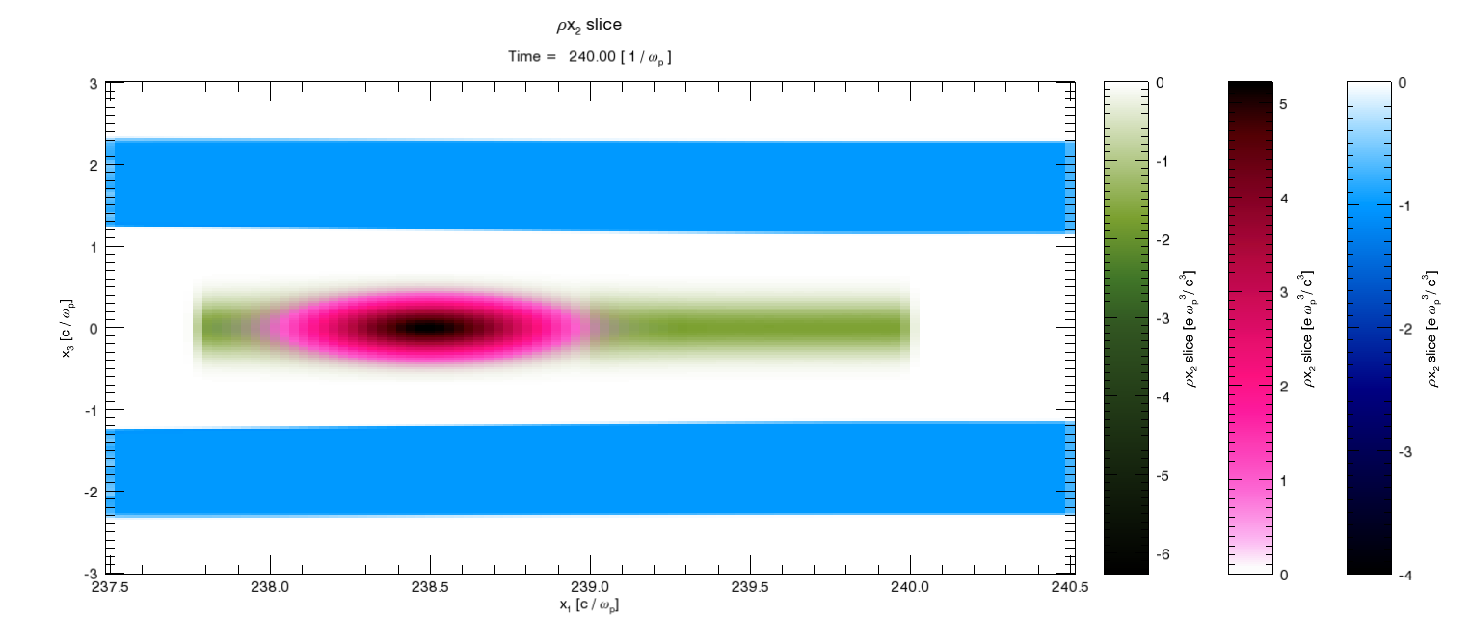
Positron Acceleration
Uniform acceleration + High efficiency + TR=1
positrons
electrons
By Shiyu Zhou

Slide 20
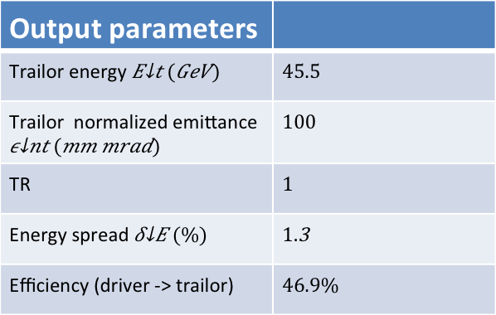

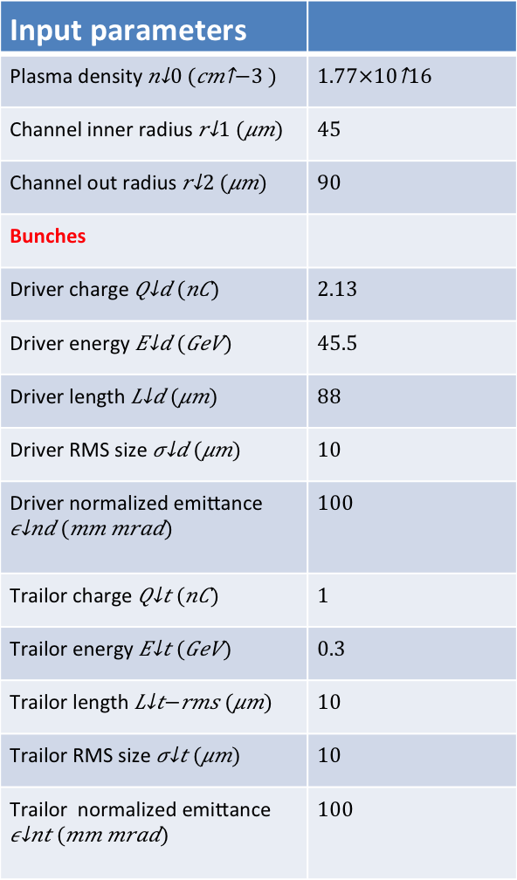
Input parameters
Plasma density
Channel inner radius
Channel out radius
Bunches
Driver charge
Driver energy
Driver length
Driver RMS size
Driver normalized emittance
Trailor charge
Trailor energy
Trailor length
Trailor RMS size
Trailor normalized emittance
Output parameters
Trailor energy
Trailor normalized emittance
TR
Energy spread
Efficiency (driver -> trailor)
Plasma length $\sim 22m$

Slide 21
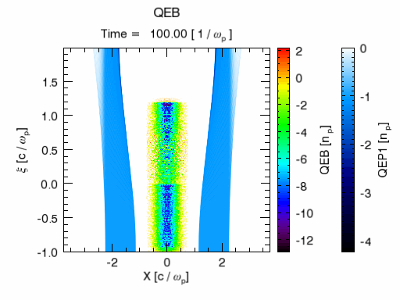
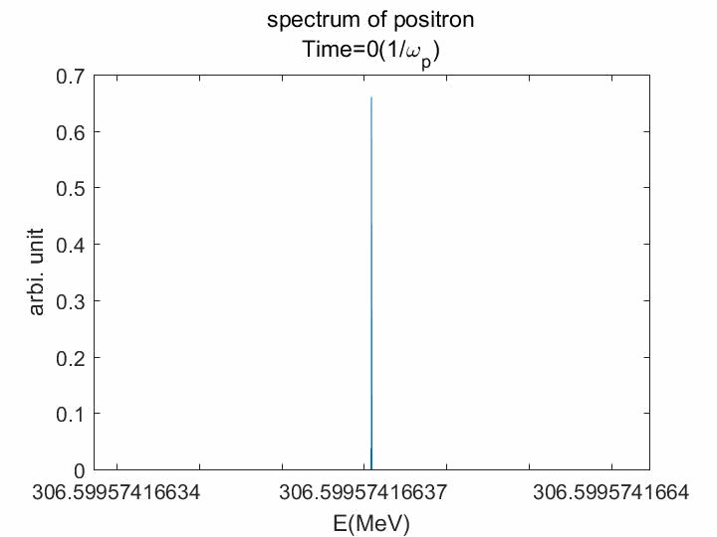
Fields Structure

Slide 22
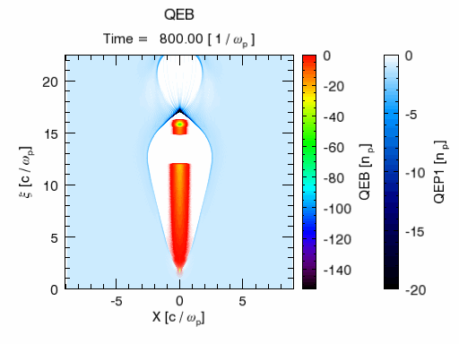
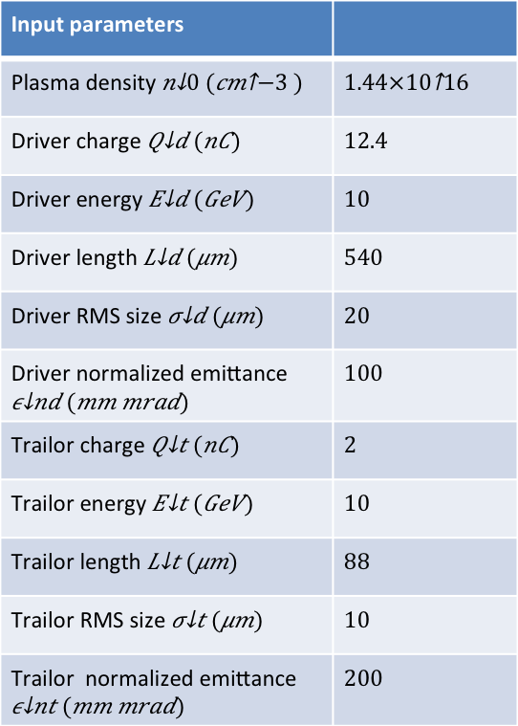
Electron driver/trailer parameters for e+ acceleration
Input parameters
Plasma density
Driver charge
Driver energy
Driver length
Driver RMS size
Driver normalized emittance
Trailor charge
Trailor energy
Trailor length
Trailor RMS size
Trailor normalized emittance
TR~3.5

Slide 23
Cascaded HTR PWFA
The 1st stage
Two shaped bunches (5ps 25nC, 1ps 5nC)
TR=2 or 3
Efficiency (60%)
The 2nd stage
Controlled injection for e (200fs 1nC or 2nC)
TR=2 or 3
Single stage efficiency (60%)
Overall TR=(1+TR1)*TR2
Overall efficiency Q3(1+TR1)*TR2/(Q1+Q2)=40%
The positron stage
Combining e+ with e- (200fs 1nC )
TR=1 Single stage efficiency (~50%)
Overall efficiency for positron 20%

Slide 24
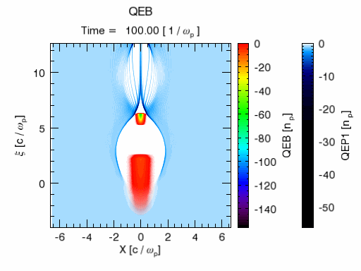
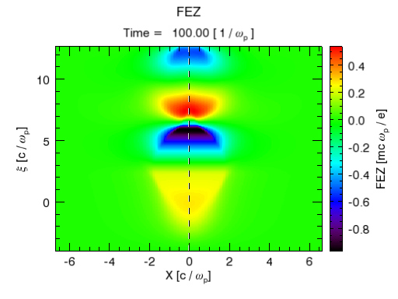
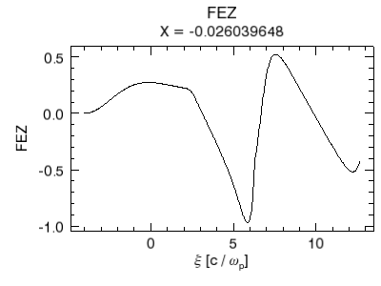
Electron Acceleration Stage ( I and II)
Parameters of Stage I
Driver pulse | 5ps
Driver charge Q1 | 25nC
Driver energy | 2GeV
Trailer pulse | 0.5ps
Trailor charge Q2 | 5nC
Trailor energy | 2GeV
Final energy | 8GeV
Average TR | 3
Efficiency | ~60%
Notes:
补了一张颜色比较深的图~

Slide 25
Thank you for your attention!

