Slide 1
CEPC parameter optimization and lattice design
Dou Wang, Jie Gao, Yuan Zhang, Yiwei Wang, Feng Su, Huiping Geng, Cai Meng, Jiyuan Zhai, Zhenchao Liu, Bai Sha, Tianjian Bian, Na Wang
CEPC AP meeting, 2016.10.14

Slide 2
parameter for CEPC partial double ring
（wangdou20161012）
 | Pre-CDR | H-high lumi. | H-low power | W | Z
Number of IPs | 2 | 2 | 2 | 2 | 2
Energy (GeV) | 120 | 120 | 120 | 80 | 45.5
Circumference (km) | 54 | 61 | 61 | 61 | 61
SR loss/turn (GeV) | 3.1 | 2.96 | 2.96 | 0.58 | 0.061
Half crossing angle (mrad) | 0 | 15 | 15 | 15 | 15
Piwinski angle | 0 | 1.88 | 1.84 | 4.11 | 5.86
N_{e}/bunch (10¹¹) | 3.79 | 2.0 | 1.98 | 0.85 | 0.6
Bunch number | 50 | 107 | 70 | 400 | 1100
Beam current (mA) | 16.6 | 16.9 | 11.0 | 26.8 | 52.0
SR power /beam (MW) | 51.7 | 50 | 32.5 | 15.7 | 3.2
Bending radius (km) | 6.1 | 6.2 | 6.2 | 6.2 | 6.2
Momentum compaction (10⁻⁵) | 3.4 | 1.48 | 1.48 | 1.48 | 3.1
β_{IP} x/y (m) | 0.8/0.0012 | 0.272/0.0013 | 0.275 /0.0013 | 0.16/0.001 | 0.12/0.001
Emittance x/y (nm) | 6.12/0.018 | 2.05/0.0062 | 2.05 /0.0062 | 0.93/0.003 | 0.87/0.0046
Transverse σ_{IP} (um) | 69.97/0.15 | 23.7/0.09 | 23.7/0.09 | 12.2/0.056 | 10.2/0.068
ξ_{x}/IP | 0.118 | 0.041 | 0.042 | 0.0145 | 0.0098
ξ_{y}/IP | 0.083 | 0.11 | 0.11 | 0.084 | 0.073
V_{RF} (GV) | 6.87 | 3.48 | 3.51 | 0.7 | 0.12
f _{RF} (MHz) | 650 | 650 | 650 | 650 | 650
Nature σ_{z} (mm) | 2.14 | 2.7 | 2.7 | 3.23 | 3.9
Total σ_{z} (mm) | 2.65 | 2.95 | 2.9 | 3.35 | 4.0
HOM power/cavity (kw) | 3.6 | 0.74 | 0.48 | 0.47 | 0.59
Energy spread (%) | 0.13 | 0.13 | 0.13 | 0.087 | 0.05
Energy acceptance (%) | 2 | 2 | 2
Energy acceptance by RF (%) | 6 | 2.3 | 2.4 | 1.3 | 1.1
n_{γ} | 0.23 | 0.35 | 0.34 | 0.28 | 0.24
Life time due to beamstrahlung_cal (minute) | 47 | 37 | 37
F (hour glass) | 0.68 | 0.82 | 0.82 | 0.89 | 0.92
L_{max}/IP (10³⁴cm⁻²s⁻¹) | 2.04 | 3.1 | 2.01 | 3.5 | 3.44

Slide 3
Parameter for single ring
（wangdou20160923）
 | Pre-CDR | New-61km
Number of IPs | 2 | 2
Energy (GeV) | 120 | 120
Circumference (km) | 54 | 61
SR loss/turn (GeV) | 3.1 | 3.0
N_{e}/bunch (10¹¹) | 3.79 | 3.91
Bunch number | 50 | 54
Beam current (mA) | 16.6 | 16.6
SR power /beam (MW) | 51.7 | 50
Bending radius (km) | 6.1 | 6.1
Momentum compaction (10⁻⁵) | 3.4 | 3.25
β_{IP} x/y (m) | 0.8/0.0012 | 0.43/0.00105
Emittance x/y (nm) | 6.12/0.018 | 6.28/0.04
Transverse σ_{IP} (um) | 69.97/0.15 | 51.7/0.2
ξ_{x}/IP | 0.118 | 0.118
ξ_{y}/IP | 0.083 | 0.074
V_{RF} (GV) | 6.87 | 6.99
f _{RF} (MHz) | 650 | 650
Nature σ_{z} (mm) | 2.14 | 2.19
Total σ_{z} (mm) | 2.65 | 2.47
HOM power/cavity (kw) | 3.6 | 3.9
Energy spread (%) | 0.13 | 0.13
Energy acceptance (%) | 2 | 2.1
Energy acceptance by RF (%) | 6 | 6
n_{γ} | 0.23 | 0.31
Life time due to beamstrahlung_cal (minute) | 47 | 34
F (hour glass) | 0.68 | 0.66
L_{max}/IP (10³⁴cm⁻²s⁻¹) | 2.04 | 2.02

Slide 4
Advantage:
Avoid pretzel orbit
Accommodate more bunches at Z/W energy
Reduce beam power with crab waist collision
bypass (pp)
bypass (pp)

Slide 5
主环达标参数
Higgs 能量
- 亮度：2×10³⁴cm⁻²s⁻¹
- 动力学孔径： 20σx/40σy/0.00(on momentum)， 5σx/5σy/0.02 (off momentum, 含磁铁误差，crab waist及束束作用)
Z能量
- 亮度：1×10³⁴cm⁻²s⁻¹

Slide 6
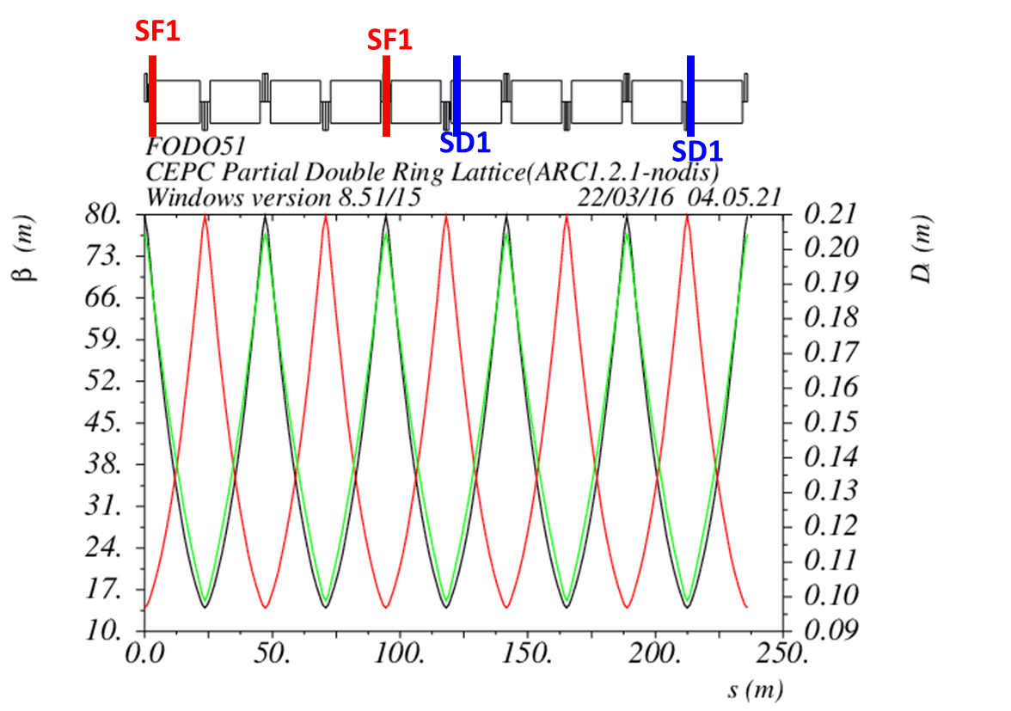
Non-interleave sextupoles in arc
(90°/90° FODO)

Slide 7
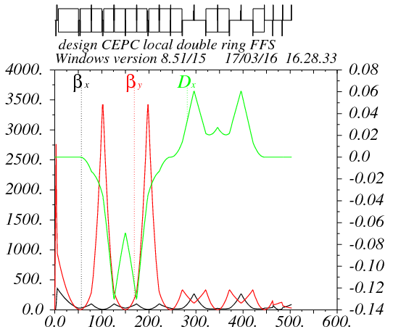
Partial double ring FFS design with crab sextupoles
Betax=0.25m
Betay=0.00136m
K2hs=26.8 m⁻³
K2vs=32.2 m⁻³
Crab sextupole
IP
Critical energy: Ec=190 keV
Dipole strength: B=0.019 T
The first FFS sextupoles of the CCS-Y section work as the crab sextupoles.

Slide 8
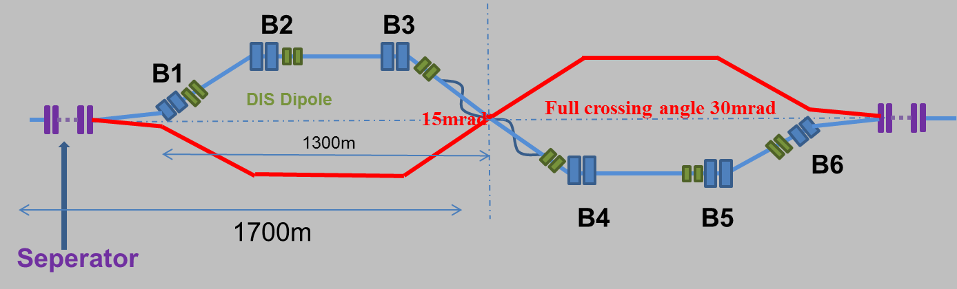
Combine with partial double ring lattice
30 mrad
10 m

Slide 9
DA bandwidth optimization without damping
(knob arc sextupoles)
test16 from Zhang Yuan@IHEP
Crab sextupoles - off
Bandwidth = 1.4%.
DA (on-momentum): 32σ_{x} × 60σ_{y}
Next step:
- Combine arc sextupoles with IR sextupoles.
- Add symmetry in arc
- open damping effect

Slide 10
CEPC damping ring requirement
Energy: 1.1GeV
Storage time: 20ms
Injected emittance (normalized): 3500 mm-mrad, injected energy spread ~ 0.25%
Transverse acceptance > 3*injection beam size
Extracted energy spread <1×10-3
No strong requirement for the extracted emittance (<0.5ε_{inj})!

Slide 11
Damping ring 达标参数
1. 引出束长小于10ps
2. 引出能散小于0.1%
3. 引出发射度要求不严格，大致上小于1500 mm.mrad就行，越小越好。
4. 横向接收度大于3倍的注入束团尺寸
5. 能量接收度大于等于1%

Slide 12
CEPC DR design
 | DR V1.0
Energy (GeV) | 1.1
circumference | 58.5
Bending radius (m) | 3.6
B0 (T) | 1.01
U0 (keV/turn) | 35.8
Damping time x/y/z (ms) | 12/12/6 (61538 turns)
δ0 (%) | 0.049
ε0 (mm.mrad) | 302
Nature σz (mm) | 7 (23ps)
Extract σz (mm) | ~7 (23ps)
εinj (mm.mrad) | 3500
εext x/y (mm.mrad) | 434/145
δinj /δext (%) | 0.25 /0.05
Energy acceptance by RF(%) | 1.0
f_{RF}=650MHz
V_{RF}=1.8MV
Bunch compressor

Slide 13
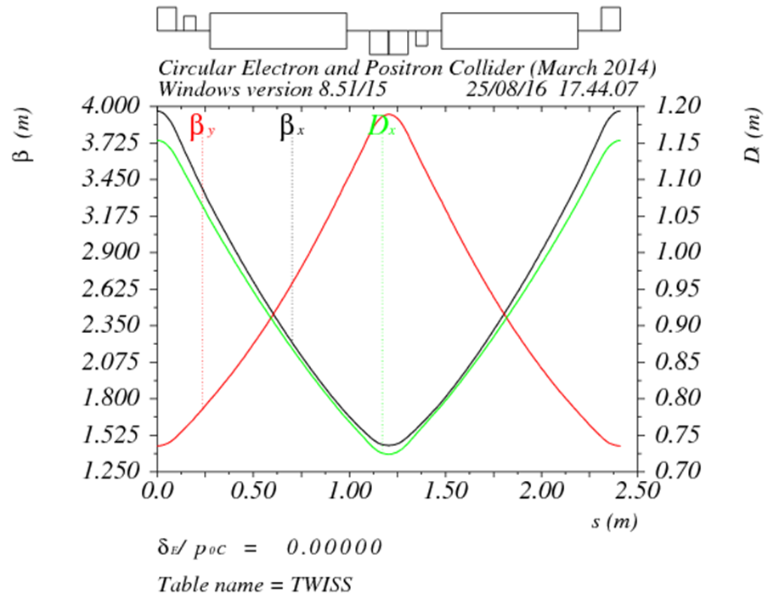
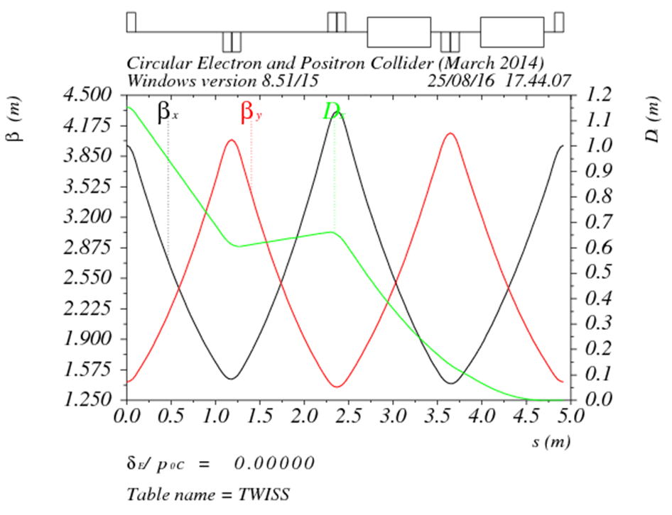
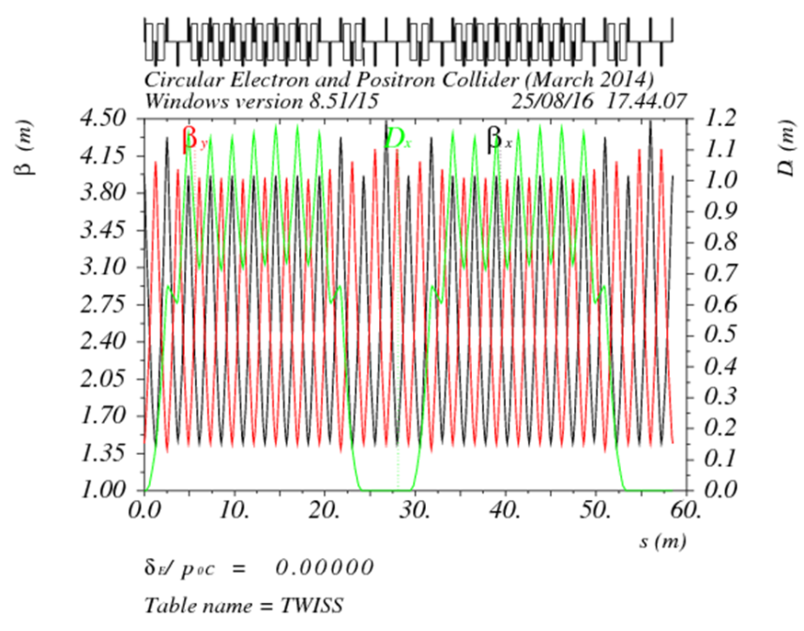
DR lattice design
FODO length (m) | 2.4
Phase per cell | 60°
Dipole length (m) | 0.71
Dipole strength (T) | 1.0
Quadrupole length (m) | 0.2
Quadrupole strength (m⁻²) | 4.1
Sextupole length (m) | 0.06

Slide 14
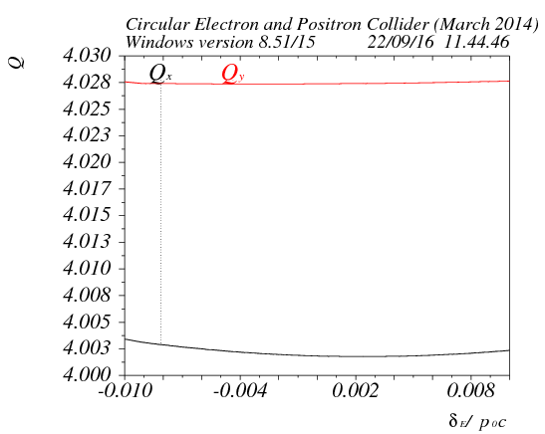
DA
Tracking 240000turns （4 damping time）
ε_{inj} / ε₀=11.6
σ_{inj} / σ₀=3.4
σ_{inj,max}=sqrt(1.626um*4m)
= 2.55mm
5 times of injection beam size

Slide 15
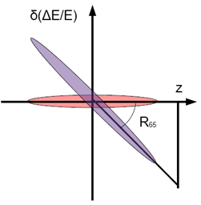
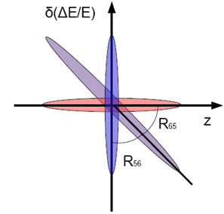
Primary design for bunch compressor
RF structure
E₀
E₁
Dispersive section

Slide 16
Parameter design
入口：σ₀=7mm， δ₀=0.05%， E₀=1.1 GeV
出口：σ₁<3mm， δ₁=??(≤0.1%)， E₁=??

Slide 17
Parameters of CEPC bunch compressor
 | BC (case I) | BC (case II)
初始能量 (GeV) | 1.1 | 1.1
初始能散 (%) | 0.05 | 0.05
初始束长 (mm) | 7 | 7
高频频率 (MHz) | 2856 | 2856
高频腔压 (MV) | 14.5 | 19.3
加速相位 (度) | 86 | 87
R₅₆ (m) | -4 | -3
出口能量 (GeV) | 1.101 | 1.101
出口能散 (%) | 0.17 | 0.23
出口束长 (mm) | 2 (6.7ps) | 1.5 (5ps)
束长压缩比：3.5~4.7
束长压缩比可调

Slide 18
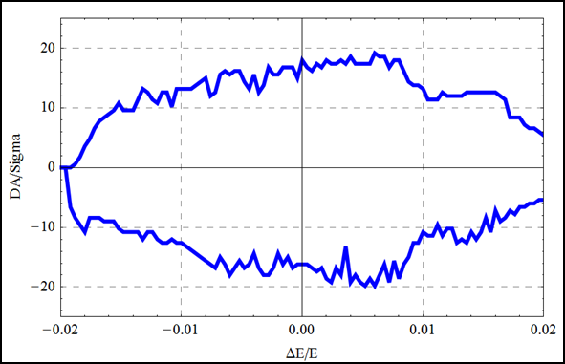
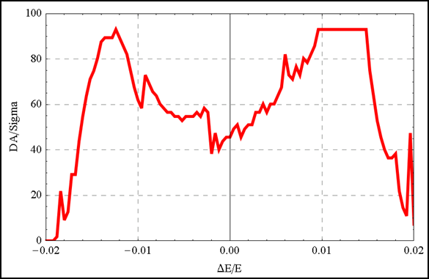
Check Yiwei’s lattice
σz=2.92mm

Slide 19
Check Yiwei’s lattice （ shorter bunch ）
Bunch length in parameter table: 2.7 mm
Plan:
- Re-optimize with 2.7mm bunch length
- Further optimization with MODE
- add additional sextupoles in IR

Slide 20

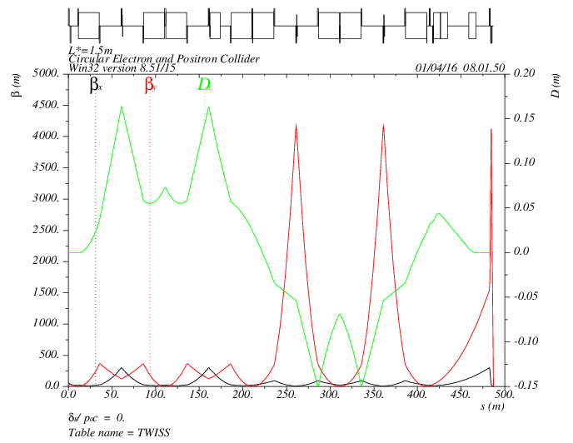
Lattice design of IR
MT
CCX
CCY
FT
IP
472kev
472kev
374kev
203kev
1952 kev
126kev
434kev
126kev
565 kev
L*= 1.5m
βx*= 0.22mm
βy*= 1mm
GQD0= -200T/m
GQF1= 200T/m
LQD0=1.69m
LQF1=0.90m

Slide 21
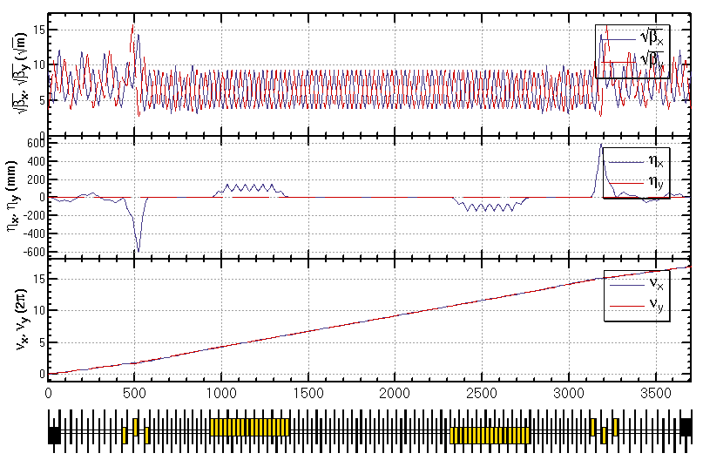
Lattice design of PDR (w/o IR)
Feng Su, Yiwei Wang
BSEP1：1631
BSEP3：1496
QBQ1：985

