Slide 1
Analysis of Chromaticity of WD-PDR4
ZHANG, Yuan and WANG, Dou
2016-10-14

Slide 2
Test22rad，phase-advance + arc sext + ir sext
Notes:
Test22rad, @acc-ap03-04-06-07-08-09, 300 个节点，运行4天没有中断

Slide 3
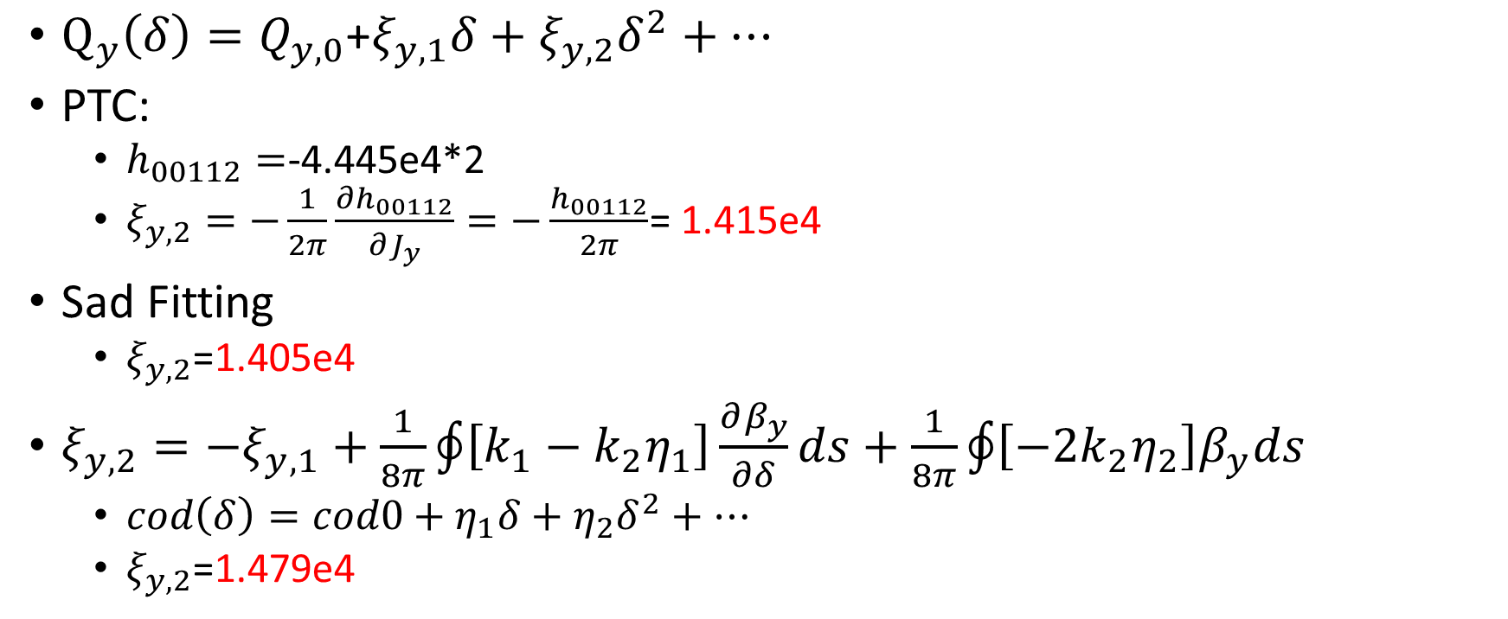
2nd order vertical chromaticity
$Q_{y}\left(δ\right)=Q_{y,0}\text{+}ξ_{y,1}δ+ξ_{y,2}δ^{2}+…$
PTC:
$h_{00112}=$-4.445e4*2
$ξ_{y,2}=−\frac{1}{2π}\frac{∂h_{00112}}{∂J_{y}}=−\frac{h_{00112}}{2π}$= 1.415e4
Sad Fitting
$ξ_{y,2}$=1.405e4
$ξ_{y,2}=−ξ_{y,1}+\frac{1}{8π}\oint{\left[k_{1}−k_{2}η_{1}\right]\frac{∂β_{y}}{∂δ}ds}+\frac{1}{8π}\oint{\left[−2k_{2}η_{2}\right]β_{y}ds}$
$cod\left(δ\right)=cod0+η_{1}δ+η_{2}δ^{2}+…$
$ξ_{y,2}$=1.479e4

Slide 4
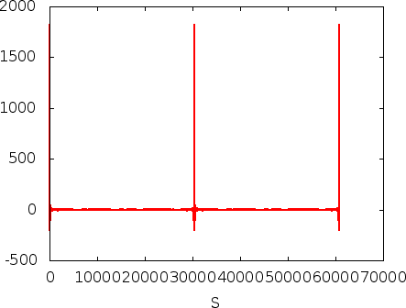
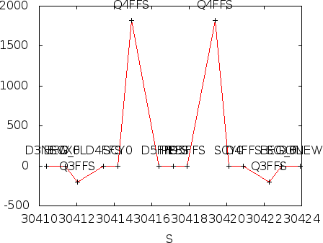
Source of 2nd order vertical chromaticity Quadrupole
Final focus Q in Y

Slide 5
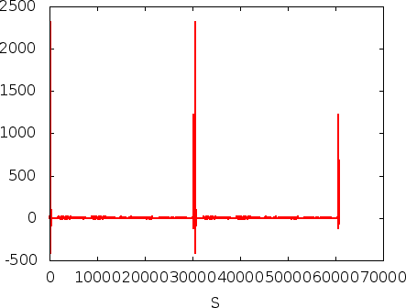
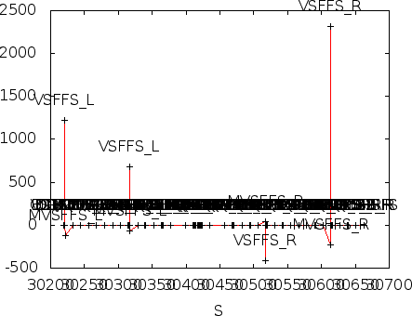
Source of 2nd order vertical chromaticity Sextupole
Main vertical chromaticity correction sextupoles

Slide 6
Partial double ring FFS design with crab sextupoles
Betax=0.25m
Betay=0.00136m
K2hs=26.8 m⁻³
K2vs=32.2 m⁻³
Crab sextupole
IP
Critical energy: Ec=190 keV
Dipole strength: B=0.019 T
Wang Dou
The first FFS sextupoles of the CCS-Y section work as the crab sextupoles.

Slide 7
Combine with partial double ring lattice
30 mrad
10 m

Slide 8
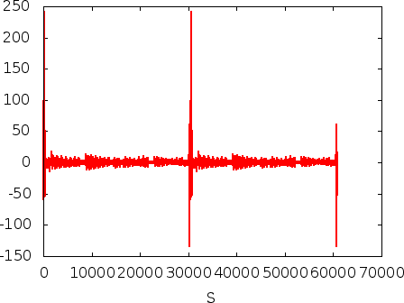
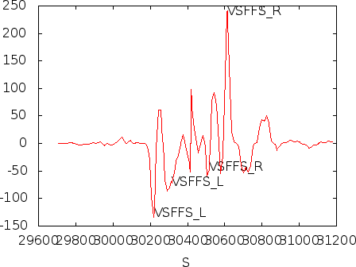
Possible correction with Sextupole
In the present design,
VSFFS_L: K2 = -9.65
VSFFS_R: K2 = 9.65
K2 = 1 is assumed

Slide 9
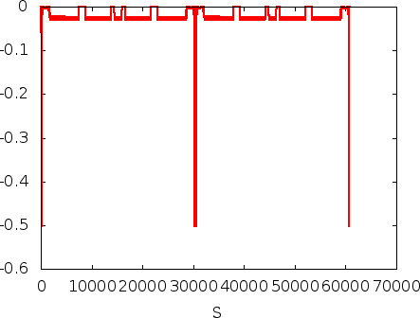
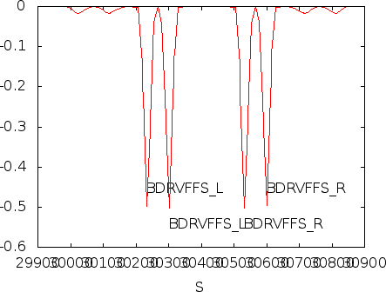
Possible correction with Octupole
$$ξ_{y,2}=\frac{1}{8π}\oint{\left[−k_{3}η_{1}^{2}\right]β_{y}ds}$$

Slide 10
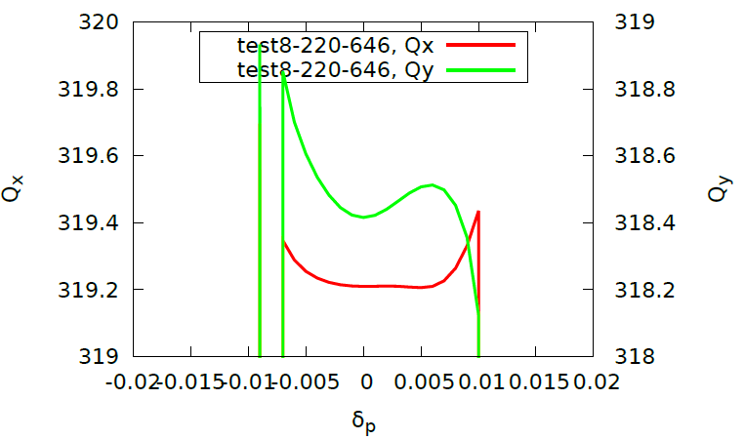
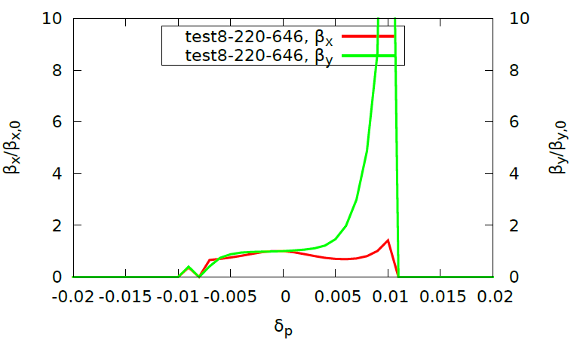
Chromatic Correction with Octupoles in IR （test8，）
The 2nd order vertical chromaticity by a octupole: $\frac{k3}{8π}D_{x}^{2}β_{y}$
Maximum poleface magnetic field is 0.1~0.2T
Aperture of octupole is assumed as 20mm, Length: 1m
The maximum k3 is about 1000. [in SAD]
If we only use one octupole , the most effective one should be 50000
DeltaP: (-0.01, 0.01) with step 0.001
Bound: k3 (-1000,1000), constraint (-2000, 2000)
2nd order chromaticity: 16500
Notes:
@acc-ap06, 8-16, 8:55, 16:00 停止

