Slide 1
CEPC主环lattice及动力学孔径研究
王毅伟，张源，苏峰，边天剑，
王逗，白莎，耿会平，高杰
CEPC AP meeting, 13 Oct 2016

Slide 2
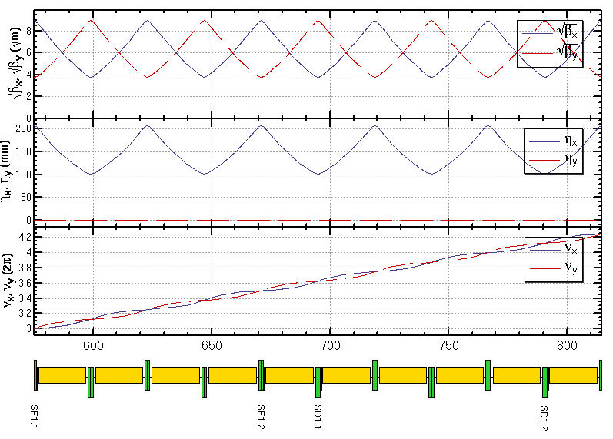
弧区lattice设计
FODO cell, 90°/90°, non-interleaved sextupole scheme
period N=5cells
all 3rd and 4th resonance driving terms (RDT) due to sextupoles cancelled, except small 4Qx, 2Qx+2Qy, 4Qy, 2Qx-2Qy
tune shift dQ(Jx, Jy) is very small
DA on momentum: large
Chromaticity dQ(δ) need to be corrected with many families
DA off momentum: with many families to correct dQ(δ) and –I break down
-I
-I
Sextupole configuration

Slide 3
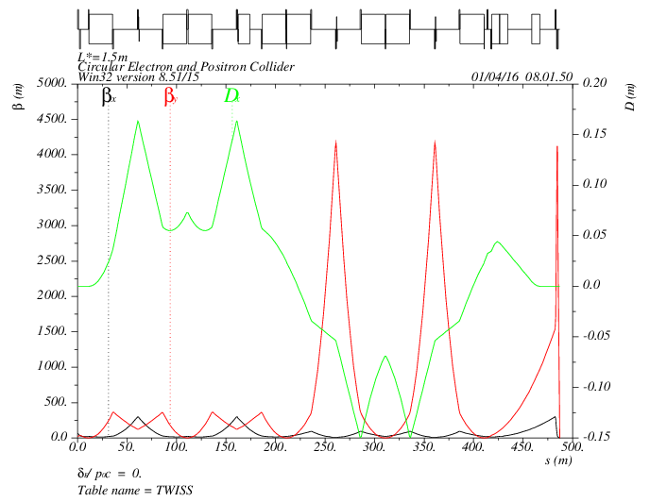
对撞区lattice设计
Local chromaticity correction with sextupoles pairs separated by –I transportation
all 3rd and 4th RDT due to sextupoles almost cancelled
up to 3rd order chromaticity corrected with main sextupoles, phase tuning and additional sextupoles
tune shift dQ(Jx, Jy) due to finite length of main sextupoles corrected with additional weak sextupoles
Break down of –I, high order dispersion could be optimized with odd dispersion scheme or Brinkmann sextupoles
MT
CCX
CCY
FT
IP
L*= 1.5m
βx*= 0.22mm
βy*= 1mm
GQD0= -200T/m
GQF1= 200T/m
LQD0=1.69m
LQF1=0.90m
-I
-I

Slide 4
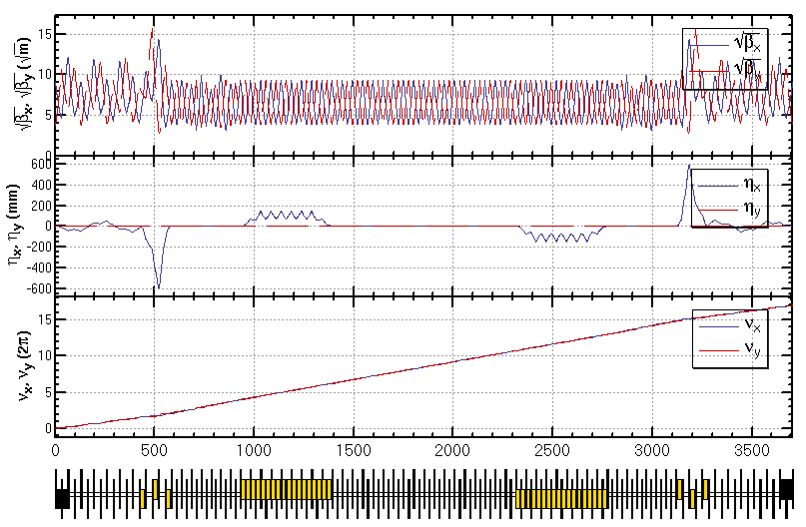
部分双环lattice设计
Feng Su, Yiwei Wang

Slide 5
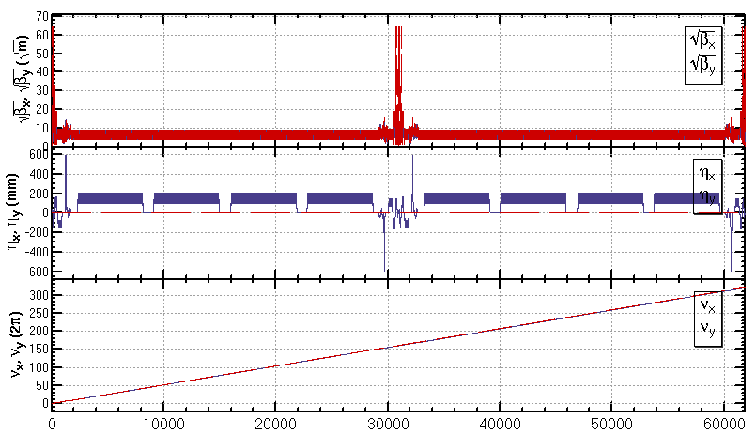
部分双环方案全环lattice
A lattice of the whole ring (ARC+PDR+IR) basically fulfilling the design parameters

Slide 6
CEPC主环动力学孔径目标
Parameter | Symbol | Unit | Value | Result 20160927
Luminosity per IP | L_{max} | 10³⁴cm⁻²s⁻¹ | 2.01 | -
Beta functions at IP | β_{x/}β_{y} | m | 0.275 /0.0013 | 0.22 /0.001
Main ring emittance | ε_{x/}ε_{y} | nm⋅rad | 2.05 /0.0062 | 2.15/0.0065
Injection emittance | ε_{x/}ε_{y} | nm⋅rad | 3.5 / 0.17 | 3.5/0.17
Transvers acceptance* | A_{x/}A_{y} | nm⋅rad | 787 / 4.17
Energy acceptance | A_{E} | % | 2.0 | 1.9
DA requirement from beam-beam (inclu. errors and beam-beam effect) | DA_{x/}DA_{y} | σ | 20 / 40 (dp/p=0) 5 / 10 (dp/p=±2%) | 16 / 45 (dp/p=0) 3 / 5 (dp/p=±2%) (no errors, mean value for two poles of axis)
DA requirement from injection (inclu. errors and beam-beam effect) | DA_{x/}DA_{y} | σ | 20 / 26 (dp/p=0 and dp/p=±0.5%) | -
Based on the parameters “wangdou20160918 H-low power” .
*assuming coupling factor κ=5% for injection beam,
βx,r=200 m, βx,i=60 m, ws = 4 mm, nr = 5, ns = 5

Slide 7
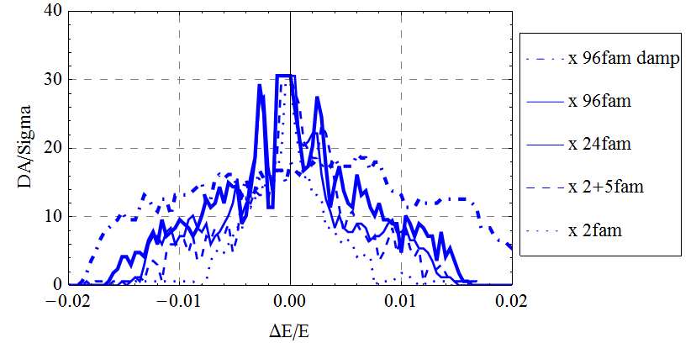
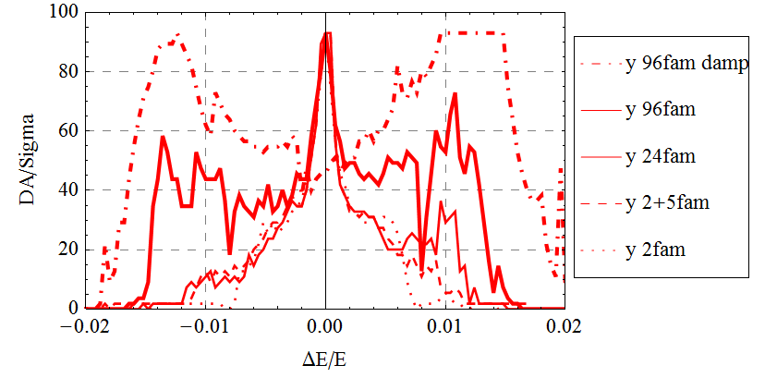
CEPC主环动力学孔径优化
Dynamic aperture study
Bare lattice
Synchrotron motion included
w/o and w/ damping
Tracking with around 1 times of damping time
Coupling factor κ=0.003 for εy
Working point (0.08, 0.22)
Downhill Simplex algorithm applied
Further optimization is possible
Larger dispersion for IR sextupoles
βy*= 1mm -> 1.3mm (new parameters)
More families in IR
Study of effects such as quantum excitation, solenoid field, errors and misalignments are under going

Slide 8
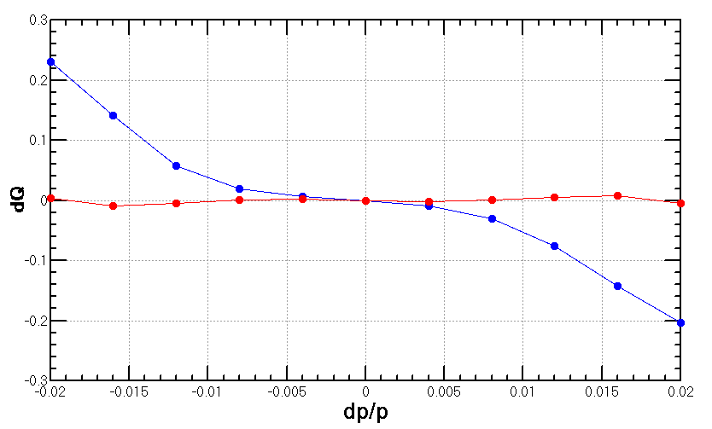
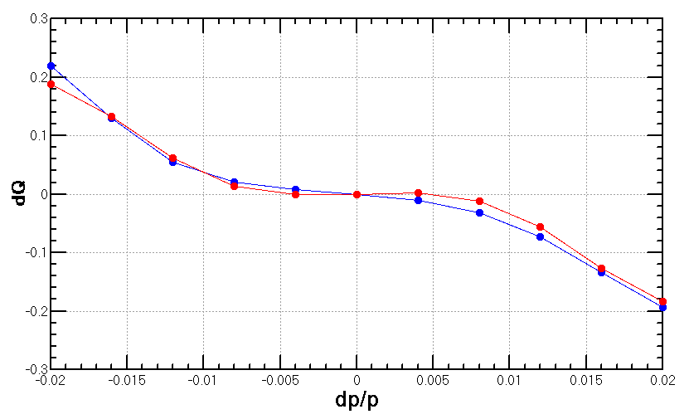
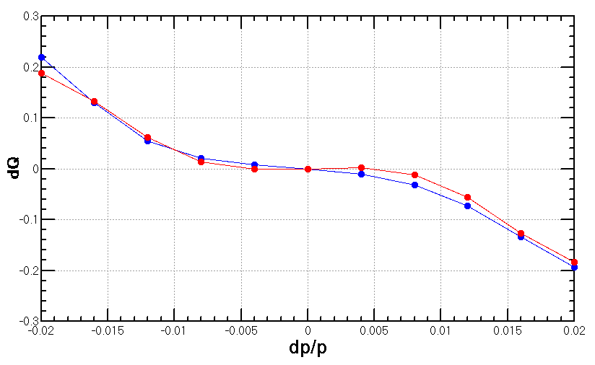
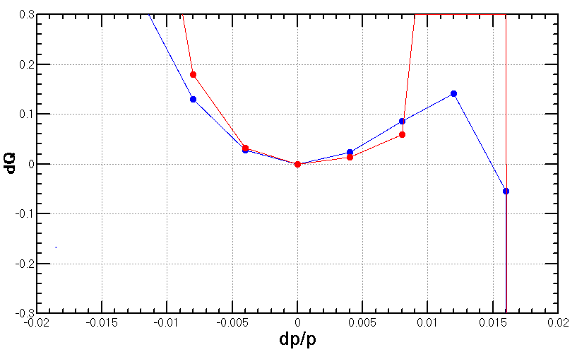
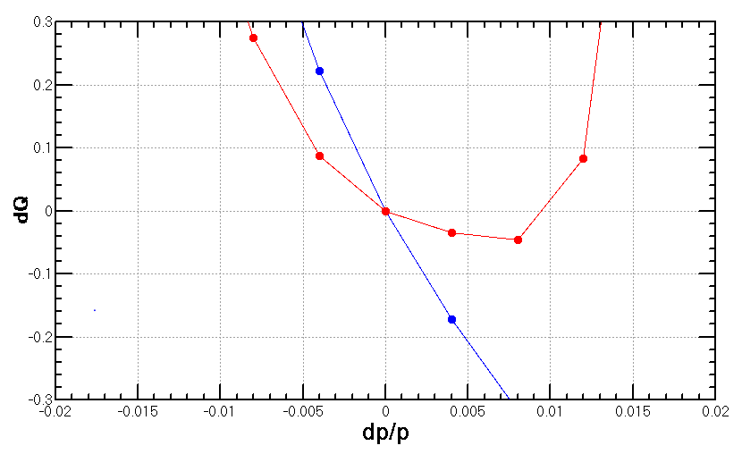
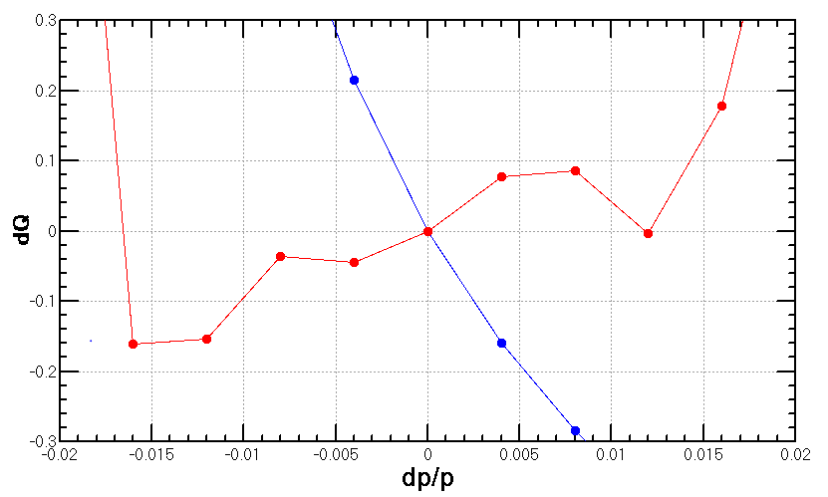
色品 (calculation with lattice)
Natural chromaticity | ξx | ξy
IR | -36 | -1155
ARC+PDR | -411 | -651
Total | -447 | -1806
FFS original (2+5)
FFS re-optimized for DA (2+5)
ARC re-optimized for DA (96+5)
FFS
Whole ring

Slide 9
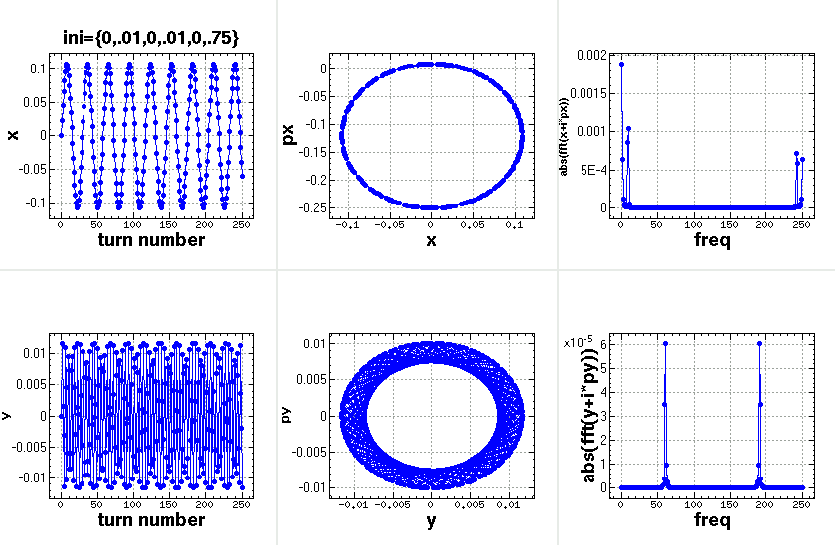
Details of FMA
w/o synchrotron motion

Slide 10
K. Oide

Slide 11
Summary
Optimization of dynamic aperture with chromatic constraint is undergoing.
Lattice with crab sextupoles is undergoing.

