Slide 1


CEPC Partial Double Ring Lattice Design and DA Study
SU Feng GAO Jie WANG Dou WANG Yiwei Li Yongjun BAI Sha
BIAN Tianjian GENG Huiping ZHANG Yuan
Institute of High Energy Physics
2016.10.21

Slide 2
Outline
Design Goal
CEPC PDR lattice设计和DA优化
CEPC APDR lattice设计和DA优化
CEPC DR lattice设计和DA优化

Slide 3
Outline
Design Goal

Slide 4
Parameter for CEPC partial double ring
（wangdou20160918）
 | Pre-CDR | H-high lumi. | H-low power | W | Z
Number of IPs | 2 | 2 | 2 | 2 | 2
Energy (GeV) | 120 | 120 | 120 | 80 | 45.5
Circumference (km) | 54 | 61 | 61 | 61 | 61
SR loss/turn (GeV) | 3.1 | 2.96 | 2.96 | 0.58 | 0.061
Half crossing angle (mrad) | 0 | 15 | 15 | 15 | 15
Piwinski angle | 0 | 1.88 | 1.84 | 5.2 | 6.4
N_{e}/bunch (10¹¹) | 3.79 | 2.0 | 1.98 | 1.16 | 0.78
Bunch number | 50 | 107 | 70 | 400 | 1100
Beam current (mA) | 16.6 | 16.9 | 11.0 | 36.5 | 67.6
SR power /beam (MW) | 51.7 | 50 | 32.5 | 21.3 | 4.1
Bending radius (km) | 6.1 | 6.2 | 6.2 | 6.2 | 6.2
Momentum compaction (10⁻⁵) | 3.4 | 1.48 | 1.48 | 1.44 | 2.9
β_{IP} x/y (m) | 0.8/0.0012 | 0.272/0.0013 | 0.275 /0.0013 | 0.1/0.001 | 0.1/0.001
Emittance x/y (nm) | 6.12/0.018 | 2.05/0.0062 | 2.05 /0.0062 | 0.93/0.0078 | 0.88/0.008
Transverse σ_{IP} (um) | 69.97/0.15 | 23.7/0.09 | 23.7/0.09 | 9.7/0.088 | 9.4/0.089
ξ_{x}/IP | 0.118 | 0.041 | 0.042 | 0.013 | 0.01
ξ_{y}/IP | 0.083 | 0.11 | 0.11 | 0.073 | 0.072
V_{RF} (GV) | 6.87 | 3.48 | 3.51 | 0.74 | 0.11
f _{RF} (MHz) | 650 | 650 | 650 | 650 | 650
Nature σ_{z} (mm) | 2.14 | 2.7 | 2.7 | 2.95 | 3.78
Total σ_{z} (mm) | 2.65 | 2.95 | 2.9 | 3.35 | 4.0
HOM power/cavity (kw) | 3.6 | 0.74 | 0.48 | 0.88 | 0.99
Energy spread (%) | 0.13 | 0.13 | 0.13 | 0.087 | 0.05
Energy acceptance (%) | 2 | 2 | 2
Energy acceptance by RF (%) | 6 | 2.3 | 2.4 | 1.7 | 1.2
n_{γ} | 0.23 | 0.35 | 0.34 | 0.49 | 0.34
Life time due to beamstrahlung_cal (minute) | 47 | 37 | 37
F (hour glass) | 0.68 | 0.82 | 0.82 | 0.92 | 0.93
L_{max}/IP (10³⁴cm⁻²s⁻¹) | 2.04 | 3.1 | 2.01 | 4.3 | 4.48

Slide 5
Design goals of main ring
Parameter | Symbol | Unit | Value
Luminosity per IP | L_{max} | 10³⁴cm⁻²s⁻¹ | 2.01
Main ring emittance | ε_{x/}ε_{y} | nm⋅rad | 2.05 /0.0062
Injection emittance | ε_{x/}ε_{y} | nm⋅rad | 3.5 / 0.17
Transvers acceptance* | A_{x/}A_{y} | nm⋅rad | 787 / 4.17
DA requirement from beam-beam (inclu. errors and beam-beam effect) | DA_{x/}DA_{y} | σ | 20 / 40 (dp/p=0) 5 / 10 (dp/p=±2%)
DA requirement from injection (inclu. errors and beam-beam effect) | DA_{x/}DA_{y} | σ | 20 / 26 (dp/p=0 and dp/p=±0.5%)
*assumming coupling factor κ=5% for injection beam,
βx,r=200 m, βx,i=60 m, ws = 4 mm, nr = 5, ns = 5

Slide 6
Outline
2. CEPC PDR Parameter and Lattice Layout

Slide 7
CEPC Partial Double Ring Layout
1/2RF
1/2RF
IP1_ee
RF
RF
3.7Km
1/2RF
1/2RF
Bypass
about 42m
IP4_pp
IP2_pp
Bypass
about 42m
1/2RF
1/2RF
IP1_ee/IP3_ee, 3.7Km
IP2_pp/IP4_pp, 1132.8m
4 Short Straights, 141.6m
4 Medium Straights, 566.4m
4 Long Straights, 944m
2 Short ARC, 24*FODO, 1132.8m
4 Medium ARC, 112*FODO, 5286.4m
4 Long ARC, 124*FODO, 5852.8m
C=61km
RF
RF
IP3_ee
1/2RF
1/2RF
SU Feng
2016.9.15

Slide 8
Parameter for CEPC partial double ring
（wangdou20160918）
 | Pre-CDR | H-high lumi. | H-low power | W | Z
Number of IPs | 2 | 2 | 2 | 2 | 2
Energy (GeV) | 120 | 120 | 120 | 80 | 45.5
Circumference (km) | 54 | 61 | 61 | 61 | 61
SR loss/turn (GeV) | 3.1 | 2.96 | 2.96 | 0.58 | 0.061
Half crossing angle (mrad) | 0 | 15 | 15 | 15 | 15
Piwinski angle | 0 | 1.88 | 1.84 | 5.2 | 6.4
N_{e}/bunch (10¹¹) | 3.79 | 2.0 | 1.98 | 1.16 | 0.78
Bunch number | 50 | 107 | 70 | 400 | 1100
Beam current (mA) | 16.6 | 16.9 | 11.0 | 36.5 | 67.6
SR power /beam (MW) | 51.7 | 50 | 32.5 | 21.3 | 4.1
Bending radius (km) | 6.1 | 6.2 | 6.2 | 6.2 | 6.2
Momentum compaction (10⁻⁵) | 3.4 | 1.48 | 1.48 | 1.44 | 2.9
β_{IP} x/y (m) | 0.8/0.0012 | 0.272/0.0013 | 0.275 /0.0013 | 0.1/0.001 | 0.1/0.001
Emittance x/y (nm) | 6.12/0.018 | 2.05/0.0062 | 2.05 /0.0062 | 0.93/0.0078 | 0.88/0.008
Transverse σ_{IP} (um) | 69.97/0.15 | 23.7/0.09 | 23.7/0.09 | 9.7/0.088 | 9.4/0.089
ξ_{x}/IP | 0.118 | 0.041 | 0.042 | 0.013 | 0.01
ξ_{y}/IP | 0.083 | 0.11 | 0.11 | 0.073 | 0.072
V_{RF} (GV) | 6.87 | 3.48 | 3.51 | 0.74 | 0.11
f _{RF} (MHz) | 650 | 650 | 650 | 650 | 650
Nature σ_{z} (mm) | 2.14 | 2.7 | 2.7 | 2.95 | 3.78
Total σ_{z} (mm) | 2.65 | 2.95 | 2.9 | 3.35 | 4.0
HOM power/cavity (kw) | 3.6 | 0.74 | 0.48 | 0.88 | 0.99
Energy spread (%) | 0.13 | 0.13 | 0.13 | 0.087 | 0.05
Energy acceptance (%) | 2 | 2 | 2
Energy acceptance by RF (%) | 6 | 2.3 | 2.4 | 1.7 | 1.2
n_{γ} | 0.23 | 0.35 | 0.34 | 0.49 | 0.34
Life time due to beamstrahlung_cal (minute) | 47 | 37 | 37
F (hour glass) | 0.68 | 0.82 | 0.82 | 0.92 | 0.93
L_{max}/IP (10³⁴cm⁻²s⁻¹) | 2.04 | 3.1 | 2.01 | 4.3 | 4.48

Slide 9
CEPC Partial Double Ring Layout
12
62.5urad
4.5m
B2
B1
614.4m
567.1m
65m
357.5m
307.2m
Full crossing angle 30mrad
15mrad
7.852m
IP
B4
Separator
1851.733m
B3
Version 1.0
sufeng
2016.9.15
For CEPC 120GeV beam:
Max. deflection per separator is 66μrad.

Slide 10
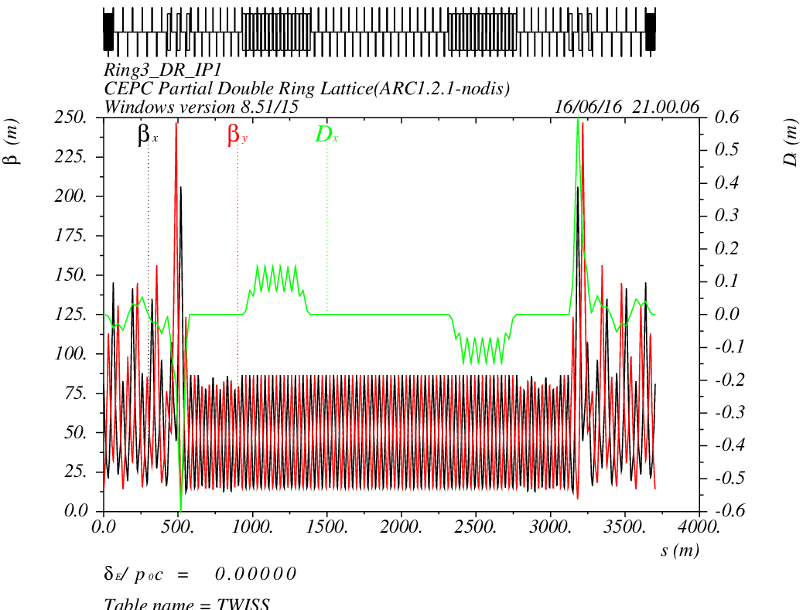
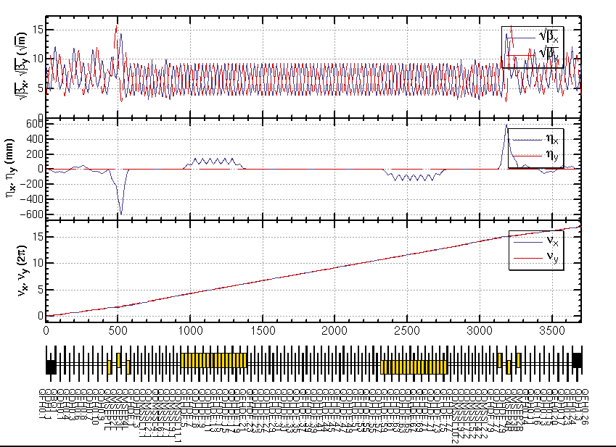
CEPC PDR1.0.3 noFFS

Slide 11
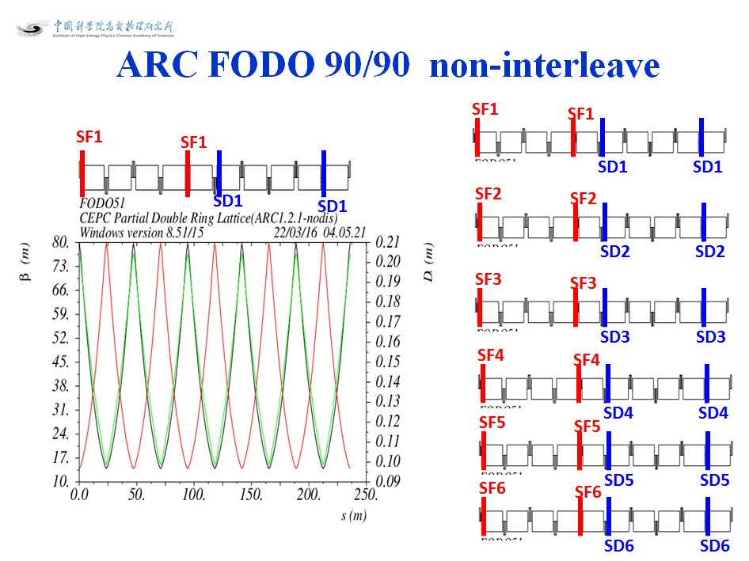
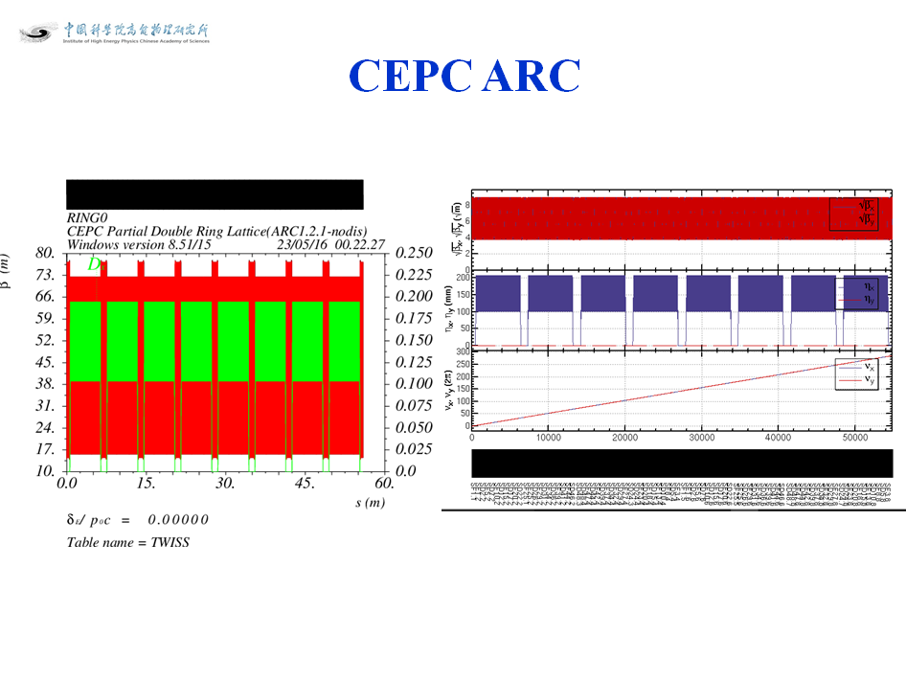
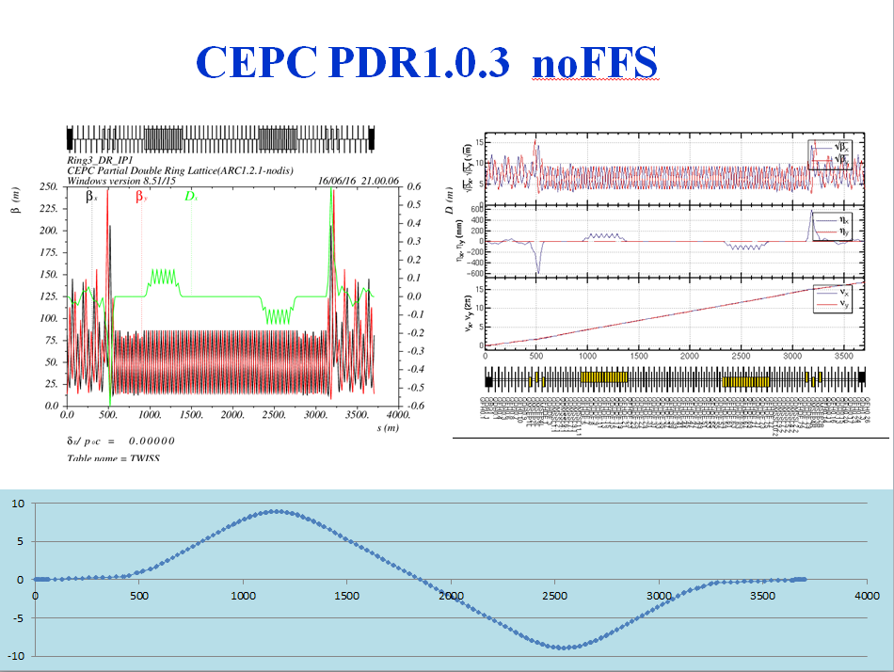
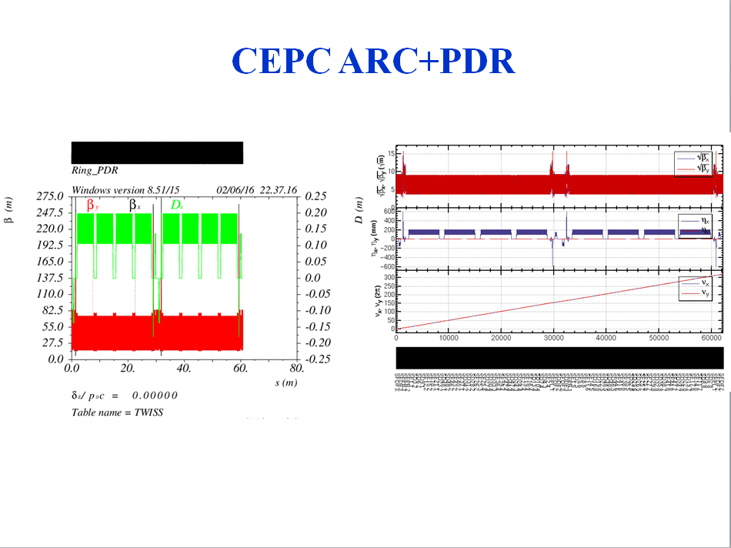

Slide 12
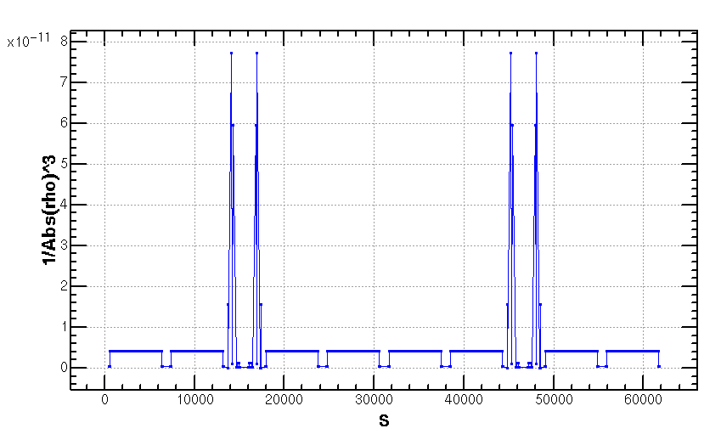
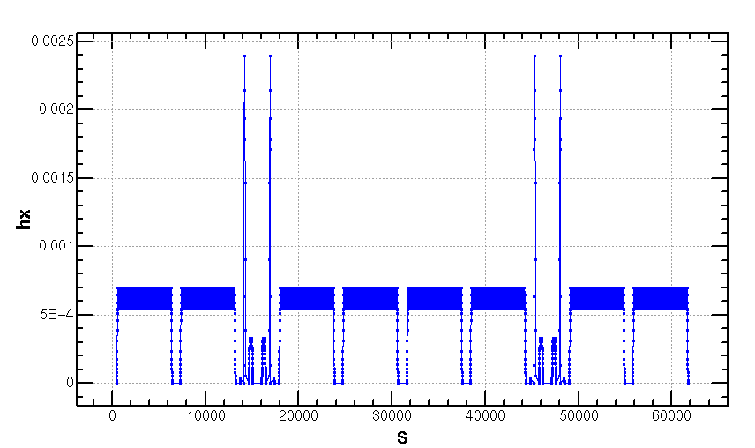
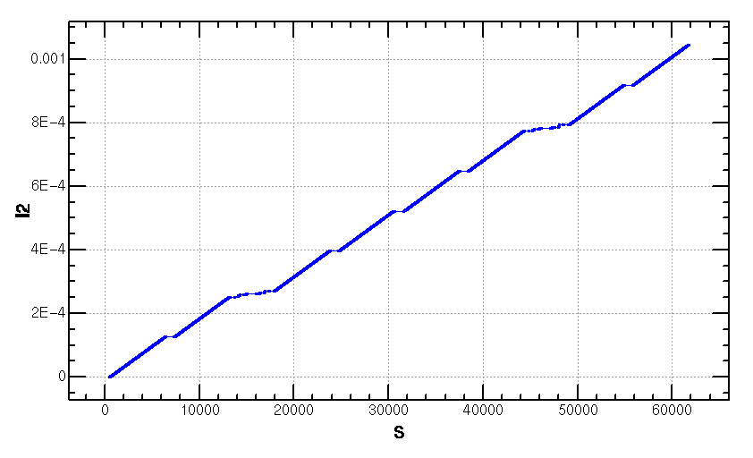
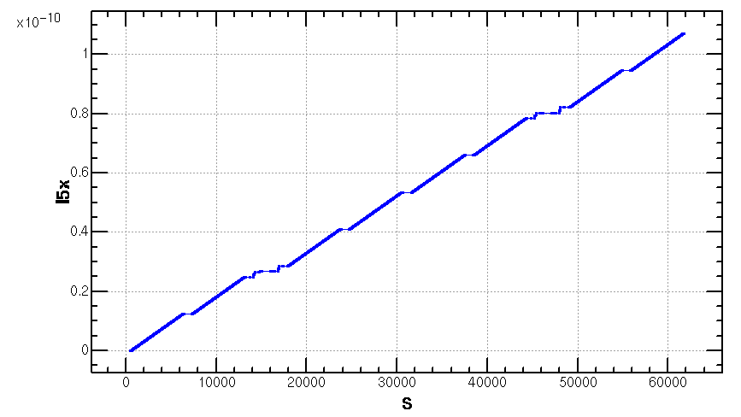
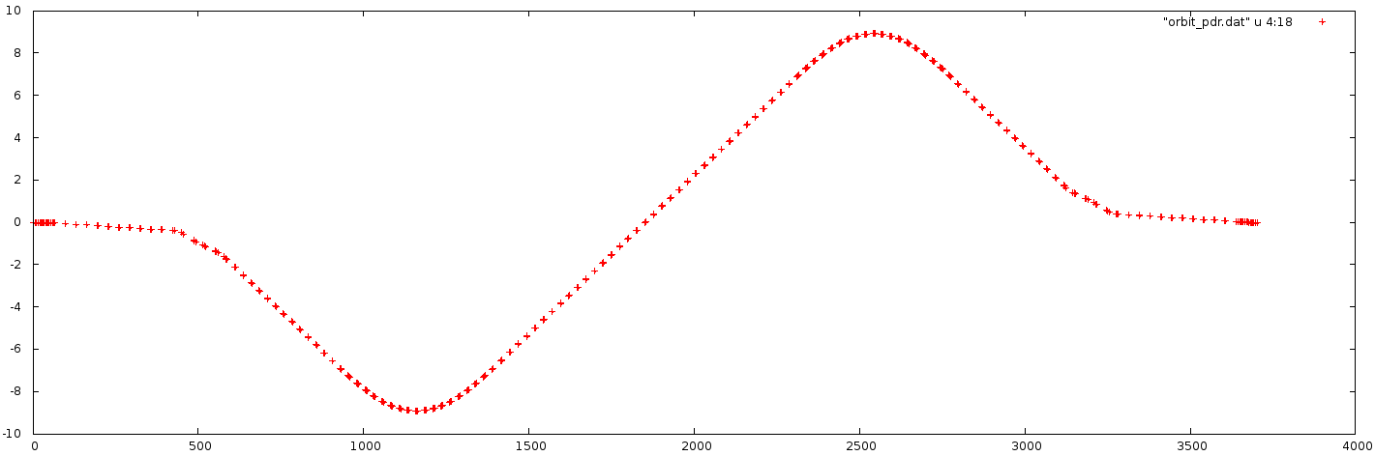
Emittance Increase (2.06nm->2.1668nm)
Notes:
Integration radius

Slide 13
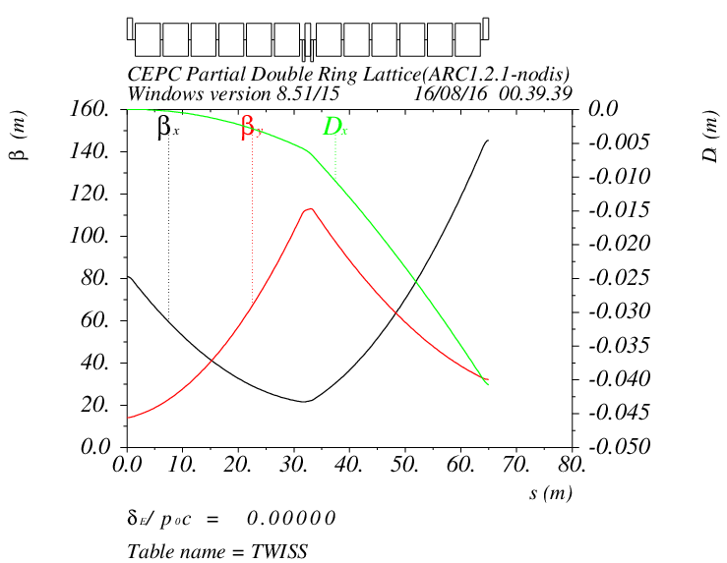
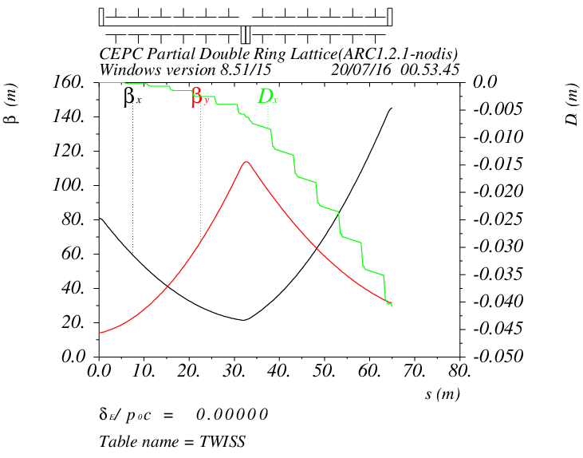
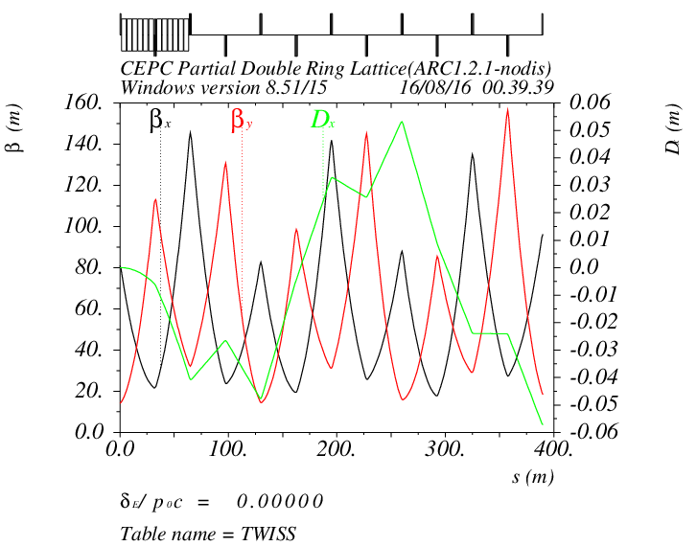
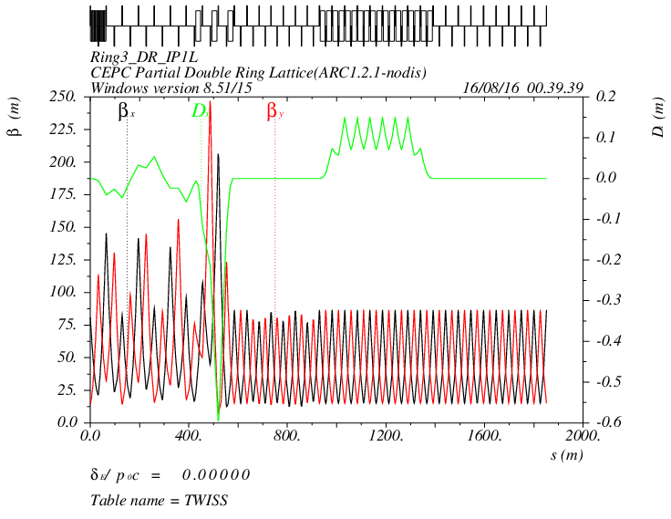
Detail of CEPC PDR1.0.3 noFFS

Slide 14
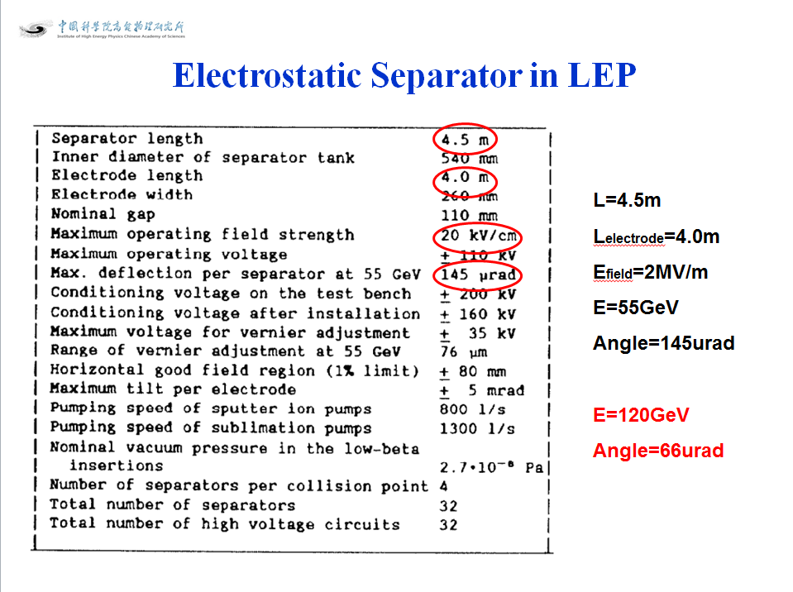
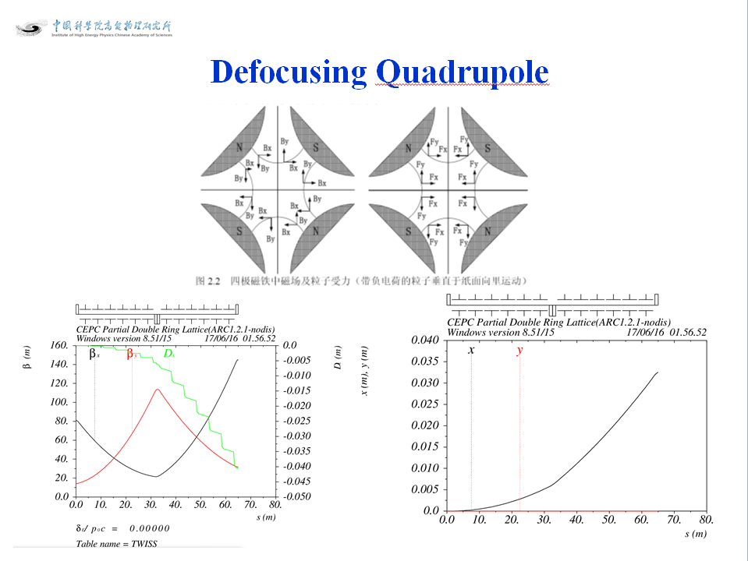
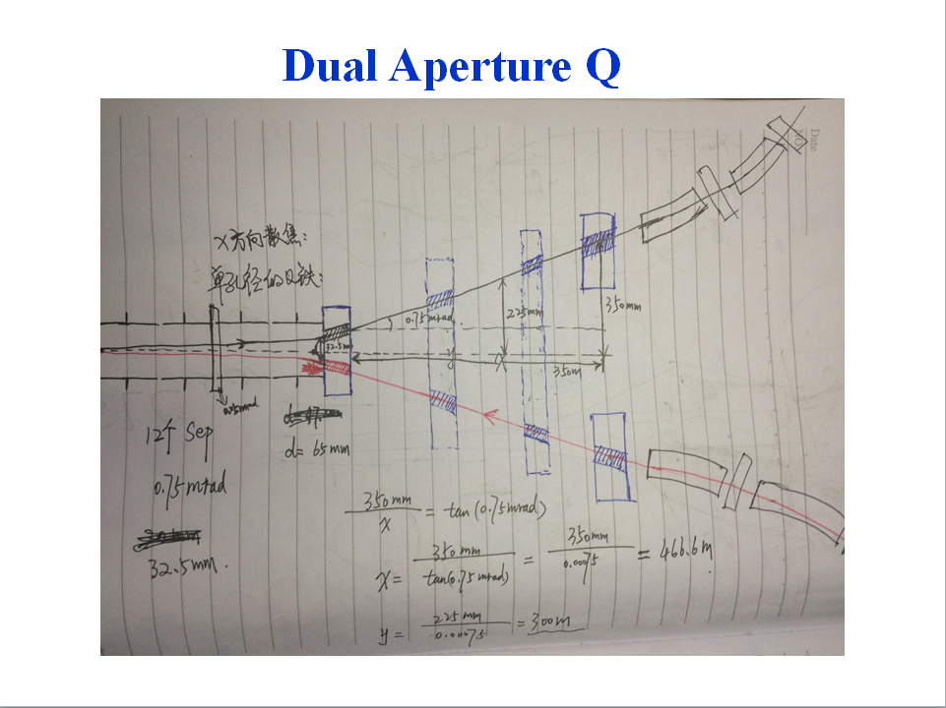
Parameters of Separators sufeng201605
Separator length | 4.5 | m
Electrode length | 4 | m
Maximum operating field strength | 1.875 | MV/m | 上限2MV/m
Beam energy | 120 | GeV
Maximum deflection per separator at 120GeV | 62.5 | urad | 微弧度
Number of separators per collision point | 12*2=24
Total number of separators (PDR) | 24*2=48
Total number of separators (APDR6) | 24*6=144
Total number of separators (APDR8) | 24*8=192
Notes:
Maximum operating field strength

Slide 15
According to CEPC Pre-CDR Magnet Parameter
Dipole magnets
Quantity | 1984
Maximum field strength(T) | 0.07
Magnetic gap (mm) | 80
Bending angle (mrad) | 3.17
Magnetic Length (m) | 18
Bending radius (m) | 6094
Good field region (mm) | 100
Core cross section (W*H) (mm) | 450*400
CEPC MQ
Quantity | 2304
Bore diameter (mm) | 100
Field Gradient (T/m) | 10
Magnetic Length (m) | 2.0
Core width and height (mm) | 700*700
Core length (mm) | 1960
CEPC MS | SD | SF
Quantity | 992 | 992
Aperture diameter (mm) | 120 | 120
Good field region (mm) | 100 | 100
Strength of sextupole field (T/m^2) | 180 | 180
Magnetic Length (m) | 700 | 400
Core width and height (mm) | 520 | 520
Length of iron core (mm) | 670 | 370
Super Conducting Q in CEPC IR | QF | QD
Field Gradient (T/m) | 304 | 309
Magnetic Length (m) | 1.25 | 0.72
Peak field in coil (T) | 7.2 | 7.1
Coil inner diameter (mm) | 40 | 40
Coil out diameter (mm) | 74 | 74
Cryostat diameter (mm) | 400 | 400
Coil mechanical length (mm) | 1500 | 950

Slide 16
Dipole Strength PDR1.0.3 without FFS
 | Angle(mrad) | L(m) | Rho(m) | Brho(E0/c)(T/m) | B(T) | Ek(KeV) | KeV/m
B0 | 3.205 | 19.6 | 6115.44 | 400 | 0.06541 | 626.349 | 31.956
BSepL | -0.0625 | 4.5 | -72000 | 400 | -0.00556 | 53.2 | 11.822
BMatch1L | -8.344 | 19.6 | -2348.99 | 400 | -0.1702 | 1630.66 | 83.1967
BMatch2L | 1.997 | 19.6 | 9814.72 | 400 | 0.0407 | 390.271 | 19.9118
BMatch3L | -7.653 | 19.6 | -2561.09 | 400 | -0.1562 | 1495.61 | 76.3069
B2 | 2.1428 | 19.6 | 9146.91 | 400 | 0.04373 | 418.764 | 21.3655
B3 | -2.1428 | 19.6 | -9146.91 | 400 | -0.04373 | 418.764 | 21.3655
BMatch3R | 7.653 | 19.6 | 2561.09 | 400 | 0.1562 | 1495.61 | 76.3069
BMatch2R | -1.997 | 19.6 | -9814.72 | 400 | -0.0407 | 390.271 | 19.9118
BMatch1R | 8.344 | 19.6 | 2348.99 | 400 | 0.1702 | 1630.66 | 83.1967
BSepR | 0.0625 | 4.5 | 72000 | 400 | 0.00556 | 53.2 | 11.822

Slide 17
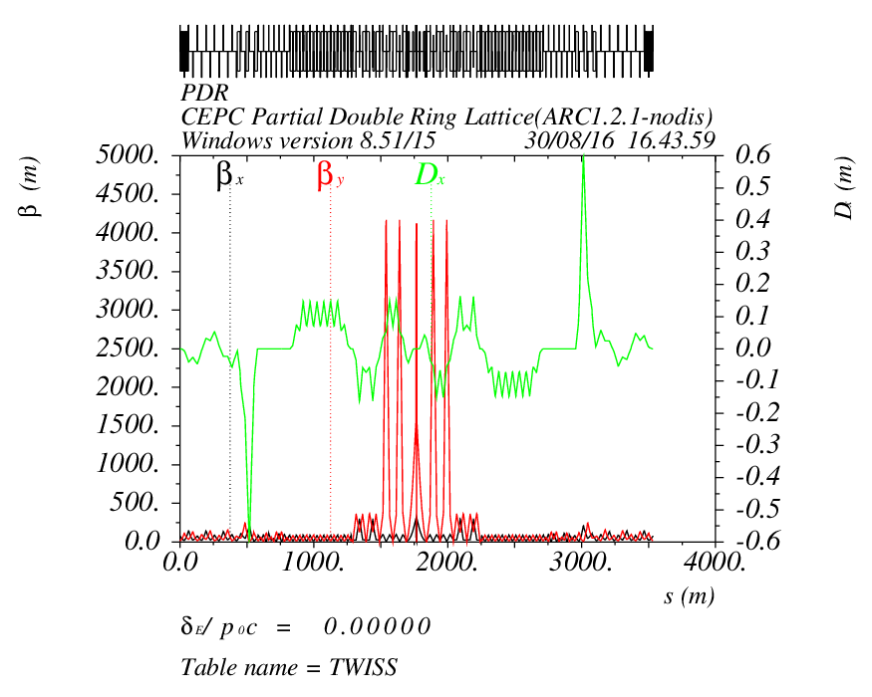
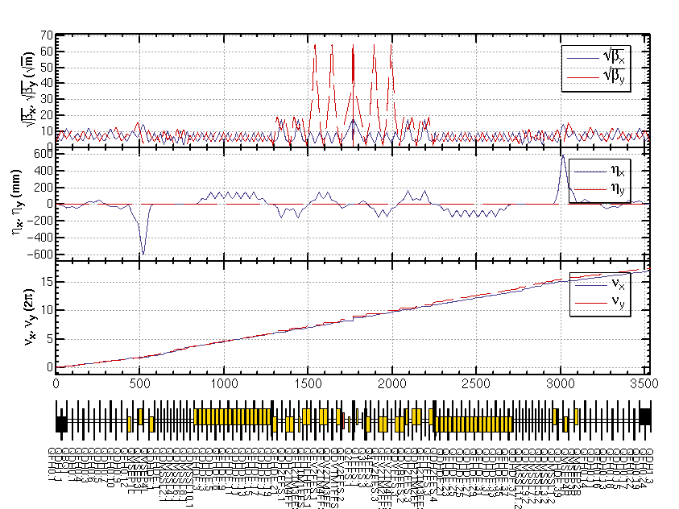
CEPC PDR1.0.3 with FFS (Yiwei20160817)

Slide 18
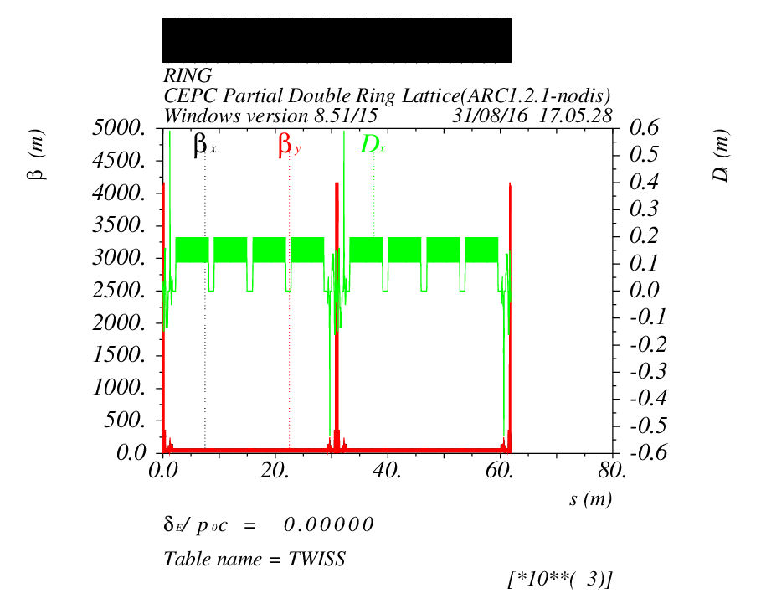
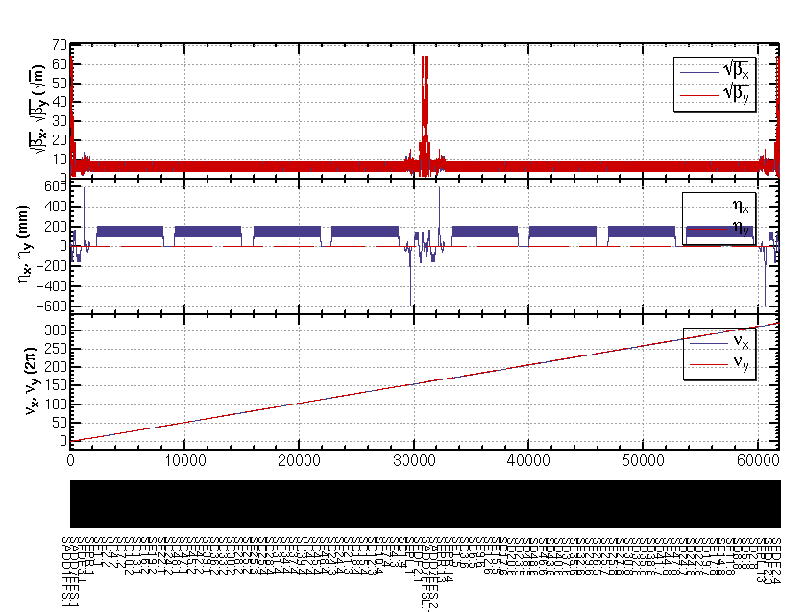
CEPC ARC+PDR_FFS

Slide 19
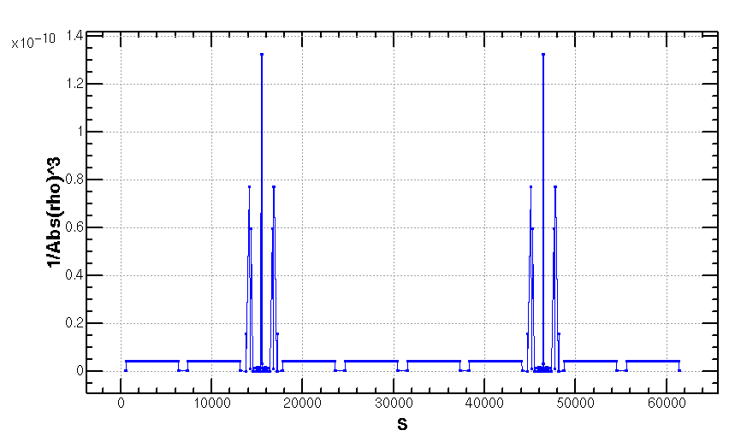
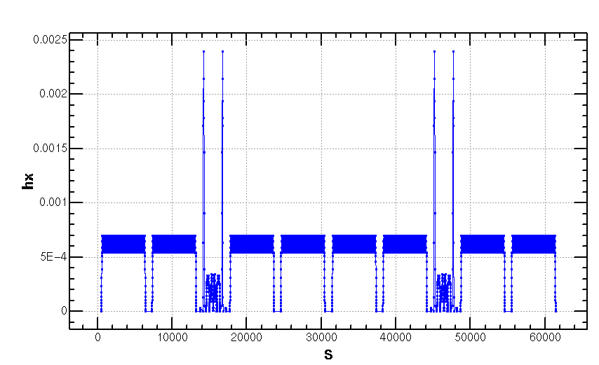
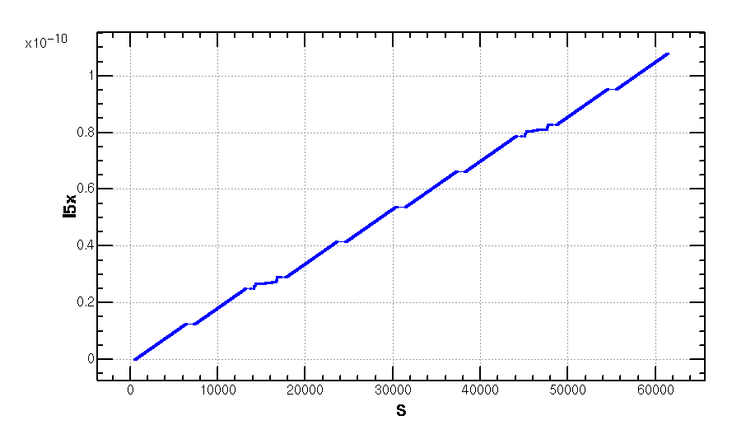
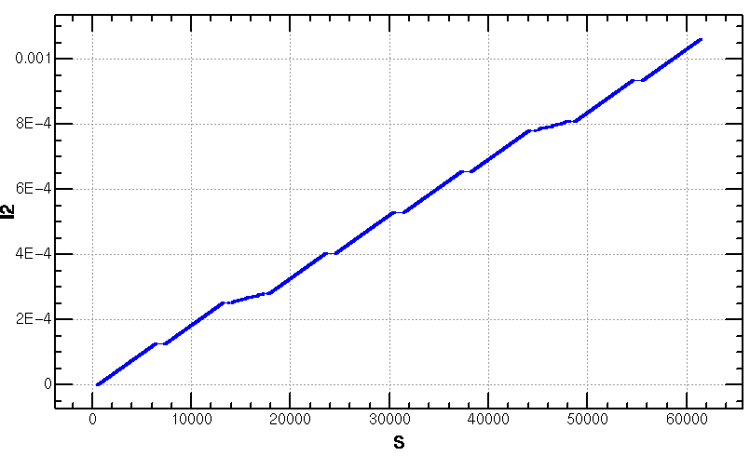
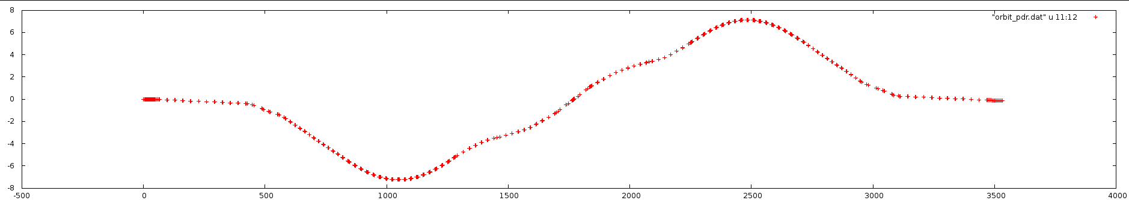
Emittance Increase (2.06nm->2.147368nm)
Notes:
Integration radius

Slide 20

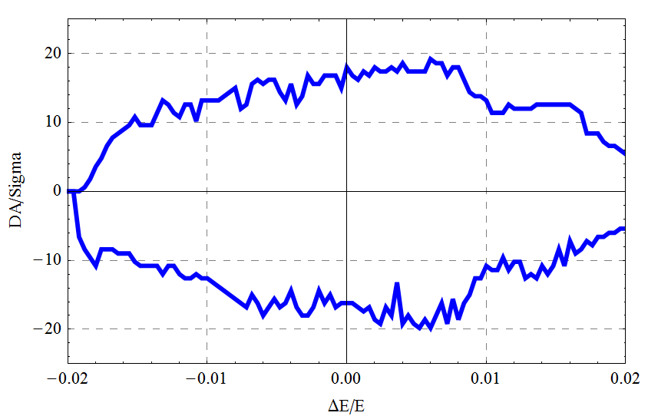
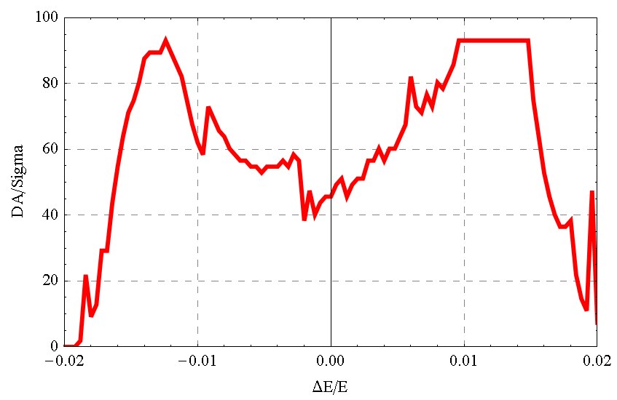
DA result
Dynamic aperture result
  W/O error of the magnets
  Synchrotron motion included, w/ damping
  Tracking with 100 turns
  Coupling factor κ=0.003 for εy
  Working point (0.08, 0.22)
DAx
DAy

Slide 21
18 45

Slide 22
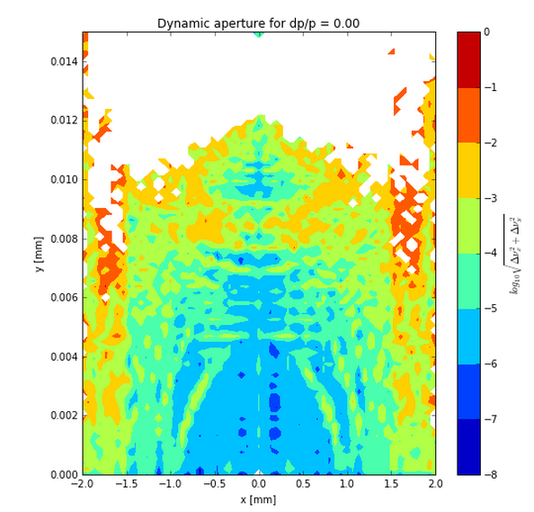
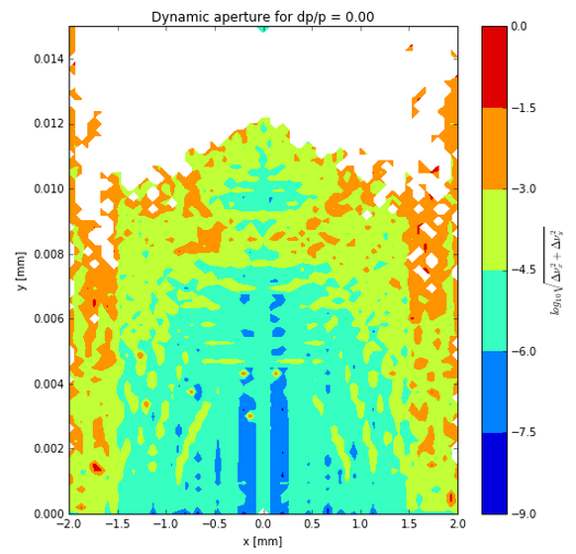
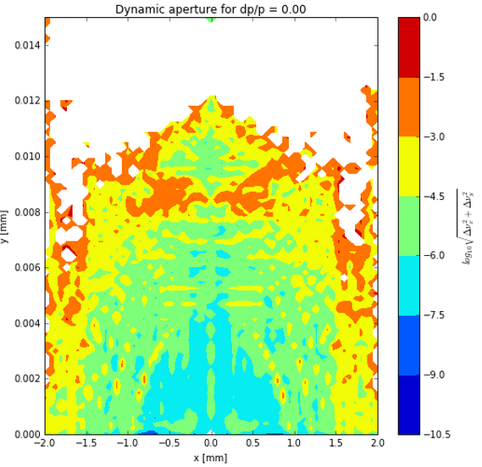
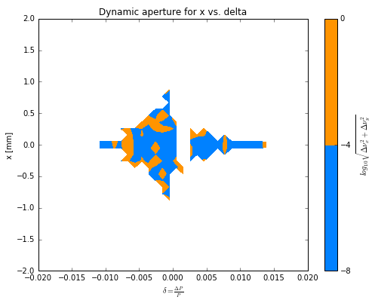
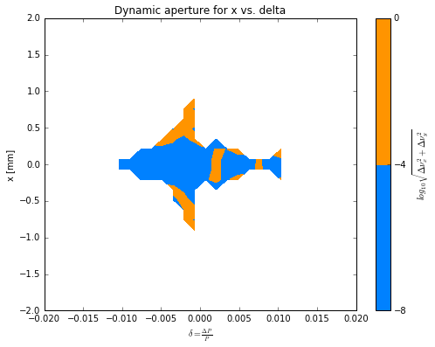
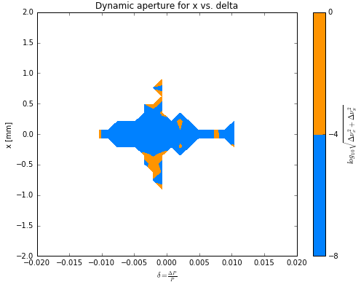
  full_ring240 half_ring480 full_ring480

Slide 23
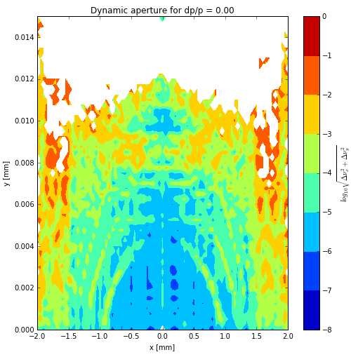
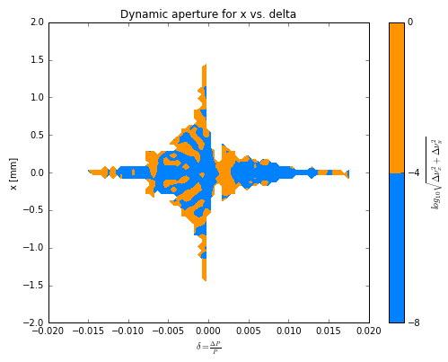
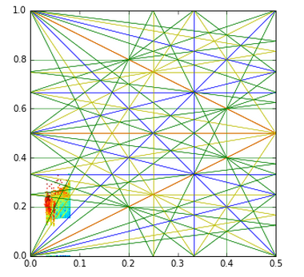
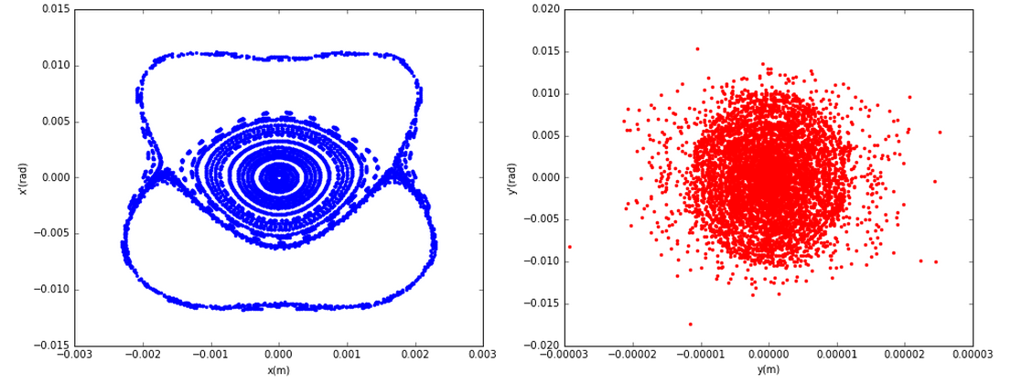
  CEPC_ARC_PDR_IR_96fam_damp ( Wang Yiwei) 100圈
0.8mm
5um
21.731um
0.08026um
37 SigmaX
63 SigmaY

Slide 24
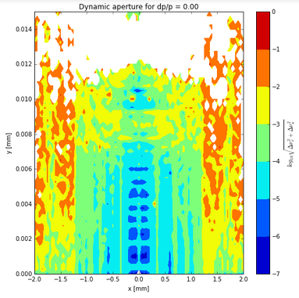
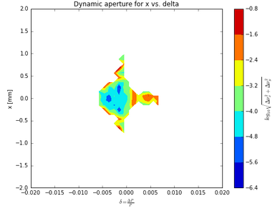
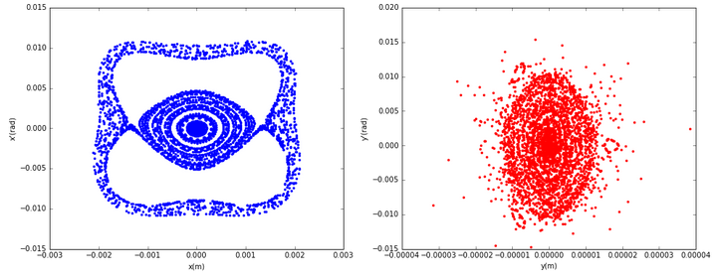
  CEPC_ARC_PDR_IR_96fam_damp 100圈优化 100代

Slide 25
3、CEPC APDR lattice设计和DA优化
Notes:
Integration radius

Slide 26
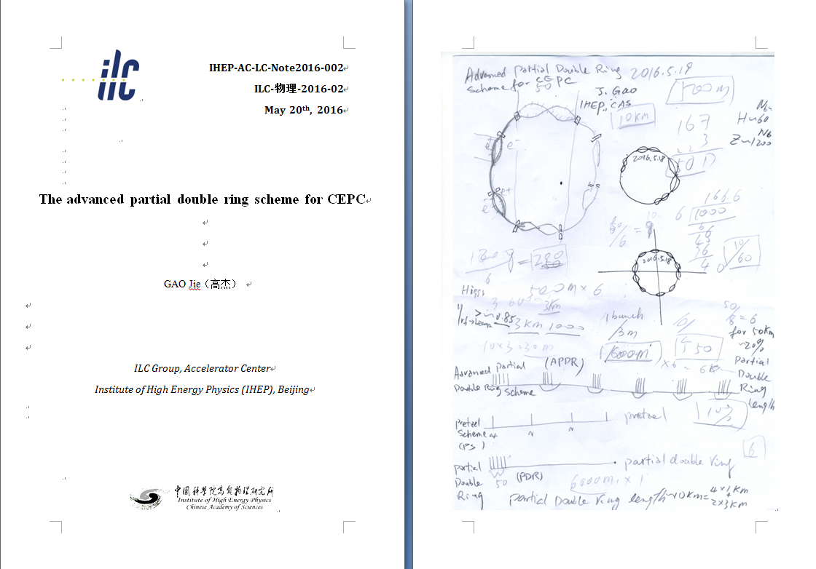
New idea：Advanced PDR （APDR）
To solve the big problem of RF system

Slide 27
CEPC Advanced Partial Double Ring Option II
RF
RF
IP1_ee
ARC
APDR
APDR
RF
3.7Km
RF
APDR
C=65640.2m
APDR
RF
RF
APDR
APDR
IP1_ee/IP3_ee, 3703.46m
IP2_pp/IP4_pp, 1132.8m
APDR, 1426m
RF Station, 188.8m
ARC1, 6041.6m
ARC1, 4902.87m
IP3_ee
RF
RF
SU Feng
2016.9.30

Slide 28
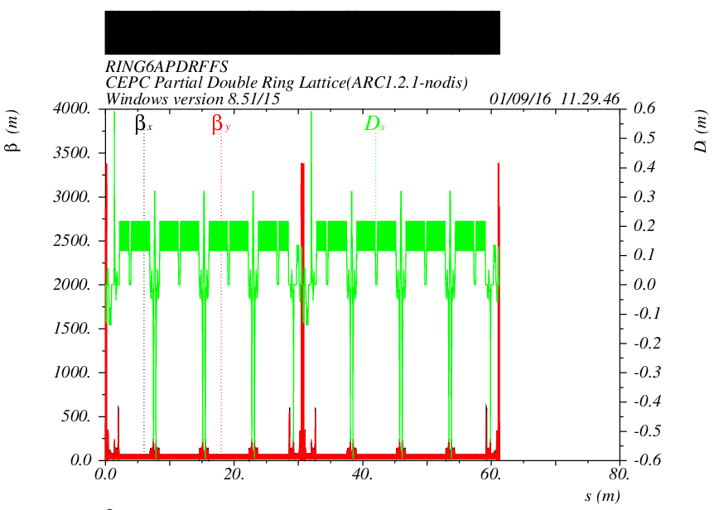
CEPC Advanced Partial Double Ring Optics II
PDR1
PDR3
APDR
APDR
APDR
APDR
APDR
APDR

Slide 29
DA of CEPC Advanced Partial Double Ring Optics II
2 groups sextupoles

Slide 30
DA of CEPC Advanced Partial Double Ring Optics II
2 groups sextupoles

Slide 31
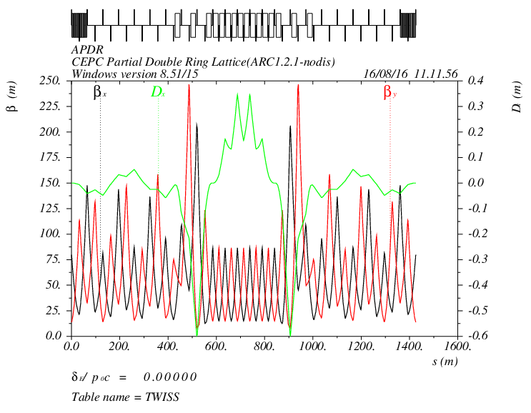
APDR Part
Need update!!
1426m

Slide 32

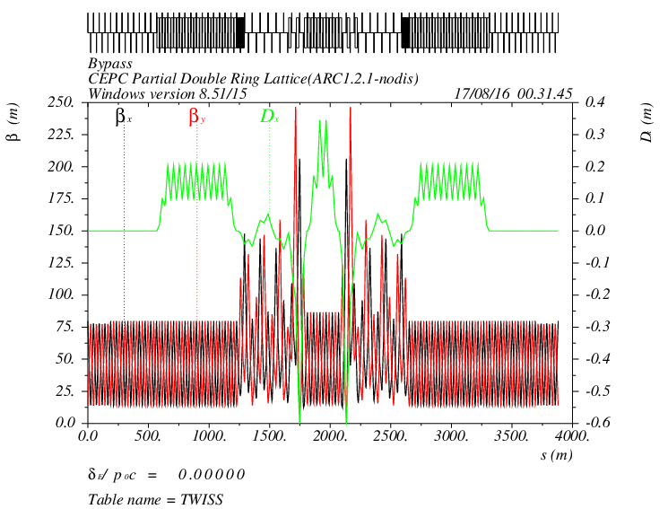
Bypass Part at IP2/4
12L_{c}
12L_{c}
566.4m
12L_{c}
12L_{c}
566.4m
L=42m
s
12L_{c}
24L_{c}
12L_{c}
566.4m
566.4m
Cell length=47.2m

Slide 33
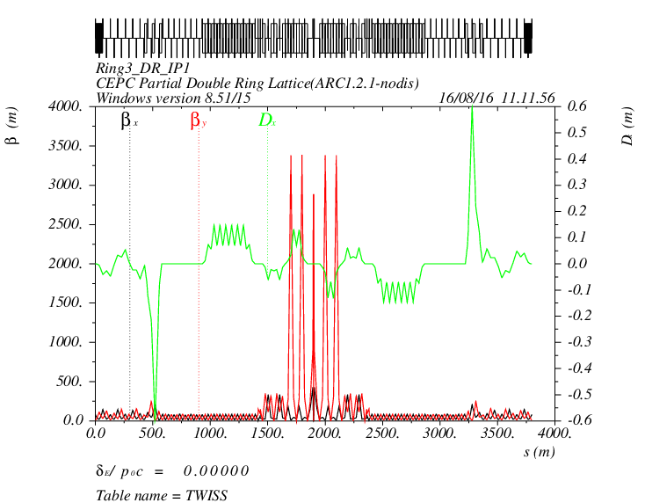
PDR Part

Slide 34
4. CEPC DR lattice设计和DA优化

Slide 35
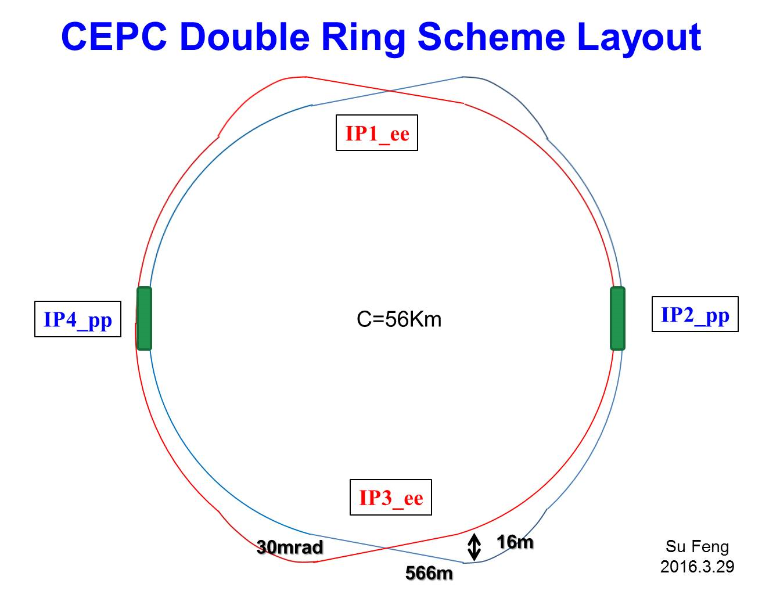
RF station
RF station

Slide 36
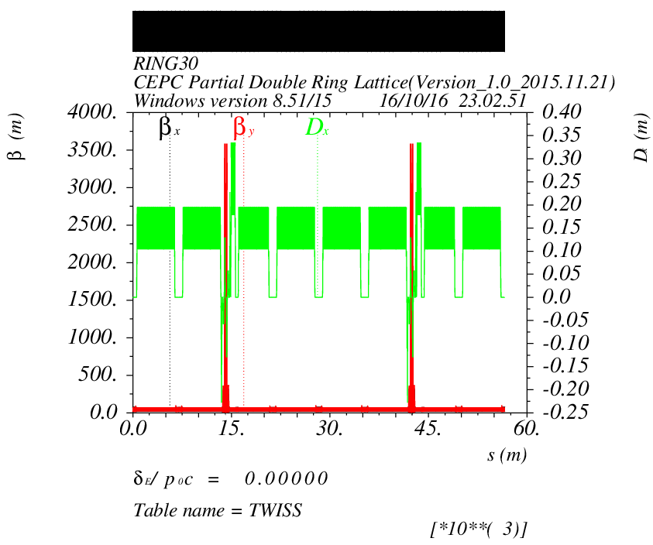
Double Ring Scheme
e-ring
IP1
IP3

Slide 37
DA of Double Ring

Slide 38
DA of Double Ring
2 groups sextupoles

Slide 39
Backup

Slide 40
CEPC Advanced Partial Double Ring Option I
1/2RF
1/2RF
ARC1
IP1_ee
RF
RF
ARC2
APDR
3Km
APDR
ARC3
1/2RF
1/2RF
Bypass
about 42m
C=62967.86m
IP4_pp
IP2_pp
ARC4
1/2RF
1/2RF
IP1_ee/IP3_ee, 2.968Km
IP2_pp/IP4_pp, 1132.8m
APDR, 1052.87m
4 Short Straights, 141.6m
4 Medium Straights, 566.4m
4 Long Straights, 1132.8m
4 ARC1, 124*FODO, 5852.8m
4 ARC2, 24*FODO, 1132.8m
4 ARC3, 79*FODO, 3728.8m
2 ARC4, 24*FODO, 1132.8m
C=65km
ARC3
APDR
APDR
RF
RF
ARC2
IP3_ee
ARC1
1/2RF
1/2RF
SU Feng
2016.5.23

Slide 41
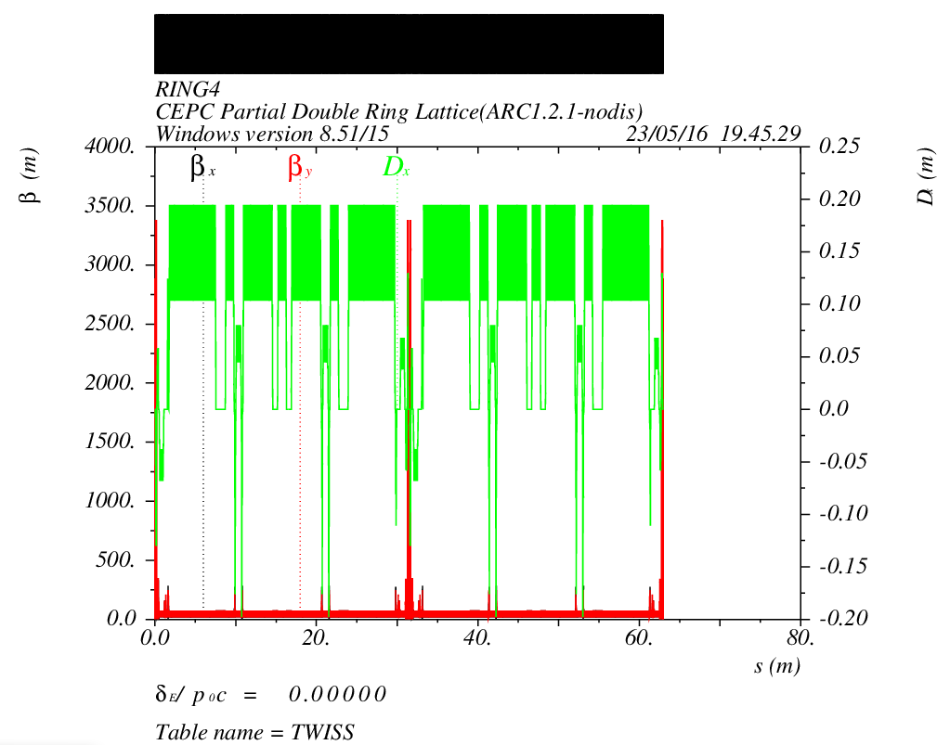
CEPC Advanced Partial Double Ring Optics I
PDR1
PDR3
Bypass2
Bypass4
APDR
APDR
APDR
APDR

Slide 42


Nonlinear Driving Term (ARC)
Betx：80.992367
bety：14.172123
2nm
Sizmax：402.47um
Sigmay：9.22um
X：60 Sigma
Y：813 Sigma
2 groups

Slide 43





Slide 44


Nonlinear Driving Term (ARC_PDR_20160630)
Betx：80.992367
bety：14.172123
2nm
Sizmax：402.47um
Sigmay：9.22um
X：45 Sigma
Y：780 Sigma
2 groups

Slide 45


Nonlinear Driving Term (ARC_PDR_FFS_2016.08.29)
Betx：0.219915m
bety：0.001m
2.147368nm
Sizmax：21.731um
Sigmay：0.08026um
X：46 Sigma
Y：37 Sigma
2 groups

Slide 46

  CEPC_ARC_PDR_IR_96fam_damp 20160929
0.8mm
5um
21.731um
0.08026um
37 SigmaX
63 SigmaY

