Slide 1
CEPC parameter optimization and lattice design
Dou Wang, Jie Gao, Yuan Zhang, Yiwei Wang, Feng Su, Huiping Geng, Cai Meng, Jiyuan Zhai, Zhenchao Liu, Bai Sha, Tianjian Bian, Na Wang
CEPC AP meeting, 2016.10.21

Slide 2
parameter for CEPC partial double ring
（wangdou20161012）
 | Pre-CDR | H-high lumi. | H-low power | W | Z
Number of IPs | 2 | 2 | 2 | 2 | 2
Energy (GeV) | 120 | 120 | 120 | 80 | 45.5
Circumference (km) | 54 | 61 | 61 | 61 | 61
SR loss/turn (GeV) | 3.1 | 2.96 | 2.96 | 0.58 | 0.061
Half crossing angle (mrad) | 0 | 15 | 15 | 15 | 15
Piwinski angle | 0 | 1.88 | 1.84 | 4.11 | 5.86
N_{e}/bunch (10¹¹) | 3.79 | 2.0 | 1.98 | 0.85 | 0.6
Bunch number | 50 | 107 | 70 | 400 | 1100
Beam current (mA) | 16.6 | 16.9 | 11.0 | 26.8 | 52.0
SR power /beam (MW) | 51.7 | 50 | 32.5 | 15.7 | 3.2
Bending radius (km) | 6.1 | 6.2 | 6.2 | 6.2 | 6.2
Momentum compaction (10⁻⁵) | 3.4 | 1.48 | 1.48 | 1.48 | 3.1
β_{IP} x/y (m) | 0.8/0.0012 | 0.272/0.0013 | 0.275 /0.0013 | 0.16/0.001 | 0.12/0.001
Emittance x/y (nm) | 6.12/0.018 | 2.05/0.0062 | 2.05 /0.0062 | 0.93/0.003 | 0.87/0.0046
Transverse σ_{IP} (um) | 69.97/0.15 | 23.7/0.09 | 23.7/0.09 | 12.2/0.056 | 10.2/0.068
ξ_{x}/IP | 0.118 | 0.041 | 0.042 | 0.0145 | 0.0098
ξ_{y}/IP | 0.083 | 0.11 | 0.11 | 0.084 | 0.073
V_{RF} (GV) | 6.87 | 3.48 | 3.51 | 0.7 | 0.12
f _{RF} (MHz) | 650 | 650 | 650 | 650 | 650
Nature σ_{z} (mm) | 2.14 | 2.7 | 2.7 | 3.23 | 3.9
Total σ_{z} (mm) | 2.65 | 2.95 | 2.9 | 3.35 | 4.0
HOM power/cavity (kw) | 3.6 | 0.74 | 0.48 | 0.47 | 0.59
Energy spread (%) | 0.13 | 0.13 | 0.13 | 0.087 | 0.05
Energy acceptance (%) | 2 | 2 | 2
Energy acceptance by RF (%) | 6 | 2.3 | 2.4 | 1.3 | 1.1
n_{γ} | 0.23 | 0.35 | 0.34 | 0.28 | 0.24
Life time due to beamstrahlung_cal (minute) | 47 | 37 | 37
F (hour glass) | 0.68 | 0.82 | 0.82 | 0.89 | 0.92
L_{max}/IP (10³⁴cm⁻²s⁻¹) | 2.04 | 3.1 | 2.01 | 3.5 | 3.44

Slide 3
parameter for CEPC –larger βy*
（wangdou20161017）
 | Pre-CDR | H-high lumi. | H-low power | H-large βy | W | Z
Number of IPs | 2 | 2 | 2 | 2 | 2 | 2
Energy (GeV) | 120 | 120 | 120 | 120 | 80 | 45.5
Circumference (km) | 54 | 61 | 61 | 61 | 61 | 61
SR loss/turn (GeV) | 3.1 | 2.96 | 2.96 | 2.96 | 0.58 | 0.061
Half crossing angle (mrad) | 0 | 15 | 15 | 15 | 15 | 15
Piwinski angle | 0 | 1.88 | 1.84 | 2.596 | 4.11 | 5.86
N_{e}/bunch (10¹¹) | 3.79 | 2.0 | 1.98 | 1.4 | 0.85 | 0.6
Bunch number | 50 | 107 | 70 | 153 | 400 | 1100
Beam current (mA) | 16.6 | 16.9 | 11.0 | 16.9 | 26.8 | 52.0
SR power /beam (MW) | 51.7 | 50 | 32.5 | 50 | 15.7 | 3.2
Bending radius (km) | 6.1 | 6.2 | 6.2 | 6.2 | 6.2 | 6.2
Momentum compaction (10⁻⁵) | 3.4 | 1.48 | 1.48 | 1.48 | 1.48 | 3.1
β_{IP} x/y (m) | 0.8/0.0012 | 0.272/0.0013 | 0.275 /0.0013 | 0.139/0.0023 | 0.16/0.001 | 0.12/0.001
Emittance x/y (nm) | 6.12/0.018 | 2.05/0.0062 | 2.05 /0.0062 | 2.05/0.0062 | 0.93/0.003 | 0.87/0.0046
Transverse σ_{IP} (um) | 69.97/0.15 | 23.7/0.09 | 23.7/0.09 | 16.9/0.12 | 12.2/0.056 | 10.2/0.068
ξ_{x}/IP | 0.118 | 0.041 | 0.042 | 0.017 | 0.0145 | 0.0098
ξ_{y}/IP | 0.083 | 0.11 | 0.11 | 0.11 | 0.084 | 0.073
V_{RF} (GV) | 6.87 | 3.48 | 3.51 | 3.51 | 0.7 | 0.12
f _{RF} (MHz) | 650 | 650 | 650 | 650 | 650 | 650
Nature σ_{z} (mm) | 2.14 | 2.7 | 2.7 | 2.68 | 3.23 | 3.9
Total σ_{z} (mm) | 2.65 | 2.95 | 2.9 | 2.91 | 3.35 | 4.0
HOM power/cavity (kw) | 3.6 | 0.74 | 0.48 | 0.52 | 0.47 | 0.59
Energy spread (%) | 0.13 | 0.13 | 0.13 | 0.13 | 0.087 | 0.05
Energy acceptance (%) | 2 | 2 | 2 | 2
Energy acceptance by RF (%) | 6 | 2.3 | 2.4 | 2.4 | 1.3 | 1.1
n_{γ} | 0.23 | 0.35 | 0.34 | 0.34 | 0.28 | 0.24
Life time due to beamstrahlung_cal (minute) | 47 | 37 | 37 | 37
F (hour glass) | 0.68 | 0.82 | 0.82 | 0.95 | 0.89 | 0.92
L_{max}/IP (10³⁴cm⁻²s⁻¹) | 2.04 | 3.1 | 2.01 | 2.03 | 3.5 | 3.44

Slide 4
New Z parameter for higher luminosity
（wangdou20161018）
 | Pre-CDR | H-high lumi. | H-low power | W | Z-high lumi.
Number of IPs | 2 | 2 | 2 | 2 | 2 | 2
Energy (GeV) | 120 | 120 | 120 | 80 | 45.5 | 45.5
Circumference (km) | 54 | 61 | 61 | 61 | 61 | 61
SR loss/turn (GeV) | 3.1 | 2.96 | 2.96 | 0.58 | 0.061 | 0.061
Half crossing angle (mrad) | 0 | 15 | 15 | 15 | 15 | 15
Piwinski angle | 0 | 1.88 | 1.84 | 4.11 | 2.36 | 5.86
N_{e}/bunch (10¹¹) | 3.79 | 2.0 | 1.98 | 0.85 | 2.0 | 0.6
Bunch number | 50 | 107 | 70 | 400 | 1100 | 3200
Beam current (mA) | 16.6 | 16.9 | 11.0 | 26.8 | 173 | 151.3
SR power /beam (MW) | 51.7 | 50 | 32.5 | 15.7 | 10.6 | 9.26
Bending radius (km) | 6.1 | 6.2 | 6.2 | 6.2 | 6.2 | 6.2
Momentum compaction (10⁻⁵) | 3.4 | 1.48 | 1.48 | 1.48 | 10.9 | 3.1
β_{IP} x/y (m) | 0.8/0.0012 | 0.272/0.0013 | 0.275 /0.0013 | 0.16/0.001 | 0.09/0.001 | 0.12/0.001
Emittance x/y (nm) | 6.12/0.018 | 2.05/0.0062 | 2.05 /0.0062 | 0.93/0.003 | 7.2/0.038 | 0.87/0.0046
Transverse σ_{IP} (um) | 69.97/0.15 | 23.7/0.09 | 23.7/0.09 | 12.2/0.056 | 25.5/0.19 | 10.2/0.068
ξ_{x}/IP | 0.118 | 0.041 | 0.042 | 0.0145 | 0.021 | 0.0098
ξ_{y}/IP | 0.083 | 0.11 | 0.11 | 0.084 | 0.079 | 0.073
V_{RF} (GV) | 6.87 | 3.48 | 3.51 | 0.7 | 3.7 | 0.12
f _{RF} (MHz) | 650 | 650 | 650 | 650 | 650 | 650
Nature σ_{z} (mm) | 2.14 | 2.7 | 2.7 | 3.23 | 3.86 | 3.9
Total σ_{z} (mm) | 2.65 | 2.95 | 2.9 | 3.35 | 4.0 | 4.0
HOM power/cavity (kw) | 3.6 | 0.74 | 0.48 | 0.47 | 6.51 | 1.7
Energy spread (%) | 0.13 | 0.13 | 0.13 | 0.087 | 0.05 | 0.05
Energy acceptance (%) | 2 | 2 | 2
Energy acceptance by RF (%) | 6 | 2.3 | 2.4 | 1.3 | 1.6 | 1.1
n_{γ} | 0.23 | 0.35 | 0.34 | 0.28 | 0.32 | 0.24
Life time due to beamstrahlung_cal (minute) | 47 | 37 | 37
F (hour glass) | 0.68 | 0.82 | 0.82 | 0.89 | 0.75 | 0.92
L_{max}/IP (10³⁴cm⁻²s⁻¹) | 2.04 | 3.1 | 2.01 | 3.5 | 10.1 | 10.0

Slide 5
Advantage:
Avoid pretzel orbit
Accommodate more bunches at Z/W energy
Reduce beam power with crab waist collision
bypass (pp)
bypass (pp)

Slide 6
CEPC damping ring requirement
Energy: 1.1GeV
Storage time: 20ms
Injected emittance (normalized): 3500 mm-mrad, injected energy spread ~ 0.25%
Transverse acceptance > 3*injection beam size
Extracted energy spread <1×10-3
No strong requirement for the extracted emittance (<0.5ε_{inj})!

Slide 7
CEPC DR design
 | DR V1.0
Energy (GeV) | 1.1
circumference | 58.5
Bending radius (m) | 3.6
B0 (T) | 1.01
U0 (keV/turn) | 35.8
Damping time x/y/z (ms) | 12/12/6 (61538 turns)
δ0 (%) | 0.049
ε0 (mm.mrad) | 302
Nature σz (mm) | 7 (23ps)
Extract σz (mm) | ~7 (23ps)
εinj (mm.mrad) | 3500
εext x/y (mm.mrad) | 434/145
δinj /δext (%) | 0.25 /0.05
Energy acceptance by RF(%) | 1.0
f_{RF}=650MHz
V_{RF}=1.8MV
Bunch compressor

Slide 8
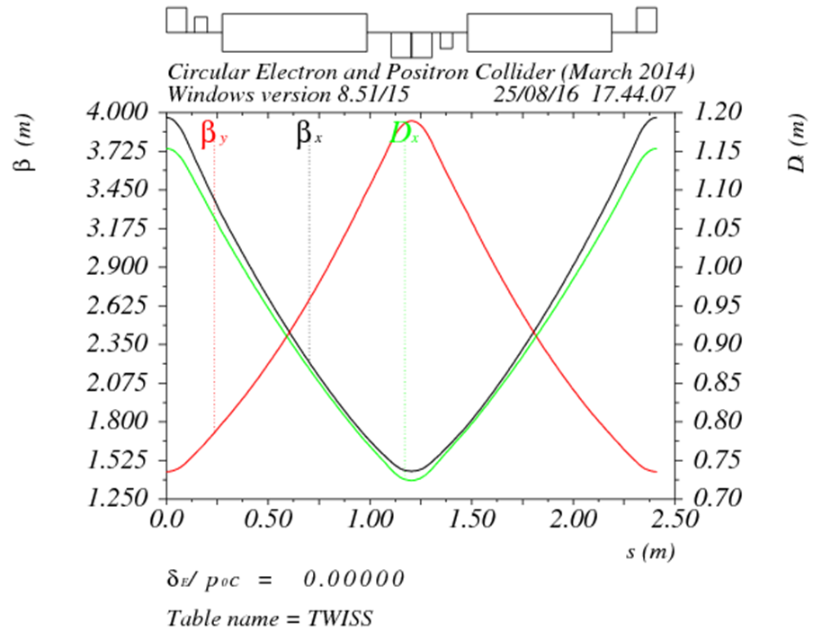
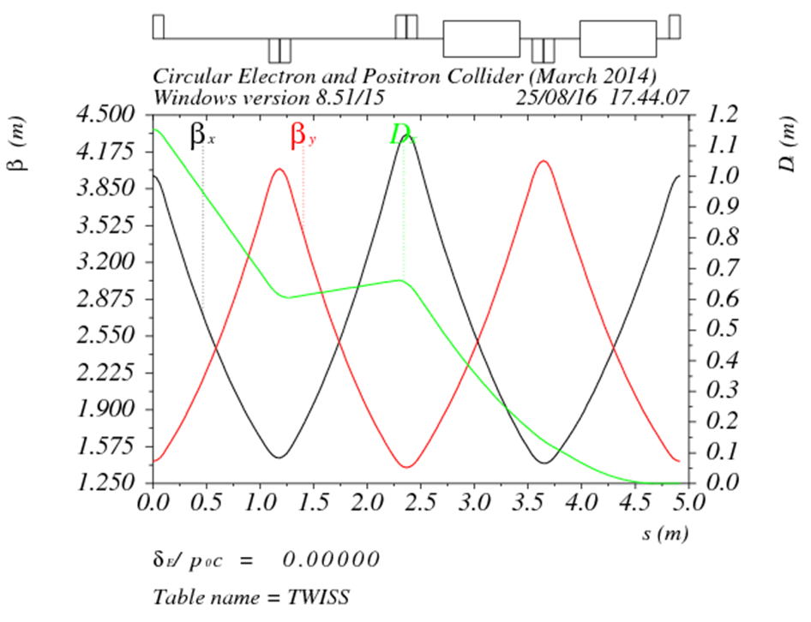
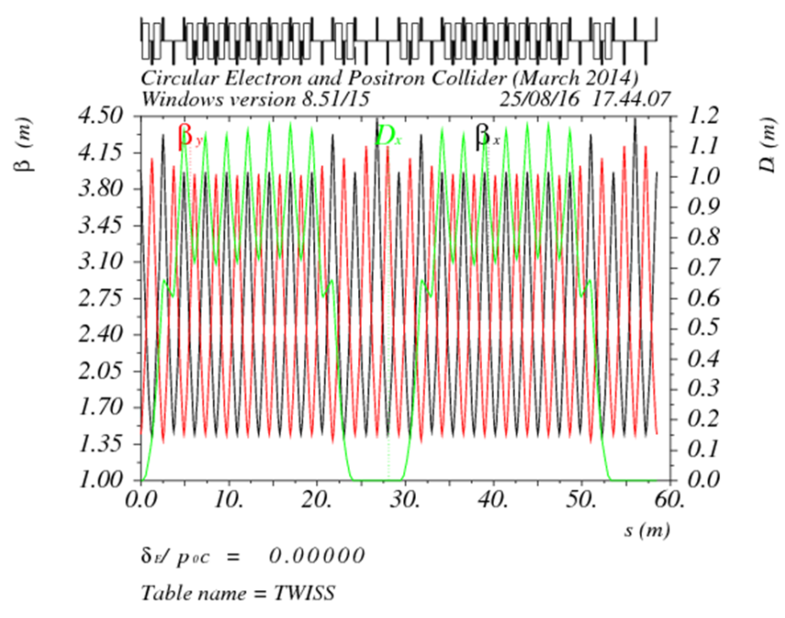
DR lattice design
FODO length (m) | 2.4
Phase per cell | 60°
Dipole length (m) | 0.71
Dipole strength (T) | 1.0
Quadrupole length (m) | 0.2
Quadrupole strength (m⁻²) | 4.1
Sextupole length (m) | 0.06

Slide 9
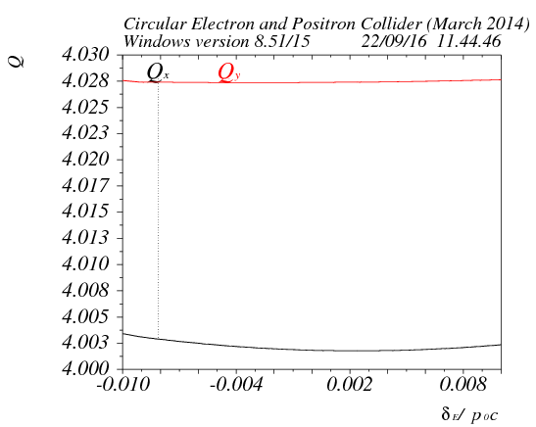
DA
Tracking 240000turns （4 damping time）
ε_{inj} / ε₀=11.6
σ_{inj} / σ₀=3.4
σ_{inj,max}=sqrt(1.626um*4m)
= 2.55mm
5 times of injection beam size

Slide 10
Status of damping ring design
 | unit | CDR | Now
Ext bunch length | ps | < 30 | 23
Ext energy spread | % | < 0.1 | 0.05
Ext emittace | mm.mrad | 1500 | 434/145
Energy acceptance | % | ≥ 1 | 1
DA |  | > 10σx/10σy | 150σx/110σy (on momentum) 30σx/60σy (±0.75%)
Damping time | ms | < 20 | 12/12/6

Slide 11
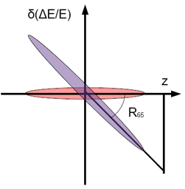
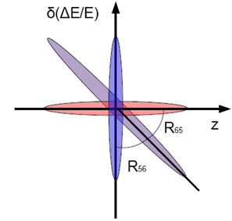
Primary design for bunch compressor
RF structure
E₀
E₁
Dispersive section

Slide 12
Parameter design
入口：σ₀=7mm， δ₀=0.05%， E₀=1.1 GeV
出口：σ₁<3mm， δ₁=??(≤0.1%)， E₁=??

Slide 13
Parameters of CEPC bunch compressor
 | BC (case I) | BC (case II)
初始能量 (GeV) | 1.1 | 1.1
初始能散 (%) | 0.05 | 0.05
初始束长 (mm) | 7 | 7
高频频率 (MHz) | 2856 | 2856
高频腔压 (MV) | 14.5 | 19.3
加速相位 (度) | 86 | 87
R₅₆ (m) | -4 | -3
出口能量 (GeV) | 1.101 | 1.101
出口能散 (%) | 0.17 | 0.23
出口束长 (mm) | 2 (6.7ps) | 1.5 (5ps)
束长压缩比：3.5~4.7
束长压缩比可调

Slide 14
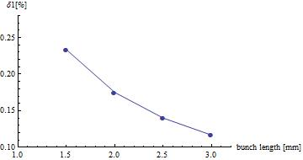
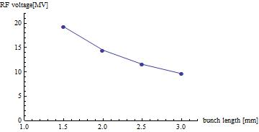
BC energy spread and VRF vs. bunch length

Slide 15
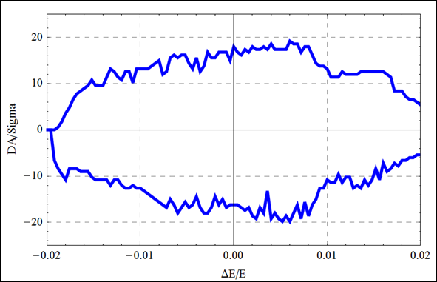
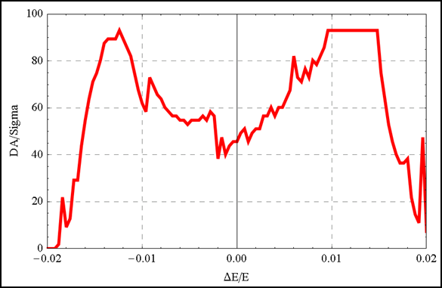
Check Yiwei’s lattice
σz=2.92mm

Slide 16
Check Yiwei’s lattice （ shorter bunch ）
Bunch length in parameter table: 2.7 mm
Plan:
- Re-optimize with 2.7mm bunch length
- Further optimization with MODE
- add additional sextupoles in IR

Slide 17

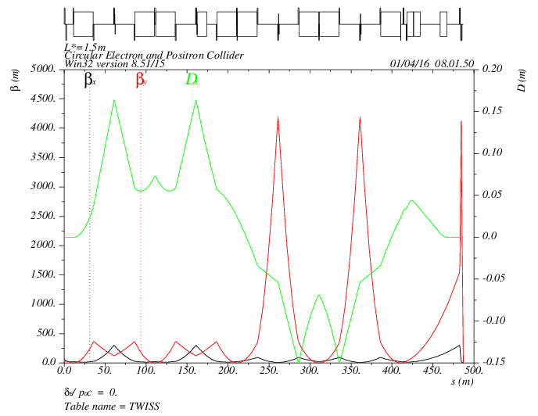
synchrotron radiation of IR
MT
CCX
CCY
FT
IP
472kev
472kev
374kev
203kev
1952 kev
126kev
434kev
126kev
565 kev
L*= 1.5m
βx*= 0.22mm
βy*= 1mm
GQD0= -200T/m
GQF1= 200T/m
LQD0=1.69m
LQF1=0.90m

Slide 18
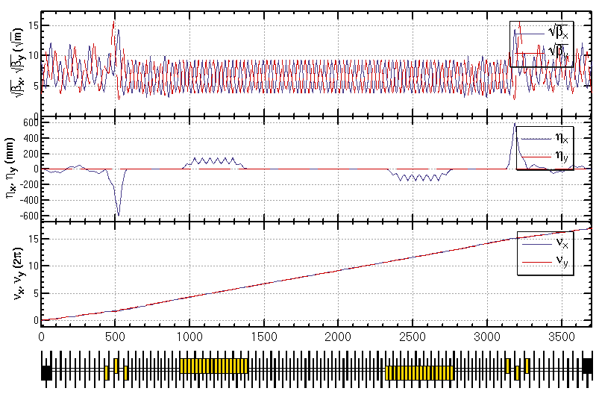
synchrotron radiation of PDR (w/o IR)
Feng Su, Yiwei Wang
BSEP1：1631kev
BSEP3：1496kev
QBQ1：985kev

Slide 19


synchrotron radiation spectrum of CEPC dipoles
Critical energy:
Energy spectrum:
Angular distribution:

Slide 20
Arc dipole

Slide 21
IP dipole

Slide 22
septum

Slide 23
Electric seperator

