Slide 1
CEPC injector beam dynamics
Cai MENG , Guoxi PEI, Xiaoping LI, Jingru ZHANG, Shilun PEI, Xiangjian WANG
Institute of High Energy Physics, CAS, Beijing

Slide 2
Main parameters of Injector
Parameter | Symbol | Unit | Value | Status
e⁻ /e⁺ beam energy | E_{e-}/E_{e+} | GeV | 6 | 6
Repetition rate | f_{rep} | Hz | 50 | 50
e⁻ /e⁺ bunch population @ 6 GeV | Ne-/Ne+ |  | 2×10¹⁰ | 2×10¹⁰
 | Ne-/Ne+ | nC | 3.2 | 3.2
Energy spread (e⁻ /e⁺ ) | σ_{E} |  | <1×10⁻³ | 1.2×10⁻³ @Long.wakefield
Emitance (e⁻ /e⁺ ) |  | mm⋅ mrad | <0.3 | <0.3 @ e⁻ 0.32 @ e⁺
e⁻ beam energy on Target |  | GeV | 4 | 4
e⁻ bunch charge on Target |  | nC | 10 | 10

Slide 3
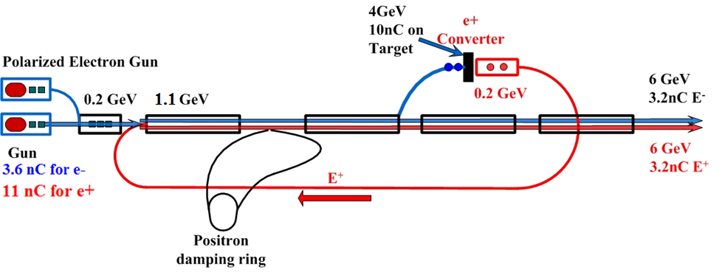
Layout of Injector

Slide 4
Energy spread

Slide 5
Distribution: Gaussian
Input Energy: 1.1 GeV
Output Energy: 6 GeV
Energy spread (e⁻ /e⁺ ) | σ_{E} | <1×10⁻³

