Slide 1

CEPC主环lattice及动力学孔径研究
王毅伟，张源，苏峰，边天剑，
王逗，白莎，耿会平，高杰
CEPC AP meeting, 13 Oct 2016

Slide 2
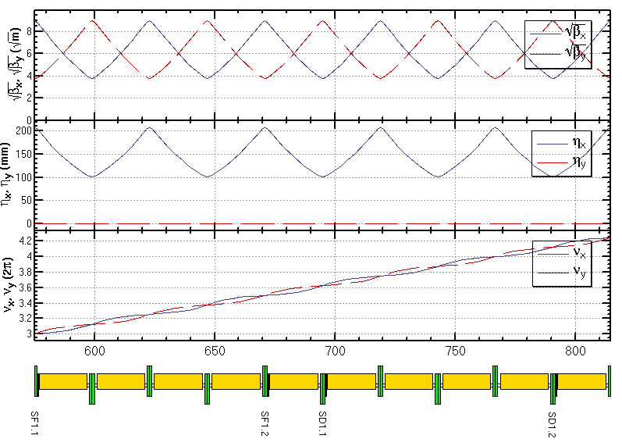
弧区lattice设计
FODO cell, 90°/90°, non-interleaved sextupole scheme
  period N=5cells
  all 3rd and 4th resonance driving terms (RDT) due to sextupoles cancelled, except small 4Qx, 2Qx+2Qy, 4Qy, 2Qx-2Qy
  tune shift dQ(Jx, Jy) is very small
    DA on momentum: large
  Chromaticity dQ(δ) need to be corrected with many families
    DA off momentum: with many families to correct dQ(δ) and –I break down
-I
-I
Sextupole configuration

Slide 3
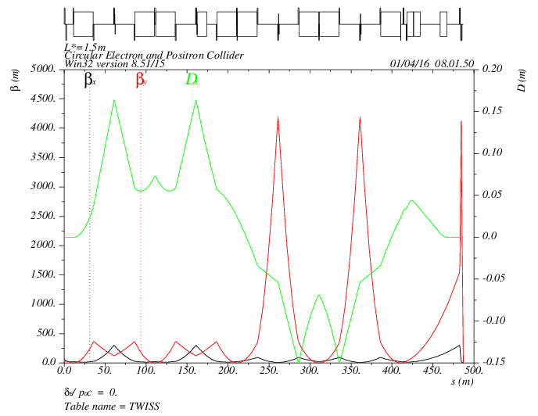
对撞区lattice设计
  Local chromaticity correction with sextupoles pairs separated by –I transportation
  all 3rd and 4th RDT due to sextupoles almost cancelled
  up to 3rd order chromaticity corrected with main sextupoles, phase tuning and additional sextupoles
  tune shift dQ(Jx, Jy) due to finite length of main sextupoles corrected with additional weak sextupoles
  Break down of –I, high order dispersion could be optimized with odd dispersion scheme or Brinkmann sextupoles
MT
CCX
CCY
FT
IP
L*= 1.5m
βx*= 0.22mm
βy*= 1mm
GQD0= -200T/m
GQF1= 200T/m
LQD0=1.69m
LQF1=0.90m
-I
-I

Slide 4
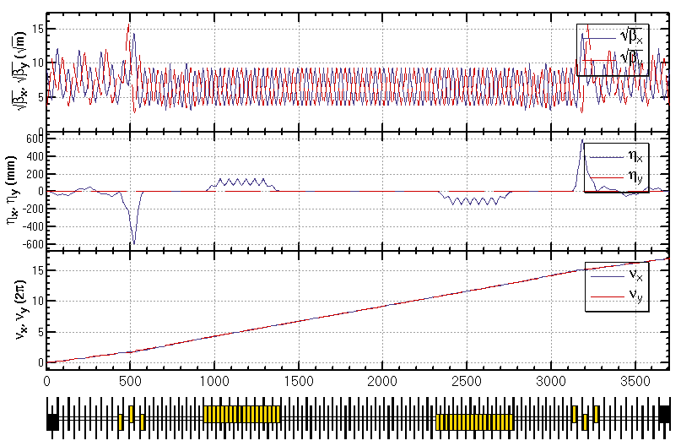
部分双环lattice设计
Feng Su, Yiwei Wang

Slide 5
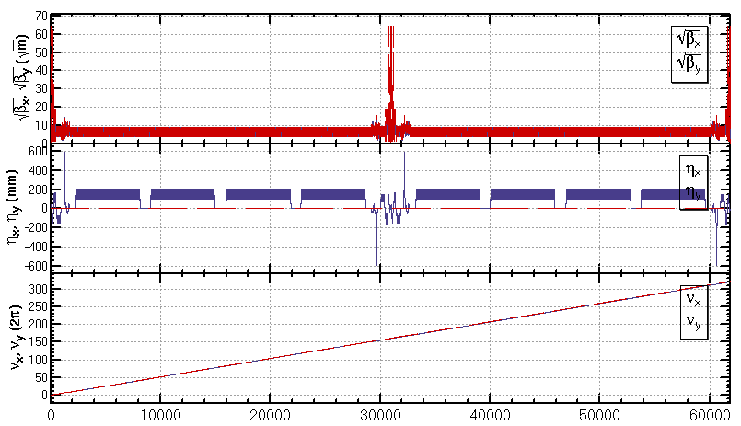
部分双环方案全环lattice
A lattice of the whole ring (ARC+PDR+IR) basically fulfilling the design parameters

Slide 6
CEPC主环动力学孔径目标
Parameter | Symbol | Unit | Value | Status 20160927
Luminosity per IP | L_{max} | 10³⁴cm⁻²s⁻¹ | 2.01 | -
Beta functions at IP | β_{x/}β_{y} | m | 0.275 /0.0013 | 0.22 /0.001
Main ring emittance | ε_{x/}ε_{y} | nm⋅rad | 2.05 /0.0062 | 2.15/0.0065
Injection emittance | ε_{x/}ε_{y} | nm⋅rad | 3.5 / 0.17 | 3.5/0.17
Transvers acceptance* | A_{x/}A_{y} | nm⋅rad | 787 / 4.17
Energy acceptance | A_{E} | % | 2.0 | 1.9
DA requirement from beam-beam (inclu. errors and beam-beam effect) | DA_{x/}DA_{y} | σ | 20 / 40 (dp/p=0) 5 / 10 (dp/p=±2%) | 16 / 45 (dp/p=0) 3 / 5 (dp/p=±2%) (no errors, mean value for two poles of axis)
DA requirement from injection (inclu. errors and beam-beam effect) | DA_{x/}DA_{y} | σ | 20 / 26 (dp/p=0 and dp/p=±0.5%) | -
Based on the parameters “wangdou20160918 H-low power” .
*assuming coupling factor κ=5% for injection beam,
βx,r=200 m, βx,i=60 m, ws = 4 mm, nr = 5, ns = 5

Slide 7
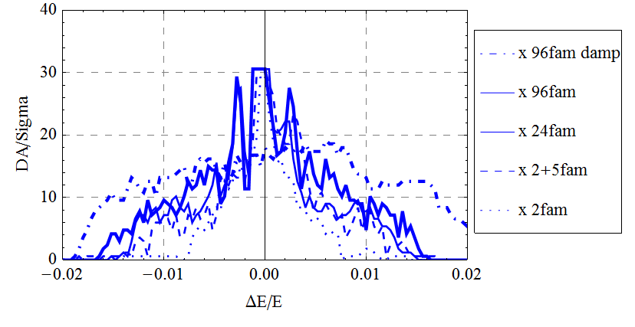
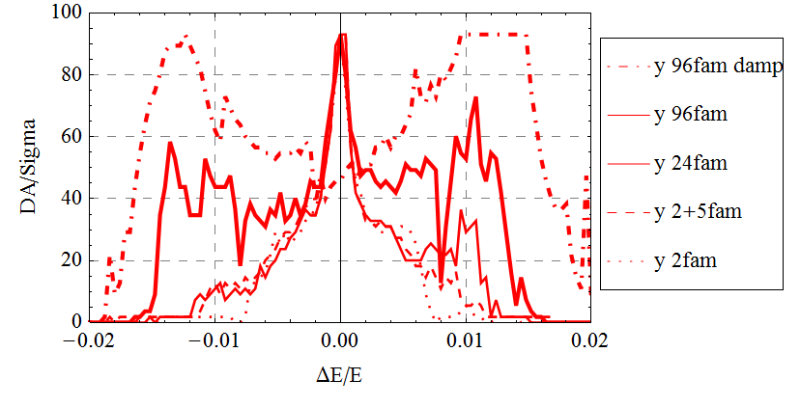
CEPC主环动力学孔径优化
Dynamic aperture study
  Bare lattice
  Synchrotron motion included
  w/o and w/ damping
  Tracking with around 1 times of damping time
  Coupling factor κ=0.003 for εy
  Working point (0.08, 0.22)
  Downhill Simplex algorithm applied
Further optimization is possible
  Larger dispersion for IR sextupoles
  βy*= 1mm -> 1.3mm (new parameters)
  More families in IR
Study of effects such as quantum excitation, solenoid field, errors and misalignments are under going

Slide 8
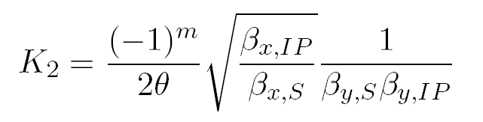
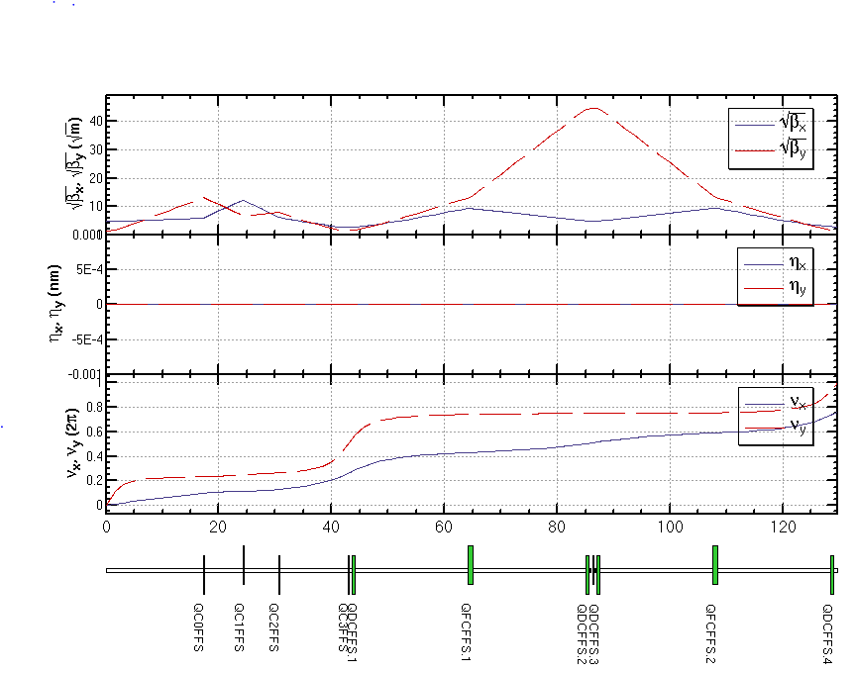
Crab sextupole (1)
Lattice design requirement
  Strength*
*Ref: Yuan Zhang, CW方案, 2008
  Phase to IP: 2m×π/2, (2n+1)×π/2 for x,y plane
  Beta function should be easily adjustted
  Chromaticity contribution especially which is not “on phase” should be small

Slide 9
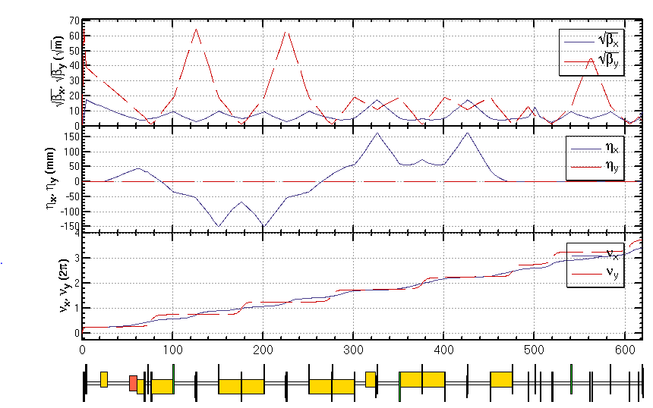
Crab sextupole (2)
Lattice of FFS is ready
  PDR need adjustment
  Chromaticity re-correction of FFS
  Finite length effect of crab sextupole need to be studied

Slide 10
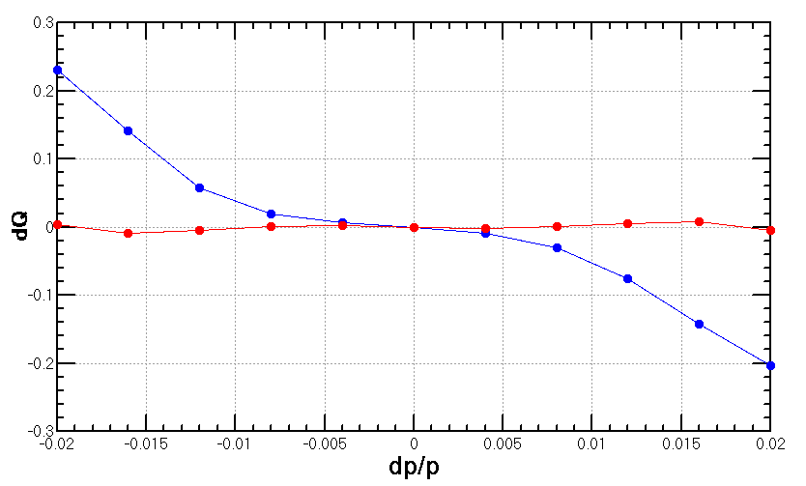
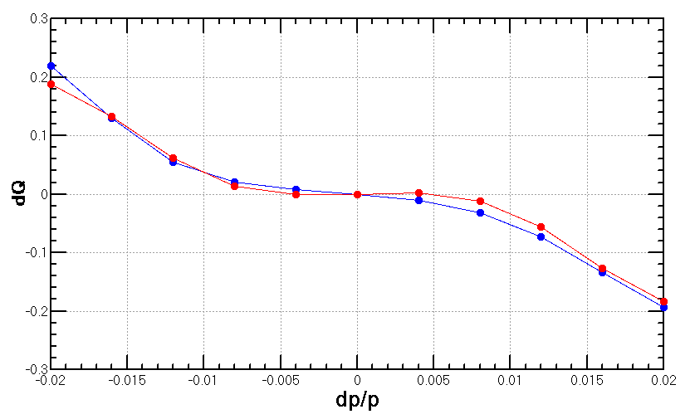
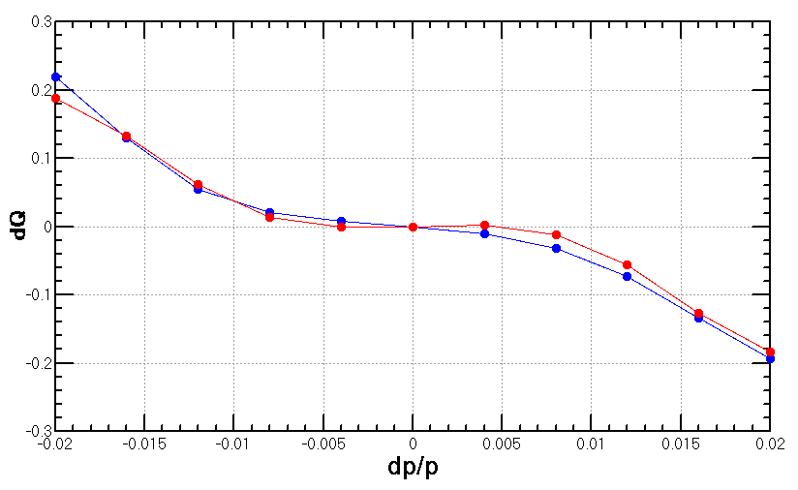
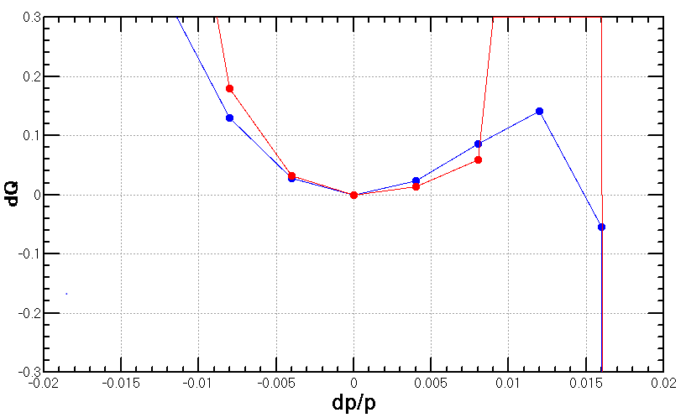
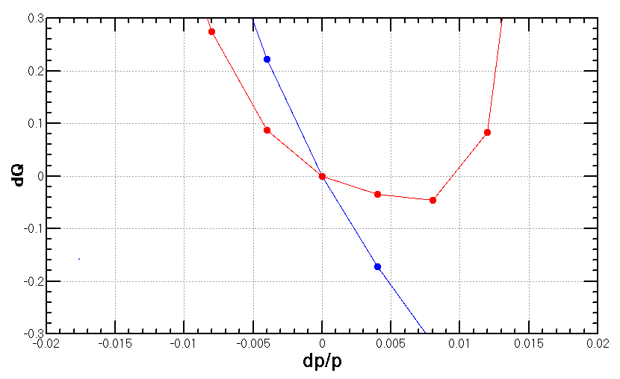
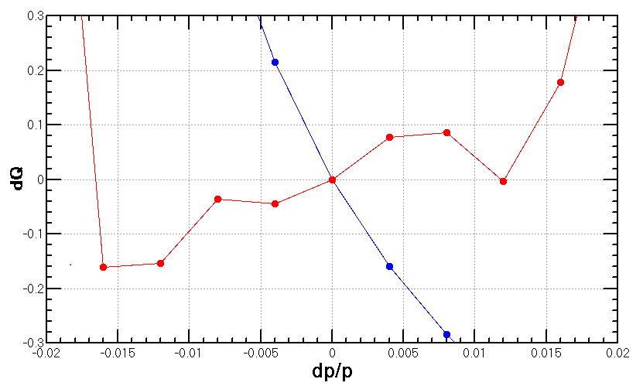
色品 (calculation with lattice)
Natural chromaticity | ξx | ξy
IR | -36 | -1155
ARC+PDR | -411 | -651
Total | -447 | -1806
FFS original (2+5)
FFS re-optimized for DA (2+5)
ARC re-optimized for DA (96+5)
FFS
Whole ring

Slide 11
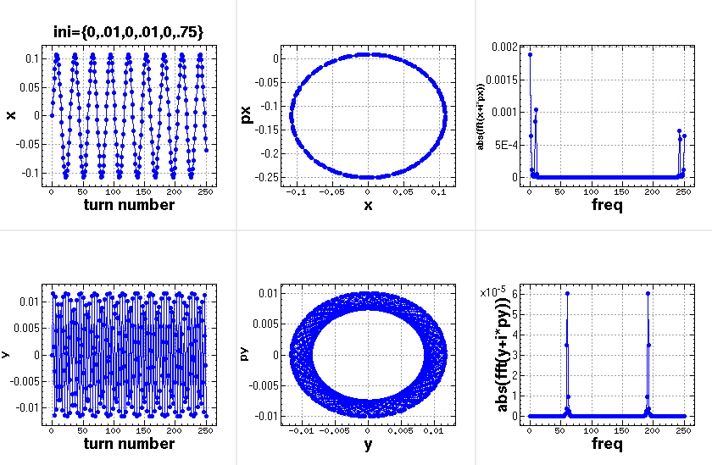
Details of FMA
w/o synchrotron motion

Slide 12
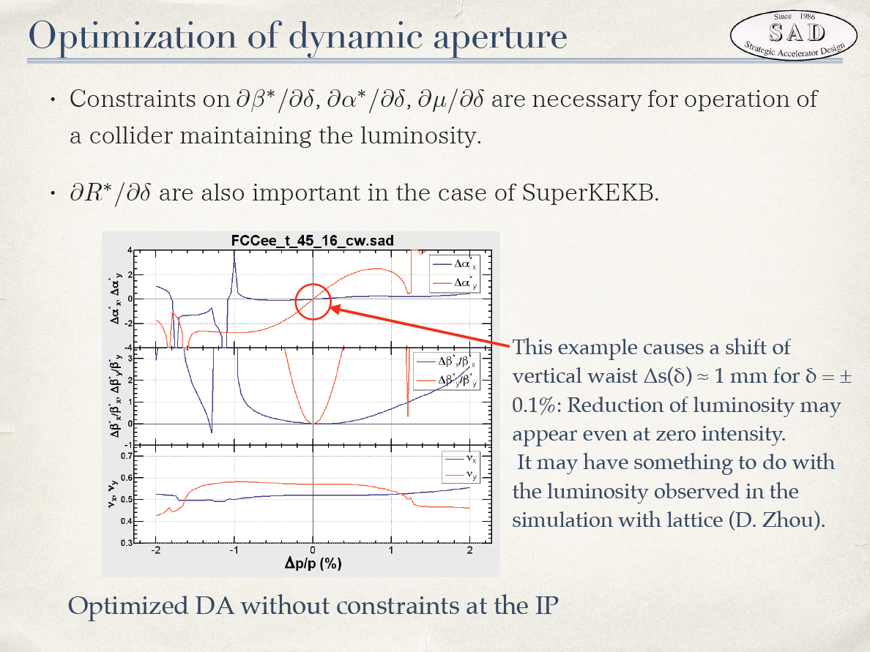
K. Oide

Slide 13
Summary
Optimization of dynamic aperture with chromatic constraint is undergoing.
Lattice with crab sextupoles is undergoing.

