Slide 1
CEPC APDR Study
Zhenchao LIU
2016-11-4

Slide 2
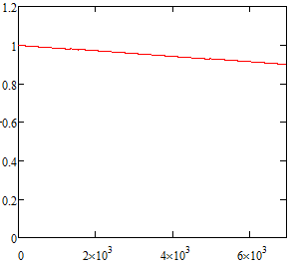
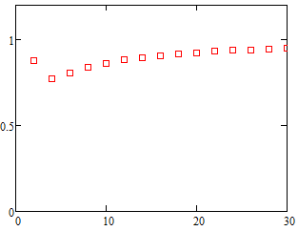
Problems in PDR
The peak power of bunch train is very high(several MW), however, there is no such large power input coupler.
Power compensation will cause low RF efficiency.
No power compensation will cause RF voltage drop and phase shift.
Power coupler limit.
e.g. Accelerator gradient decrease in one RF cavity (H-high lumi.)(The peak beam power is 4.9MW@15MV/m; Assume 300kW input power & 15MV/m of the 5cell cavity）
Final Eacc/Initial Eacc
Final Eacc/Initial Eacc
RF cycles
Initial Eacc(MV/m)
Field decrease in one cavity at the bunch train passing period
Field decrease vs. various initial field gradient of the cavity
The design is very challenging for the RF!

Slide 3
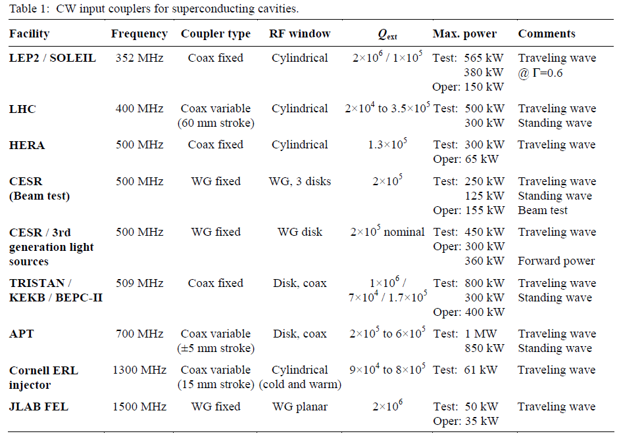
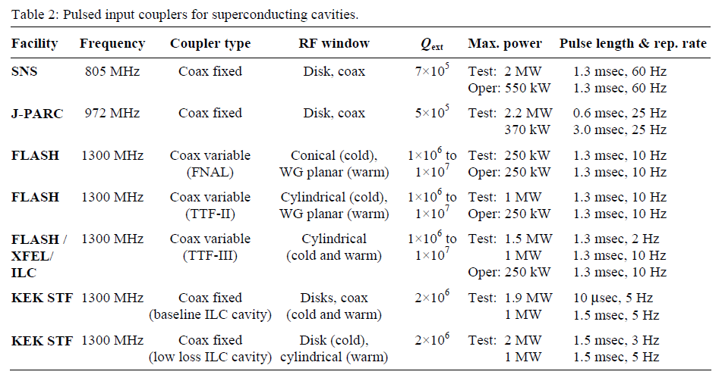
Limitations on the power coupler
The average power of input coupler is ~300kW
The peak power of input coupler is ~1MW .
The maximum power is limited by the ceramic window
S. Belomestnykh，OVERVIEW OF INPUT POWER COUPLER DEVELOPMENTS PULSED AND CW，WE305, SRF2007

Slide 4
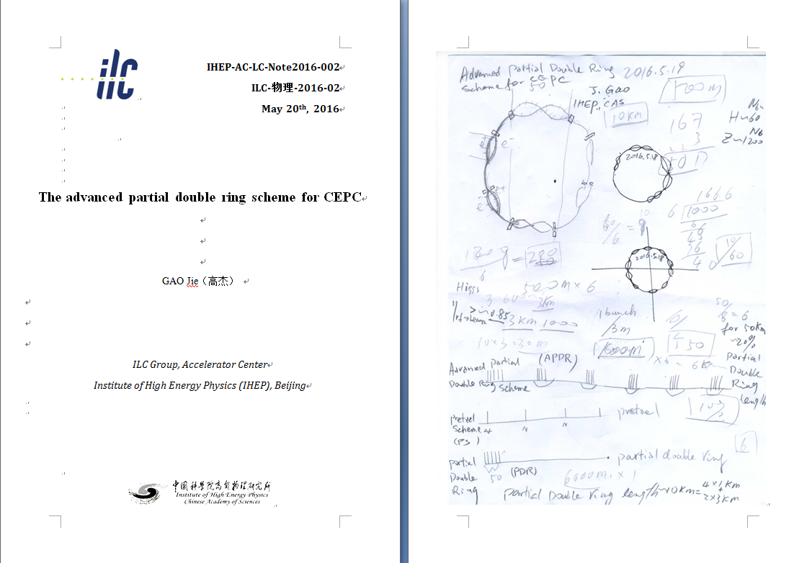
New idea：APDR

Slide 5
Nonconstant Voltage and Phase (NVP) Acceleration method
New acceleration method for CEPC to solve RF efficiency
The bunches in a bunch train will be accelerated at different Vc_{i}
The bunches in a bunch train will be accelerated at different synchrotron phase to keep constant energy gain.
Va_{i}=Vc_{i}*cosϕs_{i}=C

Slide 6
parameter for CEPC partial double ring （wangdou20160325）
 | Pre-CDR | H-high lumi. | H-low power | W | Z
Number of IPs | 2 | 2 | 2 | 2 | 2
Energy (GeV) | 120 | 120 | 120 | 80 | 45.5
Circumference (km) | 54 | 54 | 54 | 54 | 54
SR loss/turn (GeV) | 3.1 | 2.96 | 2.96 | 0.59 | 0.062
Half crossing angle (mrad) | 0 | 15 | 15 | 15 | 15
Piwinski angle | 0 | 2.5 | 2.6 | 5 | 7.6
N_{e}/bunch (10¹¹) | 3.79 | 2.85 | 2.67 | 0.74 | 0.46
Bunch number | 50 | 67 | 44 | 400 | 1100
Beam current (mA) | 16.6 | 16.9 | 10.5 | 26.2 | 45.4
SR power /beam (MW) | 51.7 | 50 | 31.2 | 15.6 | 2.8
Bending radius (km) | 6.1 | 6.2 | 6.2 | 6.1 | 6.1
Momentum compaction (10⁻⁵) | 3.4 | 2.5 | 2.2 | 2.4 | 3.5
β_{IP} x/y (m) | 0.8/0.0012 | 0.25/0.00136 | 0.268 /0.00124 | 0.1/0.001 | 0.1/0.001
Emittance x/y (nm) | 6.12/0.018 | 2.45/0.0074 | 2.06 /0.0062 | 1.02/0.003 | 0.62/0.0028
Transverse σ_{IP} (um) | 69.97/0.15 | 24.8/0.1 | 23.5/0.088 | 10.1/0.056 | 7.9/0.053
ξ_{x}/IP | 0.118 | 0.03 | 0.032 | 0.008 | 0.006
ξ_{y}/IP | 0.083 | 0.11 | 0.11 | 0.074 | 0.073
V_{RF} (GV) | 6.87 | 3.62 | 3.53 | 0.81 | 0.12
f _{RF} (MHz) | 650 | 650 | 650 | 650 | 650
Nature σ_{z} (mm) | 2.14 | 3.1 | 3.0 | 3.25 | 3.9
Total σ_{z} (mm) | 2.65 | 4.1 | 4.0 | 3.35 | 4.0
HOM power/cavity (kw) | 3.6 | 2.2 | 1.3 | 0.99 | 0.99
Energy spread (%) | 0.13 | 0.13 | 0.13 | 0.09 | 0.05
Energy acceptance (%) | 2 | 2 | 2
Energy acceptance by RF (%) | 6 | 2.2 | 2.1 | 1.7 | 1.1
n_{γ} | 0.23 | 0.47 | 0.47 | 0.3 | 0.24
Life time due to beamstrahlung_cal (minute) | 47 | 36 | 32
F (hour glass) | 0.68 | 0.82 | 0.81 | 0.92 | 0.95
L_{max}/IP (10³⁴cm⁻²s⁻¹) | 2.04 | 2.96 | 2.01 | 3.09 | 3.09

Slide 7
New SRF layout-6 ring
IP1
RF station
Double Ring
(1km/3km)
C≈60km
RF&DR center 30°equispaced
IP3

Slide 8
6 double ring | APDR(HL V_{RF}=3.62) | APDR (H-low power) | APDR (Z)
Number of IPs | 2 | 2 | 2
Energy (GeV) | 120 | 120 | 45.5
Circumference (km) | 54 | 54 | 54
SR loss/turn (GeV) | 2.96 | 2.96 | 0.062
Half crossing angle (mrad) | 15 | 15 | 15
Piwinski angle | 2.5 | 2.6 | 8.5
N_{e}/bunch (10¹¹) | 2.85 | 2.67 | 0.46
Bunch number | 22x3 | 15x3 | 367x3
Beam current (mA) | 17 | 10.5 | 45.4
SR power /beam (MW) | 50 | 31.2 | 2.8
Bending radius (km) | 6.2 | 6.2 | 6.1
V_{RF} (GV) | 3.62 | 3.53 | 0.357/0/12
f _{RF} (MHz) | 650 | 650 | 650
Cavity No. | 384 | 384 | 48/24
Cavity gradient | 20.6 | 20 | 16.2/21.7
Accelerating phase | 35.2-32.3 | 33-30.9 | 80.2-79.8/58.9-56.9
CW power/cavity （kW） | 260 | 163 | 117/233
Peak power/train (kW) | 2345 | 1148 | 1237
Total Power （MW) | 100.4 | 62.7 | 5.6
Cell/cavity | 2 | 2 | 2/1
Cavity/module | 8 | 8 | 4/4
Module/station | 8 | 8 | 2/1
Total module | 48 | 48 | 12/6
R/Q (Ω) | 206 | 206 | 206/103
G | 268 | 268 | 268
HOM loss factor/cavity (V/pC) | 0.54 | 0.54 | 0.54
HOM power/cavity (kW) | 0.838 | 0.485 | 0.361/0.18
Working Temperature（K） | 2 | 2 | 2
Q0 | 2E10 | 2E10 | 2E10
τ（ms） | 0.811 | 1.242 | 2.243/0.507
QL | 1.656e6 | 2.536e6 | 4.58e6/1.03e6
Bandwidth(kHz) | 0.196 | 0.128 | 0.071/0.314
Detuning F (kHz) | -0.138 | -0.083 | -0.234/-0.520
Stored energy/cavity(J) | 107.4 | 100 | 65.3/59.1
Frev(kHz) | 5.484 | 5.484 | 5.484
Gap length (us) | 26.7 | 26.7 | 26.7
η(RF to beam efficiency)(%) | ~100 | ~100 | ~100
Vc decrease(%) | 3.3 | 2.2 | 2.5/5.3
TB/τ | 0.0158 | 0.021 | 0.012/0.053

Slide 9
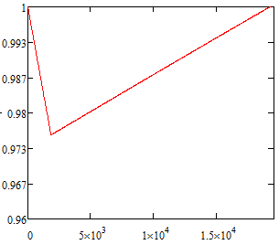
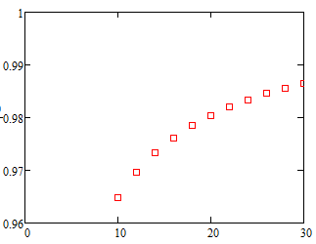
Accelerator gradient decrease in one RF cavity (Z)
Bunch train passing
Bunch train space
Assume matching
Final Eacc/Initial Eacc
Final Eacc/Initial Eacc
Initial Eacc(MV/m)
RF cycles
Field evolution in cavity
Field decrease vs. various initial field gradient of the cavity

Slide 10
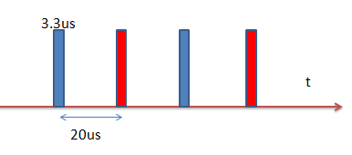
New SRF layout-8 ring
IP1
RF station
Double Ring
(1km/3km)
C≈62km
RF&DR center 22.5°equispaced
IP3

Slide 11
8 double ring | APDR(HL V_{RF}=3.62) | APDR (H-low power V_{RF}=3.53) | APDR (Z)
Number of IPs | 2 | 2 | 2
Energy (GeV) | 120 | 120 | 45.5
Circumference (km) | 54 | 54 | 54
SR loss/turn (GeV) | 2.96 | 2.96 | 0.062
Half crossing angle (mrad) | 15 | 15 | 15
Piwinski angle | 2.5 | 2.6 | 8.5
N_{e}/bunch (10¹¹) | 2.85 | 2.67 | 0.46
Bunch number | 17x4 | 11x4 | 275x4
Beam current (mA) | 17 | 10.5 | 45.4
SR power /beam (MW) | 50 | 31.2 | 2.8
Bending radius (km) | 6.2 | 6.2 | 6.1
V_{RF} (GV) | 3.62 | 3.53 | 0.357/0.12/0.12
f _{RF} (MHz) | 650 | 650 | 650
Cavity No. | 384 | 384/768/192 | 48/16/16
Cavity gradient | 20.6 | 20/20/20 | 16.2/16.3/32.6
Accelerating phase | 35.2-33 | 33-31.6/33-31.6/33-31.6 | 80.1-79.9/58.9-56.9/58.9-58
CW power/cavity （kW） | 260 | 163.3/81.6/326.6 | 117/350/350
Peak power/train (kW) | 1389 | 843 | 884
Total Power （MW） | 100.4 | 62.7 | 5.6
Cell/cavity | 2 | 2/1/4 | 2/2/1
Cavity/module | 6 | 6/12/3 | 6/2/2
Module/station | 8 | 8/8/8 | 1/1/1
Total module | 64 | 64/64/64 | 8/8/8
R/Q (Ω) | 206 | 206/103/412 | 206/206/103
G | 268 | 268 | 268
HOM loss factor/cavity (V/pC) | 0.54 | 0.54/0.27/1.08 | 0.54/0.54/0.27
HOM power/cavity (kW) | 0.838 | 0.485/0.24/0.97 | 0.36/0.36/0.18
Working Temperature（K） | 2 | 2 | 2
Q0 | 2E10 | 2E10 | 2E10
τ（ms） | 0.811 | 1.242 | 2.243/0.76/0.76
QL | 1.656e6 | 2.53e6 | 4.58e6/1.55e6/1.55e6
Bandwidth(kHz) | 0.196 | 0.128 | 0.071/0.209/0.209
Detuning F (kHz) | -0.138 | -0.083 | -0.234/-0.347/-0.347
Stored energy/cavity(J) | 107.4 | 100 | 65.3/65.3/133
Frev(kHz) | 5.484 | 5.484 | 5.484
Gap length TB (us) | 20 | 20 | 20
η(RF to beam efficiency)(%) | ~100 | ~100 | ~100
Vc decrease(%) | 2.5 | 1.6 | 1.7/5.3/2.5
TB/τ | 0.025 | 0.0098 | 0.0089/0.0263/0.0263

Slide 12
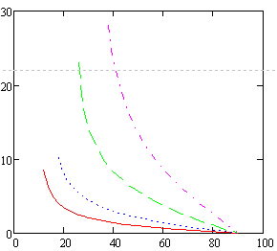
Phase shift
P_{cw}<<P_{pulse} case:
Larger synchrotron phase will make smaller phase shift for the bunches in a bunch train for the same voltage drop
Large voltage drop should choose larger synchrotron phase
Large synchrotron phase means more cavities (more cost)
2% Vc decrease
←APDR case
4% Vc decrease
Phase shift (degree)
10% Vc decrease
← PDR case
20% Vc decrease
Synchrotron phase of first bunch (degree)

Slide 13
Bunch No. | Pre CDR (CW, P_{g}=P_{avg}) |  | PDR (CW, P_{g}=P_{pulse}, very low RF efficiency) |  | APDR 8 ring (HL, CW, P_{g}=P_{avg}) |  | APDR 8 ring (H-low power, CW, P_{g}=P_{avg}) |  | APDR 8 ring (Z, P_{g}=P_{avg})
 | Vc | Phase shift | Vc | Phase shift | Vc | Phase shift | Vc | Phase shift | Vc | Phase shift
1 | 1 | 0 | 1 | 0 | 1 | 2.00 | 1 | 1.40 | 1 | 2.0000
2 | 1 | 0 | 1 | 0 | 0.9984 | 1.88 | 0.9984 | 1.26 | 0.9998 | 1.9927
3 | 1 | 0 | 1 | 0 | 0.9969 | 1.75 | 0.9968 | 1.12 | 0.9996 | 1.9855
4 | 1 | 0 | 1 | 0 | 0.9953 | 1.63 | 0.9952 | 0.98 | 0.9994 | 1.9782
5 | 1 | 0 | 1 | 0 | 0.9938 | 1.50 | 0.9936 | 0.84 | 0.9992 | 1.9709
6 | 1 | 0 | 1 | 0 | 0.9922 | 1.38 | 0.992 | 0.70 | 0.9990 | 1.9636
7 | 1 | 0 | 1 | 0 | 0.9906 | 1.25 | 0.9904 | 0.56 | 0.9988 | 1.9564
8 | 1 | 0 | 1 | 0 | 0.9891 | 1.13 | 0.9888 | 0.42 | 0.9987 | 1.9491
9 | 1 | 0 | 1 | 0 | 0.9875 | 1.00 | 0.9872 | 0.28 | 0.9985 | 1.9418
10 | 1 | 0 | 1 | 0 | 0.9859 | 0.88 | 0.9856 | 0.14 | 0.9983 | 1.9345
11 | 1 | 0 | 1 | 0 | 0.9844 | 0.75 | 0.984 | 0 | 0.9981 | 1.9273
15 | 1 | 0 | 1 | 0 | 0.9781 | 0.25 |  |  | 0.9973 | 1.8982
17 | 1 | 0 | 1 | 0 | 0.9750 | 0 |  |  | 0.9969 | 1.8836
50 | 1 | 0 | 1 | 0 |  |  |  |  | 0.9906 | 1.6436
67 |  |  | 1 | 0 |  |  |  |  | 0.9873 | 1.5200
275 |  |  |  |  |  |  |  |  | 0.0947 | 0
Assume V_{rf} is constant at the first bunch of bunch trains and the change of V_{b} is negligible.

Slide 14
Bunch No. | Pre CDR (CW, P_{g}=P_{avg}) |  | PDR (CW, P_{g}=P_{pulse}, very low RF efficiency) |  | APDR 6 ring (H-low power, CW, P_{g}=P_{avg}) |  | APDR 6 ring (HL, CW, P_{g}=P_{avg}) |  | APDR 6 ring (Z, P_{g}=P_{avg})
 | Vc | Phase shift | Vc | Phase shift | Vc | Phase shift | Vc | Phase shift | Vc | Phase shift
1 | 1 | 0 | 1 | 0 | 1 | 2.20 | 1 | 2.60 | 1 | 2.6000
2 | 1 | 0 | 1 | 0 | 0.9984 | 2.04 | 0.9984 | 2.48 | 0.9998 | 2.5929
3 | 1 | 0 | 1 | 0 | 0.9968 | 1.89 | 0.9969 | 2.35 | 0.9996 | 2.5858
4 | 1 | 0 | 1 | 0 | 0.9952 | 1.73 | 0.9953 | 2.23 | 0.9994 | 2.5787
5 | 1 | 0 | 1 | 0 | 0.9936 | 1.57 | 0.9937 | 2.10 | 0.9992 | 2.5716
6 | 1 | 0 | 1 | 0 | 0.992 | 1.41 | 0.9921 | 1.98 | 0.9989 | 2.5645
7 | 1 | 0 | 1 | 0 | 0.9904 | 1.26 | 0.9906 | 1.86 | 0.9987 | 2.5574
8 | 1 | 0 | 1 | 0 | 0.9888 | 1.10 | 0.9890 | 1.73 | 0.9985 | 2.5503
9 | 1 | 0 | 1 | 0 | 0.9872 | 0.94 | 0.9874 | 1.61 | 0.9983 | 2.5432
10 | 1 | 0 | 1 | 0 | 0.9856 | 0.79 | 0.9859 | 1.49 | 0.9981 | 2.5361
11 | 1 | 0 | 1 | 0 | 0.984 | 0.63 | 0.9843 | 1.36 | 0.9979 | 2.5290
15 | 1 | 0 | 1 | 0 | 0.9776 | 0 | 0.9780 | 0.87 | 0.9971 | 2.5005
22 | 1 | 0 | 1 | 0 |  |  | 0.9670 | 0 | 0.9956 | 2.4508
50 | 1 | 0 | 1 | 0 |  |  |  |  | 0.9897 | 2.2519
67 |  |  | 1 | 0 |  |  |  |  | 0.9861 | 2.1311
367 |  |  |  |  |  |  |  |  | 0.0923 | 0
Assume V_{rf} is constant at the first bunch of bunch trains and the change of V_{b} is negligible.

Slide 15
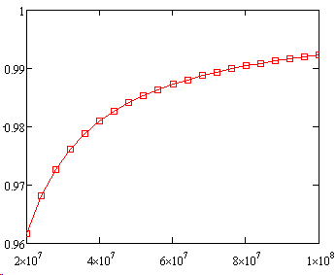
Compare with LEP
Assume:
φ_{e}= 1deg., φ_{s}=116deg., φ_{align}=3deg., I_{b}=0.45mA, h=31324, Q=40000, R_{s}=774MΩ（14 cavities）
V₀ (initial peak voltage)from 20MV-100MV
2.3MV/cavity(acc. voltage)
Voltage decrease:
V_{left}/V₀
1 bunch ~1%
4 bunches ~4%
APDR:
8 DR: 2.5%(HL)5.3/2.5%(Z)
6 DR: 3.3%(HL)
V₀(V)
Voltage drop is acceptable!

Slide 16
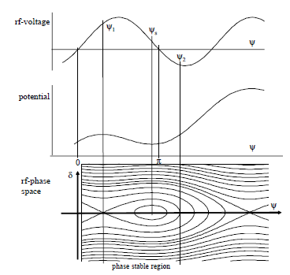
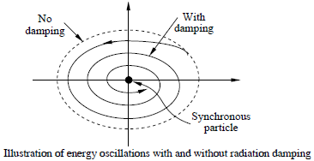
Bunch position
The e+ and e- bunch trains should be symmetry to the two IPs.
The phase shift of the synchrotron phase between each bunch in a bunch train is 0.14 degree for the H low power mode. The total phase shift is 1.4 degree.
After enough synchrotron damping, the bunches will be at its synchrotron phase separately.
If the transport matrix from cavity to IP is the same for e+ and e- bunch trains, there will be no shift for the position of colliding.
RADIATION DAMPING, R.P. Walker

Slide 17
Cavity requirements
Aim: To minimize the RF voltage drop of the cavity
Solutions:
Voltage drop formula:
R/Q=Vc^2/ωU, assume P_{pulse}>>P_{cw}
d, cavity effective length, q bunch charge, N_{b} bunches per train, N_{cav} cavity number.
Proper RF cavity number
Proper RF cavity gradient
Proper RF cavity R/Q for the large voltage drop cavities
(by Z.C. Liu)

Slide 18
Conclusion
The 8-double ring and 6-double ring are available when using the same parameter as PDR(V_{RF}=3.62GV) for HL. The 8-double ring has a lower phase variation than the 6-double ring .
The phase region is from 35.2-33 degree for bunches in a bunch train for the 8-double ring HL mode. The phase region is from 35.2-32.3 degree for the 6-double ring HL mode.
The bunch energy gain in each cavity is constant.
The RF to beam efficiency is ~100%.
V_{b} reaches constant value after about 65 circles (I_{b}=C, ~0.012s).
Beam can be stored by increasing bunch charges stably (with reflection in low current).
V_{c} should keep constant phase and value for each bunch separately.

Slide 19
RF compensation
Aim : To compensate the voltage drop.
Solutions:
DF cavity?
Keep voltage constant
RF induce no higher order perturbation
n, total cavity number; q, bunch charge; V_{i}, cavity voltage when the i_{th} bunch passed; φ_{i}, RF phase of the i_{th} bunch in cavity; m, total DF cavity number; V_{di}, DF cavity voltage when the i_{th} bunch passed; φ_{di}, RF phase of the i_{th} bunch in DF cavity.
Assume each bunch has a constant phase φ_{i} in the cavity and φ_{di} in the DF cavity.

Slide 20
Simple case
Assume there are two bunches
Energy gain:
First order of energy gain:

Slide 21
Problems
DF cavity should be proper located to fix the bunch position at equal space at IP or RF cavity.
Asymmetry is needed in the two rings.
Lattice simulation with two types of cavity is needed.

Slide 22
Thanks!

