Slide 1
eeFACT2016
Huiping Geng
CEPC Accelerator Group Meeting
2016.11.04

Slide 2
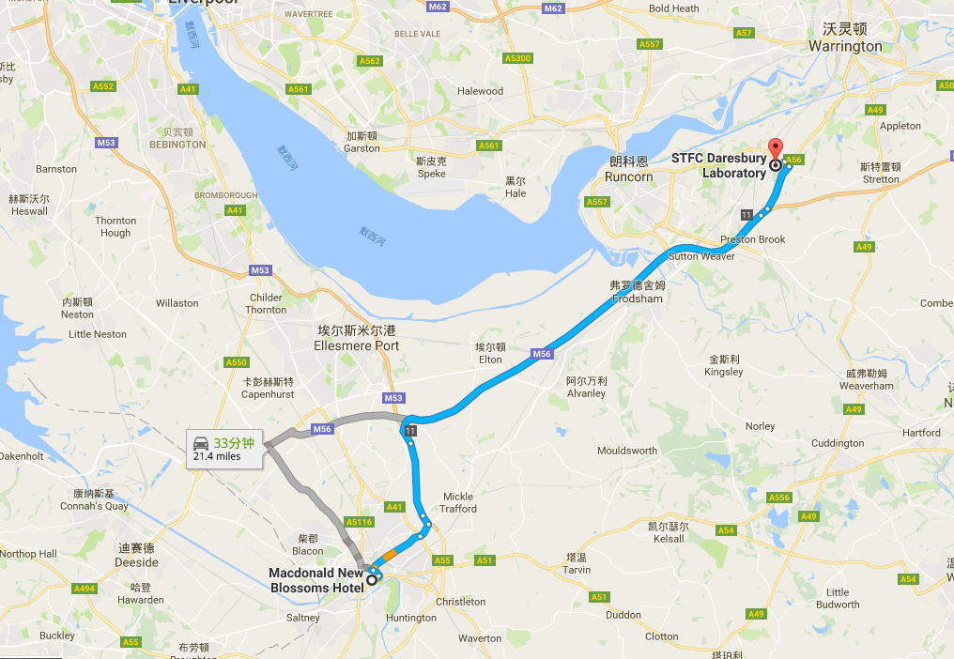
Time and place
24-27 October 2016
Cockcroft Institute at Daresbury Laboratory, UK
宾馆距离开会地点约半个小时车程，每天早上7：45/8:00 大巴车来接，下午6:30左右大巴车把人送回宾馆

Slide 3
Agenda
3.5 days，the morning of the fourth day is summary
One session, no parallel sessions
Topics-Day1
Motivation and Requirements for Factories Chaired by Peter Ratoff
Overviews Chaired by Jorg Wenninger
Design Concepts Chaired by Ralph Assmann
Optics Issues Chaired by Katsunobu Oide
Polarization Chaired by Alain Blondel

Slide 4
Agenda-cont’
内容覆盖范围很广，与高能环形正负电子对撞机相关的大部分课题都涉及了。这次的workshop更像一个大讲堂，不是强调研究的最新进展，而是把相关的topics做了一个全面的review。
Topics-Day2
IR and MDI Chaired by Yoshihiro Funakoshi
Injector and Beam Injection Chaired by John Seeman
Impedance Issues and Beam Instabilities Chaired by Frank Zimmermann
Machine Tuning Chaired by Marica Biagini
Topics-Day3
Superconducting RF Chaired by Bob Rimmer
Beam Instrumentation and Beam Diagnostics Chaired by Hitoshi Fukuma
Other Technologies & Energy Efficiency Chaired by Weiren Chou
Beam-beam Issues Chaired by Alex Chao
Topics-Day4
Summary of each session

Slide 5
Presentations in Optics session
总结了加crab sextupole以后对动力学孔径的影响
算了不同误差引起的发射度的变化，用的Anton的lattice
报告了pretzel和PDR（感谢苏峰和毅伟提供了PPT）的最新进展

Slide 6
Presentations in Machine tuning session
总结了LHC的束流调试方法
总结了SuperKEKB束流调试的方法
Knobs used in KEKB
误差分析，但是用的不是Oide的lattice

Slide 7
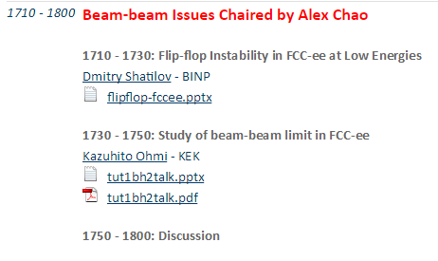
Presentations in Machine tuning session
赵午在summary里做了很全面的总结

Slide 8
Comments to CEPC
From Oide：
Partial double ring does not solve the problem (restriction on bunch numbers) at Z
Sawtooth effect is different for e+ and e-, for both pretzel and partial double ring, need to be studied
Earth field is not a problem ( with shielding and correction)
Wiggle bend scheme doesn’t help the absolute accuracy of field

