Slide 1
Update on pretzel scheme design
Geng Huiping
CEPC accelerator meeting
2016.11.04

Slide 2
Outline
Pretzel scheme design
Issues and correction
DA w/o FFS
DA w/ FFS
Summary

Slide 3
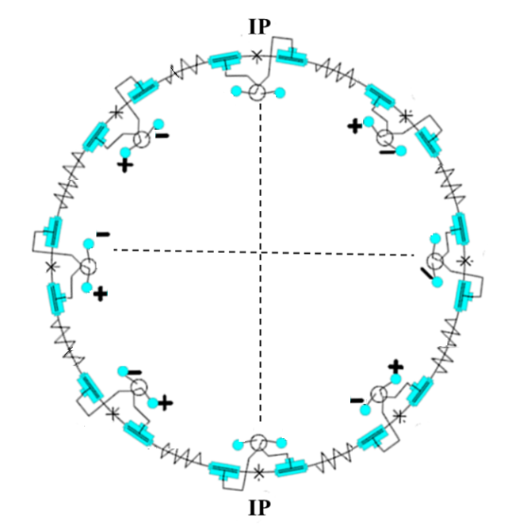
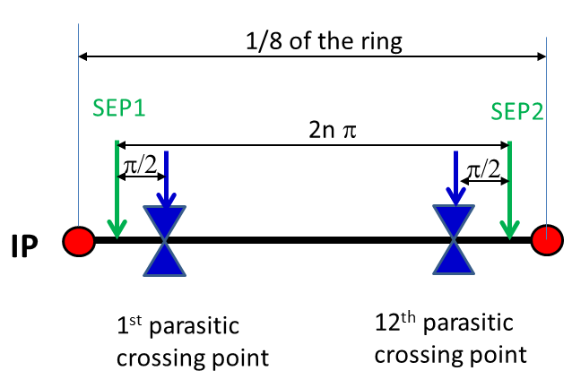
Pretzel orbit design
60/60 degree phase advance FODO cells, with interleaved sextupoles
Designed for 50 bunches/beam, every 4pi phase advance has one collision point
Horizontal separation is adopted to avoid big coupling
No off-center orbit in RF section to avoid beam instability and HOM in the cavity
One pair of electrostatic separators for each arc
For each arc, the first separator will be placed before the first parasitic collision point in this region to generate the orbit, and the second separator will be placed after the last collision point in this region to remove the orbit

Slide 4
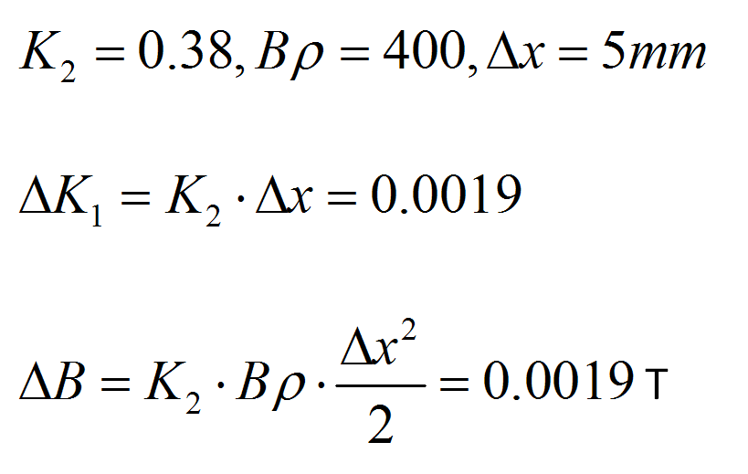
Issues with pretzel orbit
Beam with off centered orbit will see extra field in quadrupoles and sextupoles.
Estimation of dipole field strength in quadrupole
Dipole field of the ring 0.066T.
Estimation of quadrupole field strength in sextupole
Quadrupole field of the ring K₁=0.022.
Dipole field of the ring 0.066T.
This will break the periodicity of the beta function, especially the dispersion function, thus degrade the dynamic aperture.

Slide 5
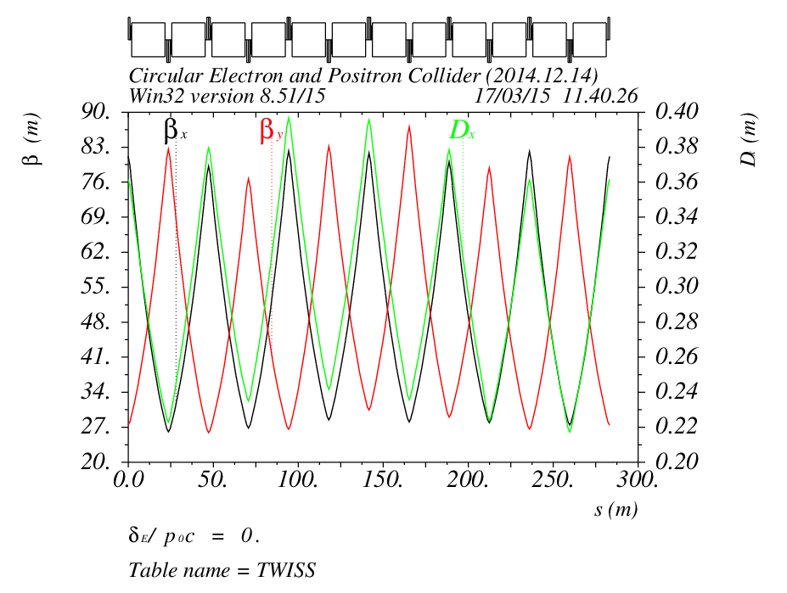
Correction of off-center-orbit effects
A new periodic solution can be found by grouping 12 FODO cells together as one new period
The maximum adjustment of quadrupole strength is ~X%
The distortion of pretzel orbit effects on beta and dispersion functions
can be mitigated by making quadrupoles individually adjustable, which can be done by adding shunts on each quadrupoles almost without increasing the cost

Slide 6
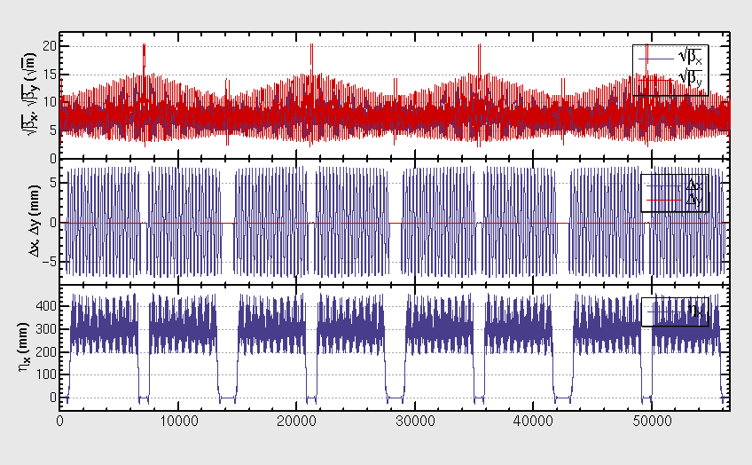
Lattice after correction of pretzel orbit effects
After correction, the orbit and dispersion function regains periodicity, but the beta functions still have some beating
We suspect the beta beating comes from the asymmetric layout of sextupoles relative to quadrupoles

Slide 7
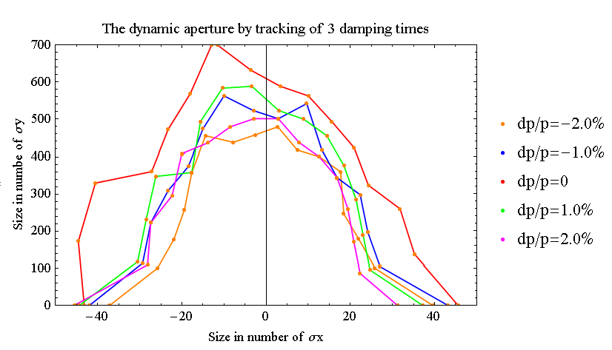
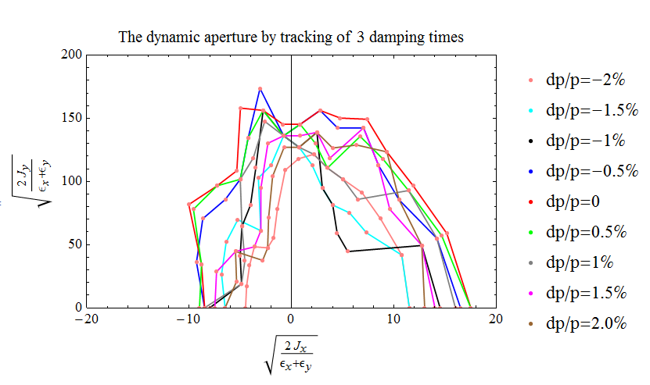
DA w/ pretzel (no FFS)
We use a Multi-Objective optimization by Differential Evolution(MODE, developed by Y. Zhang) code to optimize the dynamic aperture
Before adding pretzel orbit, the DA is: ~40σx/600σy @0.0% dp/p, ~30σx/450σy @2.0% dp/p
After adding pretzel orbit, the DA is: ~20σx/150σy @0.0% dp/p, ~16σx/120σy @2.0% dp/p

Slide 8
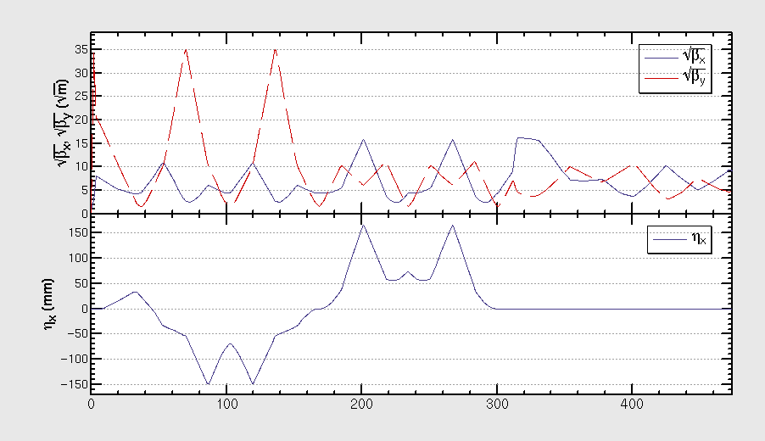
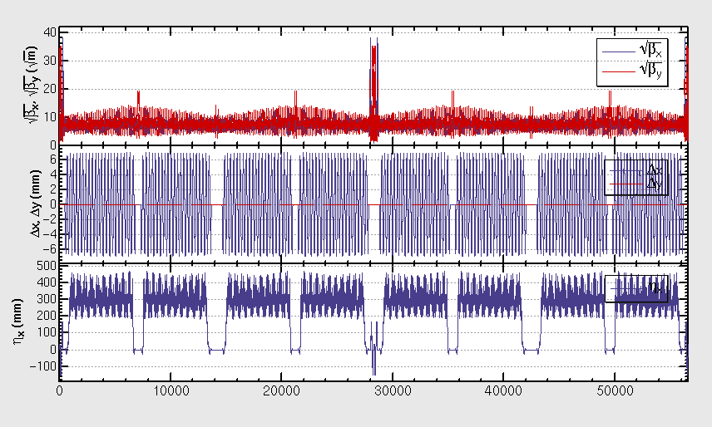
Combination with FFS
One version of FFS (which has been optimized for the ring without pretzel orbit) is inserted to the lattice with pretzel
The betatron and dispersion functions of the FFS are shown in the left plot
The whole lattice of the ring is shown in the right plot
Courtesy of Yiwei Wang, βy*=3mm

Slide 9
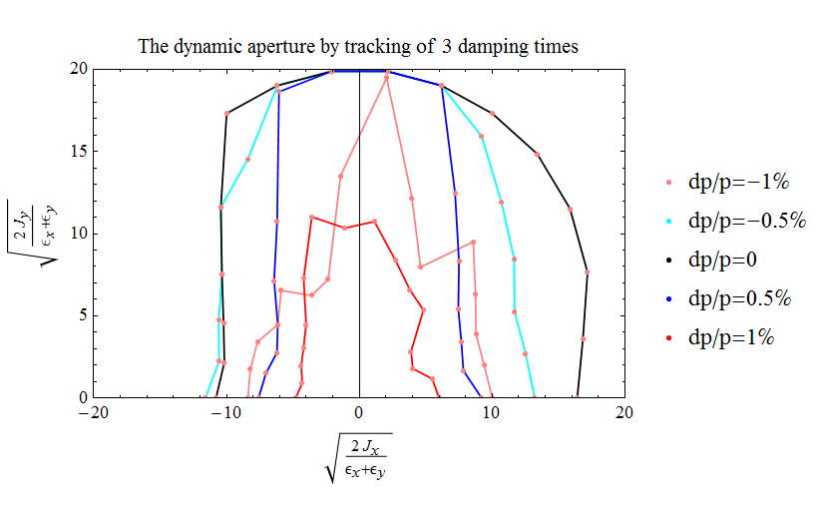
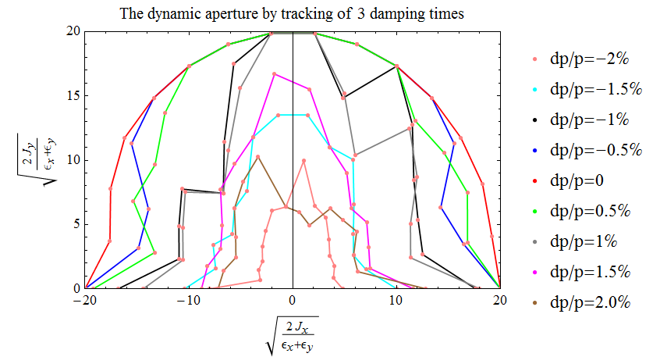
DA w/ pretzel and FFS
Dynamic aperture has been optimized with MODE, all sextupoles has been set free
DA (w/o pretzel) is,~20σx@0.0% dp/p,~16σx @1.0% dp/p,~4σx/ 6σy @2.0% dp/p
DA (w/ pretzel) is,~16σx @0.0% dp/p,~6σx/ 10σy @1.0% dp/p,~0σx @2.0% dp/p

Slide 10
Summary
A multi-objective code MODE has been developed, and proved to be very effective in optimizing dynamic aperture
The dynamic aperture of single ring has been greatly improved, but has not reached ±2% momentum spread
Optimization work are still going on……

Slide 11
Thank you !

