Slide 1
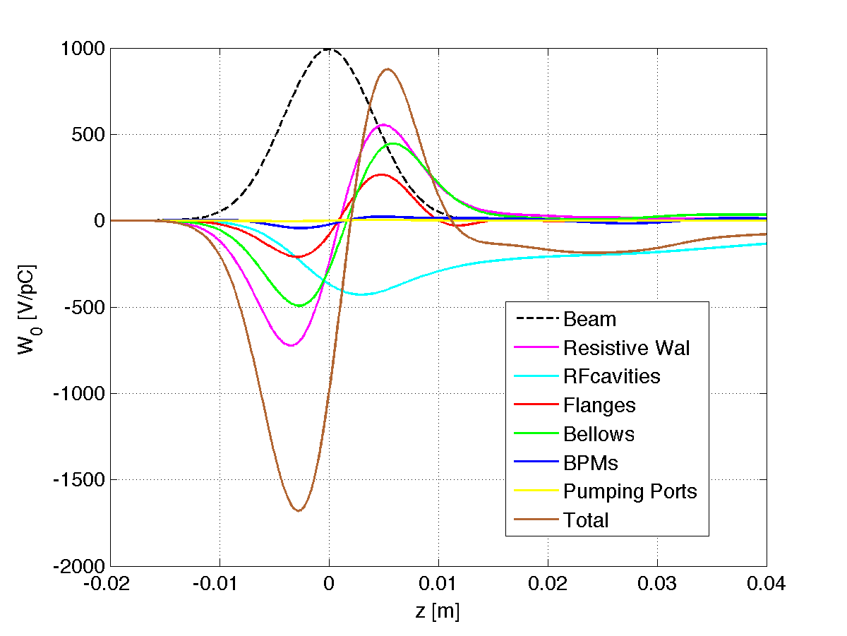
Impedance model – budget
Components | Number | R, kΩ | L, nH | Z||/n, mΩ | k_{loss}, V/pC | HOM power, kW
Resistive wall | - | 6.7 | 487.7 | 17.0 | 138.4 | 106.3
RF cavities | 384 | 14.9 | -132.7 | - | 307.5 | 236.1
Flanges | ~10000 | 0.7 | 165.5 | 5.8 | 15.1 | 11.6
BPMs | 2300 | 0.6 | 21.4 | 0.7 | 11.6 | 8.9
Bellows | ~10000 | 5.9 | 331.5 | 11.6 | 122.3 | 93.9
Pumping ports | ~10000 | 0.007 | 3.1 | 0.1 | 0.1 | 0.1
Total |  | 28.8 | 876.5 | 35.2 | 595.0 | 456.9
L and R are effective inductance and resistance, determined by fitting the bunch wake potentials.
The impedance is dominated by resistive wall, RF cavities, flanges and bellows.
Lower impedance design for large number items should be considered.
More impedance contributions will be included in future studies.
Longitudinal wake potential at σ_{z}=4.1mm

Slide 2
Single bunch instability
Microwave instability
Impedance threshold estimated by Boussard or Keil-Schnell criteria
(LEP measured: 30 mΩ)
Preliminary estimate shows the impedance budget > MWI threshold
Often believed to be too passive for short bunched beam
High frequency part of impedance may lead to turbulent distribution
Needed to be studied with macro-particle tracking or Vlasov solver
Particle double ring |  |  |  | Single ring
H-High lumi | H-low power | W | Z | H
14.5 mΩ | 14.3 mΩ | 8.3 mΩ | 5.5 mΩ | 13.7 mΩ

Slide 3
Coupled bunch instability
A conservative assumption is that the bunch spectrum overlaps the resonant frequency and the instability growth rate less than the synchrotron radiation damping. This limits the shunt impedance at any resonance frequency of the HOMs.
With ν_{s}=0.08, <β>=30.5m, τ_{z}=7ms, τ_{y}=14ms
In the longitudinal case:
In the transverse case:
 | Particle double ring |  |  |  | Single ring
 | H-High lumi | H-low power | W | Z | H
f*ReZ|| [GHz•GΩ] | 11.0 | 16.8 | 5.2 | 0.7 | 5.1
ReZ_{T} [GΩ/m] | 6.8 | 10.4 | 3.1 | 1.7 | 6.9

