Slide 1
CEPC parameter and DA optimization
Dou Wang, Jie Gao, Yuan Zhang, Yiwei Wang, Feng Su, Huiping Geng, Cai Meng, Bai Sha, Tianjian Bian, Na Wang
CEPC AP meeting, 2016.10.28

Slide 2
Difficulties of CEPC single ring scheme
 | H |  | Z
 | Pre-CDR | Low-HOM
Number of IPs | 2 | 2 | 2
Energy (GeV) | 120 | 120 | 45.5
Circumference (km) | 54 | 54 | 54
SR loss/turn (GeV) | 3.1 | 3.1 | 0.062
N_{e}/bunch (10¹¹) | 3.79 | 1.0 | 0.13
Bunch number | 50 | 187 | 4800 | 100
Beam current (mA) | 16.6 | 16.6 | 55.5 | 1.1
SR power /beam (MW) | 51.7 | 50 | 3.45 | 0.072
Bending radius (km) | 6.1 | 6.1 | 6.1
Momentum compaction (10⁻⁵) | 3.4 | 3.4 | 3.4
β_{IP} x/y (m) | 0.8/0.0012 | 0.06/0.001 | 0.4/0.0012
Emittance x/y (nm) | 6.12/0.018 | 6.13/0.018 | 0.9/0.018
Transverse σ_{IP} (um) | 69.97/0.15 | 19.2/0.13 | 18.9/0.15
ξ_{x}/IP | 0.118 | 0.031 | 0.072
ξ_{y}/IP | 0.083 | 0.074 | 0.028
V_{RF} (GV) | 6.87 | 6.87 | 0.68
f _{RF} (MHz) | 650 | 650 | 650
Nature σ_{z} (mm) | 2.14 | 2.13 | 1.5
Total σ_{z} (mm) | 2.65 | 2.4 | 1.5
HOM power/cavity (kw) | 3.6 | 1.0 | 0.55 | 0.01
Energy spread (%) | 0.13 | 0.13 | 0.05
Energy acceptance (%) | 2 | 1.5
Energy acceptance by RF (%) | 6 | 6.1 | 4.5
n_{γ} | 0.23 | 0.21 | 0.028
Life time due to beamstrahlung_cal (minute) | 47 | 46
F (hour glass) | 0.68 | 0.66 | 0.82
L_{max}/IP (10³⁴cm⁻²s⁻¹) | 2.04 | 2.1 | 1.04 | 0.022

Slide 3
Advantage:
Avoid pretzel orbit
Accommodate more bunches at Z/W energy
Reduce beam power with crab waist collision
bypass (pp)
bypass (pp)

Slide 4
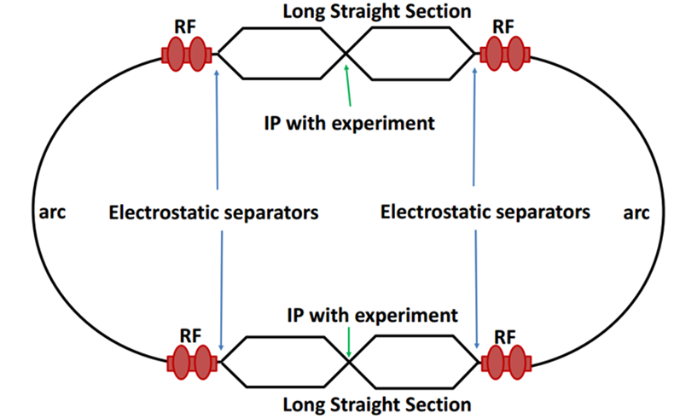
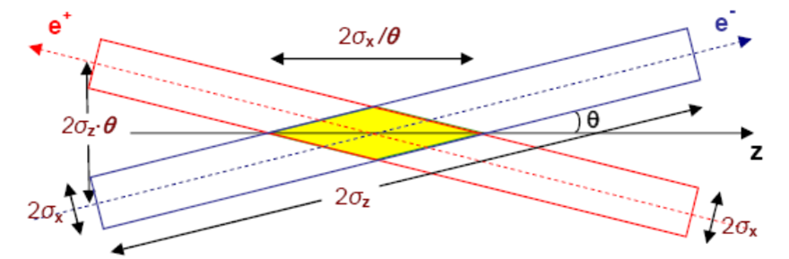
Machine constraints / given parameters
Energy E₀
Circumference C₀
N_{IP}
Beam power P₀
β_{y}*
Emittance coupling factor κ_{ε}
Bending radius ρ
Piwinski angle Φ
ξy enhancement by crab waist F_{l} ~1.5 (2.6)
Energy acceptance (DA)
Phase advance per cell (FODO)

Slide 5
Constraints for parameter choice
Limit of Beam-beam tune shift
F_{l}: ξy enhancement by crab waist
Beam lifetime due to beamstrahlung
BS life time: 30 min
V.I. Telnov
Beamstrahlung energy spread
A=δ₀/δ_{BS} (A≥3)
HOM power per cavity
*J. Gao, emittance growth and beam lifetime limitations due to beam-beam effects in e+e- storage rings, Nucl. Instr. and methods A533（2004）p. 270-274.

Slide 6
parameter for CEPC partial double ring
（wangdou20160325-54km）
 | Pre-CDR | H-high lumi. | H-low power | W | Z
Number of IPs | 2 | 2 | 2 | 2 | 2
Energy (GeV) | 120 | 120 | 120 | 80 | 45.5
Circumference (km) | 54 | 54 | 54 | 54 | 54
SR loss/turn (GeV) | 3.1 | 2.96 | 2.96 | 0.59 | 0.062
Half crossing angle (mrad) | 0 | 15 | 15 | 15 | 15
Piwinski angle | 0 | 2.5 | 2.6 | 5 | 8.5/7.6
N_{e}/bunch (10¹¹) | 3.79 | 2.85 | 2.67 | 0.74 | 0.46
Bunch number | 50 | 67 | 44 | 400 | 1100
Beam current (mA) | 16.6 | 16.9 | 10.5 | 26.2 | 45.4
SR power /beam (MW) | 51.7 | 50 | 31.2 | 15.6 | 2.8
Bending radius (km) | 6.1 | 6.2 | 6.2 | 6.1 | 6.1
Momentum compaction (10⁻⁵) | 3.4 | 2.5 | 2.2 | 2.4 | 3.5
β_{IP} x/y (m) | 0.8/0.0012 | 0.25/0.00136 | 0.268 /0.00124 | 0.1/0.001 | 0.1/0.001
Emittance x/y (nm) | 6.12/0.018 | 2.45/0.0074 | 2.06 /0.0062 | 1.02/0.003 | 0.62/0.0028
Transverse σ_{IP} (um) | 69.97/0.15 | 24.8/0.1 | 23.5/0.088 | 10.1/0.056 | 7.9/0.053
ξ_{x}/IP | 0.118 | 0.03 | 0.032 | 0.008 | 0.005/0.006
ξ_{y}/IP | 0.083 | 0.11 | 0.11 | 0.074 | 0.084/0.073
V_{RF} (GV) | 6.87 | 3.62 | 3.53 | 0.81 | 0.12
f _{RF} (MHz) | 650 | 650 | 650 | 650 | 650
Nature σ_{z} (mm) | 2.14 | 3.1 | 3.0 | 3.25 | 3.9
Total σ_{z} (mm) | 2.65 | 4.1 | 4.0 | 3.35 | 4.0
HOM power/cavity (kw) | 3.6 | 2.2 | 1.3 | 0.99 | 0.99
Energy spread (%) | 0.13 | 0.13 | 0.13 | 0.09 | 0.05
Energy acceptance (%) | 2 | 2 | 2
Energy acceptance by RF (%) | 6 | 2.2 | 2.1 | 1.7 | 1.1
n_{γ} | 0.23 | 0.47 | 0.47 | 0.3 | 0.27/0.24
Life time due to beamstrahlung_cal (minute) | 47 | 36 | 32
F (hour glass) | 0.68 | 0.82 | 0.81 | 0.92 | 0.95
L_{max}/IP (10³⁴cm⁻²s⁻¹) | 2.04 | 2.96 | 2.01 | 3.09 | 3.61/3.09

Slide 7
parameter for CEPC partial double ring
（wangdou20161012-61km）
 | Pre-CDR | H-high lumi. | H-low power | W | Z
Number of IPs | 2 | 2 | 2 | 2 | 2
Energy (GeV) | 120 | 120 | 120 | 80 | 45.5
Circumference (km) | 54 | 61 | 61 | 61 | 61
SR loss/turn (GeV) | 3.1 | 2.96 | 2.96 | 0.58 | 0.061
Half crossing angle (mrad) | 0 | 15 | 15 | 15 | 15
Piwinski angle | 0 | 1.88 | 1.84 | 4.11 | 5.86
N_{e}/bunch (10¹¹) | 3.79 | 2.0 | 1.98 | 0.85 | 0.6
Bunch number | 50 | 107 | 70 | 400 | 1100
Beam current (mA) | 16.6 | 16.9 | 11.0 | 26.8 | 52.0
SR power /beam (MW) | 51.7 | 50 | 32.5 | 15.7 | 3.2
Bending radius (km) | 6.1 | 6.2 | 6.2 | 6.2 | 6.2
Momentum compaction (10⁻⁵) | 3.4 | 1.48 | 1.48 | 1.48 | 3.1
β_{IP} x/y (m) | 0.8/0.0012 | 0.272/0.0013 | 0.275 /0.0013 | 0.16/0.001 | 0.12/0.001
Emittance x/y (nm) | 6.12/0.018 | 2.05/0.0062 | 2.05 /0.0062 | 0.93/0.003 | 0.87/0.0046
Transverse σ_{IP} (um) | 69.97/0.15 | 23.7/0.09 | 23.7/0.09 | 12.2/0.056 | 10.2/0.068
ξ_{x}/IP | 0.118 | 0.041 | 0.042 | 0.0145 | 0.0098
ξ_{y}/IP | 0.083 | 0.11 | 0.11 | 0.084 | 0.073
V_{RF} (GV) | 6.87 | 3.48 | 3.51 | 0.7 | 0.12
f _{RF} (MHz) | 650 | 650 | 650 | 650 | 650
Nature σ_{z} (mm) | 2.14 | 2.7 | 2.7 | 3.23 | 3.9
Total σ_{z} (mm) | 2.65 | 2.95 | 2.9 | 3.35 | 4.0
HOM power/cavity (kw) | 3.6 | 0.74 | 0.48 | 0.47 | 0.59
Energy spread (%) | 0.13 | 0.13 | 0.13 | 0.087 | 0.05
Energy acceptance (%) | 2 | 2 | 2
Energy acceptance by RF (%) | 6 | 2.3 | 2.4 | 1.3 | 1.1
n_{γ} | 0.23 | 0.35 | 0.34 | 0.28 | 0.24
Life time due to beamstrahlung_cal (minute) | 47 | 37 | 37
F (hour glass) | 0.68 | 0.82 | 0.82 | 0.89 | 0.92
L_{max}/IP (10³⁴cm⁻²s⁻¹) | 2.04 | 3.1 | 2.01 | 3.5 | 3.44

Slide 8
parameter for CEPC –larger βy*
（wangdou20161017-61km）
 | Pre-CDR | H-high lumi. | H-low power | H-large βy | W | Z
Number of IPs | 2 | 2 | 2 | 2 | 2 | 2
Energy (GeV) | 120 | 120 | 120 | 120 | 80 | 45.5
Circumference (km) | 54 | 61 | 61 | 61 | 61 | 61
SR loss/turn (GeV) | 3.1 | 2.96 | 2.96 | 2.96 | 0.58 | 0.061
Half crossing angle (mrad) | 0 | 15 | 15 | 15 | 15 | 15
Piwinski angle | 0 | 1.88 | 1.84 | 2.596 | 4.11 | 5.86
N_{e}/bunch (10¹¹) | 3.79 | 2.0 | 1.98 | 1.4 | 0.85 | 0.6
Bunch number | 50 | 107 | 70 | 153 | 400 | 1100
Beam current (mA) | 16.6 | 16.9 | 11.0 | 16.9 | 26.8 | 52.0
SR power /beam (MW) | 51.7 | 50 | 32.5 | 50 | 15.7 | 3.2
Bending radius (km) | 6.1 | 6.2 | 6.2 | 6.2 | 6.2 | 6.2
Momentum compaction (10⁻⁵) | 3.4 | 1.48 | 1.48 | 1.48 | 1.48 | 3.1
β_{IP} x/y (m) | 0.8/0.0012 | 0.272/0.0013 | 0.275 /0.0013 | 0.139/0.0023 | 0.16/0.001 | 0.12/0.001
Emittance x/y (nm) | 6.12/0.018 | 2.05/0.0062 | 2.05 /0.0062 | 2.05/0.0062 | 0.93/0.003 | 0.87/0.0046
Transverse σ_{IP} (um) | 69.97/0.15 | 23.7/0.09 | 23.7/0.09 | 16.9/0.12 | 12.2/0.056 | 10.2/0.068
ξ_{x}/IP | 0.118 | 0.041 | 0.042 | 0.017 | 0.0145 | 0.0098
ξ_{y}/IP | 0.083 | 0.11 | 0.11 | 0.11 | 0.084 | 0.073
V_{RF} (GV) | 6.87 | 3.48 | 3.51 | 3.51 | 0.7 | 0.12
f _{RF} (MHz) | 650 | 650 | 650 | 650 | 650 | 650
Nature σ_{z} (mm) | 2.14 | 2.7 | 2.7 | 2.68 | 3.23 | 3.9
Total σ_{z} (mm) | 2.65 | 2.95 | 2.9 | 2.91 | 3.35 | 4.0
HOM power/cavity (kw) | 3.6 | 0.74 | 0.48 | 0.52 | 0.47 | 0.59
Energy spread (%) | 0.13 | 0.13 | 0.13 | 0.13 | 0.087 | 0.05
Energy acceptance (%) | 2 | 2 | 2 | 2
Energy acceptance by RF (%) | 6 | 2.3 | 2.4 | 2.4 | 1.3 | 1.1
n_{γ} | 0.23 | 0.35 | 0.34 | 0.34 | 0.28 | 0.24
Life time due to beamstrahlung_cal (minute) | 47 | 37 | 37 | 37
F (hour glass) | 0.68 | 0.82 | 0.82 | 0.95 | 0.89 | 0.92
L_{max}/IP (10³⁴cm⁻²s⁻¹) | 2.04 | 3.1 | 2.01 | 2.03 | 3.5 | 3.44

Slide 9
New Z parameter for higher luminosity
（wangdou20161018-61km）
 | Pre-CDR | H-high lumi. | H-low power | W | Z-high lumi.
Number of IPs | 2 | 2 | 2 | 2 | 2 | 2
Energy (GeV) | 120 | 120 | 120 | 80 | 45.5 | 45.5
Circumference (km) | 54 | 61 | 61 | 61 | 61 | 61
SR loss/turn (GeV) | 3.1 | 2.96 | 2.96 | 0.58 | 0.061 | 0.061
Half crossing angle (mrad) | 0 | 15 | 15 | 15 | 15 | 15
Piwinski angle | 0 | 1.88 | 1.84 | 4.11 | 5.86 | 5.86
N_{e}/bunch (10¹¹) | 3.79 | 2.0 | 1.98 | 0.85 | 0.6 | 0.6
Bunch number | 50 | 107 | 70 | 400 | 1100 | 3200
Beam current (mA) | 16.6 | 16.9 | 11.0 | 26.8 | 52.0 | 151.3
SR power /beam (MW) | 51.7 | 50 | 32.5 | 15.7 | 3.2 | 9.26
Bending radius (km) | 6.1 | 6.2 | 6.2 | 6.2 | 6.2 | 6.2
Momentum compaction (10⁻⁵) | 3.4 | 1.48 | 1.48 | 1.48 | 3.1 | 3.1
β_{IP} x/y (m) | 0.8/0.0012 | 0.272/0.0013 | 0.275 /0.0013 | 0.16/0.001 | 0.12/0.001 | 0.12/0.001
Emittance x/y (nm) | 6.12/0.018 | 2.05/0.0062 | 2.05 /0.0062 | 0.93/0.003 | 0.87/0.0046 | 0.87/0.0046
Transverse σ_{IP} (um) | 69.97/0.15 | 23.7/0.09 | 23.7/0.09 | 12.2/0.056 | 10.2/0.068 | 10.2/0.068
ξ_{x}/IP | 0.118 | 0.041 | 0.042 | 0.0145 | 0.0098 | 0.0098
ξ_{y}/IP | 0.083 | 0.11 | 0.11 | 0.084 | 0.073 | 0.073
V_{RF} (GV) | 6.87 | 3.48 | 3.51 | 0.7 | 0.12 | 0.12
f _{RF} (MHz) | 650 | 650 | 650 | 650 | 650 | 650
Nature σ_{z} (mm) | 2.14 | 2.7 | 2.7 | 3.23 | 3.9 | 3.9
Total σ_{z} (mm) | 2.65 | 2.95 | 2.9 | 3.35 | 4.0 | 4.0
HOM power/cavity (kw) | 3.6 | 0.74 | 0.48 | 0.47 | 0.59 | 1.7
Energy spread (%) | 0.13 | 0.13 | 0.13 | 0.087 | 0.05 | 0.05
Energy acceptance (%) | 2 | 2 | 2
Energy acceptance by RF (%) | 6 | 2.3 | 2.4 | 1.3 | 1.1 | 1.1
n_{γ} | 0.23 | 0.35 | 0.34 | 0.28 | 0.24 | 0.24
Life time due to beamstrahlung_cal (minute) | 47 | 37 | 37
F (hour glass) | 0.68 | 0.82 | 0.82 | 0.89 | 0.92 | 0.92
L_{max}/IP (10³⁴cm⁻²s⁻¹) | 2.04 | 3.1 | 2.01 | 3.5 | 3.44 | 10.0

Slide 10
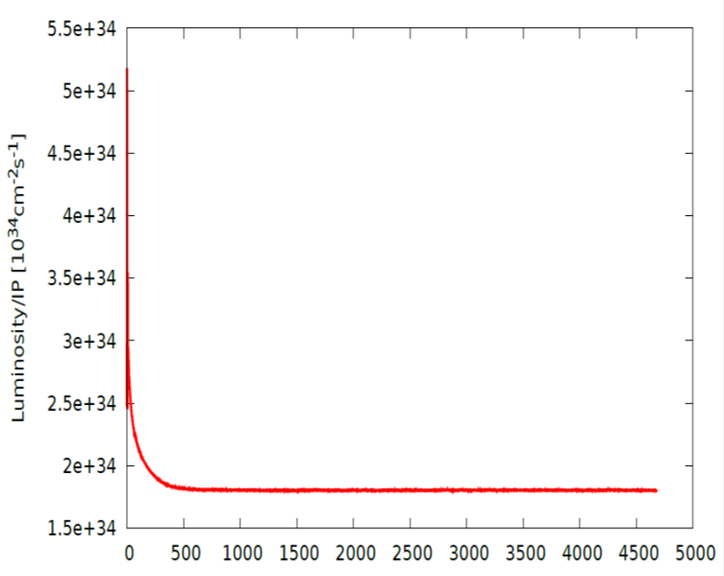
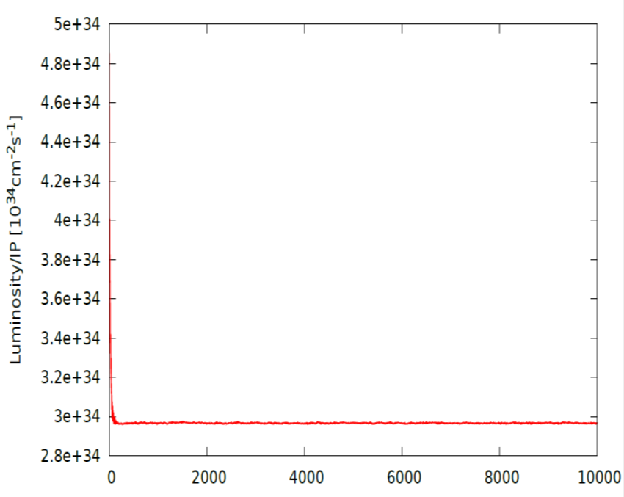
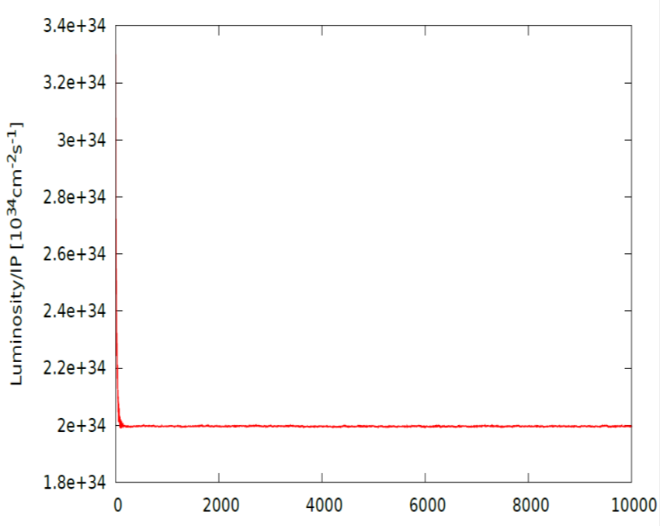
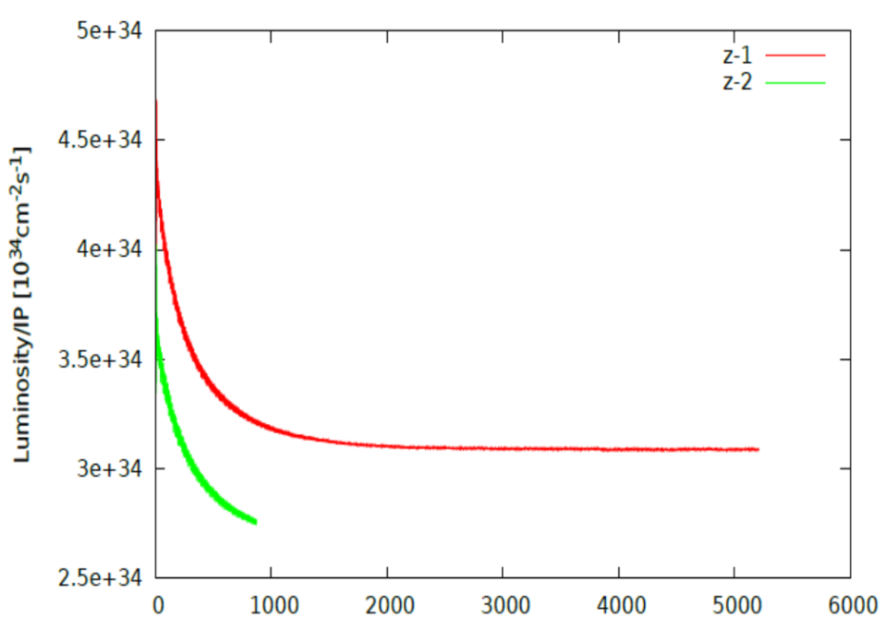



Beam-beam simulation-54km
IBB: Strong-Strong Beam-Beam Code with Beamstrahlung effect
Developed by Y. Zhang@IHEP
Case: Pre-CDR
Case: H-high lum
Lifetime: 108 min(16$σ_{p}$)
Lifetime: 118 min(16$σ_{p}$)
Case: H-low power
Case Z
Lifetime: 97 min(16$σ_{p}$)

Slide 11
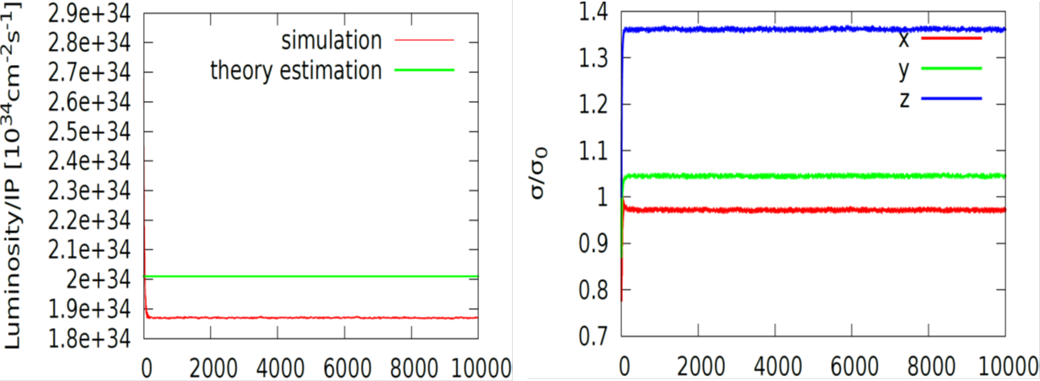
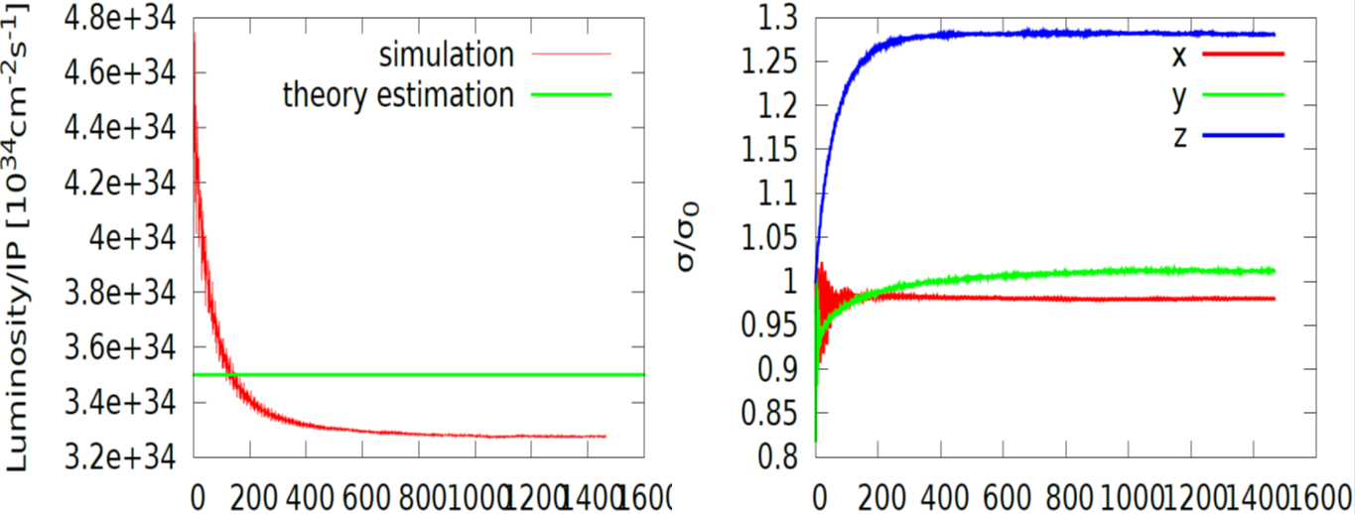
Beam-beam simulation-61km
IBB: Strong-Strong Beam-Beam Code with Beamstrahlung effect
Developed by Y. Zhang@IHEP
Case: H-low power
Lifetime: 260 min
Case: w

Slide 12
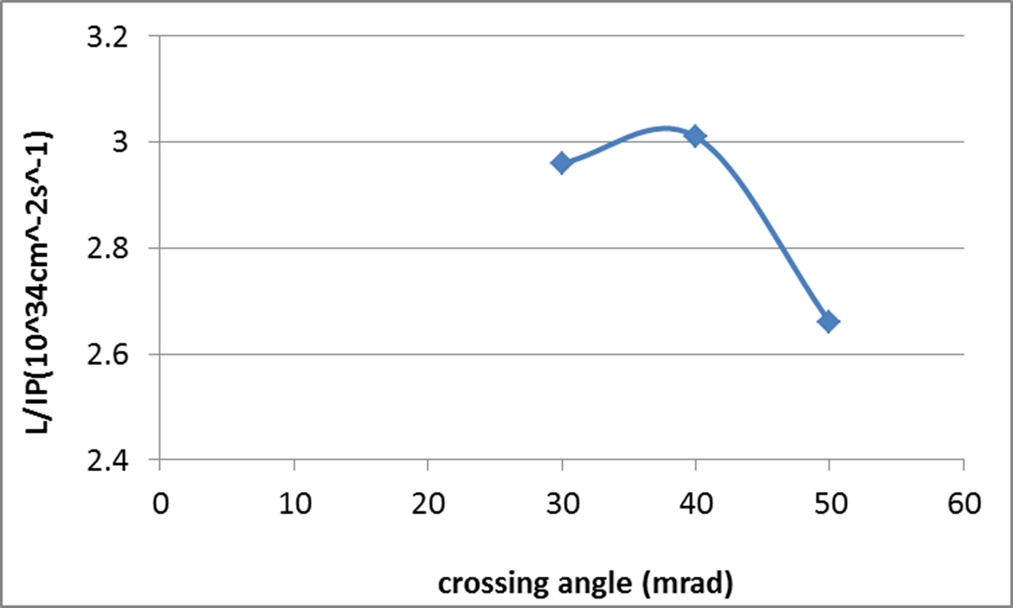
CEPC Higgs luminosity vs. crossing angle
54 km ring

Slide 13
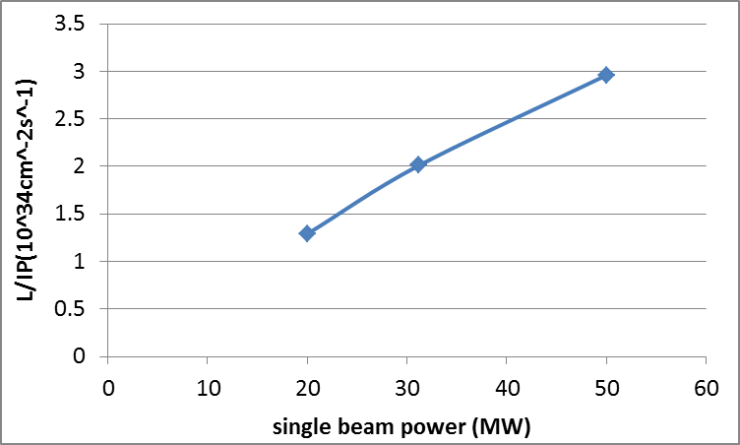
CEPC Higgs Luminosity vs beam power
54 km ring

Slide 14
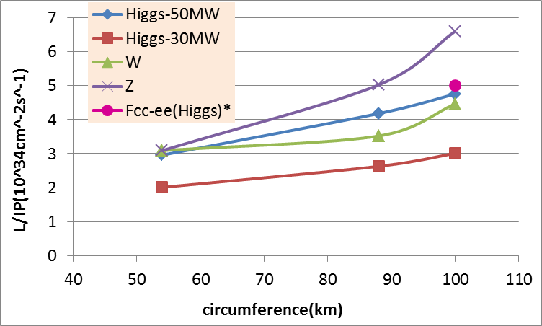
CEPC PDR Luminosity vs circumference
* Fabiola Gianotti, Future Circular ColliderDesign Study, ICFA meeting, J-PARC, 25-2-2016.

Slide 15
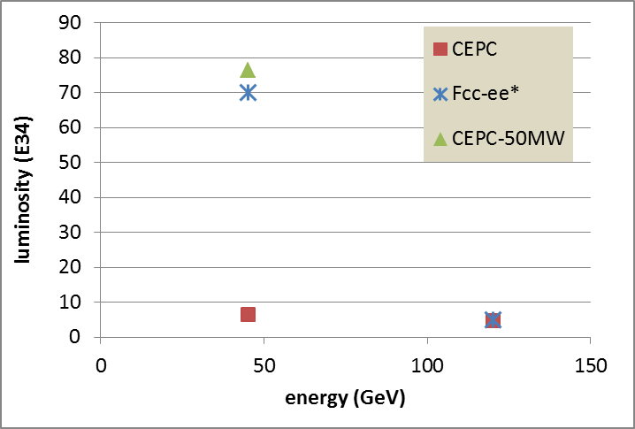
100km CEPC PDR vs Fcc-ee
P_{HOM,CEPC}=11.3 kw
The large difference of Z is due to the constraint for RF HOM power.
* Fabiola Gianotti, Future Circular ColliderDesign Study, ICFA meeting, J-PARC, 25-2-2016.

Slide 16
Parameter for single ring-61km
（wangdou20160923）
 | Pre-CDR | New-61km
Number of IPs | 2 | 2
Energy (GeV) | 120 | 120
Circumference (km) | 54 | 61
SR loss/turn (GeV) | 3.1 | 3.0
N_{e}/bunch (10¹¹) | 3.79 | 3.91
Bunch number | 50 | 54
Beam current (mA) | 16.6 | 16.6
SR power /beam (MW) | 51.7 | 50
Bending radius (km) | 6.1 | 6.1
Momentum compaction (10⁻⁵) | 3.4 | 3.25
β_{IP} x/y (m) | 0.8/0.0012 | 0.43/0.00105
Emittance x/y (nm) | 6.12/0.018 | 6.28/0.04
Transverse σ_{IP} (um) | 69.97/0.15 | 51.7/0.2
ξ_{x}/IP | 0.118 | 0.118
ξ_{y}/IP | 0.083 | 0.074
V_{RF} (GV) | 6.87 | 6.99
f _{RF} (MHz) | 650 | 650
Nature σ_{z} (mm) | 2.14 | 2.19
Total σ_{z} (mm) | 2.65 | 2.47
HOM power/cavity (kw) | 3.6 | 3.9
Energy spread (%) | 0.13 | 0.13
Energy acceptance (%) | 2 | 2.1
Energy acceptance by RF (%) | 6 | 6
n_{γ} | 0.23 | 0.31
Life time due to beamstrahlung_cal (minute) | 47 | 34
F (hour glass) | 0.68 | 0.66
L_{max}/IP (10³⁴cm⁻²s⁻¹) | 2.04 | 2.02

Slide 17
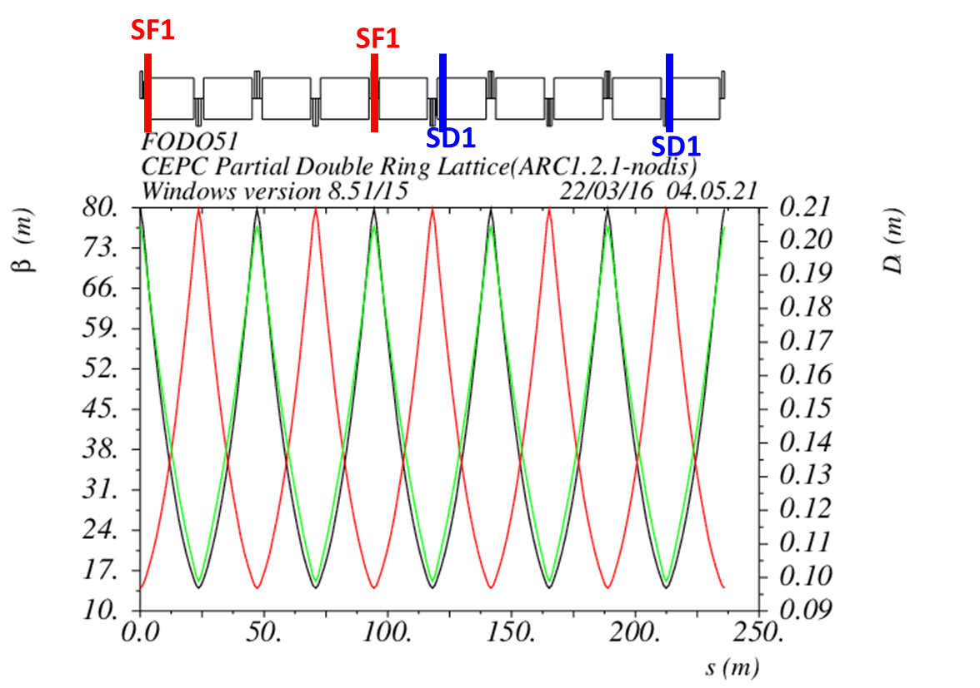
Non-interleave sextupoles in arc
(90°/90° FODO)

Slide 18
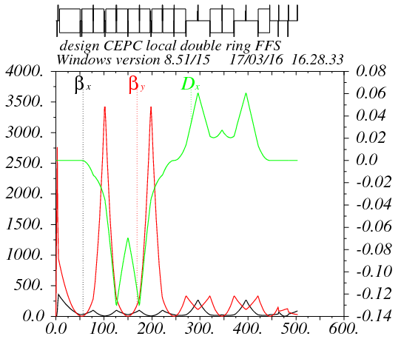
Partial double ring FFS design with crab sextupoles
Betax=0.25m
Betay=0.00136m
K2hs=26.8 m⁻³
K2vs=32.2 m⁻³
Crab sextupole
IP
Critical energy: Ec=190 keV
Dipole strength: B=0.019 T
The second FFS sextupoles of the CCS-Y section work as the crab sextupoles.

Slide 19
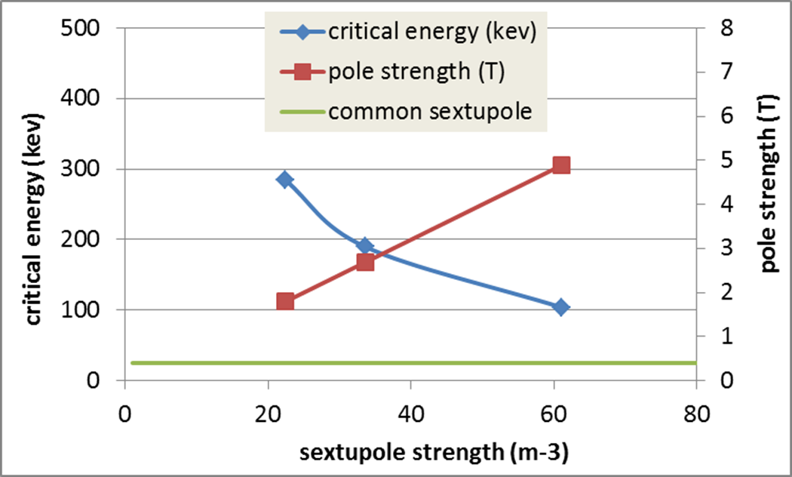
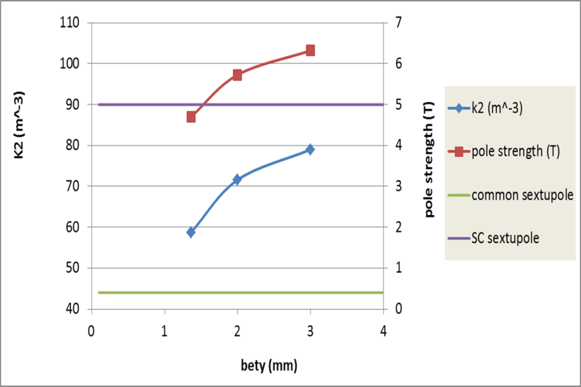
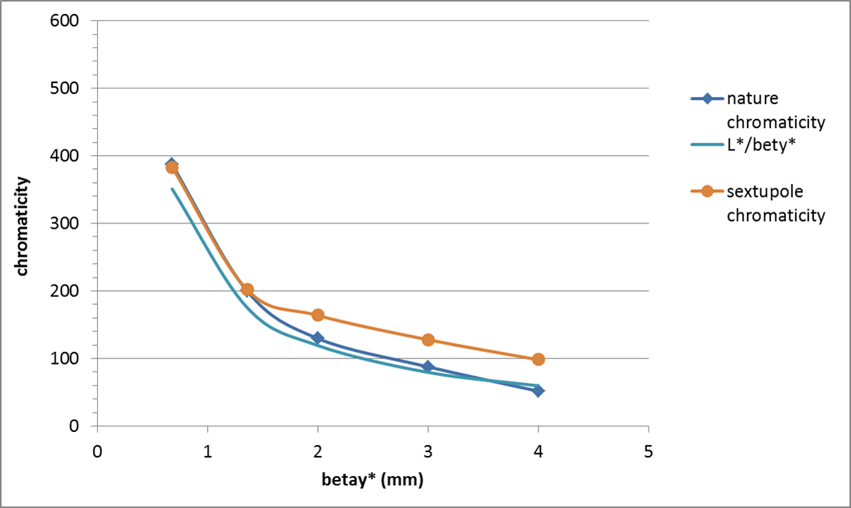
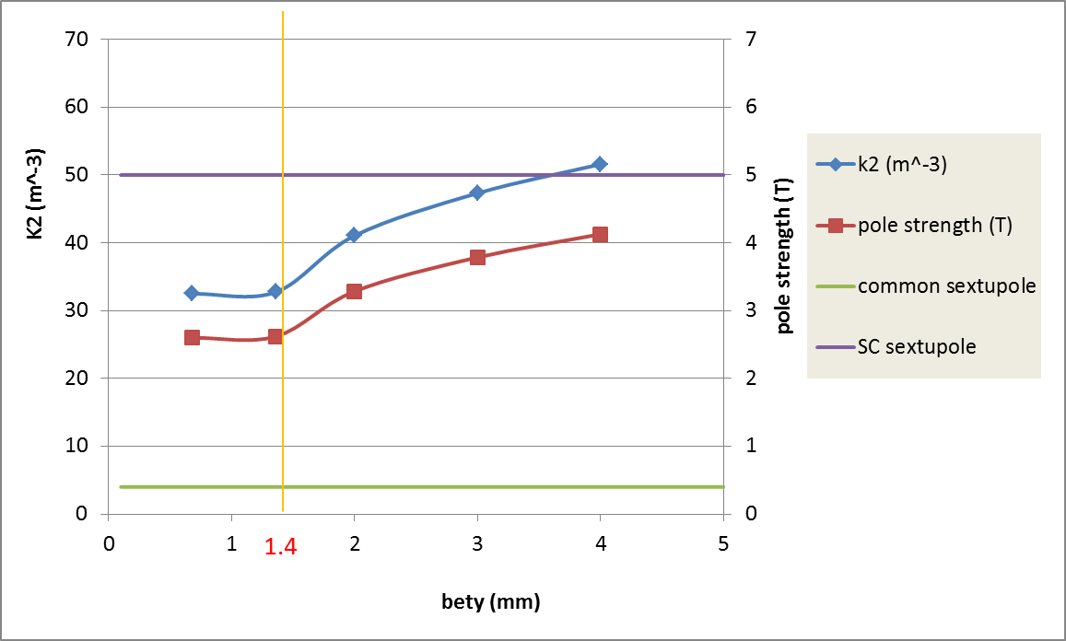
CEPC IR sextupole strength
Ec=100keV
Ec=190keV
Ec=190keV

Slide 20
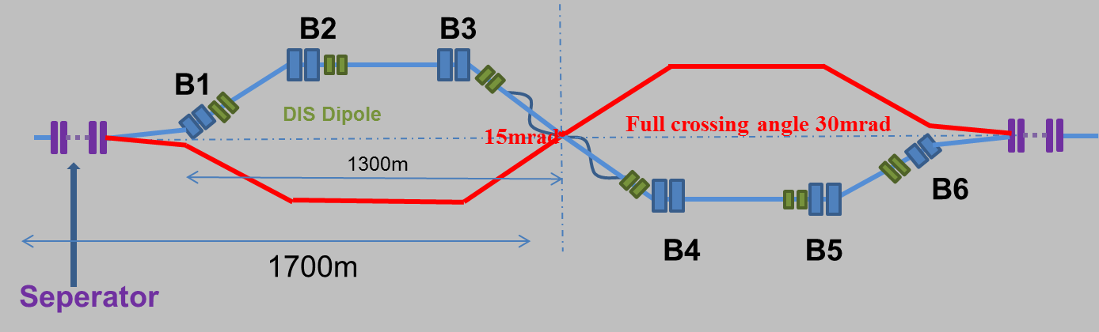
Combine with partial double ring lattice
30 mrad
10 m

Slide 21
DA bandwidth optimization with MODE
(knob arc sextupoles)
Crab sextupoles – off
Damping -off
test16 from Zhang Yuan@IHEP
Bandwidth = 1.4%.
DA (on-momentum): 32σ_{x} × 60σ_{y}
Next step:
- Combine arc sextupoles with IR sextupoles.
- Add symmetry in arc

Slide 22
CEPC Advanced Partial Double Ring Layout I
1/2RF
1/2RF
ARC1
IP1_ee
RF
RF
ARC2
APDR
3Km
APDR
ARC3
1/2RF
1/2RF
Bypass
about 42m
IP4_pp
IP2_pp
ARC4
1/2RF
1/2RF
IP1_ee/IP3_ee, 2.968Km
IP2_pp/IP4_pp, 1132.8m
APDR, 1052.87m
4 Short Straights, 141.6m
4 Medium Straights, 566.4m
4 Long Straights, 1132.8m
4 ARC1, 124*FODO, 5852.8m
4 ARC2, 24*FODO, 1132.8m
4 ARC3, 79*FODO, 3728.8m
2 ARC4, 24*FODO, 1132.8m
ARC3
APDR
C=62967.86m
APDR
RF
RF
ARC2
IP3_ee
ARC1
1/2RF
1/2RF
SU Feng
2016.5.23

Slide 23
CEPC Advanced Partial Double Ring Layout II
1/2RF
1/2RF
1/2RF
ARC
1/2RF
IP1_ee
1/2RF
APDR
APDR
1/2RF
3Km
1/2RF
1/2RF
APDR
APDR
1/2RF
1/2RF
C=65640.2m
IP1_ee/IP3_ee, 2.968Km
IP2_pp/IP4_pp, 1132.8m
APDR, 1052.87m
4 Short Straights, 94.4m
12 Long Straights, 566.4m
4 Long ARC, 124*FODO, 5852.8m
4 Medium ARC, 104*FODO, 4908.8m
4 Short ARC, 14*FODO, 660.8m
1/2RF
1/2RF
APDR
APDR
1/2RF
IP3_ee
1/2RF
1/2RF
1/2RF
SU Feng
2016.6.2

Slide 24
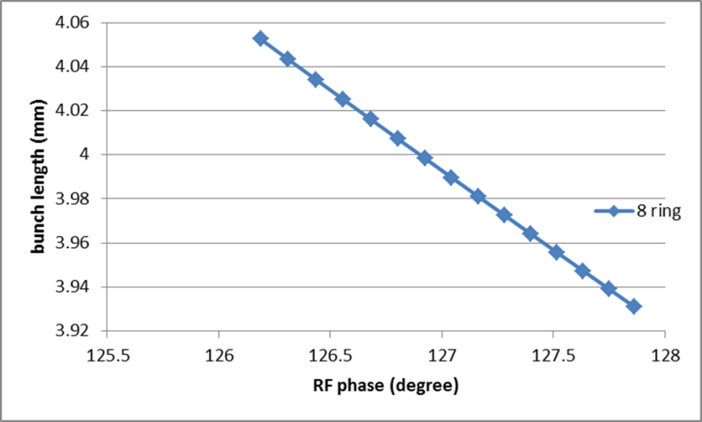
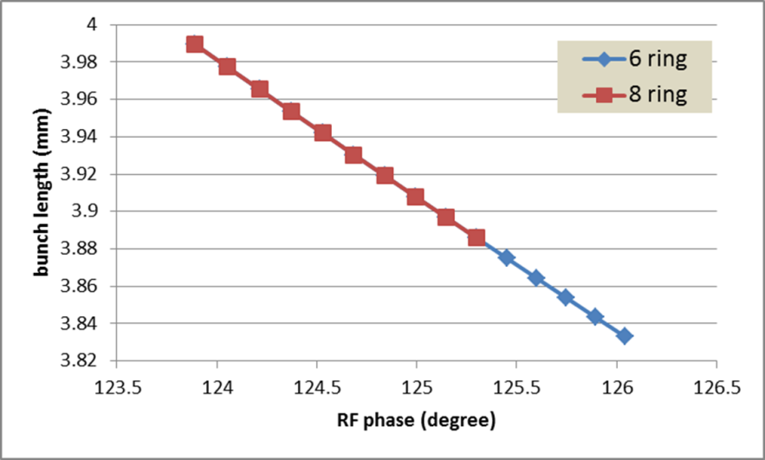
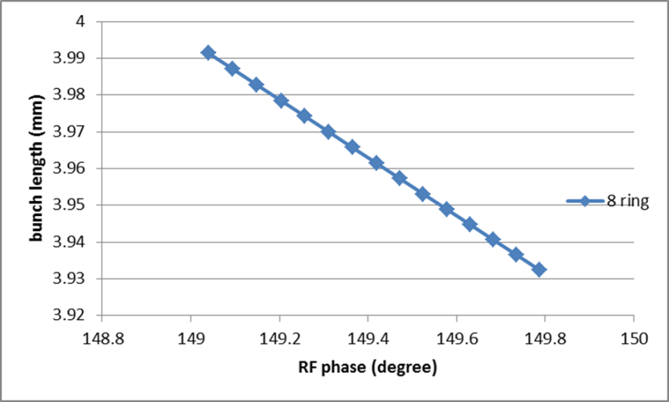
Bunch length error with RF phase adjustment
H-high lum
H-low power
For H-low power, error of bunch length: ~-4% (6 ring), ~-3% (8 ring)
Z
For H-high lum., error of bunch length: ~-3% (8 ring)
For Z, error of bunch length: ~-1.5% (8 ring)

Slide 25
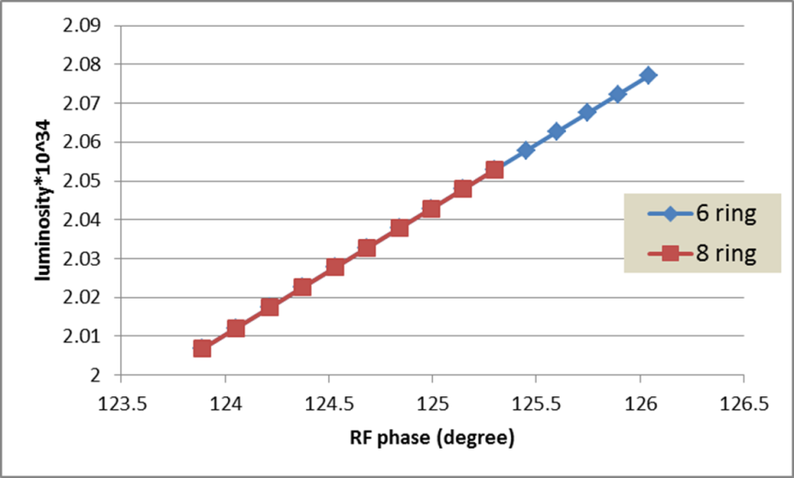
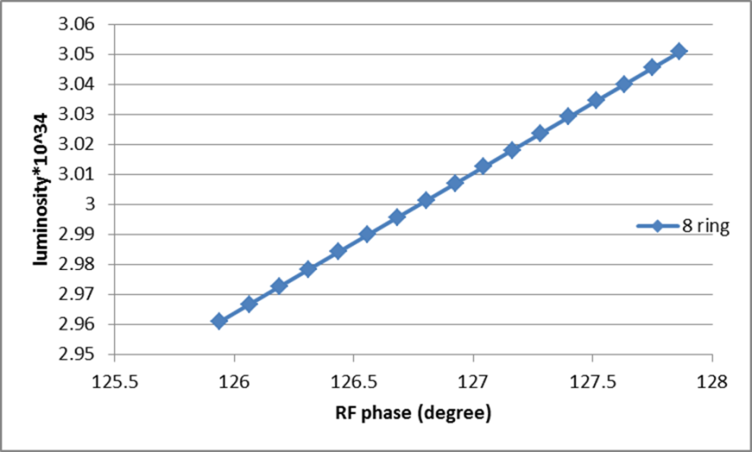
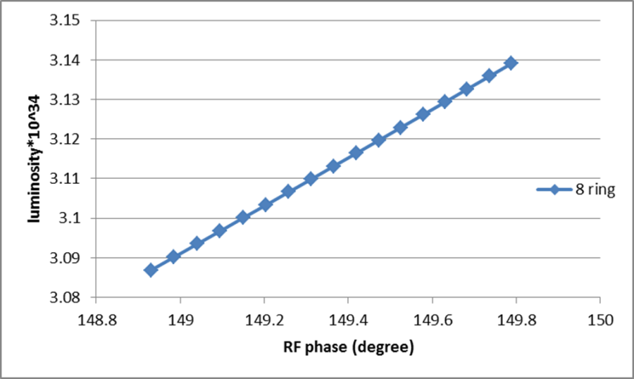
Luminosity change with RF phase adjustment
H-low power
H-high lum
For H-high lum., error of luminosity: ~3% (8 ring)
Z
For H-low power, error of luminosity: ~ 3.5% (6 ring), ~2.4% (8 ring)
For Z, error of luminosity: ~1.7% (8 ring)

Slide 26
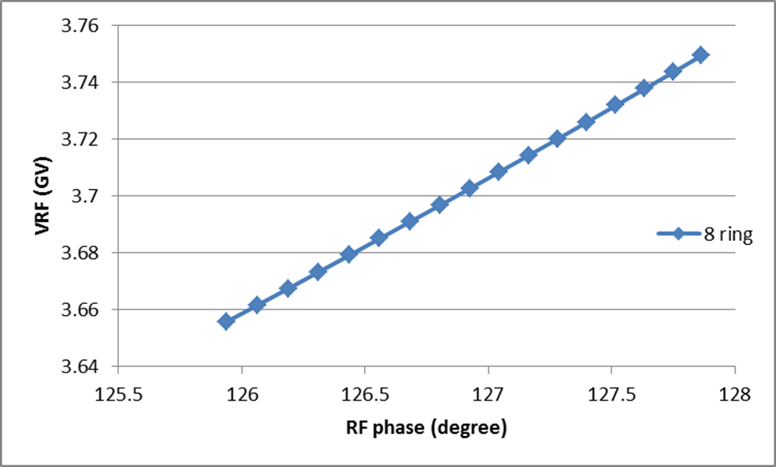
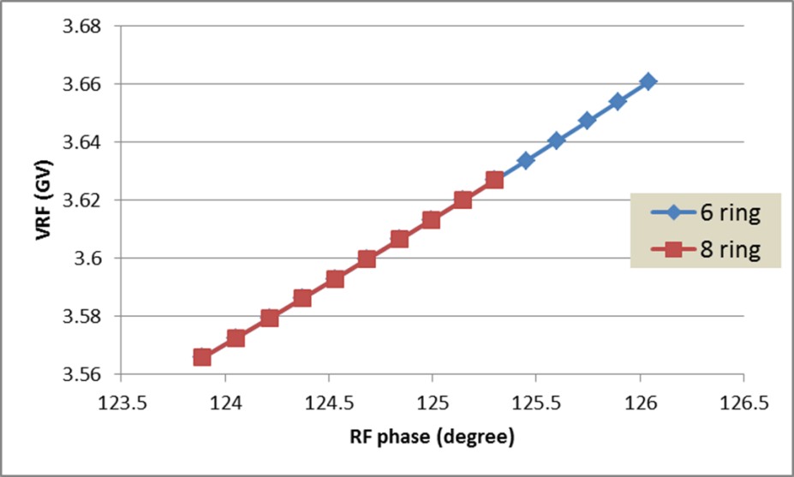
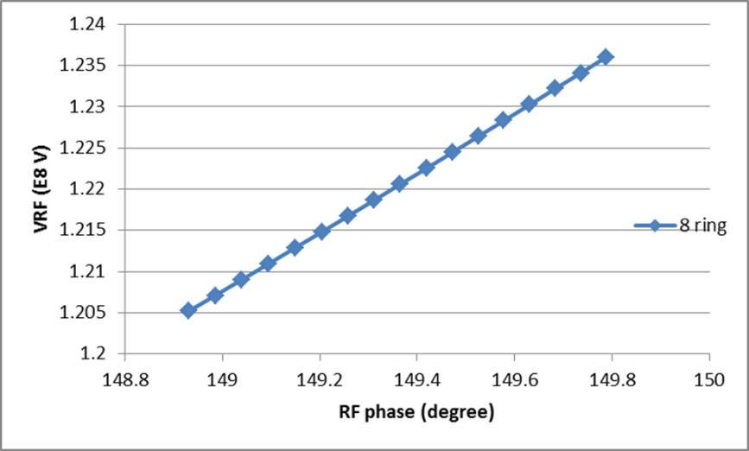
RF voltage change with RF phase adjustment
H-high lum
H-low power
For H-high lum., error of VRF: ~ 2.6% (8 ring)
Z
For H-low power, error of RF acceptance: ~ 2.8% (6 ring), ~ 2% (8 ring)
For Z, error of VRF: ~ 2.6% (8 ring)
RF efficiency will be a little lower than 100%.

Slide 27
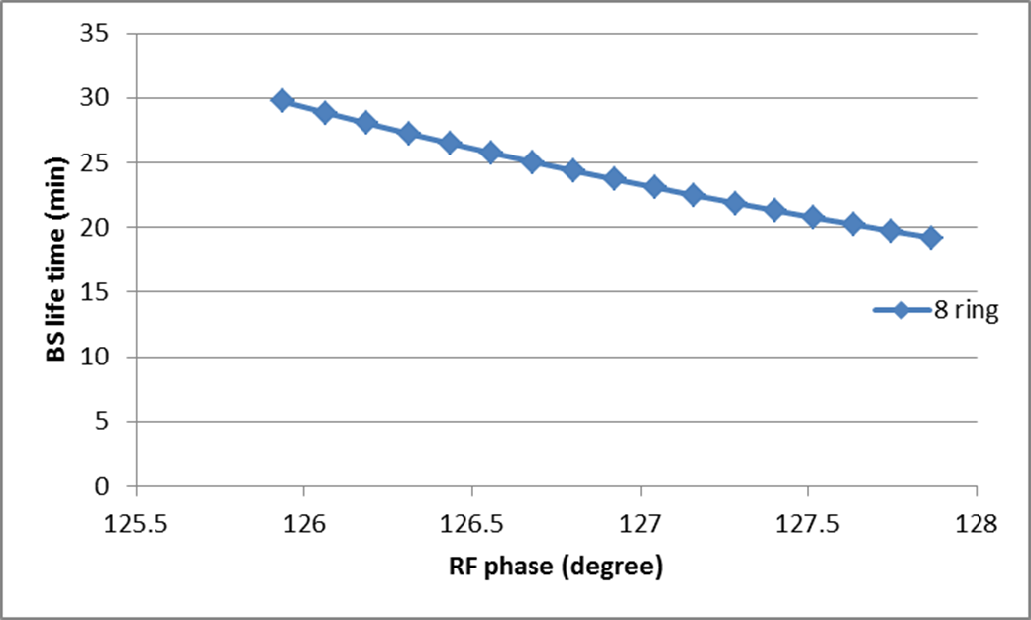
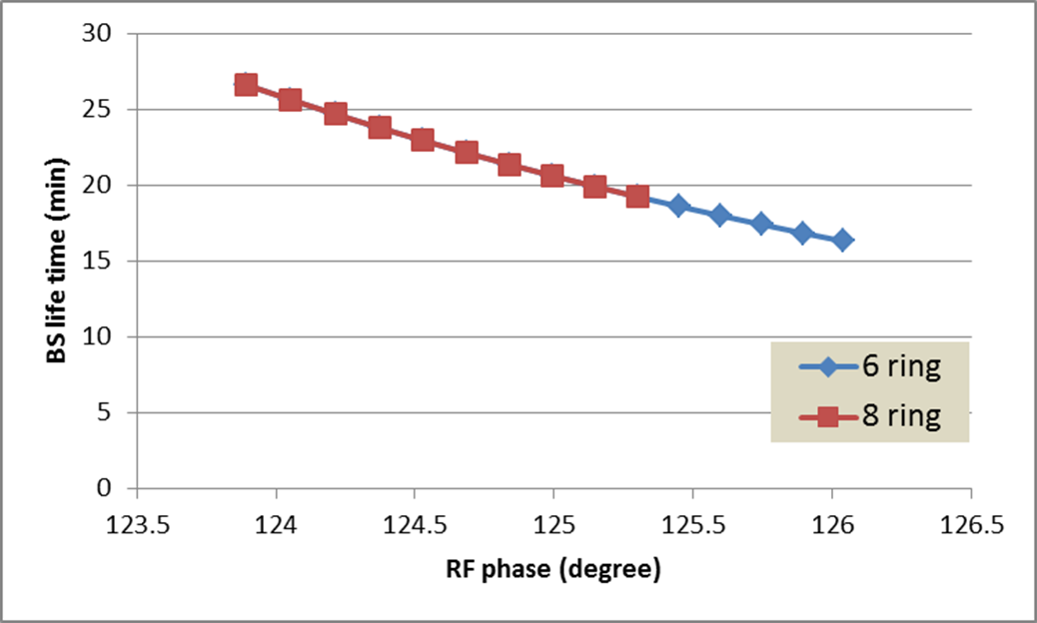
BS life time with RF phase adjustment
H-high lum
H-low power
For H-high lum., error of BS life time: ~-36% (8 ring)
For H-low power, error of BS life time: ~-37% (6 ring), ~-30% (8 ring)
BS life time will be lower than the requirement!!

Slide 28

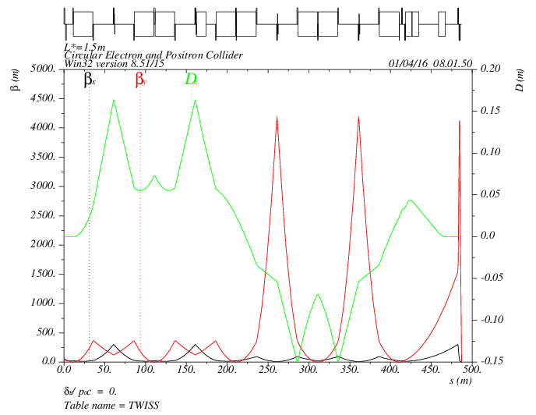
synchrotron radiation of IR
(lattice: CEPC_ARC_PDR_IR_96fam_damp-new.sad)
Yiwei Wang
MT
CCX
CCY
FT
IP
472kev
472kev
374kev
203kev
1952 kev
126kev
434kev
126kev
565 kev
L*= 1.5m
βx*= 0.22mm
βy*= 1mm
GQD0= -200T/m
GQF1= 200T/m
LQD0=1.69m
LQF1=0.90m

Slide 29
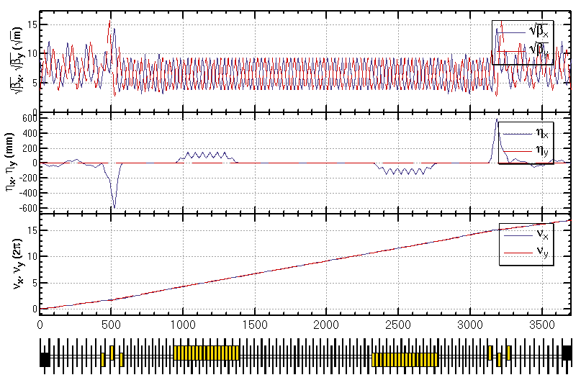
synchrotron radiation of PDR (w/o IR)
Feng Su, Yiwei Wang
BSEP1：1631kev
BSEP3：1496kev
QBQ1：985kev

Slide 30
DA optimization with Yiwei’s lattice
(code: MODE- zhangy@ihep.ac.cn)
Bunch length in parameter table: 2.7 mm
Damping effect - open
Plan:
- Re-optimize with 2.7mm bunch length
- Further optimization with MODE
- add additional sextupoles in IR

Slide 31
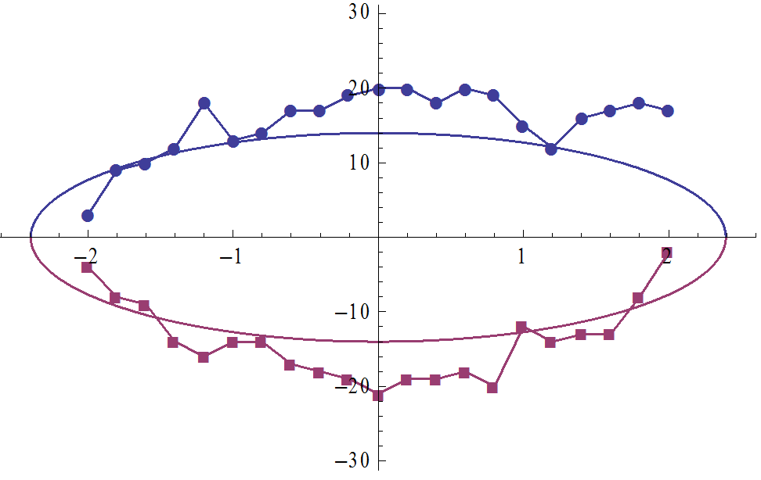


Intial
165 generation
DA [σx]
DA [σx]
0%: 18σx/-18 σx
+2%: 6σx/-4 σx
-2%: 1σx/-6 σx
0%: 20σx/-21 σx
+2%: 18σx/-3 σx
-2%: 3σx/-4 σx

Slide 32
CEPC damping ring requirement
Energy: 1.1GeV
Storage time: 20ms
Injected emittance (normalized): 3500 mm-mrad, injected energy spread ~ 0.25%
Transverse acceptance > 3*injection beam size
Extracted energy spread <1×10-3
No strong requirement for the extracted emittance (<0.5ε_{inj})!

Slide 33
CEPC DR design
 | DR V1.0
Energy (GeV) | 1.1
circumference | 58.5
Bending radius (m) | 3.6
B0 (T) | 1.01
U0 (keV/turn) | 35.8
Damping time x/y/z (ms) | 12/12/6 (61538 turns)
δ0 (%) | 0.049
ε0 (mm.mrad) | 302
Nature σz (mm) | 7 (23ps)
Extract σz (mm) | ~7 (23ps)
εinj (mm.mrad) | 3500
εext x/y (mm.mrad) | 434/145
δinj /δext (%) | 0.25 /0.05
Energy acceptance by RF(%) | 1.0
f_{RF}=650MHz
V_{RF}=1.8MV
Bunch compressor

Slide 34
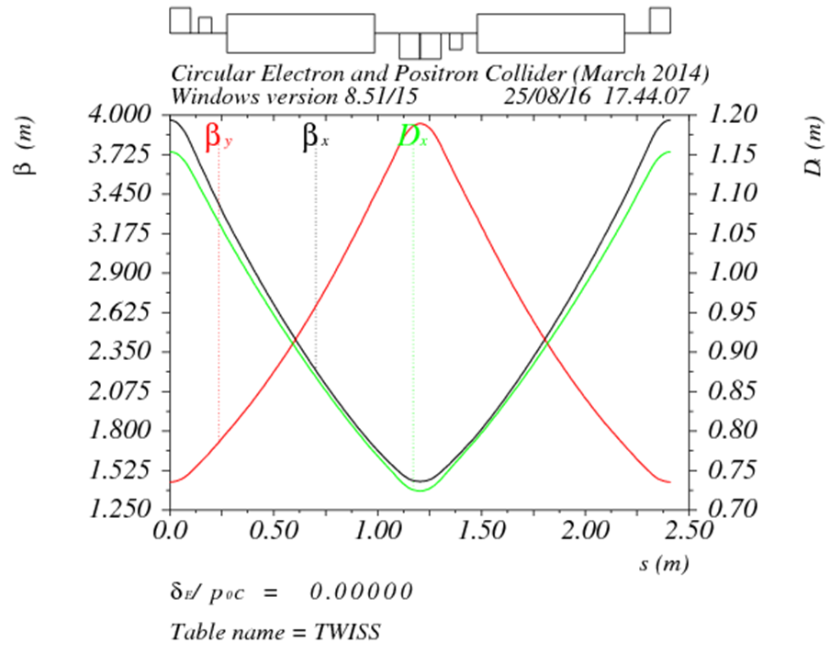
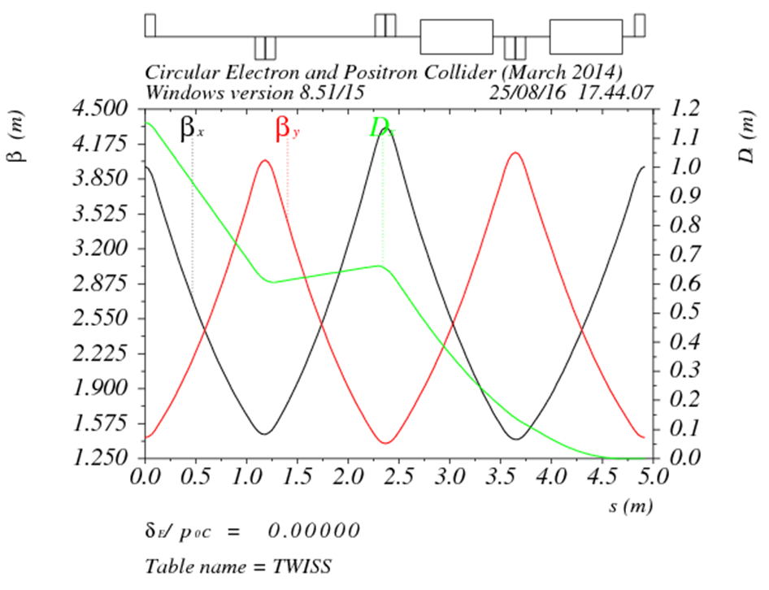
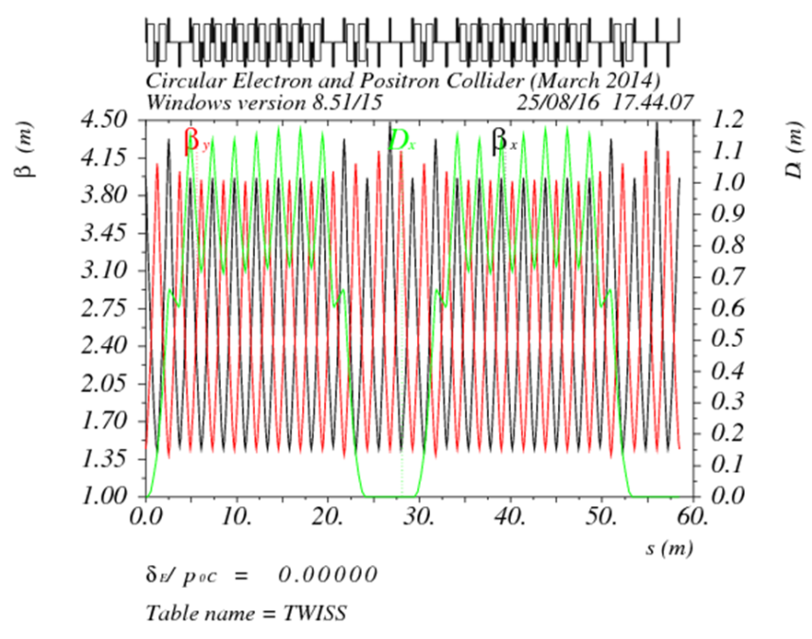
DR lattice design
FODO length (m) | 2.4
Phase per cell | 60°
Dipole length (m) | 0.71
Dipole strength (T) | 1.0
Quadrupole length (m) | 0.2
Quadrupole strength (m⁻²) | 4.1
Sextupole length (m) | 0.06

Slide 35
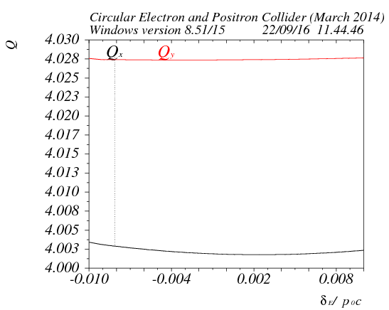
DA
Tracking 240000turns （4 damping time）
ε_{inj} / ε₀=11.6
σ_{inj} / σ₀=3.4
σ_{inj,max}=sqrt(1.626um*4m)
= 2.55mm
5 times of injection beam size

Slide 36
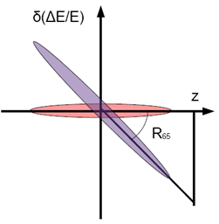
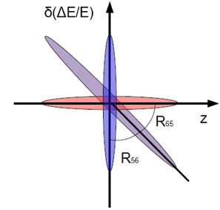
Primary design for bunch compressor
RF structure
E₀
E₁
Dispersive section

Slide 37
Parameter design
入口：σ₀=7mm， δ₀=0.05%， E₀=1.1 GeV
出口：σ₁<3mm， δ₁=??(≤0.1%)， E₁=1.1 GeV

Slide 38
Parameters of CEPC bunch compressor
 | BC (case I) | BC (case II)
初始能量 (GeV) | 1.1 | 1.1
初始能散 (%) | 0.05 | 0.05
初始束长 (mm) | 7 | 7
高频频率 (MHz) | 2856 | 2856
高频腔压 (MV) | 14.5 | 19.3
加速相位 (度) | 86 | 87
R₅₆ (m) | -4 | -3
出口能量 (GeV) | 1.101 | 1.101
出口能散 (%) | 0.17 | 0.23
出口束长 (mm) | 2 (6.7ps) | 1.5 (5ps)
Compression ratio：3.5~4.7
Compression ratio is flexible.

Slide 39
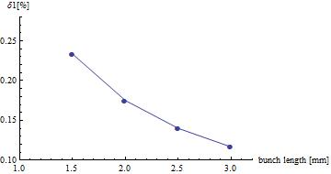
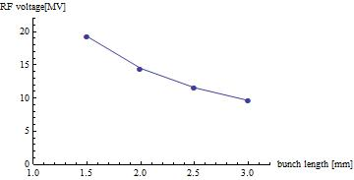
BC energy spread and VRF vs. bunch length
At the end of bunch compressor, shorter bunch length gives larger energy spread and need higher RF voltage.

