Slide 1

HOM coupler design and collective instability study
Hongjuan Zheng
2016-11-04

Slide 2
Outline
HOM coupler design
  Research target
  Research content
  Research achievement
Collective instability study
  Bunch lengthening analysis
Conclusion
References

Slide 3
HOM coupler design
Research target
Cut off TE11：1126MHz
Cut off TM01：1471MHz
Beam stability:
HOM Qe~10⁴
HOM power:
If beam spectrum coincide with HOM, the requirement for Qe should less than 10³. (For TM011, if resonance happen, Pt=300W (Qe=10³))
Maximum power: 1 kW
Dangerous monopole: aroud1200MHz
Dangerous dipole: 800MHz~900MHz, 1200MHz
HOM coupler bandwidth: 800~1400MHz
HOM damper: ＞1400MHz

Slide 4
HOM coupler design
HOM coupler layout and size
80mm
cryogenic
RT
156mm
HOM
FM
HOM
HOM damper
Bandwidth: ＞1400MHz
100mm
HOM coupler
Bandwidth: 800~1400MHz

Slide 5
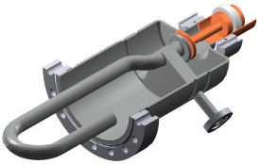
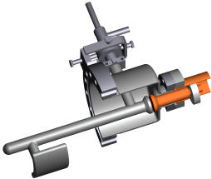
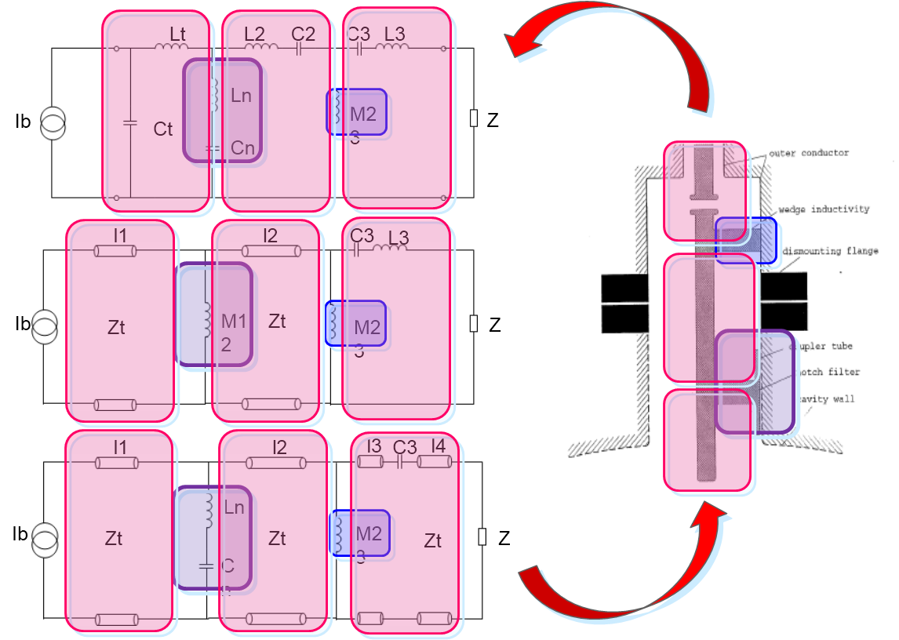
HOM coupler design
HOM coupler design scheme
Coupler structure: coaxial LC filter
Design content
LHC narrow band and broadband coupler: design value—1 kW, test—600 W (4.5K)
LEPII: 850 W /coupler (CW test)
RF design
thermal analysis
broadband filter
surface heating analysis, static heat loss and dynamic heat loss
detuning approach:
equivalent circuit (transmission line model)
optimize each part according to S21 curve
change to 3D model
electromagnetic optimization

Slide 6
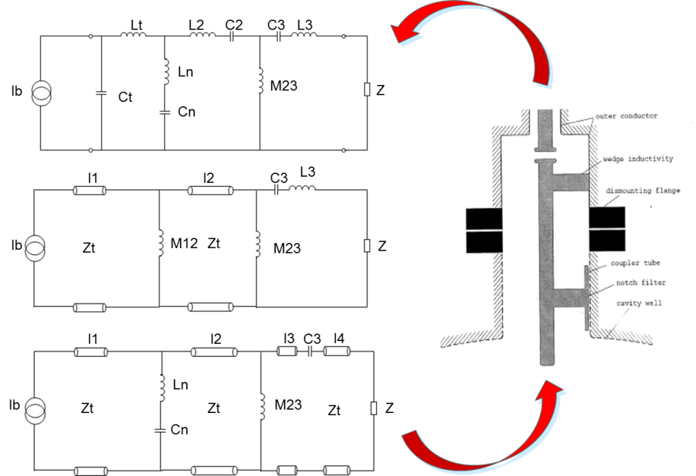
HOM coupler design
Transmission line equivalent circuit results
l4
l3
l2
l1
Values for the transmission line equivalent circuit：
l1=4.83cm, l2=10.027cm, l3=2.0cm, l4=1.0cm, Ln=13.52nH, Cn=4.43pF, M23=8.29nH, C3=1.57pF, Zt=96.6 Ω, Z=50 Ω
Outer diameter of the coupling tube is 80 mm. Inner diameter of the coupling tube is 16 mm.

Slide 7
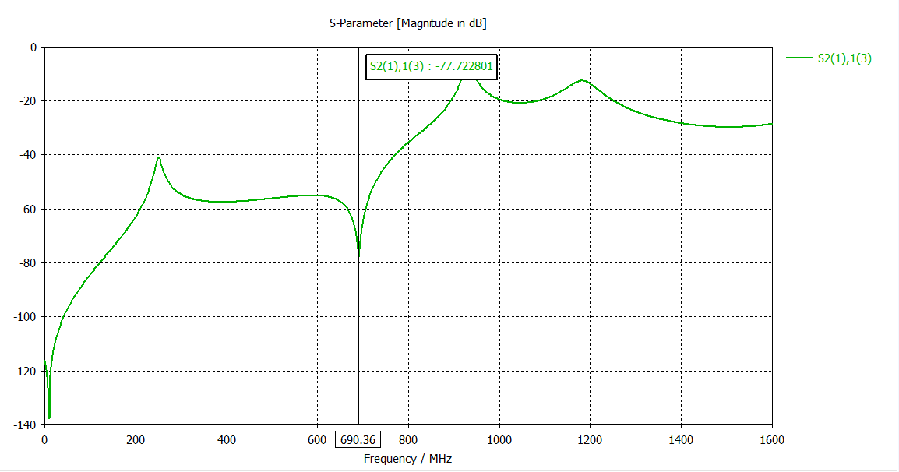
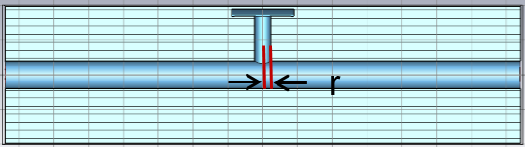
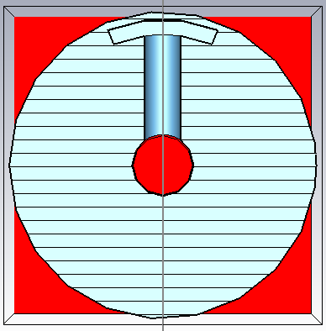
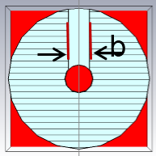
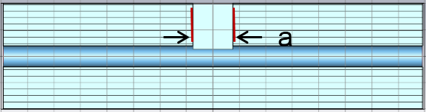
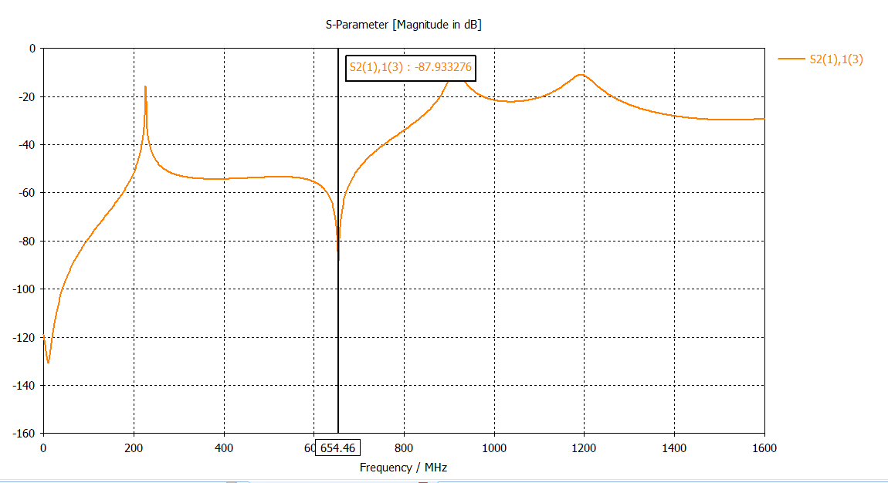
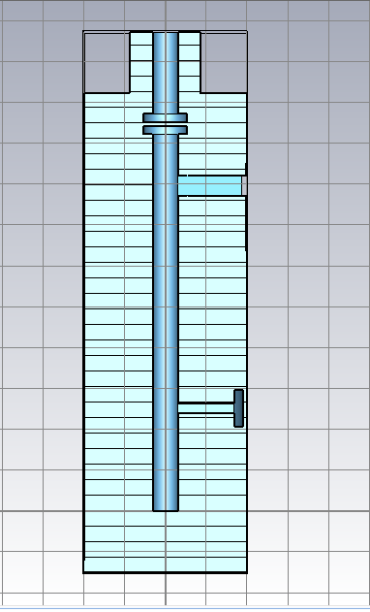
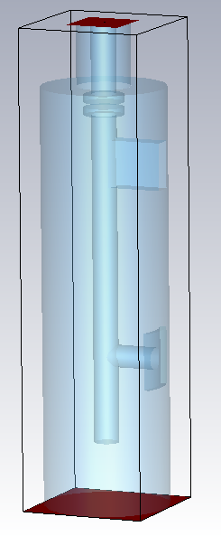
HOM coupler design
3D model construction
TM01-TEM
Design requirement: M12=8.29 nH
r=4.7 mm M12=11.925 nH
S21 curve
Design requirement: M23=6.79 nH
a=30 mm, b=12 mm M23=6.78 nH
mutual inductance
after tune fundamental mode f
notch filter inductance

Slide 8
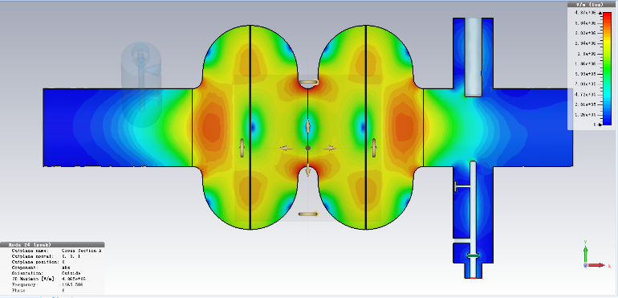
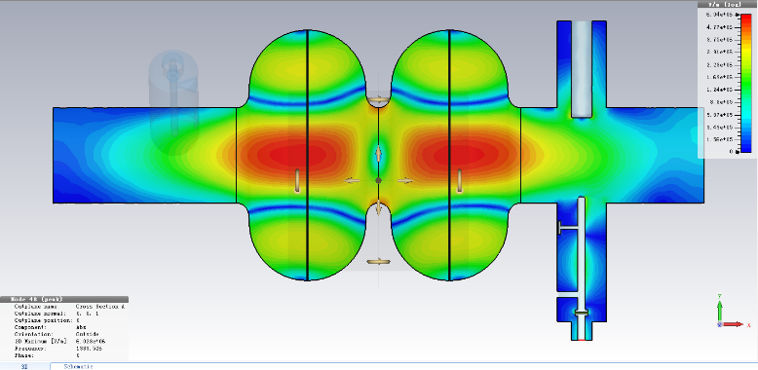
HOM coupler design
Monopole mode damping results
use average current to calculate the threshold
not include the frequency spread
For Z, 32 cavity used
TM020
TM011
Continue to optimize the broadband damping results
Increase the probe head area
Increase the insert depth

Slide 9
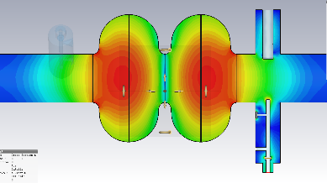
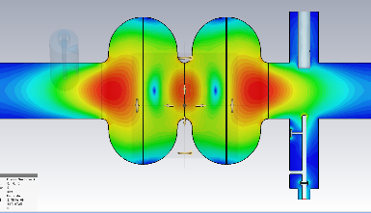
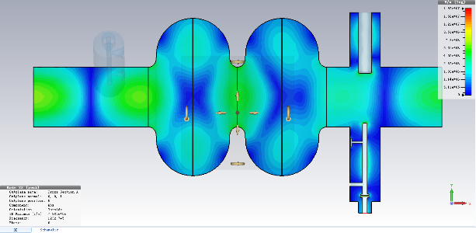
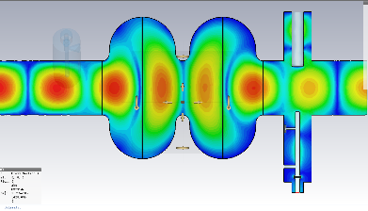
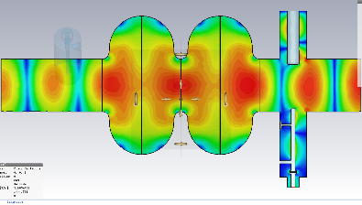
HOM coupler design
Dipole mode damping results
use average current to calculate the threshold
not include the frequency spread
For Z, 32 cavity used
TM111/TE121
TE111
TM110
Hybrid
Continue to optimize the broadband damping results
Increase the probe head area
Increase the insert depth

Slide 10
Parameters for CEPC partial double ring
（wangdou20160918/23）
 | Pre-CDR | H-high lumi. | H-low power | W | Z
Number of IPs | 2 | 2 | 2 | 2 | 2
Energy (GeV) | 120 | 120 | 120 | 80 | 45.5
Circumference (km) | 54 | 61 | 61 | 61 | 61
SR loss/turn (GeV) | 3.1 | 2.96 | 2.96 | 0.58 | 0.061
Half crossing angle (mrad) | 0 | 15 | 15 | 15 | 15
Piwinski angle | 0 | 1.88 | 1.84 | 5.2 | 6.4
N_{e}/bunch (10¹¹) | 3.79 | 2.0 | 1.98 | 1.16 | 0.78
Bunch number | 50 | 107 | 70 | 400 | 1100
Beam current (mA) | 16.6 | 16.9 | 11.0 | 36.5 | 67.6
SR power /beam (MW) | 51.7 | 50 | 32.5 | 21.3 | 4.1
Bending radius (km) | 6.1 | 6.2 | 6.2 | 6.2 | 6.2
Momentum compaction (10⁻⁵) | 3.4 | 1.48 | 1.48 | 1.44 | 2.9
β_{IP} x/y (m) | 0.8/0.0012 | 0.272/0.0013 | 0.275 /0.0013 | 0.1/0.001 | 0.1/0.001
Emittance x/y (nm) | 6.12/0.018 | 2.05/0.0062 | 2.05 /0.0062 | 0.93/0.0078 | 0.88/0.008
Transverse σ_{IP} (um) | 69.97/0.15 | 23.7/0.09 | 23.7/0.09 | 9.7/0.088 | 9.4/0.089
ξ_{x}/IP | 0.118 | 0.041 | 0.042 | 0.013 | 0.01
ξ_{y}/IP | 0.083 | 0.11 | 0.11 | 0.073 | 0.072
V_{RF} (GV) | 6.87 | 3.48 | 3.51 | 0.74 | 0.11
f _{RF} (MHz) | 650 | 650 | 650 | 650 | 650
Nature σ_{z} (mm) | 2.14 | 2.7 | 2.7 | 2.95 | 3.78
Total σ_{z} (mm) | 2.65 | 2.95 | 2.9 | 3.35 | 4.0
HOM power/cavity (kw) | 3.6 | 0.74 | 0.48 | 0.88 | 0.99
Energy spread (%) | 0.13 | 0.13 | 0.13 | 0.087 | 0.05
Energy acceptance (%) | 2 | 2 | 2
Energy acceptance by RF (%) | 6 | 2.3 | 2.4 | 1.7 | 1.2
n_{γ} | 0.23 | 0.35 | 0.34 | 0.49 | 0.34
Life time due to beamstrahlung_cal (minute) | 47 | 37 | 37
F (hour glass) | 0.68 | 0.82 | 0.82 | 0.92 | 0.93
L_{max}/IP (10³⁴cm⁻²s⁻¹) | 2.04 | 3.1 | 2.01 | 4.3 | 4.48

Slide 11
Bunch lengthening analysis
Impedance budget (from Na Wang)
Coupling impedance dominated by
  Resistive wall impedance
  Vacuum elements with large numbers (RF cavities, flanges, BPMs, bellows, …)
  Vacuum elementts with large impedances (IP duct, collimators, kickers, …)
Components | Number | R, kΩ | L, nH | Z||/n, mΩ | k_{loss}, V/pC
Resistive wall | - | 6.7 | 487.7 | 17.0 | 138.4
RF cavities | 384 | 14.9 | -132.7 | - | 307.5
Flanges | ~10000 | 0.7 | 165.5 | 5.8 | 15.1
BPMs | 2300 | 0.6 | 21.4 | 0.7 | 11.6
Bellows | ~10000 | 5.9 | 331.5 | 11.6 | 122.3
Pumping ports | ~10000 | 0.007 | 3.1 | 0.1 | 0.1
Total(σ=4.1mm) |  | 28.8 | 876.5 | 35.2 | 595.0

Slide 12
Bunch lengthening analysis
Theory used
The analytical expression that describes the wake potential of a storage ring is:
The bunch lengthening equation is as follows:
Energy spread is:
[1] J. Gao, On the single bunch longitudinal collective effects in electron storage rings, Nuclear Instruments and Methods in Physics Research A 491(2002) 1-8.

Slide 13
Bunch lengthening analysis
Bunch lengthening for Higgs high luminosity design
With σ=2.95 mm, bunch current = 0.158 mA
bunch lengthening is 44.9%
energy spread is 23.7%

Slide 14
Bunch lengthening analysis
Bunch lengthening for Higgs low power design
With σ=2.9 mm, bunch current = 0.157 mA
bunch lengthening is 45.3%
energy spread is 24.2%

Slide 15
Bunch lengthening analysis
Bunch lengthening for W design
With σ=3.35 mm, bunch current = 0.091 mA
bunch lengthening is 78%
energy spread is 52.2%

Slide 16
Bunch lengthening analysis
Bunch lengthening for Z design
With σ=4 mm, bunch current = 0.061 mA
bunch lengthening is 184.2%
energy spread is 169.1%

Slide 17
Bunch lengthening analysis
Conclusion for bunch lengthening analysis
The estimated results show that the bunch lengthening is a problem in CEPC, especially for Z design.
The cavities in the ring contribute more than half total loss factors.
The resistive wall contributes more than half total inductance.
It is better to remove most of the cavities for the Z design no matter for the bunch lengthening problem or the RF considerations.

Slide 18
Conclusion
The preliminary design of HOM coupler is given. In order to meet the requirement, more work need to do.
Improve the damping for TE111 mode.
Improve the notch filter design for the fundamental mode.
Thermal analysis.
The bunch lengthening analysis results show that the bunch lengthening is a problem for CEPC, especially for Z design.

Slide 19
References
K. Papke, U. Van Rienen,F. Gerigk. HOM Couplers for CERN SPL Cavities[J]. 2013.
David M. Pozar. Microwave Engineering, Publishing House of Electronics Industry, Beijing. P160
Byrd, J. and J. Corlett. Study of Coupled-bunch Collective Effects in the ALS. in Particle Accelerator Conference, Proceedings of the 1993. IEEE
Frank Gerigk, CERN, Studienarbeit
J. Gao, On the single bunch longitudinal collective effects in electron storage rings, Nuclear Instruments and Methods in Physics Research A 491(2002) p. 1-8.
J. Gao, An empirical equation for bunch lengthening in electron storage ring, Nuclear Instruments and Methods in Physics Research A 432 (1999) p. 539-543.
J. Gao, Review of some important beam physics issues in electron positron collider designs, Modern Physics Letters A, Vol. 30, No. 11 (2015), 1530006 (20 pages).
P. Wilson, et al., Bunch lengthening and related effects in SPEARII, IEEE Trans. Nucl. Sci. NS-24 (1977) p.1211.

