Slide 1
CEPC parameter and DA optimization
Dou Wang, Jie Gao, Yuan Zhang, Yiwei Wang, Feng Su, Huiping Geng, Cai Meng, Bai Sha, Tianjian Bian, Na Wang
CEPC AP meeting, 2016.11.11

Slide 2
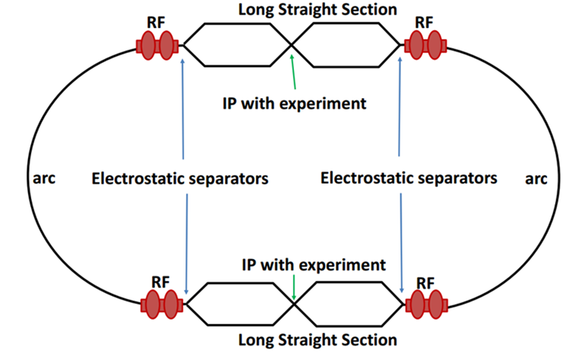
Machine constraints / given parameters
Energy E₀
Circumference C₀
N_{IP}
Beam power P₀
β_{y}*
Emittance coupling factor κ_{ε}
Bending radius ρ
Piwinski angle Φ
ξy enhancement by crab waist F_{l} ~1.5 (2.6)
Energy acceptance (DA)
Phase advance per cell (FODO)

Slide 3
Constraints for parameter choice
Limit of Beam-beam tune shift
F_{l}: ξy enhancement by crab waist
Beam lifetime due to beamstrahlung
BS life time: 30 min
V.I. Telnov
Beamstrahlung energy spread
A=δ₀/δ_{BS} (A≥3)
HOM power per cavity
*J. Gao, emittance growth and beam lifetime limitations due to beam-beam effects in e+e- storage rings, Nucl. Instr. and methods A533（2004）p. 270-274.

Slide 4
parameter for CEPC partial double ring （wangdou20161109-61km）
 | Pre-CDR | H-high lumi. | H-low power | W | Z | Z-5cell
Number of IPs | 2 | 2 | 2 | 2 | 2 | 2
Energy (GeV) | 120 | 120 | 120 | 80 | 45.5 | 45.5
Circumference (km) | 54 | 61 | 61 | 61 | 61 | 61
SR loss/turn (GeV) | 3.1 | 2.96 | 2.96 | 0.58 | 0.061 | 0.061
Half crossing angle (mrad) | 0 | 15 | 15 | 15 | 15 | 15
Piwinski angle | 0 | 1.88 | 1.84 | 4.11 | 5.86 | 5.87
N_{e}/bunch (10¹¹) | 3.79 | 2.0 | 1.98 | 0.85 | 0.6 | 0.6
Bunch number | 50 | 107 | 70 | 400 | 1100 | 700
Beam current (mA) | 16.6 | 16.9 | 11.0 | 26.8 | 52.0 | 33.1
SR power /beam (MW) | 51.7 | 50 | 32.5 | 15.7 | 3.2 | 2.0
Bending radius (km) | 6.1 | 6.2 | 6.2 | 6.2 | 6.2 | 6.2
Momentum compaction (10⁻⁵) | 3.4 | 1.48 | 1.48 | 1.48 | 3.1 | 3.1
β_{IP} x/y (m) | 0.8/0.0012 | 0.272/0.0013 | 0.275 /0.0013 | 0.16/0.001 | 0.12/0.001 | 0.12/0.001
Emittance x/y (nm) | 6.12/0.018 | 2.05/0.0062 | 2.05 /0.0062 | 0.93/0.003 | 0.87/0.0046 | 0.87/0.0046
Transverse σ_{IP} (um) | 69.97/0.15 | 23.7/0.09 | 23.7/0.09 | 12.2/0.056 | 10.2/0.068 | 10.2/0.068
ξ_{x}/IP | 0.118 | 0.041 | 0.042 | 0.0145 | 0.0098 | 0.0098
ξ_{y}/IP | 0.083 | 0.11 | 0.11 | 0.084 | 0.073 | 0.073
V_{RF} (GV) | 6.87 | 3.48 | 3.51 | 0.7 | 0.12 | 0.12
f _{RF} (MHz) | 650 | 650 | 650 | 650 | 650 | 650
Nature σ_{z} (mm) | 2.14 | 2.7 | 2.7 | 3.23 | 3.9 | 3.9
Total σ_{z} (mm) | 2.65 | 2.95 | 2.9 | 3.35 | 4.0 | 4.0
HOM power/cavity (kw) | 3.6 | 0.74 | 0.48 | 0.47 | 0.59 | 0.93
Energy spread (%) | 0.13 | 0.13 | 0.13 | 0.087 | 0.05 | 0.05
Energy acceptance (%) | 2 | 2 | 2
Energy acceptance by RF (%) | 6 | 2.3 | 2.4 | 1.3 | 1.1 | 1.1
n_{γ} | 0.23 | 0.35 | 0.34 | 0.28 | 0.24 | 0.24
Life time due to beamstrahlung_cal (minute) | 47 | 37 | 37
F (hour glass) | 0.68 | 0.82 | 0.82 | 0.89 | 0.92 | 0.92
L_{max}/IP (10³⁴cm⁻²s⁻¹) | 2.04 | 3.1 | 2.01 | 3.5 | 3.44 | 2.2

Slide 5
parameter for CEPC partial double ring （wangdou20161110-100km）
 | Pre-CDR | H-high lumi. | H-low power
Number of IPs | 2 | 2 | 2
Energy (GeV) | 120 | 120 | 120
Circumference (km) | 54 | 100 | 100
SR loss/turn (GeV) | 3.1 | 1.67 | 1.67
Half crossing angle (mrad) | 0 | 15 | 15
Piwinski angle | 0 | 2.5 | 2.5
N_{e}/bunch (10¹¹) | 3.79 | 1.12 | 1.12
Bunch number | 50 | 333 | 211
Beam current (mA) | 16.6 | 17.98 | 11.4
SR power /beam (MW) | 51.7 | 30 | 19
Bending radius (km) | 6.1 | 11 | 11
Momentum compaction (10⁻⁵) | 3.4 | 0.96 | 0.96
β_{IP} x/y (m) | 0.8/0.0012 | 0.3/0.001 | 0.3 /0.001
Emittance x/y (nm) | 6.12/0.018 | 1.01/0.0031 | 1.01/0.0031
Transverse σ_{IP} (um) | 69.97/0.15 | 17.4/0.055 | 17.4/0.055
ξ_{x}/IP | 0.118 | 0.029 | 0.029
ξ_{y}/IP | 0.083 | 0.083 | 0.083
V_{RF} (GV) | 6.87 | 2.0 | 2.0
f _{RF} (MHz) | 650 | 650 | 650
Nature σ_{z} (mm) | 2.14 | 2.72 | 2.72
Total σ_{z} (mm) | 2.65 | 2.9 | 2.9
HOM power/cavity (kw) | 3.6 | 0.45 | 0.28
Energy spread (%) | 0.13 | 0.098 | 0.098
Energy acceptance (%) | 2 | 1.5 | 1.5
Energy acceptance by RF (%) | 6 | 1.8 | 1.8
n_{γ} | 0.23 | 0.26 | 0.26
Life time due to beamstrahlung_cal (minute) | 47 | 52 | 52
F (hour glass) | 0.68 | 0.83 | 0.83
L_{max}/IP (10³⁴cm⁻²s⁻¹) | 2.04 | 3.25 | 2.06
2cell cavity
help DA optimization!

Slide 6
Primary consideration of lattice design
Arc cell : 90° FODO cell
Cell length: 66m
Bending radius of dipole: 11km
Bending angle per cell: 0.00533979rad
Emittance : 1.01 nm
Number of FODO cell: 1176
Total length of arc: 77 km
Total length of PDR(inc. IR): 10km
Total length of straight: 13 km
alphap = 9.56384×10⁻⁶

