Slide 1
Sawtooth effect in CEPC APDR
Sha Bai, Chenghui Yu, Feng Su, Huiping Geng,
Yiwei Wang, Dou Wang, Tianjian Bian, Jie Gao
CEPC-AP-meeting
2016-11-18

Slide 2
CEPC Advanced Partial Double Ring Layout
RF
RF
IP1_ee
ARC
APDR
APDR
RF
3.7Km
RF
APDR
C=61251.2m
APDR
RF
RF
APDR
APDR
IP1_ee/IP3_ee, 3741m
IP2_pp/IP4_pp, 1132.8m
APDR, 1426m
RF Station, 188.8m
ARC1, 6041.6m
ARC1, 4902.87m
IP3_ee
RF
RF
SU Feng
2016.9.30

Slide 3
Dynamic aperture without sawtooth

Slide 4
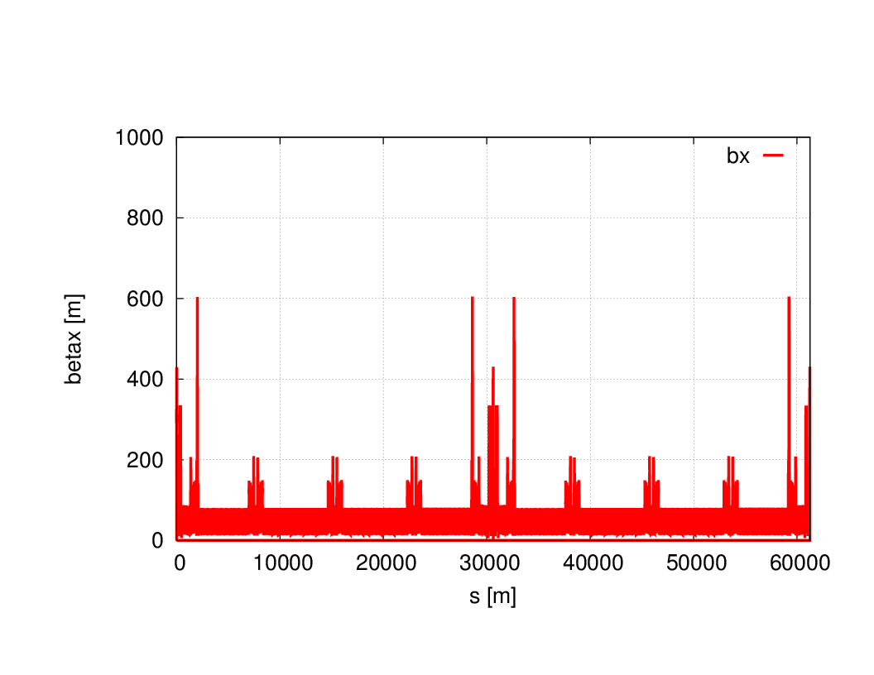
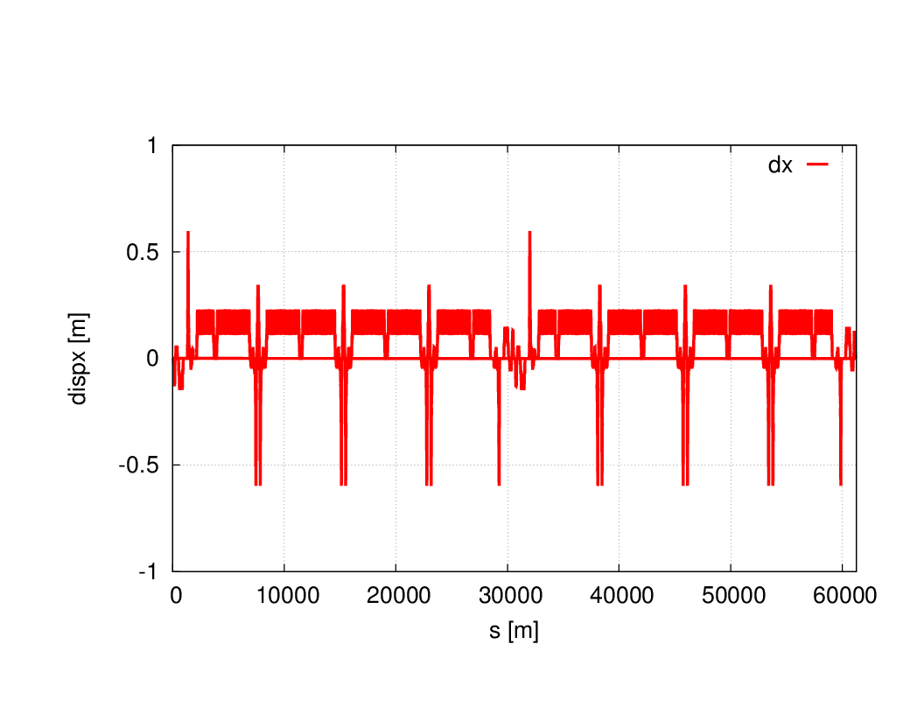
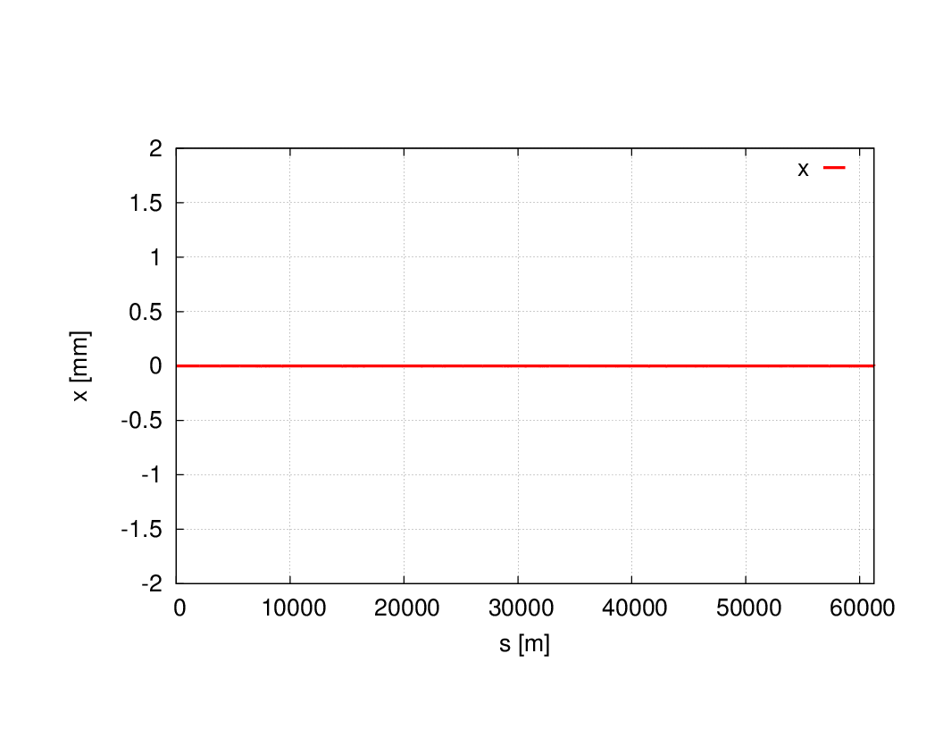
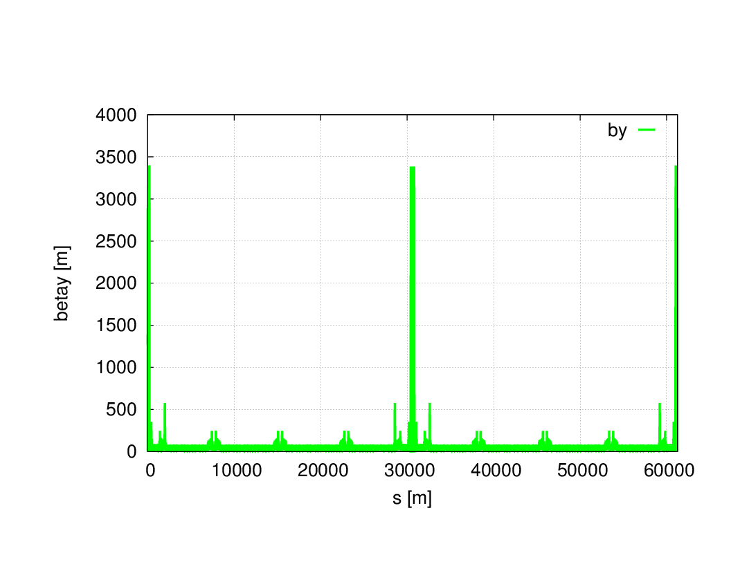
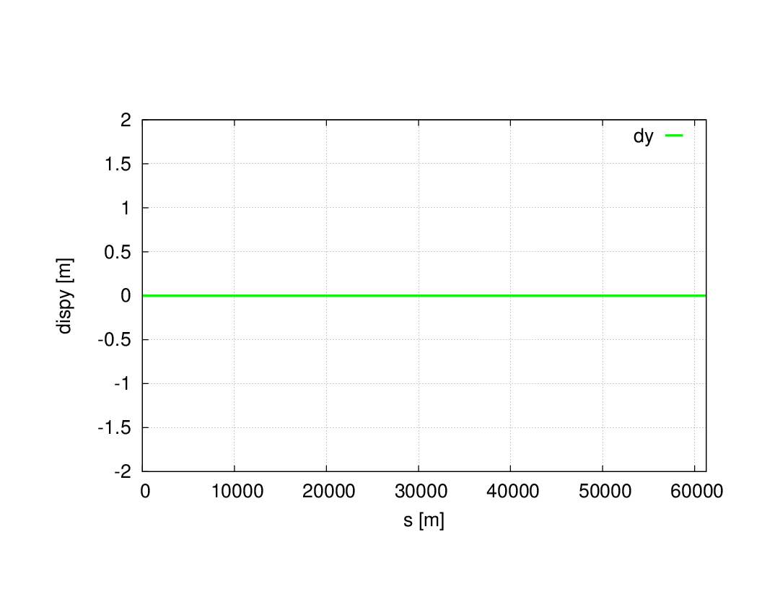
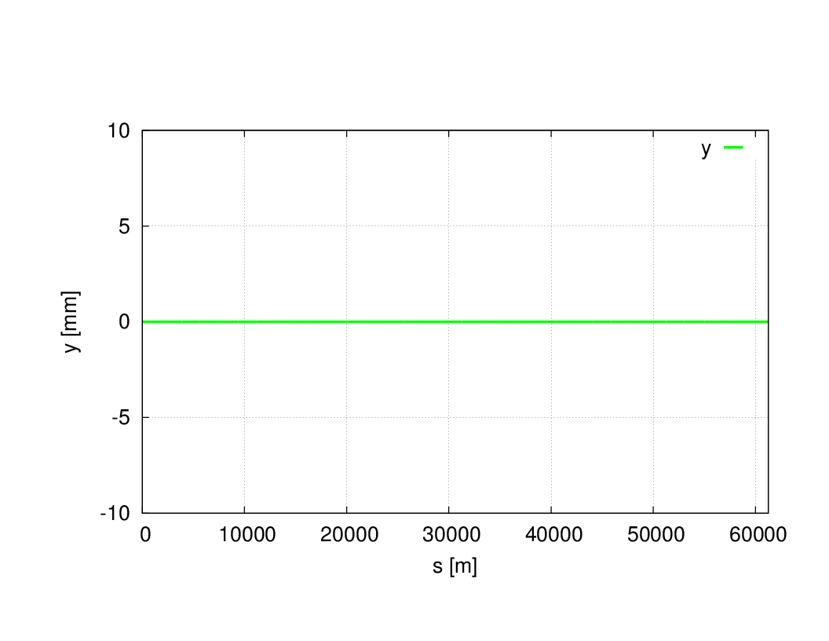
Without sawtooth
Tune (-0.3226684 , -0.4420881) IP β function(.248005 , .001358) emitx=3.19e-9m bunch length=3.68mm

Slide 5
Oide
EMIT calculates the 6D transfer matrix, damping matrix, and the equilibrium beam envelope matrix along the closed orbit. If RADCOD is on, the closed orbit takes the radiation loss into account.
Twiss parameters are calculated if CODPLOT is on, by versions later than 1.0.10.11k64-pre1 . The earlier versions do not calculate Twiss parameters with RADCOD/EMIT.

Slide 6
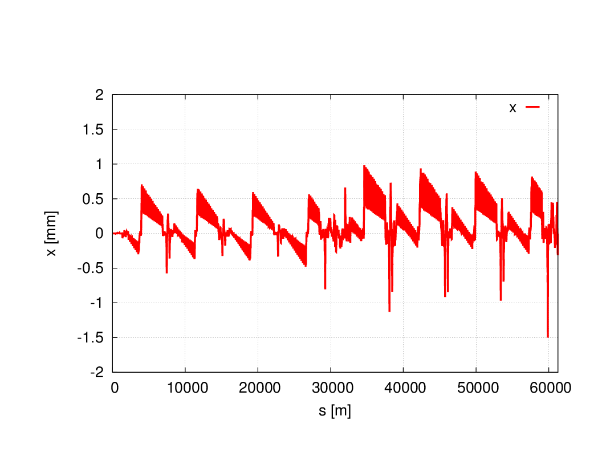
With sawtooth
Tune (-0.2892152 , -0.4379655 ) IP β function(.21429 , .001576) emitx=3.93e-9m bunch length=8.06mm

Slide 7
Dynamic aperture with sawtooth

Slide 8
Magnet modification is on-going……

