Slide 1
Calculation of sawtooth effect
H. Geng
CEPC AP group meeting
2016.11.18

Slide 2
Contents
MAD8
SAD
Results

Slide 3
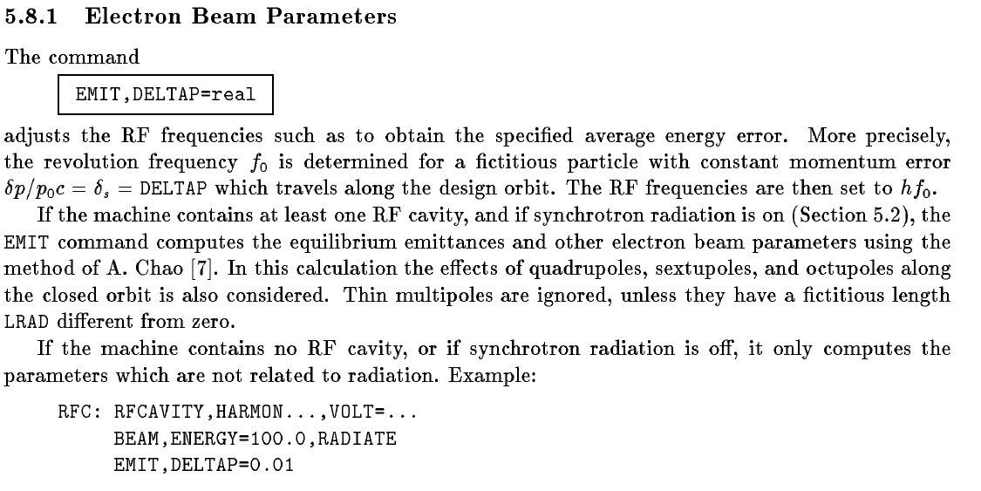
MAD8

Slide 4
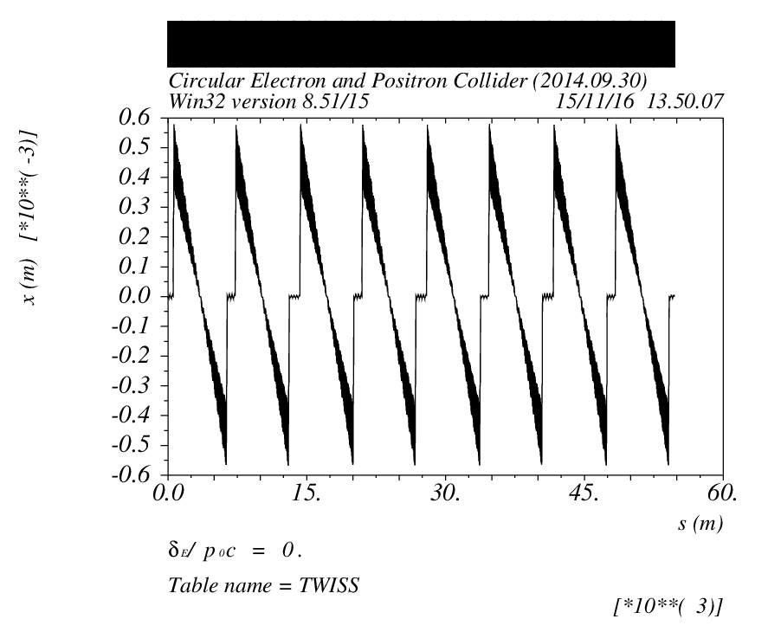
Single ring -v20140930

Slide 5
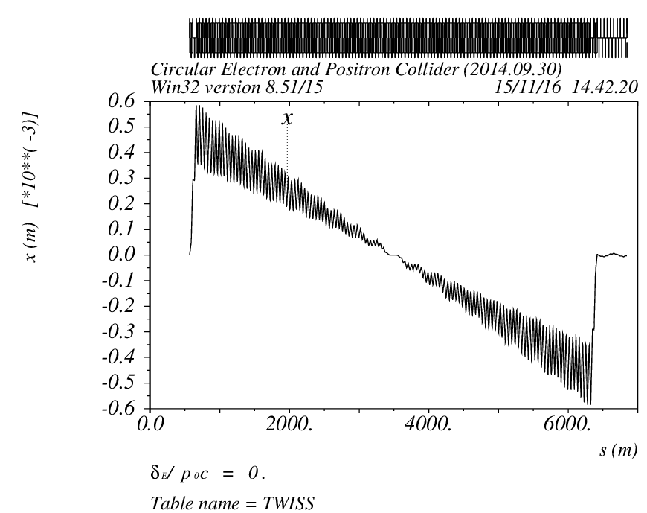
1/8 ring, RF[1]/RF[2]

Slide 6
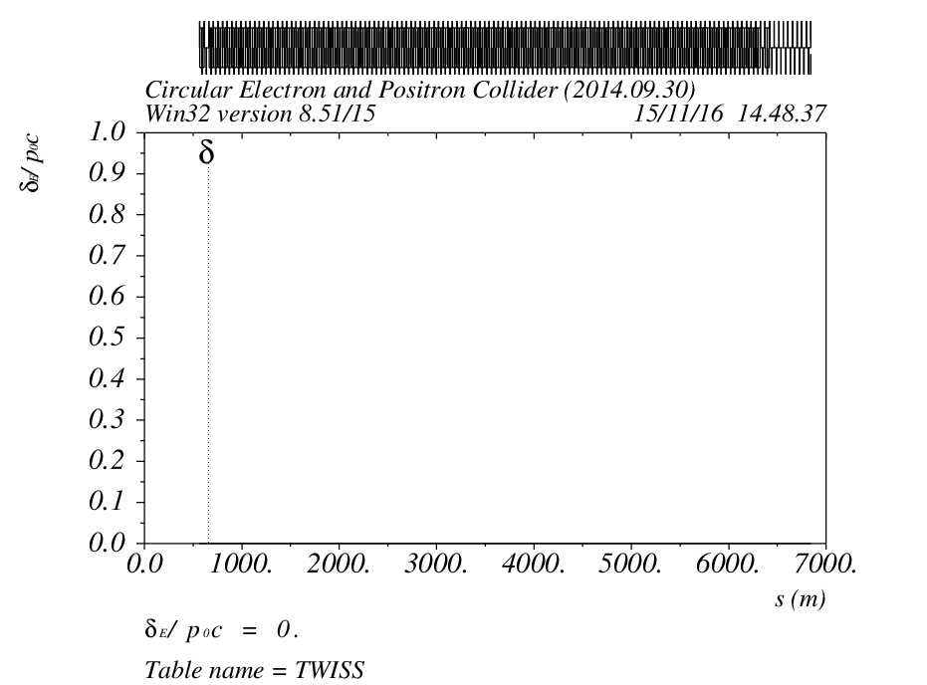
1/8 ring, RF[1]/RF[2]

Slide 7
结论
用mad可以直接看同步辐射对闭轨的影响，但是无法看到对optics的影响
如果想看optics的变化，需要重新定义每一个元件的强度，手动加入能量变化对束流感受到的元件强度的影响

Slide 8
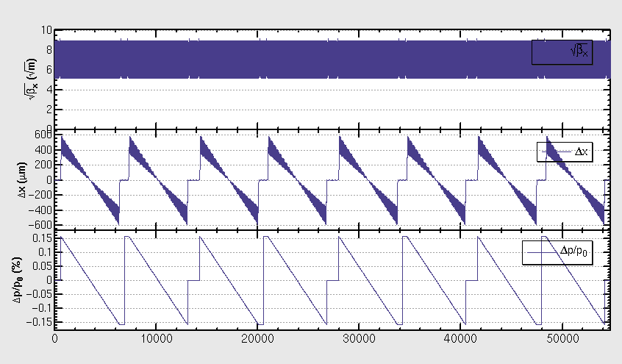
SAD

Slide 9
K. Oide
EMIT calculates the 6D transfer matrix, damping matrix, and the equilibrium beam envelope matrix along the closed orbit. If RADCOD is on, the closed orbit takes the radiation loss into account. Twiss parameters are calculated if CODPLOT is on, by versions later than 1.0.10.11k64-pre1 . The earlier versions do not calculate Twiss parameters with RADCOD/EMIT.

Slide 10
小结
MAD和SAD中，均需要重新定义lattice，按照束流能量的变化，手动加入能量变化对束流感受到的元件强度的影响，来模拟sawtooth 效应

Slide 11
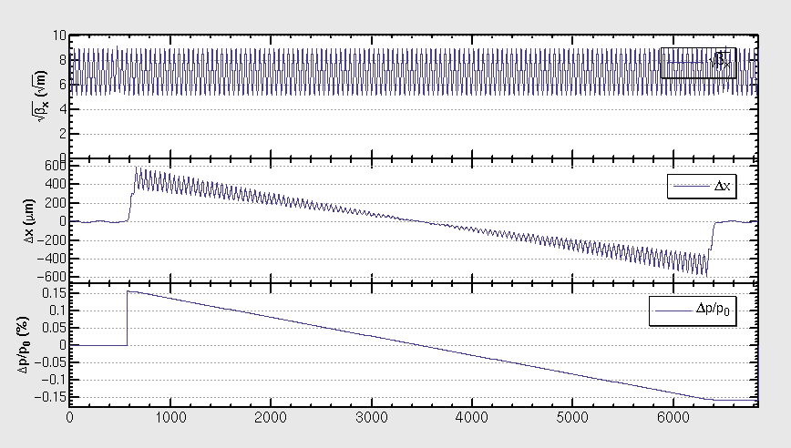
Single ring -v20140930-1/8 ring
dE=0，RADCOD ON, 重现原SAD结果 (B铁定义为angle+K0)

Slide 12
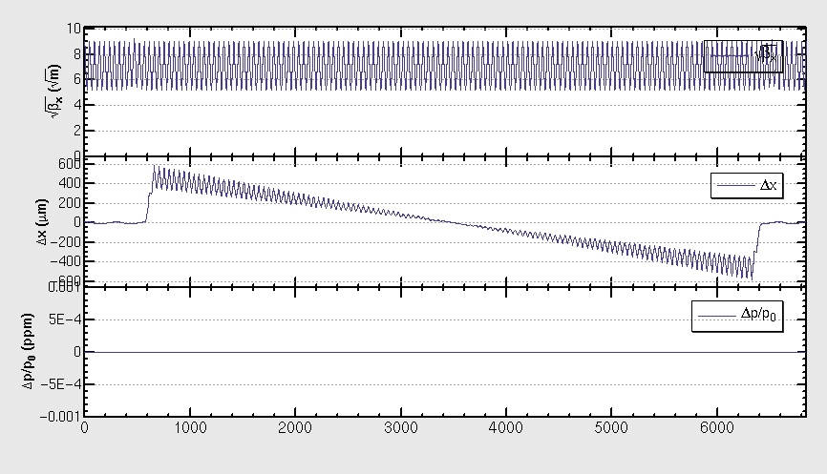
Single ring -v20140930-1/8 ring
dE=3012.9402/1952*10^6 V, RADCOD OFF, 重现上述结果（此处束流能量不发生变化）

Slide 13
Single ring -v20140930-1/8 ring
均为不带FFS的初步结果
DE=0 V, cell, cal, emit, result
DE=3012.9402/1952*10^6 V, cell, cal, emit, result

Slide 14
Summary
Sawtooth effect need to be simulated by changing the lattice
No strong effect observed w/o FFS
Preliminary results, need to be checked
Work on-going…

