Slide 1
Sawtooth effect in CEPC PDR
Sha Bai, Yiwei Wang, Huiping Geng,
Chenghui Yu, Feng Su, Tianjian Bian, Jie Gao
CEPC-AP-meeting
2016-11-25

Slide 2
Introduce sawtooth method
Scale magnets
Add RADCOD;CODPLOT in SAD newest version

Slide 3
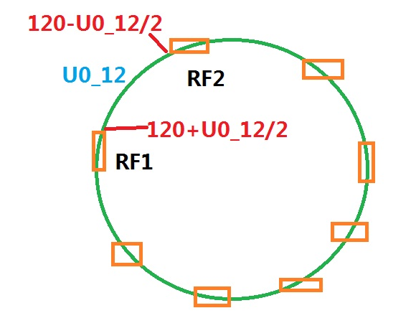
Scale magnets
Scaling B,Q,S magnets in all arc section
Lattice version: CEPC-ARC4-PDR3-IR1
Energy loss of each B magnet=U0/Bnumber

Slide 4
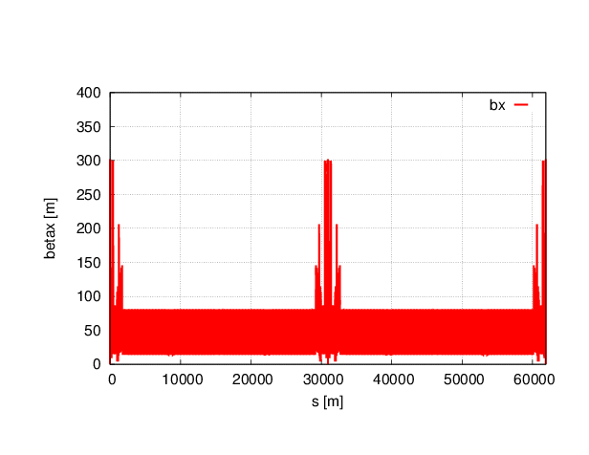
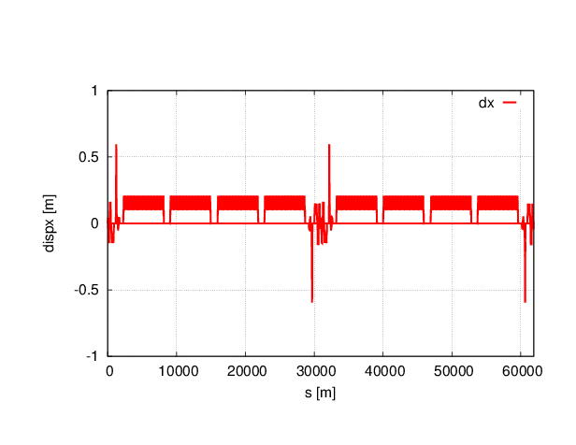
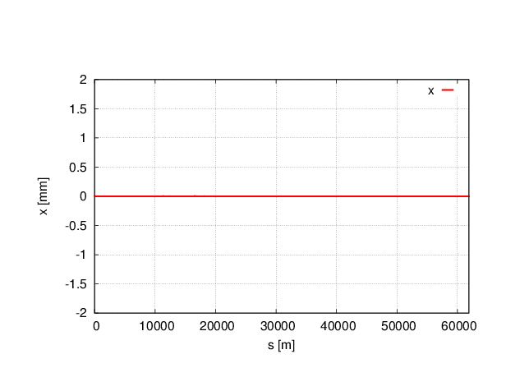
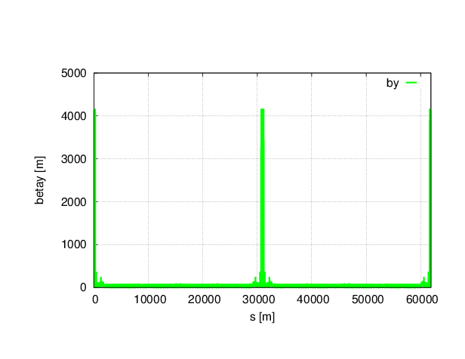
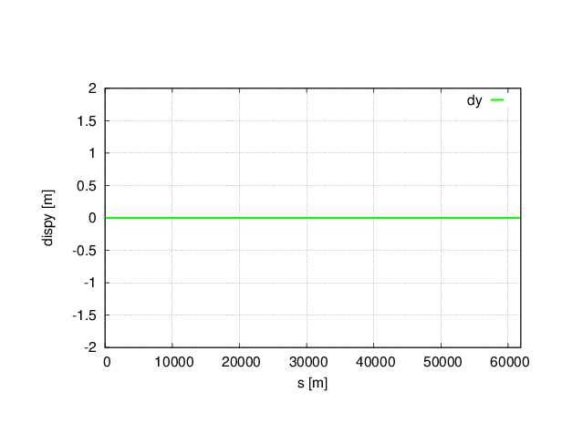
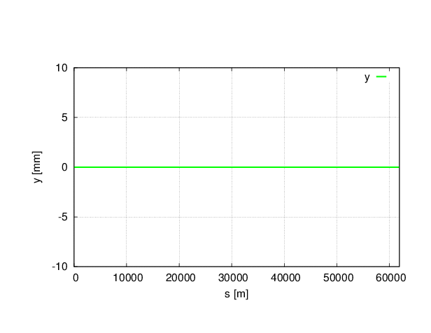
Without sawtooth

Slide 5

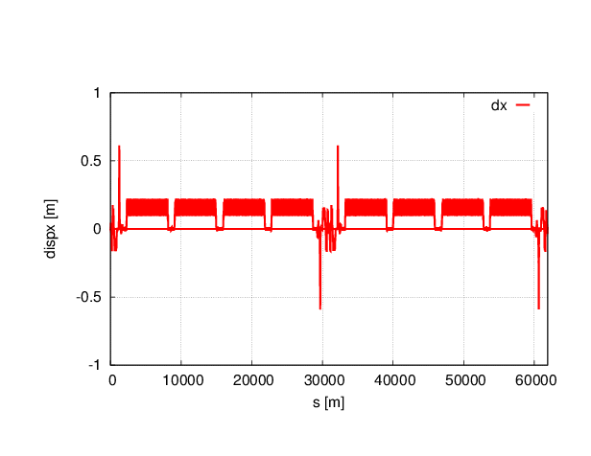
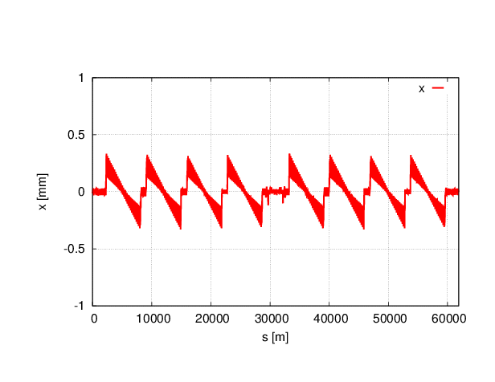
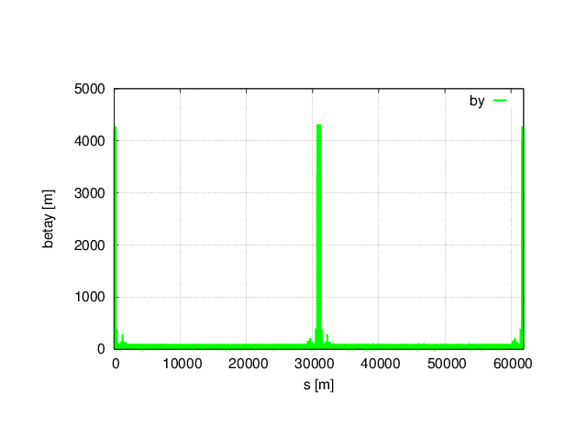

With sawtooth

Slide 6
Twiss parameters comparison
 | NO Sawtooth | Sawtooth
μ_{x} | 0.0800001 | 0.0791565
μ_{y} | 0.2200000 | 0.2162617
β_{x}* | 0.219915 | 0.220747
β_{y}* | 0.001000 | 0.001013
ε_{x} | 2.15121nm | 2.25805nm
ε_{z} | 3.38423E-6 m | 3.89783E-6 m
Bunch length | 2.53716622 mm | 2.92415163 mm

Slide 7
Dynamic aperture comparison
No sawtooth
With sawtooth
Off-momentum DA reduced obviously.

Slide 8
Introduce sawtooth method
Scale magnets
Add RADCOD;CODPLOT in SAD newest version

Slide 9
Without sawtooth

Slide 10

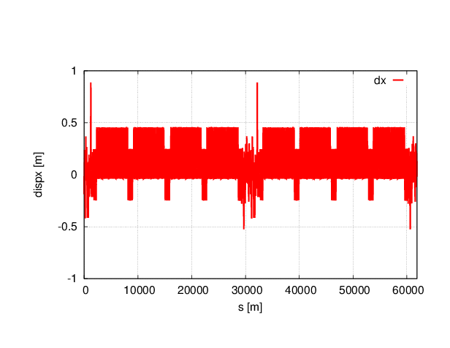
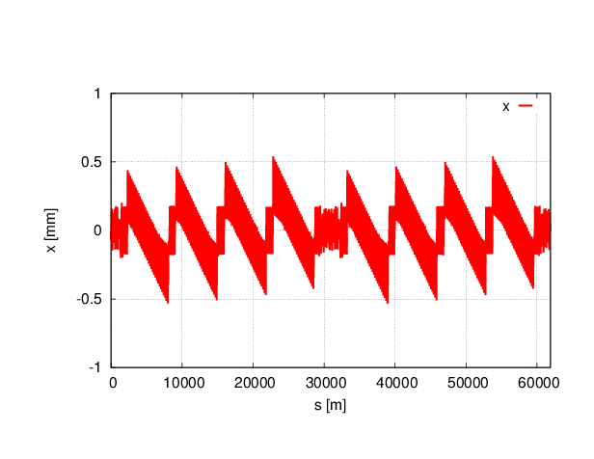

With sawtooth

Slide 11
Twiss parameters comparison
 | NO Sawtooth | Sawtooth
μ_{x} | 0.0800001 | 0.0809842
μ_{y} | 0.2200000 | 0.2189670
β_{x}* | 0.219915 | 0.219713
β_{y}* | 0.001000 | 0.001081
ε_{x} | 2.15121nm | 5.2697nm
ε_{z} | 3.38423E-6 m | 3.67405E-6 m
Bunch length | 2.53716622 mm | 2.83797076 mm

Slide 12
Dynamic aperture comparison
No sawtooth
With sawtooth
Off-momentum DA reduced obviously.

Slide 13
Conclusions
With sawtooth effect, tune change at 3 digits after the decimal point.
Off-momentum DA reduced a lot with sawtooth effect.

