Slide 1
Calculation of sawtooth effect
H. Geng
CEPC AP group meeting
2016.11.25

Slide 2
Contents
Sawtooth with FFS
Summary

Slide 3
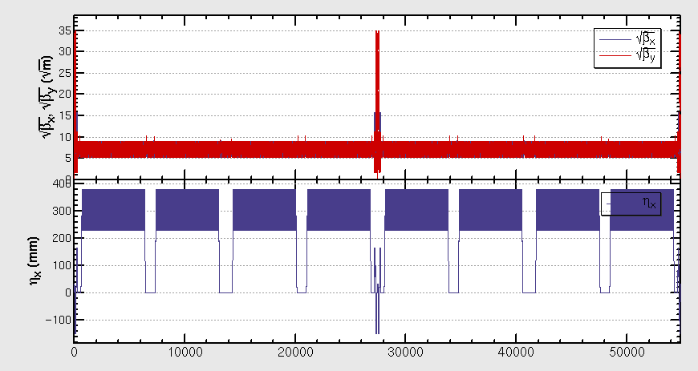
Sawtooth in FFS
算出对撞区每一块B铁的同步辐射能量损失，然后对相应的元件进行能量强度修正

Slide 4
Sawtooth with FFS
DE=3.0GeV

Slide 5
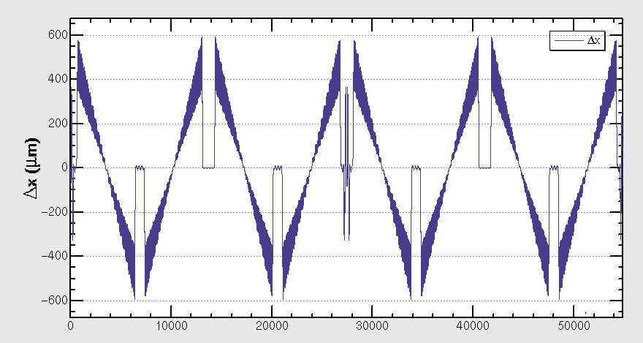
Closed orbit with DE=3GeV

Slide 6
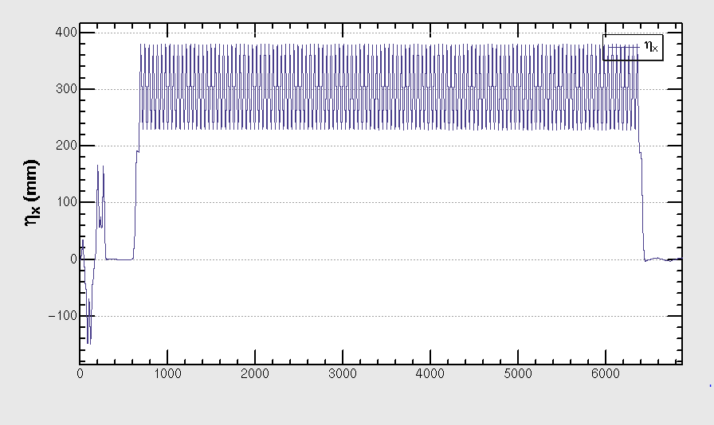
dispersion

Slide 7
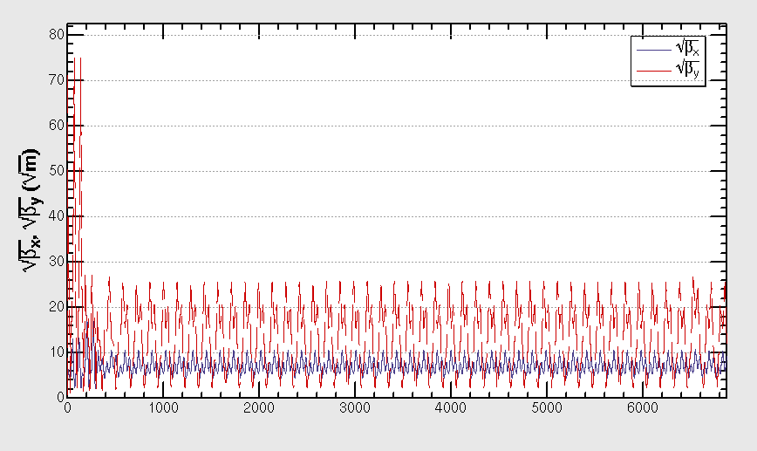
Beta function

Slide 8
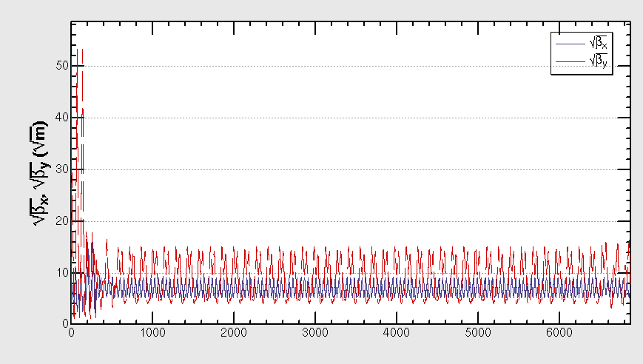
ONLY with SR in FFS

Slide 9
Summary
Sawtooth effect in FFS makes the lattice unstable
Need to be corrected
Work on-going…

