Slide 1
Sawtooth effect in CEPC PDR
Sha Bai, Yiwei Wang, Huiping Geng,
Chenghui Yu, Feng Su, Tianjian Bian, Jie Gao
CEPC-AP-meeting
2016-12-02

Slide 2
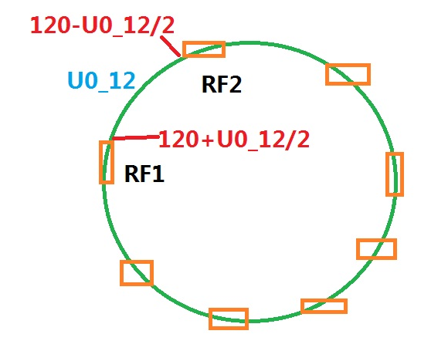
Scale magnets
Scaling B,Q,S magnets in all arc section
Scaling B,Q manets in public beamline
Lattice version: CEPC-ARC4-PDR3-IR1
Energy loss of each B magnet=U0/Bnumber

Slide 3
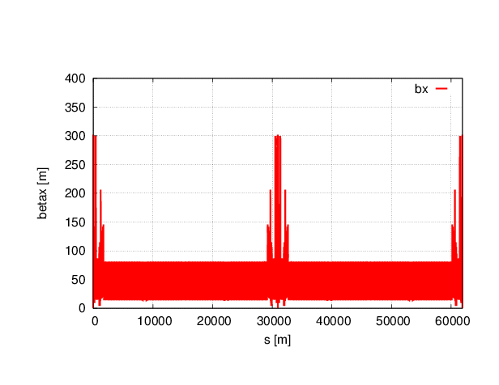
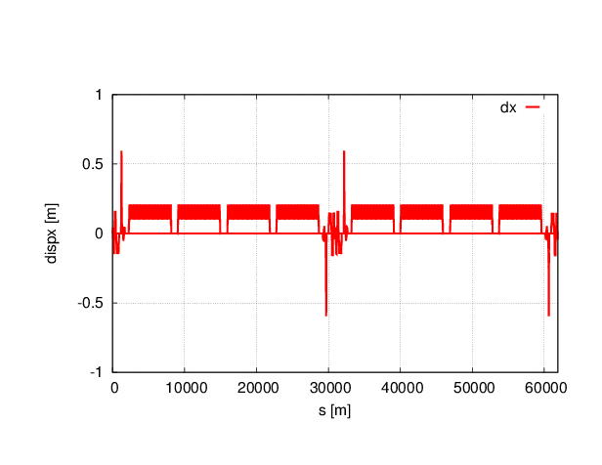
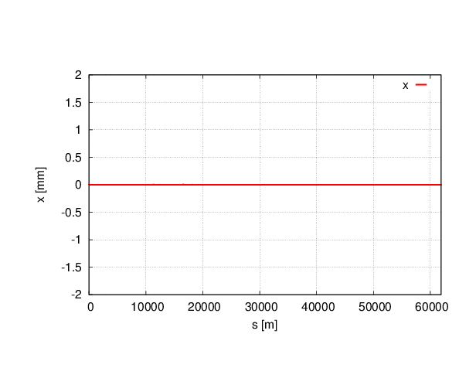
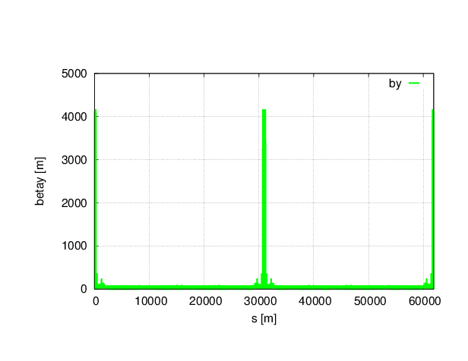
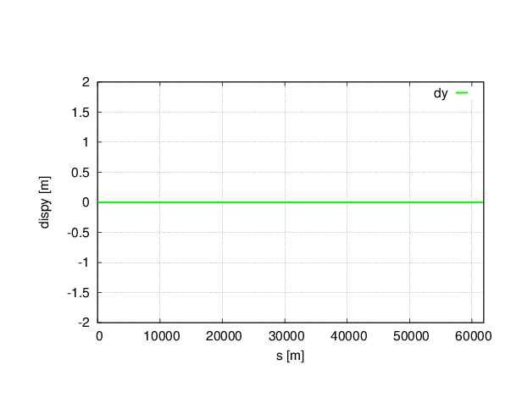
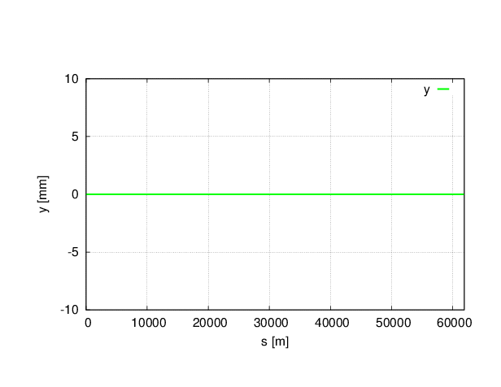
Without sawtooth

Slide 4

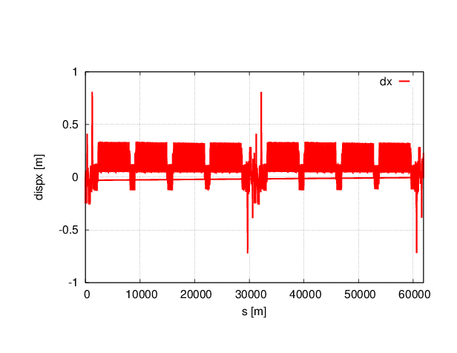
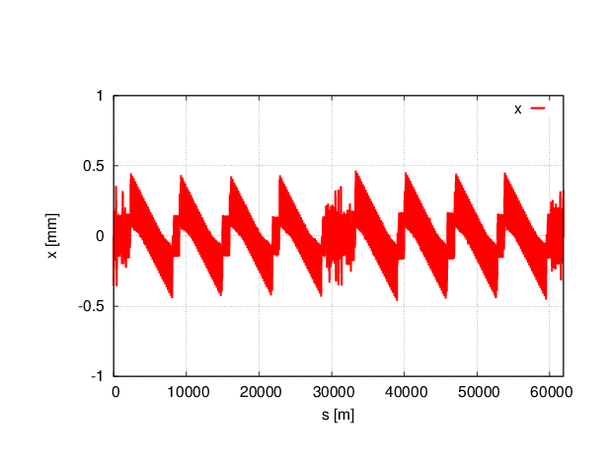
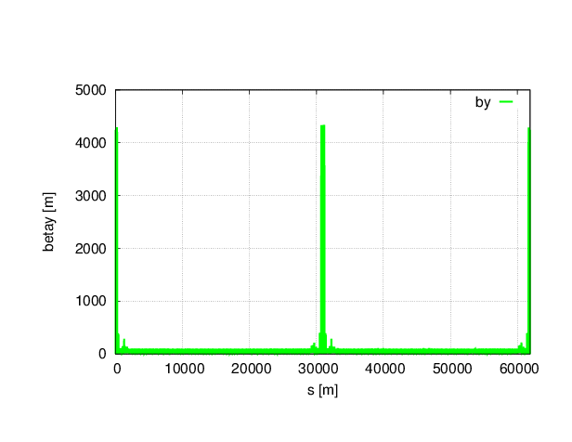

With sawtooth

Slide 5
Twiss parameters comparison
 | NO Sawtooth | Sawtooth (only 8 arc magnets) | Sawtooth (add public magnets)
μ_{x} | 0.0800001 | 0.0791565 | 0.0792002
μ_{y} | 0.2200000 | 0.2162617 | 0.2164171
β_{x}* | 0.219915 | 0.220747 | 0.220100
β_{y}* | 0.001000 | 0.001013 | 0.001008
ε_{x} | 2.15121 nm | 2.25805 nm | 29.8862 nm
ε_{z} | 3.38423E-6 m | 3.89783E-6 m | 3.29575E-6 m
Bunch length | 2.53716622 mm | 2.92415163 mm | 2.65484053 mm

Slide 6
Dynamic aperture comparison
No sawtooth
With sawtooth
Both On-momentum and Off-momentum DA reduced obviously.

Slide 7
Chromaticity of all Q,S magnets
(8 arc section scaling)
Number of elements

Slide 8
Chromaticity of all Q,S magnets
(8 arc section and public magnets scaling)

Slide 9
2nd order Chromaticity of all Q,S magnets
(8 arc section and public magnets scaling)
Number of elements
Number of elements

Slide 10
2nd order Chromaticity of all Q,S magnets
(8 arc section and public magnets scaling)
Number of elements
Number of elements

Slide 11
2nd order Chromaticity of all Q,S magnets
(8 arc section and public magnets scaling)
Number of elements
Number of elements

Slide 12
Conclusions
With sawtooth effect, tune change at 3 digits after the decimal point.
Both On-momentum and Off-momentum DA reduced a lot with sawtooth effect. Off-momentum DA beyond 0.5% reduced to zero.

